Slide 1
QA and Conditional Authorizations

Slide 2
How Much is My REHS Worth?
Job Posting 2020:
Are you tired of auguring holes in 95 degree weather?? Beat the heat with this new employment opportunity!! XXXXX County requires PITS on all new soil evaluations! XXXXX County is currently seeking an Onsite Water Protection expert!! XXXXX County Board of Commissioners are extremely pro-employee and pro-environmental health!
In addition, XXXXX County takes into consideration current government agency employee service and with proper documentation and approval, accrual rates for earned vacation leave may be awarded based on tenure.
We also offer a $5000 sign on bonus for individuals that qualify for an Environmental Health Specialist that is currently authorized in food & lodging and actively working in another county!

Slide 3
How Much is My REHS Worth?
XXXX County is currently seeking a new member for our Food & Lodging team. XXXXX County is a rapidly growing community from Lake ☺ in the south to the ☺ Mountains in the north!
In addition, XXXX County takes into consideration current government agency employee service and with proper documentation and approval, accrual rates for earned vacation leave may be awarded based on tenure. We also offer a $5000 sign on bonus for individuals that qualify for an Environmental Health Specialist that is currently authorized in food & lodging and actively working in another county!
Health Department - Environmental Health Specialist - Food Protection & Facilities Program
Rate of Pay: $40,742.22 - $63,191.42
Details: Hiring Range: $40,742.22 - $55,022.26

Slide 4
How Much is My REHS Worth?
Our comprehensive benefits package and wellness programs are the rewards that go beyond the paycheck, including a 5% employer contribution to NC 401(k); on-site Employee Health Centers; employee assistance programs; and medical, dental, vision and life insurance options. The County also offers a generous paid leave program that includes sick, annual, community service, parental, military and bereavement leave. These benefits, along with our award-winning wellness programs, set us apart as an employer of choice and affirm our commitment to supporting employees and their families, both inside and outside of work.
Market Range Minimum: $22.21 ($46,196.80)
Market Range Midpoint: $29.99 ($62,379.20)
Market Range Maximum: $37.76 ($78,540.80)

Slide 5
My REHS is Worth What?????
The posting will be available through the XXXXX County website; please use the link below.
Posting Title: Sr. Environmental Health Specialist
Apply before Wednesday 5/20/XX…………
Salary: Minimum = $46,960 Market = $ 58,700 Maximum = $82,180

Slide 6
More Benefits!
XXXX County Environmental Health receives excellent support from the Health Director, County Manager, and the Commissioners. If you are interested in working for a progressive county with an experienced, team oriented and motivated staff of Environmental Health Specialists, please consider applying with us! XXXXX County offers some excellent benefits such as:
A flex schedule with the option to work 4 – 10 hour days and enjoy a nice, long 3-day weekend
Career ladder
2% 401k match
Clothing allowance
Use of the employee wellness clinic at no charge
Use of the county gym at no charge to employees

Slide 7
Holy Cow!
XXXXX County Environmental Health is currently seeking 1 fully Authorized Environmental Health Program Specialist in Onsite Wastewater, 2 fully Authorized Environmental Health Specialist in Onsite Wastewater and 2 fully Authorized Environmental Health Specialist in the Food & Lodging Program.
XXXX County is nestled between XXXXX to the North and XXXXX to the South with the mighty ☺ River serving as our easterly border. We have deep historical roots with XXXXX having that small town feel but yet big potential. It’s a great place to work with a competitive benefits package.
In addition, we are offering a $25,000 SIGNING BONUS FOR HIRED APPLICANTS THAT ARE FULLY AUTHORIZED IN THEIR FIELD OF APPLICATION ALONG WITH ABOVE AVERAGE SALARY RANGES. That’s right you read that correctly, $25,000 SIGNING BONUS, GREAT SALARY AND BENEFITS.
Why wouldn’t you want to work here? If you would like to become part of our team please follow the link below and fill out an application.
Notes:
Approximately $65,000 to train an intern to first authorization

Slide 8
Maybe This is Why I Got a Bonus…….
PHYSICAL DEMANDS
Working conditions are typical of those encountered in most indoor/outdoor activities with the additional considerations of exposure to inclement weather, difficult terrain, or filth. Employees may have contact with antagonistic and/or uncooperative members of the general public, and decisions rendered in some cases result in considerable emotional stress.
WORK ENVIRONMENT
Employees may be exposed to moving machinery, hot grease, or communicable diseases which may result in some lost time.

Slide 9
All Kidding Aside……
As an REHS, you are a valuable NC Commodity!
There are about 1,300 REHS’s working in NC
It took a lot of time and work to get your REHS, so let’s protect it and polish up our authorizations with some QA!
Notes:
Your county has made a large investment in you! You are an asset to your community!

Slide 10
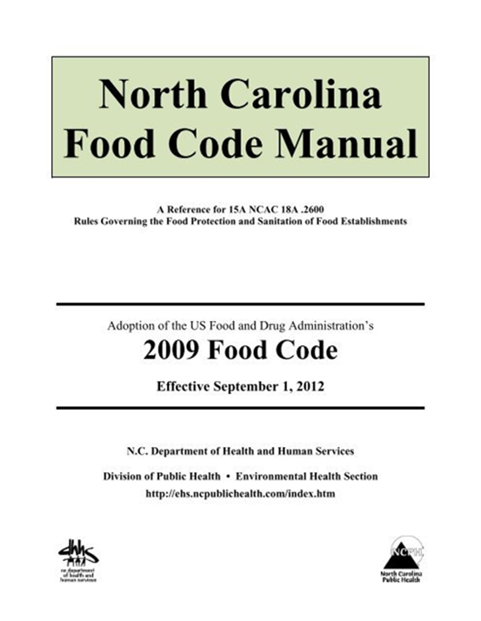
QA Program: Food Protection Branch
DHHS implemented a Quality Assurance (QA) program on July 1, 2019
Goal: REHS’s across the state are enforcing the .2600 rules and Food Code correctly and consistently
The QA field assessment is based on conducting a risk-based inspection
For a quality, risk-based inspection, you need to assess processes and procedures used by facilities to ensure that they are effective at keeping food safe.
Notes:
-The goal of the QA program is to make sure that REHS’s across the State are enforcing the .2600 rules and the NC Food Code correctly. (and consistently)
-The risk based inspection should focus on the 5 major risk factors.
improper holding temperatures, inadequate cooking, contaminated equipment, food from unsafe sources, and poor personal hygiene
This is just an overview of the Food Protection Branch QA program - think about how the elements of this program could be applied to your program

Slide 11
Overview – QA Components
Prioritization Policy
Staffing Level Assessments
QA Field Assessment Requirements
QA File Review Requirements
Future QA Matrix
Notes:
Prioritization policy – what we will do in the event that we are short staffed or must turn our resources to an FBI investigation, etc.
SLAT- manpower study, but accounts for routine, value added activities, program standard activities, ServSafe, administrative duties, etc.
Matrix – Combination of inspection compliance, SLAT and QA activities dictates funding for the county – much better scenario than in the past AND it builds consistency
The goal is to train and gain improvement, not to take away authorizations. A main complaint by industry is that every inspector interprets the code differently. NC wants to continuously make efforts to build consistency
-recent complaint by a major chain of inconsistencies – some were legit, others not

Slide 12
Prioritization Policy
Each county will be responsible to have a policy in place that prioritizes workload when there are insufficient resources to complete all mandated inspections per 15A NCAC .0213.
The State has developed a template that may be used
Notes:
Higher-risk establishments such as those serving HSPs and establishments with specialized food processes are inspected at 100% - (still talk of replacing one inspection with a verification visit)
All other establishments shall miss no more than one grading period per fiscal year with category IV establishments taking priority.
When missing only one inspection per FY is not possible, category IV establishments shall still be prioritized above category III; category III prioritized above category II; category I will take lowest priority
Risk factor violations documented on previous inspections, length of time since completion of last inspection and frequency of complaints from the public are taken into consideration when prioritizing the workload

Slide 13
Staffing Level Assessment Tool
Staffing Level Assessment Tool (SLAT) formally known as Manpower Study is a new tool developed utilizing the CFP guidance document
The purpose of this tool is to provide an up-to-date and accurate method to track staffing needs for only the Food, Lodging, and Institutions program
This tool now accounts for routine, additional, and value-added activities within each jurisdiction
Notes:
Purpose is to identify adequate staffing levels for FLI programs
May add other EH programs later
Focus on quality inspections vs. inspection compliance rates
Some counties are achieving 100% inspection compliance and are not performing at a high quality level
Some counties that are not achieving 100% compliance and are not short-staffed
Required once per accreditation cycle beginning the Spring of 2021

Slide 14
Staffing Level Assessment Tool
Information was sent out via Regional Weekly Update in July 2019
SLAT collection began July 2019. For the first year, the expectation is that counties begin tracking necessary information
  An assessment of your county can be completed if all the necessary information is available. Reach out to your EHRS for information
Workbooks that counties should focus on:
  SLAT Information Request – County Submission
  Job Description Workbook – County Submission
  Reference Spreadsheet (helpful in counties without a digital system in place)
  Activity Codes
Notes:
All information was sent via weekly update but can be resubmitted as needed
Emphasis: The first year of SLAT should be solely for the purpose of capturing data and determining the best way to capture date. Evaluate the method of tracking and determine if there may be a better way. Some counties may be ready for a SLAT evaluation but should not feel pressured to complete one prior to June 2020.
SLAT Information Request - County Submission – This form will have all the information that will be needed to input into the main SLAT workbook. It will include definitions of items and it will also request time off for employees – This portion is important to ensure that the most accurate time is noted. For example, a work year is 2080 hours but an employee may only devote 1400 hours after vacation, sick, holiday, and other time off
Job Description Workbook – County Submission – From the workbook above the job description will denote how much of the time they have available to work is utilized for the FLI Program. For example, an employee can work 1400 hours in one given year but only devotes 20% of their time – this allows for only 280 hours devoted!
Reference Spreadsheet (helpful in counties without a digital system in place) – Reference sheet is available for counties that do not have a digital system in place
Activity Codes – These were created with the review of activity codes within counties through the assistance of CDP

Slide 15
County: | Contact Name: Contact Ph #:
Type of Establishment | Number in County
Instructions: Complete this tab with FLI establishments within the county
Restaurants (01)
Category I
Category II
Category III
Category IV
Food Stands (02)
Category I
Category II
Category III
Category IV
Mobile Food Units (03)
Category I
Category II
Category III
Category IV
Push Carts (04)
Category I
Category II
Category III
Category IV
Private School Lunchrooms (05)
Category I
Category II
Category III
Category IV

Slide 16
Activities | Number of Activities in a Year | Average Hours (per activity) ex. 2.50 hours per Activity | Comments (Press ALT+ENTER for new line)
Instructions: Read the definitons within each activity to determine the number completed within the county. If average hours are required submit this information with comments that indicate how the county reached this conclusion.
Consultative Visits completed for items such as HACCP plan verification/validation, risk control plans consultations, visits completed after a verification visit to ensure compliance, or general consultative visits.
Complaint Visits Visits completed in direct response to a complaint made by the public such as unconfirmed illnesses, unsanitary conditions, insects/rodents, improper food handling, poor resident treatment/care, or water/power outage.
Critical Item Visits These visits will vary from year to year. This includes visits that are required within 10 days of inspection. Critical item visits are required at any time a correction is not made for a P or PF item.
Temporary Food Establishments (TFEs) Includes time invested in completing a TFE inspection and issuing the permit. This time also includes surveillance of TFE events if needed.
Notes:
Consultative, Complaint Visits, Critical violation visits, TFE’s

Slide 17
Time
Work hours/ day
Work days/week
* Projected Sick Leave/ Yr
* Projected Vacation Hrs/ Yr
Paid Holiday Hrs/ Yr
Education Travel/ Yr
Incidentals (weather)Hrs/Yr
** Personal Time Off (PTO)
Notes:
Info about employee time off/education/travel/sick/vacation

Slide 18
QA Field Assessments
July 1, 2020 – June 30, 2021
Must complete ≥ 2 QA Field Assessments per REHS
  Routine Inspections
  Standardization
  County options for review (Regional vs. Leader vs. Peer)
  Planning and communication
Notes:
1. Make sure people are aware of the timeframe
2. 2 inspections; A field assessment is 1 routine inspection
3. IF a REHS is doing any routine inspections, they will be required to complete the QA requirements
4. Successful standardization within the FY may take the place of the required assessments
5. Counties have the option to do regional review* (1-2 REHS by the Regional), leader review (Regional reviews the leader and leader reviews FLI staff)(doesn't exclude supervisors that do not do routine inspections that want to do QA of their staff), peer review (1 assessment by leader & 1 by peer)
*Regional review may not be needed in some cases where there are 2 (1 individual supervises other and wants to do the QA))
6. Regionals should be discussing plans with each county ahead of time – use regional staff as resource for QA questions

Slide 19
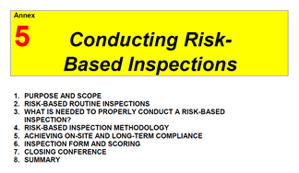
Before you begin…
Read Annex 5 of the FDA Food Code: Conducting Risk-Based Inspections (p. 589)
Read and understand the NC Quality Assurance Field Assessment Marking Instructions
Ask questions
Notes:
Doesn’t hurt to read the annex again if you already have. If you haven’t taken the RBI course, this is a great place to start.
Why read the marking instructions if I am not going to be an assessor? Reading the instructions lets you know how you will be assessed.
Now is the time to ask questions and understand how you will be evaluated. Asking for help will help you going forward.

Slide 20
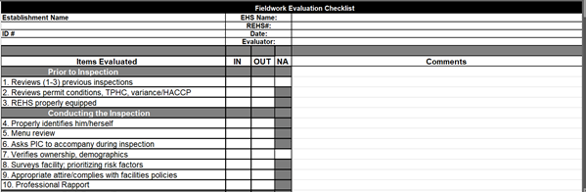
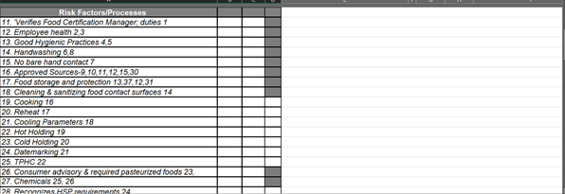
Documentation of QA Assessments
Notes:
Suggest to use the totals from field assessment tab (shown on next slide) when entering in data, but the field assessment tab can be used, This form does not formulate over to the compliance totals, but may be easier to read comments and provide feedback for individuals; County has the choice if they want to use this form
Field Assessment Form provided by the State (developed and piloted by local health departments)
Filled out by the assessor
1. Demographic info
2. 53 items to be evaluated; numbered on left side
3. Items do not directly correspond with the NC Food Establishment Inspection Form
Example: #1 on Inspection Form is not #1 on the QA assessment (#11)
4. Inspection Form item #s are shown in the header of each QA assessment item
Some items include multiple inspection form items

Slide 21
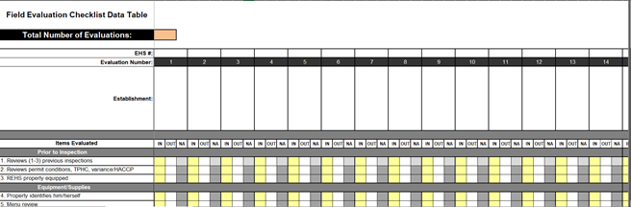
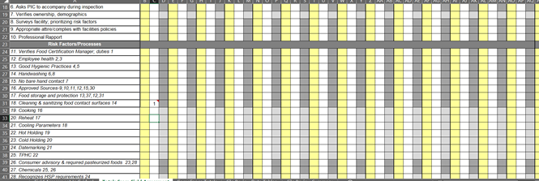
Documentation of QA Assessments
CDP Users
Notes:
Can either transfer information from field assessment for to the totals from field assessment tab or just enter all info here to begin with. Up to the county, but all information must be collected in this tab
Must change the number of evaluations each time an assessment is entered in
Enter REHS # and Establishment info including ID #
Items evaluated are the same as the field assessment form so they can be pasted in
Columns line up so make sure you stay within the appropriate column
Ins and Outs indicated with a “1” – comments can be added and a flag will appear (further explanation of comments on next slide)

Slide 22
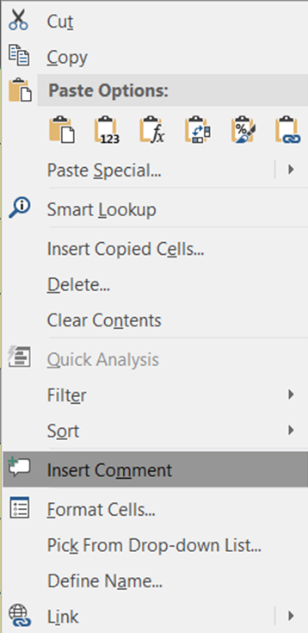
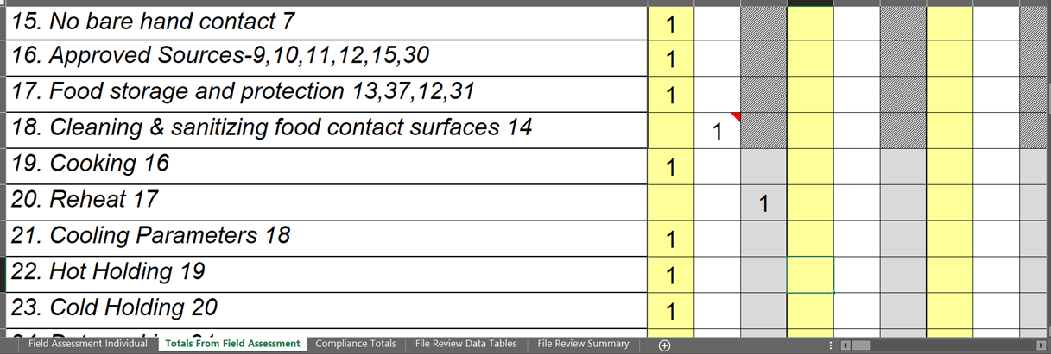
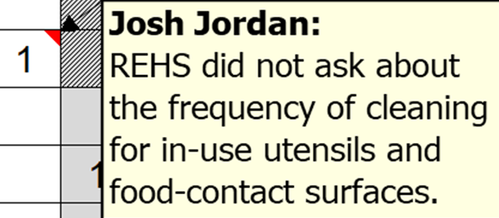
Documentation of QA Assessments
Notes:
1. comments may be entered on each box by right clicking and adding a comment (if using 2016 or newer version of Excel, use NOTES instead of comments)(older versions are not compatible with new version of threaded comments)
2./3. comments/notes are indicated with flag
4. Some items need to marked N/A – why would reheating be marked N/A? Answer: if REHS asked appropriate questions about reheating and reheating did not take place during the inspection
QA Assessments will be compiled together to assess training needs

Slide 23
Compilation of QA Assessments
All assessments must be compiled together in the Totals from Field Assessment tab
The Compliance Totals tab will tabulate based on this data
  Shows strengths and weaknesses the FLI program
  Identifies training needs
Notes:
Tabulating all REHS assessments will show the training needs of the FLI program
Describe how to interpret the data on this table from the Compliance Totals tab. (*Animation* will appear over the surveys facility row with next 3 clicks.) Describe what it means to survey the facility and how to appropriately prioritize risk factors; how to do a menu review, and why it is important to verify ownership
Areas < 70% should be addressed by program manager – policy revision forthcoming to represent this requirement

Slide 24
Individual Score
Scores are tabulated at the bottom of each inspection column on the Totals from Field Assessments tab and on the field assessment form. Scores are as follows:
  ≥ 85% = Acceptable
  70% - 84% = Acceptable, but needs improvement
  < 70% = immediate training and re-assessment is needed
Notes:
1. ≥ 85% leader should provide feedback to REHS and no further action is needed
Remediation is applied to strengthen FLI programs in NC – leaders should be implementing training/remediation when they see the need. Regionals will look at compliance totals and trends and offer help when needed/requested.
2. 70% - 84% leader should document discussion with REHS to work on areas in need of improvement and re-assess in the next FY (they may re-assess earlier if they would like)
3. < 70% leaders should make a written plan to provide some immediate training (ex. Review Annex 5, read marking instructions, etc.) and then re-assess in a short period of time (time may vary depending on the training needed)
The goal is to train and gain improvement, not to take away authorizations
A main complaint by industry is that every inspector interprets the code differently
NC wants to continuously make efforts to build consistency

Slide 25
File Review Requirements
With each QA Field Assessment a corresponding review of the establishment’s file shall be completed.
  The 3 most recent inspections will be used
  Non-qualifying file?
In addition to those 2 file reviews, 1 randomly selected establishment file will be reviewed per REHS in the FLI program
Total of 3 files reviewed per REHS per FY
The county may use the file review tabs provided in the QA workbook or use their own file review document as long as it includes the criteria in the workbook
  Information must be provided that acknowledge training needs
Notes:
Files should be reviewed by leaders only
Marking Instructions are available for the NC File Review as well
Important for file review: if the inspection for the field assessment is the only inspection completed by that REHS in the last 3 inspections, that file should not be reviewed (choose a random file to review) – The inspection is reviewed for completeness during the assessment and will create redundant work if used – we want to focus on the inspections completed by the REHS being assessed
File review notes are for the work of the REHS being evaluated – inspections completed by other REHS will not be used to penalize the REHS being evaluated; however the work should be viewed to see if repeats and long-term compliance are appropriately documented
*Supervisor that does not do routine inspections may not have a file to review

Slide 26
8. Surveys facility; prioritizing risk factors
IN/OUT This item is marked IN/OUT based on how the REHS initially surveys the food establishment to determine which of the 5 FDA foodborne illness risk factors (improper holding temperatures, inadequate cooking, contaminated equipment, food from unsafe sources, and poor personal hygiene) should be prioritized. The REHS should identify any active preparation and should give priority to: bare hand contact/handwashing violations, personal hygiene, receiving, reheating, cooking temperatures, and cooling items. This item shall be marked OUT if the REHS prioritizes static (not likely to change over time) over dynamic (likely to change quickly) processes or fails to ask open-ended questions regarding receiving, reheating, cooking and cooling during the survey.
NA Marking this is not an option for this item.

Slide 27
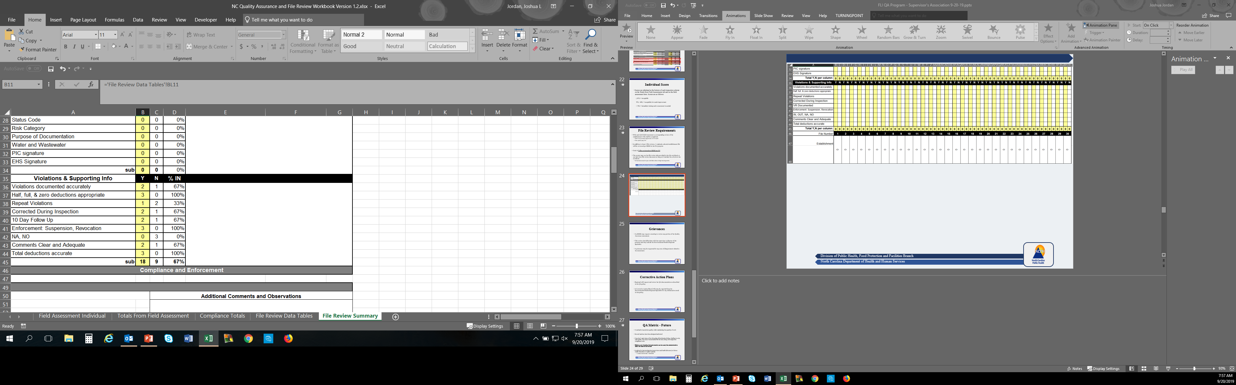
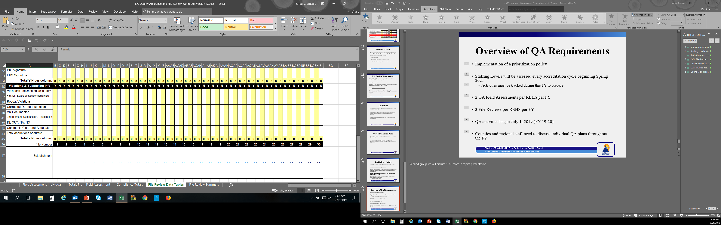

Slide 28
Grievances
An REHS may request a meeting to review any portion of the Quality Assurance assessment.
This review should be done with the supervisor or director of the program and may include the Environmental Health Regional Specialist.
A grievance may be requested for any area of disagreement related to the assessment.
Notes:
Removed the portion of the pilot QA policy that spoke about 75% or less and 95% or higher because we didn’t want to penalize those programs that incentivize high performers.

Slide 29
Corrective Action Plans
Regional will request and review the QA documentation as described in the QA policy
A Corrective Action Plan (CAP) may be required from the Environmental Health Regional Specialist for any deficiencies noted in this policy.
Notes:
The idea is for the county to implement their own corrective actions and trainings. The county should be tracking progress as the year goes on and may send information a little at a time to their regional. If the regionals find discrepancies, they will work with county to fix them.
Please be transparent with your regional and seek advice for training needs throughout the new QA process.

Slide 30
Overview of QA Requirements
Implementation of a prioritization policy
Staffing Levels will be assessed every accreditation cycle beginning Spring 2021
  Activities must be tracked during this FY to prepare
2 QA Field Assessments per REHS per FY
3 File Reviews per REHS per FY
QA activities began July 1, 2019 (FY 19-20)
Counties and regional staff need to discuss individual QA plans throughout the FY

Slide 31
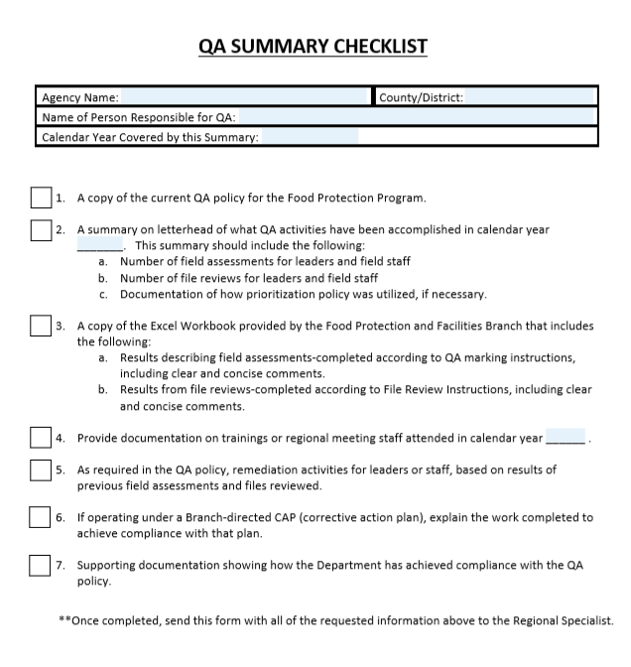

Slide 32
QA Program
Should provide consistency and accuracy in rule enforcement
Provides tools that allow an assessor to be fair
Tools also allow the person being assessed to know what to expect
Provides a means to assess staffing needs (Do we have enough folks?)
Provides a mechanism to show employee improvement
Provides a means to reveal staff (or program) training needs

Slide 33
Conditional Authorization
15A NCAC 01O .0107 DENIAL, SUSPENSION AND REVOCATION
(b) The State Environmental Health Director, Division of Public Health may place an individual on conditional status for a period not to exceed six months if the individual's failure to properly enforce laws, rules and policies may be corrected with additional education and oversight.
The Director may suspend or revoke the authorization anytime during the conditional period if satisfactory progress is not made and the Director shall suspend or revoke the authorization after the conditional period if the individual does not demonstrate the necessary knowledge, skills and ability to warrant an unconditional authorization.

Slide 34
Conditional Authorization
What prompts an investigation of an REHS?
What tools can we use to determine if conditional authorization is appropriate?
How can we assess performance issues fairly?
What tools can we use to improve performance?
How/when is conditional authorization determined to be lifted?
How/when is conditional authorization elevated to ITS or ITR?
Can an REHS appeal?

Slide 35
What Prompts an Investigation?
A performance problem is identified by:
Direct observation by the Regional Specialist of substandard performance
Request for assistance from an LHD
  after they suspect a performance problem exists or
  a complaint from outside the Section (a citizen complaint, etc.)

Slide 36
So, What Do We Do?
The Regional Specialist contacts their branch head, the Section’s OET, the local supervisor, and the authorized agent in question about the problem.
The Regional Specialist investigates the performance problem.
Notes:
QA tool encourages consistency, it has marking instructions- so it is fair, the person being assessed knows what to expect, appeal procedure

Slide 37
What Next?
The Regional Specialist contacts the State EH Director, their branch head and the OET to advise them of the results of the investigation and consults as to how to proceed.
The Regional Specialist contacts the local health director, local supervisor, and the authorized agent in question about the problem to discuss what further action is needed

Slide 38
What If?
If no further action is needed, the findings of the investigation are discussed with the local supervisor and the authorized agent in question. A letter is sent to the local health department and other involved parties of the findings.
If further action is needed, the Regional Specialist determines if performance can be improved through further training, education, practice, and evaluation.

Slide 39
Can the Issue be “Fixed”?
If the performance cannot be improved by training or practice, the Regional Specialist and their branch head consults with the Attorney General’s office before issuing an Intent to Suspend or Intent to Revoke authorization of the agent.
If the performance can be improved by training or practice, an action plan is created with input from the local health director, local supervisor, the branch head and the OET

Slide 40
We Need an Action Plan!
The State EH Director issues a letter that has been approved by the AG’s office to the local supervisor and the authorized agent in question during a conference; including the action plan and an explanation of why the agent’s authorization status is changing.
The action plan is initiated.
In accordance with the action plan, the Regional Specialist writes a summary of the agent’s progress and any further recommendations to the local supervisor, the branch head, and the OET.

Slide 41
What Happens When Conditional Status is Over?
If at the end of the conditional status, or at any point during the conditional period, the Regional Specialist has evidence that the performance cannot be improved by the action plan, the Section contacts the AG’s office to receive input before issuing an Intent to Suspend or Intent to Revoke the authorization of the agent.
If the performance has been corrected at the end of the conditional status, the findings are discussed with the local health director, local supervisor, the branch head and the OET. A letter is sent to the local agent and other involved parties (person who lodged complaint, etc.) detailing the findings, and the conditional status is removed.

Slide 42
Appeals
An agent may appeal a denial, suspension, and/or revocation in accordance with G.S. 150B.
If an appeal is properly submitted in a timely matter they may continue to work as an authorized agent in the area in question until a final agency decision is made pursuant to G.S. 150B-36.
However, all inspection forms and permits completed by the agent during that period must be countersigned by another authorized agent who concurs with the findings and conclusions reflected on the inspection forms and permits.

Slide 43

Discussion?
Notes:
-Questions?

