Slide 1
Ethics for Environmental health Specialists
Shane smith, rehs,

Slide 2
Florida Health Inspectors arrested for taking bribes (May 2012)

Slide 3
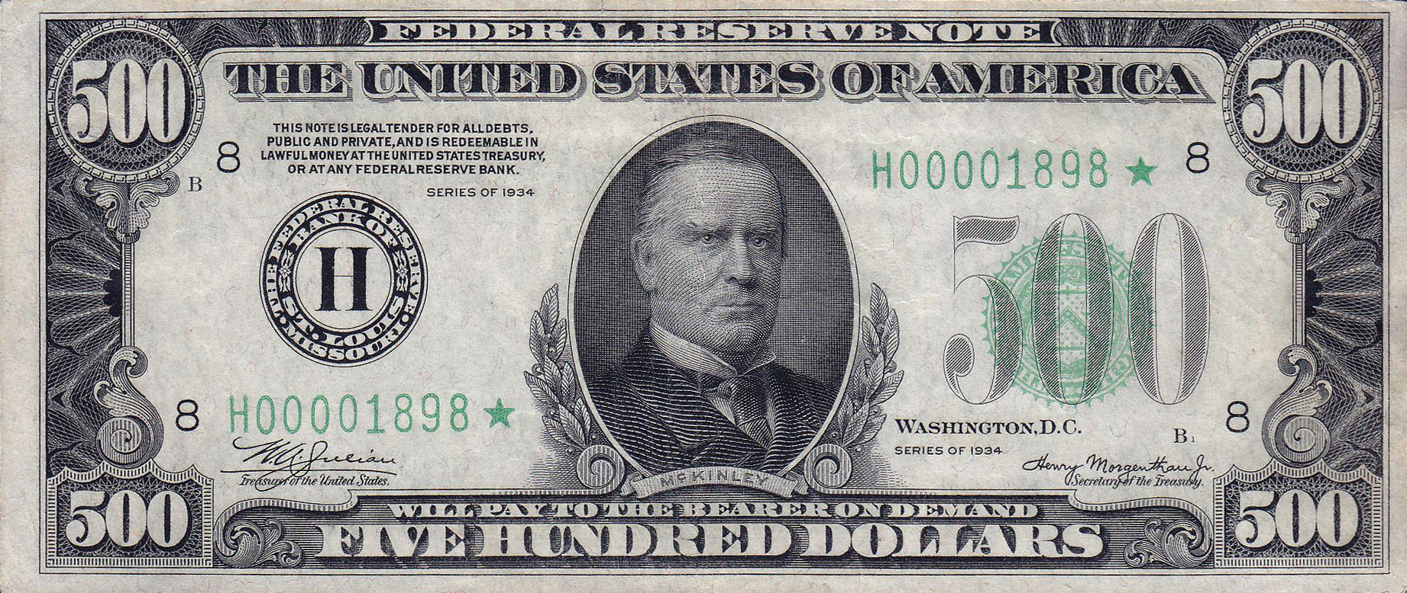
New York
Photo licensed under CC BY-SA
Photo licensed under CC BY-NC-ND

Slide 4
New York—43 inspectors arrested and charged with extortion.
Indiana—Environmental Health Specialist charged with using county credit card to purchase $25 of gas for personal vehicle.
North Carolina
Environmental Health Specialist charged with felonies for issuing fraudulent septic permits and receiving bribes.
Fraudulent inspection reports written in the office.

Slide 5
Ethics defined
The discipline dealing with what is good and bad and with moral duty and obligation. (Webster)
Morals—Fundamentally appropriate behavior.
Doing what is good rather than what is bad. (Bell, Fleming)

Slide 6
Ethics
Ethics is knowing the difference between what you have a right to do and what is right to do.
~Potter Stewart, Associate Justice of the US Supreme Court

Slide 7
Why have ethics codes, regulations, or statutes?
Minimum standard of conduct
Certainty and Accountability (Bell)
Provides an obligation to stakeholders (including fellow professionals)
Maintains professionalism

Slide 8
Codes of Ethics

Slide 9
How are nc laws and rules tied to ethics?
NC State Board of Environmental Health Specialist Examiners
NCGS 90A-67—Requires Board to adopt Code of Ethics
21 NCAC 62 .0415—Incorporates Code of Ethics adopted by NCPHA-EH Section
NCGS 90A-53(2)—Qualifications for registration
NCGS 90A-64(10)—Suspension and revocation of certificates

Slide 10
Code of ethics
I
Follow “recognized scientific principles with the full realization that the lives, health, and well being of people may depend upon my professional judgement”
“Pledge to protect the health and well being of the citizens”

Slide 11
Code of ethics
II
“Maintain an acceptable level of competence by continued study, observation, and personal investigation”
III
“Perform services only in the areas of my competence”

Slide 12
Code of ethics
IV
“Uphold the integrity of my profession”
V
Will not deceive or mislead the public
VI
“Ethically loyal, professional and impartial to all parties”

Slide 13
Code of ethics
VII
“To uphold and enforce the applicable laws, rules, and principles of public health”
VIII
“To promote the highest attainable standard of health without discrimination”

Slide 14
Suspensions and revocations of certificates (NCGS 90A-64)
Fraud, deceit, perjury
Unprofessional conduct
Dishonesty
Incompetency
Crime involving moral turpitude (an act or behavior that gravely violates the sentiment or accepted standard of the community)
e.g., bribery, blackmail, larceny, extortion

Slide 15
Denial, suspension and revocation (delegation of authority--15A NCAC 01O .0107)
Fraud, deceit, dishonesty, perjury
Drug or alcohol induced intoxication while performing duties
Incompetency
Unprofessionalism in performing duties
Neglect of duty
Failure to properly interpret or enforce laws, rules, or policies
e.g., Position Statements

Slide 16
What would you do?

Slide 17
If faced with a possible ethics situation…
Consult your health director
Consult your county attorney
Consult your EH Regional Specialist
Consult a member of the REHS Board

Slide 19
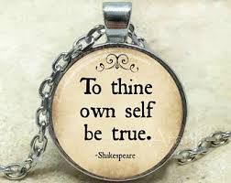

Slide 20
Shane Smith
919-707-5872
Shane.smith@dhhs.nc.gov

