Slide 1
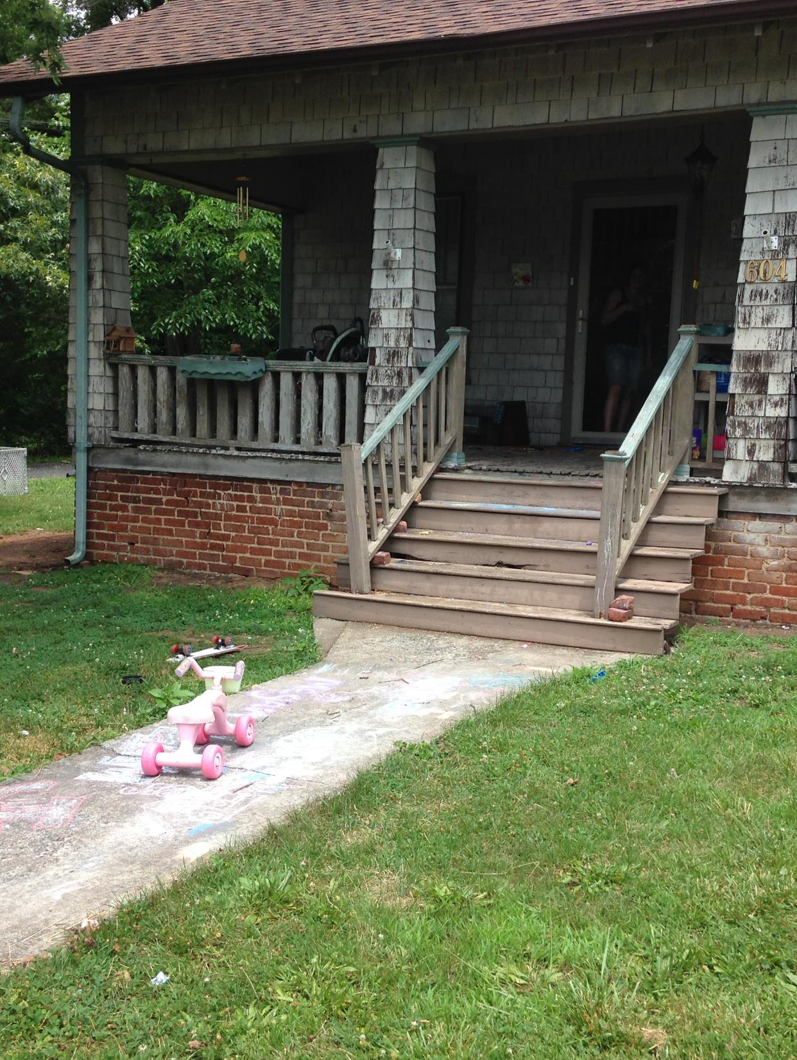
Environmental Investigation of Child Lead Poisoning Hazards
W. David Brown, RS MPA
Surveillance Coordinator
Children’s Environmental Health
NC DHHS/Division of Public Health
919-218-5460
w.david.brown@dhhs.nc.gov

Slide 2
Many children are exposed to lead poisoning hazards in their environment.
Exposure can come from many sources such as paint, dust, soil, water, consumer and food products, family hobbies and occupations.
A child’s primary mode of exposure is through ingestion from normal hand to mouth activity.
Lead-based paint is the most widespread and dangerous high-dose source of lead exposure for young children.
This Photo by Unknown Author is licensed under CC BY-ND

Slide 3
When Do We Investigate?
All cases of confirmed lead poisoning (CLP)
blood lead levels >10 ug/dL
2 samples (consecutive)
within 12 months
the investigation is mandatory – it’s the law!
We offer a home investigation for all cases of elevated blood lead level (EBL)
blood lead levels is 5 - 9 ug/dL
2 samples (consecutive)
within 12 months
the investigation is voluntary with signed consent
Pregnant Women
State law includes environmental investigations and remediation for pregnant women with similarly elevated blood lead levels. In cases of pregnant women the focus is on investigation and remediation of the primary residence, AND referrals must come directly from a medical provider.

Slide 4
Purpose of the Environmental Investigation
Identify Lead Poisoning Hazards
Educational opportunity for parents, child care providers, school personnel
Discuss Interim Control Measures
Discuss the importance of proper maintenance and repairs

Slide 5
Records Review
Review records prior to going out in the field:
Check NCLEAD to confirm blood lead levels
Review provider notes/concerns/look for sibling information on past investigations, property status, language, etc.
Google earth picture of the home and neighborhood
Confirm investigation and follow up before appointment
Tax card will confirm date(s) of construction and ownership

Slide 6
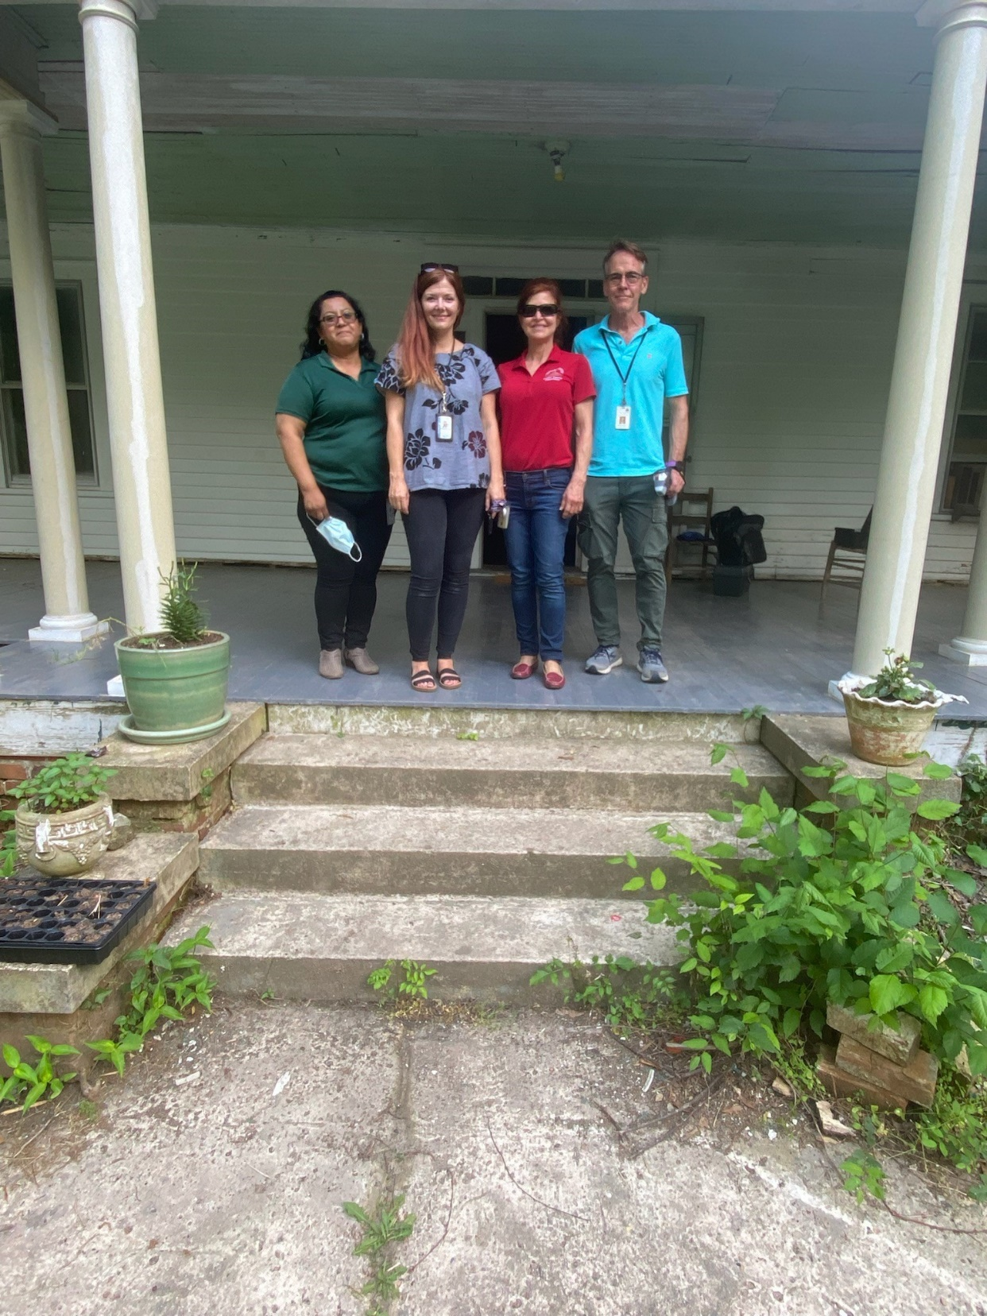
Investigation Team
From left to right:
Nellie Benitez - Lead Outreach Worker and Spanish Language Translator
Lisa Morgan – Food and Lodging Supervisor and Authorized Lead Agent
Elizabeth Fridley - RN, Child Health Nurse
David Brown – Regional Environmental Health Specialist

Slide 7
Plan with Safety and Education in Mind
Your personal safety is paramount – be smart
COVID-19 Protocols
Investigations require a team do not investigate alone
Always leave an itinerary with your office
Always take a charged cell phone and official ID
Never enter a residence if only a minor is home
Approach, demeanor and attitude makes a difference
Always ask the resident if they know why you are there
If needed obtain signed consent
Don’t sit on upholstered furniture
Be mindful of where you place and leave your belongings and equipment
Above all be respectful you are in someone’s home
Show empathy
Listen
Provide language appropriate materials
Always look around the corner of the house before walking around a corner
Never trust a rope or chain
You may see guns, weapons and drugs
Park your car where you can easily be seen and get out

Slide 8
Environmental Investigation
The Interview
Make sure parents know why you are there
Review information provided on the 3651 form and verify (name, address, date of birth, parents' names, length of time at residence and supplemental addresses
Discuss potential sources of lead exposure in the child’s environment
Identify sleeping and play areas
Take forms and materials with you in the field
Habits and hobbies

Slide 9
Investigate
Areas of curiosity and mouthable surfaces
Objects used for pulling to a standing position
Bathing areas
Food preparation, storage and utensils
Look under, behind and in the small spaces
Ask questions
Always ask the child’s parents where they think the lead exposure is occurring
Document your findings, sketches, diagram
Record XRF readings

Slide 10
Does the child consume any homemade or foreign manufactured herbs, vitamins, teas, medications or supplements home remedies?
Travel
Mouthable objects
Home hobbies
Food preparation, diet and spices
What is their potable water source

Slide 11
PAINT

Slide 12
Why was lead-based paint so popular?
The durability of lead made it an excellent paint additive, but the sweetness made it tempting to young children to eat.
But was it safe?
Childhood lead poisoning was linked to lead-based paints in 1904. Several European countries banned the use of interior lead-based paints in 1909.
In 1922, the League of Nations banned lead-based paint but the United States declined to adopt this rule.
In 1943, a report concluded that children eating lead paint chips could suffer from neurological disorders including behavior, learning, and intelligence problems.
Notes:
At one time baby cribs were painted with lead-based paint, which resulted in infant illness and death.

Slide 13
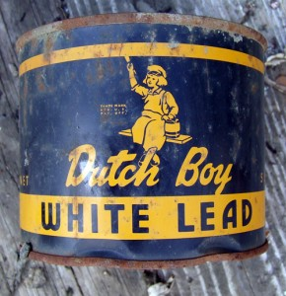
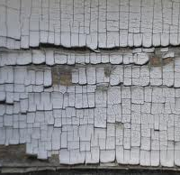
Lead-Based Paint

Slide 14
Selling quality!

Slide 15
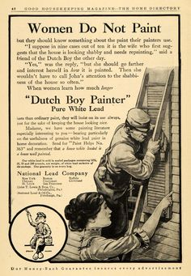

Slide 16
Lead Poisoning Trifecta
1978
Lead-based paints were banned for residential use in 1978.
1986
Lead solder was banned from use in public water supplies 1986.
1996
Leaded gasoline was banned from use in all on-road vehicles in the US.
When was lead paint banned in the EU?
Use of lead-based interior paints was banned in France, Belgium and Austria in 1909. Much of Europe followed suit before 1940. It took the U.S. until 1978 to make this move, even though health experts had, for decades, recognized the potentially acute — even deadly — and irreversible hazards of lead exposure.
Solder is a fusible metal alloy used to create a permanent bond between metal workpieces. Solder is melted in order to adhere to and connect the pieces after cooling, which requires that an alloy suitable for use as solder have a lower melting point than the pieces being joined
When did they stop putting lead in gasoline?
By 1975, unleaded gasoline was universally available. Effective January 1, 1996, leaded gasoline was banned by the Clean Air Act for use in new vehicles other than aircraft, racing cars, farm equipment, and marine engines.
Lead has been blended with gasoline, primarily to boost octane levels, since the early 1920s.

Slide 17
Lead-based Paint

Slide 18
Generally, we are not too concerned with paint in good condition, however, examine and sample readily accessible:
Deteriorated paint
Loose and flaking paint
Paint chips on surfaces
Friction and impact surfaces

Slide 19
Readily Accessible - substances that can be ingested or inhaled by a child less than six years of age
Includes deteriorated paint that is peeling, chipping, cracking, flaking, or blistering to the extent that the paint has separated from the substrate.
Also includes dust, soil, water, toys, vinyl miniblinds, doors and jambs, stairs, railings, windows, interior sills, baseboards and other components.

Slide 20
X-ray Fluorescence Analyzer
The primary field method for providing quantitative analysis of surface coatings and substrates is the X-ray Fluorescence Analyzer (XRF).

Slide 21
XRF Units
Field Testing with XRF

Slide 22
XRF analysis the most cost effective and quickest method of screening a large number of surfaces.
1
Lead content is expressed in milligrams per square centimeter mg/cm²
2
1.0 mg/cm² or greater is considered a lead poisoning hazard.
3

Slide 23
DIY

Slide 25
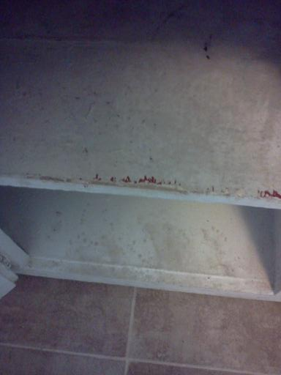
Mouthable Surfaces

Slide 26
Painted Friction/Impact Surfaces
Window sashes
Door jambs

Slide 27
Sample Collection and Analysis
Another quantitative method of determining hazards is by laboratory analysis.
Paint, dust, soil, water and …. other stuff!
Normally samples are submitted to the State Laboratory of Public Health where lead content is determined by atomic absorption spectroscopy (AAS).

Slide 28
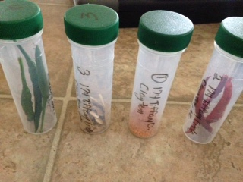
Chemical Analysis
Lead content is reported as percent by weight
0.5% or 5000 ppm is considered a lead poisoning hazard

Slide 29
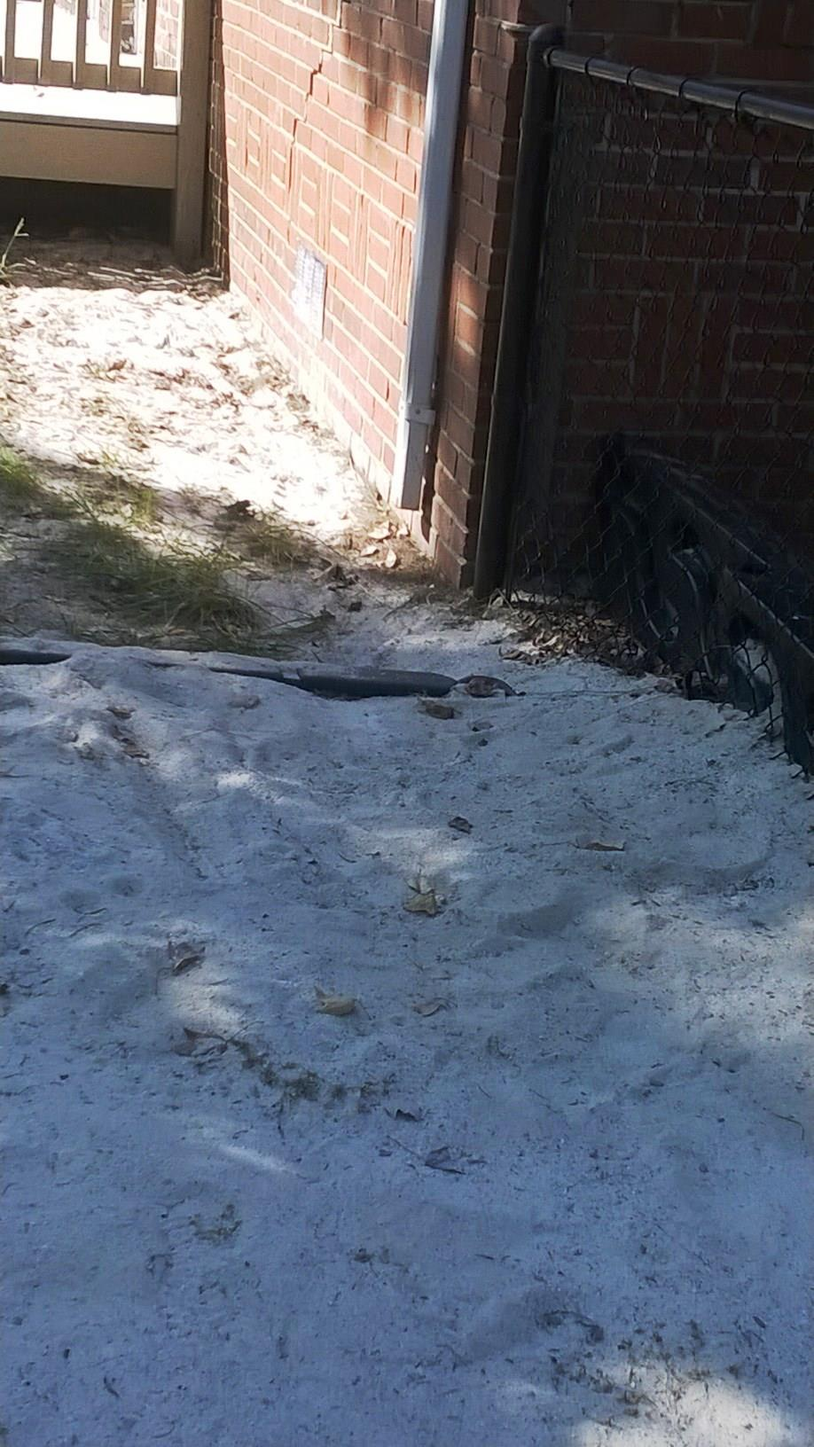
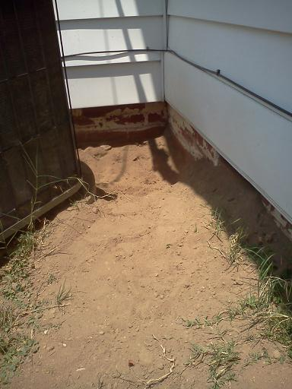
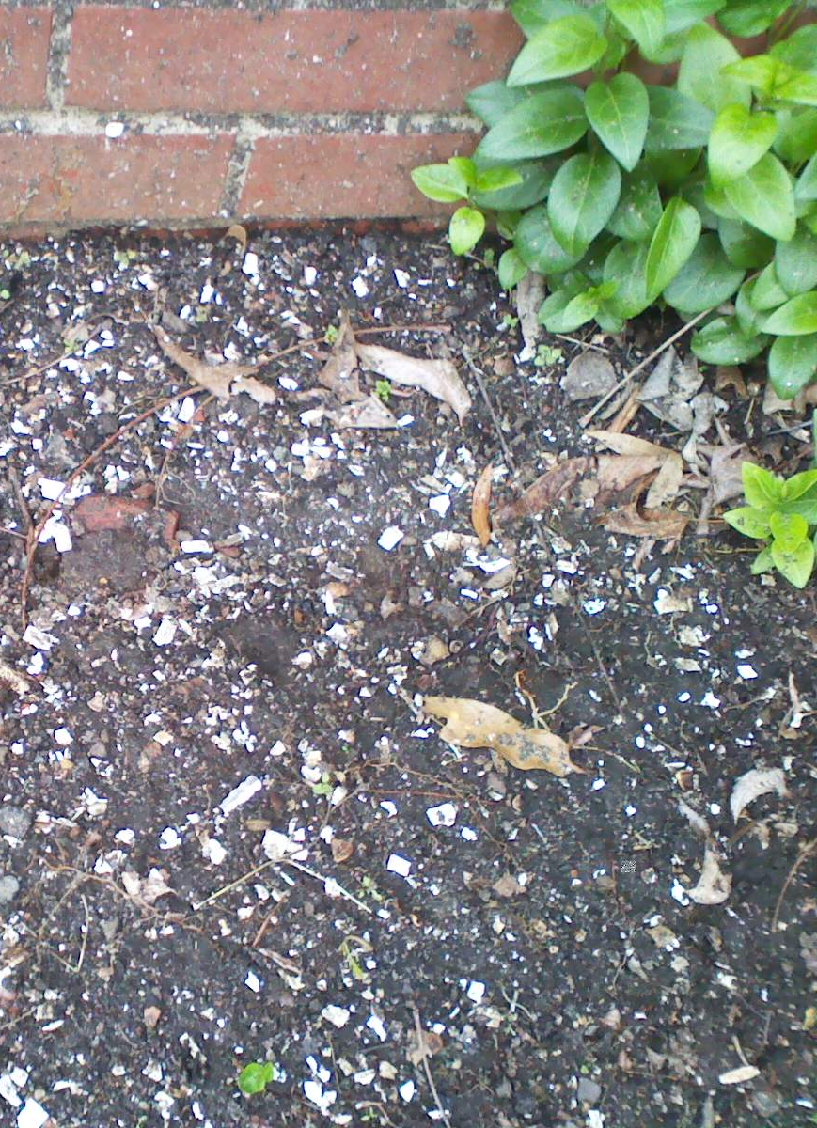
SOIL

Slide 30
Soil Hazard Levels
Soil hazard levels are reported in parts per million (ppm) of lead. A lead poisoning hazard is any concentration of lead in bare soil:
> 400 ppm in play areas, gardens, pet sleeping areas, and areas within three feet of a residential housing unit or child-occupied facility.
> 1200 ppm in other locations of yard

Slide 31
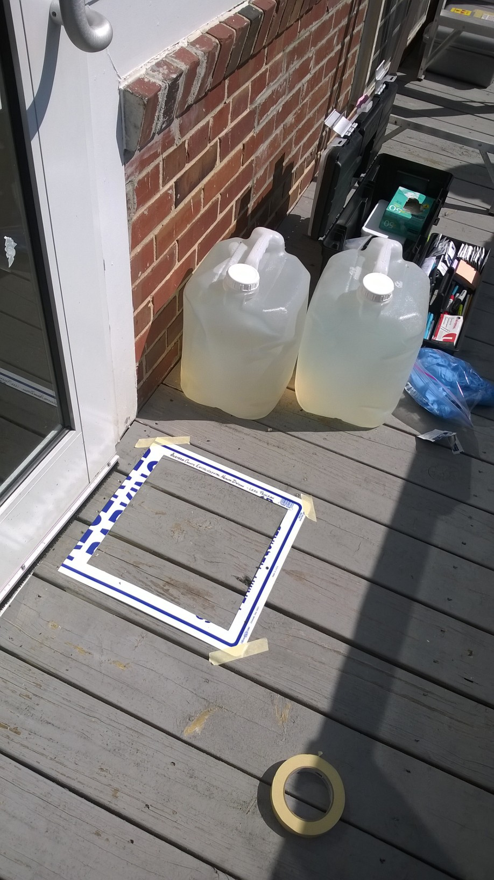
Dust
Floors, porches, windowsills, miniblinds, workshop and home hobby areas, laundry areas
Other items/areas are sampled based on information obtained during the visit
Dust hazards occur as lead-based paint deteriorates, breaks down or is disturbed

Slide 32
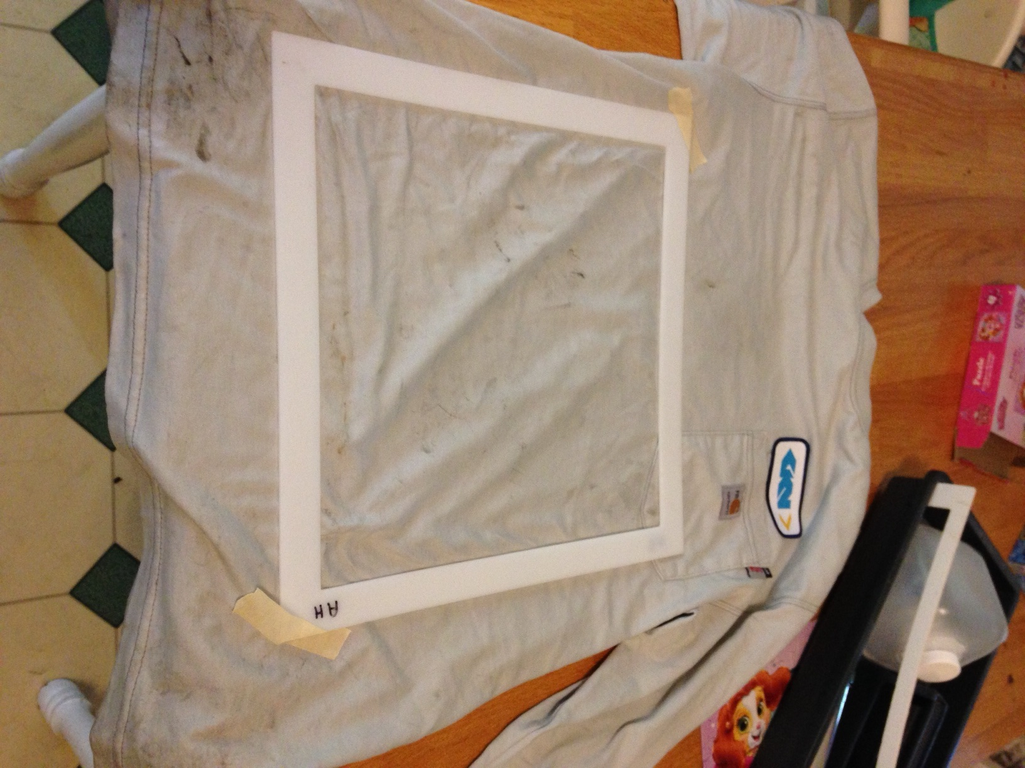
If occupation or hobby is a potential source of exposure you may need to collect dust wipes from work clothes, shoes, car seats, furniture, changing and laundry areas
Dust sampling is required after remediation

Slide 33
Dust Hazard Levels
Dust hazard levels are reported in micrograms per square foot (ug/ft²) of lead. Effective December 1, 2022, a lead poisoning hazard in dust is any concentration of lead:
> 10 ug/ft² floors
> 100 ug/ft² window sills
> 400 ug/ ft² window troughs (clearance only)

Slide 34
Water
Hazard Level > 10 ppb
Leave the aerator on the mouth of the faucet when sampling
Normally sample from the kitchen tap
First draw samples are most useful
You can also pull a sample from the well head
Water is usually contaminated by lead leaching from lead soldered joints, fixtures, or pipes

Slide 35
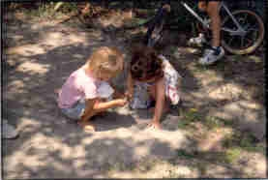
Focus on areas where the child spends time inside and outside of the home. Focus on those areas and look for evidence of exposure.

Slide 36
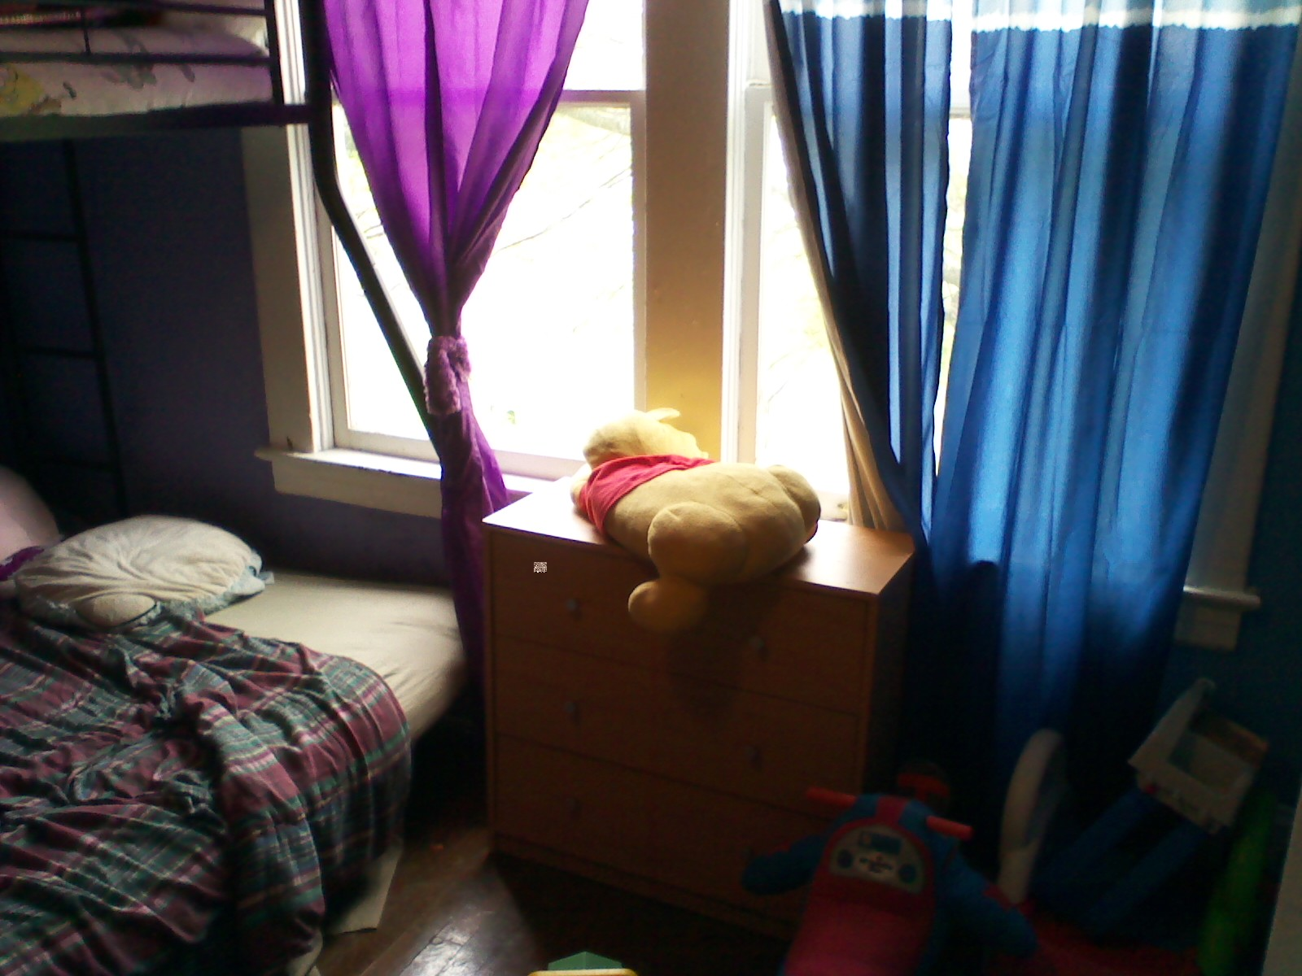

Slide 37
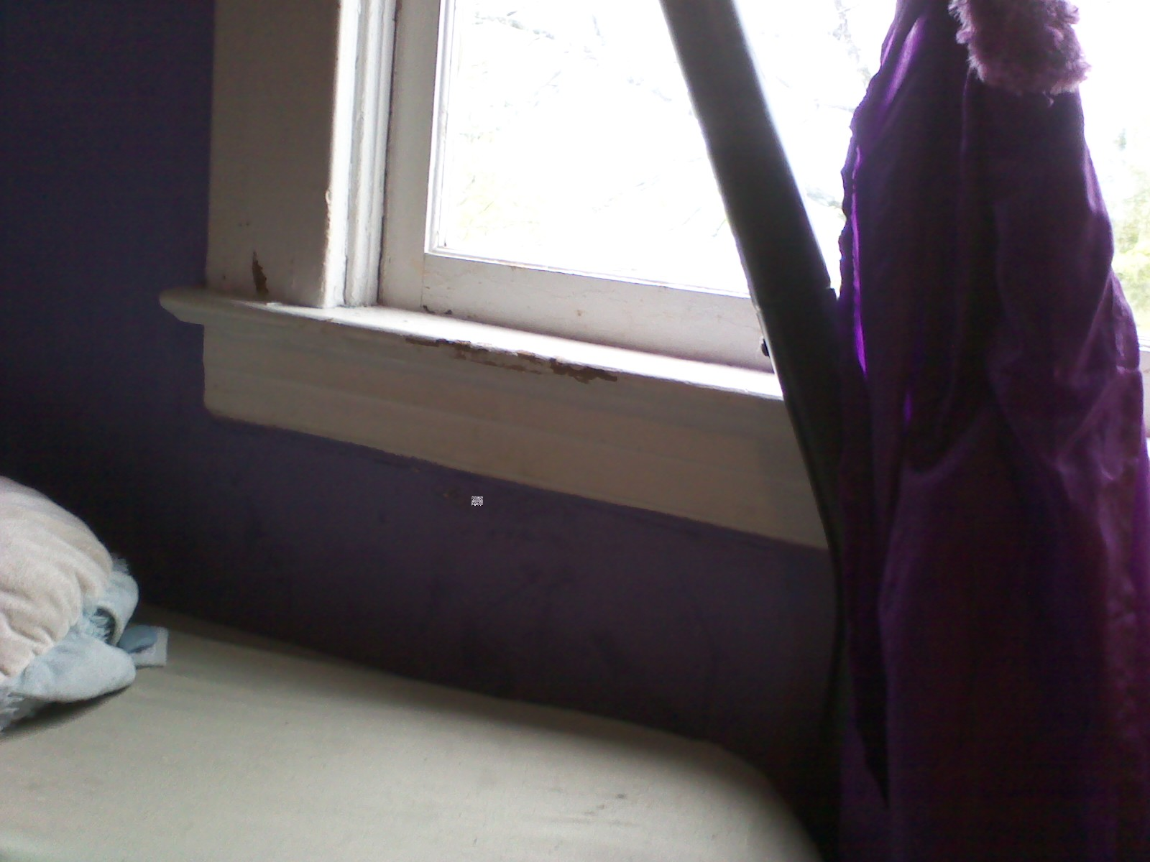

Slide 38
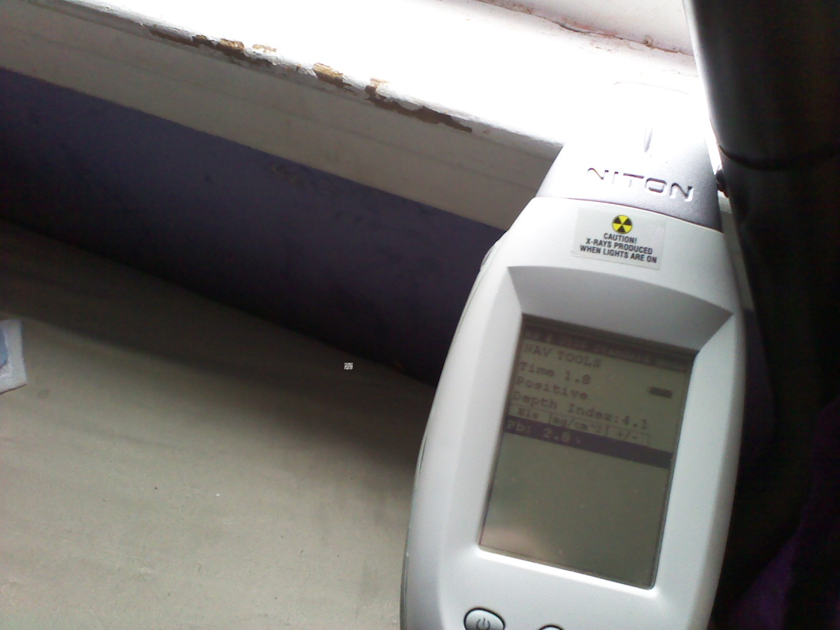

Slide 39
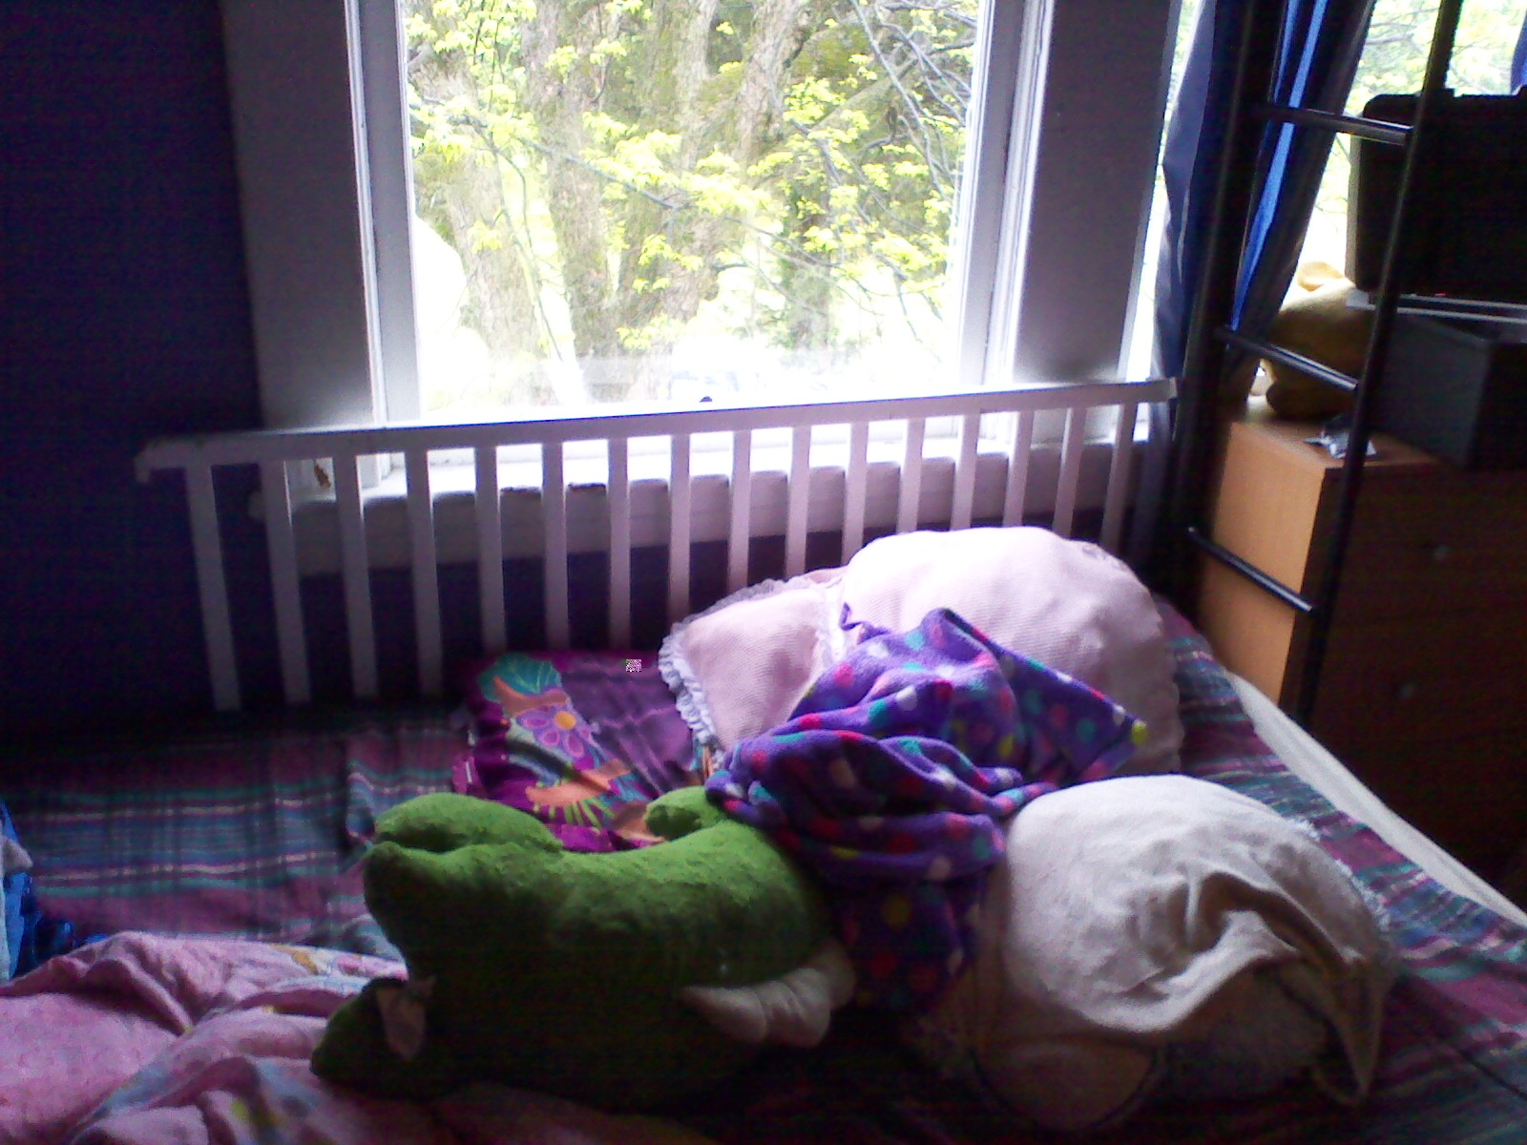

Slide 40
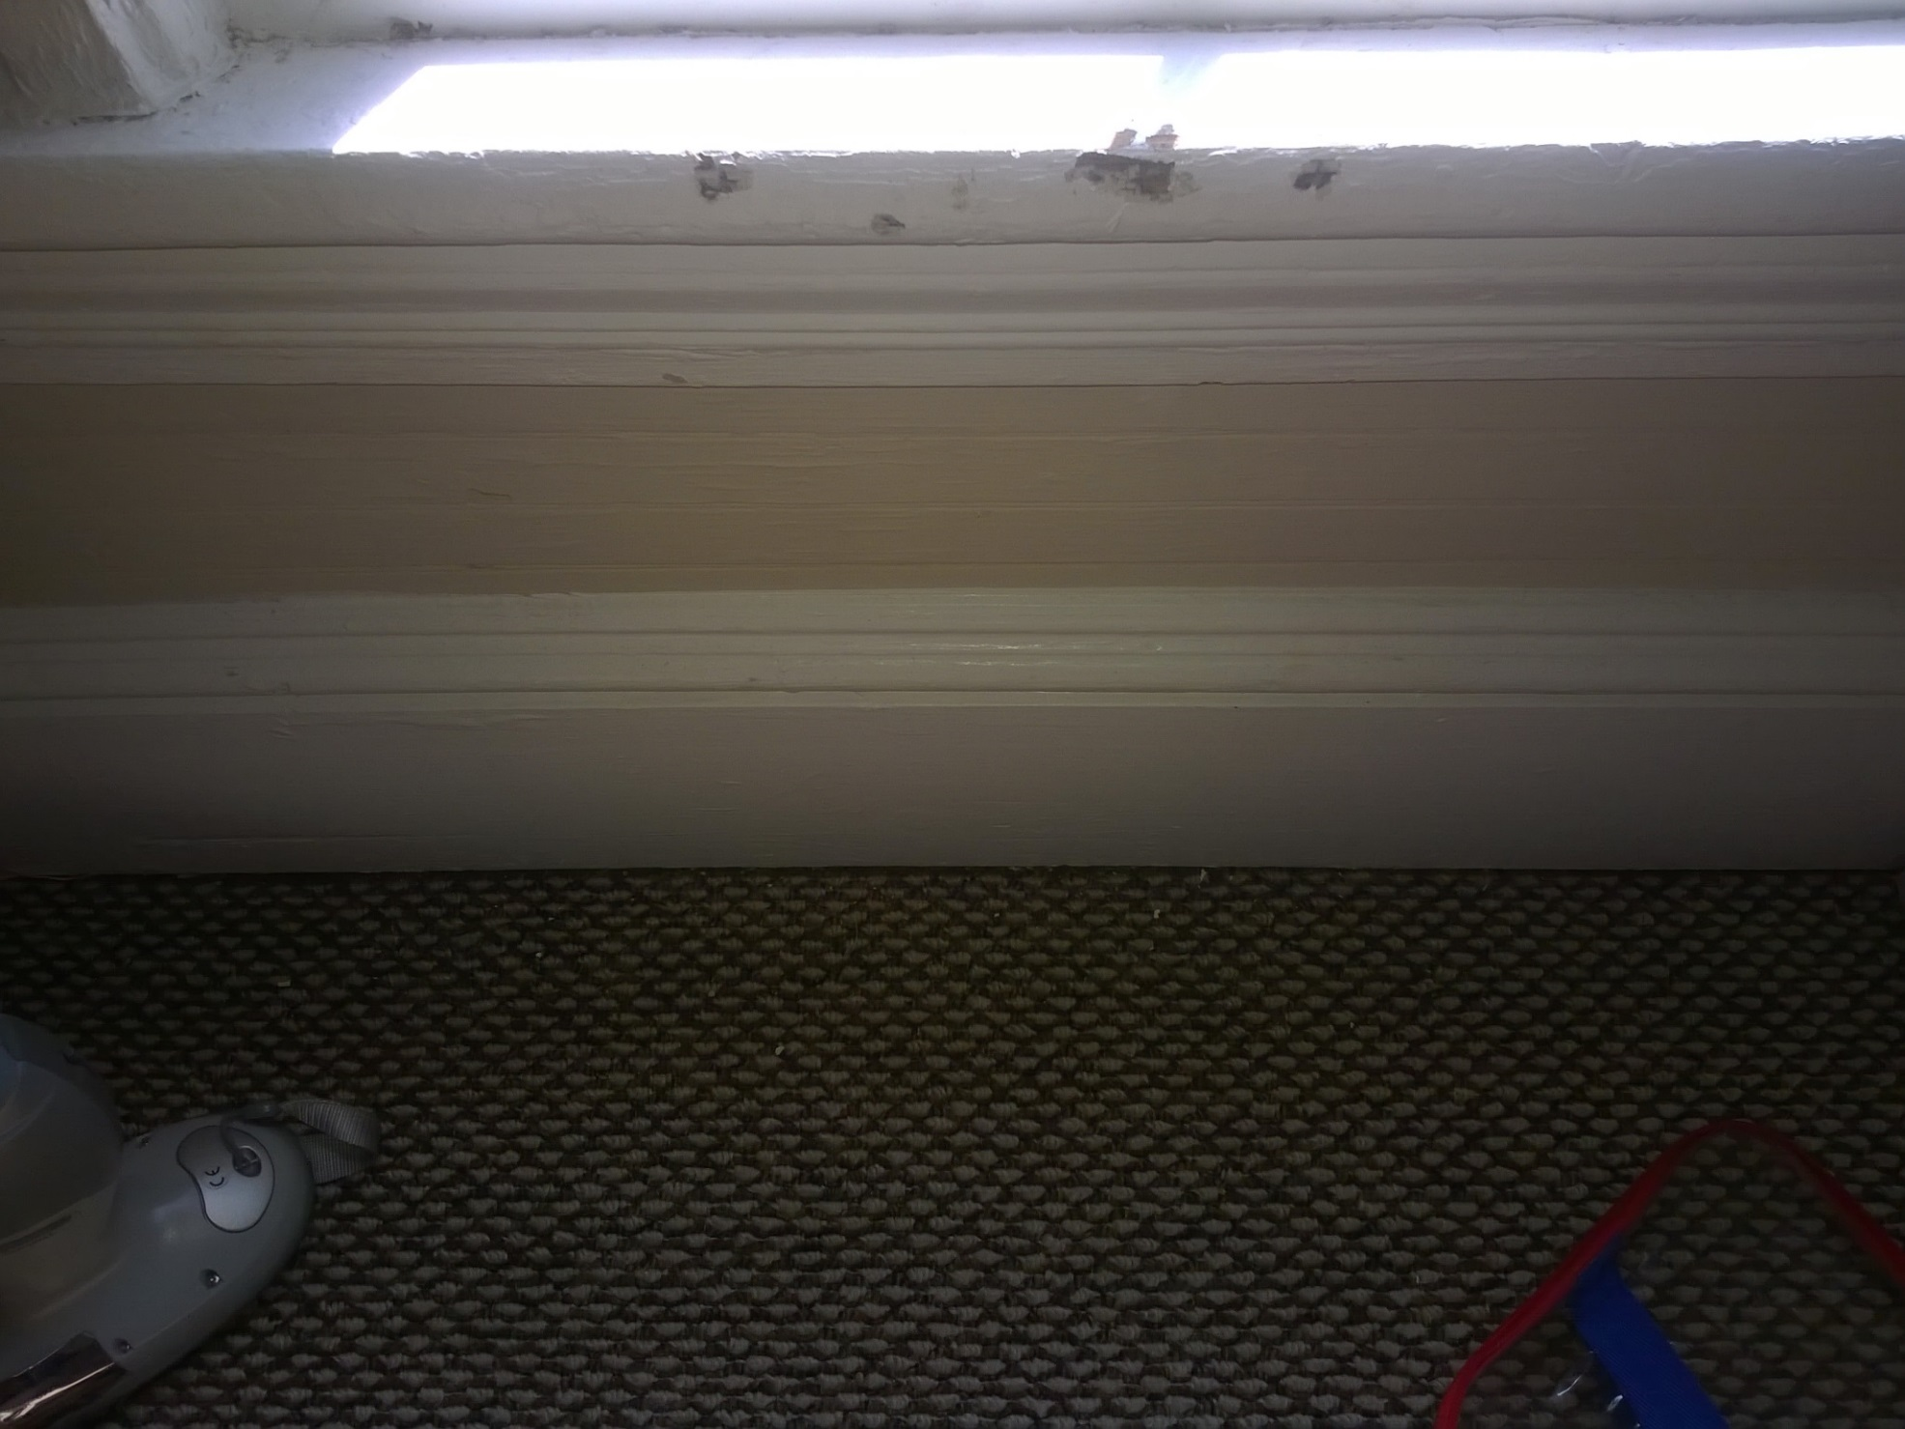

Slide 41
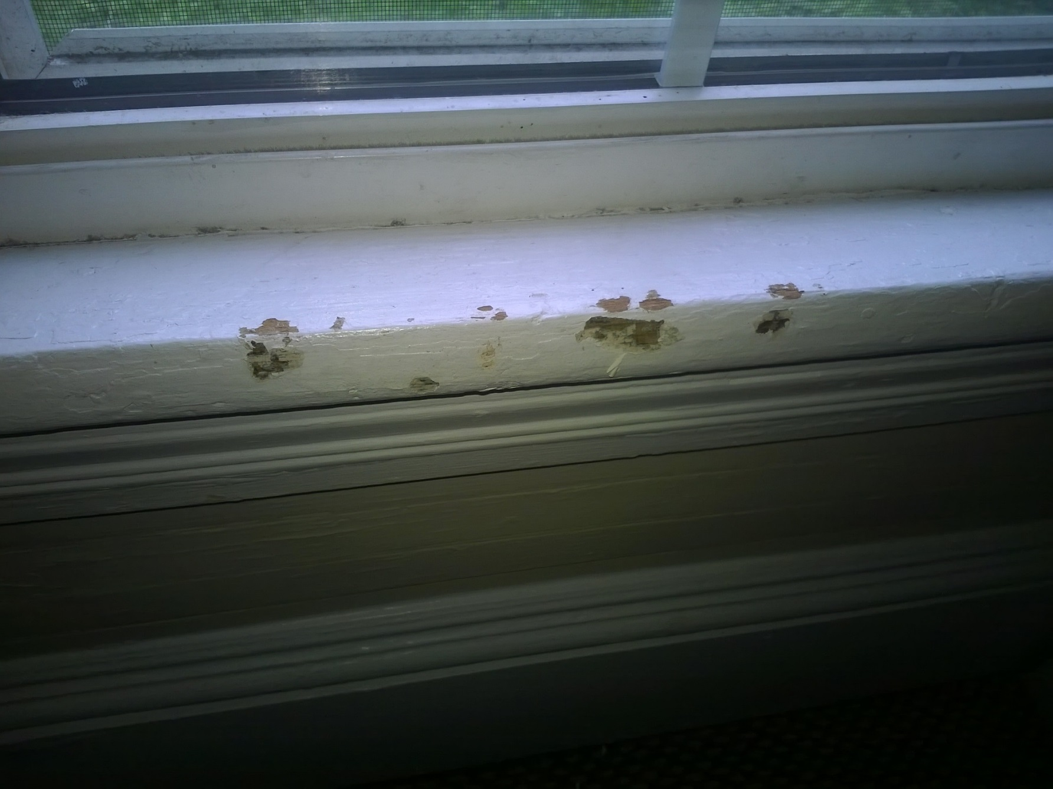

Slide 42
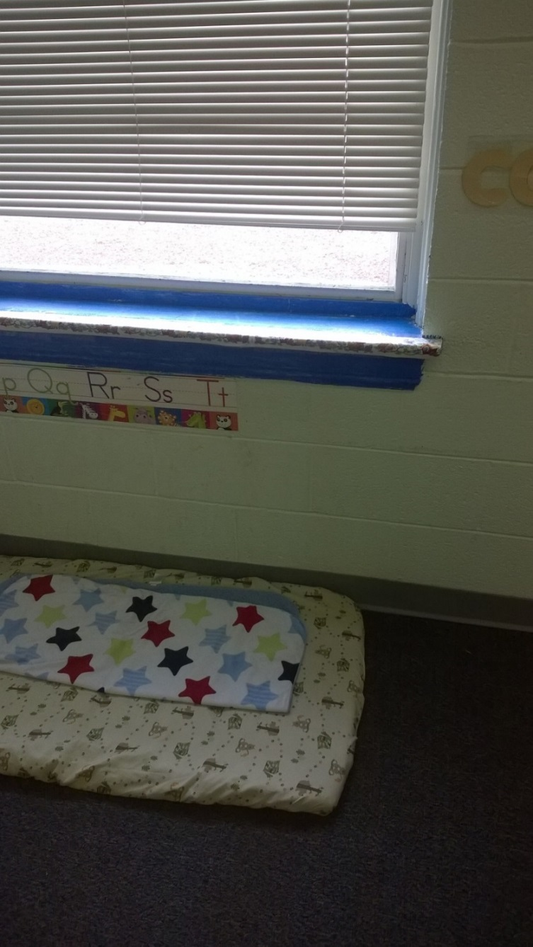
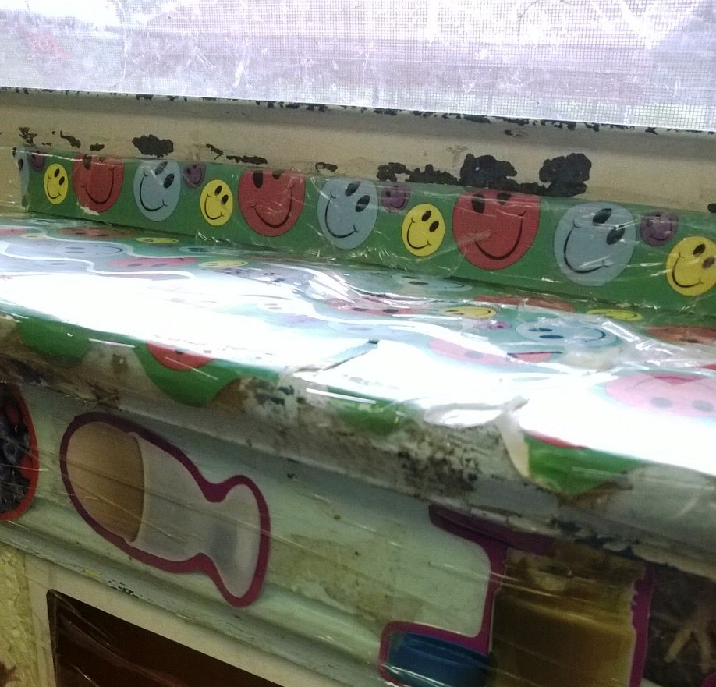

Slide 43
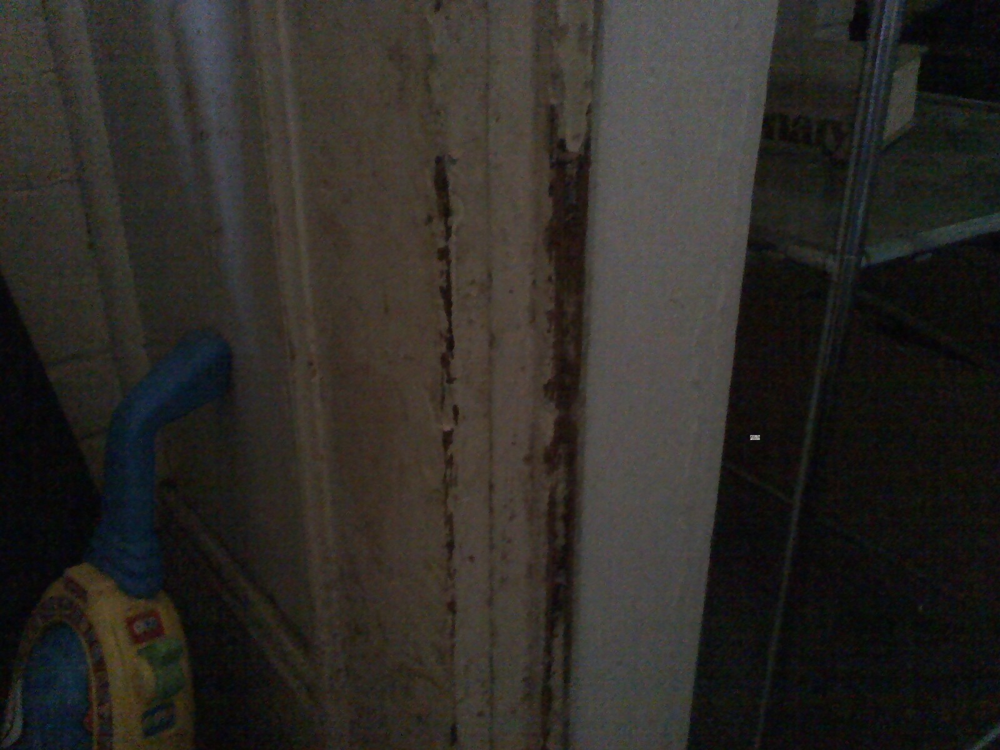

Slide 44
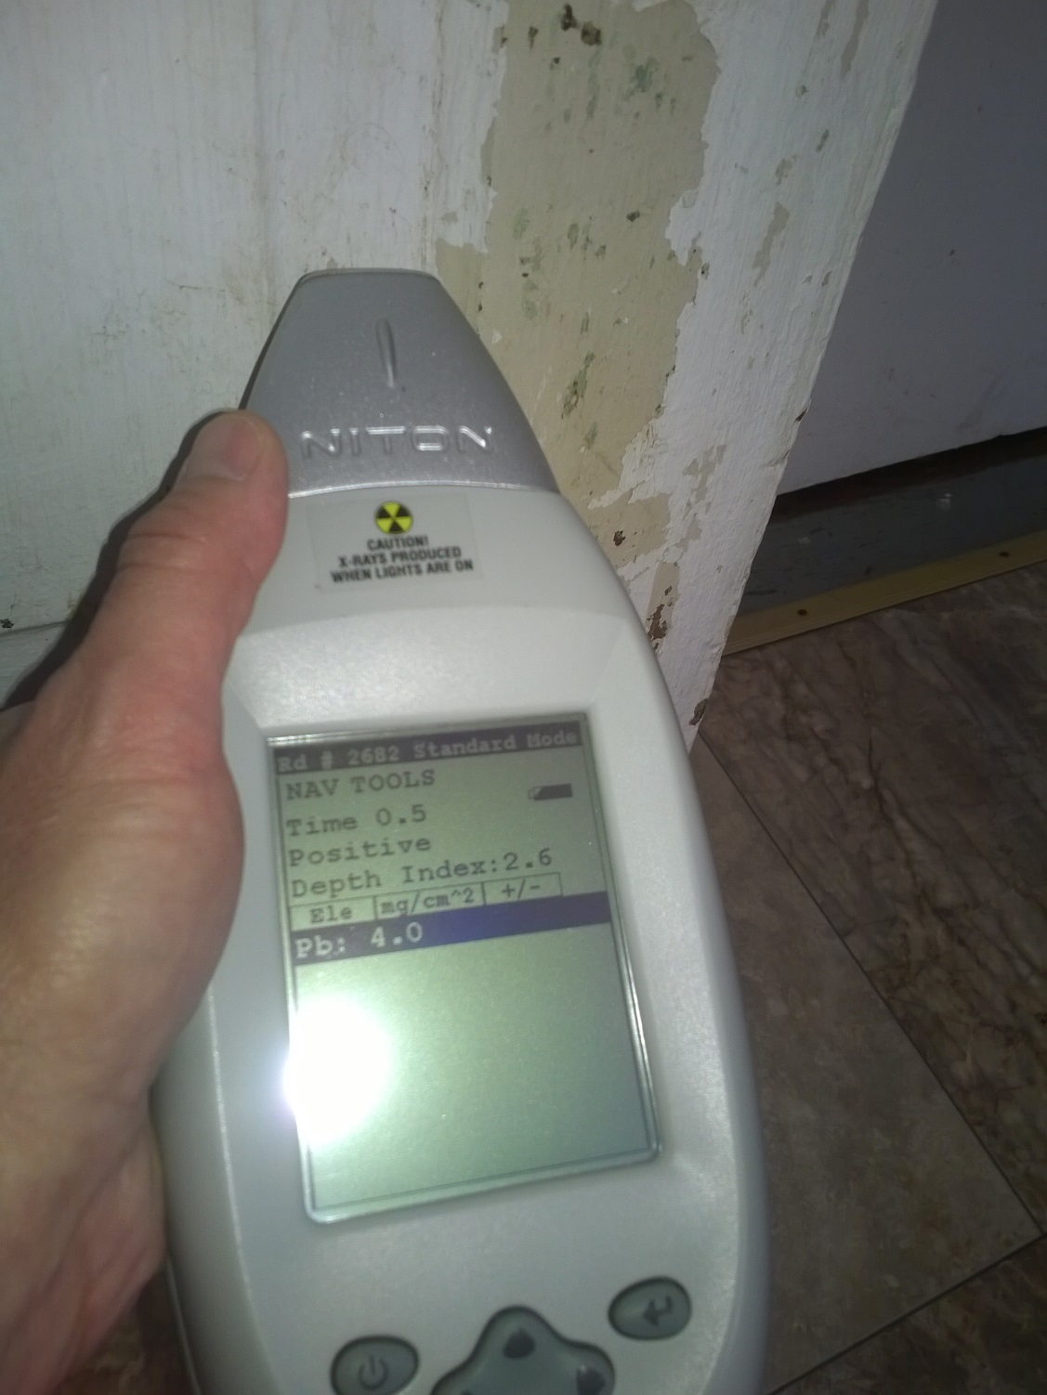

Slide 45
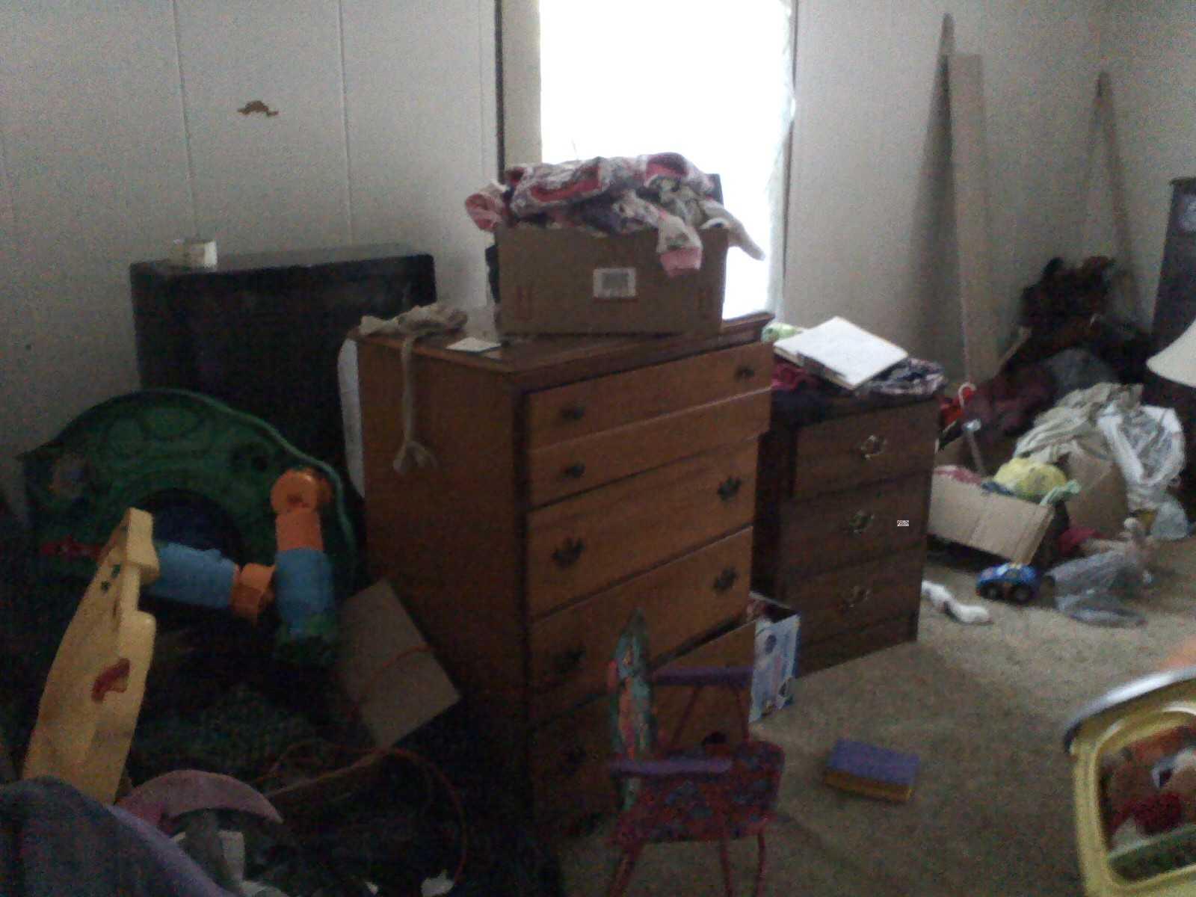

Slide 46
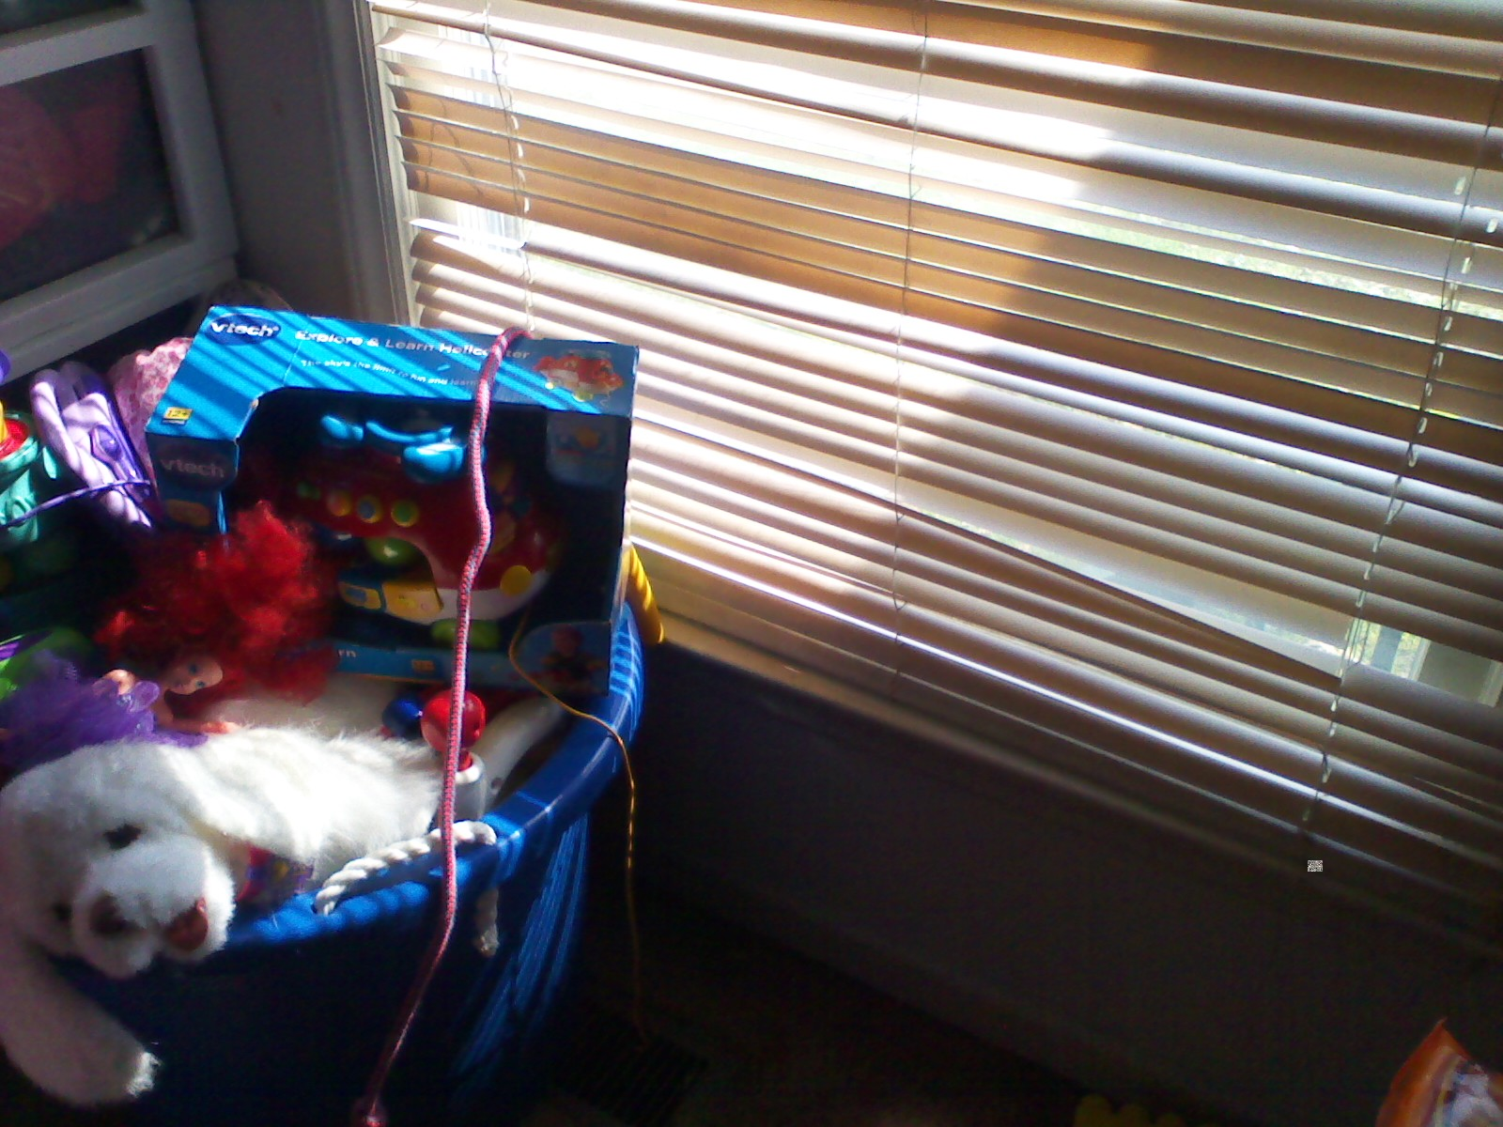

Slide 47
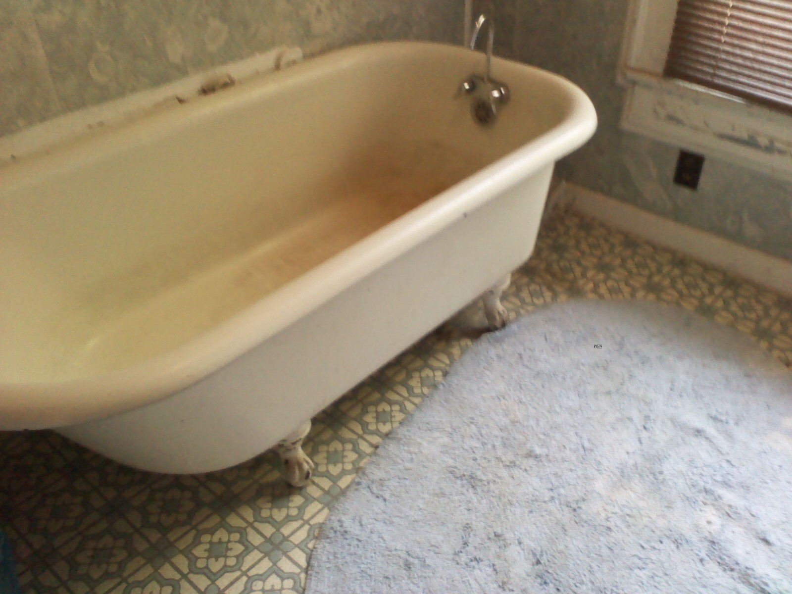

Slide 48
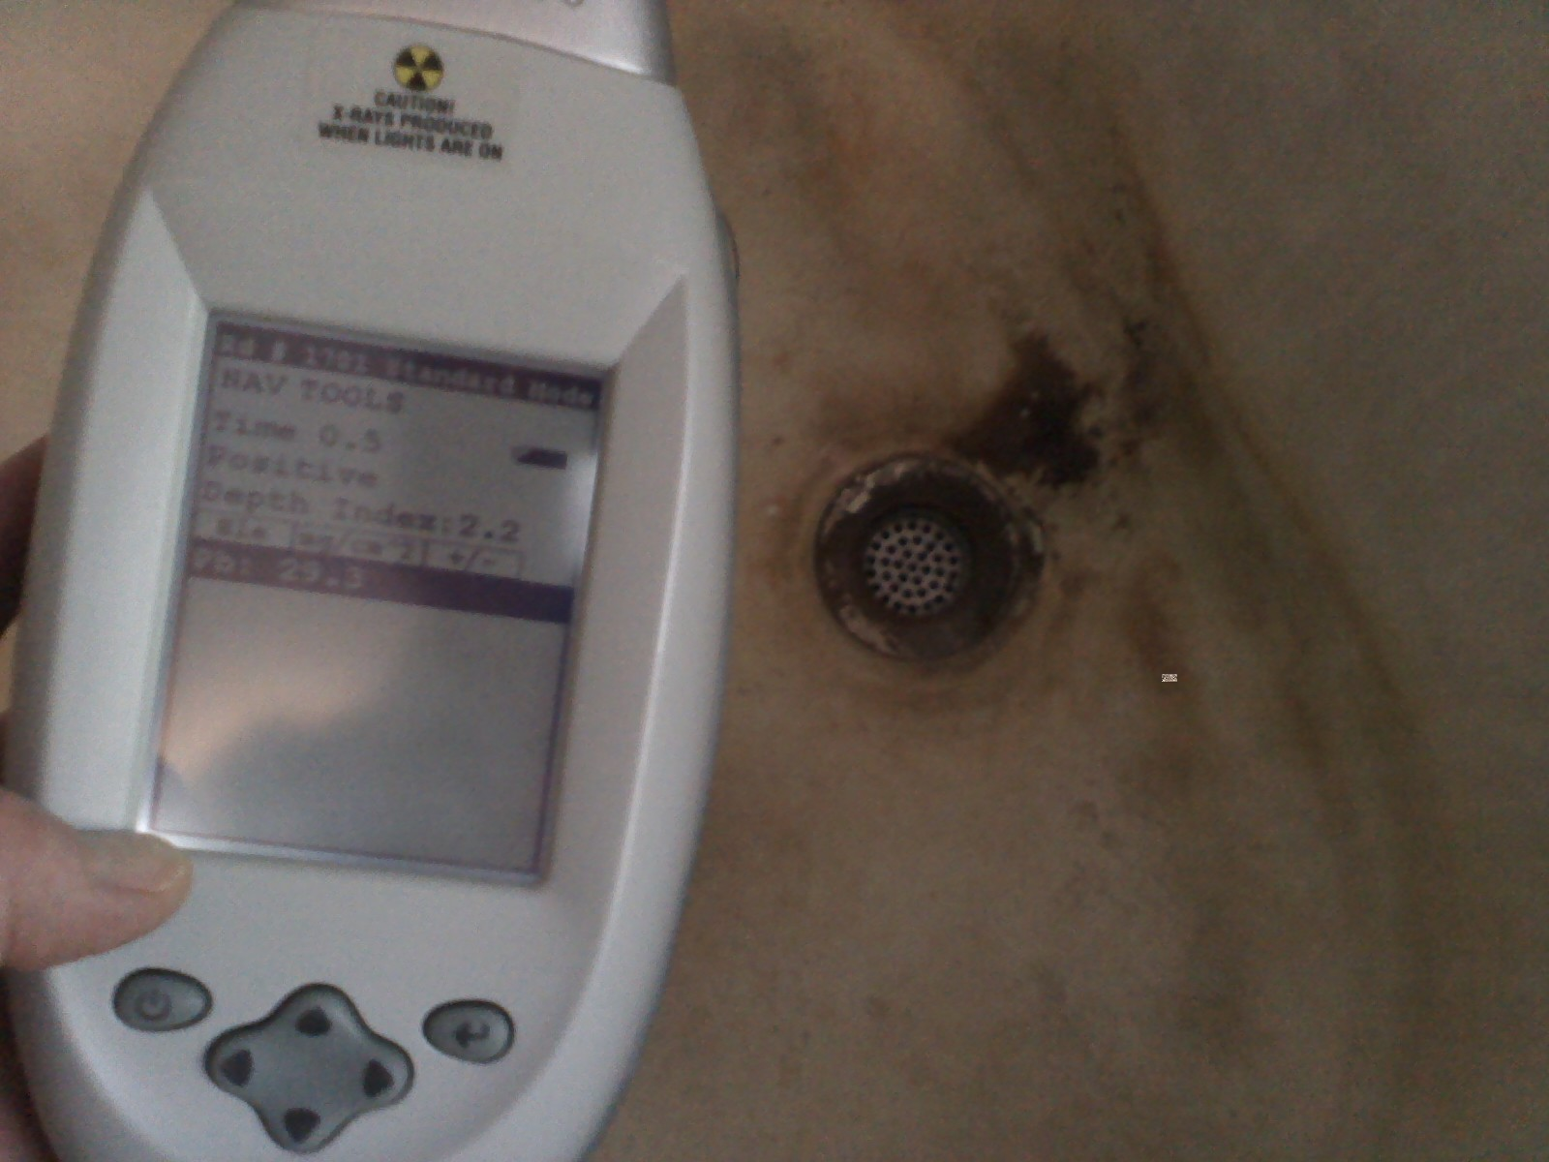

Slide 49
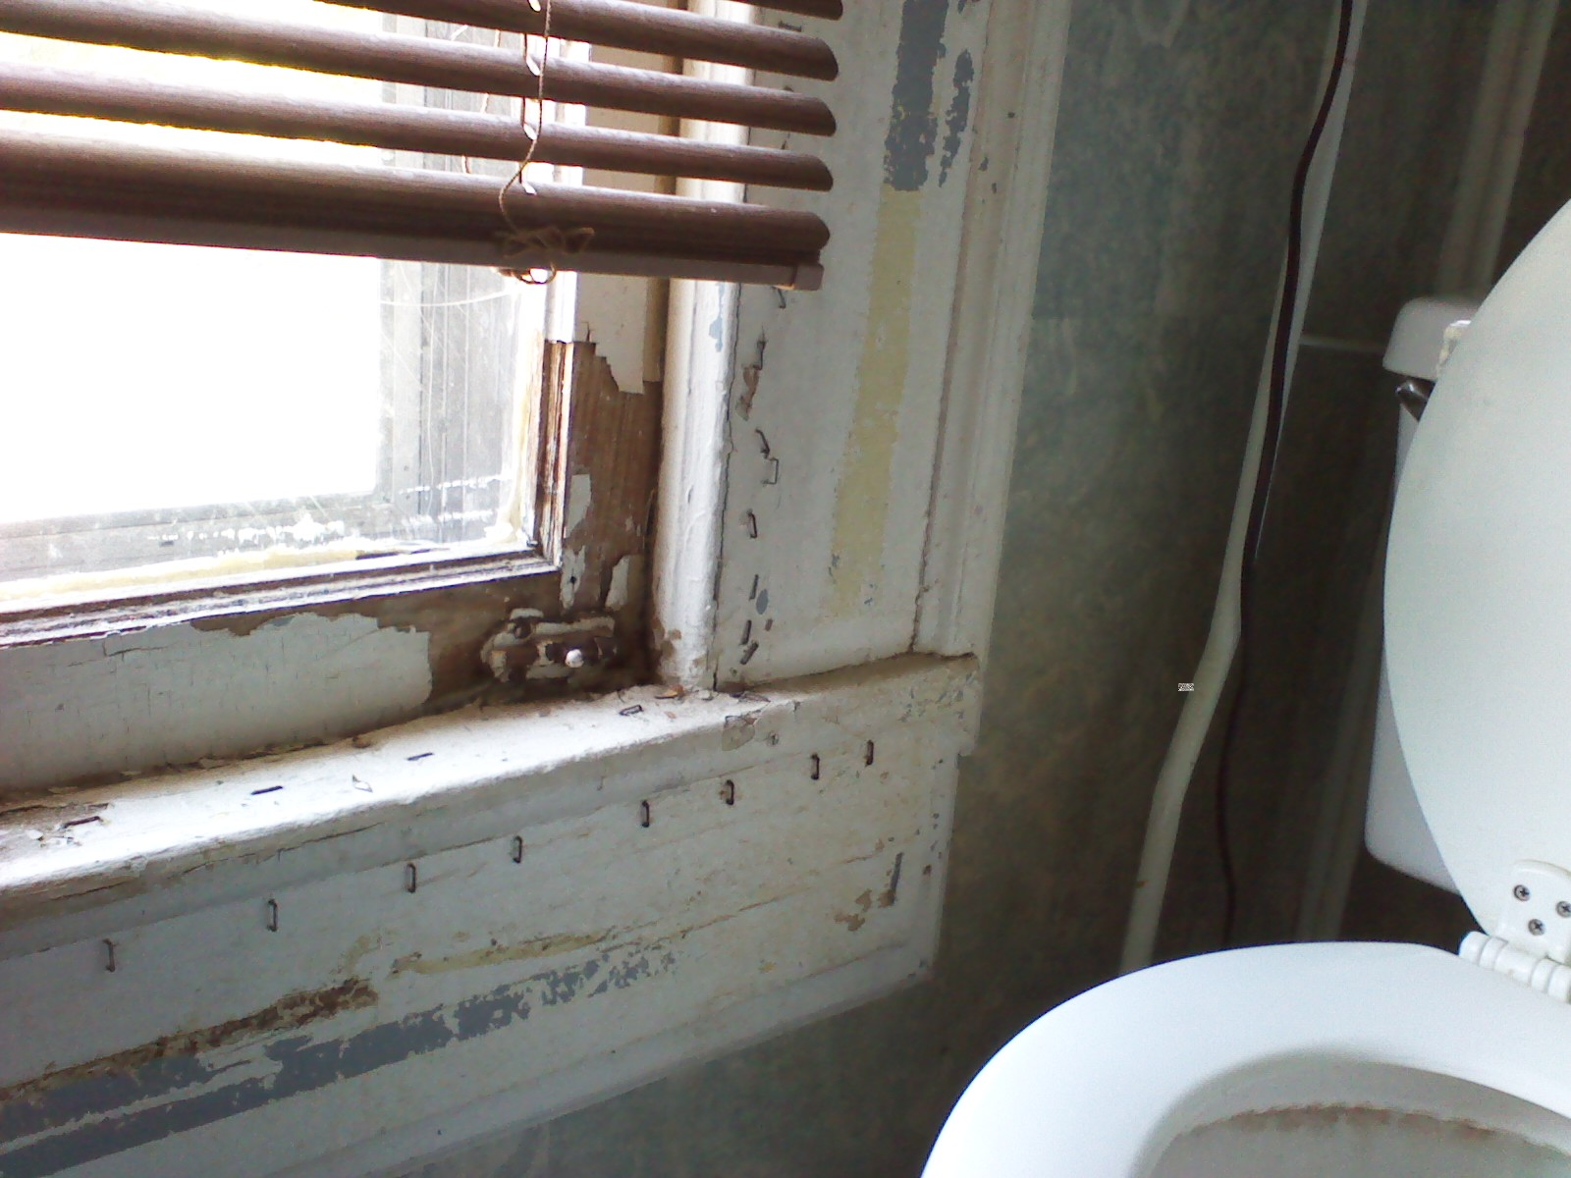

Slide 50
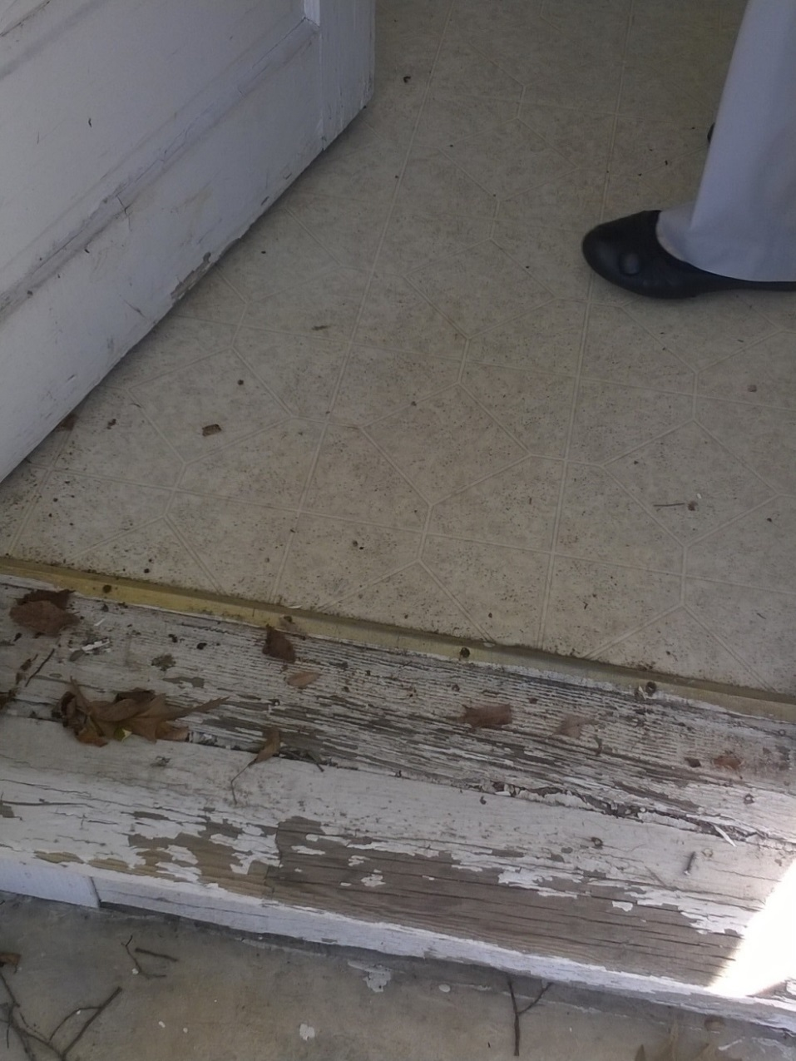
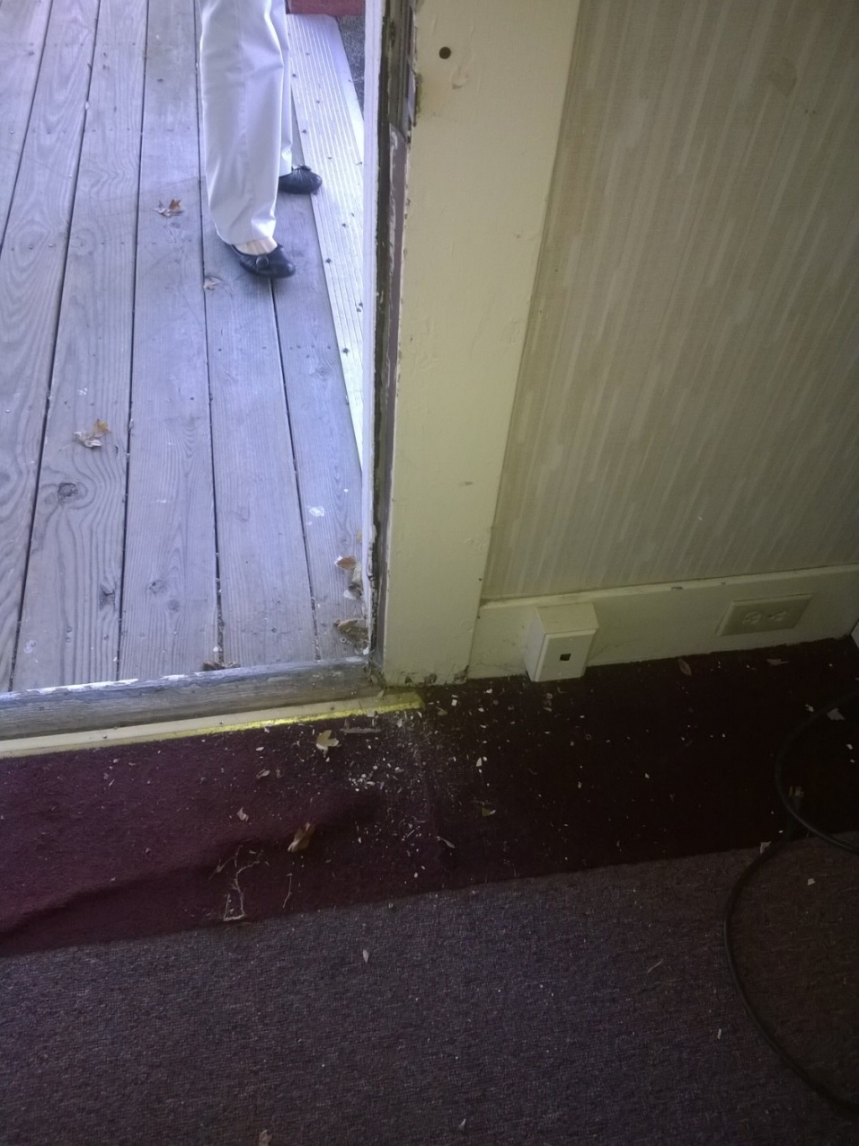

Slide 51
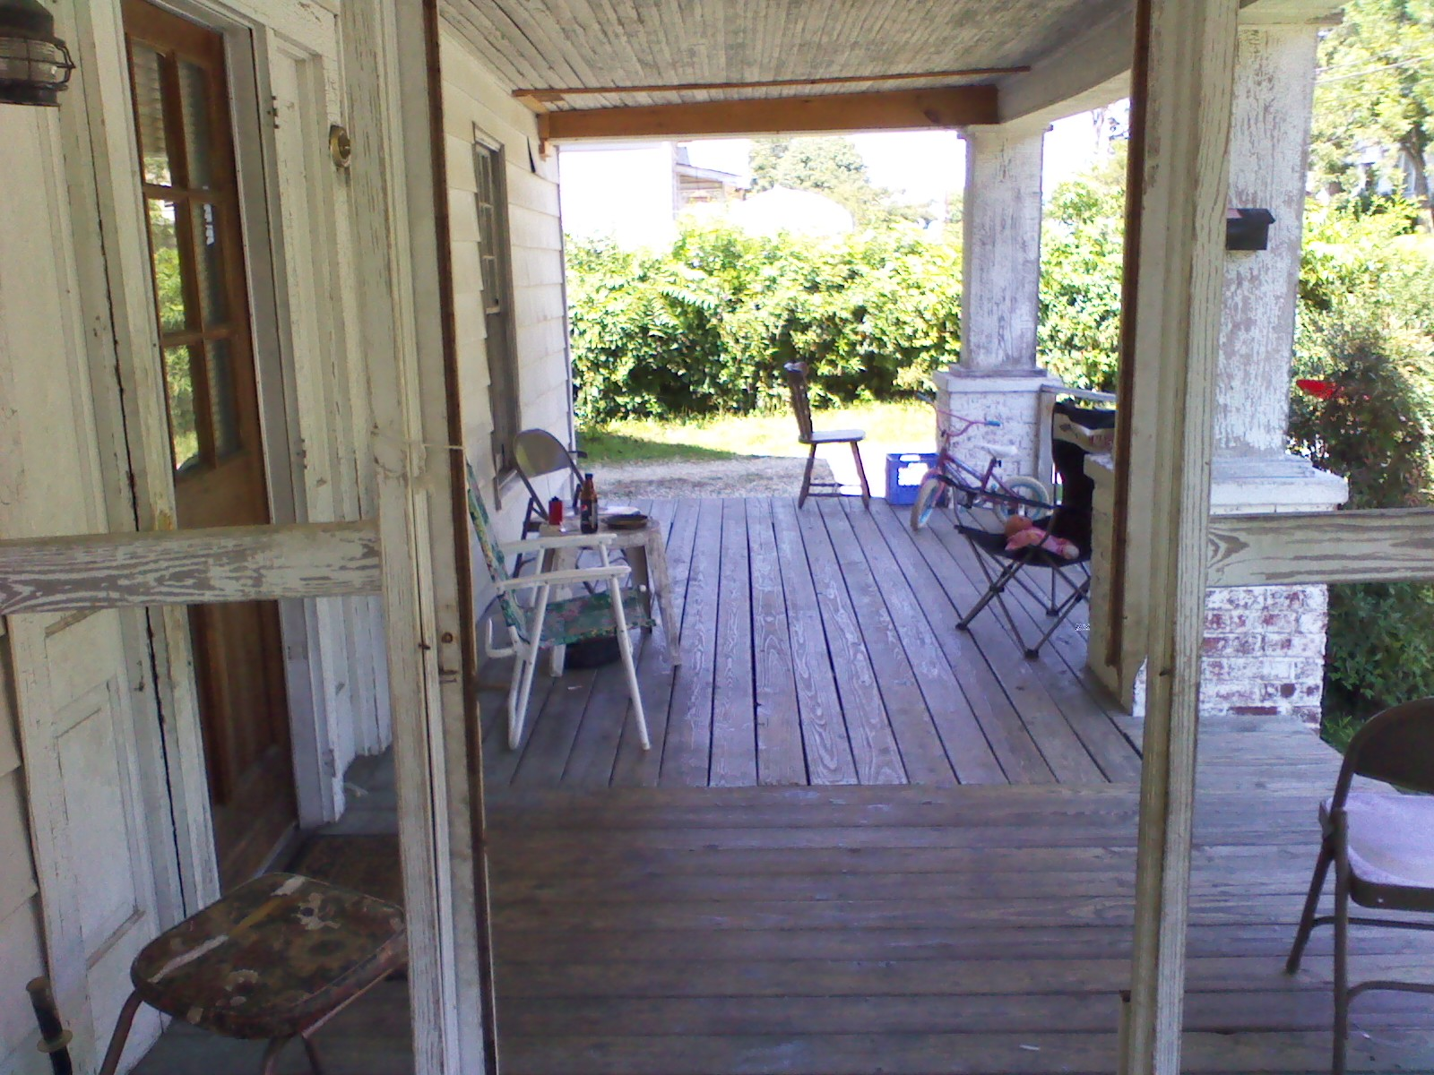

Slide 52
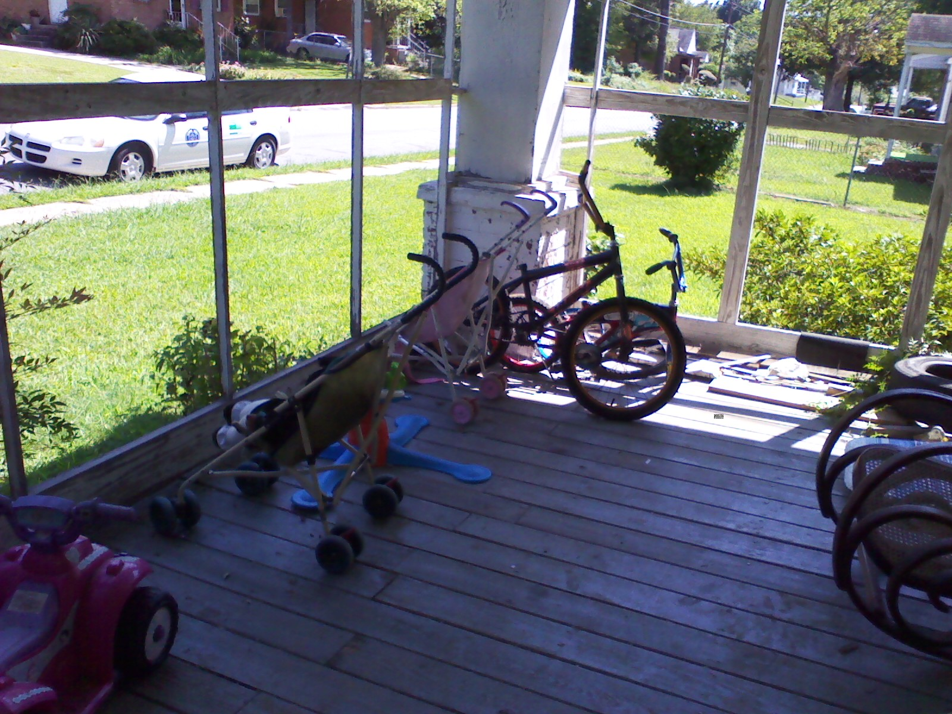

Slide 53
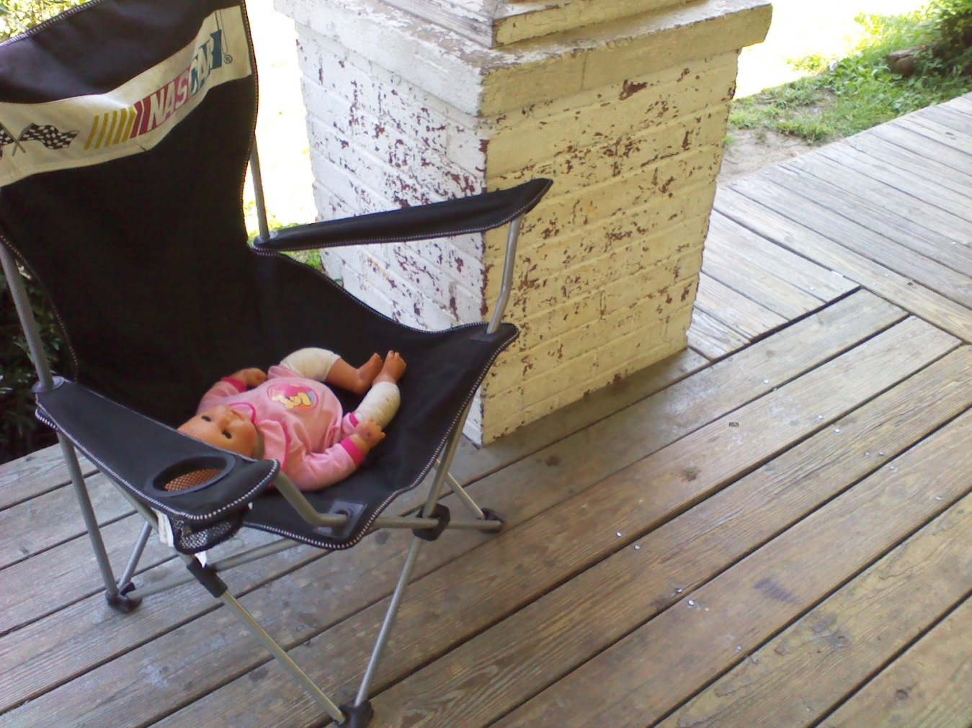
Where do the children play and spend their time?

Slide 54
Safe Spaces
Safe rooms or safe zones in and out of the house.
Locate play areas away from the house foundation and old structures.
Older porches and outbuildings often have lead-based paint.
Who does the repair and maintenance work?

Slide 55
RRP RULE
North Carolina’s Lead Program for Renovation, Repair and Painting (RRP)
Effective January 1, 2010
Intended to protect building occupants and children from lead-based paint hazards
Lead-safe work practices
Notes:
Hand out given to audience – why?
To raise awareness of this EPA / NC requirement to protect children and building occupants from lead-based paint hazards.

Slide 56
Who does it apply to?
Housing and child-occupied facilities built prior to 1978.
Assumed to contain lead-based paint unless testing shows that none exists.
The rule requires companies performing renovations in these facilities:
to be certified by the NC Program
to use a certified renovator on each project
train their employees to follow lead-safe work practices
Notes:
This rule applies to –
What happened in 1978

Slide 57
Lead Contaminated Tap Water How does lead enter the water supply?
Lead and lead compounds have been used in a wide variety of plumbing products: pipes, solders, fixtures, service lines.

Slide 58
The EPA set the action level for lead in water at 15 ppb and at 1.3 ppm (1.3 mg/L) for copper.
Before using water for drinking or cooking, "flush" the cold water faucet.
Clean the aerator screen.

Slide 59
Lead-Glazed Ceramics

Slide 60
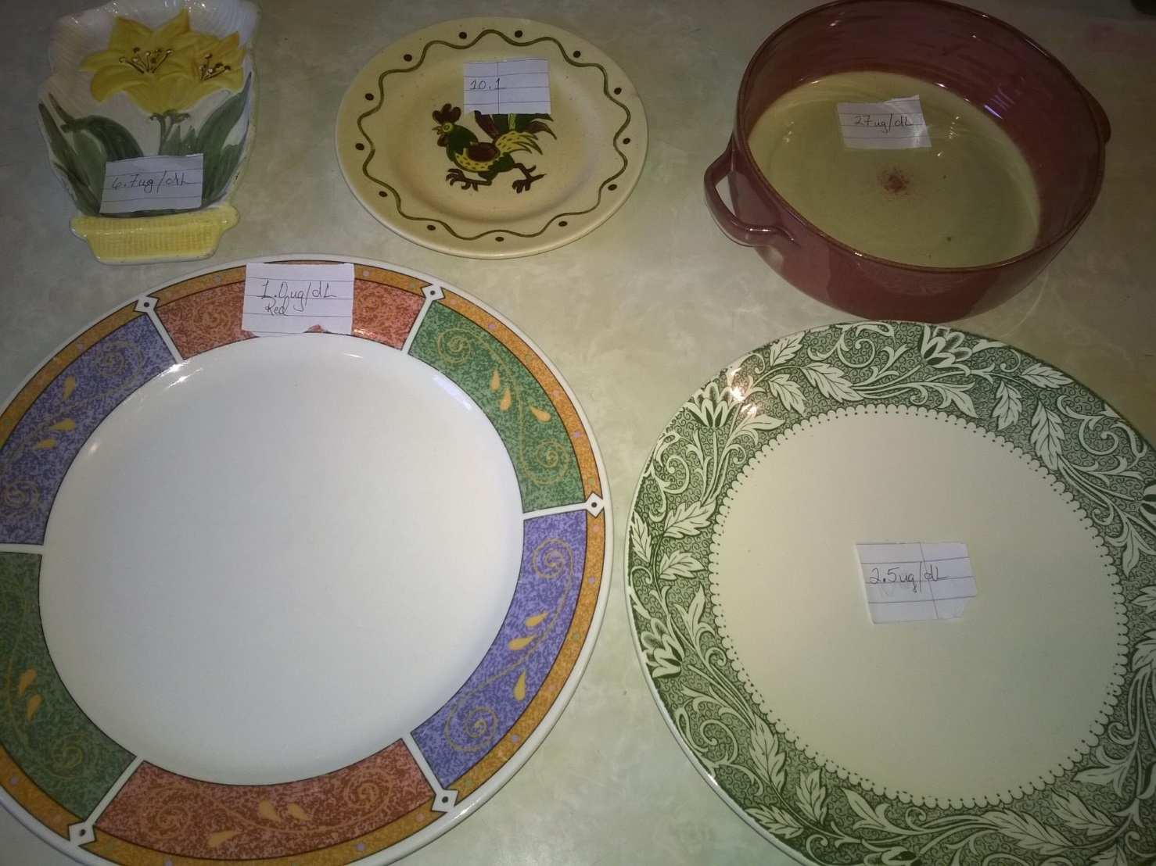

Slide 61
Sweet Toxic

Slide 62
Folk Medicines and Herbal Remedies
Lead has been found in powders and tablets given for arthritis, infertility, upset stomach, menstrual cramps, colic and other illnesses.
Greta (lead oxide) Azarcon (lead tetroxide) are Hispanic traditional remedies taken for an upset stomach (empacho), constipation, diarrhea, vomiting, and used on teething babies. Greta and Azarcon are both fine orange powders that have a lead content as high as 90%.
Ghasard, an Indian folk remedy, has also been found to contain lead. It is a brown powder used as a tonic.
Ba-baw-san is a Chinese herbal remedy that contains lead. It is used to treat colic pain or to pacify young children.

Slide 63
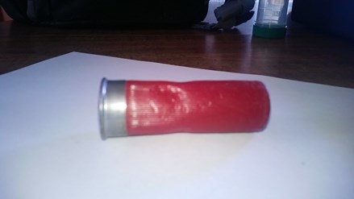

Slide 64
Toys
High concentrations of lead found in millions of toys produced by Mattel in 2007 has caused them to agree to settle lawsuits in excess of $50 million. These toys posed a health hazard to children due to the high concentrations of lead in the toys. MSNBC – 11/2009
Dora the Explorer
Sesame Street toys
Barbie, Batman
Polly Pocket
Serge cars

Slide 65
The Wrap Up
Complete forms and notes
Collect equipment and samples
Provide educational materials
Ask if any questions
Leave contact information
Chain of custody
Package samples

Slide 66
https://tamararubin.com/
https://nchealthyhomes.com/

Slide 67
Thank you! You make a difference!

