Slide 1
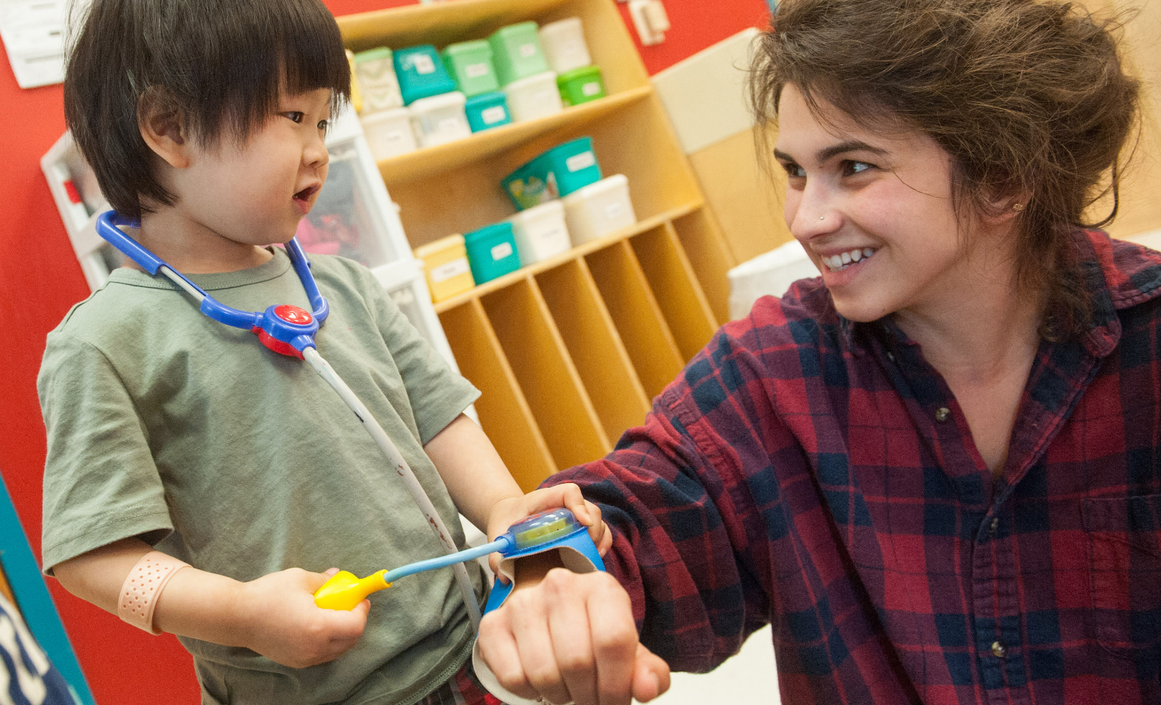
Medical Follow-up and
Clinical Management of Children after Blood Lead Testing
Photo from CDC/ Julia Whitney, Stephen Griffin, 2015
Samantha Sites, MPH
Jeffrey Smedley, MPH
Public Health Epidemiologists
Children’s Environmental Health
Environmental Health Section
DHHS/Division of Public Health

Slide 2
Coordination
*Better outcomes are achieved when clinical and environmental services operate in close coordination.*
Notes:
Ed [and Dr. Langley] have touched on this, but I want to start off by acknowledging teamwork and coordination. I think we can all agree on the concept, but in the actual execution it is difficult with conflicting schedules, time in the field, too much on our to-do lists, leaving another voicemail, and so on. The thing to remember is that when we do work together in a coordinated manner, we will achieve better outcomes for our patients and clients.

Slide 3
The Lead Team
The patient and patient’s family
Health care provider
Public Health Nurse
Environmental Health Specialist
Nutritionist
Laboratory
Social services liaison
Developmental services
Support and advocacy Groups
Notes:
I am not going to read this slide to you, but these are some of the folks that make up “the Lead Team.” We all need to strive to work together.
Support and Advocacy Groups include United Parents Against Lead (UPAL), National Center for Healthy Housing.

Slide 4
NC Childhood Lead Poisoning Prevention Program
State Childhood Lead Surveillance Team and Regional EHS
Data management
Environmental investigation and sampling
Local/County EHS County Lead Nurses
Blood lead testing
Environmental investigation and sampling
Primary Care Providers
Blood lead testing
Clinical evaluation and interventions
Coordinate training and response
Lead risk screening
Clinical case management
Education
Education
Education
Education
Notes:
You have seen a version of this slide before in Ed’s presentation. This is a diagram of the immediate care team and each division’s areas of responsibility. Note that I’ve added education as a component in each of these “spheres of influence.”

Slide 5

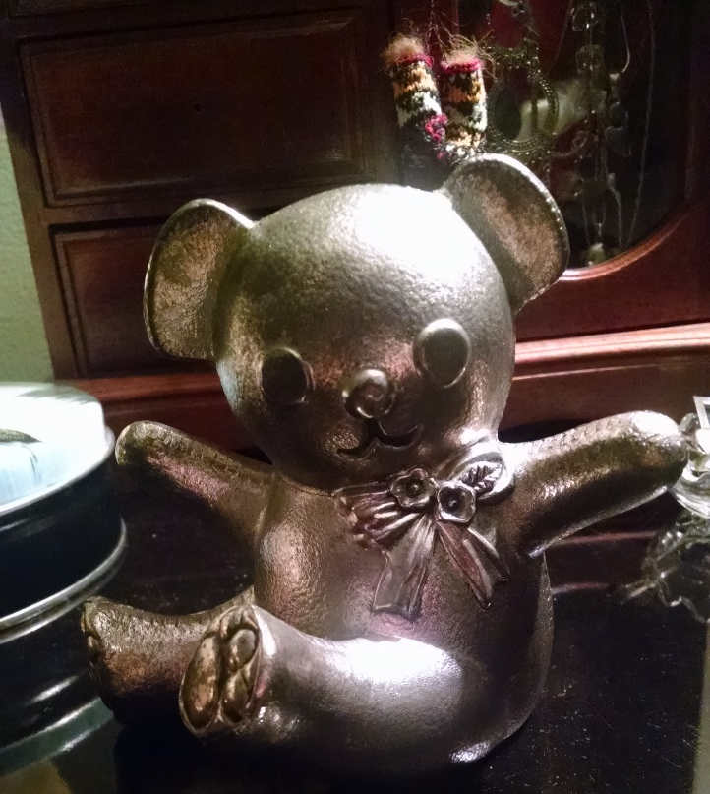
Clinical Evaluation:
Environmental History
In office/by phone
  Complete environmental assessment (DHHS Form 3651) for potential sources of lead
Home visits
  Assess home sanitation
  Check meal preparation area
  Observe hand washing practices
Notes:
A useful tool in the clinical evaluation is the environmental history. The clinician can use Form 3958 for a lead risk assessment & will generally coordinate completion of Form 3651 for an exposure history for the child with confirmed levels greater than or equal to 5 mcg/dL.
During home visits, you will assess the living environment using Form 3640 as a guide; David Brown is going to talk further about this form later today.
Regarding the video at the beginning, some of you noted HCP hesitancy to test because a child was not in a high-risk zip code. I will point out that Form 3958 (Lead Risk Assessment Questionnaire) lists those high-risk zip codes, but it also indicates that testing should be performed for all children where there was a “yes’ or ‘not sure’ answer to any of the questions.

Slide 6
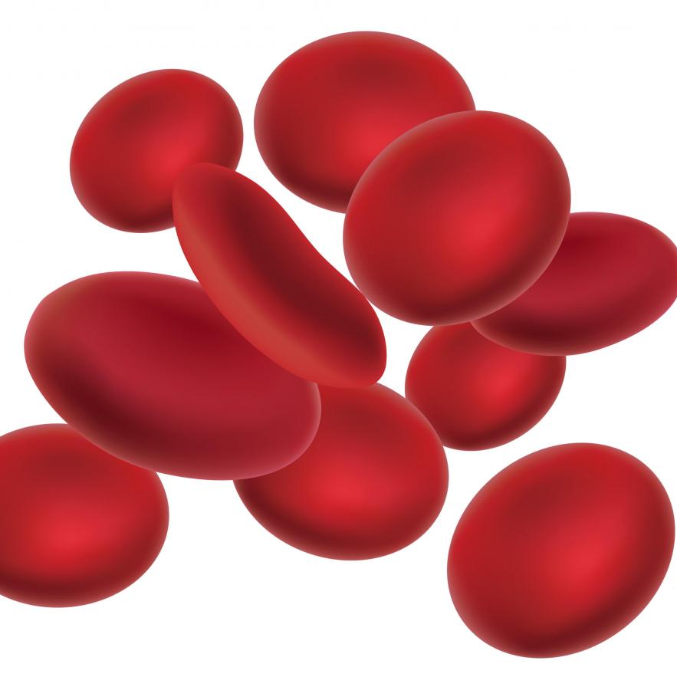

Clinical Evaluation:
Nutritional Assessment
Diet
Water
Vitamin and mineral deficiencies
Food insecurity
Notes:
The clinic will also follow up by performing a nutritional assessment. They will want to work loosely with you and the child’s family to ensure that the child has a diet that is rich in calcium, iron, zinc, and vitamin C. We want to make sure that the water supply for drinking and cooking is free from lead contamination. We can work with various social service partners to ensure that the child and family are not suffering from food insecurity.

Slide 7

Blood Lead Testing
Notes:
Next, I am going to talk about blood lead testing.

Slide 8
New Lower Blood Lead Reference Value (BLRV)
  Clinical Follow-up for Lead
  now* begins
  at the level of 3.5 ug/dL
  *as of March 21, 2022
Notes:
You should also know that in the fall of 2021, the CDC lowered the BLRV for children from 5 µg/dL to 3.5 µg/dL. Children with blood lead levels at or above the BLRV represent those with the highest levels of lead in their blood compared to other children in the U.S.
This means that CDC now recommends that clinical follow-up for children begin at 3.5 ug/dL instead of 5ug/dL. Some of you may be familiar with follow-up beginning at the higher level, but that has now changed. However, required environmental follow-up services are not affected by these revised recommendations; they still occur beginning at 5 ug/dL.

Slide 9

Types of Blood Lead Testing
  Capillary (“fingerstick”) for screening is performed on the blood of an asymptomatic child to determine whether the child has an elevated BLL
    Wash hands with soap and water
      See CDC poster
      www.cdc.gov/biomonitoring/pdf/Lead_Fingerstick_Poster-508.pdf
    Can be performed:
      In-house on a point of care (POC) analyzer
      At an outside reference laboratory
  Venous (“armstick”) for diagnostic test is performed on a child that has a screening BLL ≥ 3.5 µg/dL
    Performed ASAP but within 3 months of an elevated screening test
    Analyzed by an outside reference laboratory
  The State Lab analyzes blood lead specimens for all children <6 years of age (and refugee children through 16 years) at no charge to Medicaid or NC Health Choice (NCHC) beneficiaries
Notes:
We typically use two sources for blood lead tests: capillary and venous. Capillary testing is primarily used for screening. When obtaining a capillary sample, it is important to wash the child’s hands thoroughly. We have included a link to a CDC poster that details the steps to collect a fingerstick blood sample (a good resource to share with providers).
If there is an elevated level (≥3.5 mcg/dL), we need a diagnostic test to confirm that reading. We prefer a venous sample for the diagnostic test because it reduces the risk of contamination.
However, capillary specimens are acceptable for a diagnostic if a venous cannot be obtained in such instances as:
Difficulty obtaining a venous specimen
Parent/guardian objection to venous draw
Clinic sends the family to another facility for venous specimens and the family never arrives
Note that a diagnostic/confirmatory test, venous or capillary, MUST be analyzed by an outside reference lab.

Slide 10

Confidentiality
Password-protect digital information
Lock up paper files
  Use the NCLEAD EVENT ID only (Ex: CONV_SITE_1261919, 10161503 – no other personally identifiable information please) when communicating about a child or property event via email, text or other unsecured method

Slide 11
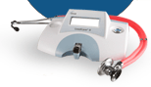
Reporting
Report all blood lead test results to parents and document reporting method in chart
Laboratories must report all blood lead test results to NC DPH within 5 days
  NC General Statutes § 130A-131.8. Laboratory reports
Point of Care (POC) blood lead analyzers (e.g., LeadCare II) have same reporting requirements as a laboratory
Elevated result not in system?
  Let CEH CLPPP staff know!!
Notes:
I put this up mostly for informational purposes. This slide mainly applies to labs, including clinics using POC analyzers. I particularly want to emphasize the last bullet. You should let us know ASAP if an elevated result is not in the system so we can find it and get it entered! We may not have processed a file yet, the child’s name may be misspelled or DOB is off and the result did not post to the correct child. You should also let us know if you put information in the Follow-up Documentation question package (or elsewhere) that requires action on our part, such as:
A missing elevated result that would make a case an EBL or CLP
A misspelled name
Incorrect DOB/address/other demographic info
New address
A case that is assigned to the wrong county
Please let us know ASAP so we can look for the missing test result and get it entered, make a correction or modify the address as needed. It can be as simple as sending an email message with the event ID (no other personally identifiable information please) and telling us to look in the Follow-up Documentation question package.
There are literally millions of records in NCLEAD. We have no practical way of knowing when a note is entered that requires action on our end unless you let us know.

Slide 12
What Is a Case?
  G.S. § 130A-131.7
  Elevated Blood Lead (EBL)
    Blood lead concentration ≥5.0 µg/dL determined by the lower of two consecutive blood tests within a 12-month period
  Confirmed Lead Poisoning (CLP)
    Blood lead concentration ≥10.0 µg/dL determined by the lower of two consecutive blood tests within a 12-month period
Notes:
Cases in North Carolina are defined by statute (G.S. § 130A-131.7)
A child becomes an Elevated Blood Lead (EBL) case when he or she has a blood lead concentration ≥5.0 µg/dL determined by the lower of two consecutive blood tests within a 12-month period.
A child becomes a Confirmed Lead Poisoning (CLP) case when he or she has a blood lead concentration ≥10.0 µg/dL determined by the lower of two consecutive blood tests within a 12-month period.
Although clinical follow-up begins at the new lower BLRV shown earlier, these BLLs still determine cases and affect environmental follow-up until the NC statute is revised.

Slide 13
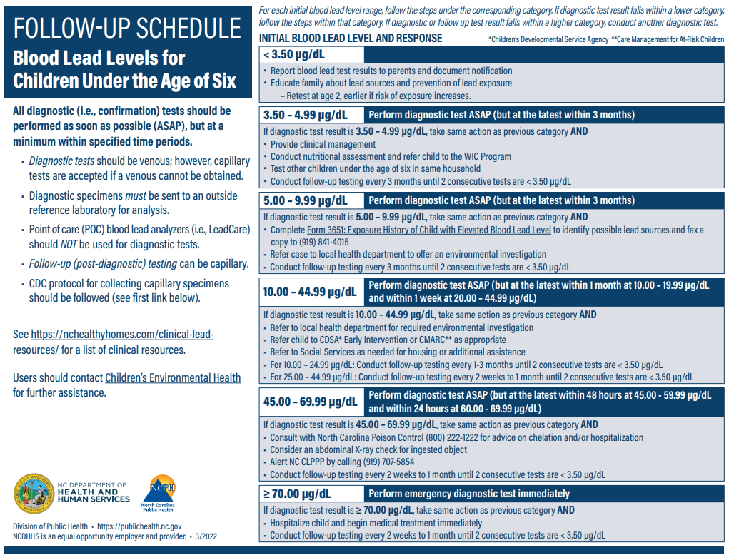
Exceeds BLRV
Elevated blood lead (EBL)
Confirmed Lead Poisoning (CLP)
Notes:
As mentioned previously, because of the new BLRV issued by the CDC, we have updated the Clinical Follow-Up Schedule for Blood Lead Levels for Children under the Age of Six. This revised follow-up schedule was sent out to providers this past spring. We will try and go into a little more detail in each of these categories in some later slides.
The most significant revision is the recommendation to perform a diagnostic test for all children who have an initial blood lead test result greater than or equal to 3.5 μg/dL, and if confirmed, to provide recommended clinical follow-up services. NC anticipates that this change will result in a four-fold increase in the need for diagnostic testing under the revised protocol compared to the previous guidelines, which recommended diagnostic testing beginning at 5 μg/dL. Note that laboratories should be reporting ALL blood lead tests even if not elevated.

Slide 14
Actions for Initial Blood Lead Level 3.5-4.99 µg/dL
Diagnostic test: ASAP but within 3 months
If confirmed at 3.5-4.99 µg/dL = Exceeds Blood Lead Reference Value (BLRV)
Provide clinical management
Conduct nutritional assessment and refer to WIC
Follow-up testing every 3 months until 2 consecutive tests <3.50
Notes:
All diagnostic tests for any initial level greater than or equal to 3.5 should done ASAP, but at least within time ranges noted. I want to note a special exception for POC laboratories: For initial results ≥3.5 µg/dL – the state requires the immediate collection of a diagnostic specimen for analysis by an outside reference laboratory – without any repeat analysis using the POC analyzer before sending the diagnostic specimen out.
The whole point of using the POC analyzer is the advantage of an immediate test result while the patient is still at the clinic, so that the diagnostic specimen can be collected during the same visit! That is why you may see same-day initial and diagnostic tests in NCLEAD.
Initial Blood Lead Levels from 3.5-4.99 µg/dL should receive a diagnostic/confirmatory test ASAP but within 3 months. If the diagnostic confirmatory test falls within the same range, clinical actions at this level should be to:
Provide clinical management
Conduct a nutritional assessment and refer the child to the Women Infants and Children (WIC) program
Conduct follow-up testing every 3 months until 2 consecutive <3.50

Slide 15
Actions for Initial Blood Lead Level 5-9.99 µg/dL
Diagnostic test: ASAP but within 3 months
If confirmed at 5-9.99 µg/dL = Elevated Blood Lead (EBL)*
Same as previous level and
Complete Form 3651 (fax a copy to CLPPP at 919-841-4015)
Refer to LHD; environmental investigation offered
Follow-up testing every 3 months until 2 consecutive tests <3.50
Notes:
Initial Blood Lead Levels from 5-9.99 µg/dL should receive a diagnostic/confirmatory test ASAP but within 3 months. If the diagnostic confirmatory test falls within the same range, clinics should perform the same actions as the previous level AND:
Complete Form 3651: Exposure History of Child with Elevated Blood Lead Level and fax a copy to CLPPP at 919-841-4015
Refer the child to the local health department to receive an offer of an environmental investigation
Conduct follow-up testing every 3 months until 2 consecutive tests <3.50
Note that a child becomes a case by statute in NC.

Slide 16
Actions for Initial Blood Lead Level 10-19.99 µg/dL
Diagnostic test: ASAP but within 1 month
If confirmed at 10-19 µg/dL = Confirmed Lead Poisoning (CLP)
Same as previous level and
Refer to LHD; environmental investigation required
Refer to CDSA or CMARC as appropriate
Refer to Social Services as needed
Follow-up testing every 1-3 months until 2 consecutive tests <3.50
Notes:
Initial Blood Lead Levels from 10-19.99 µg/dL should receive a diagnostic/confirmatory test ASAP but within 1 month. If the diagnostic confirmatory test falls within the same range, clinics should perform the same actions as the previous level AND:
Refer the child to the local health department to receive a required environmental investigation
Refer the child to the Children’s Developmental Service Agency (CDSA) or Care Management for At-Risk Children (CMARC) as appropriate
Refer to Social Services as needed for housing or additional assistance
Conduct follow-up testing every 1-3 months until 2 consecutive tests <3.50

Slide 17
Actions for Initial Blood Lead Level 20-44.99 µg/dL
Diagnostic test: ASAP but within 1 week
If confirmed at 20-44.99 µg/dL = Confirmed Lead Poisoning (CLP)
Same as previous level and
For 20-24.99 µg/dL
  Follow-up testing every 1-3 months until 2 consecutive tests <3.50
For 25-44.99 µg/dL
  Follow-up testing every 2 weeks to 1 month until 2 consecutive tests <3.50
Notes:
Initial Blood Lead Levels from 20-44.99 µg/dL should receive a diagnostic/confirmatory test ASAP but within 1 week. If the diagnostic confirmatory test falls within the same range, clinics should perform the same actions as the previous level AND:
Conduct follow-up testing every 1-3 months until 2 consecutive tests<3.50 for confirmed levels from 20-24.99 µg/dL
Conduct follow-up testing every 2 week to 1 month until 2 consecutive tests <3.50 for confirmed levels from 25-44.99 µg/dL

Slide 18
Actions for Initial Blood Lead Level 45-59.99 µg/dL
Diagnostic test: ASAP but within 48 hours
If confirmed at 45-59.99 µg/dL = Confirmed Lead Poisoning (CLP)
Same as previous level and
Consult with North Carolina Poison Control (800) 222-1222 for advice on chelation and/or hospitalization
Consider an abdominal X-ray check for ingested object
Alert NC CLPPP by calling (919) 707-5854
Follow-up testing every 2 weeks to 1 month until 2 consecutive tests <3.50
Notes:
Initial Blood Lead Levels from 45-59.99 µg/dL should receive a diagnostic/confirmatory test ASAP but within 48 hours. If the diagnostic confirmatory test falls within the same range, clinics should perform the same actions as the previous level AND:
Consult with North Carolina Poison Control (800) 222-1222 for advice on chelation and/or hospitalization
Consider an abdominal X-ray check for ingested object
Alert NC CLPPP by calling (919) 707-5854
Follow-up testing every 2 weeks to 1 month until 2 consecutive tests <3.50

Slide 19
Actions for Initial Blood Lead Level 60-69.99 µg/dL
Diagnostic test: ASAP but within 24 hours
If confirmed at 60-69.99 µg/dL = Confirmed Lead Poisoning (CLP)
Otherwise, same as previous level
Notes:
Initial Blood Lead Levels from 60-69.99 µg/dL should receive a diagnostic/confirmatory test ASAP but within 24 hours. Otherwise, actions are the same as the 45-59.99 µg/dL level.

Slide 20
Actions for Initial Blood Lead Level ≥70 µg/dL
Diagnostic test: Immediately as emergency lab
If confirmed at >70 µg/dL = Confirmed Lead Poisoning (CLP)
Same as previous level and
Hospitalize child and begin medical treatment immediately
Follow-up testing every 2 weeks to 1 month until 2 consecutive tests <3.50
Notes:
Initial Blood Lead Levels ≥70 µg/dL should receive a diagnostic/confirmatory test immediately as an emergency lab procedure. If the diagnostic confirmatory test falls within the same range, clinics should perform the same actions as the previous level AND:
Hospitalize the child and begin medical treatment immediately
Conduct follow-up testing every 2 weeks to 1 month until 2 consecutive tests <3.50

Slide 21
Environmental Investigation Referral
Occurs with 2 consecutive lead tests > 5 µg/dL within a 12-month period
  Private clinics:
      Fill out Form 3651 – Evaluation of Child with Elevated Blood Lead Level
      Mail/fax to NC CEH at (919) 841-4015
  Health department clinician
      Complete the Clinical Assessment question package in NCLEAD
      --OR--
      Scan and attach a copy of Form 3651 to the child event

Slide 22

Follow-up Test
A blood laboratory test for lead that is used to monitor the status of a child with a previously elevated diagnostic test for lead
  Must be repeated at appropriate interval (see follow-up schedule) until 2 consecutive tests < 3.50 µg/dL
  Can be capillary unless follow-up test result puts child into a higher risk category
Notes:
The need for follow-up testing should be emphasized to families who may not understand the importance of follow-up testing for asymptomatic children. The child’s lead levels should be monitored to make sure levels are going down and not up.

Slide 23
Follow-up Testing Intervals
Confirmed Level | Test every… | Until 2 consecutive tests are <3.5 µg/dL
3.5-9.99 µg/dL | 3 months
10-24.99 µg/dL | 1-3 months
25-69.99 µg/dL | 2 weeks to 1 month
≥70 µg/dL | 2 weeks to 1 month (as frequently as possible)

Slide 24

Educating the Family on Lead Poisoning Prevention

Slide 25

Family Lead Education
Child’s blood lead level and what it means
Importance of follow-up testing
Health effects of lead exposure
Sources of lead and how to reduce exposure
Pregnant women can get tested for FREE at their local health departments!
Test other children under 6 in household if one child is an EBL
Notes:
The need for follow-up testing should be emphasized to families who may not understand the importance of follow-up testing for asymptomatic children. The child’s lead levels should be monitored to make sure levels are going down and not up.

Slide 26
Tips
Look
Look for every opportunity to educate!
Provide
Provide information to parents, guardians, caregivers, and community members
Listen
Listen non-judgmentally
Encourage
Encourage questions
Explain
Explain lead poisoning prevention messages using appropriate language level and native language
Inform
ALWAYS inform further follow-up may be needed

Slide 27

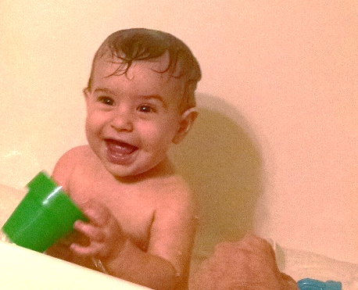
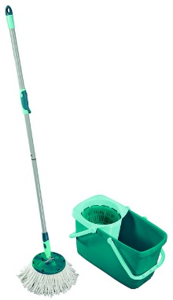
Actions Parents Can Take to Reduce Exposure to Lead Dust
Wash child’s hands before eating
Bathe child before bed
Clean using wet methods
Block access to dirt near foundation of home
This Photo by Unknown Author is licensed under CC BY

Slide 28
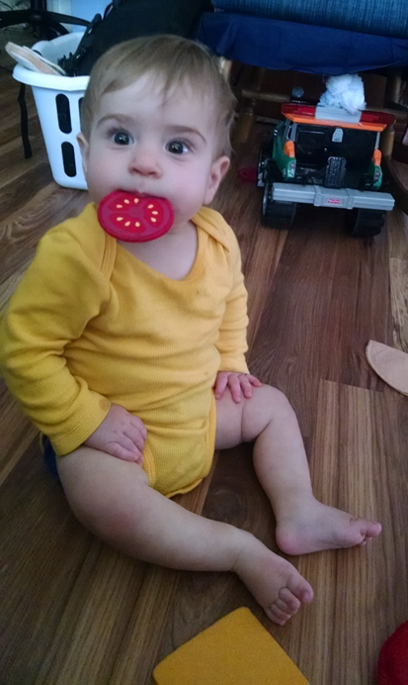
More Tips for Parents
Give regular snacks and nutritious foods (vitamin C, iron, calcium, zinc)
Leave shoes at the door
Limit mouthing activities to toys and food
Have children tested at 1- and 2-year-old well-child visits
For more information, go to: http://www.cdc.gov/nceh/lead/

Slide 29

Breastfeeding
Breastfed infants are exposed to lower concentrations of lead than formula-fed infants
Mothers with maternal serum lead levels ≥40 µg/dL should “pump and dump” until their blood lead levels drop to <40 µg/dL
Notes:
It is recommended that mothers with BLLs <40 μg/dL should breastfeed, but it is important to note:
Infant BLLs should be monitored if his or her mother’s BLLs are between 5 and 39.99 μg/dL. Breastfeeding should continue for all infants with BLLs below 5 μg/dL.
If infant BLLs are rising or failing to decline by 5 μg/dL or more, the healthcare provider will benefit from information collected during an environmental investigation. If no external source is identified, maternal BLLs are ≥20 μg/dL and infant BLLs are ≥5 μg/dL, then breast milk may be the source of lead exposure.
Mothers should consider temporarily pumping and discarding their breast milk until maternal BLLs are lower.
Mothers with BLLs ≥40 μg/dL are encouraged to pump and discard their milk until their BLLs drop below 40 µg/dL.
Note that testing breast milk for lead is not recommended.

Slide 30

Special Recommendations for Refugees
Test refugee children 6 months to 16 years during physical exam at time of arrival to U.S.
  If ≥ 6 years old, note “Refugee” on lab slip
Ages 6 months to 6 years old need to have 2 blood lead tests regardless of the results of 1st blood lead test
  2nd test to be done 3-6 months after permanent placement
< 6 years old should undergo nutritional assessments and testing for hemoglobin or hematocrit level
  Provide daily pediatric multivitamins with iron
Notes:
Domestic screening guidance for newly arrived refugee children has been updated to reflect the lowering of the BLRV to 3.5 μg/dL. The following guidance for screening newly arrived refugee children, pregnant and lactating women and adolescent girls remains unchanged:
All refugee infants and children ≤16 years of age should be screened for lead exposure with a blood test. Repeat testing with a blood test 3-6 months after initial testing is recommended for all refugee infants and children ≤6 years, regardless of initial screening result. Repeat testing is also recommended for children and adolescents 7-16 years of age with blood lead levels above the BLRV at initial screening.
Older adolescents (over 16 years of age) should also be tested if there is a high index of suspicion (siblings with elevated BLRV, suspected environmental exposures, etc.). Repeat testing may also be warranted.
Pregnant and lactating women and adolescent girls should be screened for lead exposure and provided with appropriate follow-up as indicated.
Please note, the lowering of the BLRV currently only applies to children. Clinicians conducting the domestic medical screening for newly arrived refugees and other newcomers should continue to use the 5 μg/dL reference value for pregnant and lactating women.

Slide 31

Follow-up of Refugee Children
Check the NC LEAD Refugee Workflows
Work with the Health Department Lead Nurse to manage cases for refugee children
Provide continuity of care by encouraging collaboration between Lead Nurse and Health Check Coordinator

Slide 32
LEADPARDY!
Mini-

Slide 33
STATE OF PRACTICE BOARD
AM I A CASE?
True or False
$200
$200
$400
$400
$600
$600
$800
$800
$1000
$1000

Slide 34
Am I a case? If so, what kind?
AM I A CASE · $200
Specimen Date | Result |  | Specimen Source | Ordering Facility | Lab Facility
04/26/2022 |  | 1 | C | 123 Pediatrics | (POC LAB - 123) 123 Pediatrics
04/26/2022 |  | 3.4 | V | 123 Pediatrics | NC State Laboratory
No – Initial test and diagnostic test are both below 5µg/dL.

Slide 35
Am I a case? If so, what kind?
AM I A CASE? · $400
Specimen Date | Result |  | Specimen Source | Ordering Facility | Lab Facility
04/26/2022 |  | 10.2 | C | 123 Pediatrics | (POC LAB - 123) 123 Pediatrics
04/26/2022 |  | 11.40 | V | 123 Pediatrics | NC State Laboratory
Yes – CLP: Initial test and diagnostic test are both 10µg/dL or greater.

Slide 36
Am I a case? If so, what kind?
AM I A CASE? · $600
Specimen Date | Result |  | Specimen Source | Ordering Facility | Lab Facility
03/26/2022 |  | 11.2 | C | 123 Pediatrics | NC State Laboratory
05/12/2022 |  | 7.3 | V | 123 Pediatrics | NC State Laboratory
Yes – EBL: There are 2 consecutive test results ≥ 5 µg/dL within a 12-month period determined by the lower of two consecutive blood tests within a 12-month period.

Slide 37
Am I a case? If so, what kind?
AM I A CASE? · $800
Specimen Date | Result |  | Specimen Source | Ordering Facility | Lab Facility
04/26/2021 |  | 6.1 | C | 123 Pediatrics | (POC LAB - 123) 123 Pediatrics
06/12/2022 |  | 5.4 | V | 123 Pediatrics | NC State Laboratory
No – Diagnostic test is over 12 months from initial specimen date. Need another diagnostic test through an outside reference lab.

Slide 38
Am I a case? If so, what kind?
AM I A CASE? · $1000
Specimen Date | Result |  | Specimen Source | Ordering Facility | Lab Facility
04/26/2022 |  | 5.5 | C | 123 Pediatrics | (POC LAB - 123) 123 Pediatrics
05/28/2022 |  | 7.2 | C | ABC Pediatrics | (POC LAB - ABC) ABC Pediatrics
No – Both tests were conducted on POC analyzers at different clinics. Still need a diagnostic test through an outside reference lab.

Slide 39
True or False:
Investigation referrals can be made any time a child has a
BLL test result ≥ 5 µg/dL
True or False · $200
FALSE – Requires 2 consecutive lead tests ≥5µg/dL within a 12-month period.

Slide 40
This case should be offered an investigation
True or False · $400
Specimen Date | Result |  | Specimen Source | Ordering Facility | Lab Facility
04/26/2022 |  | 10.2 | C | 123 Pediatrics | (POC LAB - 123) 123 Pediatrics
04/26/2022 |  | 11.40 | V | 123 Pediatrics | NC State Laboratory
FALSE – This case requires an investigation, confirmed CLP
(2 consecutive BLL results ≥10µg/dL within a 12-month period).

Slide 41
Entering notes in about a case in NCLEAD notifies someone in the CEH CLPPP that the case has been updated
True or False · $600
FALSE – If you enter information that requires attention by CEH CLPPP, please call or email someone and let us know that you have updated the case.

Slide 42
The following child is no longer an EBL
True or False · $800
Specimen Date | Result |  | Specimen Source | Ordering Facility | Lab Facility
03/26/2022 |  | 5.5 | C | 123 Pediatrics | (POC LAB - 123) 123 Pediatrics
03/26/2022 |  | 7.4 | V | 123 Pediatrics | NC State Laboratory
06/15/2022 |  | 3.4 | C | 123 Pediatrics | (POC LAB - 123) 123 Pediatrics
09/17/2022 |  | 3.4 | C | 123 Pediatrics | (POC LAB - 123) 123 Pediatrics
True – The child has 2 consecutive BLL results
<5µg/dL within a 12-month period.

Slide 43
When communicating about a child or property event by email, text or other unsecured method, you should only refer to the NCLEAD Event ID
True or False · $1000
TRUE – Confidentiality requires that you only refer to a child or property event using the Event ID. Never use the name, address, or other confidential info in messages that are not securely encrypted.

Slide 44
Credits
“Leadpardy” presentation template by SlidesCarnival.com
Special thanks to all the people who made and released these awesome resources for free:

Slide 45

Questions?
Contact information:
Samantha Sites, 919-819-0055, samantha.sites@dhhs.nc.gov

