Slide 1
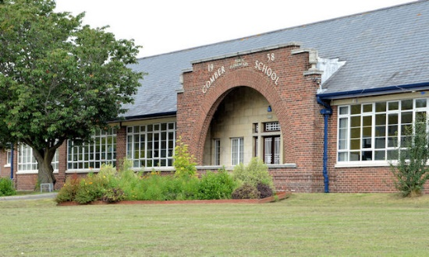

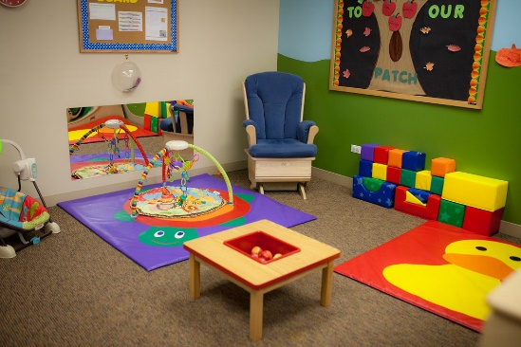
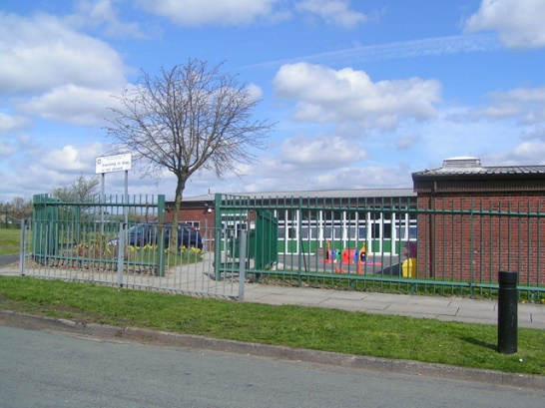
Child
Occupied Facilities
&
Lead
Kimly Blount, REHS
Children’s Environmental Health
Kimly.Blount@dhhs.nc.gov
This Photo by Unknown Author is licensed under CC BY

Slide 2
Child Occupied Facilities
Child Care Centers
Schools
Pre-K Programs
Child Care Homes

Slide 3
When is a Lead Investigation Required?
The Department learns of a confirmed Lead Poisoning
**10 ug/dL
The Department Reasonably Suspects that a lead poisoning hazard to children exists
Pre- 1978
Deteriorating Paint
Accessible to a child under the age of six

Slide 4
LEAD INVESTIGATIONS COF
Lead Poisoned Child
  Supplemental Address
      Required Investigation
      Required Remediation
  Ordered by local HD
Routine Sanitation Inspection
      Schools
      Child Care Centers
Proposed Centers
  Referrals by DCDEE or Env Health
  Recommended remediation by HD

Slide 5
Lead Investigation Protocols for
COFs
Lead Poisoned Child Supplemental Address
Routine Sanitation Inspection (Child Care Center)
Proposed Child Care Center
Routine Sanitation Inspection (School)
Child Care Homes

Slide 6
Lead in Child Occupied Facilities
Investigation
Result Interpretation
Notification
Remediation
Monitoring

Slide 7
What constitutes a Lead Hazard?
The following constitutes a hazard
*True or False*
  Built in 1956
Children under the age of six attend
Lead check swab turns Red

Slide 8
Result Interpretation:
What Constitutes A Hazard?
XRF
Paint Chip
Dust (floors, window sills)
      Window troughs (clearance)
Soil
Water

Slide 9
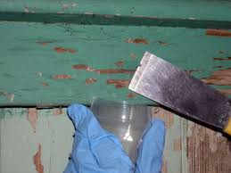
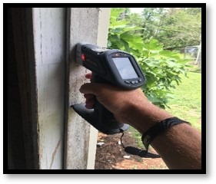
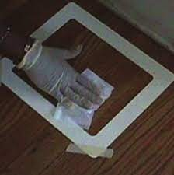
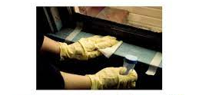
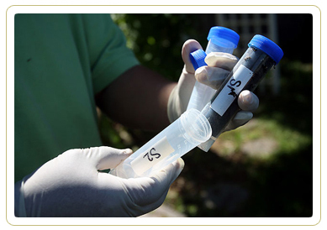
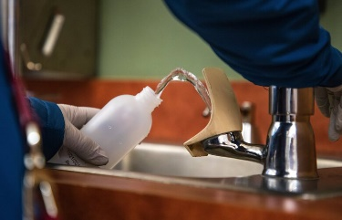
Result Interpretation:
What Constitutes A Hazard?
XRF
1.0 mg/cm²
Paint Chip
0.5% by weight or 5000 ppm
Current Dust:
  Floors: 40 μg/ft² Dec 1st: 10 μg/ft²
  window sills: 250 μg/ft² Dec 1st: 100 μg/ft²
      Window troughs (clearance): <400 μg/ft²
Soil
400 ppm (play area) or 1200ppm (other parts of yard)
Water
10 ppb

Slide 10
Notification
When lead poisoning hazards are identified, state law requires:
  Written notification to:
    owner/managing agent
    All persons attending the facility
  Request for names of children that have attended the facility in the past 6 months
  **Written notices for schools are sent to the Superintendent
  **Written notices for child care centers are sent to the licensed operator & DCDEE
  May need to modify notices

Slide 11
REMEDIATION
Once investigation is completed and hazards are found:
Required Remediation
-vs-
Recommended Remediation

Slide 12
REMEDIATION
If child occupied facility is attended by a child with Confirmed Lead Poisoning and a lead poisoning hazard exists
REMEDIATION IS REQUIRED!

Slide 13
Child Care Centers
When a Lead Poisoning Hazard exists in a child care center but no Child is determined to be Lead-Poisoned
*The Division of Child Development & Early Education (DCDEE) is responsible for requiring remediation
*The lead authorized agent acts as a consultant for the remediation.

Slide 14
Child Care Centers
Child Care Sanitation Rules (2800)
.2816 Lead Poisoning Hazards
In child care centers, areas accessible to children shall be free of identified lead poisoning hazards as defined under G.S. 130A-131.7(7)

Slide 15
Child Care Centers
.2816 Lead Poisoning Hazards
Effective October 1, 2019
Lead in Water Testing Rule
An amendment to Rule 15A NCAC 18A .2816
This amendment requires that all licensed child care centers test all drinking water faucets and food preparation sinks for lead contamination within one year, and new centers must test upon application for a license. After that, centers will need to test once every three years.
General Commenting was not recommended after July 1, 2021

Slide 16
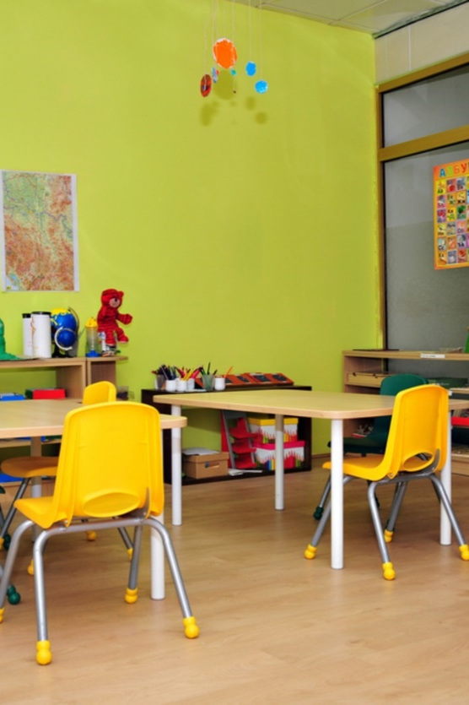
Child Care Centers
Inspection Protocol
  Pre- Opening site visit/inspection
  Regular Inspections (once each 6 months)
  Identified lead poisoning hazards
    6-point demerit item
    *Even if a 6-point demerit item for lead is marked during a child care sanitation inspection (without a confirmed poisoned child), enforcement is under the authority of DCDEE*

Slide 17
Child Care Centers
MOA allows child care centers to use the Maintenance Standard as a remediation option
More permanent measures are recommended in a child occupied setting
Conditions should be noted during each inspection
Monitoring

Slide 18
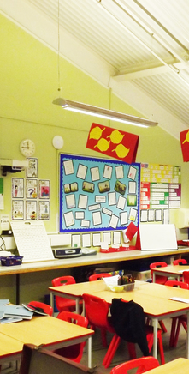
School-Based Centers
Inspection Protocol
  Lead investigation will include more areas than are normally inspected during a sanitation inspection
  Designated floor plan diagram
  Site Visits
  Lead Investigations
  Accessible areas -vs- inspected areas
  Flow of Children in the Facility
This Photo by Unknown Author is licensed under CC BY-ND

Slide 19
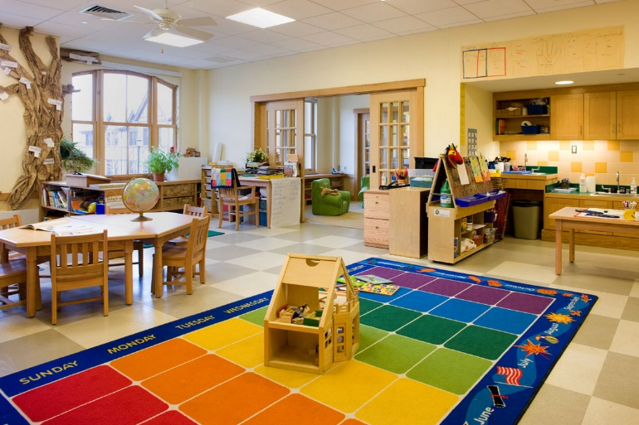
School-Based Centers
Site Visits
  Initial site visit
    Most programs are already in existence therefore, day to day operation can be readily observed.
    Determine licensed space by diagram provided to DCDEE.
    Look for potential lead hazards.
    Determine the accessible areas -vs- the inspected areas.
    Obtain written documentation from facility.
This Photo by Unknown Author is licensed under CC BY

Slide 20
School-Based Centers
Criteria for Lead Investigation
  Child occupied facility
  Pre 1978 construction
  Deteriorated paint conditions
  referral
Lead referral should be made by authorized lead agent and/or by DCDEE (form letter)
Some facilities have multiple programs
*Lead investigation is based on accessibility*
Therefore, all accessible areas as well as licensed areas are investigated for lead poisoning hazards.
This Photo by Unknown Author is licensed under CC BY

Slide 21
Child Care Homes
MOA with DCDEE
Child Care Consultant observes/suspects conditions that may be hazardous can make a referral to the local HD for a lead investigation (written)
Conduct as any other investigation under Reasonable Suspicion
Local authorized agent will act as a consultant

Slide 22
When Hazards Are Found
**Remember**
  If no children with confirmed lead poisoning are identified, remediation cannot be enforced by the local HD but will still need to marked during sanitation inspections (provisional/disapproved)
  Child Care Centers/Homes - (DCDEE) has the authority to revoke the facility license
  No such enforcement options exist for schools (notify the superintendent of the local school program)
  *Always send written notification to required parties

Slide 23
Monitoring
Monitoring in Child Occupied Facilities
Child Care Centers
Schools
Child Care Homes
Questions?

Slide 24
Exercise
Based on the provided information below, highlight the areas on the school plan that would be included during your lead investigation.
During your inspection PK children are in Rm 301 art class.
Storage Rm 109 is used for speech therapy and tutoring for K- 3rd
Entrance #1, #2 and the main entrance are utilized for pick-ups/drop-offs all entrances are used for emergency exits.
Play area is accessed through side entrance #2.
Two kindergarten classrooms are located on Hall#1 beside Rm 125.
Classroom beside music rm 302 is computer lab visited by kindergarteners once a week.
Small office near Entrance #2 is used as nursing station.
Licensed afterschool program is housed in the last classroom beside Rm #126. It is reported they go outside daily after completing homework or to auditorium if raining.
*Are there any areas that you question on Hall #2 that are not included in the information provided by the school?
Designated PK Floor plan includes
  PK Rms 125,124,127,126
  Restrooms located b/w classrooms
  Cafeteria
Rooms 301(art)
Rooms 302 (music)
Auditorium
Multipurpose
These rooms are not part of the licensed space, but all are visited 2-3 times per week by Pre-K and once a week by Kindergarten class.

