Slide 1
Chapter 10 – “Means of Egress”
Mark G. Bailey N. C. Dept. of Insurance OSFM/Engineering Division

Slide 2
What Makes Up the North Carolina Fire Prevention Code?
North Carolina Building Code Council
2018 North Carolina Codes

Slide 3
How Is a Code Section Written?
Prescriptively
(i.e. Door Width, Activation time, Travel Distance)
Performance-based
(i.e. Locking Arrangements, Alternative Methods)
This class will concentrate on key elements of Chapter 10 and the reason they are written this way. This is important to understand the overall objective of Chapter 10 and to properly apply it.

Slide 4
How is the code modified?
Changes based on experiences
Accident investigations
Developing technologies
Consistency with referenced standards
Historically catastrophic accidents that helped formed the code include the following….

Slide 5
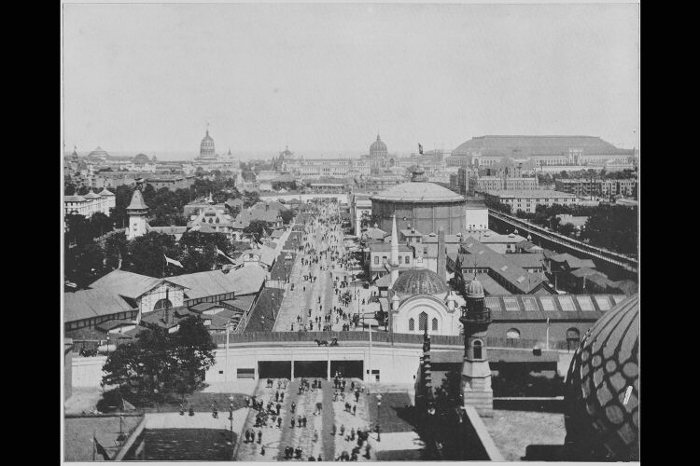
What happen On October 8, 1871
The Great Chicago Fire, The Peshtigo Wisconsin Fire and The Great Michigan Fire in Holland, Michigan Know As “Port Huron Fire” All Happen on This Date.

Slide 6
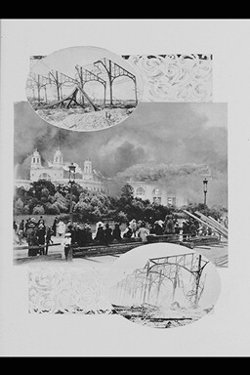
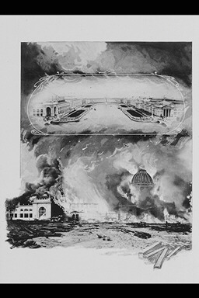
In The Port Huron Fire = 50 People Died; In The Great Chicago Fire = 300 People Died with 100,000 homeless and In The Peshtigo Wisconsin Fire = more than 1,200 people Perished

Slide 7
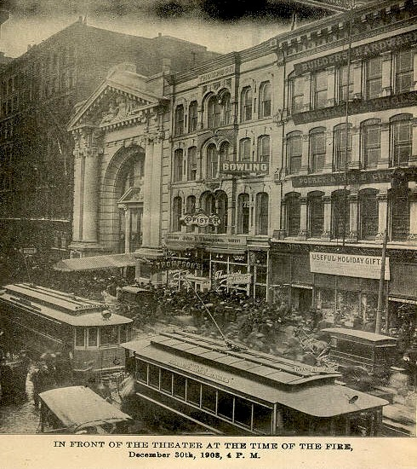
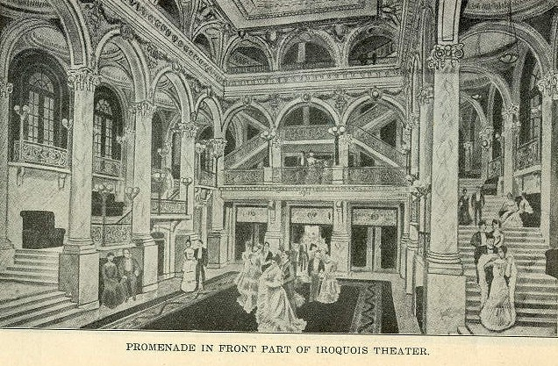
Iroquois Theater Fire 1903
635 casualties
Building Structure Slightly Damaged
Arcing light sprayed sparks against a velvet curtain
Doors opened in or were locked
Unfamiliar Door Latches
Exits were not marked
No Fire Drills

Slide 8
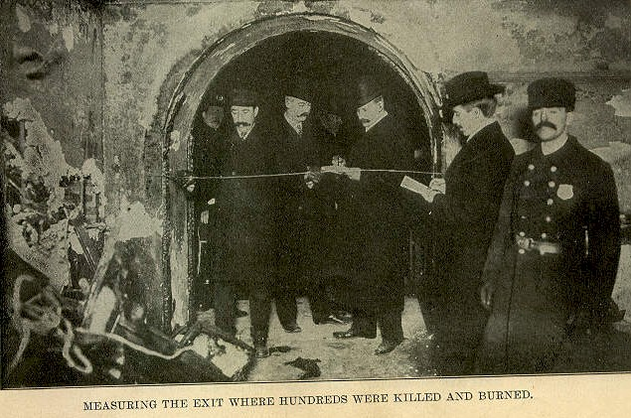
More Iroquois Theater Fire 1903
Fire Started under fire escape
Narrow Openings

Slide 9
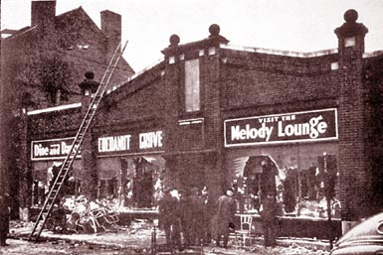
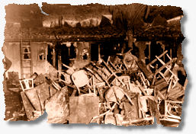
Coconut Grove Fire 1942
492 Deaths
Exceeded Occupant load
Interior finish spread fire
Revolving door jammed (other doors locked)
Part of the main floor collapsed into the basement
Exceeded occupant load

Slide 10
Our Lady of Angels Fire (Chicago) 1958
90 pupils and 3 nuns died
One exit (combustible stairway)
1600 students (K-8th grade)
No sprinklers, No Fire Alarms, No detection and No Monitoring
Combustible interior (including floor wax)
Fire extinguishers 7’ off floor
Fire burned 30-minutes before response
Building within scope of code per grandfather clauses in 1949 Chicago code
Notes:
Heavy doors protected persons on the first floor
No door on the second floor
Fire started in the basement in a barrel

Slide 11
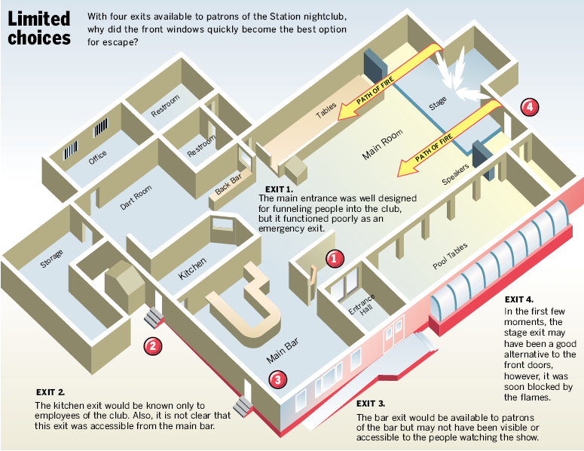

Slide 12
Fire Example

Slide 13
First – Lets Set The Stage
Chapter 10 establishes consensus guidelines for safe egress from occupied spaces within an acceptable time frame.
The following factors become important in the design:
Occupancy classification
How a space is used
Travel distance
Clear width
Level of protection

Slide 14
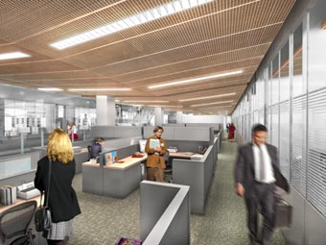
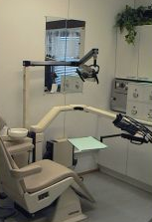
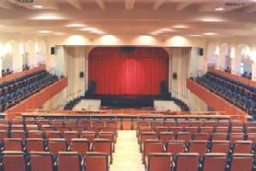
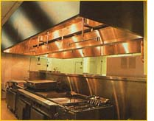
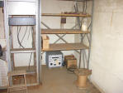
What are the Correct Occupancies?
Each occupancy represents a different hazard…

Slide 15
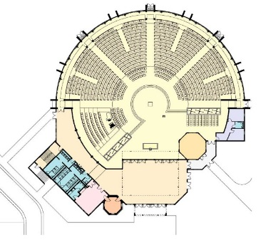
Group A Occupancies
Occupancy
Hazard
Group A-1 (Viewing performing arts or theater) | Low lighting, high occupant loads, hesitation to leave
Group A-2 (Assembly intended for food/drink consumption) | Ill-defined aisles, loud conditions, alcohol, high occupant loads
Group A-3 (Assembly for recreation, worship or amusement) | High occupant loads, potentially slow egress speed
Group A-4 (Indoor arenas) | High occupant loads, smoke obstruction, potentially slow egress speed
Group A-5 (Outdoor arenas) | High occupant loads, potentially slow egress speed
Notes:
Don’t forget delay to ADA

Slide 16
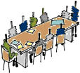
Group B Occupancies
Business occupancies include:
An office (typically)
Use of a building for
Professional or
Service-type transactions (i.e. doctor’s office, car wash)
A Group B occupancy is not expected to have a high occupant density or high fuel load.
Meeting areas accessory to a Group B occupancy with an occupant load fewer than 50-persons are classified as Group B.

Slide 17
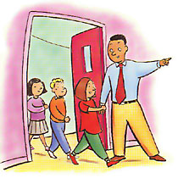
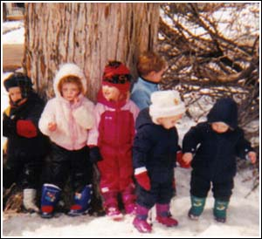
Group E Occupancies
K through 12th grade
Delay to egress
Possible panic or confusion
Moderate occupant densities
1st Grade and lower students are limited to the first floor to prevent vertical travel.

Slide 18
Group I Occupancies
Occupancy
Hazard
Group I-1 – Supervised occupancy (ambulatory) | Delay to egress due to sleeping occupants
Group I-2 Supervised occupancy (non-ambulatory) | Delay to egress due to non-ambulatory occupants
Group I-3 – Restrained | Restrained occupancies
Group I-4 – Day Care | Delay to egress due to facilitating child egress/rescue

Slide 19
Group R Occupancies
Occupancy
Hazard
Group R-1 – Transient residence (hotels) | Transient occupants Delay due to sleeping occupants
Group R-2 – Permanent, multi-tenant residence (apartments) | Delay due to sleeping occupants Shared building with adjacent occupants
Group R-3 – One and two family dwellings | Traditionally outside scope of the code Except for Day Care
Group R-4 – Residential Care/Assisted living | Supervised environment Delay to egress due to occupant assistance

Slide 20
What is the overall common thread of Chapter 10?
All paths leading from an occupied area of a building are classified as one of the following:
Exit Access
Exit
Exit Discharge
Notes:
Most important point of the class

Slide 21
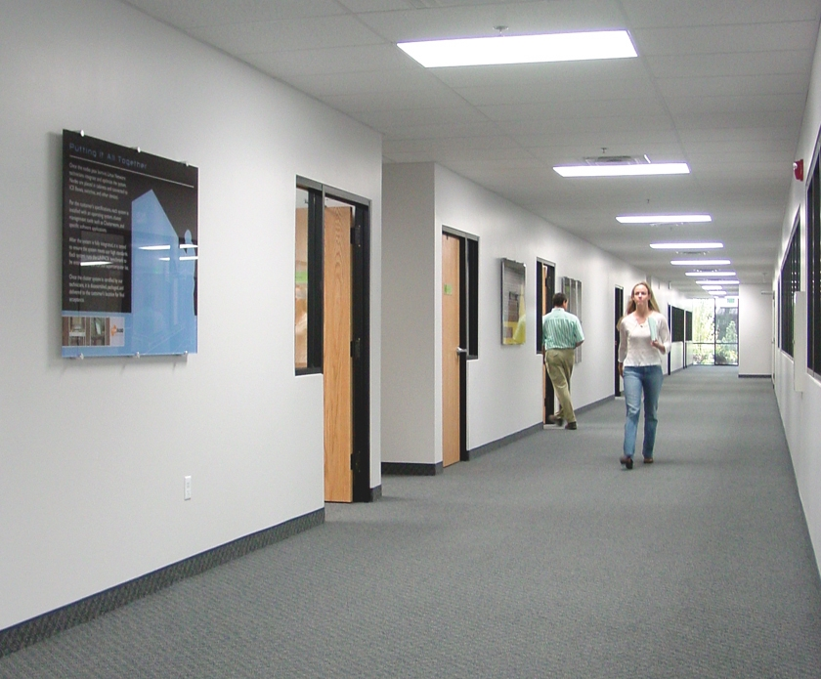
Exit Access
Defined as –
“That portion of a means of egress system that leads from any occupied point in a building or structure to an exit.”

Slide 22
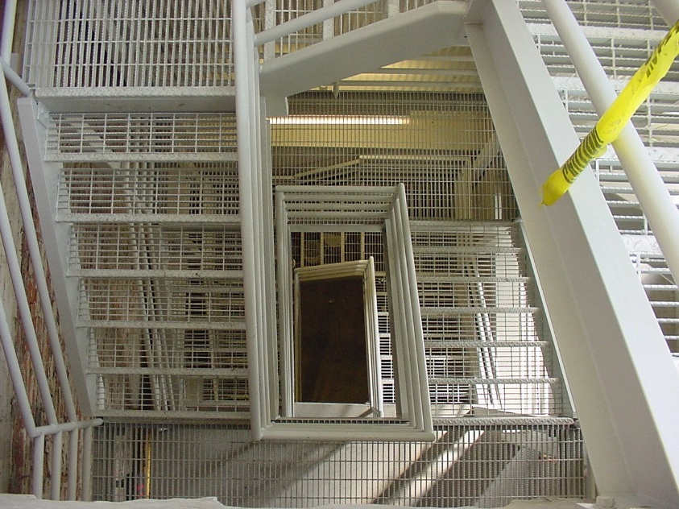
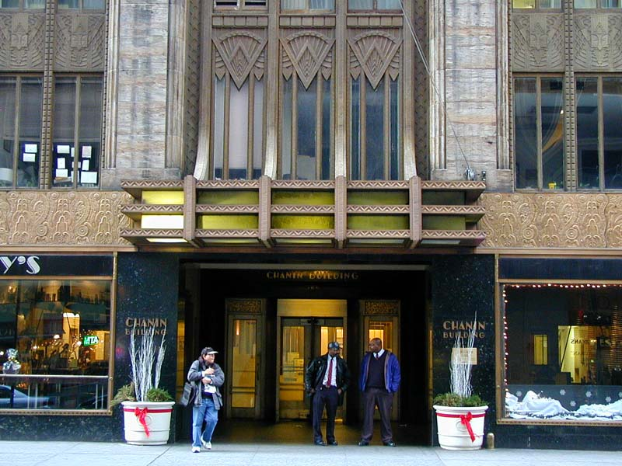
Exits
Defined as –
“That portion of a means of egress system which is separated from other interior spaces of a building or structure by fire-resistance rated construction and opening protectives as required to provide a protected path of egress travel between the exit access and the exit discharge. Exits include exterior exit doors at ground level, exit enclosure, exit passageways, exterior exit stairs, exterior exit ramps and horizontal exits.”

Slide 23
EXIT EXAMPLES

Slide 24
Exit Discharge
Exterior door/gates
Landing and construction
Outdoor Conditions

Slide 25
Fire Partitions
NCSBC 708
1-hour rated
Intended for
dwelling unit separations
guestroom separations
tenant separations in covered malls and
corridors
Can terminate at a rated ceiling
Penetrations are not limited
With some exceptions, required to be designed with supporting construction.

Slide 26
Fire Barriers
NCSBC 707
Intended for
shaft enclosures
exit enclosures
exit passageways
horizontal exits
incidental areas and
mixed occupancies
Required to extend from floor to ceiling
Openings limited to 25% of the wall
With some exceptions, required to be designed with supporting construction.

Slide 27
Fire Walls
NCSBC 706
Most misunderstood wall by name,
Required to have structural independence
(allowing one side to collapse without effecting the opposite side)
Opening limited to 25% or 120 square feet (simply 25% if sprinklered),
Required to be non-combustible,
No longer required to be rated 4-hours
Allows a single structure to be designed as two adjacent buildings

Slide 28
What is the benefit of a Fire Wall?

Slide 29
Smoke Barriers
NCSBC 709
1-hour rated – allowed to be 0.10” of steel in I-3 occupancies
Extends
exterior wall to exterior wall and
floor to deck
Divides smoke zones
Allows “defend in place” design
Zone 1
Zone 2
Zone 3

Slide 30
How Many People are we Going to Accommodate?
The code establishes a “Design Occupant Load”.
The building needs to be designed to accommodate potential occupant loads – not the expected occupant load.

Slide 31
Occupant Load Calculation Methods
The Design Occupant Load is based on the largest number generated by one of the following 4 methods:
Table 1004.1.2: in most cases, the minimum occupant load
1004.6: combination of occupants from accessory areas through a primary area
1004.3: the actual number of occupants expected (an actual expected load)
1004.2: An increase to accommodate a special event incorporated in the overall design (not to exceed 5 sf per occupant)
Notes:
Occupied spaces become the basis for Occupant Load Calculations

Slide 32
Using the Table
Table 1004.1.2 discerns between “net” and “gross”
Occupant densities are independent from the occupant classification
Areas are based on dedicated use of space
References 1004.4 for fixed seats

Slide 33
Table 1004.1.2
1004.4

Slide 34
Occupancy Classification?
Similar to Section 302.3 of the building code, Section 1004 requires that we identify the use of the space – not the occupancy classification
For Example; a cafeteria can be a Group A-2, but contain multiple occupant densities.

Slide 35
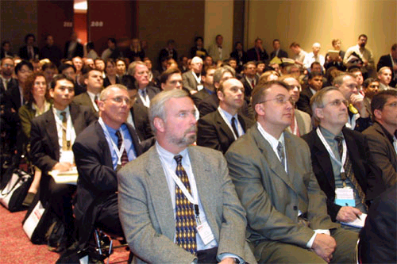
Occupant Load Calculation
Need to assign means of egress requirements to applicable areas of the building
When an area is shared between two separate occupancies, the most stringent applies (1004.9)

Slide 36
Occupant Load Application
Sometimes re-defines occupancy classification (i.e. Group A).

Slide 37
How Many Paths are Needed?
Table 1006.3.1
Occupant Load | Minimum Number of Exits
1-500 | 2
501-1,000 | 3
More than 1,000 | 4
Table 1006.3.1
Minimum Number of Exits for Occupant Load
Except as modified in Sections 1006.3, Table 1006.2.1 and Table 1006.3.2(1) represents the minimum number of Exits and paths
Paths for each exit (1006.3)

Slide 38
Spaces with One MOE
Two paths of egress are required unless the space:
Meets the occupant load of Table 1006.2.1 and
Common path of travel does not exceed Table 1006.2.1, Table 1006.2.1(2) or Table 1006.3.2(2)
Except for Group I-2 occupancies that comply with Section 1006.2.1 Exception 2
Table 1006.2.1
OCCUPANCY | MAXIMUM OCCUPANT LOAD
A, B, E, F, M, U | 50
H-1, H-2, H-3 | 3
H-4, H-5, I-1, I-3, I-4, R | 10
S | 30

Slide 39
Door Placement When 2 MOEs Required
At least two of the doors are required to be placed one-half of the diagonal distance
As the crow flies
One-third when building is sprinklered per NFPA 13 or NFPA 13R
Other doors required to be arranged a reasonable distance apart
Sized so does not reduce clear width to less than 50% if one path is obstructed
17’
80’

Slide 40
Three or More MOE
At least two exits shall meet the separation requirement
The remaining exits are required to be arranged at a reasonable distance

Slide 41
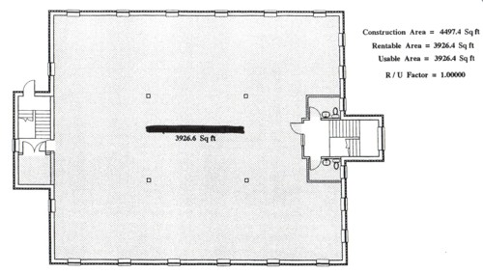
Remote Exit Determination
Maximum Overall Diagonal Dimension
74’-0”
37’-0”max
EXAMPLE: If maximum diagonal = 74; then 1/2 max diagonal = 37’-0”
…the exit doors shall be placed a distance apart equal to not less than one-half the length of the maximum overall diagonal dimension of the building or area to be served measured in a straight line between exit doors or exit access doorways.

Slide 42
Egress Width
How Many People can Squeeze Through?

Slide 43
Minimum Egress Width
Corridors (Section 1020)
Exit Passageways Cannot be less than 44-inches when serving 50 persons or more or less than 36-inches when serving less than 50 (Section 1024.2)
Aisles 1018 & 1029 Tables1029.12.2.1 and Table 1029.6.2

Slide 44
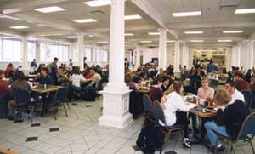
Tables and Chairs
Public Group B and M areas are required to have a clear path when fixtures are located on one side and 44-inches when located on both sides

Slide 45
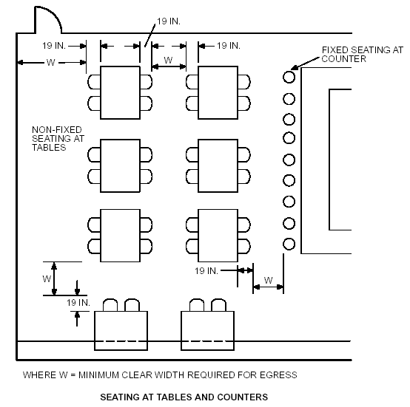
Seating at Tables

Slide 46
Travel Distance

Slide 47
Travel Distance Measured
Only the Exit Access is subject to a distance limitation
Travel Distance in the exit is not limited

Slide 48
Table 1017.2 Exit Access Travel Distance
OCCUPANCY | W/O SPRINKLERS | WITH SPRINKLERS
A, E, F-1, I-1, M,R, S-1, | 200 | 250
B | 200 | 300
F-2, S-2, U | 300 | 400
H-1 | NOT PERMITTED | 75
H-2 | NOT PERMITTED | 100
H-3 | NOT PERMITTED | 150
H-4 | NOT PERMITTED | 175
H-5 | NOT PERMITTED | 200
The distances are an empirical representation of the hazard associated with the occupancy.

Slide 49
Door Swing (1010.1.2)
Egress doors are required to be side-swinging, except
Private garages, office areas, factory and storage areas with an occupant load less than 10 persons
Detention areas of Group I-3 occupancies
Within single dwellings of Group R-2, R-3 and R-4
Revolving door (other than Group H)
Horizontal doors allowed by 1010.1.4.3
Power operated doors allowed by 1010.1.4.2

Slide 50
DOORS

Slide 51
Readily Distinguishable (1003.3.1)
Are the doors easily recognizable?

Slide 52
Door Encroachment
Doors that open onto a corridor cannot reduce the perpendicular egress width to less than ½ or 7-inches when fully open (1005.7.1)

Slide 53
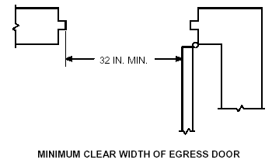
Minimum Door Width (1010.1.1)
The minimum clear width of a doorway cannot be less than 32-inches
When 2 adjacent doors are provided, one leaf is required to be at least 32-inches
Group I-2 occupancies used for the movement of beds is required to be at least 41.5 inches
The maximum width is 48-inches

Slide 54
Exceptions to the Minimum Door Width
The minimum doorway clear width is not applicable to non-egress doors in Group R-2, R-3 or R-4 occupancies and closets not greater than 10 sf
Doorways for Group I-4 sleeping rooms can be 28-inches

Slide 55
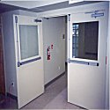
Projections into the Doorway (1010.1.1.1)
Projections are not allowed lower than 34” above the floor
4” projections are allowed between the heights of 34 and 80 inches

Slide 56
Door Force (1010.1.3)
A door is required to unlatch with a pressure 15 lbs or less
A door is required to be placed in motion with a pressure 30 lbs or less
A door is required to be placed in a full-open position with a pressure of 15 lbs or less

Slide 57
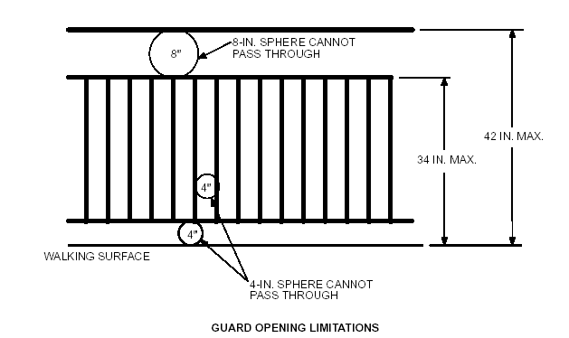
Guards (1015)
Height 1015.3
Openings 1015.4

Slide 58
General Egress Provisions [Method of Egress (MOE)]

Slide 59
Corridor Ventilation

Slide 60
Exits Used for Another Purpose

Slide 61
Continuity
The MOE cannot be interrupted
Locked doors?
Obstructions cannot be placed within the MOE
Storage in the MOE
A MOE path cannot be diminished
Narrowing corridor
Stair landings?

Slide 62
Egress Through Intervening Spaces
Egress through accessory spaces with a discernable path is allowed (1016.2), except as follows:
Cannot pass through:
High-hazard spaces (unless the origin is also high-hazard), kitchens, storerooms, closets, or spaces with similar purposes
A space subject to locking
Egress from one dwelling space (or sleeping areas)
Cannot lead through other sleeping areas, toilet rooms or bathrooms
But can lead through a kitchen in the same dwelling unit

Slide 63
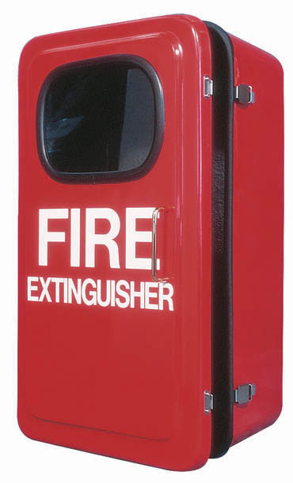
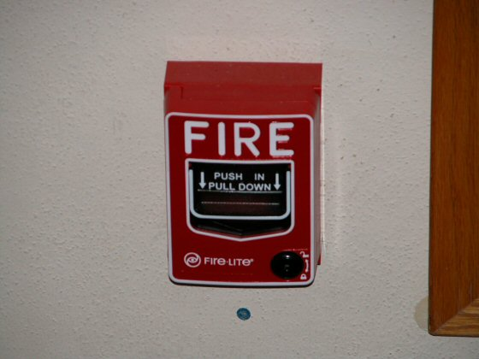
Allowable Obstructions
4-inches into a walking surface between 27-80 inches, except handrails (1003.3.2)
Obstructions reducing clear width is not allowed (1003.3).
Notes:
Note the language is not limited to required width

Slide 64
Floor Surfaces
Slip Resistant:
Floor Surface(1003.4) & Ramps Surface (1012.7.1)
When changes of elevation less than 12-inches, required to be a ramp, except (1003.5);
Group I-2 occupancies serving non-ambulatory persons requires a ramp for all changes in elevation
Groups F, H, R-2 and R-3 can have a single 7-inch step
Exterior doors for Groups S and U not required to be accessible
Up to two risers are allowed on non-accessible routes with a 13-inch thread and a handrail w/i 30-inches egress of the centerline of the stair

Slide 65
Locks and Latches
Egress doors are required to be readily openable from the egress side without the use of a key, special knowledge or special effort, except;
Places of restraint or detention (including special needs Group I-2)
For pairs of doors, automatic flush bolts are allowed on the inactive leaf if the door is not equipped with hardware and does not require more than one operation
Doors from Group R guestrooms or dwellings can be equipped with a night latch, dead bolt or security chain
Double-cylinder dead bolts……

Slide 66
Related Definitions
Means of Egress:
A continuous and unobstructed path of vertical and horizontal egress travel from any point in a building or structure to a public way. A means of egress consist of three (3) separate and distinct parts: the exit access, the exit and the exit discharge.
Occupant Load:
The number of persons for which the means of egress of a building or portion thereof is designed.

Slide 67
Related Definitions
Public Way:
A street, alley or other parcel of land open to the outside air leading to street, that has been deeded, dedicated or otherwise permanently appropriated to the public for public use and which has a clear width and height of not less than 10 feet.
Corridor:
An enclosed exit access component that defines and provides a path of egress travel to an exit.

Slide 68
Bldg Codes for Child Care
ACCESS REQUIREMENTS
EGRESS REQUIREMENTS
Accessible entrance requirements
Door width measurement
Accessible door hardware
Level of exit discharge
Remote exits
Acceptable room locations for children < 3 years old
Toilet fixtures

Slide 69
Accessible Entrance Requirements
An accessible entrance requires:
This means no stairs - no gravel paths
Fixed, firm, non-slip
4’- 0” wide path of travel with maximum 1:12 slopes

Slide 70
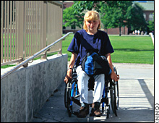
Accessible Entrance Requirements
An accessible ramp requires:
Maximum 1:12 slopes with minimum 4’-0” width between handrails on both sides
Handrail extensions top and bottom of ramp within 27” of floor or ground surface
2” edge protection where drop-offs > 1/2”

Slide 71
Door Width Measurement
The required 32” clear dimension is measured:
with the door in the fully open position
from the face of the strike jamb stop to the finished face of the door in the 90° open position
INSIDE
60” min
DIRECTION OF TRAVEL
OUT SWINGING DOOR
OUTSIDE

Slide 72
Door Width Measurement
The required 32” clear dimension is measured:
with the door in the fully open position
from the face of the strike jamb stop to the finished face of the door in the 90° open position
INSIDE
12” min
DIRECTION OF TRAVEL
60” min
IN SWINGING DOOR
OUTSIDE

Slide 73
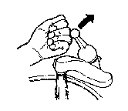
Accessible Door Hardware
Operable door hardware requires a shape that is easy to grasp with one hand and does not require tight-grasping, tight pinching, or any wrist-twisting motion to operate.
Similar requirements apply to lavatory controls, drawer pulls, etc.

Slide 74
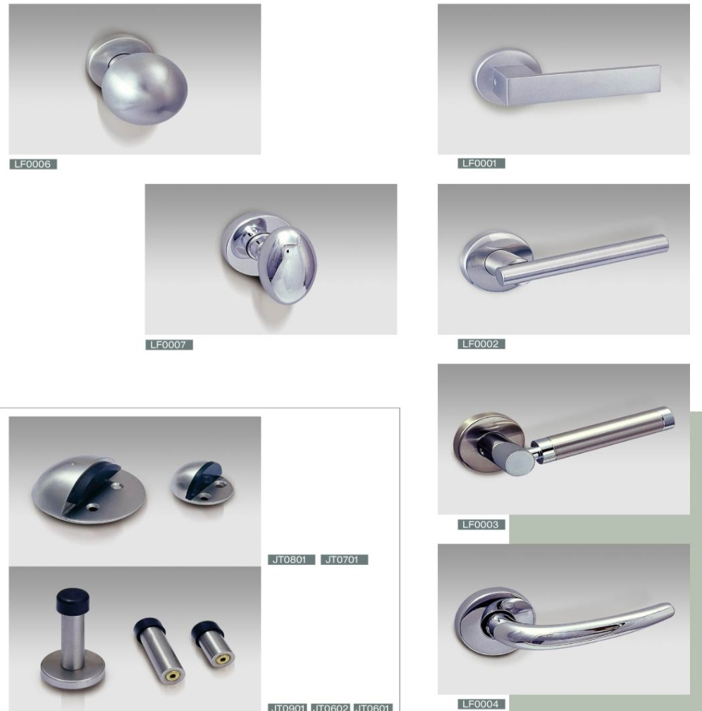
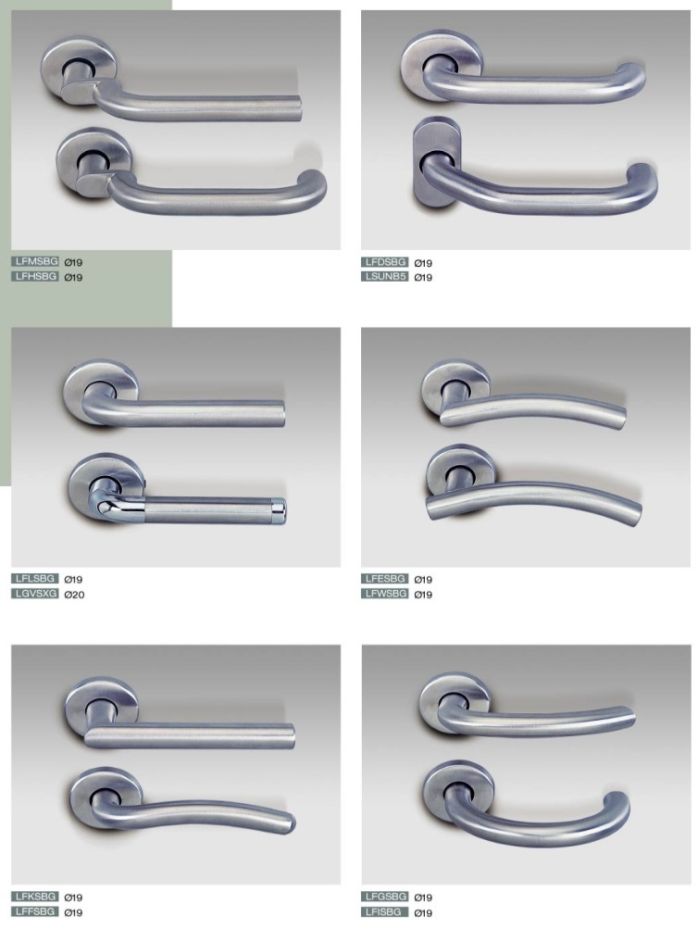
Accessible Door Hardware
DO NOT USE THESE
USE THESE

Slide 75
Level of Exit Discharge
1028 EXIT DISCHARGE, LEVEL OF - The horizontal plane located at the point at which an exit terminates and an exit discharge begins.
EXIT TERMINATES HERE

Slide 76
Double cylinder deadbolts
Allowed at the main exterior door of Group A (with an occupant load not exceeding 300 persons), Group B, F, M and S, subject to the following:
Easily distinguishable
Visible sign
Can be revoked by the code official

Slide 77
Bolt Locks
Manually operated bolt locks or surface bolts are not allowed (1010.1.9.4)

Slide 78
Delayed Egress Locks (1010.1.9.7)
Listed locks are required to be approved
Cannot be used on Groups A, E or H
Buildings are required to have a sprinkler or smoke detection system
Path cannot have more than one delayed egress lock
Subject to the 6 provisions in the code

Slide 79
Panic Hardware (1010.1.10)
Required for doors serving
Group A or E occupancies with an occupant load of 100 or more,
Groups H-1. H-2, H-3 pr H-5 with any occupancy
Hardware has to extend over ½ of the door width
Required to unlatch at 15 lbs
No additional hardware is allowed, unless part of the panic hardware

Slide 80
Kitchen Egress
The Problem:

Slide 81
Kitchen Egress
One Solution:

Slide 82
Envir. Health Egress Questions
Question #1: Are Bolt Locks/Slide Bolt Locks approved to be used in a Child Care Center?
Answer : Section 1010.1.9.4 “Bolt locks” of the 2018 North Carolina Building Code prohibits use of these types of locks; see attached code section.

Slide 83
Bolt Locks
Manually operated bolt locks or surface bolts are not allowed (1010.1.9.4)

Slide 84
Envir. Health Egress Questions
Question #2: Does the Building Code require the kitchen to be locked?
Answer : No, the building code does not require kitchens to be locked nor does the building code allow egress through a kitchen Section 1016.2 (5), but it does require that if someone is located in a kitchen, they would have to be able to get out of the kitchen ; where most kitchens only require one means of egress (or one door to lead you to an exit).

Slide 85
Envir. Health Egress Questions
Answer (Cont.) : That door may be locked from the point of someone getting into the kitchen , but the person leaving the kitchen should be able to open the door with a single action as stated on Section 1010.9.5 “ Unlatching” nor should there be a key, special knowledge, or effort be required to open the door accordion to Section 1010.1.9 “Door operations” of the 2018 North Carolina Building Code.

Slide 86
Envir. Health Egress Questions
1016.2 Egress through intervening spaces. Egress through intervening spaces shall comply with this section.
Exit access through an enclosed elevator lobby is permitted. Access to not less than one of the required exits shall be provided without travel through the enclosed elevator lobbies required by Section 3006. Where the path of exit access travel passes through an enclosed elevator lobby, the level of protection required for the enclosed elevator lobby is not required to be extended to the exit unless direct access to an exit is required by other sections of this code.
Egress from a room or space shall not pass through adjoining or intervening rooms or areas, except where such adjoining rooms or areas and the area served are accessory to one or the other, are not a Group H occupancy and provide a discernible path of egress travel to an exit.

Slide 87
Envir. Health Egress Questions
1016.2 (Continued)
Exception: Means of egress are not prohibited through adjoining or intervening rooms or spaces in a Group H, S or F occupancy where the adjoining or intervening rooms or spaces are the same or a lesser hazard occupancy group.
An exit access shall not pass through a room that can be locked to prevent egress.
Means of egress from dwelling units or sleeping areas shall not lead through other sleeping areas, toilet rooms or bathrooms.
Egress shall not pass-through kitchens, storage rooms, closets or spaces used for similar purposes.

Slide 88
Envir. Health Egress Questions
Question #3: What type of locks are approved to be used to lock the kitchen if the operator decides to lock the kitchen when it is not in use at the center? 15A NCAC 18A .2820 Storage (b) States, “All corrosive agents, pesticides, bleaches, detergents, cleansers, polishes, any product which is under pressure in an aerosol dispenser, and any substance which may be hazardous to a child if ingested, inhaled,

Slide 89
Envir. Health Egress Questions
Question #3 (Cont.): or handled shall be kept in its original container or in another labeled container, used according to the manufacturer's instructions and stored in a locked storage room or cabinet when not in use. Locked storage rooms and cabinets shall include those which are unlocked with a combination, electronic or magnetic device, key, or equivalent locking device.”

Slide 90
Envir. Health Egress Questions
Answer : The types of locks would be the type that can be open from the egress side by a single action without the need of key, special knowledge, or effort be required to open the door see Section 1010.1.9 through 1010.1.9.5.

Slide 91
Envir. Health Egress Questions
1010.1.9 Door operations. Except as specifically permitted by this section, egress doors shall be readily openable from the egress side without the use of a key or special knowledge or effort.
1010.1.9.1 Hardware. Door handles, pulls, latches, locks and other operating devices on doors required to be accessible by Chapter 11 shall not require tight grasping, tight pinching or twisting of the wrist to operate.
1010.1.9.2 Hardware height. Door handles, pulls, latches, locks and other operating devices shall be installed 34 inches (864 mm) minimum and 48 inches (1219 mm) maximum above the finished floor. Locks used only for security purposes and not used for normal operation are permitted at any height.

Slide 92
Envir. Health Egress Questions
1010.1.9.4 Bolt locks. Manually operated flush bolts or surface bolts are not permitted.
1010.1.9.5 Unlatching. The unlatching of any door or leaf shall not require more than one operation.
Exceptions:
Places of detention or restraint.
Where manually operated bolt locks are permitted by Section 1010.1.9.4.
Doors with automatic flush bolts as permitted by Section 1010.1.9.3, Item 3.
Doors from individual dwelling units and sleeping units of Group R occupancies as permitted by Section 1010.1.9.3, Item 4.

Slide 93
Envir. Health Egress Questions
Question #4: Can Rainwater or collected Rainwater be used in a Child Care Center?
Answer : 1)Rainwater is a nonpotable water as such rainwater is not safe for drinking, personal or culinary utilization.
2) Untreated rainwater can only be used for outdoor irrigation, decorative foutains, yard hydrants, vehicle washing industrial processes (e.g., dust control, indoor bibs spray)

Slide 94
Envir. Health Egress Questions
Question #4 (continued): Can Rainwater or collected Rainwater be used in a Child Care Center?
Answer (continued): 3)Treated rainwater (disinfection and filtration) can only be used for toilet flushing, urinal flushing, evaporative cooling tower make-up, trap primers, fire suppression systems, clothes washers, outdoor pools and spas.

Slide 95
Envir. Health Egress Questions
Question #5: Are Air Fryers allowed to be used in a Child Care Center?
Answer : This one was a hard one, no this office does not have an opinion at this time on a non-fuel-burning appliance that is non vented and have not been tested by a third-party agency should as UL.
I looked online at different types of Air Fryers and none of them had been tested (at minimal they should have been tested in accordance with UL 710B)

Slide 96
Envir. Health Egress Questions
Question #5 (continued): Are Air Fryers allowed to be used in a Child Care Center?
Answer (continued): All commercial factory-built appliances should be tested, listed and labeled; at this time, this office can not recommend the use of these unlisted/untested or unlabeled Air Fryers in a commercial kitchen.

Slide 97
Envir. Health Egress Questions
Question #5 (continued): Are Air Fryers allowed to be used in a Child Care Center?
Answer (continued): As for the question; I would treat this Air Fryer just like a “fryer” it has the possibility of releasing vapors, hot steam and white smoke (which should be unplugged immediately).

Slide 98
Envir. Health Egress Questions
Question #5 (continued): Are Air Fryers allowed to be used in a Child Care Center?
Answer (end): This appliance is designed for household use only. It may not be safe in environments such as staff kitchens, farms, motel and other non-residential environments (this caution comes from several air fryers manufactories owner’s manuals)

Slide 99
Questions?
How to reach me for answers to further questions:
PHONE 919-647-0015
FAX 919-715-0067
E-MAIL mark.bailey@ncdoi.gov
On the e-mail, please include:
your name,
firm or jurisdiction, and
phone number

