Slide 1
Toilets, Lavatories, Diapering & Diaper Changing Facilities
Brenda Bass, REHS
Regional Specialist
Environmental Health Section
Children’s Environmental Health Program

Slide 2
Terms: New or Clarified:
(21) Hand antiseptic
(22) Handwash Lavatory(same):means a sink that is equipped with hot and cold water under pressure for the primary purpose of handwashing.
(2) Approved Disinfectant
(12) Detergent Solution means a solution comprised of water and soap.
(13)Disinfect
(34) Sanitize
(20) Good Repair. Items that are in good repair shall be free of substrate damage, deterioration, peeling surfaces, and broken or missing parts and shall operate in accordance with the manufacturer's or builder's instructions
(35) Sanitizing solution means a solution containing 50 to 200 parts per million (ppm) of chlorine or a sanitizer as defined at 40 C.F.R. 158.2203 that is registered with the EPA in accordance with 40 C.F.R. 152 that is approved by the EPA for use on food-contact surfaces, does not require a final rinse step, and has a testing method that can be used by child care center employees to confirm that the prescribed chemical concentrations are met and that is prepared and maintained in accordance with Rule .2812(j) of this Section.
Notes:
Hand antiseptic is a term utilized in the Food Code; thus it is being defined as much. Hand sanitizers fall under the criteria of hand antiseptics,
Detergent solution- if they still label their bottles soapy water, this is not a noncompliant issue.

Slide 3
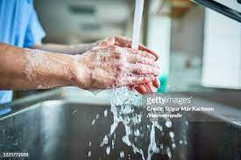
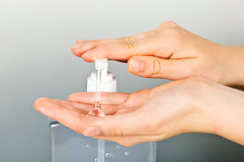
Handwashing .2803
Lists times & places handwashing must take place for children(a) and childcare employees(c).
Describes handwashing procedures(e).
Describes proper use of hand antiseptic products.(b)
(d)Except when the action that necessitates handwashing is diapering and before eating meals or snacks, hand antiseptics may be used in lieu of handwashing while a child is outdoors, provided that the child's hands are washed when the child returns indoors.

Slide 4
Toilets .2817(a)
Toilet tissue paper shall be provided in each toilet room and stored in a clean dry place.
Toilet rooms shall include or be adjacent to a handwash lavatory.
Storage in toilet rooms shall be limited to toileting and diapering supplies.
All toilet fixtures shall be kept clean and in good repair.

Slide 5
Toilets .2817(a) continues..
All toilet fixtures shall be kept clean and in good repair.
Toilet fixtures shall be child-sized, adult-sized toilets that are adapted to accommodate children, or potty chairs

Slide 6
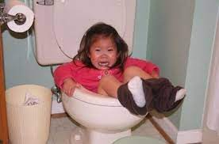
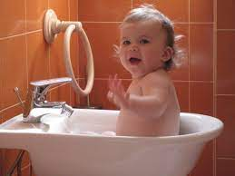
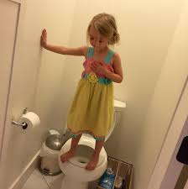
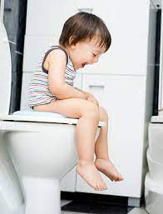
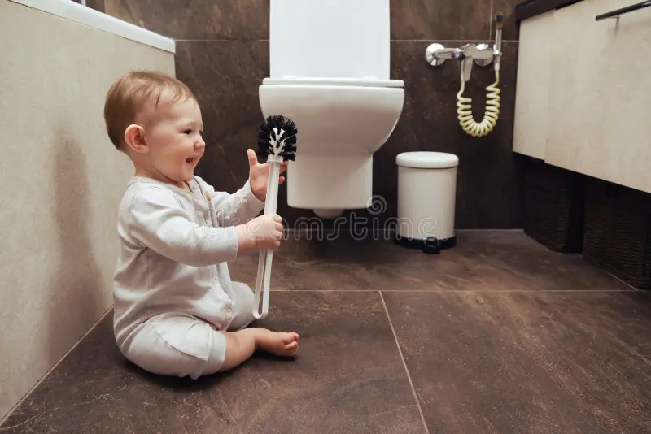
Which one is a child-sized or an adult-sized toilet that is adapted to accommodate children?
A.
B
C.
D.
E.
F.
NONE!

Slide 7
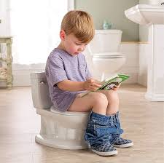
Toilets .2817
(b) Toilet fixtures shall be cleaned and disinfected daily and when visibly soiled.
(c) If potty chairs are used, they shall be located and stored in a toilet room equipped with a spray-rinse toilet or
utility sink.
Potty chairs shall be emptied,
rinsed, cleaned and disinfected
after each use.
(d) When cloth diapers are used and emptied, the diaper changing area shall be located next to a toilet room

Slide 8
Lavatories .2818
All handwash lavatory areas shall be:
kept clean and in good repair(a) and…
not be used for storage(a)
Water from a handwash lavatory shall not be used for consumption.(a)
(c) Lavatories shall be cleaned and disinfected with each change of use, when visibly soiled, and at least daily.

Slide 9
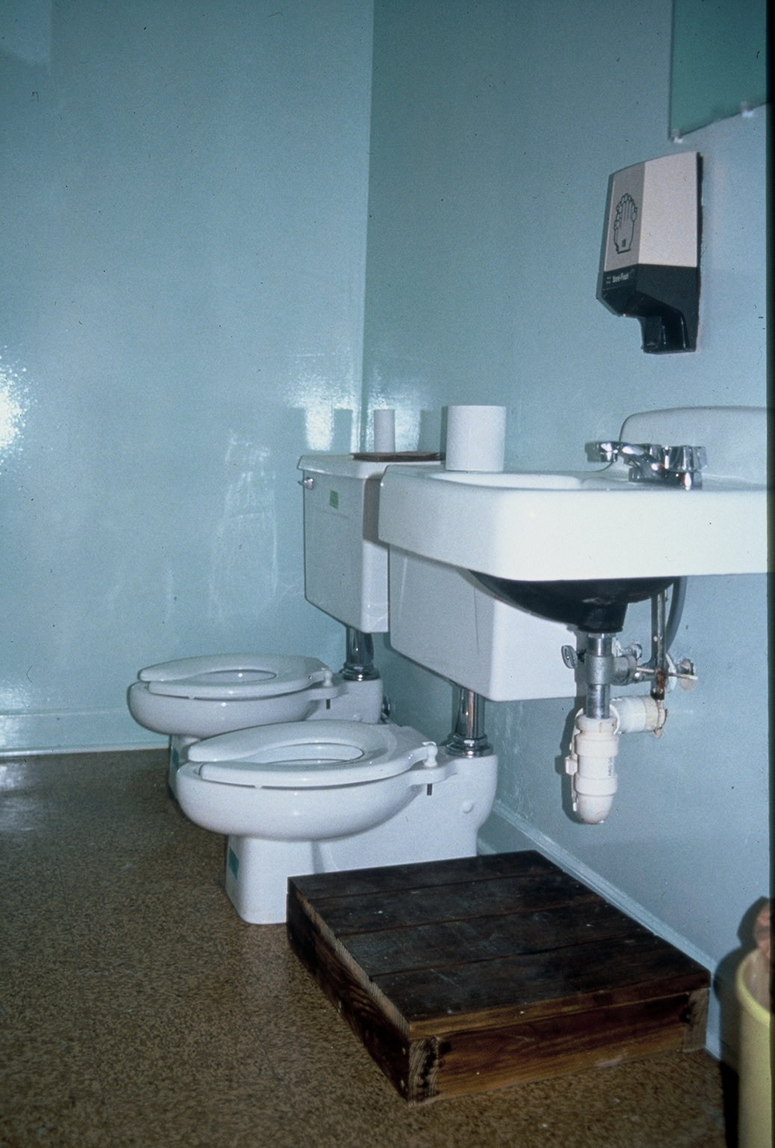
.2818 Lavatories continued….
Lavatories with flush-rimmed sinks or with an attached operable drinking fountain shall not be used for handwashing.(a)
Equipped with hot and cold water or tempered water specified in Rule.2815(e)
Liquid soap
Disposable towels or other hand-drying devices
Handwash signs posted at every handwash lavatory.
What issues(noncompliance)do you see in this restroom?
Notes:
Toilet paper storage, sink not very accessible to smaller children, paper towels or hand dryer, no handwashing sign.

Slide 10
...with each change of use... Use
(c) Lavatories shall be cleaned and disinfected with each change of use, when visibly soiled, and at least daily Change of use includes, but is not limited to, a classroom handwash lavatory used for rinsing toothbrushes, a food preparation handwash lavatory used for toy cleaning, or a classroom handwash lavatory used for diaper changing handwashing. Change of use occurs when a handwash lavatory is used outside of its original intent.

Slide 11
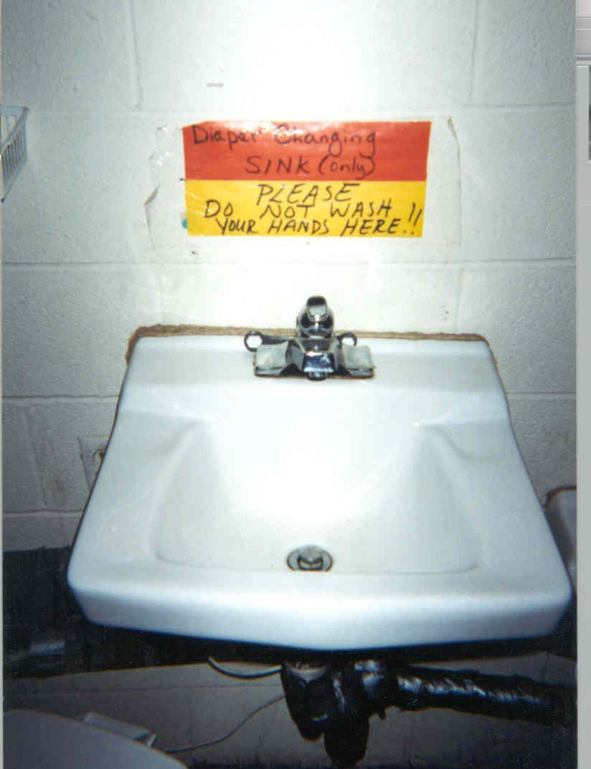
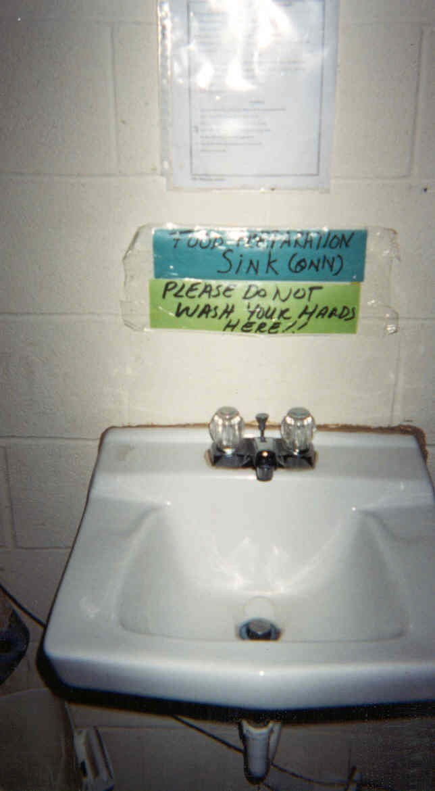
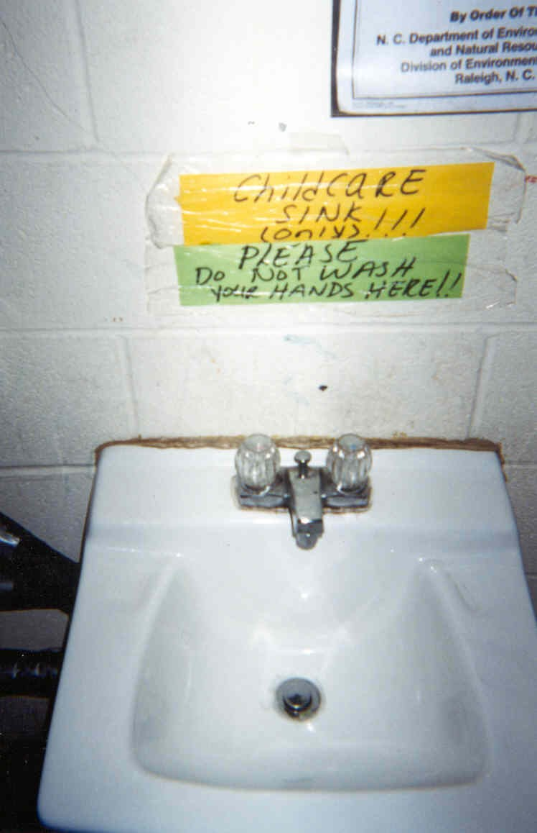
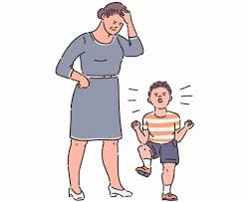
Notes:
1st sink- Food preparation handwashing lavatory- Do not wash your hands here
2nd sink- Diaper changing handwashing lavatory-Do not wash your hands here
3rd- Childcare sink- average classroom handwashing sink-Do not wash your hands here

Slide 12
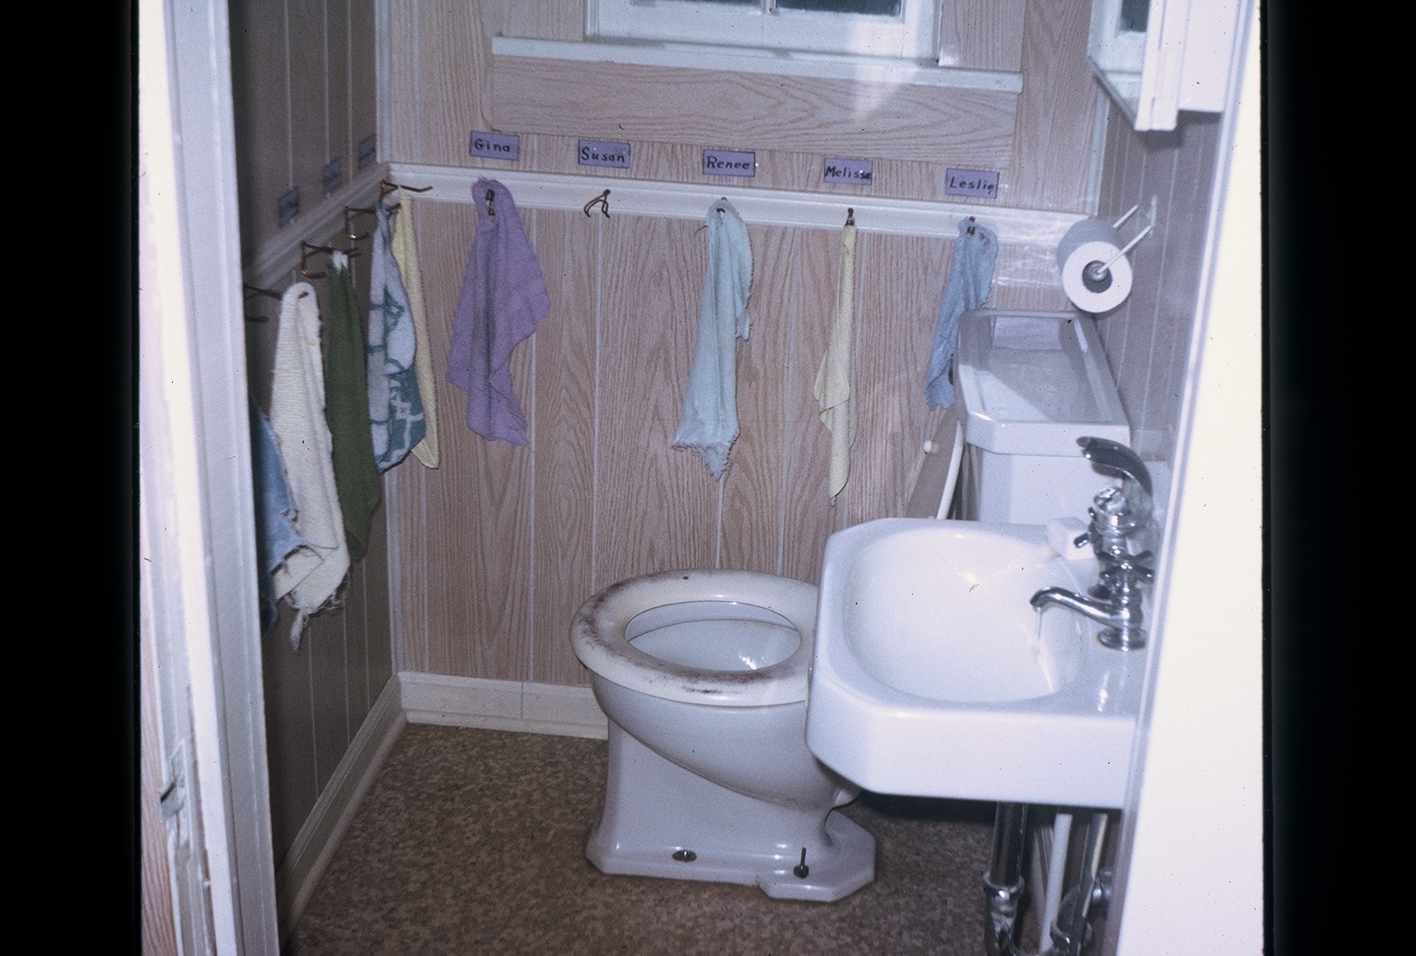
Notes:
Problems: Cloth towels, attached water fountain, toilet paper, toilet seat, walls absorbent, one faucet

Slide 13
Diapering and Diaper Changing Facilities .2819(a)
Each diaper changing station shall INCLUDE a handwashing lavatory.
Exception - In or next to diaper changing area
Centers licensed for fewer than 13 children and located in a residence.
Diaper changing areas designated for school age children.

Slide 14
Diapering .2819(b)
Diapering surfaces shall be smooth, intact, nonabsorbent, easily cleanable and approved by the department.
Nothing shall be placed on the diapering surface except for those items required for diapering and the child whose diaper will be changed.

Slide 15
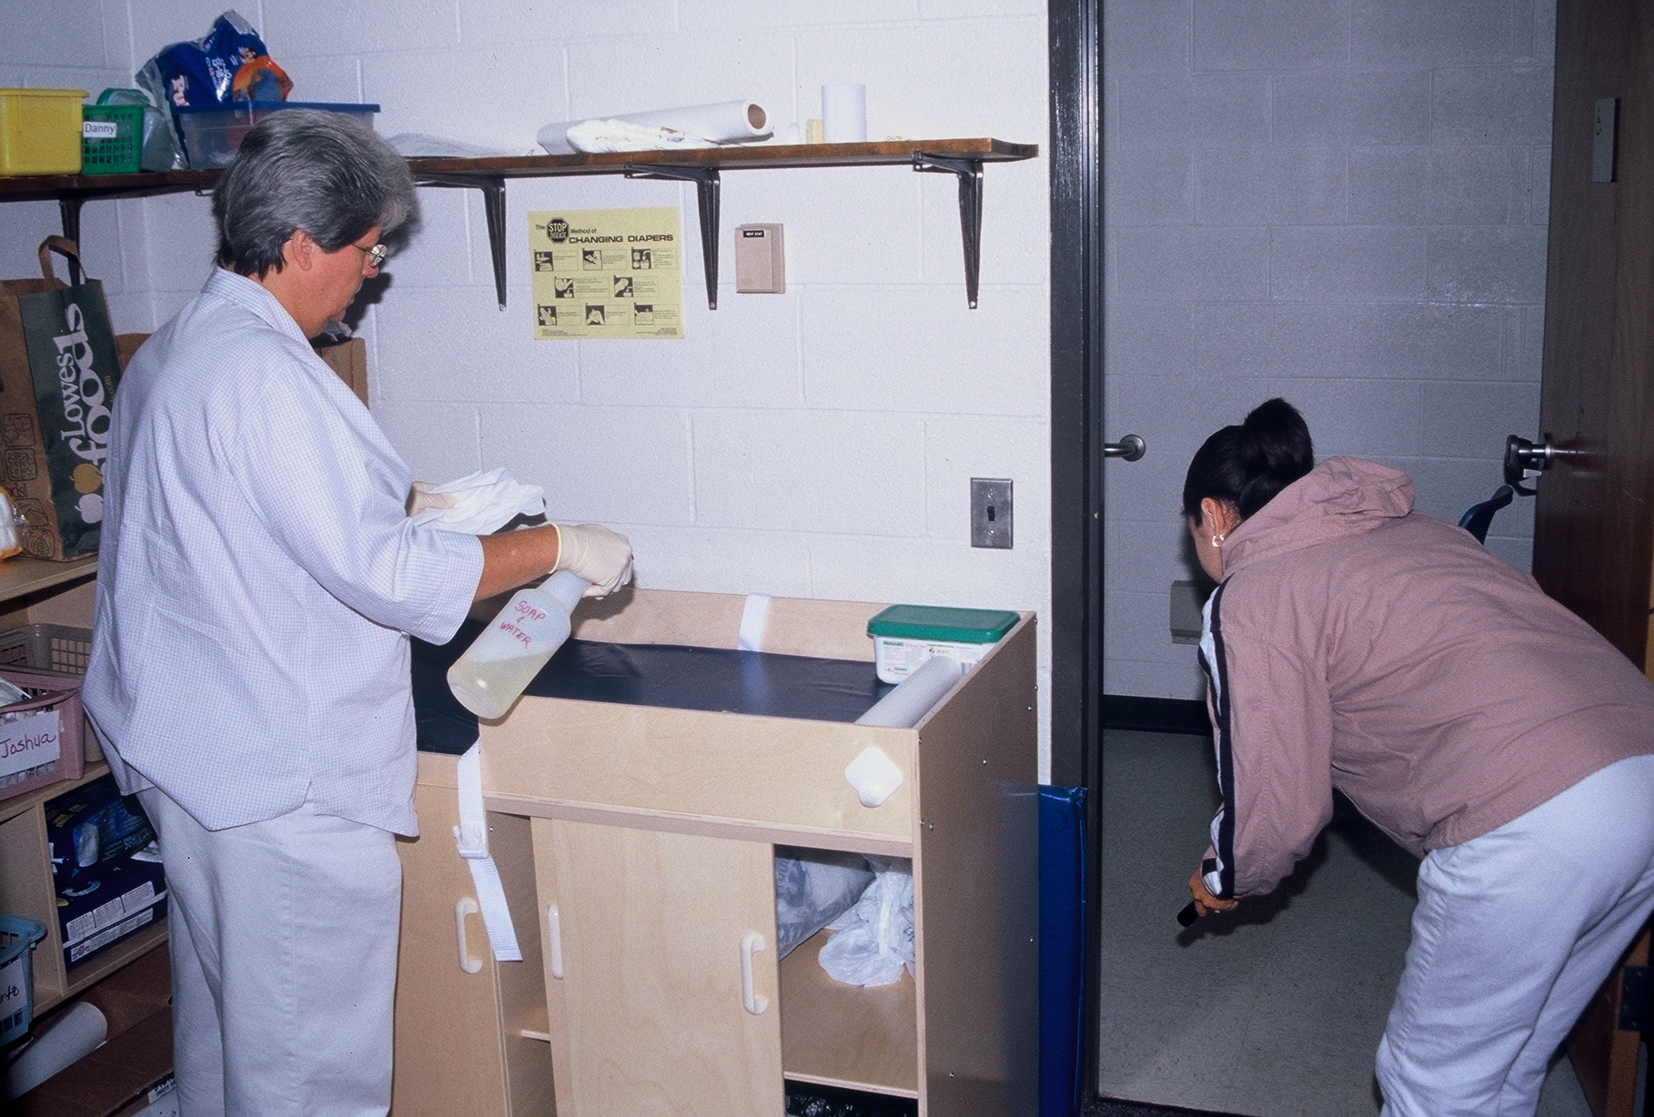
Diapering
(c) Diapering surfaces shall be disinfected using an approved disinfectant. Approved disinfectants and detergent solution shall be kept in separate and labeled bottles at each diaper changing station. Approved disinfectants that are chlorine disinfecting solutions shall be stored in hand pump spray bottles. No cloths or sponges shall be used on diapering surfaces.
Notes:
This is a picture of a center licensed designed for school are children, therefore it meets the exception..

Slide 16
Approved Disinfectant defined… [2]
A chlorine solution containing 500 to 800 parts per million (ppm) of chlorine or a disinfectant as defined at 40 C.F.R. 158.2203 that is registered with the United States Environmental Protection Agency (EPA) in accordance with 40 C.F.R. 152 with use indicated in schools and child care settings and that is prepared and maintained in accordance with Rule .2812(i) of this Section.

Slide 17
Approved Disinfectant .2812(i)
(i) An approved disinfectant shall be provided for cleaning purposes. Throughout this Section, when an approved disinfectant is used in a childcare center, …
1. the manufacturer's Safety Data Sheets for the disinfectant product shall be kept on file at the child care center …
2. and the instructions for use of the disinfectant product shall be followed.
When a chlorine solution is prepared by a child care center employee for use as an approved disinfectant, then …
1. the solution shall be prepared for use within 24 hours and...
2. a testing method shall be used to ensure compliance with the prescribed chlorine concentration.
3. To achieve the maximum germ reduction with a chlorine disinfecting solution, the surface being disinfected shall be made wet with the chlorine disinfecting solution and allowed to air dry or be dried only after the surface has been in contact with the chlorine disinfecting solution for a minimum of two minutes.

Slide 18
I know I have mixed my chlorine disinfectant correctly,
What went wrong ???!!!

Slide 19
Application | Bleach Per Gallon Of Water | Bleach Per Quart of Water | Bleach (Free Chlorine Concentration) | Recommended Labeling
 |  | 5.25% Sodium Hypochlorite
Disinfecting Strength | ¼ Cup | 1 Tablespoon | 500 – 800 ppm | Disinfectant
Sanitizing Strength | 1 tablespoon | ¾ Teaspoon | 50 – 200 ppm | Sanitizer
 |  | 6.00% Sodium Hypochlorite
Disinfecting Strength | 3 ½ Tablespoons | 2 ½ Teaspoons | 500 – 800 ppm | Disinfectant
Sanitizing Strength | 2 ½ Teaspoons | ½ Teaspoon | 50 – 200 ppm | Sanitizer
 |  | 8.25% Sodium Hypochlorite
Disinfecting Strength | 2 ½ Tablespoon | 2 Teaspoon | 500 – 800 ppm | Disinfectant
Sanitizing Strength | 2 Teaspoon | ½ Teaspoon | 50 – 200 ppm | Sanitizer

Slide 20
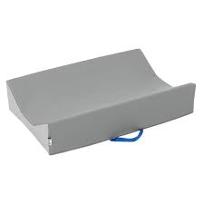
(c) If diapering is performed on the floor in a toilet room, then a smooth, intact, nonabsorbent barrier that is clean and in good repair shall be placed on the floor to minimize cross-contamination.
.2819(c)
Store barrier in a manner where a child can not have contact.
Examples are diapering mats or nonabsorbent medical grade paper liner.

Slide 21
Diapering .2819(d)
Diapering Procedures Demonstration

Slide 22
(e) Vinyl or latex disposable gloves shall be used by child care center employees during the diaper changing process if the employee's hands have cuts, sores, or chapped skin.
(g) Receptacles containing soiled disposable diapers shall be emptied in a garbage area located outside the child care center building daily.
(h)Proper methods for diaper changing and handwashing shall be posted in the diaper changing area.

Slide 23
SUMMARY: Cleaning and Disinfecting with an approved disinfectant
Lavatories must be cleaned and disinfected with each change of use, as needed and at least daily.
Toilet fixtures shall be cleaned and disinfected at least daily and when visibly soiled.
Diapering surfaces shall be cleaned and disinfected after each use.

Slide 24
Primary Plan Review Considerations
What activities require access to lavatories?
Location of lavatories serving toilets.
Location of the diapering lavatory.
Location of the food prep lavatory.
Using change of use- does the operator understand the procedures of change of use, to use it effectively?
Do they have diapering procedures?
Thoughts on the approved disinfectant to be used. At the diaper changing station, where will I store my bottles to be used?

Slide 25
A Virtual Mini Inspection
What issues do you see at these diaper changing stations?

Slide 26
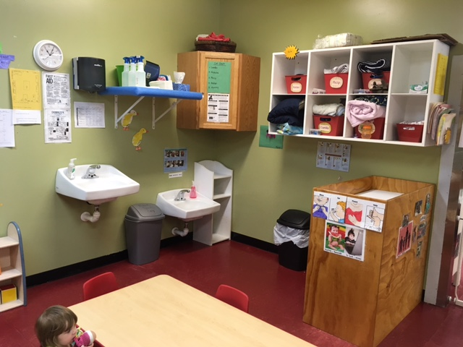

Slide 27
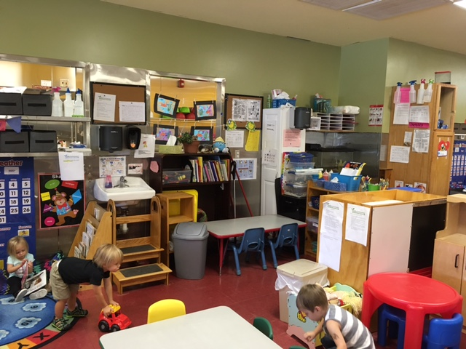

Slide 28
Thank you!

