Slide 1

WASTEWATER AND SOLID WASTE
IN CHILD CARE CENTERS
What Goes In, Must Go Out.
Rules .2829 and .2830
Rob Pearsall
Environmental Health Regional Specialist
(910)-624-1835
Robert.pearsall@dhhs.nc.gov
Notes:
.2829 Wastewater – 6 pts
.2830 Solid Wastes – 2 pts.
15A NCAC 18A .2829 WASTEWATER
In child care centers, all wastewater shall be disposed of in a publicly-owned wastewater treatment system or by an
approved properly operating on-site wastewater system under 15A NCAC 18A .1900. Septic systems shall be sized
to accommodate anticipated children and staff for all shifts.

Slide 2
15 NCAC 18A .2829
15A NCAC 18A .2829 WASTEWATER
In child care centers, all wastewater originating from the child care center shall be disposed of using a publicly-operated sewage treatment system or an individual sewage disposal system that meets the requirements of the rules at Section .1900 of this Subchapter. Septic systems shall be of adequate size to accommodate the wastewater needs of the anticipated number of children and staff for all shifts.
Notes:
2 Key Parts #43
How Do We Know If It Is Approved?
How Do We Know If It Is Sized Properly?
15A NCAC 18A .2829 WASTEWATER
In child care centers, all wastewater shall be disposed of in a publicly-owned wastewater treatment system or by an
approved properly operating on-site wastewater system under 15A NCAC 18A .1900. Septic systems shall be sized
to accommodate anticipated children and staff for all shifts.

Slide 3
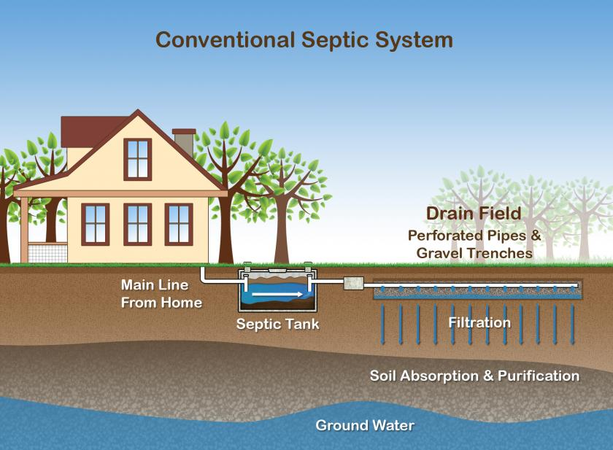
Basic Septic System
Notes:
Basic system

Slide 4
Basic Wastewater Considerations
  Community System or On-site (.1900 rules)
  Type of system - Permit
  Mechanical and monitoring records
  Check records for compliance
  Determine if there have been previous failures or repairs
  System Sizing
Notes:
If a new commercial built facility normally would go through plan review, which would include a septic system design by an authorized specialist based on use and projected flow rate.
A residential or home-based child care center may utilize an existing on-site system that an authorized agent will need to determine if it is adequate for the projected use. 15GAL/PERSON PROPOSED 15 gal/person open ≤ 12 hr shift Without Laundry - Add 1 gal/person/hr open for more than 12 hr shift hrs per day Add 5 gal/person with full kitchen Full Kitchen Meet Food Code. Warming Kitchen Does not meet Food Code.
If records are lacking you may be able to get a rough idea of the drain field size based on the size of the septic tank.
Tank should be pumped out prior to use and regularly once the child care center is operating.
What else should you do for a proposed child care center in an existing home / building
What about the water supply – is there a well or community system – is it in compliance. Has the water been tested for inorganic contaminates – i.e. lead, copper
Age of the dwelling – potential for lead based paint

Slide 5
Basic Considerations (cont.)
  What is the season
  Have there been any building additions, renovations or change of use
  When during the inspection, do you check the drain field area
  Are there any leaking faucets, hung toilets
  Centers located in basements
  If you are unsure consult with the on-site staff or regional specialist
Notes:
Systems Fail in wet months.
Additions could be over drainfield or system could not have been upsized.
Inspect at end. Don't want to track pathogens, cant fix during inspection.
Basements may need grinder pumps.
Watch for hung toilets – can easily flood out a system – kids putting things down the toilet.

Slide 6
Building Renovations and Change of Use
  Home to a residential child care home
  Does the center plan to increase enrollment
  What is on their menu
  Do other groups or organizations use the facility
Notes:
Increase in water flow and increased kitchen waste-Grease Trap
Remind people to check with zoning, the building inspector and fire inspector
Two shifts?
3 bedroom 360 15 x 24 = 360

Slide 7
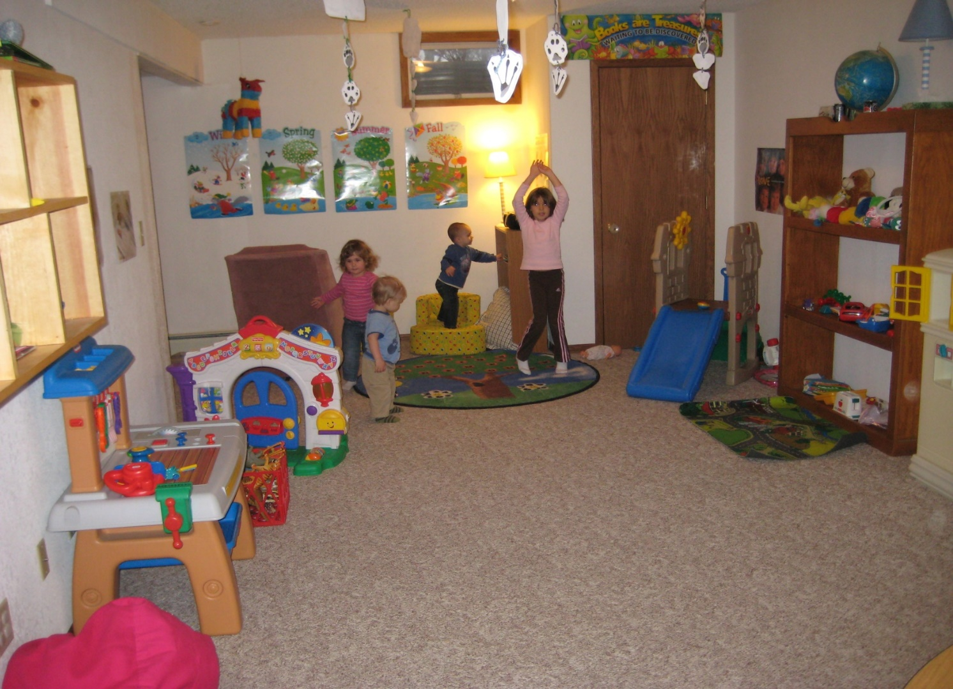
Child care center in a basement – any concerns?
Notes:
Many church-based centers are located in basements.
Mold, dampness, laundry room, poor ventilation, sump pump working, storm drain, wall-to-wall carpeting, check storage rooms for overhead sewer pipes etc…
Sewage Pump.

Slide 8
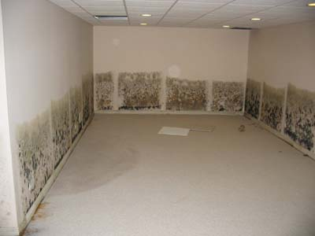
What is behind the paneling or carpet?
Notes:
Roof drains piped away from the building
Drainage away from the building foundation

Slide 9
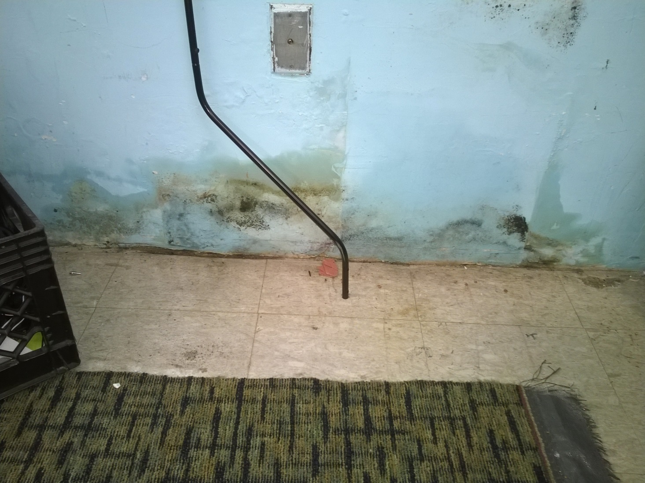
Masonry Wall – Black Mold

Slide 10
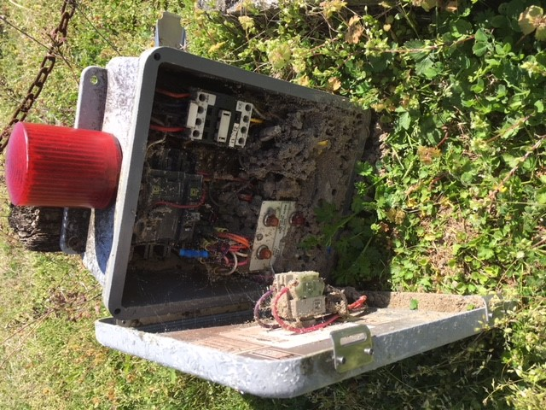
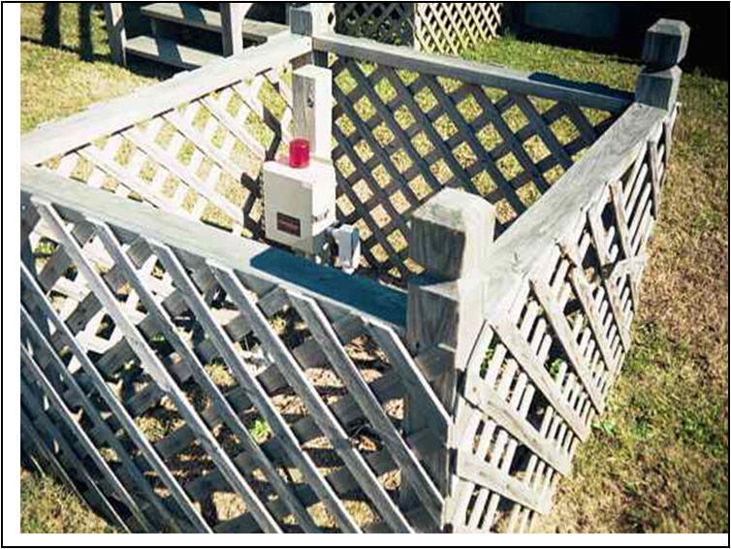
Septic System Controls
Pumps or other mechanical devices should be fenced off or inaccessible if located on the playground area.
Do you see a problem?
Notes:
.2832 Outdoor Learning Environment & Premises (a) last sentence (3rd sentence) reads: “Wells, grease traps, cisterns and utility equipment shall be made inaccessible to children.”
Wood CCA?

Slide 11
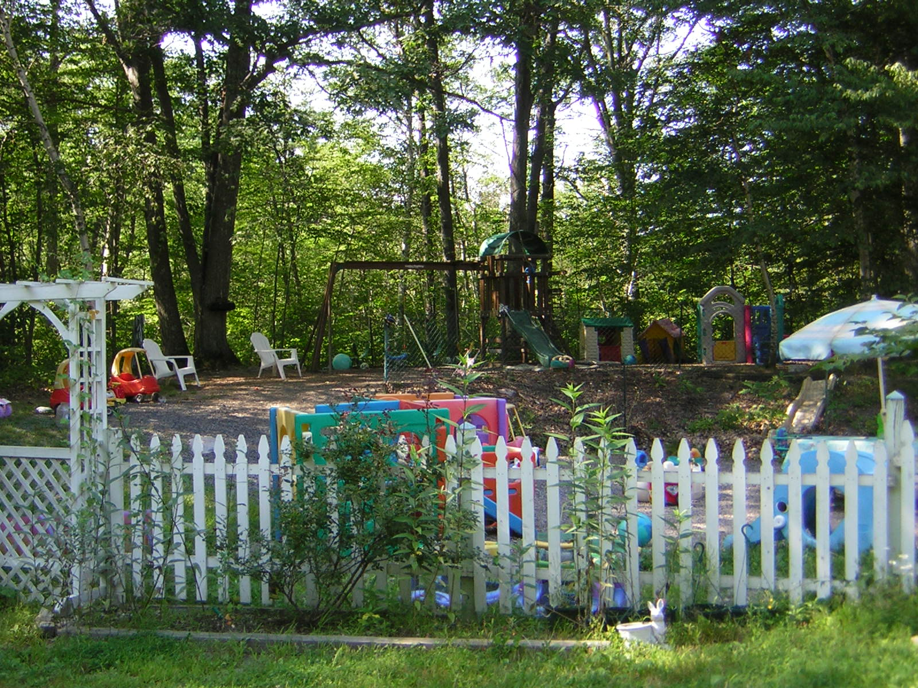
Exterior Play Structures
Do you have any concerns? What should you be looking for?
Notes:
Not ideal, but allowed.
DO not want kids on playground if not functioning properly.
Look at grading from drain field to playground.

Slide 12

Failure Near Outdoor Learning Environment
Notes:
A system failure may require moving/closing the playground.
Sewage hazard on the playground – what would you do? Close
How many demerits, classification? 6
How much time would you give the operator to repair the system – what if it was in the winter? Pump. Reasonable

Slide 13
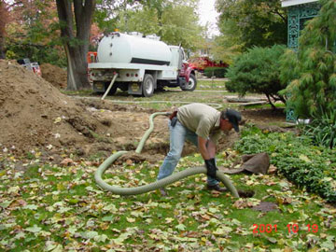
Temporary Control
Notes:
How much time would you give the operator to repair the system – what if it was in the winter? Pump. Reasonable
Pump

Slide 14
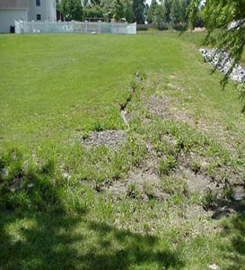
Look both in and around the play area
Notes:
Walk entire field .

Slide 15
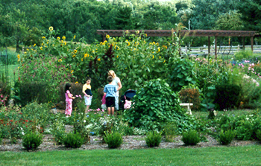
Gardens Over Septic Drainfields
Do you have any concerns? What should you be looking for?
Notes:
Gardening over the septic drain field is not a good idea.
Systems are being installed more shallow today than in previous years and are easily damaged by roots, cutting blades, cultivating etc…
Many plants have long aggressive root systems that can quickly clog the leach field.
Can lead to excessive nitrogen concentrations in the plants.

Slide 16
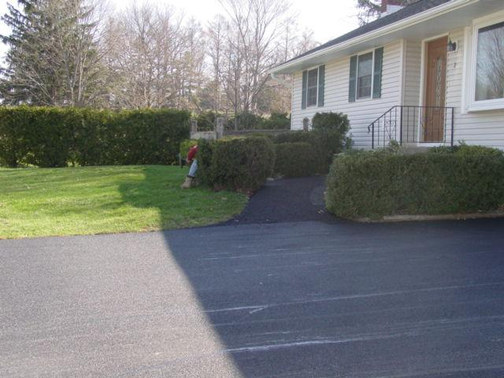
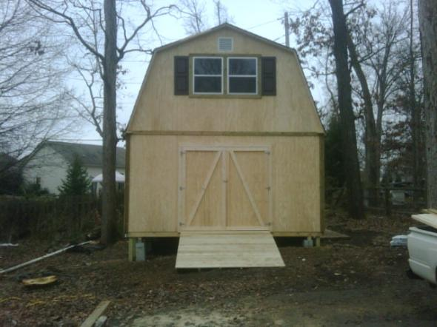
Buildings and Parking
Do you have any concerns?
Notes:
Know where to locate outbuildings and parking, especially as the center grows and needs additional parking and storage and playground areas.

Slide 17
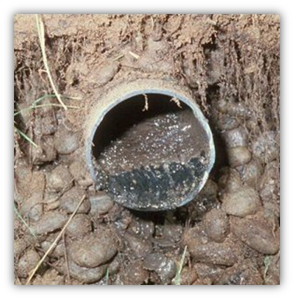
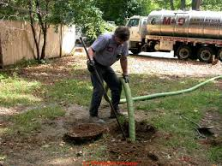
Septic Problems
Notes:
Clogged pipes, Result of not pumping
Or not installing grease trap if needed. Talk to center about menu and need for grease trap.

Slide 18
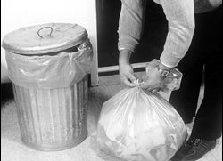
.2830 – plastic – lined, cleanable, covered containers
Solid Wastes
Remove food scraps and other waste materials daily
Notes:
Removed at least Daily to exterior 2 point #44
15A NCAC 18A .2830 SOLID WASTES
(a) In child care centers, food scraps and other putrescible materials shall be placed in a plastic-lined, cleanable,
covered container and removed to an exterior garbage area at least daily. Scrap paper, cardboard boxes and similar
items shall be stored in containers or designated areas.

Slide 19
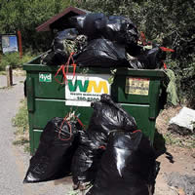
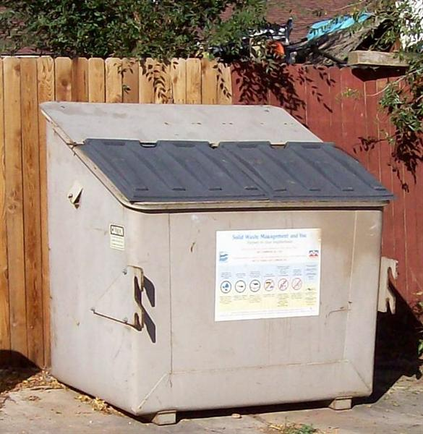
Exterior Garbage - .2830(c, d)
Notes:
(c) Dumpsters and other containerized systems shall be kept clean and covered.
(d) Solid wastes shall be disposed of to prevent conditions that attract and harbor pests and other public health nuisances.
http://www.deh.enr.state.nc.us/

Slide 20
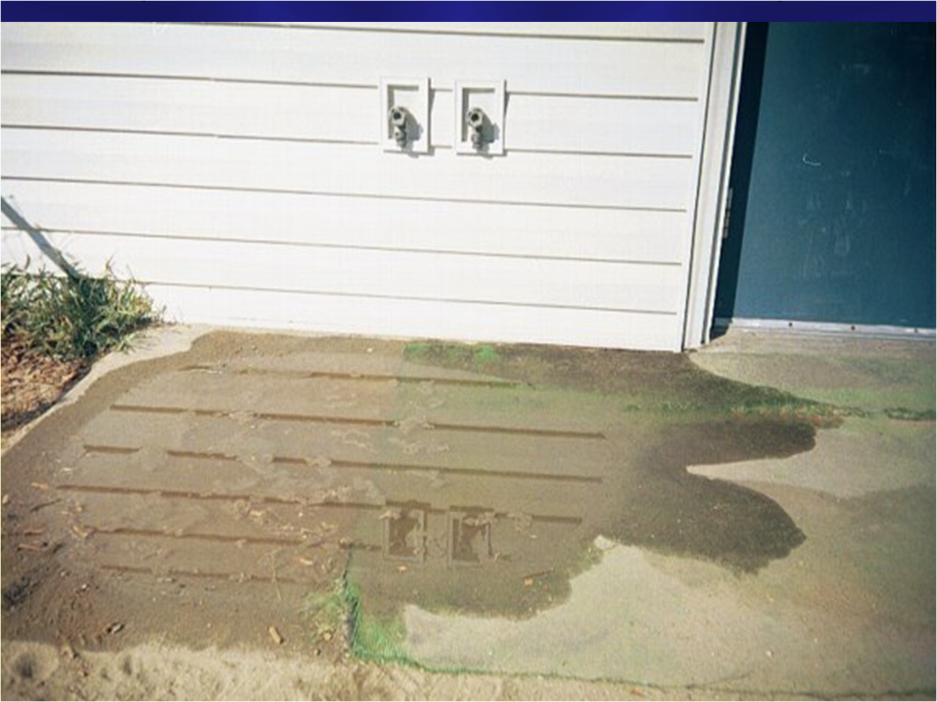
Can Wash Pad
Does this meet the requirements of .2830(b)?
Need to eliminate standing water – mosquito control
Back flow prevention on the faucets to prevent back siphonage.
Cleaning facilities (>13 children), threaded nozzle and water of at least 80 F –drained to an approved system.
Notes:
(b) Solid waste containers, mops, and other cleaning equipment shall be kept clean when not in use. Facilities shall be provided at the child care center for the washing and storage of solid waste containers and mops, except that such facilities shall not be required for child care centers licensed for fewer than 13 children and located in a residence. Washing facilities required under this Paragraph shall include a faucet with a threaded nozzle that delivers water of at least 80 degrees Fahrenheit. The faucet shall be located in either a designated utility sink or above a curbed impervious pad that is sloped to drain into a system that meets the requirements of Rule .2829 of this Section. Washing facilities used for solid waste containers that were installed at the child care center prior to July 1, 1991 shall be permitted to be used if the facilities are in good repair.
Watch for Burn Hazard.

Slide 21
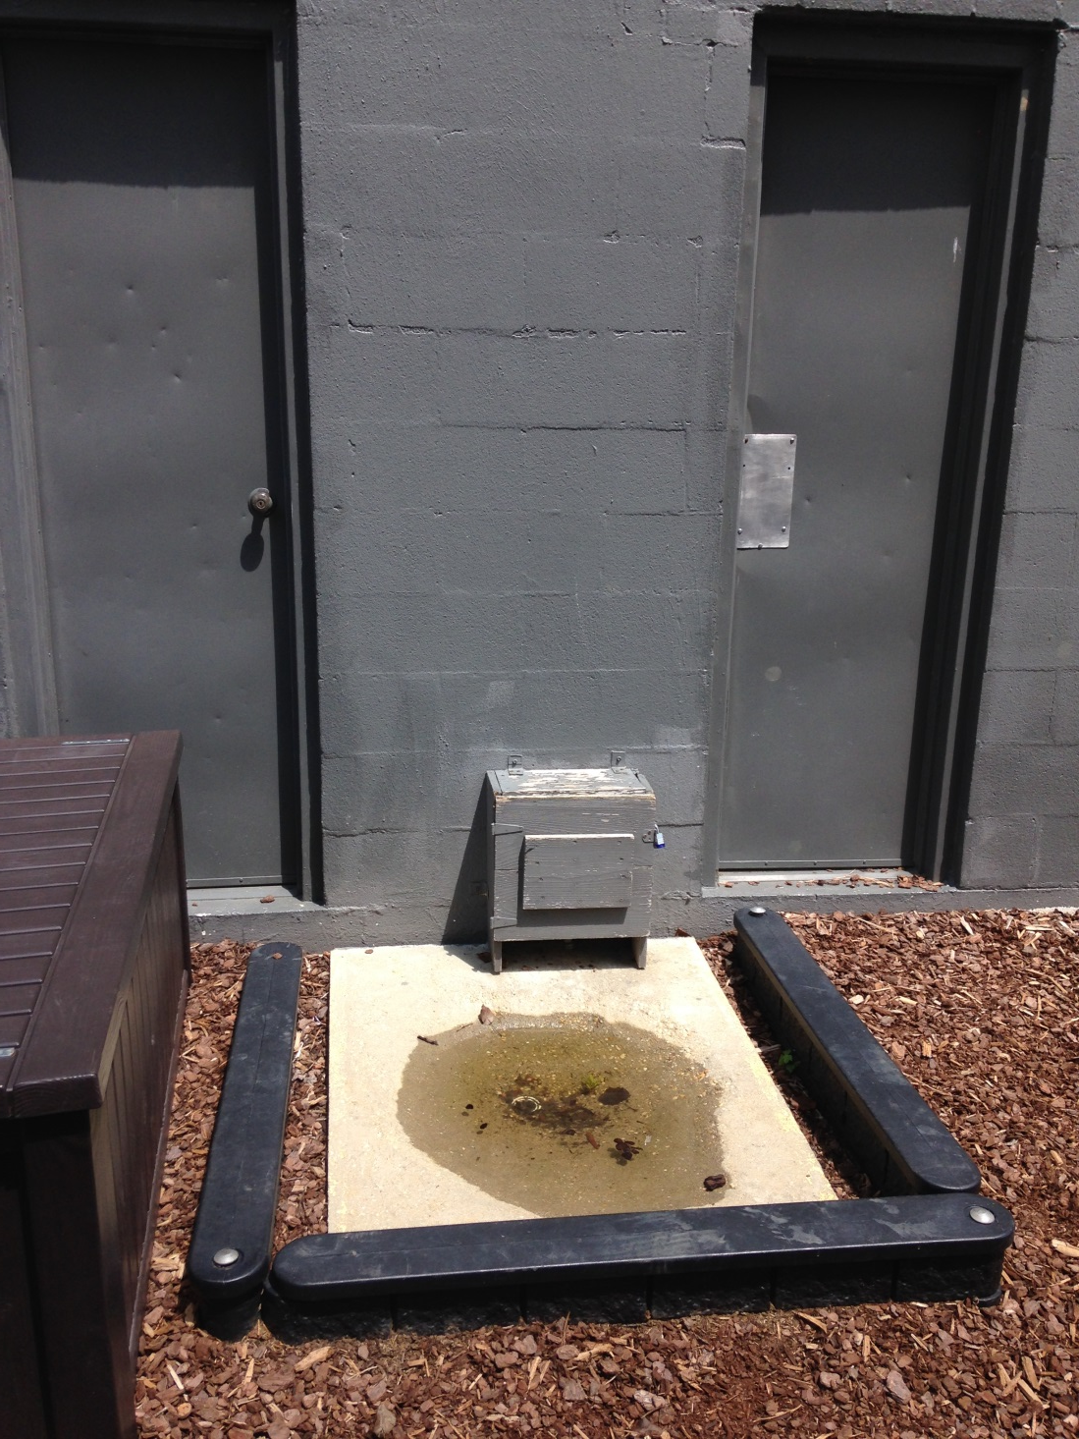
Notes:
Watch for Burn Hazard!!!!!!

Slide 22
END
Questions?

