Slide 1
About the NC Rated License Assessment Project

Slide 2
Today we will discuss:
An overview of NCRLAP and the assessment process
Information about the Environment Rating Scales
Common questions

Slide 3
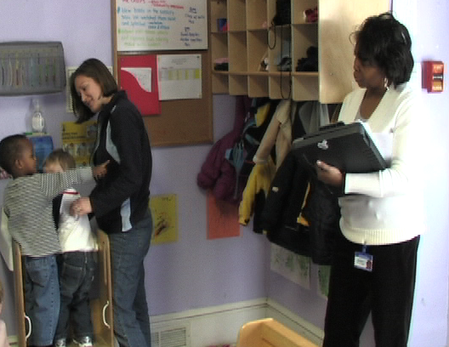
NCRLAP: Who we are
“The purpose of NCRLAP is to conduct assessments for child care centers and family child care homes attempting to earn a higher star rating in the NC star rated license system.”
Notes:
NCRLAP Began in 1999 to assess child care quality using the Environment Rating Scales and is a funded by a grant from the Division of Child Development and Early Education. The grant is based and managed at UNCG though most of our staff are located across the state and work out of home offices.
The assessment scores count as part of the program standards of the license; therefore, the assessment process is considered high stakes in North Carolina. This means that the assessment scores are used as part of our regulatory system
To achieve this goal of consistency, we have an extensive training and reliability system in place. Once an assessor is reliable, there is continued on-going training through our reliability system with frequent reliability checks

Slide 4
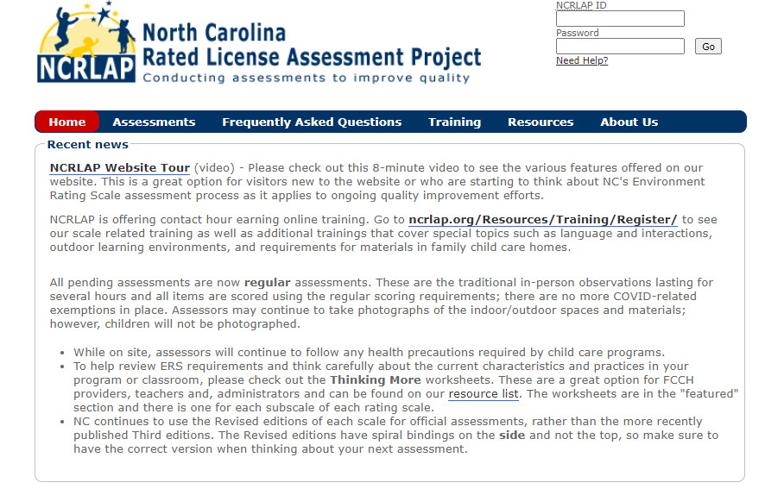
Website: ncrlap.org
Notes:
To help programs prepare for the assessment process and quality enhancement, our website provides much information and training resources about what to expect during the process and best practices for children. It is designed so programs can easily find resources about all age groups/scales and then can find resources specific to certain age groups and Rating Scales.
There are worksheets, videos, and activities.
We also have an online training calendar that shows NCRLAP training events across the state such as when we do sessions at local and state conferences as well as dates for weekly webinars. The webinars are held during naptime- 1:00 usually on Tuesdays and discuss the lowest scoring items and indicators.

Slide 5
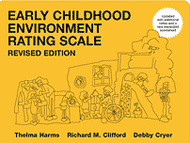
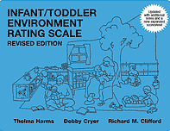
The Environment Rating Scales
ECERS-R – Preschool children 2½ through 5 years old
ITERS-R – Infants and toddlers from birth through 2½ years of age
SACERS-U – School age children 5 to 12 years old
FCCERS-R – Home child care programs for children ages birth-12 years
Notes:
In NC, the Environment Rating Scales are used to assess global quality which means that a variety of process and structural characteristics are considered – will discuss more in a minute
Each scale includes 32-39 items (good to have scale to show them that these are actual published books), each of which includes multiple indicators, there are hundreds of indicators in each scale. The scales are based on a 7 point scale (1=Inadequate. 3= Minimal or indicators that represent basic care for children- what keeps children and safe and healthy and these indicators usually align with Child Care and Sanitation rule requirements. 5 is the Good level children. If a program receives an overall score of 5, the quality level is considered developmentally appropriate – this is the “bar” for NC assessments. There is another level of quality- the (7) or excellent level. Programs do not have to illustrate these indicators to have a developmentally appropriate program, but these indicators are further enriching, further enhancing elements. To determine the overall final score – each item is scored and then all item scores are averaged. Therefore, many (literally 100’s) of indicators factor into each score – one item does not “make or break” a program’s star rated license – there are many important considerations related to child care quality.

Slide 6
NC Additional Notes
NC Additional Notes are found at our website:
ncrlap.org
Notes:
When an assessor conducts an observation, not only are the ERS used for the observation, but the assessor also uses the NC Additional Notes. These notes further clarify information in the scale that we have received many questions about either from our own staff, child care providers, or DCDEE.
Programs can and should access these notes on our website. It may be helpful for you to be aware that there are often questions about the additional notes used by assessors and this is because the author’s also post additional notes on their website that include some requirements or explanations that our staff do not use. Therefore, for NC assessments, the NC notes posted on our website are used – we do reference the author’s notes for 2 of the scales, but our notes should always be the starting point for licensure related assessments/questions.
A few quick examples of differences that we often receive questions about 1) the authors allow hand sanitizer to be used in lieu of actual handwashing BUT because our assessments occur as part of the NC child care license we still require actual handwashing, just as is specified in the sanitation rules. Hand sanitizer can only be used in limited situations (such as outdoors without running water, not freely accessible to children, etc.). Also, for NCRLAP assessments a solid barrier between cots/cribs is acceptable as is explained in the child care rules – you may hear a child care provider say that the rating scales don’t allow a barrier any longer, but that is because they are looking at the authors/ERSI notes rather than our – in these cases please refer them to our website and notes.

Slide 7
What does quality look like?
Notes:
Next, I want to talk more about the major areas of the child care environment considered by the ERS as well as some of the important considerations programs think about in these specific areas when planning for quality care. Keep in mind that child care environments are unique and can look very different while still providing quality care and meeting rating scale requirements.

Slide 8
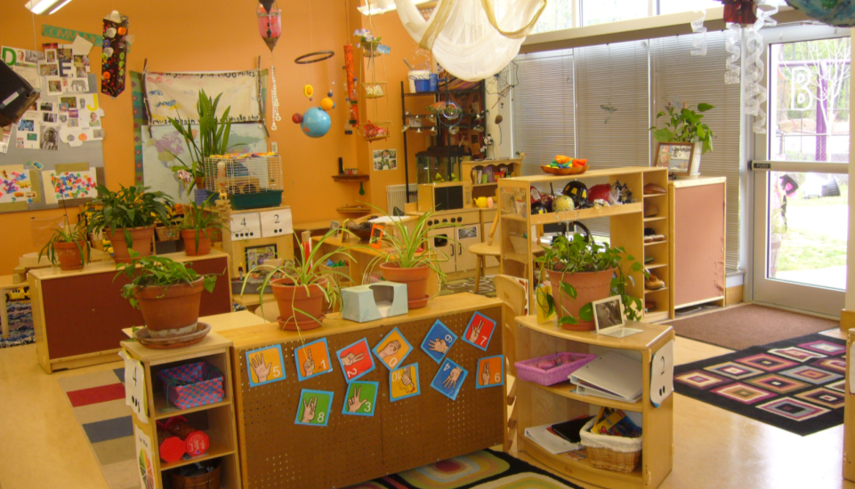
Indoor space
Furnishings and equipment used for routine care and play
Room arrangement
Display
Notes:
Amount and cleanliness of space, furnishings, room arrangement, visual supervision, types of play areas, presences of softness, display. Run though the names of items in this subscale, maybe a few quick descriptions/comments depending on time

Slide 9
Language and Interactions
Strategic questioning techniques
How, why, what if…?
Positive language and guidance
Appropriate interactions and modeling
Facilitation of play and learning
Notes:
Literacy development and content of language used. Run though the names of items in these two subscales, maybe a few quick descriptions/comments depending on time

Slide 10
Learning materials
Different activity areas in the classroom
Access to age-appropriate materials
Variety of options for play and learning throughout the day
Notes:
Types of materials; quantity and variety; amount of time. Run though the names of items in this subscales, maybe a few quick descriptions/comments depending on time

Slide 11
Program Structure
Daily schedule of events
Time for free play
Group experiences
Meeting needs of the group and individual children including children with disabilities
Notes:
Daily schedule, transitions, frequency of outdoor play weather permitting, balance of free play vs. group activities, small group, whole group, etc. provisions for children with disabilities. Run though the names of items in this subscales, maybe a few quick descriptions/comments depending on time

Slide 12
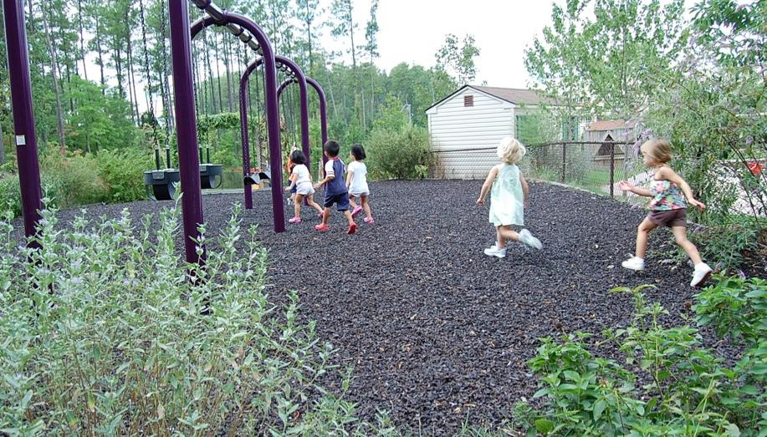
Gross Motor & Outdoor Space
Access to GM equipment
Appropriate, safe outdoor space
Supervision of GM activities
Notes:
Mention separately – relation to safety, characteristics of the outdoor space(s), types of materials, play opportunities, etc.
The ERS considers how children are supervised during GM time, much time children are scheduled for gross motor play and outdoor time and have access to appropriate gross motor equipment each day.
In recent years, several programs in NC are considering their outdoor spaces and are working to naturalize their outdoor areas mainly due to grass roots efforts by professionals in the field and support from the Natural Learning Initiative out of NC State..

Slide 13
Personal Care Routines
Health considerations
Sanitation
Safety
Notes:
Then – of most interest to this group are the safety, health and sanitation issues, routine care needs such as meals/snacks, toileting, and nap. Some of the content is similar or the same to what is found in the sanitation rules, but the rating scales also include different considerations and do not consider everything that is included in the sanitation rules. These differences at times may appear contradictory but really are not – simply that our different roles, look for different aspects leading to better and higher quality.
This subscale deals with health, sanitation, and safety of the children. The lowest scoring items/indicators are typically associated these items for the ITERS-R, ECERS-R, and FCCERS-R rating scales.
Over the last 14 years, since these items show up on the lower scoring list, we at NCRLAP have noticed that programs can become “hypersensitive” to handwashing and sanitation concerns. Give brief example of programs having children re-wash hands excessively while creating longer wait times and sometimes discipline/negative interaction issues.
We think a helpful reminder to teaching staff is the fact that for most indicators for health/sanitation, perfection is not required- 75% in many cases or a few lapses are allowed. The scale allows for a few misses.

Slide 14
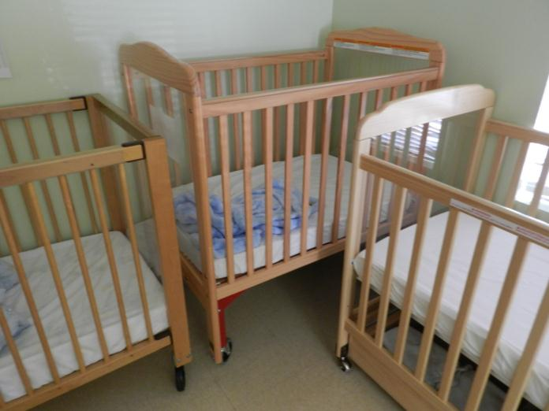
Some issues are quick fixes some are not
Solid barrier is OK
Solid barrier is okay
L-shape spacing
Is this 3 feet apart?
No
Notes:
This is an example of a slide we show during provider trainings and an issue that is addressed in another one of our website resources: When a self-assessment or mock assessment completed by a TA agency shows areas needing improvement, some issues will be quick fixes. This image shows a common issue with crib placement. The scale requirement for nap/rest is 3 feet apart or separated by a solid barrier. The two on the left are fine because they are separated by a solid barrier. When programs use an L-shape arrangement, they often place the cribs too close together. The slats allow for air flow- it’s not a complete solid barrier and the cribs are not 3 feet apart. So, with some room rearranging, the crib on the right can move down and be appropriately space- quick fix! However, for other classrooms due to limited space for routine care and play areas, this may be the only option for the number of children enrolled. Moving the crib down could negatively impact the infant’s play area.
For administrators, issues such as this are important to discuss with staff. Talking with teachers ahead of time can make them aware that if this arrangement remains the same, this item will score lower on the scale. It’s an issue in the environment- not a personal reflection of the teacher. (May want to mention that in this room there was another evacuation crib close to the door – the one in the corner is not the only one!)
Understanding these programmatic level decisions through the lens of the assessment process can help prepare teachers for the reading the report later. It can help each staff member sort the item/indicator scores regarding what is within the teacher’s control, within the administration’s control- responsibility, and the issues that are not likely going to improve or change quickly such as the size of a room (without renovation) or dropping the group size (without budget considerations).
Some similar environment issues can be steps to access the center or playground, round door knobs, l-shaped room, furnishings that are not appropriately sized for most of the children, etc.
With that said, it is also important for staff members to under that there is no perfect environment and some items will score lower but if many items score well because there are positive interactions, children can use a variety of appropriate materials throughout the day, a program can still receive a good overall average score of 5 or better.

Slide 15
A closer look
The ERS and Sanitation Rules
Differences in requirements are common, but actual conflicts are not.
Common questions
Hand sanitizer vs. handwashing
Diaper changing process
Cot/mat/crib separation
Table cleaning/sanitizing
Notes:
Run through bullets
Quickly reinforce – as already mentioned handwashing is still a requirement – that is a note posted at author’s website NOT used by NCRLAP, we line up with sanitation (15 seconds is fine)
NCRLAP Uses the diaper change poster, unaware of any differences
Nap – does require 3 feet separation or solid barrier– this is an example of a higher standard in the ERS since 18 inches or a solid barrier is required in the sanitation rules. For NCRLAP solid barriers are fine as long as extend the entire length of exposed sleep surface and do not allow air to pass through. Crib ends (solid) are fine for NCRLAP – another author note not applied by us as mentioned earlier
The scales require cleaning/sanitizing of tables – another additional ERS requirement – do not test sanitizer simply look for it to sit for 2 min.
Also likely to get a bunch of sanitizer questions – we rely on them to tell us what is approved – ask if new memo about Chloroglass/A to B/DBK (all same product) being OK has been sent please – if so we’d like a copy. Explain we do not use test strips, etc. but if unfamiliar with product will ask program for the MSDS sheet or EHS documentation that it is OK

Slide 16
Helping programs implement good practices daily
Understanding the “why”
Using the tools as a method to increase knowledge of best practice vs. passing the test
View the assessment and licensing process as more of an instructional tool and less of a “high stakes test”
Let’s work together to guide programs toward better practice, not as “an event” that happens to them
Notes:
We all have the shared hope that programs will perceive licensing and beyond that the assessment process as a pathway for program enhancement and sustained quality by focusing in on what is good for children and implementing best practices each day.
As one of you said, “understanding the why” for the Rating Scale requirements. Why is item X, indicator 5.2 an indicator of quality of best practices? Why is this good for children’s development. When programs understand this, I think they are more likely motivated to actually do it.
I think we all agree that when programs use the process as a self-study- a time for them to focus on program strengths/weakness, make decisions about what changes they may need to make, take the time to brainstorm, implement, and evaluate the changes, the assessment process can be viewed as a time for verification. The assessors use the assessment tool to objectively evaluate program quality. From there, the program views the results and considers if they did meet the desired goal or if there is more work to be done.
Of course, the system does have some accountability or “teeth” so to speak. The higher the star rating, the more money a program can receive for reimbursement rates or potentially charge more for tuition fees. Even though there are some concrete desired scores or outcomes, if we continue (NCRLAP and the TA Specialists) frame this process as a means for program enhancement, perhaps we can help directors, teachers, and home providers view the process less as a “test” for one day.

Slide 17
When it all comes together
Children have much time for play, interactions and learning throughout the day because safe and healthy practices occur seamlessly and efficiently.
Notes:
It’s a good thing for children and our communities – the work we all complete and our different roles are important in reaching this goal

Slide 18
Website: www.ncrlap.org

Slide 19
Contact information:. 1-866-362-7527 www.ncrlap.org ncrlap@uncg.edu
NC Rated License Assessment Project

Slide 20
References
Harms, T., Clifford, R., & Cryer, D. (2005). Early childhood
environment rating scale. (Revised edition). New York, NY: Teachers
College Press.
Harms, T.; Clifford, R.; & Cryer, D. (2006). Infant/toddler
environment rating scale. (Revised edition). New York, NY: Teachers
College Press.
Harms, T.; Clifford, R.; & Cryer, D. (2007). Family child care
environment rating scale. (Revised edition) New York, NY: Teachers
College Press.
Harms, T.; Jacobs, E.; & White, D. (1996). School-age care
environment rating scale. New York, NY: Teachers College Press.

