Slide 1
Communicable Disease Prevention and Outbreak Investigation
W. David Brown, R.S., M.P.A.
Surveillance Coordinator
Children’s Environmental Health Program

Slide 2
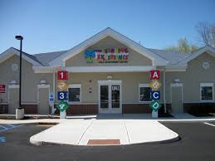
4,607 licensed child care centers
246,622 children enrolled in licensed
child care centers
https://ncchildcare.ncdhhs.gov/County/Child-Care-Snapshot
Source, Division of Child Development and Early Education Monthly Statistical Summary Report - May 2017 Number of Children Served Receiving Subsidy - 63,509

Slide 3
Working Parents
In most families with children at home, the majority of mothers work outside the home. Among married couple families, two-thirds of mothers are employed (67.3 percent)
https://www.americanprogress.org
Sixty percent of the children
of moms working outside the
home receive care in a setting
other than their home.
Notes:
Includes single parent households. Communicable Diseases are illnesses caused by microorganisms and transmitted from an infected person or animal to another person or animal. Some diseases are passed on by direct or indirect contact with infected persons or with their excretions. Most diseases are spread through contact or close proximity because the bacteria or viruses are airborne;

Slide 4
In most families, every adult works. When a child stays home sick someone must stay home to provide care—and this person is usually a mother, a wife, or an adult daughter.
https://www.caregiver.org/caregiver-statistics-demographics

Slide 5
Impact and Cost of Illness
Child illness accounts for 40 per cent of parental absenteeism from work.
Children in child care are 30 percent more likely to contract a diarrheal illnesses than children cared for at home.
Children in child care centers were 4.5 times more likely to be hospitalized than children in other settings.
Parents of children in child care centers miss an average of 1 to 4 weeks of work each year to care for their sick children.
Employee workdays lost to illness cost US businesses between $2 - $12 billion/yr.
WHAT YOU DO MAKES A DIFFERENCE!
Illness associated with child day care: a study of incidence and cost.
D M Bell, D W Gleiber, A A Mercer, R Phifer, R H Guinter, A J Cohen, E U Epstein and M Narayanan.
Department of Pediatrics, Memphis State University.
http://www.ajph.org/cgi/content/abstract/79/4/479?ck=nck
Notes:
The costs of illnesses costs businesses between $2-$12 billion per year due to work days missed
Parents of children in child care centers miss an average of 1 to 4 weeks of work each year to care for their sick children

Slide 6
CHILD ILLNESS
What is the most common childhood surgery performed under general anesthesia?
The child’s average age for this procedure is one to three years.
More than a million are performed in North America each year.
Notes:
ear tube surgeries (myringotomy)

Slide 7
Ear tubes - tiny, hollow tubes, usually made of plastic or metal, that are surgically inserted into the eardrum creating an airway that ventilates the middle ear and prevents the accumulation of fluids behind the eardrum.
Doctors frequently recommend ear tubes if a child gets frequent ear infections or if the condition affects hearing and speech.
In children without tubes, ear infections are often treated with antibiotics by mouth or by injection. In children with tubes, the infection can drain out the tube and it can usually be treated with antibiotic eardrops.
In most children, ear tubes last somewhere between six months and two years before the body naturally pushes the tubes out and into the ear canal.

Slide 8
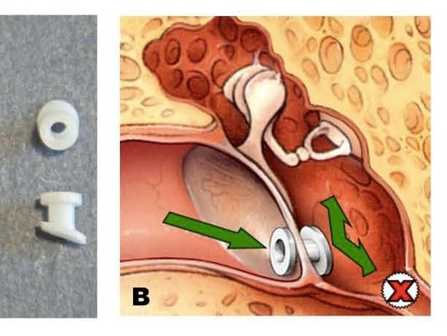
Seven percent of children in the U.S. receive a set of tubes by age three.

Slide 9
Risk Factors of Illness
Crowded conditions and close contact
Poor personal hygiene
Limited immunity
Mobility of teachers and students
Poor classroom design and layout
Illness associated with child day care: a study of incidence and cost. D M Bell, D W Gleiber, A A Mercer, R Phifer, R H Guinter, A J Cohen, E U Epstein and M Narayanan.

Slide 10
Risk Factors continued
Inadequate infection control
Understaffing
Staff turnover averages 40%
Average salary for a preschool teacher in NC is $13.66
https://www.ziprecruiter.com/Salaries/PRE-K-Teacher-Salary--in-North-Carolina
Lack of Training
Animals and pets
Poor center design and layout
Notes:
Pets in child care centers can spread disease. For example box turtles, chickens, iguanas, snakes. Petting zoos and other animals
The average annual turnover in childcare facilities is about 40 percent.
No national standards exist and wide variation between States
http://profiles.nlm.nih.gov/ps/access/NNBCTV.pdf

Slide 11
Modes of Transmission
Fecal-Oral
Blood
Food and drinking water
Surfaces
Animal to human
Airborne
Notes:
.2822 mouthable toys

Slide 12
Strategies to Reduce Communicable Disease
Use approved methods of cleaning and disinfecting.
Consult your HVAC technician to increase fresh air circulation.
When possible, move educational activities outdoors.
Use an EPA registered disinfectant and follow the required contact times.
Correctly wear and use gloves.
Immunizations.

Slide 13
Prevention Measures
Hand washing .2803
Communicable Diseases and Conditions .2827
Sick child policy
Toy Cleaning .2822
Sink/Toilet/Counter Sanitation .2817, .2818
Diapering Area Disinfection .2819
Proper Food Handling .2806, .2807, 2808
Separate Storage for Clothes .2820

Slide 14
Control Measures
The spread of infection in child care is reduced if all staff, students and visitors adhere to basic hygiene measures.
Sick policies
Proper hand washing
Proper wound management
Follow NC child care
rules, policies and Executive Orders
TRAINING-TRAINING-TRAINING
Notes:
Pre-covid

Slide 15
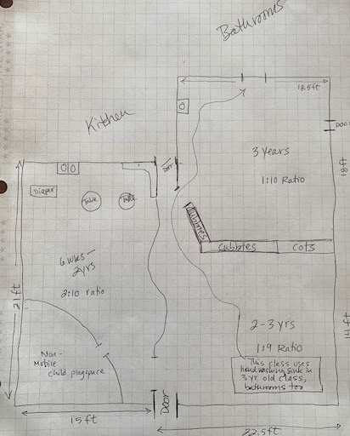
Does this meet the requirements of .2802?

Slide 16
Transmission of COVID-19:
COVID-19 is spread by respiratory droplets released when people talk, cough, or sneeze.
The virus may also spread to hands from a contaminated surface and then to the nose or mouth, causing infection.
“…Personal prevention practices (such as handwashing and staying home when sick) and environmental cleaning and disinfection are important principles......to help lower the risk of COVID-19 exposure and spread in child care settings.”

Slide 17
COVID Cluster in childcare center
If you receive a report of a COVID cluster in a child care or school setting notify Veronica Bryant the Emergency Preparedness and Outbreak Coordinator for DPH and your communicable disease nurse.
Veronica Bryant, REHS
Mobile: 919-218-6943
Veronica.bryabt@dhhs.nc.gov
5605 Six Forks Road
1632 Mail Service Center
Raleigh, NC, 27699-1632
Emergency Preparedness and Outbreak Coordinator
Division of Public Health, Environmental Health Section
North Carolina Department of Health and Human Services

Slide 18
Communicable Disease Toolkit - Identifying and Preventing the Spread of Illness in Early Care
https://healthychildcare.unc.edu/resources/communicable-disease-resources/communicable-disease-toolkit-for-early-care-and-education-programs/
Child care programs should notify the parents or guardians of potentially exposed children for any communicable disease.
If you receive a report of a COVID cluster in a child care or school setting please notify your Communicable Disease Nurse and Veronica Bryant* the Emergency Preparedness and Outbreak Coordinator.
Practice and recommend layered protection strategies.
*Veronica Bryant, REHS
Mobile: 919-218-6943
Veronica.bryabt@dhhs.nc.gov
1632 Mail Service Center
Raleigh, NC, 27699-1632
Emergency Preparedness and Outbreak Coordinator
North Carolina Department of Health and Human Services

Slide 19
What is a COVID Cluster ?
In a child care or school setting, a COVID-19 cluster is defined as a minimum of five positive cases identified through a positive molecular (PCR) or positive antigen test result with illness onsets or initial positive results within a 14-day period and plausible epidemiologic linkage between cases.

Slide 20
During a Communicable Disease Outbreak Modified Play Activities
Water play in individual buckets, and sensory play (such as rice, beans, or playdough activities) using individually labelled supplies, and outdoor sand play is acceptable if social distancing measures can be maintained.
Outdoor water play using sprinklers is considered similar to playground usage and is allowed. However, water for outdoor play cannot be collected or recirculated and must drain quickly to avoid puddling.

Slide 21
hand hygiene stations
Set up at the entrance of the facility, so that people can clean their hands before they enter. If a sink with soap and water is not available, provide hand sanitizer with at least 60 percent alcohol. Keep hand sanitizer out of children’s reach and supervise use.

Slide 22
Wall-mounted hand sanitizer dispensers located in corridors, maximum volume of 41 oz

Slide 23
Know Your Chemicals

Slide 24
List N: Disinfectants for Coronavirus (COVID-19) Click here to find a product to kill COVID-19

Slide 25
Highlighted Recommended Actions
Social distancing
Restrict teachers to one classroom
Waiting areas 6’ space markings
Keep children together in their assigned room
Limit mixing of children
Nap time space increase spacing and place children head to toe
Increase outdoor learning

Slide 27
Required vs. Recommended in North Carolina
All children in North Carolina are required to be vaccinated against:
Diphtheria
Hepatitis B
Hib Disease
Measles
Meningococcal
Mumps
Pertussis (whooping cough)
Pneumococcal
Polio
Rubella
Tetanus
Varicella (chickenpox)
The CDC also recommends children be vaccinated against the following diseases, although immunization against these diseases is not required for children in North Carolina:
Hepatitis A
Influenza
Rotavirus
Human Papillomavirus
Proof of required immunizations and health assessments are required within 30 days of the first date of attendance at school. After 30 days, children are generally excluded from school until documentation is provided.

Slide 28
Lice are usually spread from child to child when sharing clothing, hats, scarves, combs, brushes, or helmets that have strands of hair with nits. Lice can also be passed when playing contact sports. People of all ages and races can get lice. The adult female louse lays seven to ten eggs per day near the scalp. Head lice cannot jump or fly, but they can crawl,
Head lice survive less than one or two days if they fall off the scalp and cannot feed. Head lice eggs (nits) cannot hatch and usually die within a week if they do not remain under ideal conditions of heat and humidity similar to those found close to the human scalp.
Items that may be contaminated by an infested person and that cannot be laundered or dry-cleaned should be sealed in plastic bag and stored for 2 weeks to kill any lice that already are present or that might hatch from any nits that may be present on the items.

Slide 29
Animals and Pets

Slide 30
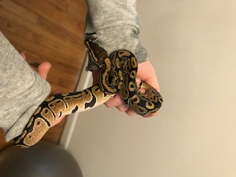
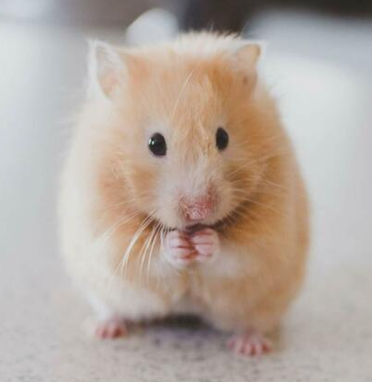
PETS
Scientists estimate that more than 6 out of every 10 known infectious diseases in people can be spread from animals, and 3 out of every 4 new or emerging infectious diseases in people come from animals.

Slide 32
Notes:
.28319 (J)
Pets kept outdoors shall be in a designated area that is maintained and separate from the outdoor area used by the children.

Slide 33
Hope Valley Preschool - Pet Education Program

Slide 34
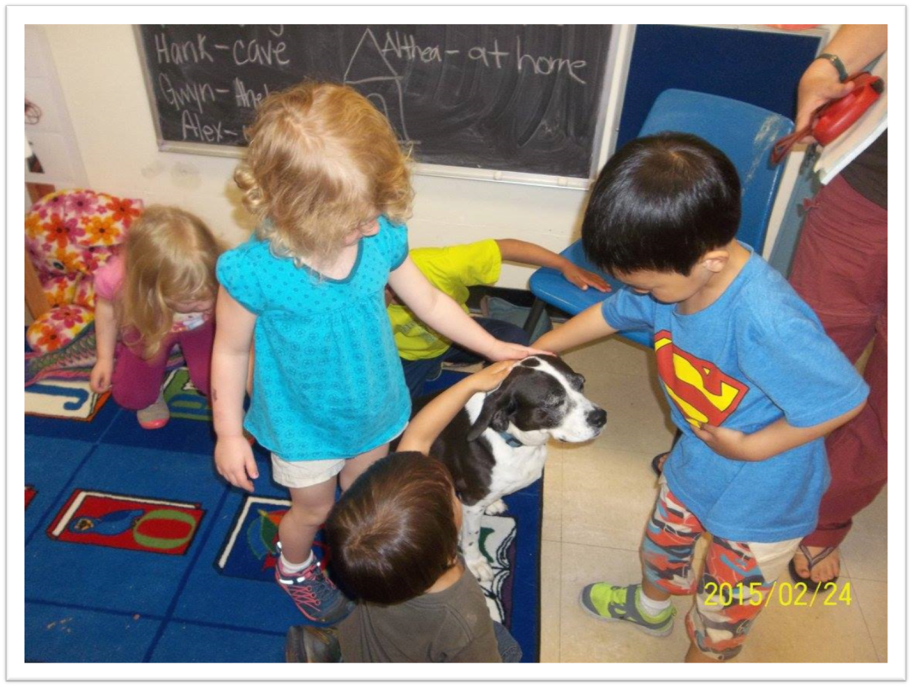

Slide 35
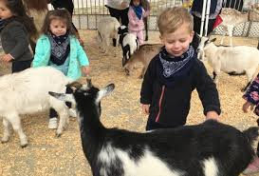
2004 State Fair

Slide 36
State faces E. coli lawsuit
Posted on Tuesday, Aug. 02, 2011 - By JANE STANCILL
North Carolina failed to properly warn the public and reduce the health risks associated with a petting zoo at the 2004 State Fair, say attorneys representing 14 children who became ill after exposure to E. coli bacteria from animal feces.
Opening arguments began Monday in a case brought by families who say they were unaware of the risks of allowing their children into a petting zoo with farm animals…An outbreak of E. coli illnesses was traced to the Crossroads Petting Zoo at the fair in 2004. In all, 108 children reportedly suffered serious diarrhea, and 15 of those came down with kidney failure a life-threatening complication that occurs in about 10 percent of those infected with E. coli O157:H7, a strain of the bacteria that was apparently transmitted from feces of goats and sheep at the petting zoo. Young children are especially at risk of developing the illness.

Slide 37
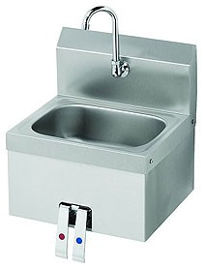
Lavatories – is hand washing easy? - conveniently located?

Slide 38
2017

Slide 39
2018 NC State Fair

Slide 40
2021
NC State Fair

Slide 41
Wegman’s 3 in 1 Lavatory

Slide 42
Jesus and Germs

Slide 43
Hand Washing
Tempered water (80 – 110 F), soap, and disposable towels
Demonstrate proper hand washing
Don’t assume staff know how.

Slide 44
Diapering Procedures - .2819
Diapering procedures posted/followed?
Is the caregiver washing their hands and the child’s hands?
Are gloves being used properly?
Cloth diapers
Are diapers being placed in a plastic-lined, covered container?

Slide 45
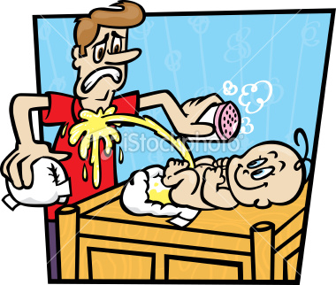
Diapering Procedures
Is the diapering surface smooth, nonabsorbent, & easily cleanable?
Is a solution of soap and water used prior to disinfecting?

Slide 46
Diapering and Toileting
Is the disinfectant concentration adequate? - 500 – 800 ppm Cl or EPA registered - .2801 (7)
Proper contact time – bleach solution 2 minutes other products are longer
Are toilets cleaned and disinfected?
Adequate amounts of toilet paper?
Are the children properly supervised?

Slide 47
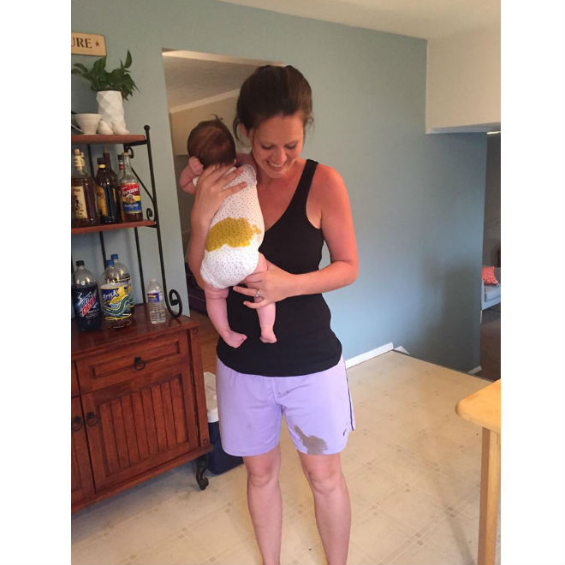
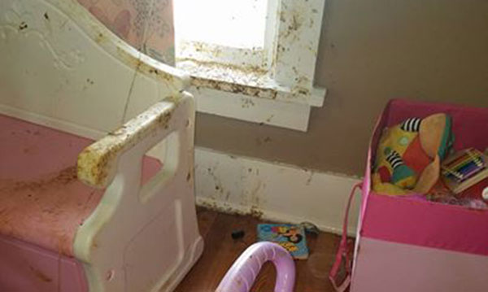
The BLOWOUT

Slide 48
Vomit and Diarrhea Clean-up Plan aka “the blowout plan”

Slide 50
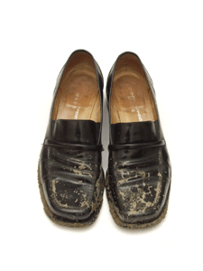
Mouth Contact Surfaces
Are sanitizing procedures being followed? - .2822
Are toys easily cleanable?
Discourage sharing of personal articles or toys
Floor surfaces – what about your shoes?
Notes:
Hard plastic toys may be washed and rinsed in a dishwasher and
cloth toys may be laundered and mechanically dried without requiring sanitizing.

Slide 51
Fecal Contamination
Most important sources of contamination:
Hands, toys, sinks, and faucets
High levels of fecal coliforms are more likely to occur on sinks and faucets than on other classroom surfaces (that is why a separate hand sink is required for food preparation).
Laborde et al., 1995

Slide 52
Fecal Contamination
Infant classrooms are more often contaminated than classrooms for toddlers.
Greater levels of contamination on staff member’s hands in classrooms for infants.
Laborde et al., 1995

Slide 53
Reducing fecal contamination
Wear disposable gloves
Hand sanitizers in addition to proper hand washing
Frequent disinfection of sinks and sanitizing of toys throughout the day.
Knee- or foot pedal-controlled sinks
All diapering activities conducted by one individual per room (best practice).
Laborde et al., 1995

Slide 54
Food Protection
The odds of children getting diarrhea in a center where the food preparer changed diapers is 18 times greater compared to centers where the food preparer did not change diapers
Best Practice, staff who prepare or serve food should not change diapers and staff who change diapers should not prepare food.
Wash raw fruits and vegetables
Temperatures maintained
Mohle-Boetani et al., 1995).

Slide 55
If an Outbreak Occurs – what do you do?
Contacting, Visiting, Inspecting
Monitoring
Testing, Exclusion, and Cohorting
Informing and Educating
Child Care facility directors and school principals must report communicable diseases (G.S. 130A-136)

Slide 56
Problems with Controlling Outbreaks in Child Care Centers
When do communicable disease outbreaks occur?
Ease of person-to-person transmission among young children
High secondary attack rates
as high as 40 percent for shigellosis
Extended duration of outbreaks
Notes:
Note the same is true in elder care facilities – norovirus outbreak in assisted care facility difficulty with stopping the outbreak – best to prevent

Slide 57
Who to Contact
EPI team leader
Environmental Health Supervisor
Regional Environmental Health Specialist
Division of Child Development
Communicable Disease Control Nurse
Laboratory Personnel
Other State Personnel (e.g., Communicable Disease Control Section)
Local pediatricians and hospital

Slide 58
Containing Cases
EPI Team
Visit the center and
conduct interviews
gather information – standard questionnaires
keep your PIO informed
In addition, visit and/or inform child care centers and child care homes in the immediate outbreak area

Slide 59
Online Resources
CDC OutbreakNet Team - national surveillance on foodborne infections
http://www.cdc.gov/foodborneoutbreaks/
FOCUS on Field Epidemiology, UNC-SPH
www.sph.unc.edu/nccphp

