Slide 1

Responding to Inquiries About Dampness and Mold Growth
David Lipton CIH
Occupational and Environmental Epidemiology
NC Division of Public Health

Slide 2
Purpose
Provide information and guidance to address inquiries about dampness, mold and indoor environmental quality in schools
Principles of Healthy Buildings
Keep buildings
Dry
Clean
Well ventilated
Properly maintained
In good repair
Pest free
Contaminant
Safe
Indoor environmental quality is influenced by:
Design
Construction
Operations
Maintenance
Activities
Interactions with people at every level

Slide 3
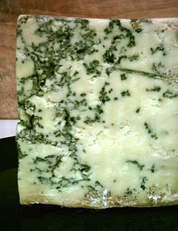
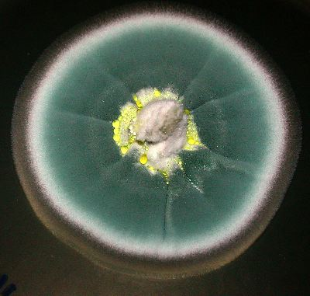
What are molds?
Kingdom of Fungi
Yeasts, mildews, and mushrooms
Decay organisms that require external food sources
Fungi -- one of many constituents of the indoor microbiome
Named by Genus and species
Ubiquitous -- more than 100,000 species worldwide
Several hundred species may be human pathogens
About 50 species typically colonize indoor environments
Penicillium roqueforti
Penicillium chrysogenum
Notes:
Also known as saprophytes
Environmental fungi, bacteria, and virus can also be found in air indoors

Slide 4
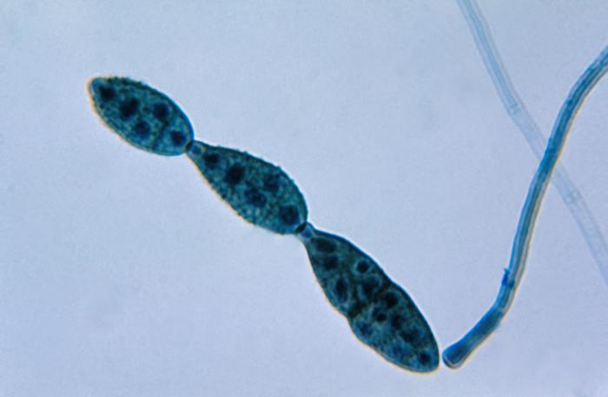
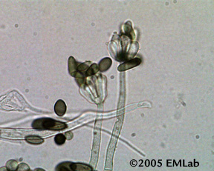
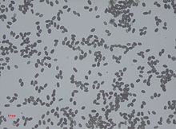
What is mold growth?
Spores --Reproductive structures
Mold Products
Hyphae vegetative growth structures
Hyphae release enzymes and other substances that decay surfaces molds are growing on (substrates)
Hyphae break off/break apart, and fragments accumulate in dusts
Hyphal fragments contain allergens, irritants and other substances
Metabolic waste products
Moldy odors-volatile organic compounds
Secondary Metabolites
Mycotoxins under some conditions
Alternaria species
Stacybotrys species
Notes:
Spores are Reproductive structures –invisible to naked eye
Adapted for dispersal and survival in the environment
Some mold spores are always present in outdoor air
Spores indoors cannot be completely and permanently eliminated -- Brought in by air movement and tracked indoors on people, animals or inanimate objects
Dispersed from indoor growth as part of reproductive cycle
Mold spores repeatedly settle on surfaces and become resuspended in air
Spores may be removed from indoor environments
Air movement waft in and waft out
Cleaning ---environmental management process of identifying, collecting, removing and safely disposing of contaminants leaving minimal residues of contaminants, cleaning agents and moisture
Air filtration general filtration and sometimes portable air cleaners
Presence of “toxigenic” mold does not mean mycotoxins are present
Fungi produce many useful products like Bread, Cheese, Antibiotics, Citric Acid

Slide 5
Environmental conditions that promote mold growth
Presence of viable mold spores
Food sources—any organic materials or organic matter
Building materials and contents --gypsum board, ceiling tiles, wallpaper, wood products, paints, glues, textiles
Organic matter: dirt, dust, dead skin cells, biofilms and oily residues on inorganic surfaces or materials (concrete, fiberglass, metal and plastic)
Temperature--optimum temperature range for many common indoor
molds is 68°F- 86°F
Adequate amount of water – free, lightly bound available for chemical reactions or uptake by microorganisms
Persistent – time scale on days to weeks, abnormal, outside of design conditions
Dust mites, other environmental bacteria, insects and other pests are associated with damp environments
Notes:
For EHS with experience in food we talk about Water Activity or Available Water

Slide 6
Thermal Environmental Conditions for Comfort
Thermal comfort is a balance heat generated by a person and gains/loses to environment
Narrow band
  Summer 74-80°F and 30-60% relative humidity
  Winter 65-76°F and 30-60% relative humidity
Assume light sedentary activity with appropriate clothing for the season
Does not account for heat sinks, radiant sources or air drafts
Comfort is subjective and variable- ideal comfort criteria satisfy 80% of people in the space
American Society of Heating Refrigeration and Air-Conditioning Engineers (ASHRAE) Standard 55

Slide 7

Moisture Balance in Air and Materials
WETTING
1. Liquid water rain, or floods, splashes, drips, and gravity
Absorbed or adsorbed into materials
2. Water vapor in air
Convection (air leaks)
Diffusion
Condensation
Built-in or stored
Ground
Gravity
Diffusion
Plumbing leaks
People
DRYING
Drainage
liquid water drains away
2. Surface evaporation
Adsorbed or absorbed water moves to surfaces and evaporates away
3. Indoor/outdoor air
Convection (air leaks)
Diffusion
4. Convection/Intentional
Exhaust ventilation
Dehumidification
Heating and cooling
Notes:
Can be generally of at specific locations, building assemblies and materials

Slide 8
Phases of water, sources, storage, wetting & drying
Phase
Liquid
Liquid & vapor
Vapor
Liquid & vapor
Sources
Precipitation & Plumbing
Surface water
& Ground water
Activities & Processes
Outdoor air
Built-in
Transport processes
Wind, gravity and Leaks
Capillarity
Diffusion
Convection
Wetting Processes
Wetting (absorption)
Rising damp/ Wicking
Sorption (adsorption)
Condensation absorption
Storage
Vapor: adsorbed into materials, in air
Liquid: capillaries pores, pools and depressions
Drying Processes
Free:
Drainage
Sorbed vapor:
Desorption
Capillary Liquid:
Evaporation
Transport processes
Gravity
Diffusion
Convection
Moisture Sinks
Vapor: Interior and Exterior Air
Liquid: To Exterior & (perhaps interior)
Straube, Moisture In Buildings ASHRAE Journal January 2002
Notes:
How are materials getting wet?
How are materials drying?
How long are materials wet enough to support mold growth?
Do materials periodically get wet and get dry?

Slide 9
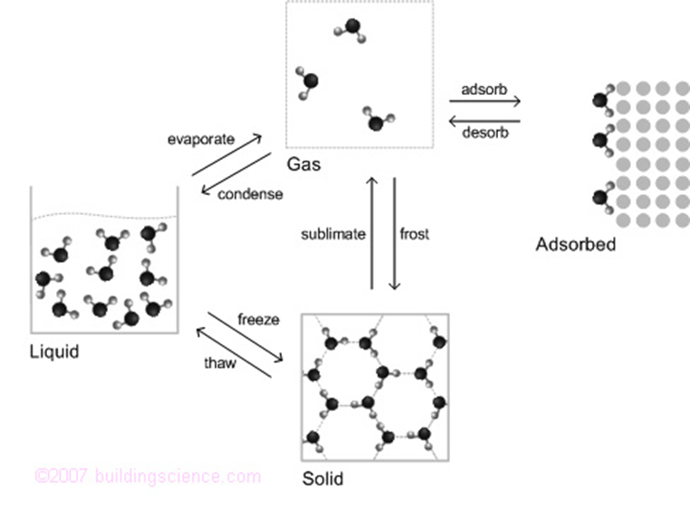
Phases of Water in Air and Materials

Slide 10
Water and Moisture Air and Materials
Water exists as a
Solid
Liquid
Gas
4th phase is chemically bound, adsorbed or absorbed water
An example of chemically bond water is gypsum is a crystalline mineral known as calcium sulfate dihydrate
Adsorption is a surface phenomenon – water molecules adhere to the surface of a material including pores
Absorption occurs when molecules diffuse of dissolve into another substance – Wood shrinks in the winter and swells in the summer as water is absorbed and desorbed into wood fibers
Notes:
Fact about drywall – Paper faced gypsum board is part of a building’s fire protection system. When exposed to the heat from a fire, heat energy is taken away from the fire to liberate the bound water molecules

Slide 11
Expressions for Water in Air and Materials
Air
Relative humidity (humidity) -- The amount of moisture in air compared to the amount of moisture that air can hold when saturated at a given temperature
Dew point – the temperature at which air is saturated--100% relative humidity
Absolute humidity – the mass (volume) water vapor per mass (volume) of air equal to the partial pressure of water vapor in air
Materials
Equilibrium Moisture Content (Wood Moisture Content) --The amount of moisture in a material compared to the amount of moisture the material could hold when saturated at a given temperature

Slide 12
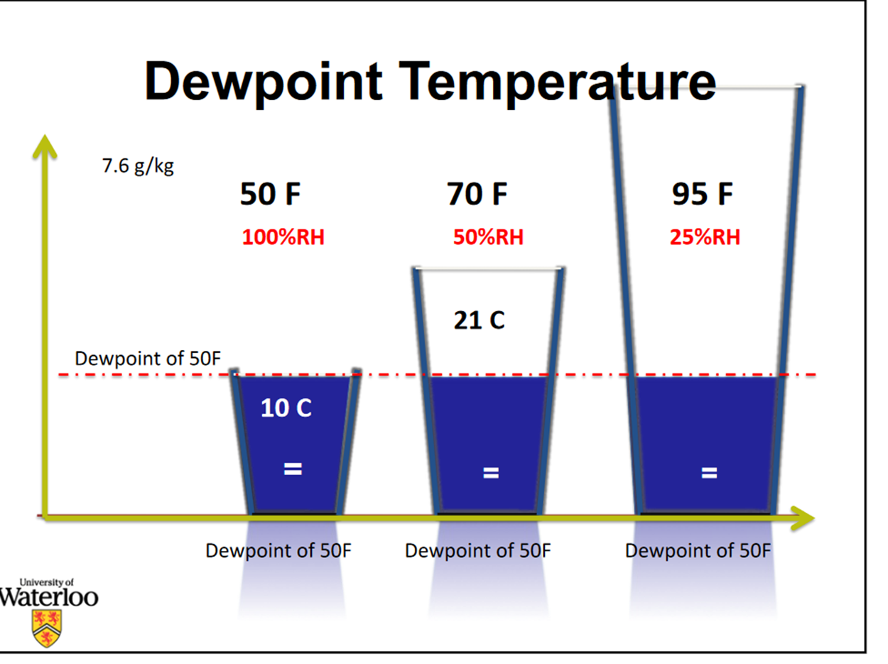
Notes:
Air at a dew point of 50

Slide 13
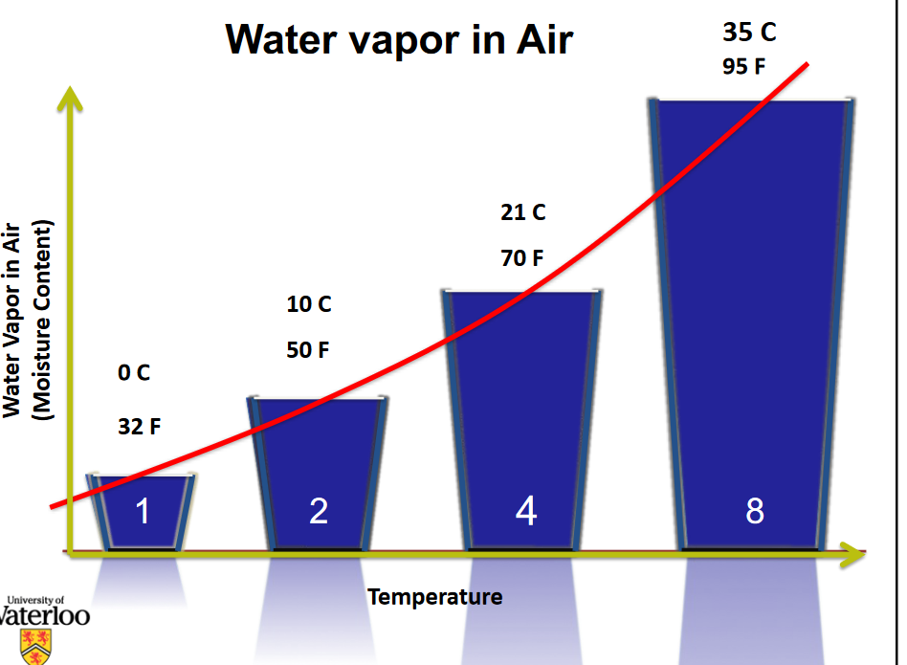
Amount of water vapor in air when saturated
Notes:
At 0$°$ and 100% RH air contains about 4.8 grams/kg of air
At 10C and 100% RH air contains about 7.6 grams/kg or air
At 21C and 100% RH air contains about 15.8 grams./kg of air
At 35C and 100% RH air contains about 37 grams/kg of air

Slide 14
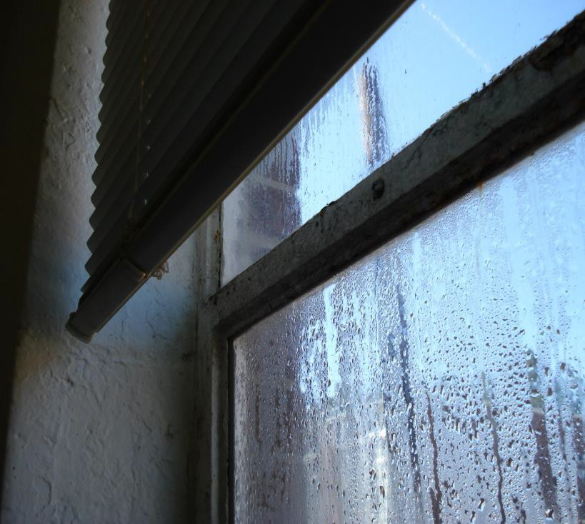
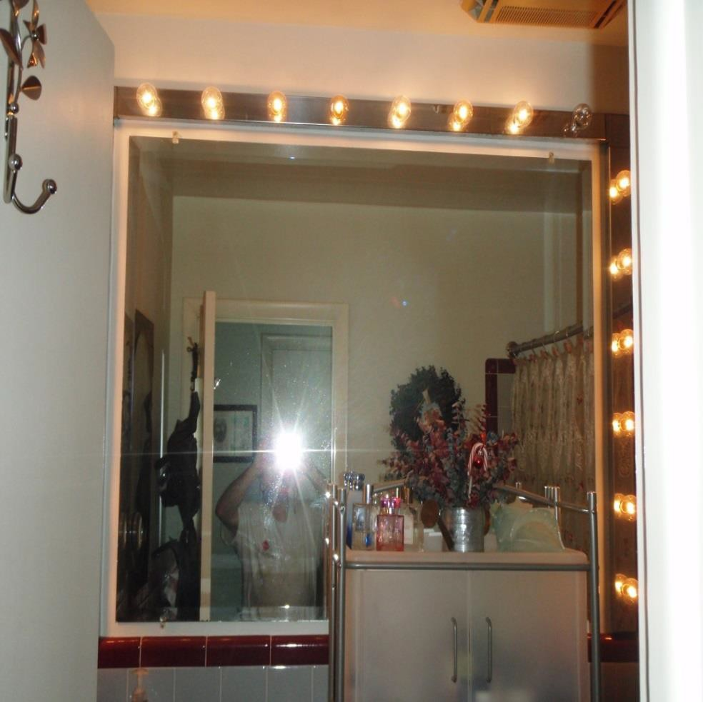
Condensation
Condensation occurs when warm moist air comes contacts with cool surfaces
Manage condensation by
Warming surfaces
Reducing amount of moisture in air
Condensation on cold single pane glass window
Lamps around vanity keep surfaces warm to prevent condensation and ventilation removes water vapor generated by showering
Notes:
Top image single pane window is cold surface air in room is warm and moist
Bottom picture – no condensation because heat from vanity lamps raises surface temperature, bathroom exhaust fan and short showers

Slide 15
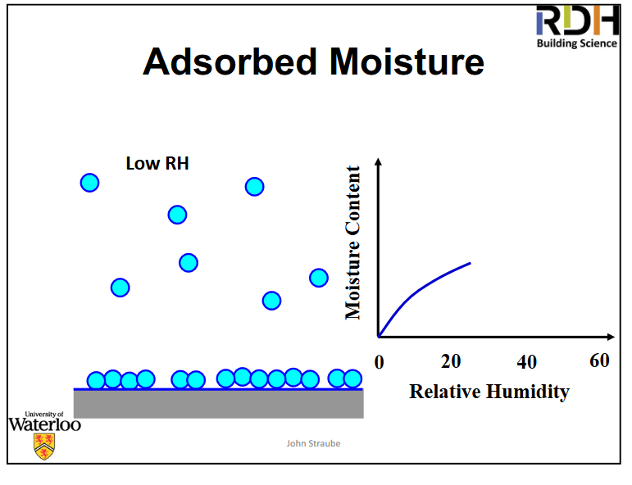
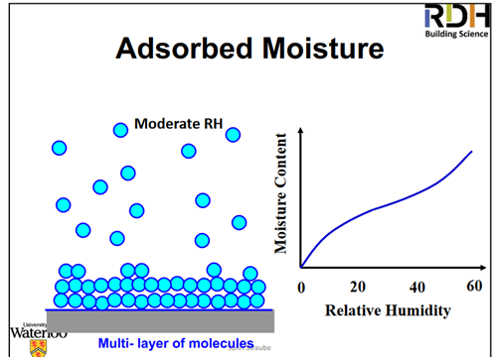
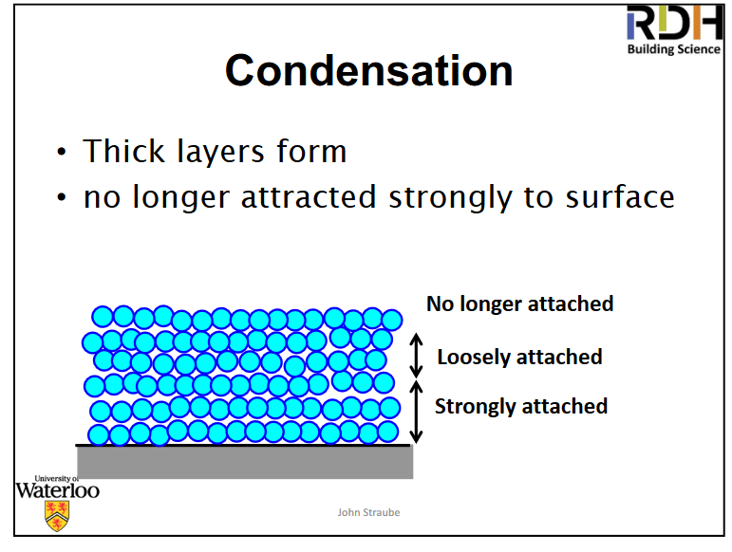
Adsorbed Moisture
Condensation is influenced by both the relative humidity of the surrounding air and the temperature of the material

Slide 16
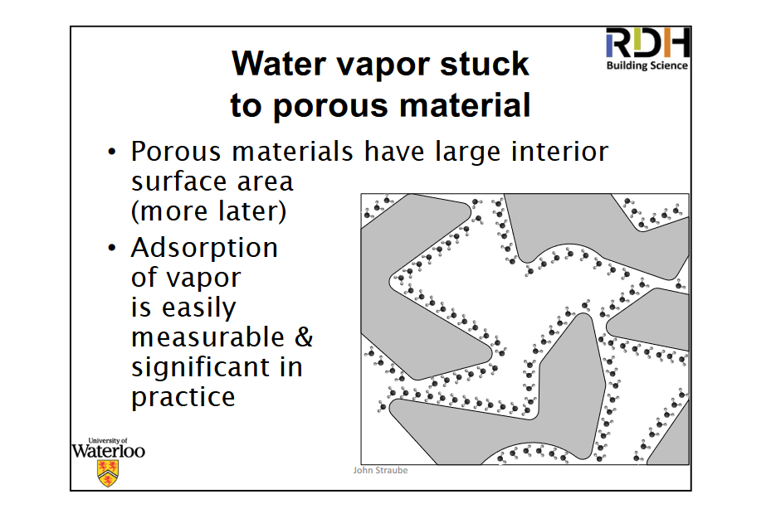
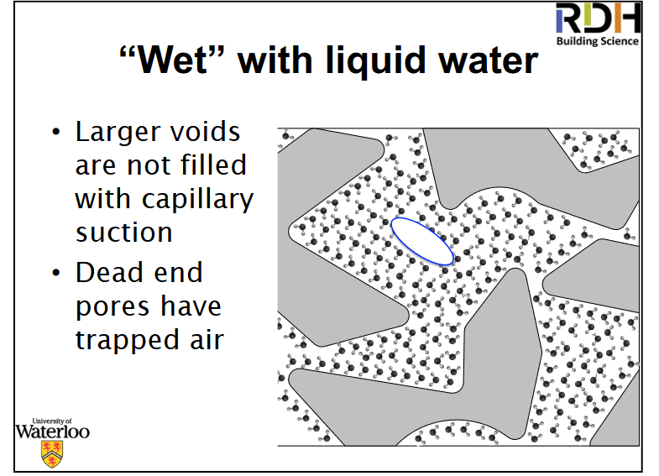
Adsorption and Condensation in Porous Materials

Slide 17
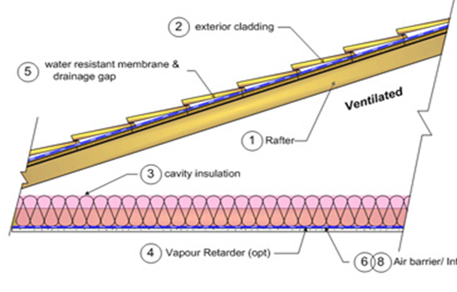
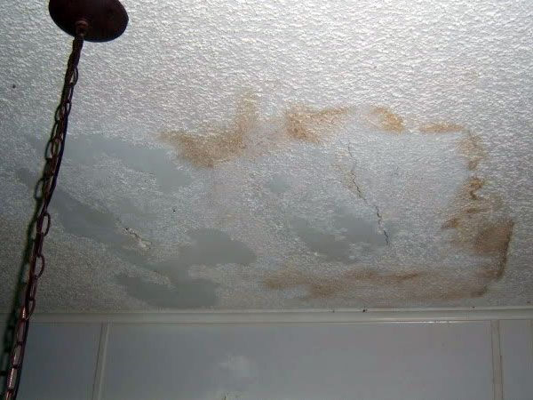
Complexity of moisture movement (wetting and drying) through materials
Notes:
Pathways and driving forces
To damage this ceiling water had to
penetrate the shingles and underlayment,
accumulate and drip down the rafter.
Drip off the rafter and
Move by capillary action through insulation and eventually ceiling materials.
While this is happening water may be moving through materials by capillarity and diffusion, evaporating into air due to high temperature in the attic, and/or removed by ventilation
My house and brown stains.

Slide 18
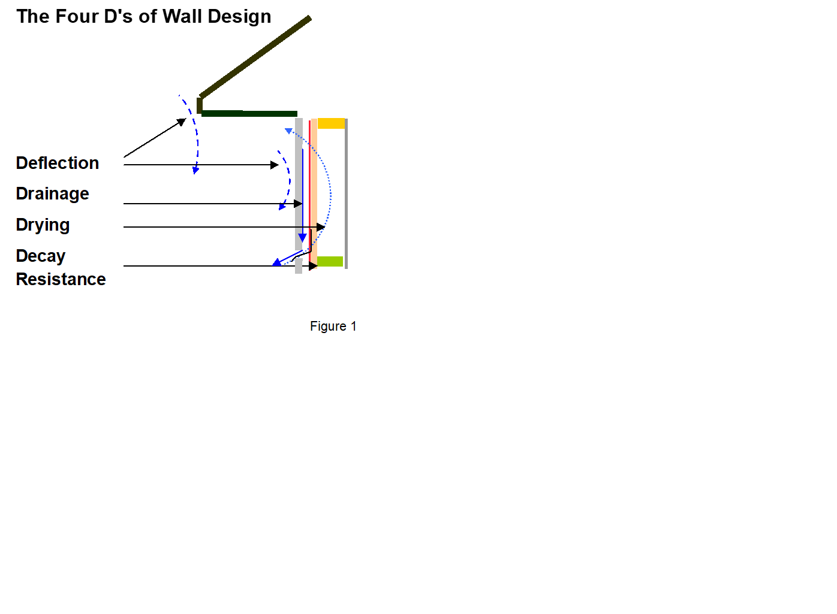
Outdoor sources

Slide 19
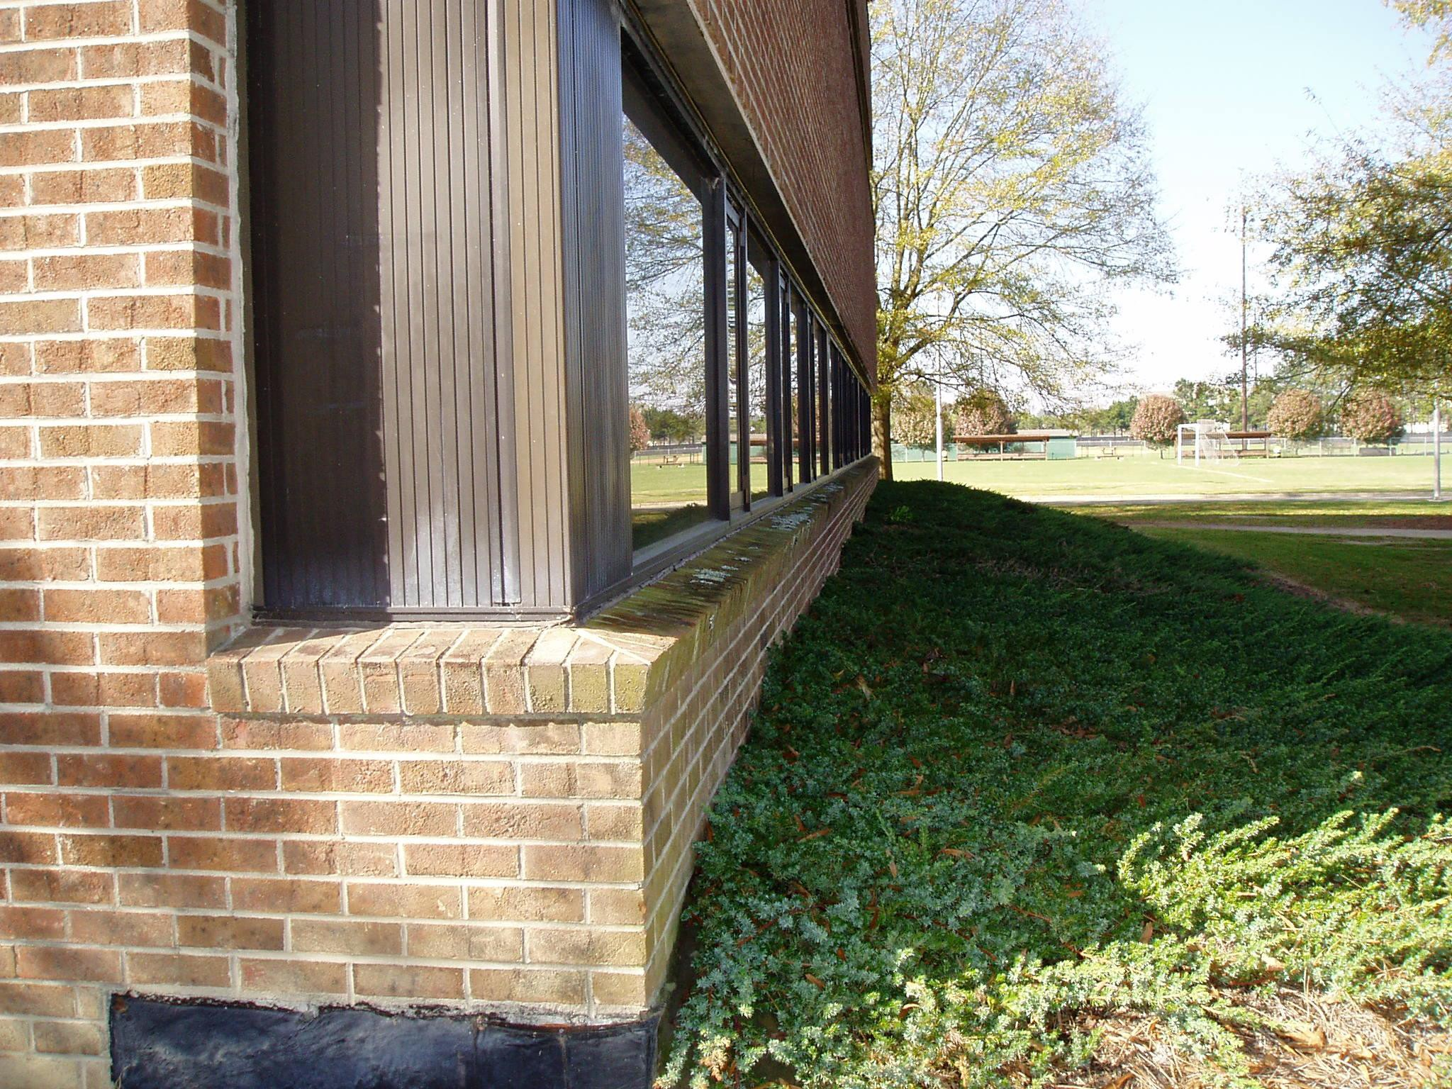
Outdoor Sources of Moisture
Notes:
North side of building – water trapped against wall by vegetation and built-up soils. Note damp proofing on exterior of foundation

Slide 20
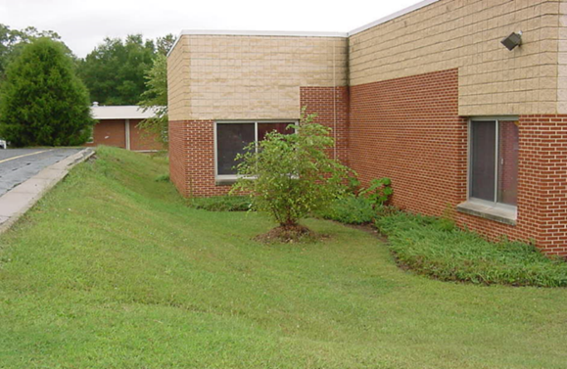
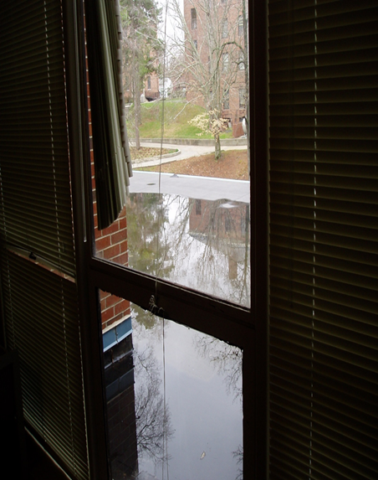
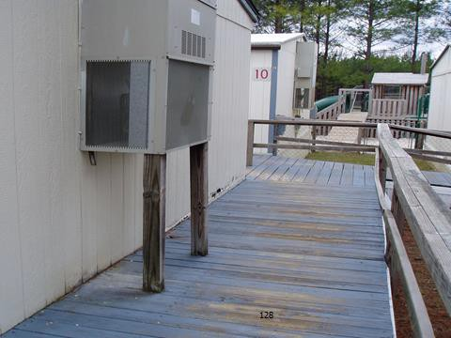
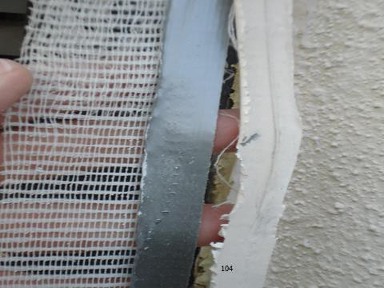
Outdoor Sources of Moisture

Slide 21
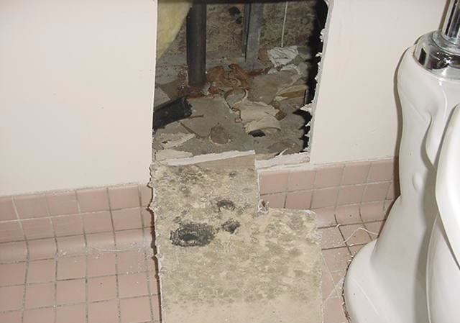
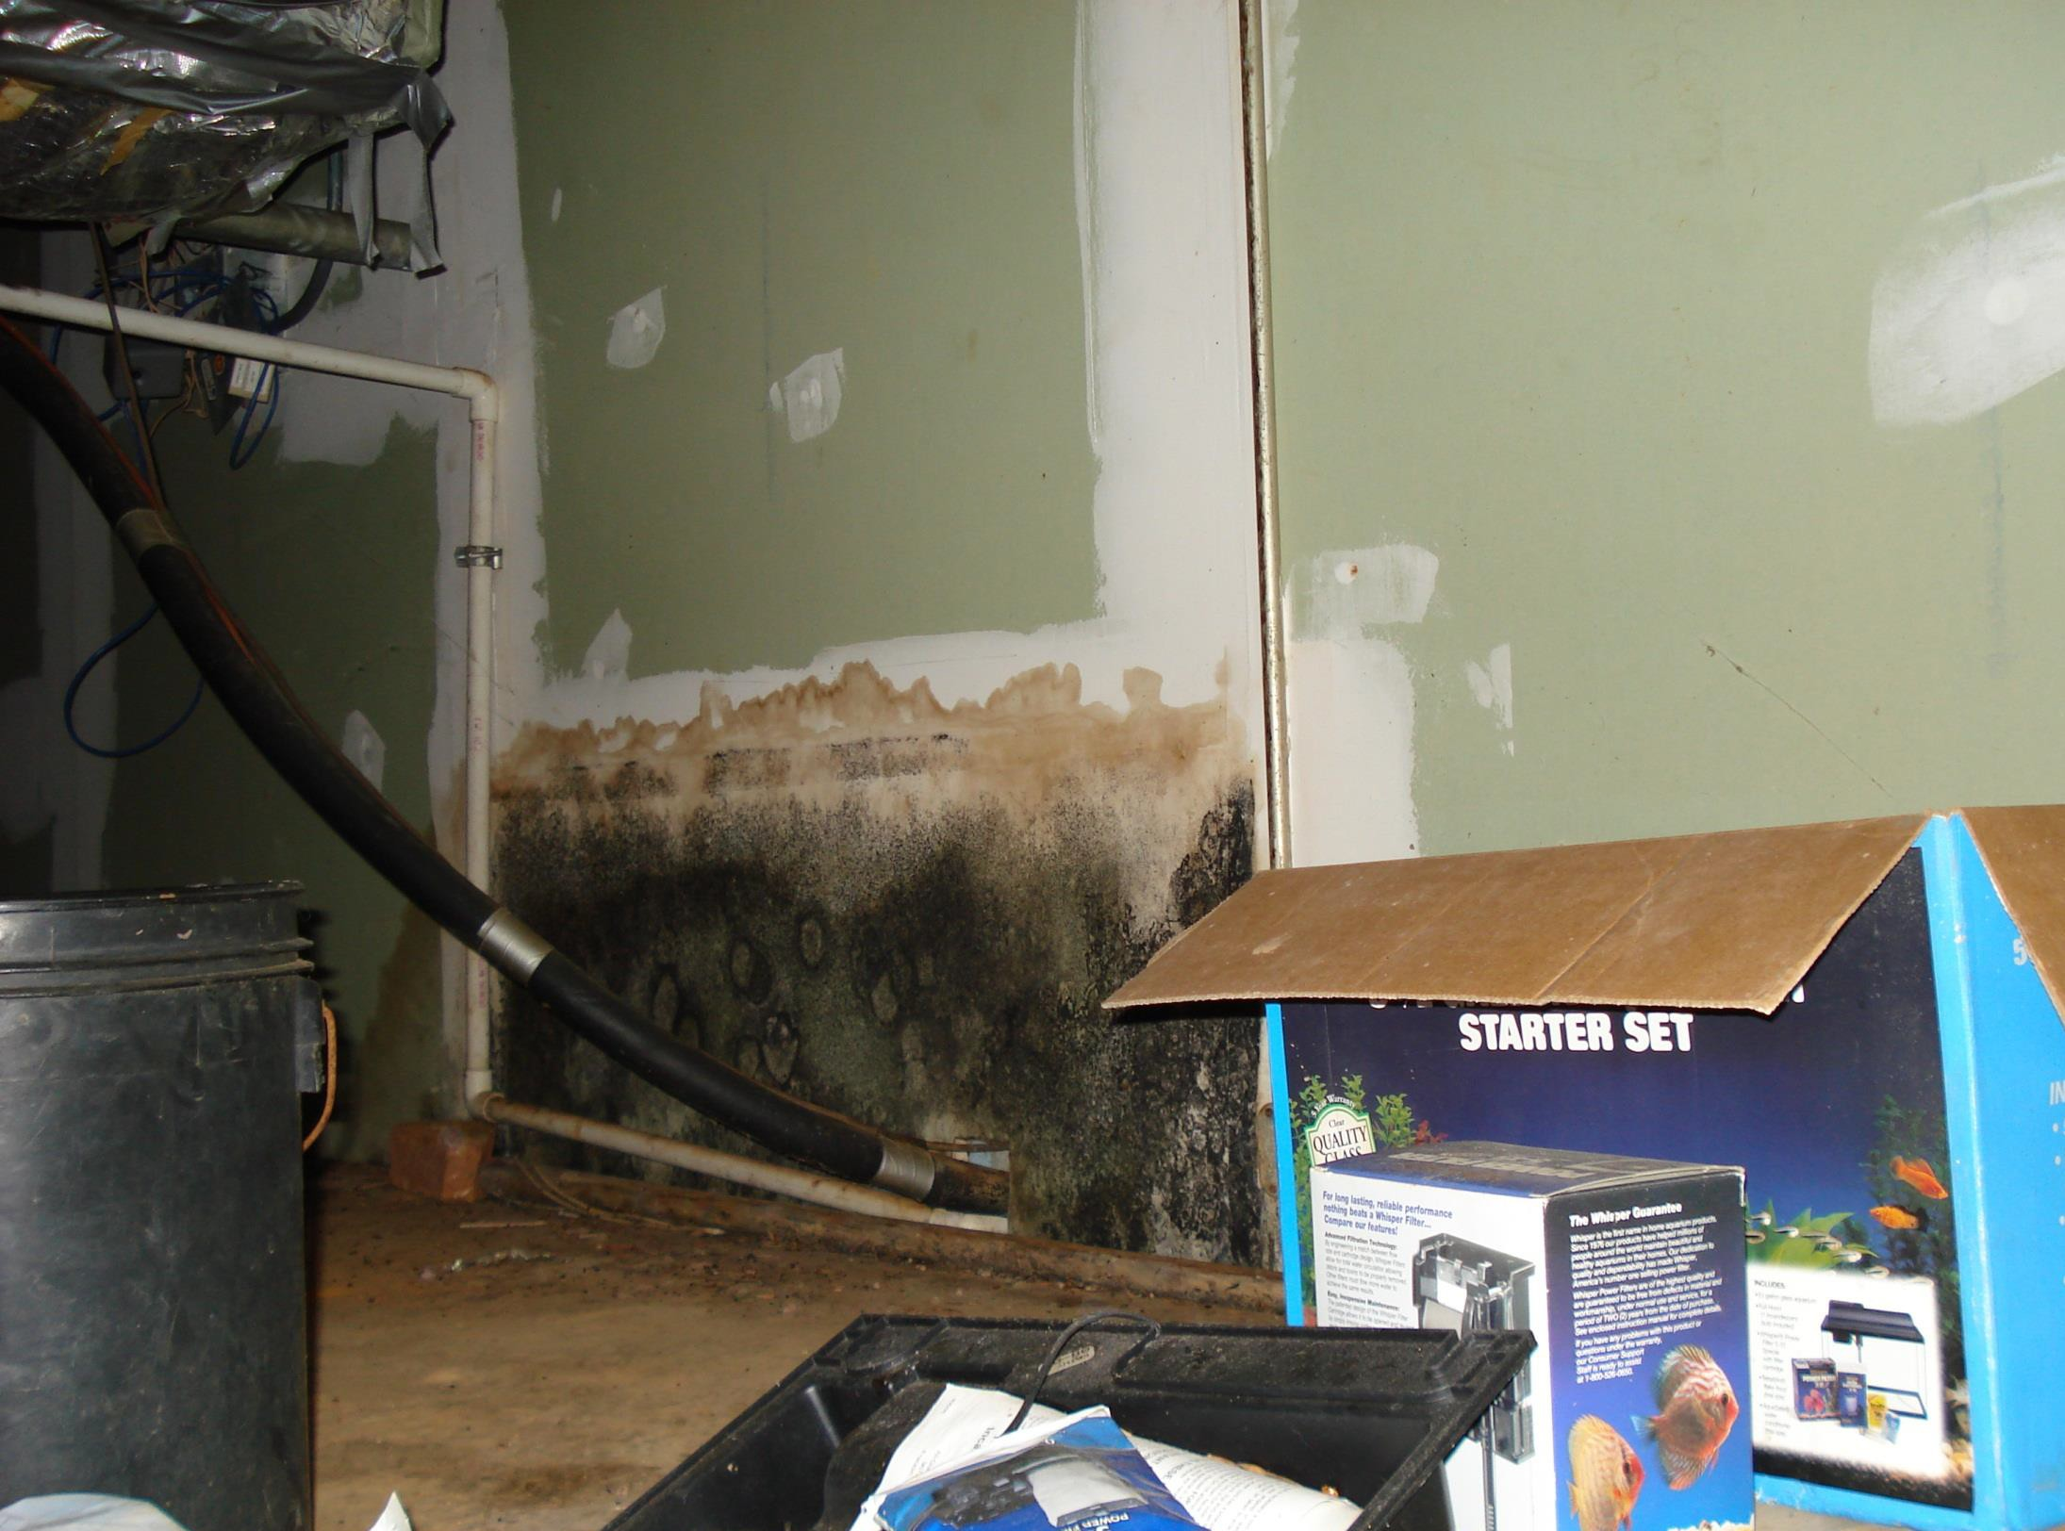
Plumbing Leaks

Slide 22
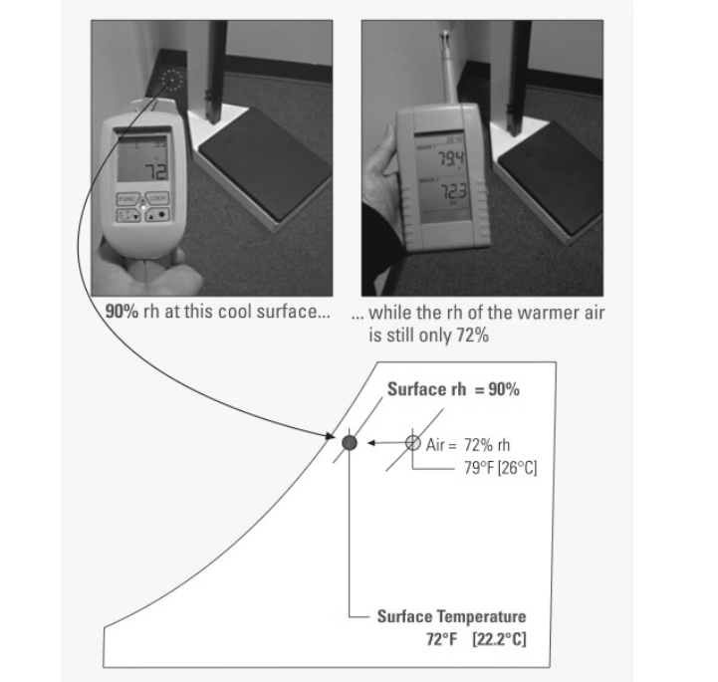
Moisture required for mold and microbial growth
Water Activity AKA Available Water
Equilibrium moisture content in materials at least 70% -- relative humidity at the surface of the material of at least 70%
Equilibrium moisture content depends on the type of material, the temperature of the material and the temperature & relative humidity of the air at the material surface
RH = relative humidity (%)
DP = Dew point (°F)
Air =79°F, RH= 72% DP=69°F
Surface = 72° F, DP = 69°F, surface RH = 90%
Notes:
Air temperature is 79°F and 72% RH, Dew point is calculated at 69°F
Surface temperature is 72°F at dew point of 69°F, air at the boundary layer of the cove base, gypsum board and carpet has a RH of 90%

Slide 23
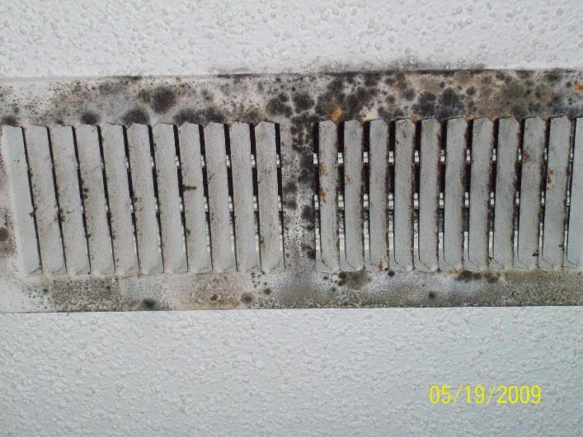
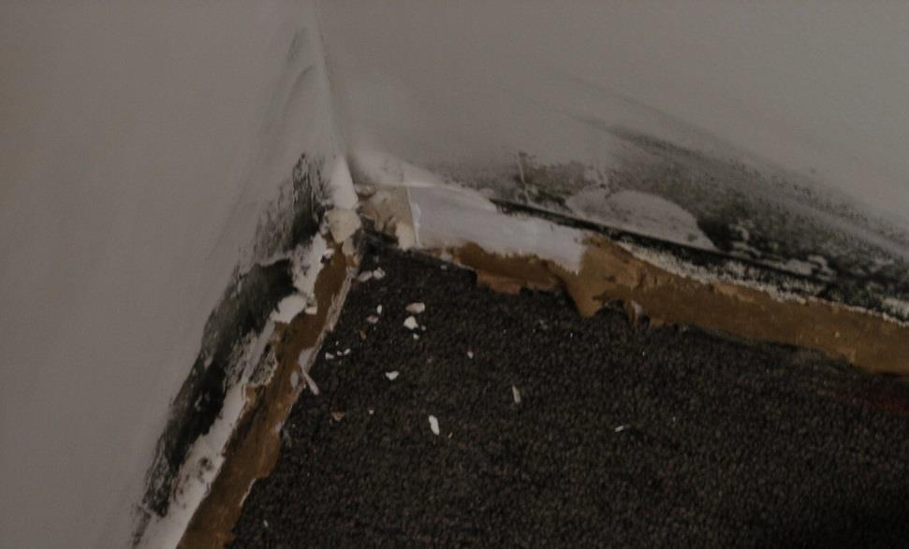
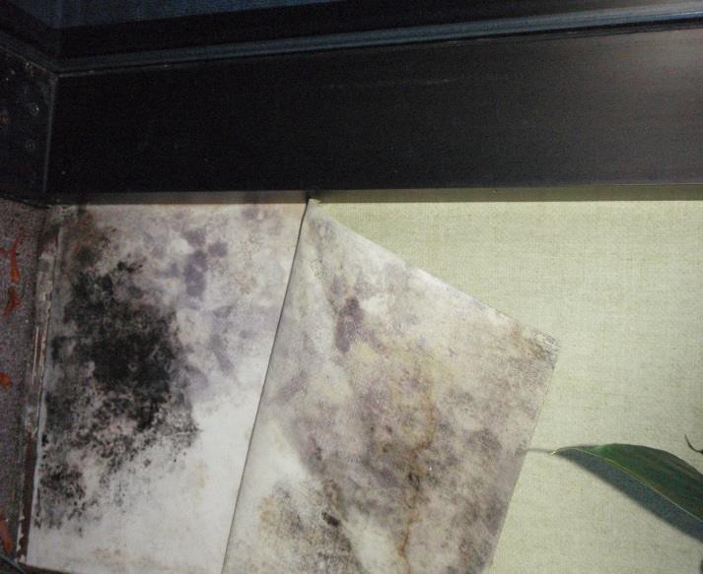
Adsorption, Absorption, and Condensation
Condensation on chilled water line above suspended ceiling dripped on to ceiling tiles
Cold surface condensation on HVAC supply vent
Overwetted carpet -- water wicked up drywall and was trapped behind cove base
Window leak-- water trapped behind vinyl wall covering

Slide 24
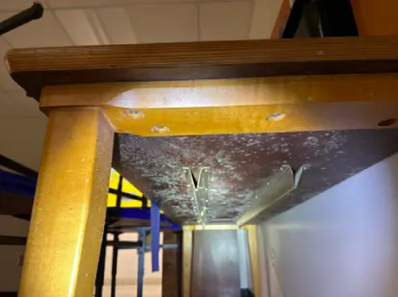
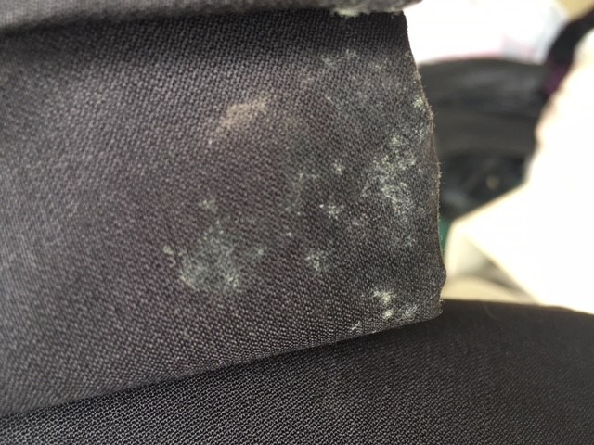
Summer Mold Syndrome

Slide 25
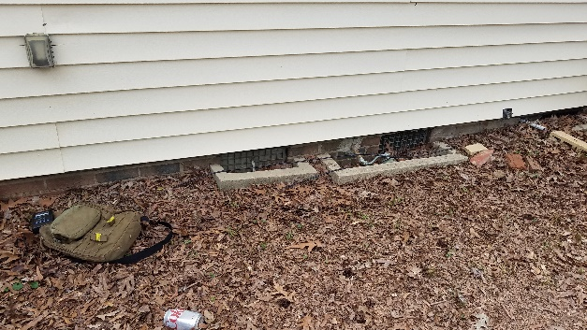
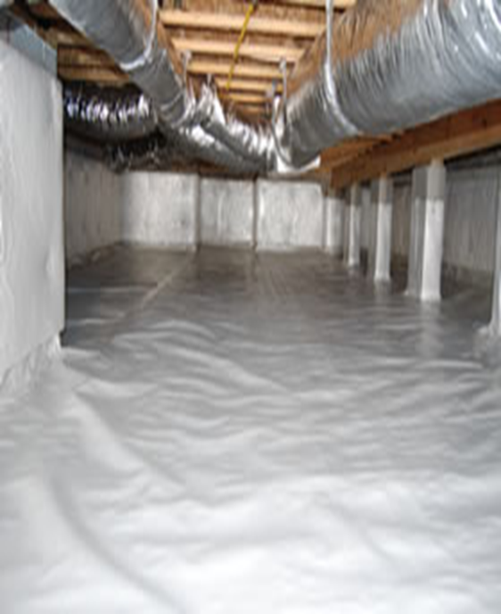
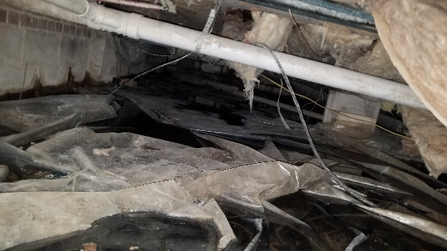
Crawlspaces
NC Building Code Section R408 wall vented crawlspaces
Exterior grading
Exterior Damp Proofing
Ground vapor retarder (100% coverage)
Exterior Vents
NC Building Code Section R409, closed, sealed or conditioned crawl spaces
Vapor retarder up foundation walls
Mechanical dehumidification
  Dehumidifier
  Supply air
  House air
  Exhaust air
  Conditioned space
Notes:
insulation and foundation vents/doors sealed and gasketed
Dehumidification– decouples crawlspace and house
Supply air – air supplied when HVAC operates
House Air – Continuous air from house into crawlspace
Exhaust air – continuous air pulled from crawlspace to the outside
Conditioned Spacel Crawlspace becomes occupied space

Slide 26
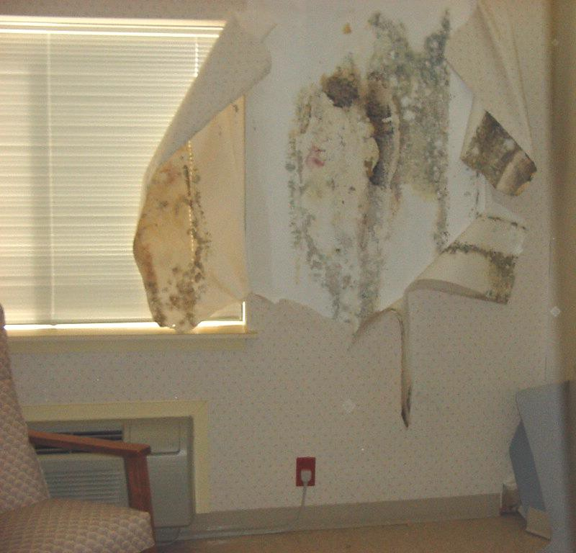
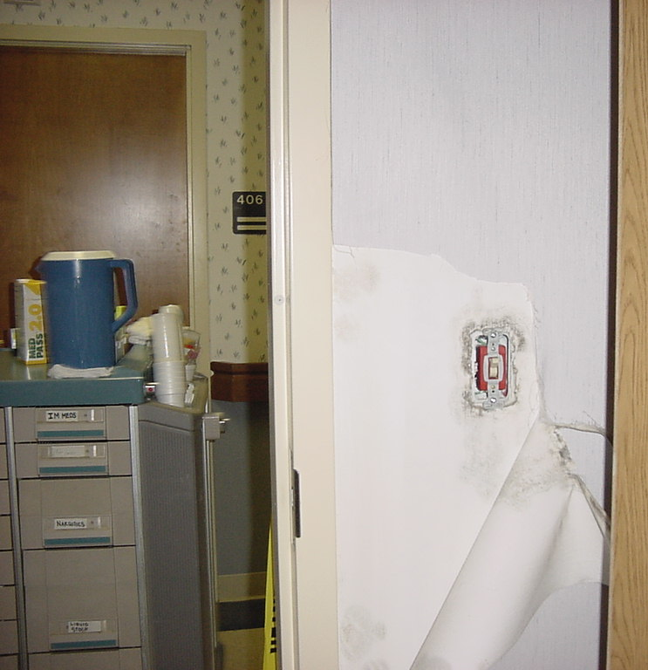
The perfect storm
Vinyl wallpaper – vapor retarding surface
Hot and humid outdoor air
Cool wall surface –Packaged Terminal Air Conditioner (PTAC)
Room depressurized by continuously operating bathroom exhaust fan

Slide 27
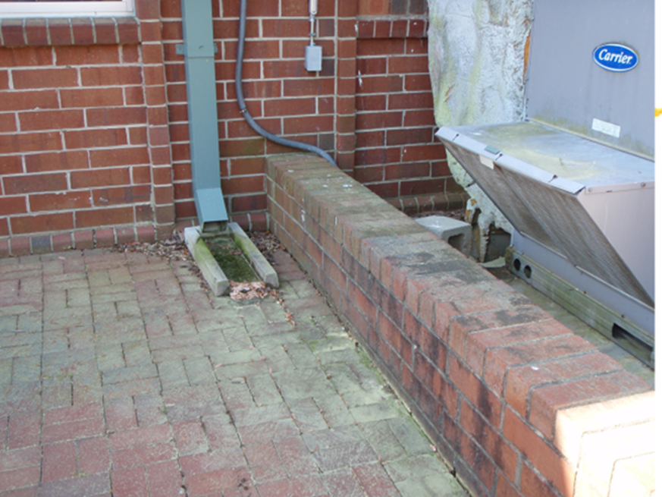
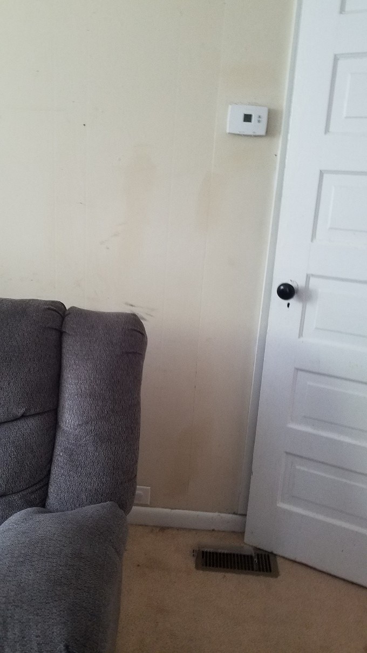
Well ventilated
Thermostat
Poor location for outdoor air intake
Supply vent
Notes:
Thermostat senses temperature of discharge air from HVAC system and does not represent air temperature in other places

Slide 28
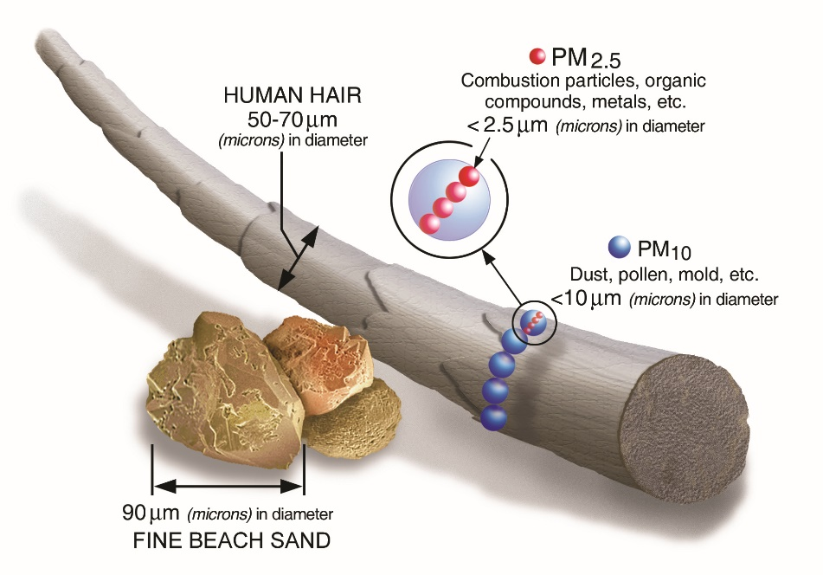
Portable Air Cleaners
Portable air cleaners may be used to supplement ventilation especially in areas where adequate ventilation is hard to achieve
Central system filters are rated Minimum Efficiency Value Rating – MERV 13 trap 75% of particles between 0.3 and 10 microns in size the best compromise between filter, efficiency, resistance to air flow and cost.
High Efficiency Particulate Air (HEPA). Filters often found on portable air cleaners trap 99.97% of particles that are 0.3 microns in diameter
Air Cleaners are rated by the Clean Air Delivery Rate (CADR), the amount of clean air supplied by the filter in cubic feet per minute (CFM) Select an air cleaner with a CADR equal to 2/3 of room’s area
Notes:
O,3 microns are size that most easily pass through an air filter. Both larger and smaller sized particles are captured at greater efficiency
Consider the noise of the air cleaner, electrical consumption, trip hazards from electrical cords
Consider the direction of air flow, direct air flow so that the air cleaner is between the potential source and potential receptors, in school, place the air cleaner if possible so that air flow through the air cleaner is from the classroom area toward the teacher. Or use two or more air cleaners to promote good air mixing
Use portable air cleaners to increase effective air changes per hour. Air Changes Per Hour equal Cubic feet of air per hour/volume of room
Example room has area of 1200 square feet with 8-foot ceilings. Room volume is 9600 cubic feet. Portable air cleaner has CADR of 240 CFM = 14,000 cubic feet per hour. Portable air cleaner adds about 1.5 air changes per hour in addition to air changes from natural and mechanical ventilation.

Slide 29
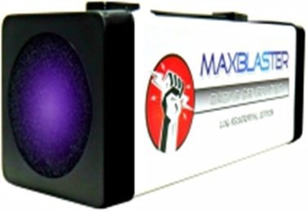
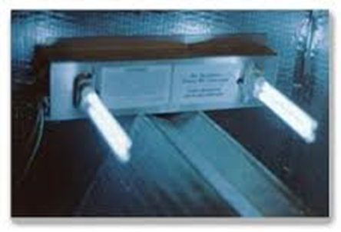
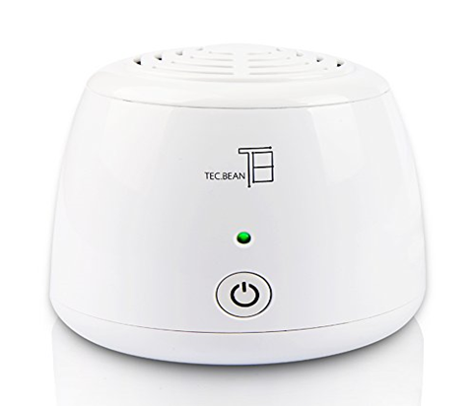
Other air cleaning devices
Never use ozone generators because ozone is a known respiratory irritant, Levels that kill or inactivate germs will easily exceed 0.05 parts per million of air, known to be a health hazard
Ultraviolet light – best results long term irradiation of wet downstream coil surfaces along with good filtration– less effective when places in ducts with rapidly moving air streams
Limited information on effectiveness of Photocatalytic Oxidation (PCO), Ionization and other additive technologies. Potential for these technologies to create different types of volatile organic compounds

Slide 30
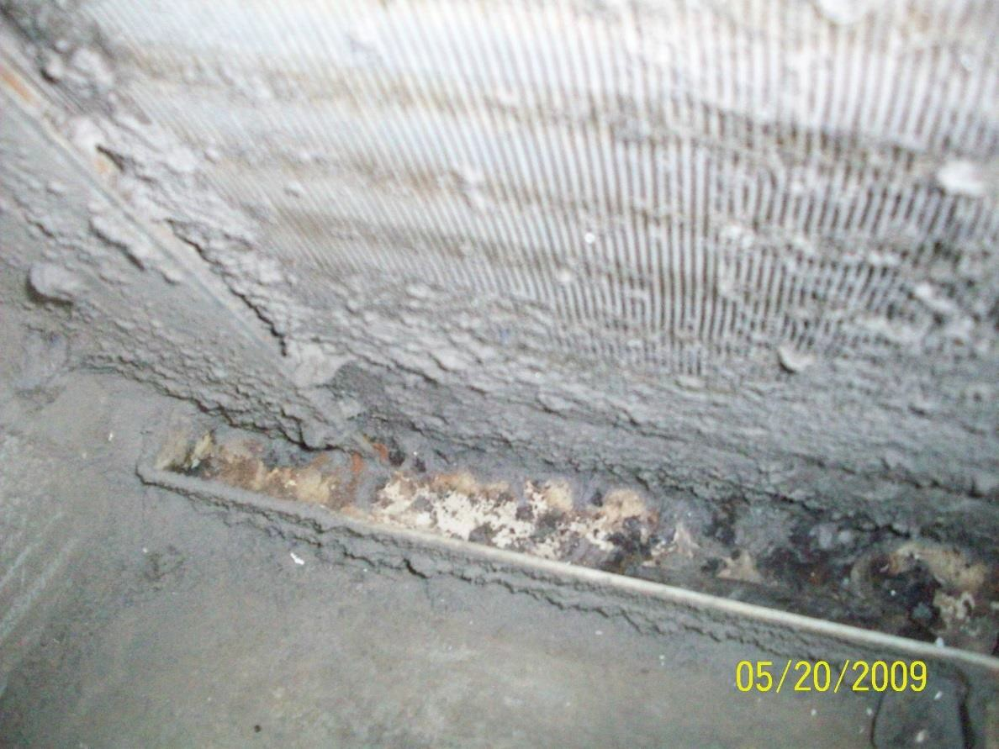
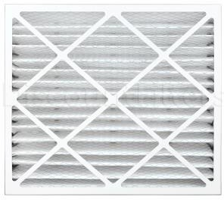
Maintenance and ventilation
Medium efficiency pleated filters capture small particles to protect people and equipment

Slide 31
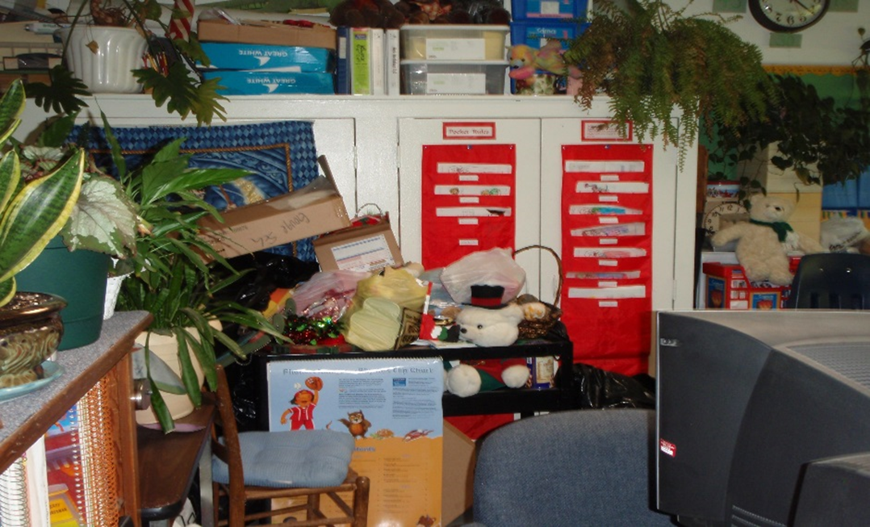
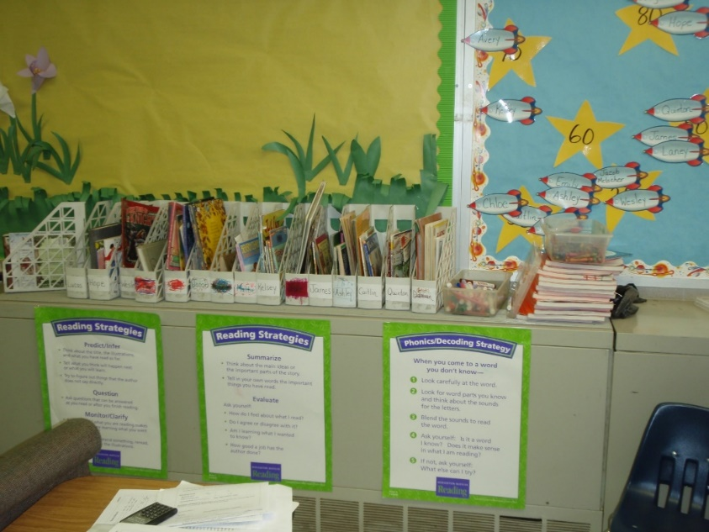
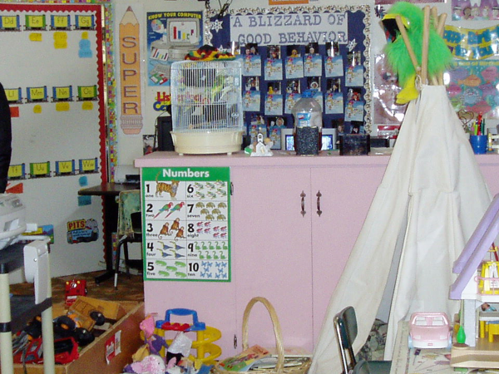
Cleaning and Clutter

Slide 32
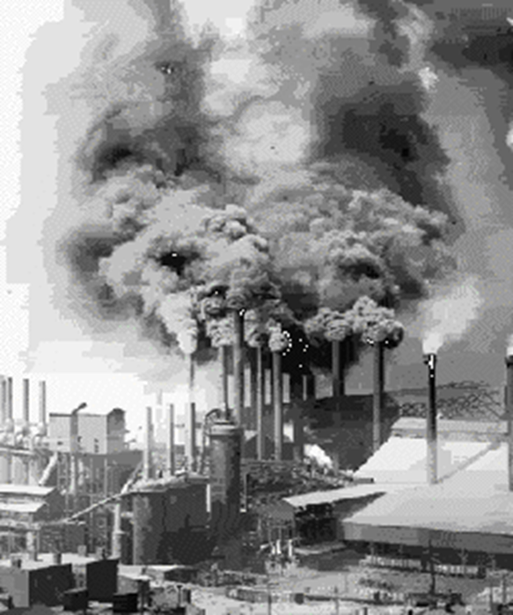

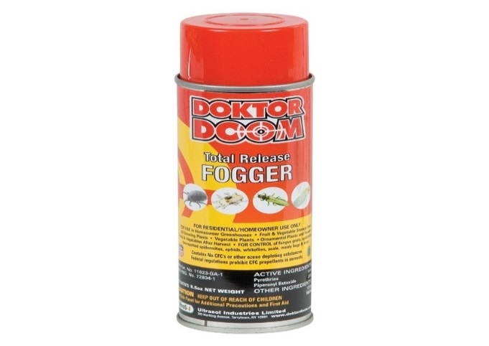
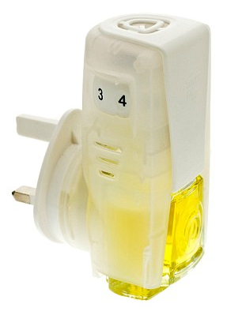
Contaminant free
Notes:
There may be damp and moldy conditions and other indoor hazards alone or in any combination

Slide 33
Dampness and mold can be expensive
Better use of resources to improve outcomes
Mold from neglect, lack of maintenance, or repairs may not be a covered peril by insurance
Professional mold remediation can cost $20/sf or more
Mold sampling: $100-150 per sample and $80-100/hour for mold professionals
Notes:
From the NCGA Joint Legislative Commission of Governmental Operations for mold testing and remediation services in the fall of 2023 for 30 school buildings in the Alamance Burlington School System
Total $22,700,00 mold remediation
Mold testing – LRC $448,000
Mold testing – ESG $62,000
Brady Services (HVAC) $16,610 Andrews elementary
Hoffman Mechanical $37,500
Dehumidifier rental $2,949.000 Builders services
Dehumidifier rental $35,000
Dehumidifier rental $34,650
Dehumidifier purchase $997,700 – redirected ESSER funds
Additional costs $2,200,000 builders' services

Slide 34
Dampness and Mold Growth Impacts to Health
Most healthy adults can inhale large numbers of mold spores without ill effects
We all inhale some mold and mold products from indoor and outdoor sources
No environment can be permanently free of mold spores
Mold growth is a complex mixture usually associated with other dampness-related contaminants
Sensitive populations and people with certain conditions are more likely to have symptoms that are more severe than healthy adults

Slide 35
Susceptible Populations and conditions
Children and elderly
People with allergies/hypersensitivity or pulmonary disease
People with compromised immune systems:
Pre-existing disease
People taking certain medications
Post-operative
HIV/AIDS
People being treated for cancer

Slide 36
Mold and Health Effects
Epidemiological evidence
(not applicable to immune compromised persons, who are at risks for fungal colonization of opportunistic infections
Institute of Medicine sufficient evidence of an association between indoor dampness and mold with cough, wheeze, upper respiratory tract (nose and throat) symptoms and exacerbation of asthma
World Health Organization added shortness of breath, bronchitis and allergic rhinosinusitis to the list in 2009
Dose response effect—likelihood and severity health of impacts increase as the size, severity, and duration of mold growth, musty odors, and water damage increase
Association is necessary but insufficient to demonstrate causation
From a public health view, association can be sufficient for further investigation or to recommend and implement remedial actions

Slide 37
Mechanisms of health impacts
  Health impacts can be
  Hypersensitivity (allergic reactions)
  Irritation and inflammation
  Occasionally opportunistic fungal infections -- in immune compromised persons
  Health effects impacts range from innocuous to serious illnesses
  Mechanisms may act alone, in series or in any combination
  Toxic Black Mold Stachybotrys chartarum
  Can produce macrocyclic trichothecene mycotoxins (MTMs) known to cause serious disease when ingested
  1993-1998 Clusters of infants in Cleveland with acute idiopathic pulmonary hemosiderosis (AIPH) raised public concerns
  MTMs can become airborne
  Unanswered question: Can people inhale concentrations of MTM sufficient to cause the health problems observed in people in SC-contaminated buildings?
  Interactions between the person, agent, other dampness related-agents, and other environmental exposures confound and confuse exposure to mold as cause of illness
Notes:
In view of the uncertainty about mycotoxins but the general agreements about other health hazards associated with dampness and mold, focus on controlling moisture sources and removal of mold and mold products

Slide 38
Other Symptoms associated with “exposure” to mold
Inadequate or insufficient evidence to determine whether an association exists between damp buildings and
Fatigue and weakness
Muscles aches, cramps, joint pains, morning stiffness
Abdominal pain, diarrhea
Headache, memory loss, concentration difficulty, confusion, learning difficulties, difficulty finding words, disorientation, mood swings, anxiety or panic
Exposure to mold and health symptoms -- how people think
Post Hoc Propter Ergo Hoc, After this, Because of this
  The cause of something is another thing that occurred earlier
“The absence of evidence is not evidence of absence”
Lack of counterfactual thinking (would there be symptoms in absence of mold)

Slide 39

Case study- Structured interview
A concerned parent calls about toxic black mold in her child's classroom. Says the mold is making her child sick, has missed days due to asthma, and that other children are also sick. Wants the classroom tested for molds. Has deployed a petri dish for two days which showed black mold growth.
How do we assist this person?
Use good communication skills
Transform “mold” into dampness and mold growth
Focus on reasons that materials and contents have become damp
enough to support mold growth
Consider other Indoor Environmental Quality (IEQ) issues
Prompt and empathetic response
Petri dishes may not represent fungal ecology – no growth would be an unexpected result. Growth on a culture plate may not represent true fungal ecology in the building-- growth is biased toward viable fungal spores, larger spore sizes, and suitability of culture media

Slide 40
Questions we ask about dampness and mold growth
Who
Have you talked with the teacher or principal?
Have you talked with the school nurse, if available?
Have you sought medical care?
Does the child have pre-existing conditions?
What
What kinds of materials are water damaged or moldy?
Provide details about where mold is growing (especially the types of materials)
How large an area is affected?
Describe the degree damage or the extent that damp materials are colonized by mold growth
Are there musty or moldy smells?
When/Where/Why
How long have conditions existed? Summer or winter?
Describe locations, of wet, water damaged or moldy materials.
Is heating and air-conditioning affected?
Ask about sources of moisture (liquid or vapor) floods, roof leaks, plumbing leaks, poor drainage, and condensation.

Slide 41
Start with a thorough and informed inspection
Background information
Structure and mechanical design
Frequency, apparent origin, and locations where moisture intrusion, penetration and accumulation has occurred or is occurring
Occupant activities in the building
Inspection to focus on
  Sources, and duration of excess moisture
  Pathways for moisture movement through building materials
  Places, types of materials, and extent of mold growth
  Degree that materials are colonized with mold growth or water damaged
  Design, operation, and maintenance of heating and air-conditioning systems
  Promptly fix low hanging fruit

Slide 42
Selecting an Air Quality Consultant
Will the service(s) lead to evidence-based action plans?
Review experience, reputation, training, and ask for references, review proposals, agree on scope of work, and work product(s) and cost
If a consultant proposes environmental testing is proposed, ask about
  Require an informed and thorough inspection of the property before sampling and testing
  Ask about the specific theory being tested
  Ask about how the sampling strategy and analytical methods will provide data to prove or disprove the theory being tested
Ask about how the results will be interpreted including limitations and uncertainties
Ask about how results inform the remedial actions
  Ask to review reports from previous projects
  Purpose, observations, findings, conclusions, and recommendations
  Show how test results confirm observations
  Reports should not include conclusions about medical causation
Notes:
that are realistic, affordable and tend to promote health and wellbeing? Are resources better used to fix the underlying problems

Slide 43
Mold Testing – CDC Guidance
Generally, it is not necessary to identify the species of mold growing in a residence, and CDC does not recommend routine sampling for molds….
Since the reaction of individuals can vary greatly either because of the person’s susceptibility or type and amount of mold present, sampling and culturing are not reliable in determining health risks….
Furthermore, reliable sampling for mold can be expensive, and standards for judging what is and what is not an acceptable or tolerable quantity of mold have not been established.
CDC Facts about Stachybotrys chartarum
Notes:
Indoor activities, weather, air exchange rates (indoors/outdoor), disturbance of growth sites frequency and duration of damp materials and reproductive cycles
Unknown measurement error when single sample is collected– measurement variability Measure twice cut once
Unknown variability over time – how does a single sample represent any other time or condition in when levels of airborne mold are known to vary widely to do known and unknown factors
Environmental conditions, disturbance or reservoirs, life cycle of fungi, activities etc

Slide 44
Mold Testing EPA Guidance
Is Sampling/Testing for Mold Necessary and Who and test my home or clean fix and remediate mold
In most cases, if visible mold growth is present, sampling is unnecessary. Consider sampling and testing as part of your site evaluation in specific instances, such as:
Cases where litigation is involved
The source(s) of the mold growth is unclear
Surface sampling may be useful to determine if an area has been adequately cleaned or remediated.
No standards for acceptable or unacceptable levels of indoor mold.
(EPA) does not certify, license or maintain lists of mold inspectors or mold remediation contractors, though some states might. North Carolina does not license, recognize certifications for mold practitioners NC Business and Occupational Licensing Database
Notes:
Budget constraints-- If it is not possible to sample properly, with a sufficient number of samples to answer the question(s) posed, it is preferable not to sample

Slide 45
General Guidance
Use sampling to prove or disprove testable theories derived from a thorough and informed survey and when
There are pre-determined sampling plans with pre-determined data quality objectives
There are pre-determined criteria to interpret results
There are pre-determined actions steps based on the results
Communications plan to inform stakeholders
  Results and interpretations (limitations, uncertainties, hazards and risks)
  Response actions
Professional judgement is needed to interpret results
Avoid using mold testing for an exposure assessment or to see what is there
https://www.epa.gov/sites/production/files/2014-08/documents/moldremediation.pdf

Slide 46
Limitations of Mold Sampling and Testing
Hazard Assessment
Levels of airborne mold vary widely in time and space indoors, outdoors, at different times, places, and for different reasons
“Grab” samples represent a snap-shot in time and space--may or may not represent other times and conditions
Testing an area may not reflect exposure, the amount of mold a person may inhaled
Testing for mold may not reflect other bioaerosols or biological contaminants in a building
Exposure Assessment
Exposure depends on environmental factors --the generation, dispersal, transport and fate of mold spores, fragments of mold growth, and mold products in the environment over time and space, AND.
Personal factors include the frequency, duration, and activities of people in the environment and their unique sensitivities and susceptibilities as individuals and groups.

Slide 47

Exposure Assessment
Exposure depends on environmental factors like the generation, dispersal, transport and fate of mold spores, fragments of mold growth, and mold products in the environment over time and space.
And
Personal factors include the frequency, duration, and activities of people in the environment and their unique sensitivities and susceptibilities as individuals and groups.
EPA -- Human Exposure and Health

Slide 48
Best practices to remediation of water damage and mold growth
Evaluate conditions to develop a workplan to restore environment to a clean and dry condition that is realistic, feasible and achievable
Find and fix sources of moisture intrusion, penetration, accumulation and condensation
Classify water quality (clean, grey, or unsanitary) based on source and time
Water ages and degrades in quality as it moves through materials and contents
Categorize water damage based on the amount of water in the affected area, the sensitivity of materials to water damage, and the drying potential of affected materials (natural or mechanical)
Determine if lead-based paint, asbestos containing building materials or other hazardous materials are or will be disturbed

Slide 49
Remedial actions for water damage and mold growth
Prompt responses prevents conditions from degrading
Based on category of source water and class of damage implement a workplan
Restorative Drying –natural or mechanical
Contain moldy areas
Isolate moldy areas and ventilate to the outdoors
Clean and dry hard and inorganic surfaces
Remove porous organic materials and contents colonized with mold growth, water damaged, decayed, corroded, will not perform as intended, and cannot be cleaned.
Clean and dry where mold and mold products were where removed and where mold and mold products may have settled, but materials are not colonized with growth
Limit airborne dust generated with work practices (use appropriate PPE for workers)
Make sure moisture sources are corrected, and work areas are dry
Verify and validate work
Notes:
Diagrams and/or surveys that detail the square feet, rooms or sections
Specific amount of time to complete the job
Itemized lists of equipment, materials and supplies
Sell sheets and product labels for all chemicals to be used on the site
Specific cleaning procedures
Description of how wastes will be handed and disposed
How to the validate the cleaning/remediation process
How do they verify the cleanup/remediation met the goals
Warranties and guarantees
Total cost and price cap

Slide 50
Verification
Is the workplan being effectively implemented? Are goals feasible and realistic?
Sterile or the complete absence of mold and mold products is not realistic, achievable or desirable
Verify that workers are following instructions for cleaning mold from surfaces or removing things that cannot be cleaned
Prove that containment is working
Has a dry standard been established for restorative drying and are conditions being monitored
Are workers using PPE appropriately?

Slide 51
Validation
Work is not complete unless all these questions are answered in the affirmative
Is it dry
Acceptable indoor room temperature and relative humidity. Lack of perceived dampness. No wet materials based on detailed, thorough and informed inspection
Is it clean
Detailed thorough and informed inspection should not find any visible contamination, dirt, dust and debris on materials, furnishings and contents
Are there odors
No musty, mildew, moldy smells and no odors from chemicals or air fresheners
Inspections should focus on places that are hard to dry and clean

Slide 52
Government and Industry Guidance
Government guidance
EPA Mold Remediation in Schools and Commercial Buildings
Industry Standards for example https://iicrc.org/
American National Standards Institute/Institute for Inspection Cleaning (ANSI/IICRC) S500 and S520 Standards are intended to be common, industry-accepted language and terminology for inspection cleaning and restoration. leaning, inspection, and restoration.
Voluntary and Consensus Standards, and unless mandated by an authority having jurisdiction, compliance is voluntary.
Authorities having Jurisdiction
Organizational for certification, accreditation and reimbursement
Local
State
Federal
Guidelines best practices
Standard Minimum Standard of care (SOC)
Policy/law --
SOC adopted into law
Notes:
When is removing mold growth a routine maintenance activity (cleaning) and when does removing mold growth (mold remediation) require processes and techniques similar to those used for asbestos lead-based paint abatement?

Slide 53

Mold remediation – questions and judgements
Are guidance and standards applicable to every site/situation?
Are guidance and standards realistic, evidence-based, and affordable?
Is cleanup/mold remediation maintenance or repairs?
Is cleanup/remediation D-Y-I or are professionals required?
When to call a professional and what kind of professional do you hire?
What kind of professionals should be selected?
What kinds of engineering controls, work practices, and personal protective equipment are needed to limit dust generation and protect workers ?
Notes:
When is removing mold growth
A routine maintenance activity (cleaning)
A repair activity requiring some knowledge skills and abilities
A major repair or renovation activity requiring significant knowledge, skills abilities, and specialized equipment
When does removing mold growth (mold remediation) require processes and techniques like those used for asbestos lead-based paint abatement?

Slide 54
Agreement
  Projects become more complex and require higher levels of control
  As category of source water deteriorates
  As class of water damages increases
  The presence of mold growth in places that increase exposure (inside HVAC systems)
  As scope of work trends away from cleaning and toward removal of moldy materials
  When there are sensitive and susceptible people or environmental that higher level of control (health care facility)

Slide 55




Biocides, sanitizers, disinfectants and anti-microbial pesticides
EPA registered as antimicrobial pesticides. The label is the law !!!
Labels must contain ingredients, EPA Registration Number, Directions for Use (what microbes does the product kill and how to use the product for safety and effectiveness), Precautionary Statements, First Aid and Storage/Disposal
Most of these products have directions to for use hard surfaces and clean surfaces and are not a substitute for cleaning to remove spores, fragments, and organic matter
Use when necessary to protect health beyond restoring surfaces to a clean and dry condition

Slide 56
Risk assessment, risk perception, and risk communication
Risk is the probability and severity of harm from hazard- qualitative or quantitative
Risk Perception Risk = Hazard X Outrage
Outrage and risk perception influenced by these factors
Involuntary
Uncontrolled
Unfamiliar
Unfair
Catastrophic potential
Poorly understood
Uncertain
Victim identity
Dreaded outcome
Mistrusted sources of information
Media attention (sensationalized)
Unethical
Previous experience
Effects on children
Delayed effects
Risk communication –provide the audiences with knowledge to make informed, reasoned, and independent judgments about risks to their health, safety and the environment
Who is audience
Risk communication should be meaningful, understandable, and actionable
Notes:
The risk communication goal is to provide guidance on best practices concerning to anticipate, recognize, evaluate and control indoor dampness and mold growth, the middle ground between mold-minimizers and fungiphobes .
A major challenge is that people’s information sources include the internet, sensationalized media reports, technical jargon, and commercial interests ( thought leaders, products and services). Remember the healthy homes goals

Slide 57

How can health departments help?
Debunk the myth of “mold” – transform “mold” into maintenance and repairs to find and fix moisture problems and remove mold growth from the environment
In regulated facilities and permitted facilities like schools, childcare and Long-term care there are general requirements that floors, walls, ceilings, furniture, fixtures, and supplies shall be kept clean and in good repair.
Good repair means free of substrate damage, deterioration, peeling surfaces, and broken or missing parts and shall operate in accordance with the manufacturer's or builder's instructions

Slide 58
Mold: Landlords and Tenants
Renting a home is a form or a contract– landlords and tenants have obligations and responsibilities. Warranty of implied habitability.
Mold is not directly regulated, in some cases they are not required by law to fix the problem
NCGS 42-42(a) Landlord to maintain fit premises
General requirement to make repairs and maintain all electrical, plumbing, sanitary, heating, ventilation, air conditioning facilities, appliances, and equipment in good safe working order
Provide operable smoke alarms and when fuel burning devices are present working carbon monoxide alarms
12 conditions defined as imminently dangerous including “Excessive standing water, sewage, or flooding problems caused by plumbing leaks or inadequate drainage that contribute to mosquito infestation or mold. Nevertheless, frame problems as maintenance and repairs
NCGS 42-43– tenant to maintain the dwelling
Keep dwelling as clean as conditions permit, Prevent unsanitary conditions from developing, tell landlord when repairs are needed
Notes:
Unsafe wiring;
(b) Unsafe flooring or steps;
(c) Unsafe ceilings or roofs;
(d) Unsafe chimneys or flues;
(e) Lack of drinkable water;
(f) Lack of operable locks on all doors leading to the outside;
(g) Broken windows or lack of operable locks on all windows on the ground level;
(h) Lack of operable heating facilities capable of heating living areas to 65° when it is 20° outside from November 1 through March 31;
(i) Lack of an operable toilet;
(j) Lack of an operable bathtub or shower;
(k) Rat infestation as a result of defects in the structure that make the premises not impervious to rodents; 4
(l) Excessive standing water, sewage, or flooding problems caused by plumbing leaks or inadequate drainage that contribute to mosquito infestation or mold.

Slide 59
Mold: Landlord and Tenants
Tell landlord immediately when something is discovered that needs to be repaired. Follow up with a written request by letter, note email, text or work order system. Keep copies
If your landlord doesn’t respond in a reasonable amount of time, consider making emergency repairs yourself. Negotiate, get pre-authorization, and clarify expectations for reimbursement by subtracting future rent or other means Keep copies of all receipts.
Do not withhold rent to convince landlord to make repairs
If landlord fails to fix safety hazards or violates local codes report conditions to local authorities
Consider assistance from Legal Aid of NC, NC Attorney General’s Office, Housing advocacy groups, and others. Inform housing counselors you are in affordable housing developments
Consider filing and civil action in small claims court. The court may order leases to be broken, return of security deposits, rent recoupment, or rent abatement. Tenant may also be able to recover costs for inconvenience and damage personal property.
Notes:
To make your case in small claims court, you’ll need to provide proof of the following:
that you have a written or oral lease;
that the landlord was required by law to fix the problem;
that you gave written notice of the problem, if required;
that the landlord failed to fix it within a reasonable time;
that you paid to fix the problem or have an estimated cost to fix the problem;
and that the problem reduced the rental value of the property.
Rent recoupment when a tenant performs repairs themselves and then sues the landlord for reimbursement or to withhold future rent until the costs are recovered.
Rent abatement occurs when tenant sues the landlord before the problem is fixed and asks the court to allow them to withhold future rent to cover the costs or to return a portion of the rents as the difference in the fair rental value of the property when it's in compliance with the law and when it's unfit. For example, if half of an apartment is uninhabitable, the landlord may reduce the rent by 50%.
Tenants often sue landlords themselves because Unless personal injuries or substantial property damage was involved, however, it may be financially impractical for a tenant to hire the attorney for representation in a Small Claims Court suit. Sometimes brief consultations with attorneys can be helpful even if not represented in court

Slide 60
Final Remarks
Indoor environmental quality, dampness, and mold can range from simplex to complex
Damp buildings can be a health and safety hazard depending on the source of water, types of affected materials, size of affected areas, degree of colonization, pathways for airborne mold to become airborne
Population of sensitive and susceptible individuals may be underestimated
Dampness and mold are always influenced by how buildings are designed, constructed, operated, maintained and activities inside them
Social and Technical Components
Best outcomes occur when stakeholders communicate, cooperate and work together to follow healthy homes principles
OEE will provide technical support to environmental health staff other organizations interested in healthy homes, dampness and mold growth

Slide 61
References
NCDHHS Occupational and Environmental Epidemiology: Mold
Gypsum Association Assessing Water Damage to Gypsum Board
Manufactured Housing Research Alliance: Moisture Control In Manufactured Homes Understanding their Causes and Finding Solutions
CDC NIOSH Preventing Occupational Respiratory Disease from Exposures caused by Dampness in Offices Schools and other Nonindustrial Buildings
World Health Organization, WHO guidelines for indoor air quality: dampness and mould
Creating Healthy School Environments Tools for Schools
Mold Remediation in Schools and Commercial Buildings

Slide 62
References
American Industrial Hygiene Association Facts about Mold for Consumers
American Industrial Hygiene Association Spore Traps Air Sampling for Direct Microscopic Examination
Journal of Allergy and Clinical Immunology Guide to interpreting inspections/investigations for indoor mold
EPA Guide to Air Cleaners in the Home
NC Attorney General: Renting a Home with link to NC Attorney General’s Office: Landlords Maintenance and Repair Duties: Your Rights as a Residential Tenant in North Carolina
NC State Extension Home Preventive Maintenance
Citizens Guide to Small Claims Court

Slide 63
References
NC Cooperatve Extension Water Damaged Carpet and Rugs
Initial Restoration for Flooded Buildings

Slide 64
Questions?
David Lipton, CIH
Industrial Hygiene Consultant
Occupational and Environmental Epidemiology
Division of Public Health
North Carolina Department of Health and Human Services
Office: (919) 707-5900
Direct: (919) 707-5961
Fax: (919) 870-4807
david.lipton@dhhs.nc.gov
www.epi.publichealth.nc.gov/oee
40

