Slide 1
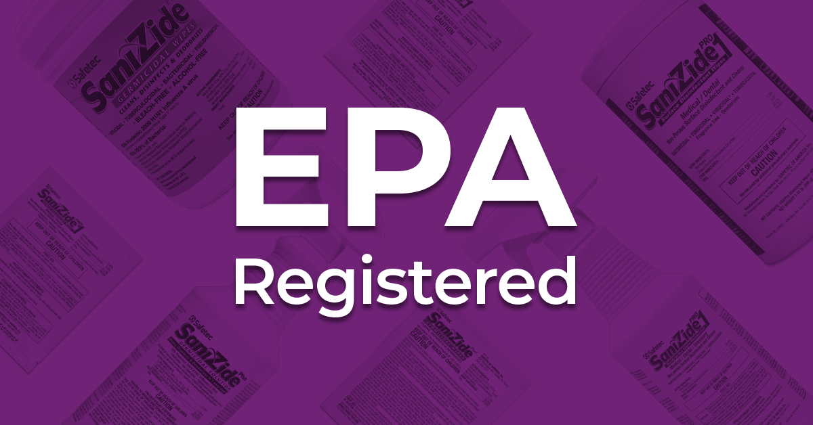
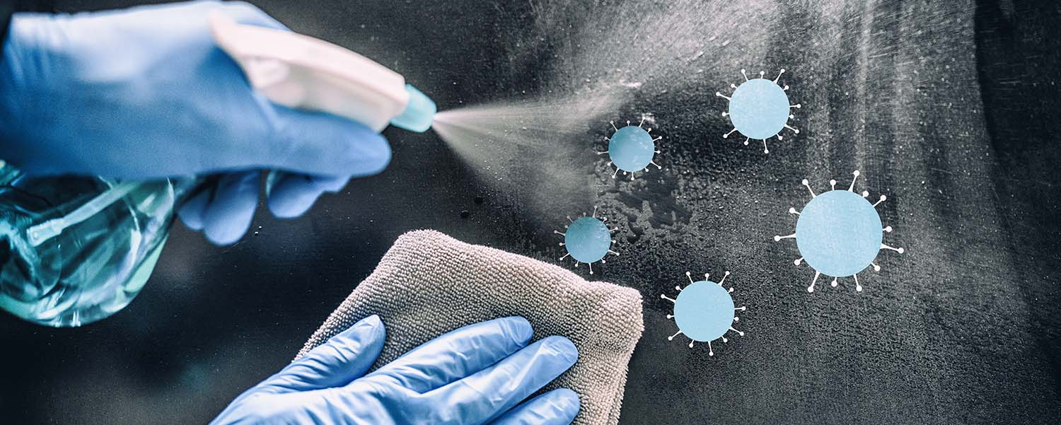
Sanitizer and Disinfectant Use, Registration and review March 12, 2026
Children’s Environmental Health
Child Care SOP 2026

Slide 2
15A NCAC 18A .2801 .2812 Sanitizing Solutions
Definition:
.2801(35) “Sanitizing Solution” means:
a solution containing 50 to 200 ppm of chlorine
or a sanitizer as defined at 40 CFR 158.2203 that is registered with the EPA in accordance with 40 CFR 152 that is
approved for use on food-contact surfaces,
does not require a final rinse step, and
has a testing method that can be used by child care center employees to confirm that the prescribed chemical concentrations are met
prepared and maintained in accordance with Rule .2812(j) of this Section

Slide 3
15A NCAC 18A .2801 .2812 Sanitizing Solutions
Usage:
.2812 (g) A testing method or equipment shall be used in accordance with the product manufacturer's instructions to test the strength of sanitizing solutions to ensure the prescribed concentrations are met.
.2812 (h) After sanitizing, all equipment and utensils shall be air dried.

Slide 4
15A NCAC 18A .2801 .2812 Sanitizing Solutions
Usage Continued:
.2812(j) A sanitizing solution shall be provided for cleaning purposes. Throughout this Section, when a sanitizing solution is used in a child care center, the manufacturer's Safety Data Sheet shall be kept on file at the child care center
the instructions for use of the sanitizing solution shall be followed.
When a chorine solution is used in a child care center it shall be prepared for use within 24 hours and a testing method or kit shall be used to ensure compliance with the prescribed chlorine concentration.
To achieve the maximum germ reduction with a chlorine solution, the cleaned surfaces shall be left wet with the chlorine solution and allowed to air dry or be dried only after a minimum contact time of at least two minutes.

Slide 5
15A NCAC 18A .2801 .2812 Approved Disinfectant
Definition:
.2801(2) "Approved Disinfectant" means:
a chlorine solution containing 500 to 800 parts per million (ppm) of chlorine
or a disinfectant as defined at 40 C.F.R. 158.2203 that is registered with the United States Environmental Protection Agency (EPA) in accordance with 40 C.F.R. 152
with use indicated in schools and child care settings
that is prepared and maintained in accordance with Rule .2812(i) of this Section.

Slide 6
15A NCAC 18A .2801 .2812 Approved Disinfectant
Usage:
.2812 (i) An approved disinfectant shall be provided for cleaning purposes. Throughout this Section, when an approved disinfectant is used in a child care center, the manufacturer's Safety Data Sheets for the disinfectant product shall be kept on file at the child care center
the instructions for use of the disinfectant product shall be followed.
When a chlorine solution is prepared by a child care center employee for use as an approved disinfectant, then the solution shall be prepared for use within 24 hours and a testing method shall be used to ensure compliance with the prescribed chlorine concentration.
To achieve the maximum germ reduction with a chlorine disinfecting solution, the surface being disinfected shall be made wet with the chlorine disinfecting solution and allowed to air dry or be dried only after the surface has been in contact with the chlorine disinfecting solution for a minimum of two minutes.

Slide 7
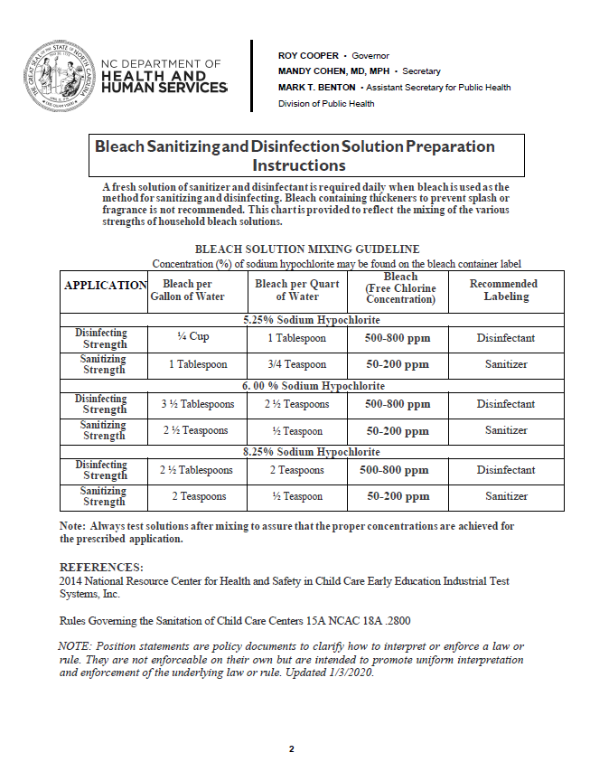
Sanitized and Disinfectant Mixing Guidance
CEH Website – Policy Memos
https://ehs.dph.ncdhhs.gov/hhccehb/cehu/ccs/policymemos.htm

Slide 8
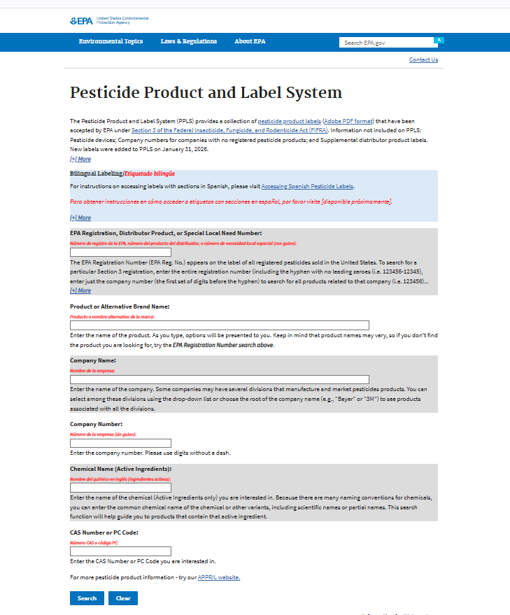
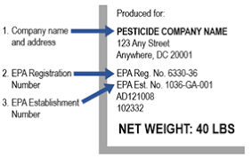
EPA Registration
https://ordspub.epa.gov/ords/pesticides/f?p=PPLS:1
Need EPA Registration #

Slide 9
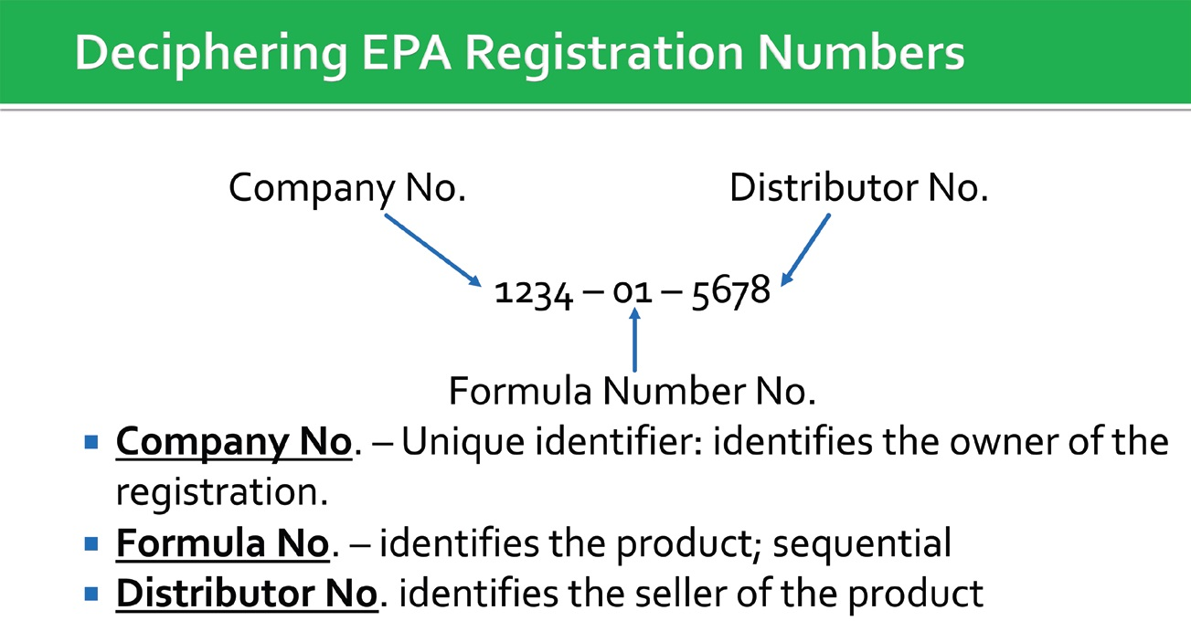
EPA Registration Numbers

Slide 10
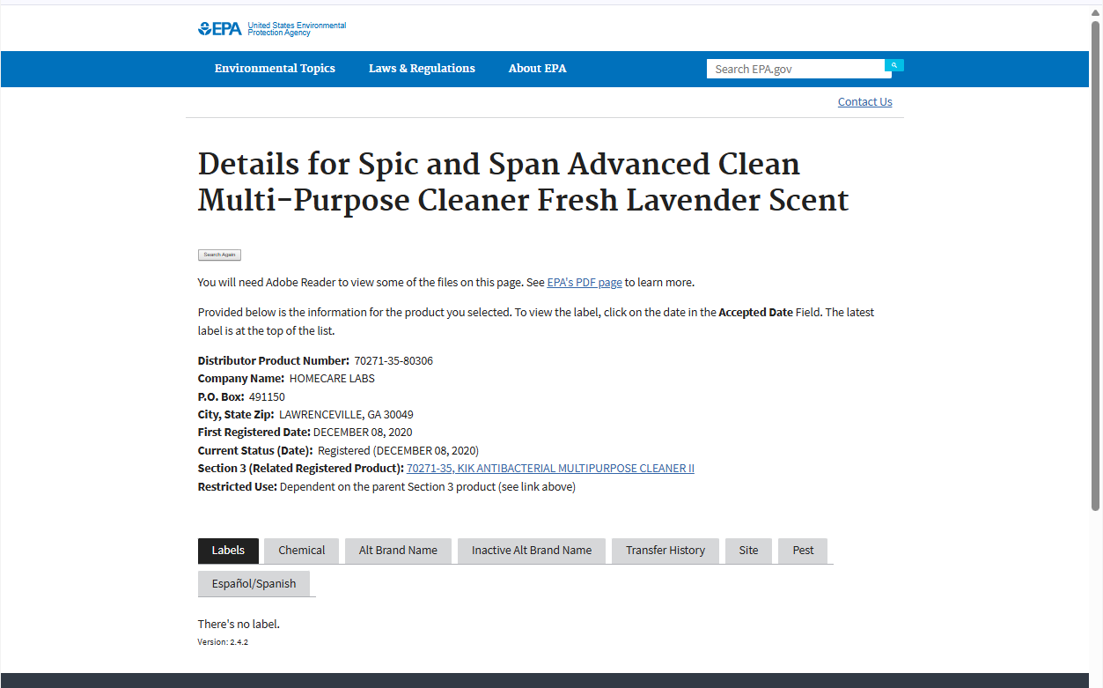
EPA Registration Numbers

Slide 11
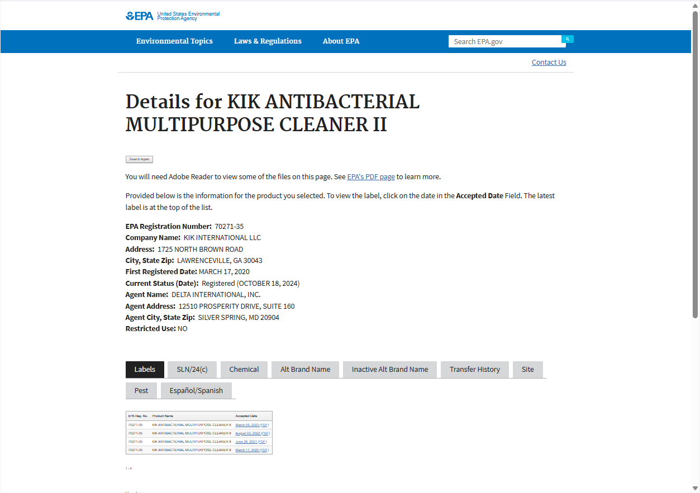
EPA Registration Numbers

Slide 12
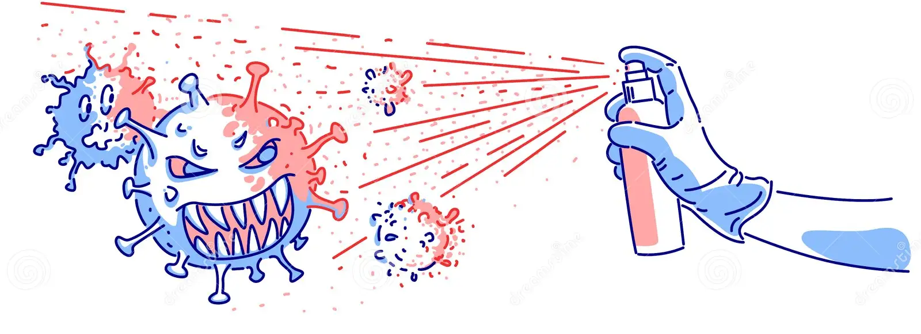
Sanitizer Exercise

Slide 13
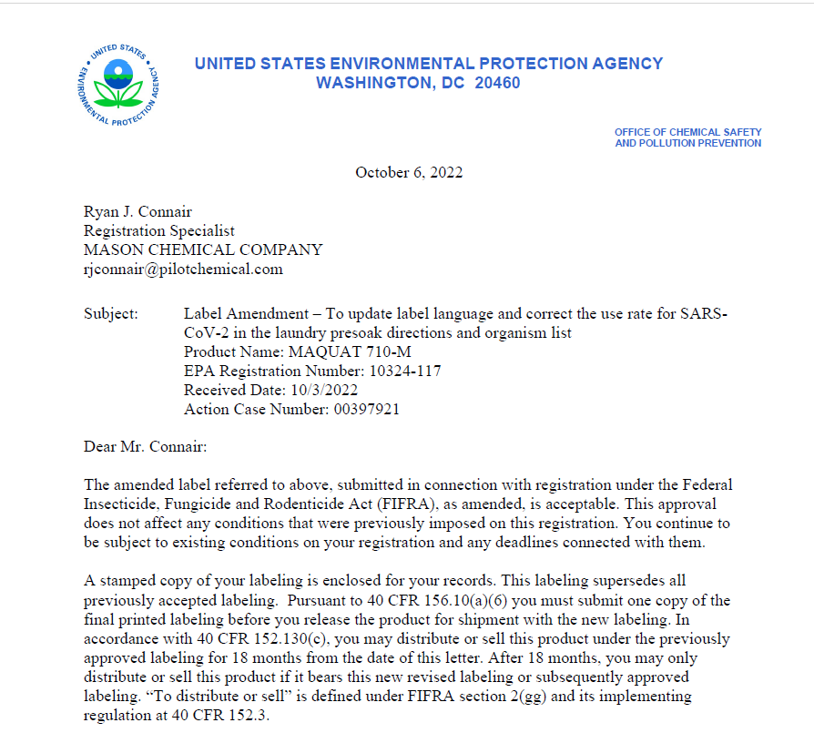
EPA Registration

Slide 14
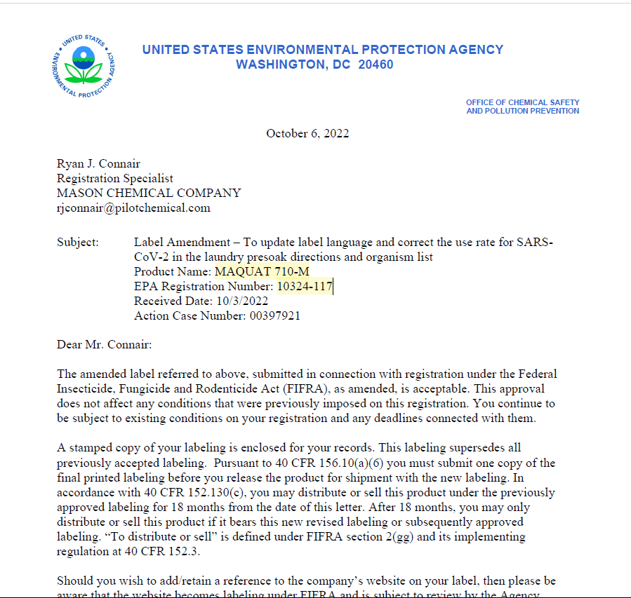
EPA Registered Sanitizer

Slide 15
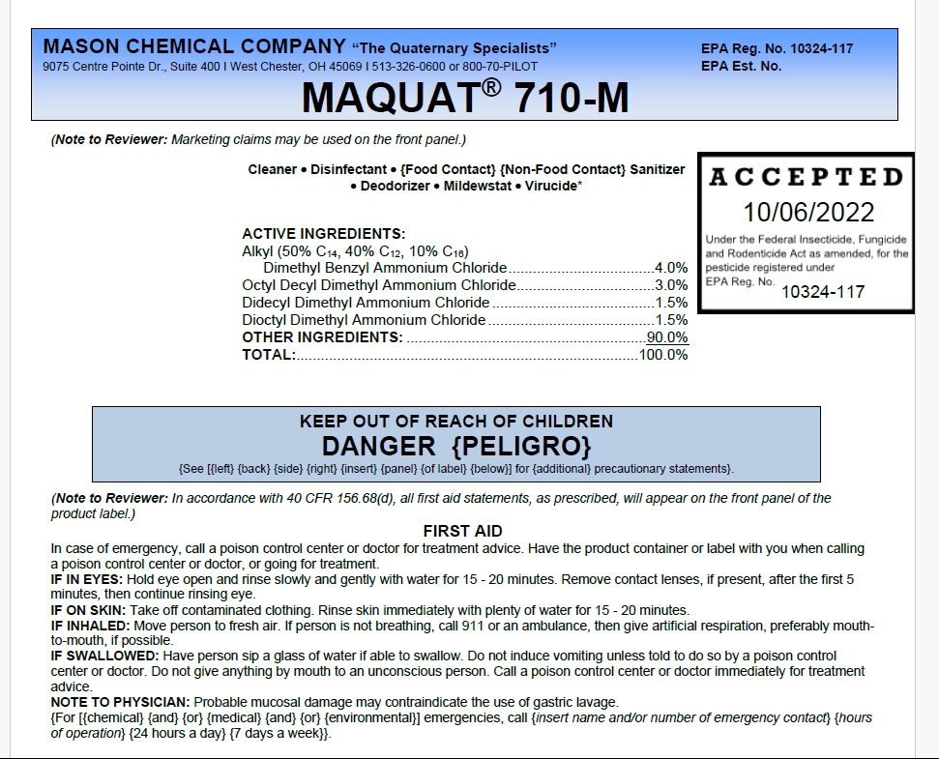
EPA Registered Sanitizer

Slide 16
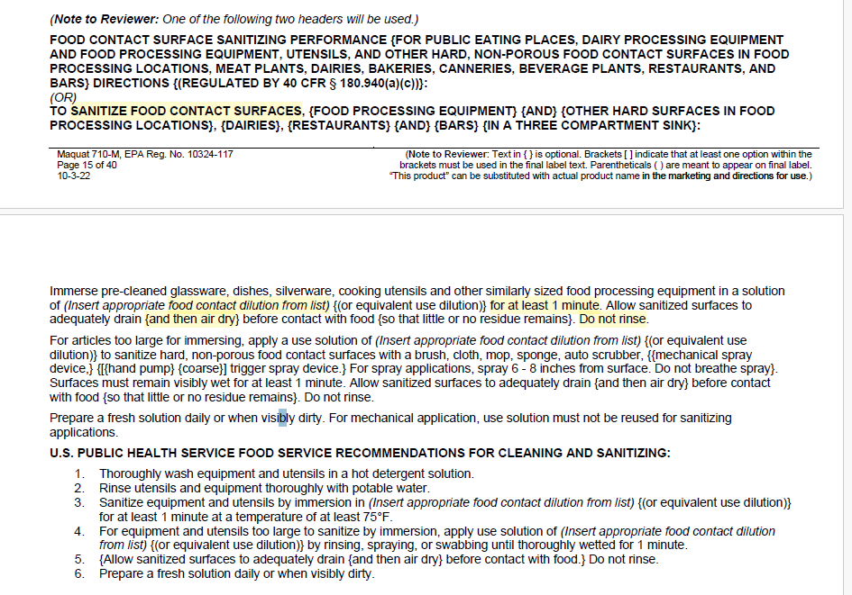
EPA Registered Sanitizer
Contact time by rule “at least 2 minutes” .2812 (5)(D)

Slide 17
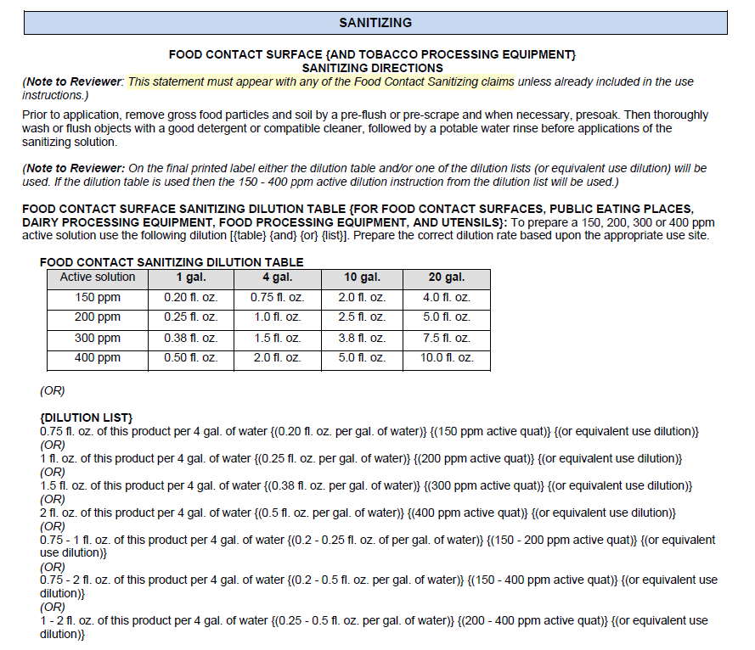
EPA
Registered Sanitizer
Test Method
200 ppm – 400 ppm by rule .2812 (5)(D)

Slide 18
EPA Registered Sanitizer
15A NCAC 18A .2812 CLEANING, SANITIZING, AND DISINFECTING EQUIPMENT, UTENSILS, AND OTHER AREAS
(D) immersion for at least two minutes in a solution containing 200 to 400 ppm of quaternary ammonium products and having a temperature of at least 75 degrees Fahrenheit, provided that the quaternary ammonium product label indicates that it is effective in water that has a hardness value at least equal to that of the water being used;

Slide 19

Disinfectant Exercise

Slide 20
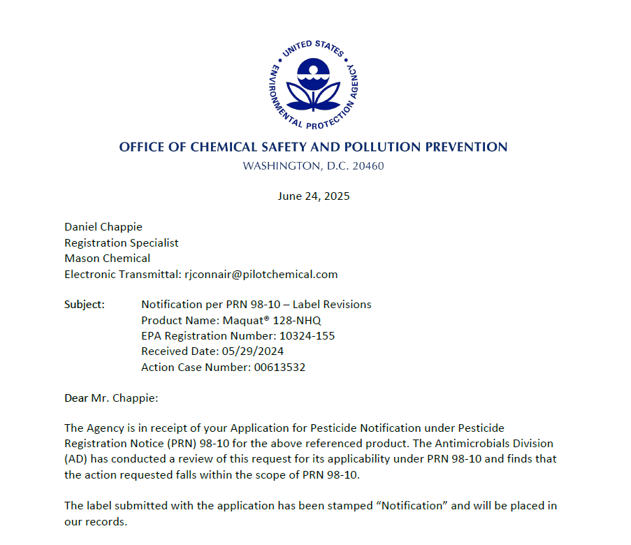
EPA
Registration

Slide 21
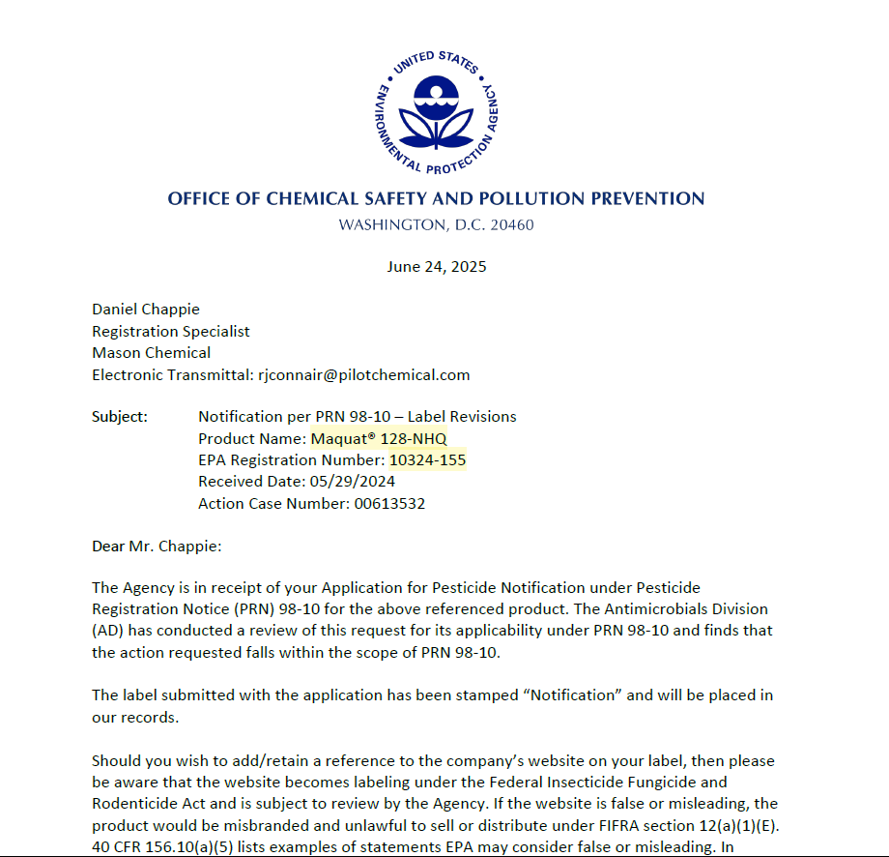
EPA
Registered Disinfectant

Slide 22
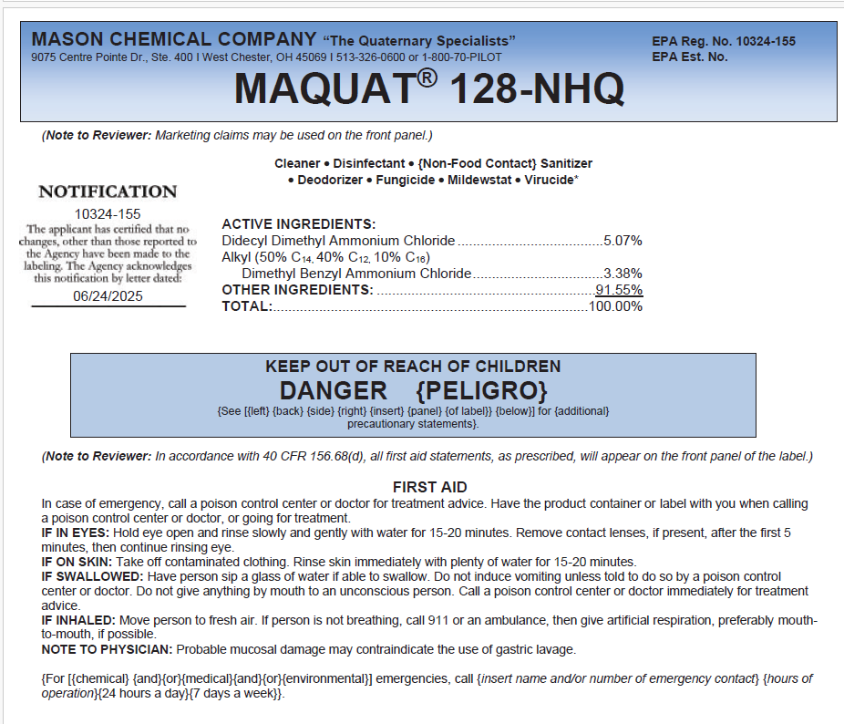
EPA
Registered Disinfectant

Slide 23
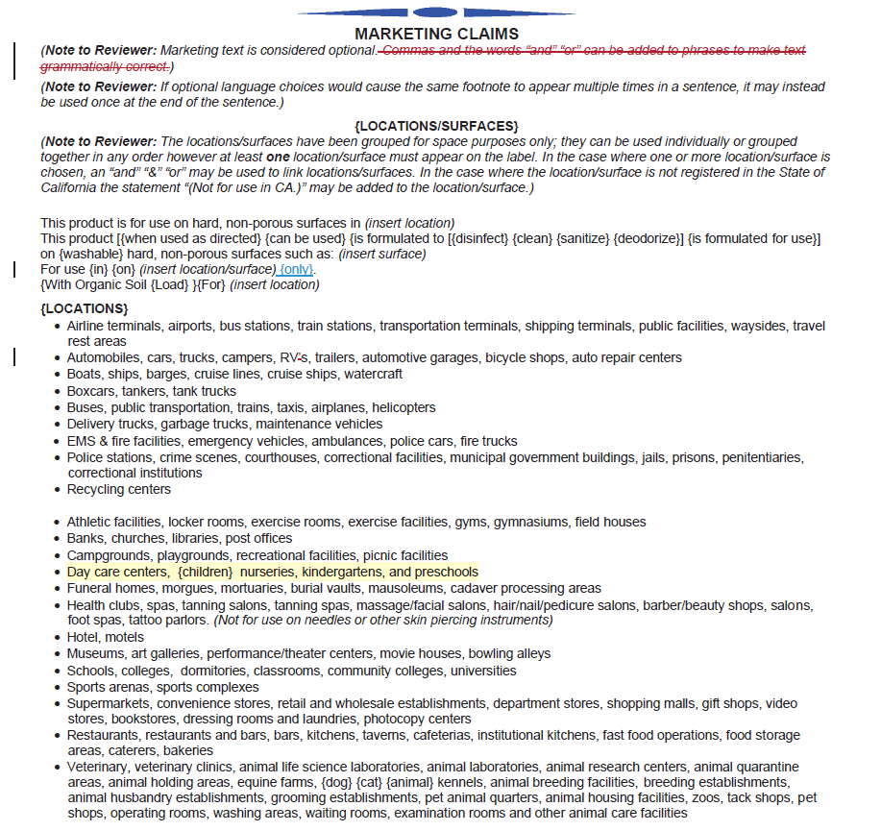
EPA
Registered Disinfectant
Locations (use indicated in schools and child care)

Slide 24
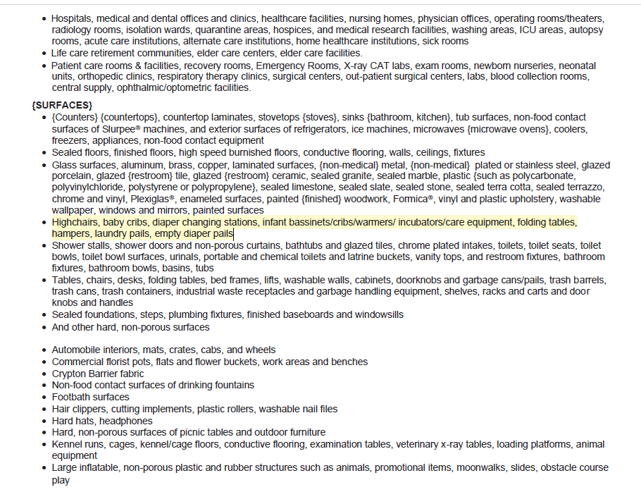
EPA
Registered Disinfectant
Surfaces are not
required by rule

Slide 25
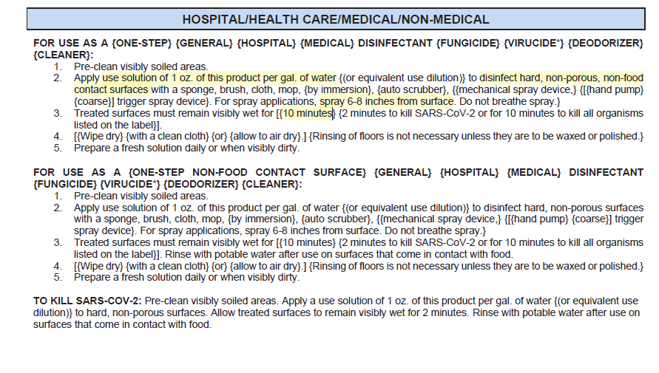
EPA
Registered Disinfectant

Slide 26
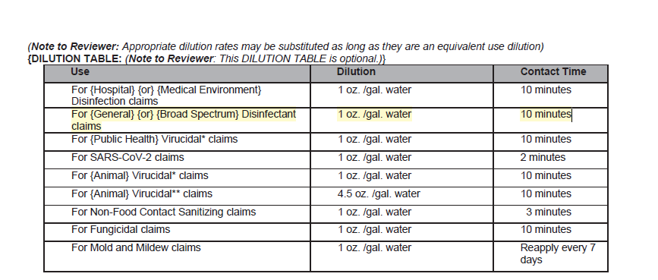
EPA
Registered Disinfectant

Slide 27
How to Determine Contact Time for EPA Registered Disinfectants
To determine the contact time for an EPA registered disinfectant:
Review instructions on the product label and determine what is listed as the contact time for a general disinfectant.
This contact time is determined during the registration process based on evaluation of the disinfectant’s effectiveness against two organisms and an alternate: Staphylococcus aureus, Salmonella enterica and Pseudomonas aeruginosa.

Slide 28
How to Determine Contact Time for EPA Registered Disinfectants
Companies can add additional contact times for other pathogens:
Some contact times may be shorter as in the case of certain viruses
Some may be longer as in the case of HepA or pathogenic fungus.
These are voluntary claims that the companies make based on the products’ performance and marketing objectives.
These voluntary claims do not change the contact time for use as a general disinfectant.

Slide 29
How to Determine Contact Time for EPA Registered Disinfectants
If the contact time for use as a general disinfectant cannot be determined by the products label:
The EPA Registration information should be reviewed, and the contact time for Staphylococcus aureus, Salmonella enterica and Pseudomonas aeruginosa, will be the required contact time.
EPA Registration information can be found by searching the EPA Registration number from products label at: https://ordspub.epa.gov/ords/pesticides/f?p=PPLS:1
See attached guidance document or contact your Regional Specialist for more information.

Slide 30
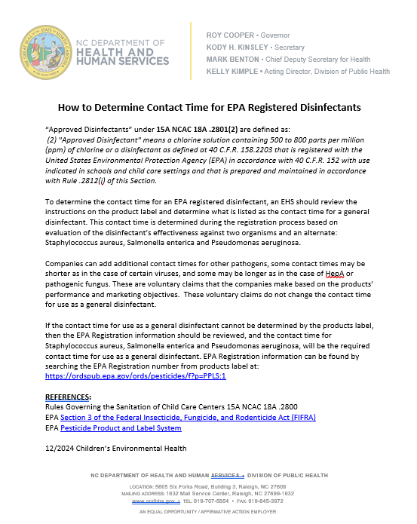

Slide 31
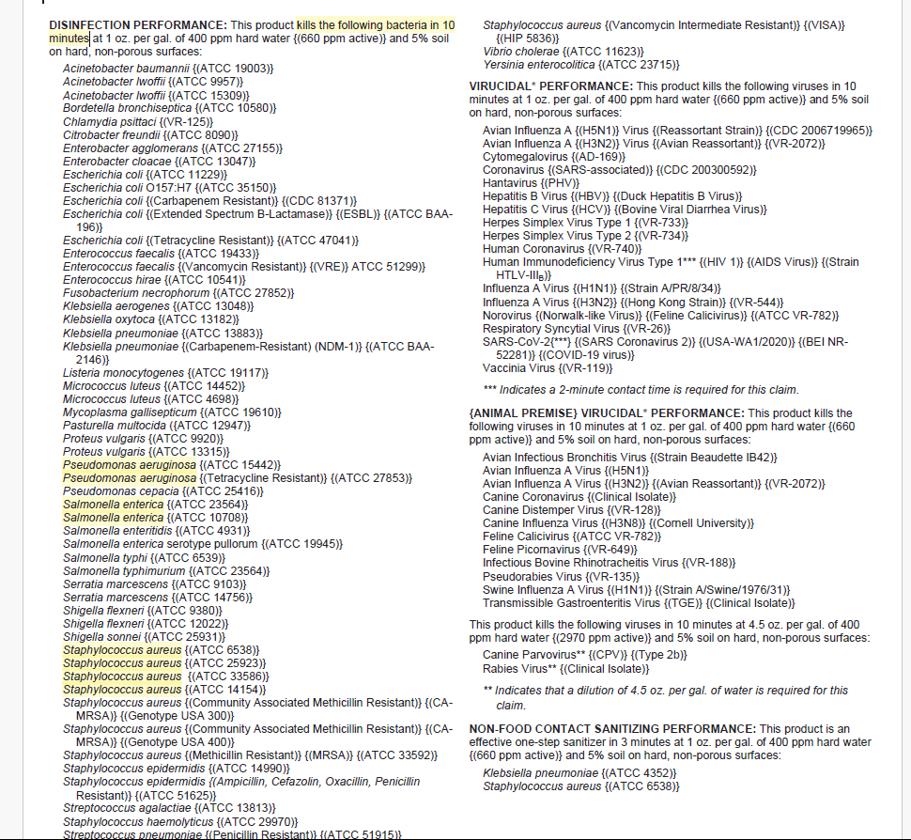
How to Determine Contact Time for EPA Registered Disinfectants MAQUAT® 128-NHQ

Slide 32

Disinfectant Contact Time Exercise

Slide 33
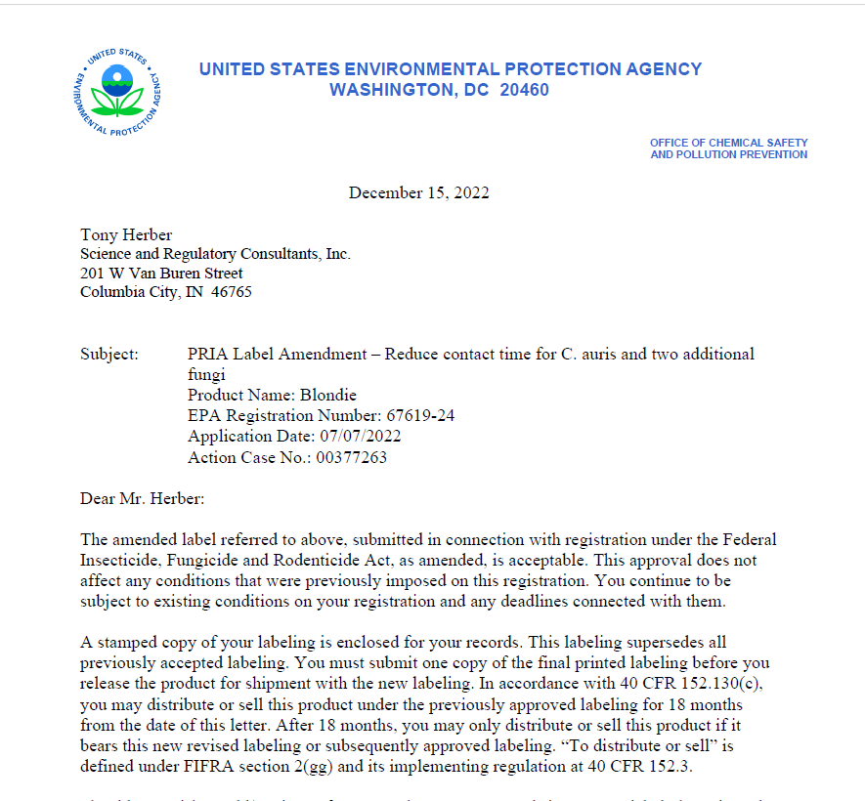
How to Determine Contact Time for EPA Registered Disinfectants

Slide 34
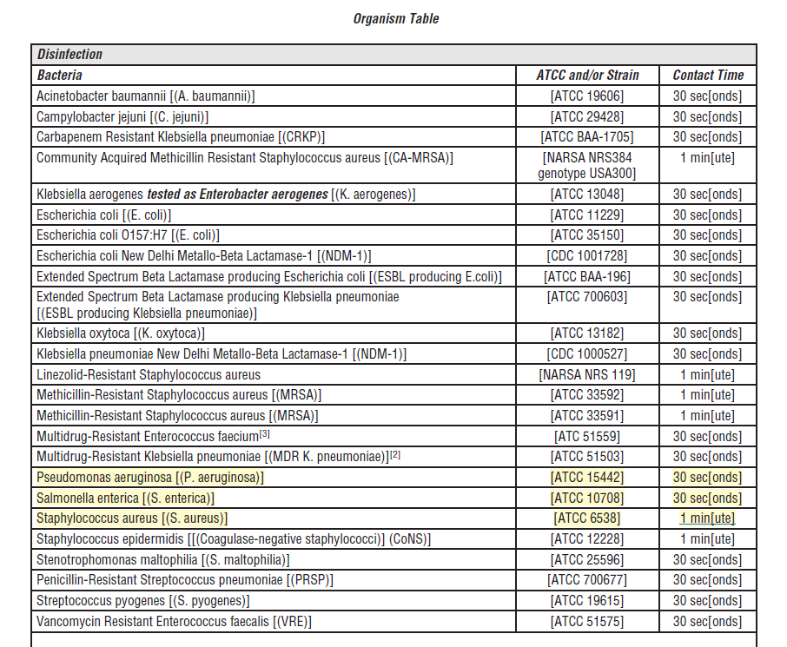
How to Determine Contact Time for EPA Registered Disinfectants Blondie Active Ingredient: Hydrogen Peroxide …… 1.4% Other Ingredients:…… 98.6% Total: ………………….… 100.0%

Slide 35
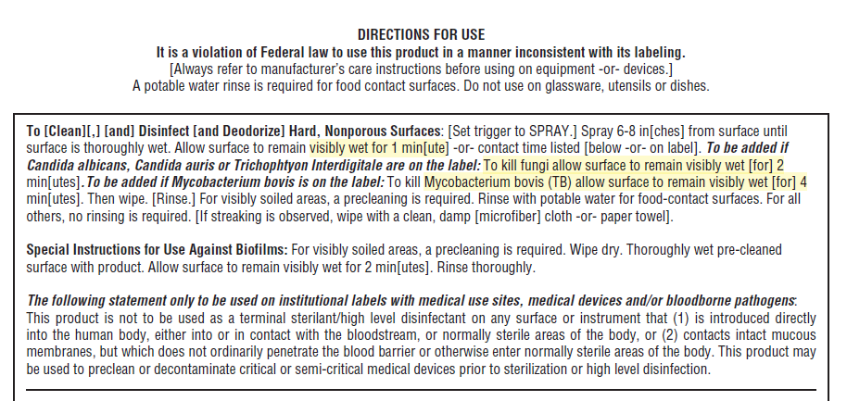
How to Determine Contact Time for EPA Registered Disinfectants Blondie Active Ingredient: Hydrogen Peroxide …… 1.4% Other Ingredients:…… 98.6% Total: ………………….… 100.0%

Slide 36


QUESTIONS?
Rob Pearsall, REHS
Children’s Environmental Health
Environmental Health Regional Specialist Team Leader
robert.pearsall@dhhs.nc.gov
(910) 624-1835

