Slide 1
Animal and Vermin Control Outdoor Learning Environment and Premises
Alan Huneycutt, REHS, MPH
Children’s Environmental Health
704-618-0138
Alan.Huneycutt@dhhs.nc.gov
2026

Slide 2
Animal and Vermin Control
15A NCAC 18A .2831

Slide 3

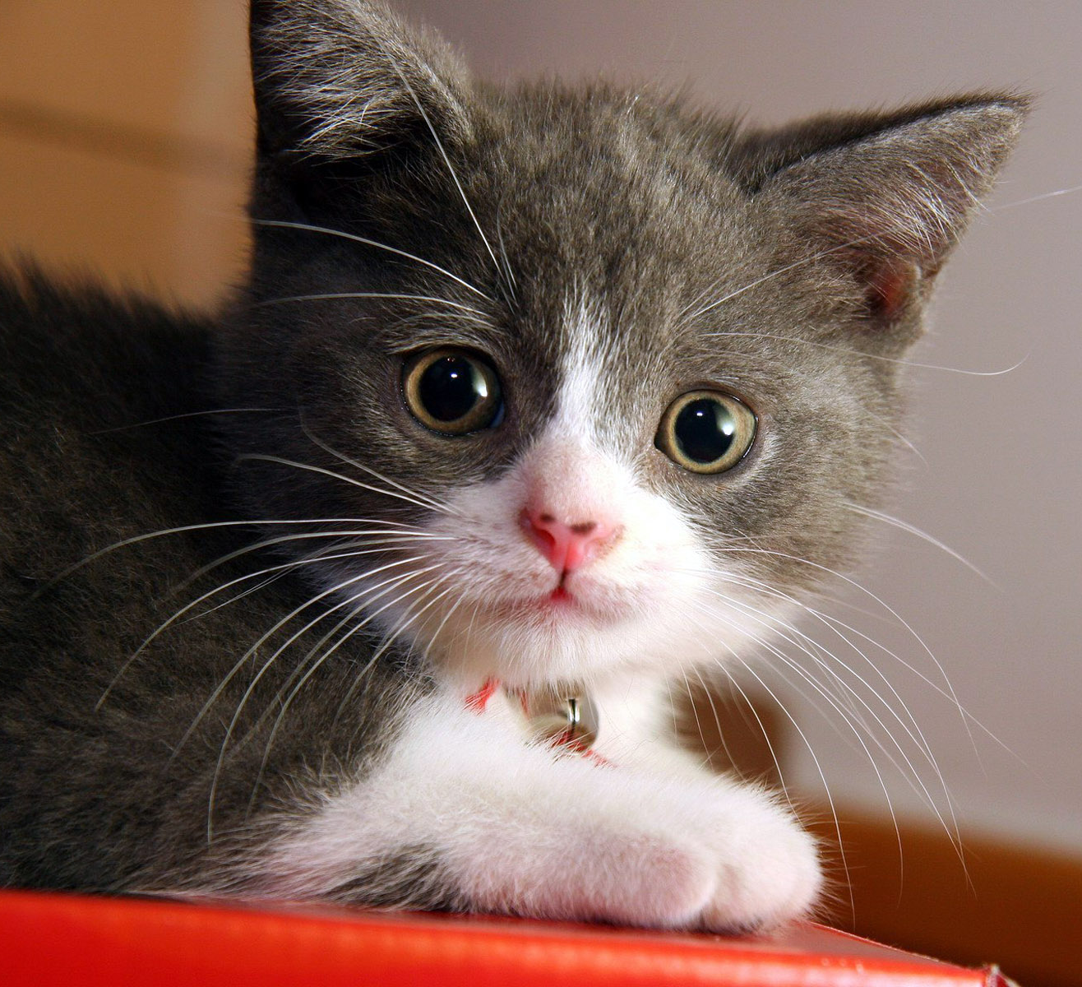

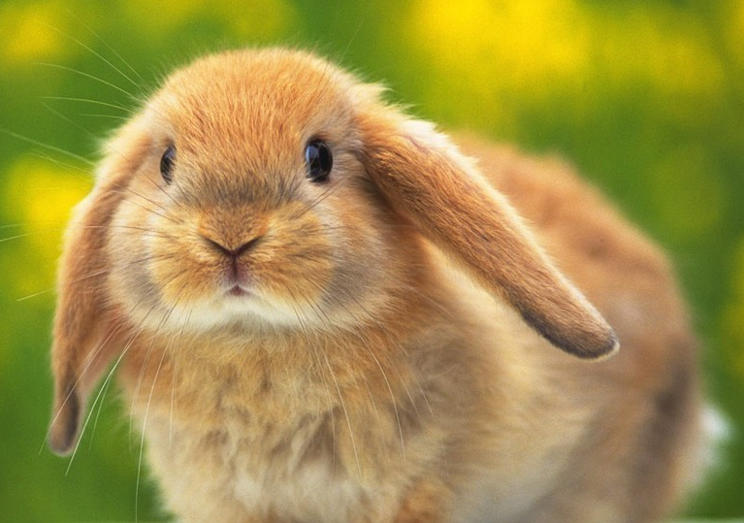
Animal and Vermin Control .2831(a)
Vaccination records available for animals on the premises
Any animals kept as pets shall be examined by a Veterinarian
Animals belonging to child care owners, employees, volunteers, visitors, and children shall not be allowed in child care centers or on the premises unless the requirements are met.

Slide 4
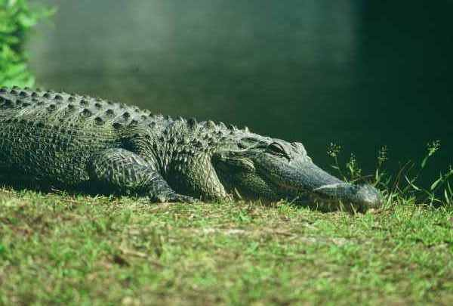
Told for the truth!
.2831(a)Turtles, iguanas, frogs, salamanders, and other reptiles or amphibians are not allowed to be kept as pets on the premises.
I was told that this alligator was found near a child care center in South Carolina. The kids were feeding it.

Slide 5
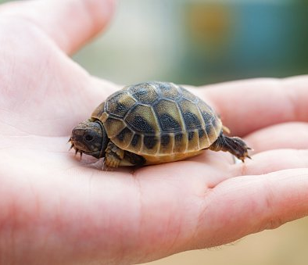
Turtles, iguanas, frogs, salamanders, and other reptiles or amphibians…
In 2015 and 2016, more than 202 people were sickened in several nationwide salmonella outbreaks linked to small turtles.
41% of patients were children younger than 5 years.
Some people in these outbreaks became sick even when they did not touch the turtles, but had turtles in their households.
Centers for Disease Control

Slide 6
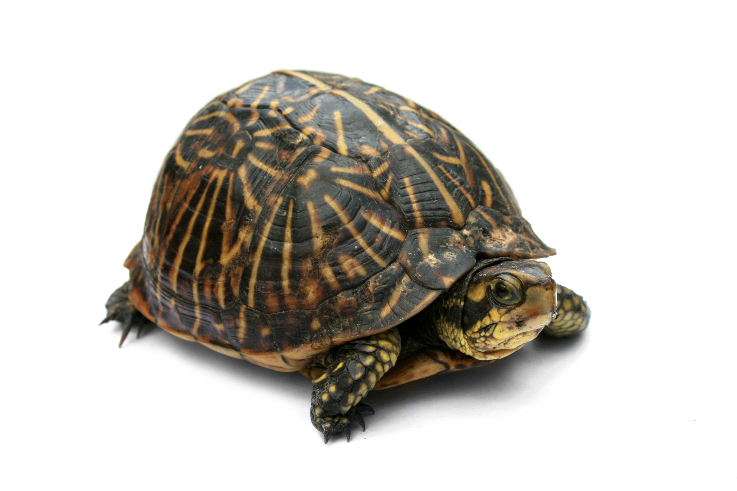
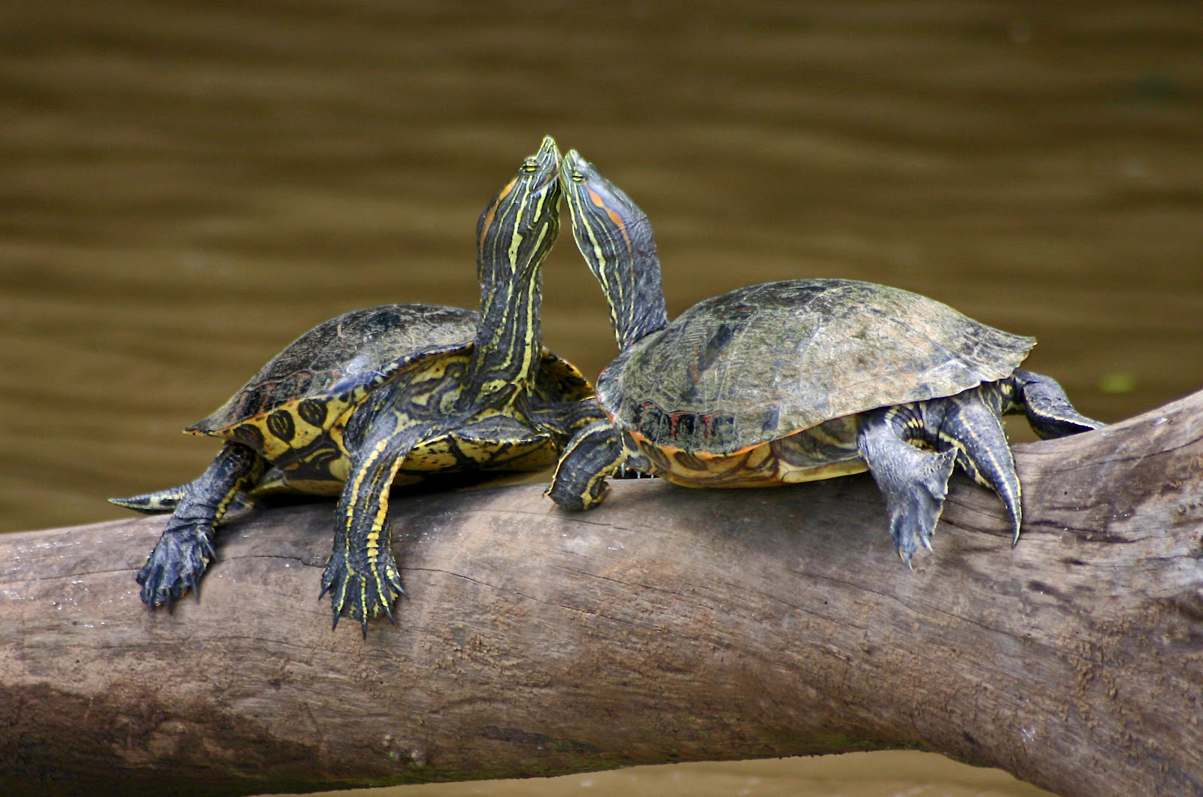
Turtles, iguanas, frogs, salamanders, and other reptiles or amphibians…
From 2006 to 2014, CDC investigated 15 multistate Salmonella outbreaks linked to turtles
921 people were sickened
156 were hospitalized
an infant died

Slide 7
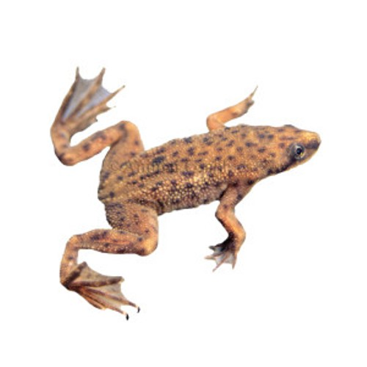
Turtles, iguanas, frogs, salamanders, and other reptiles or amphibians…
In 2011, CDC investigated an outbreak linked to African dwarf frogs
241 people were sickened
69% were younger than 10 years.

Slide 8
Turtles, iguanas, frogs, salamanders, and other reptiles or amphibians…
Most, if not all, reptiles carry Salmonella in their intestinal tract and intermittently or continuously shed these bacteria in their feces.
Studies have shown that 85% of all turtles, 77% of lizards, and 92% of snakes carry one of the 500 serotypes of Salmonella.
Salmonella usually do not cause any illness in reptiles, but can cause serious illness in people. (Petco)

Slide 9
Turtles, iguanas, frogs, salamanders, and other reptiles or amphibians…
Pregnant women, children, elderly or frail adults, or immunosuppressed people are particularly at risk of infection or serious complications of salmonellosis. At a minimum, they need to take extra precautions; ideally, they should avoid contact with reptiles. (Petco)

Slide 10
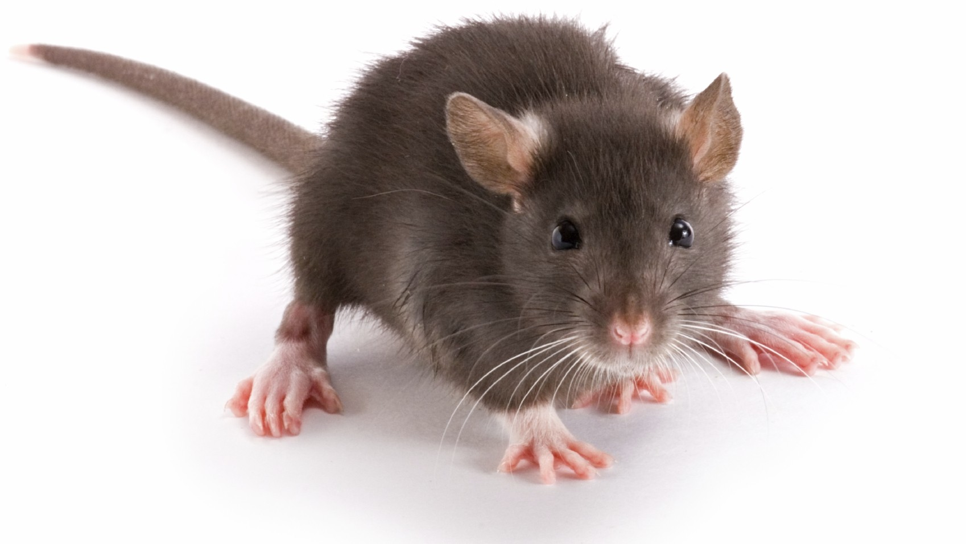
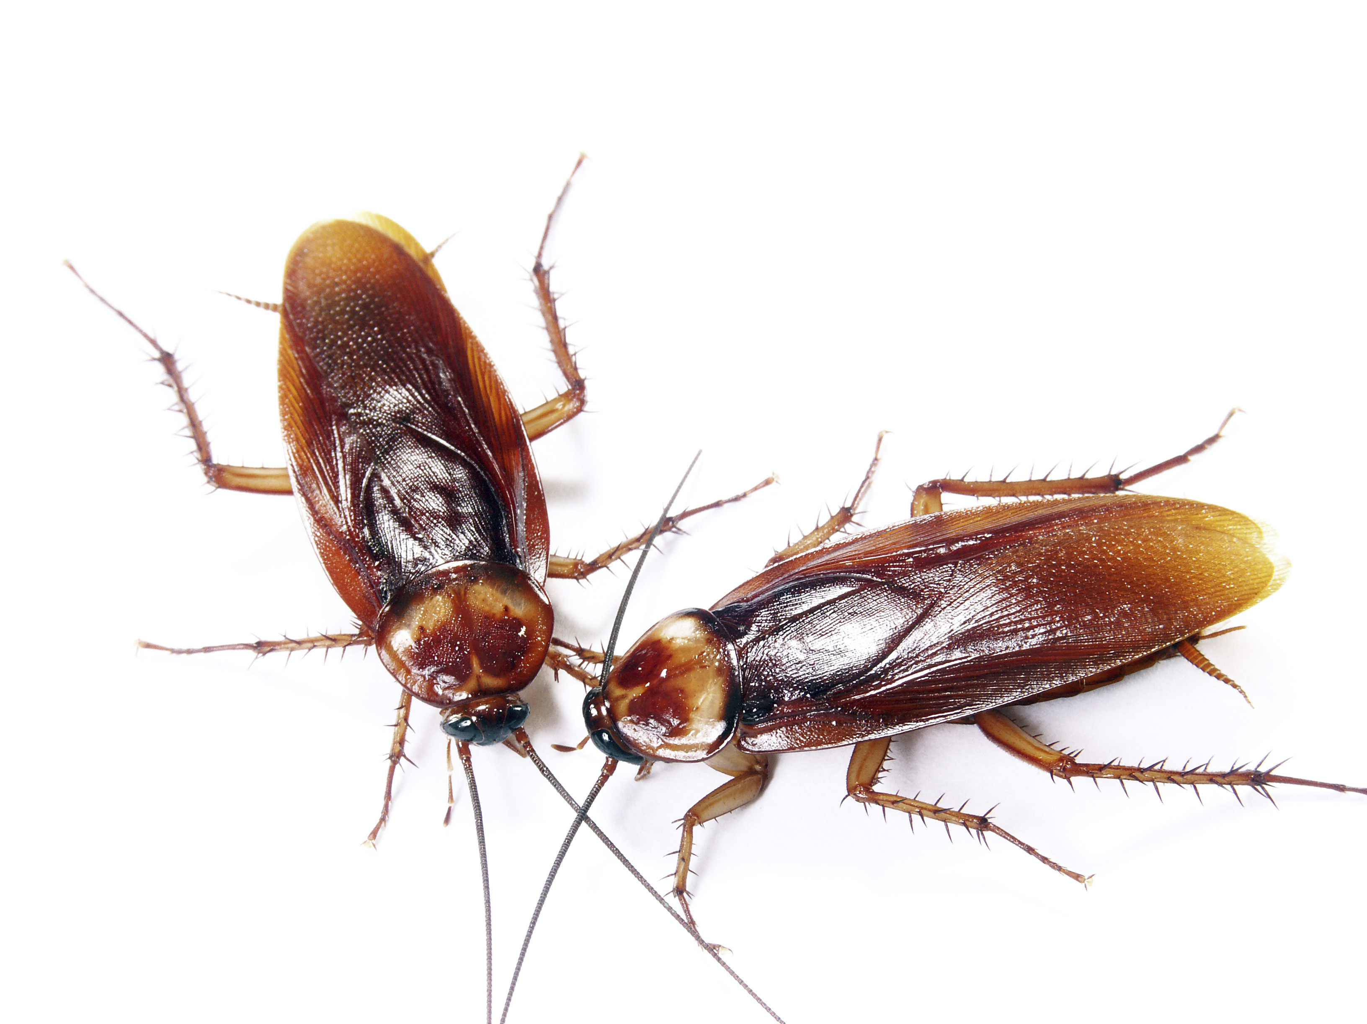
Insects, Rodents and other Vermin
What have you heard an operator say?

Slide 11
Insects, Rodents and other Vermin
What have you heard?
I’ve never seen one before.
We clean that everyday.
We’ve had problems ever since the flood.
They come from next door.
I think they (pest control company) are spraying water.
I’ve done everything.

Slide 12
Effective measures… .2831(b)
Cleaning is essential in preventing pests
Caulking cracks and gaps
Containing food
Reducing clutter
Maintaining buildings to control entry of pests
Maintaining Waste areas
Self inspections

Slide 13
Structural Control for Pests
Structural improvements will not eliminate pests, but can control the entry of pests!
Suggest improvements during inspections
Encourage facility self inspections and communication with staff

Slide 14
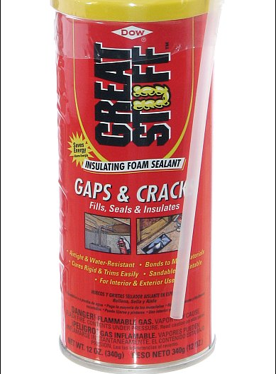
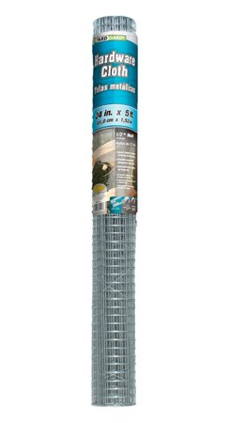
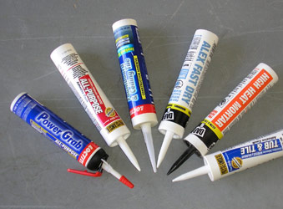
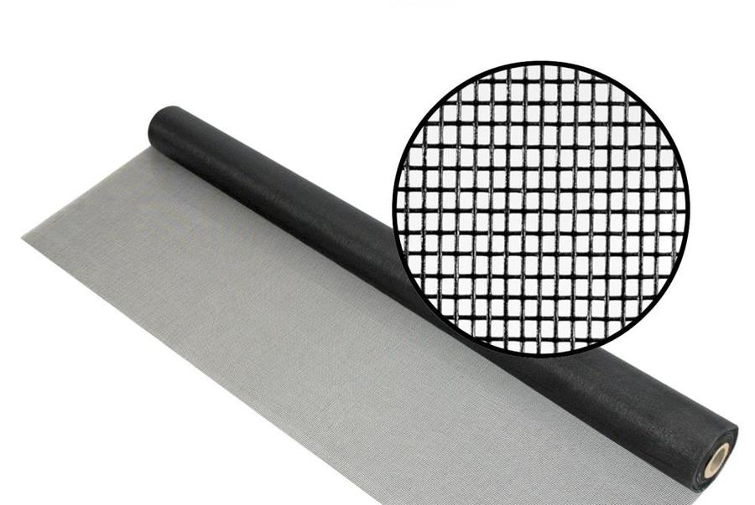
Supplies are readily available
Caulking
Expanding foam insulation/sealer
Window/door screen
¼ inch Hardware Cloth

Slide 15
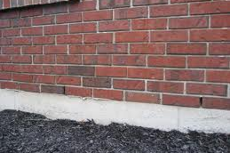
Structural controls for pests
Weep holes in masonry are to allow an outlet for moisture.
Do not seal them! Screen them!

Slide 16
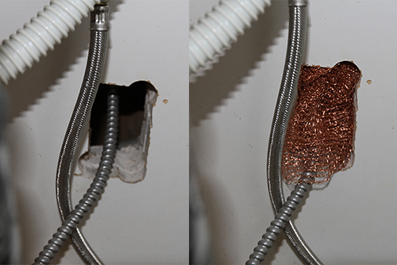
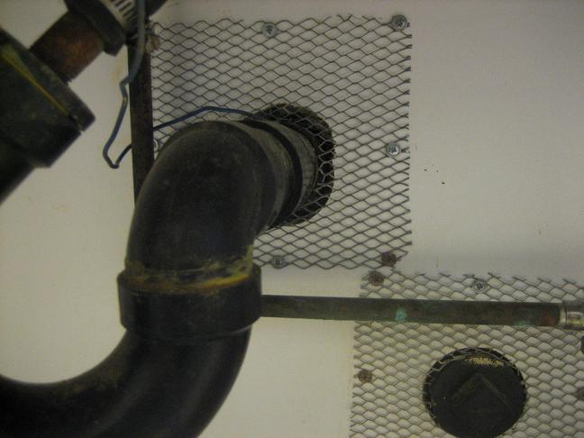
Structural controls for pests

Slide 17
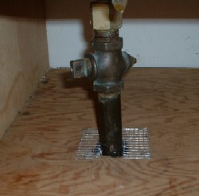
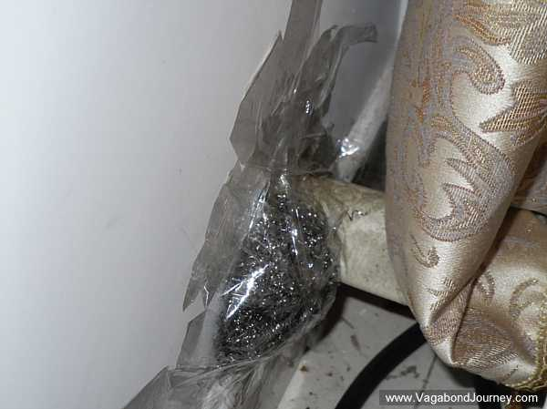
Structural controls for pests

Slide 18
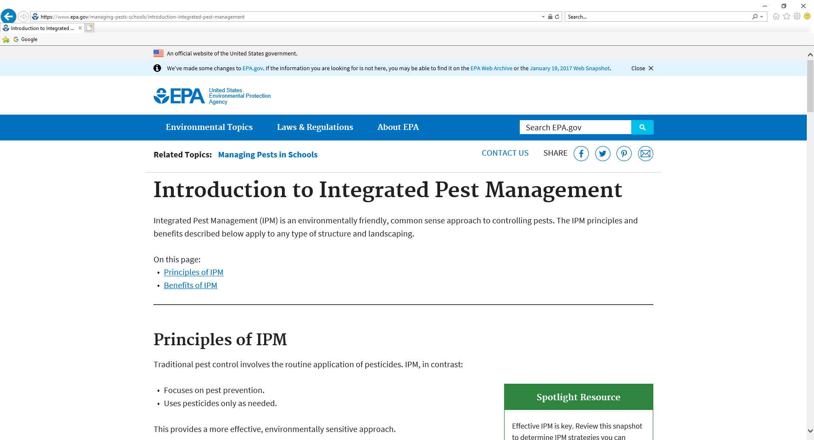
More information available from…

Slide 19
Pesticides… .2831(c) and (d)
In food preparation areas only fly traps, pyrethrin based insecticides, or a fly swatter shall be used for extermination of flying pests
Insecticides shall not come in contact …
Pesticides shall be used in accordance with the directions on the label and shall be stored in a locked storage room or cabinet separate from foods and medications.
Pesticides shall not be applied or used while children are present in the area.

Slide 20
Chromated Copper Arsenate (CCA) pressure-treated wood .2831 (e), (f), and (g)
Decks, fences, playground equipment and other products constructed or installed after September 1, 2006 shall not be made from CCA wood.
CCA wood installed or constructed shall be sealed using oil based semi-transparent sealant, oil-based clear stain or water based clear stain applied at lease once every two years.
Soil under CCA wood shall be removed and replaced with similar material, covered or otherwise made inaccessible to children. (rule provides more detail)

Slide 21
For more information on CCA
There is an interagency (CPSC, EPA and others) consumer awareness brochure called CCA-Pressure Treated Wood. It is CPSC publication 270.
More information at https://www.epa.gov/ingredients-used-pesticide-products/chromated-arsenicals-cca
CCA form is available on the CEH website

Slide 22
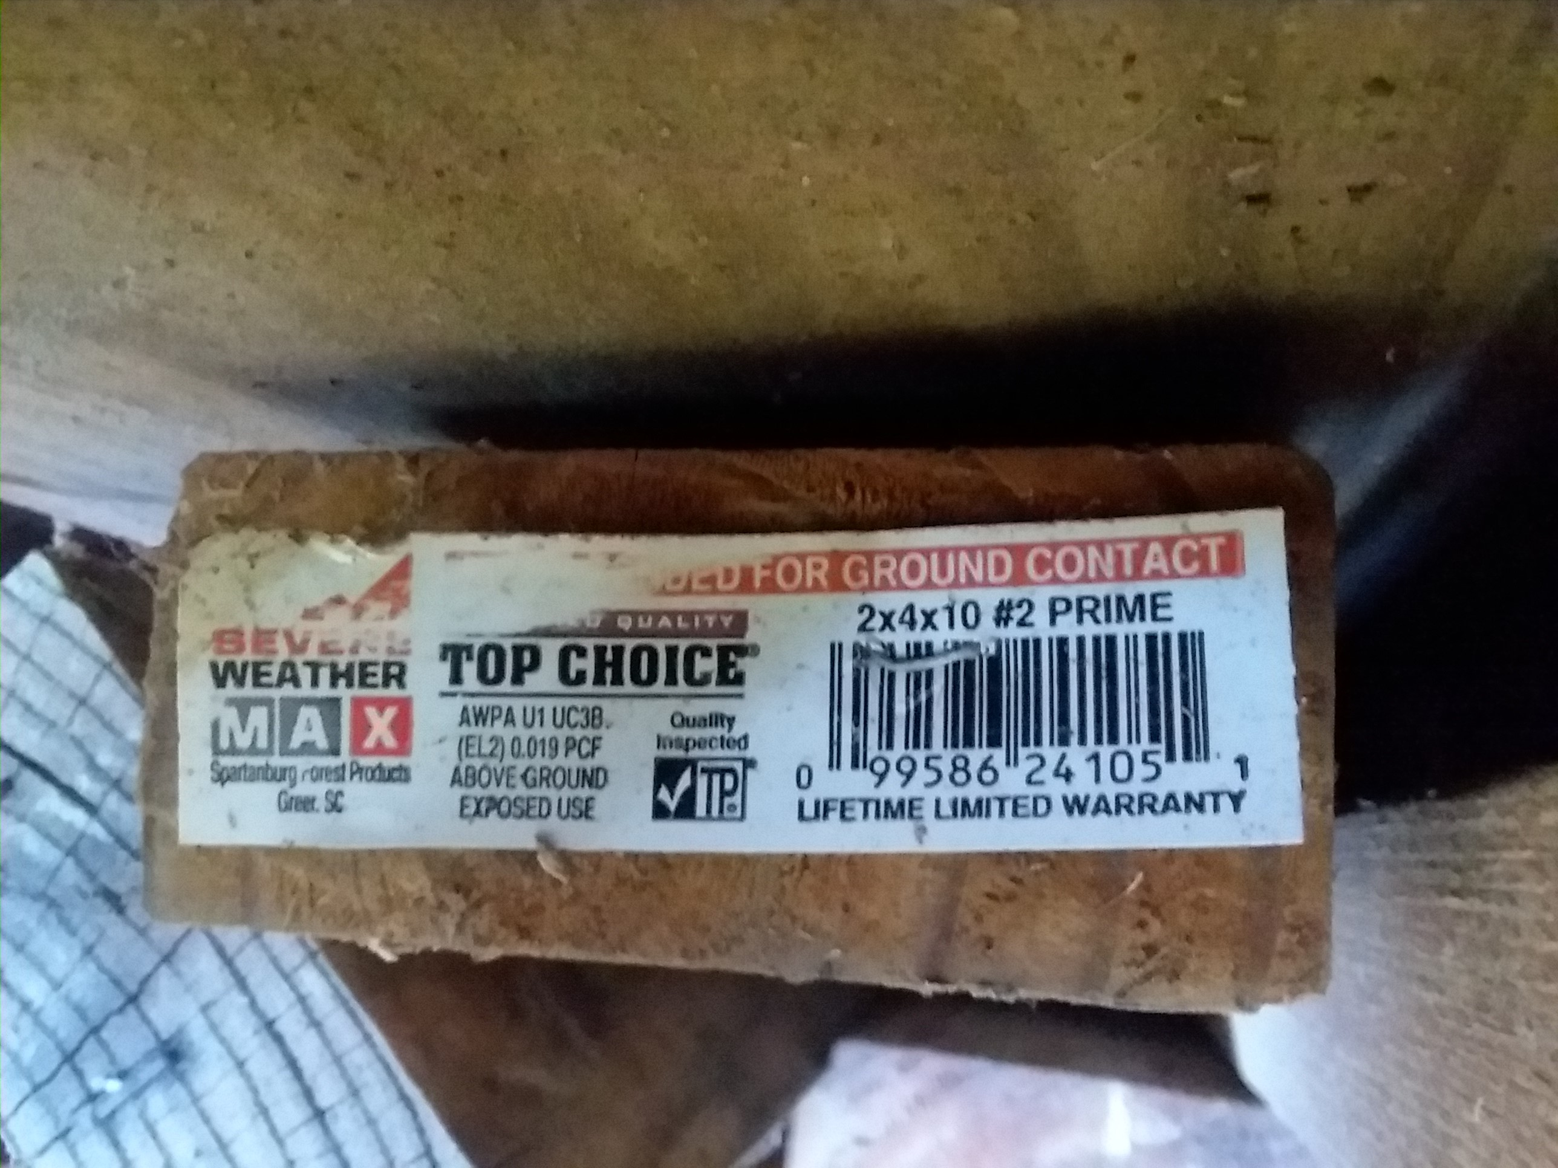
Treated wood tag
In this case EL2 is the preservative name code for DCOI-Imidicloprid-Stabilizer. Not CCA.

Slide 23
Any composting….2831(h)
…areas shall be covered and maintained to prevent attracting pests. Worm bins shall be covered.

Slide 24
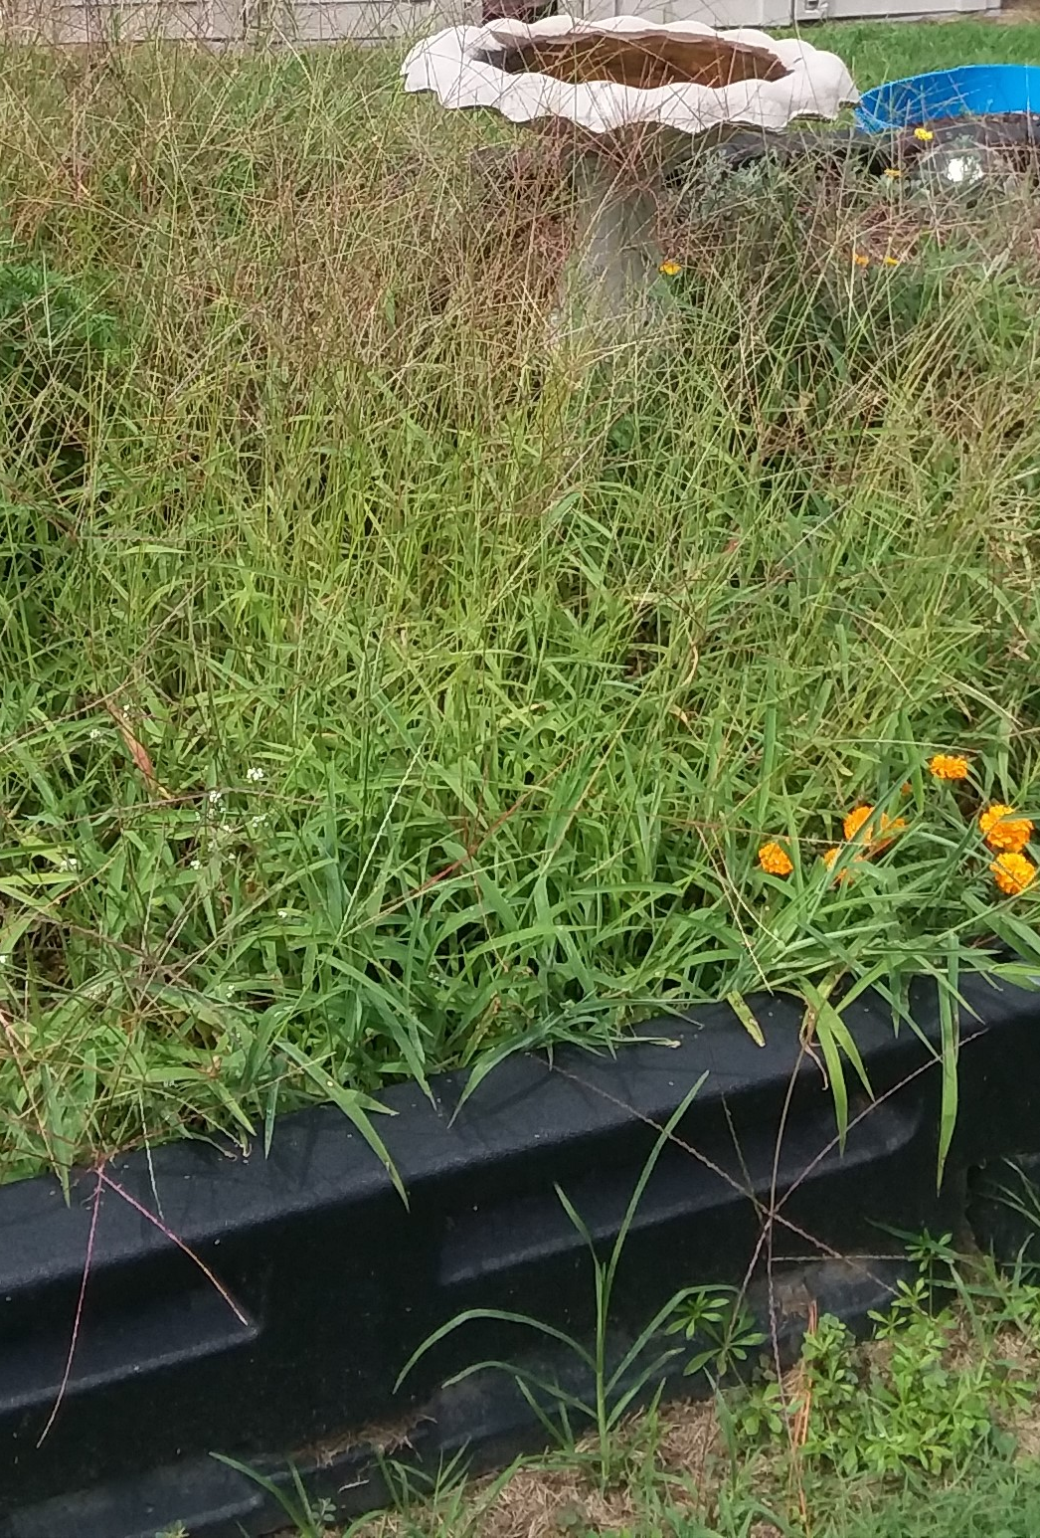
…vegetation shall be maintained… .2831(i)
Grass, fruit and vegetable gardens, vines on fences, and other vegetation shall be maintained to prevent the harboring and breeding of pests.

Slide 25
Outdoor Learning Environment and Premises
15A NCAC 18A .2832

Slide 26
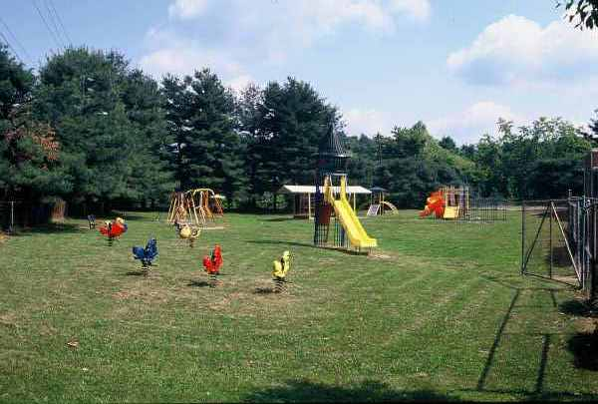
2832(a) …the premises...
What does this play ground have going for it?

Slide 27
2832(a) …the premises...
It appears to be:
-Clean
-drained to minimize standing water
-free of liter
-Maintained to minimize the pests

Slide 28
But…take a walk around the playground:

Slide 29
From there you can’t see:
what’s in the shade of the trees
What’s outside the gate to the right
broken or damaged equipment
Fencing condition
Storage shed/room?
Dead limbs hanging from the trees
If the structure with the roof is a sandbox

Slide 30
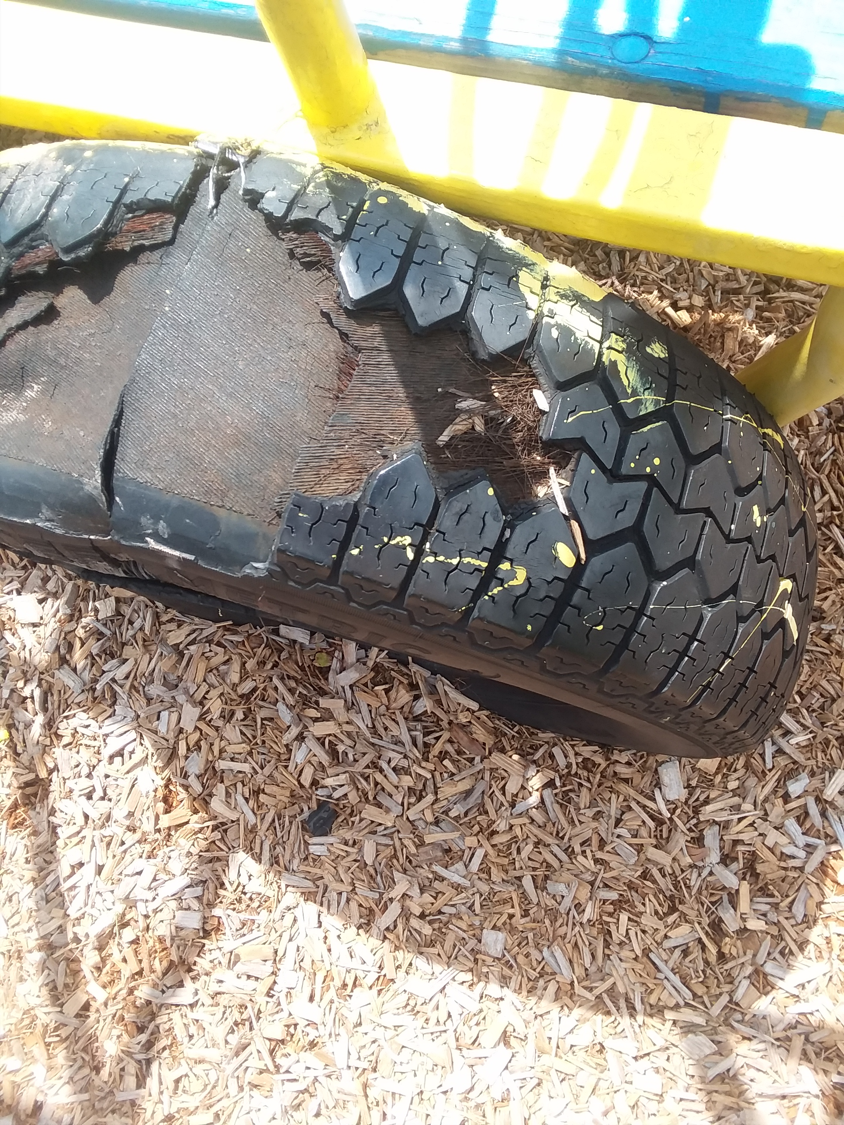
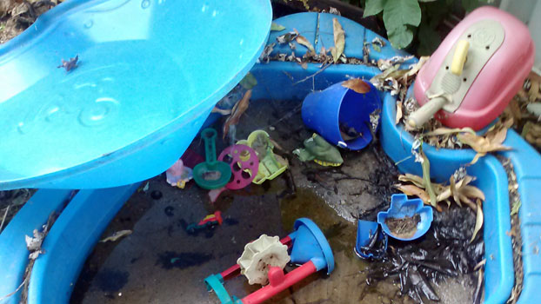
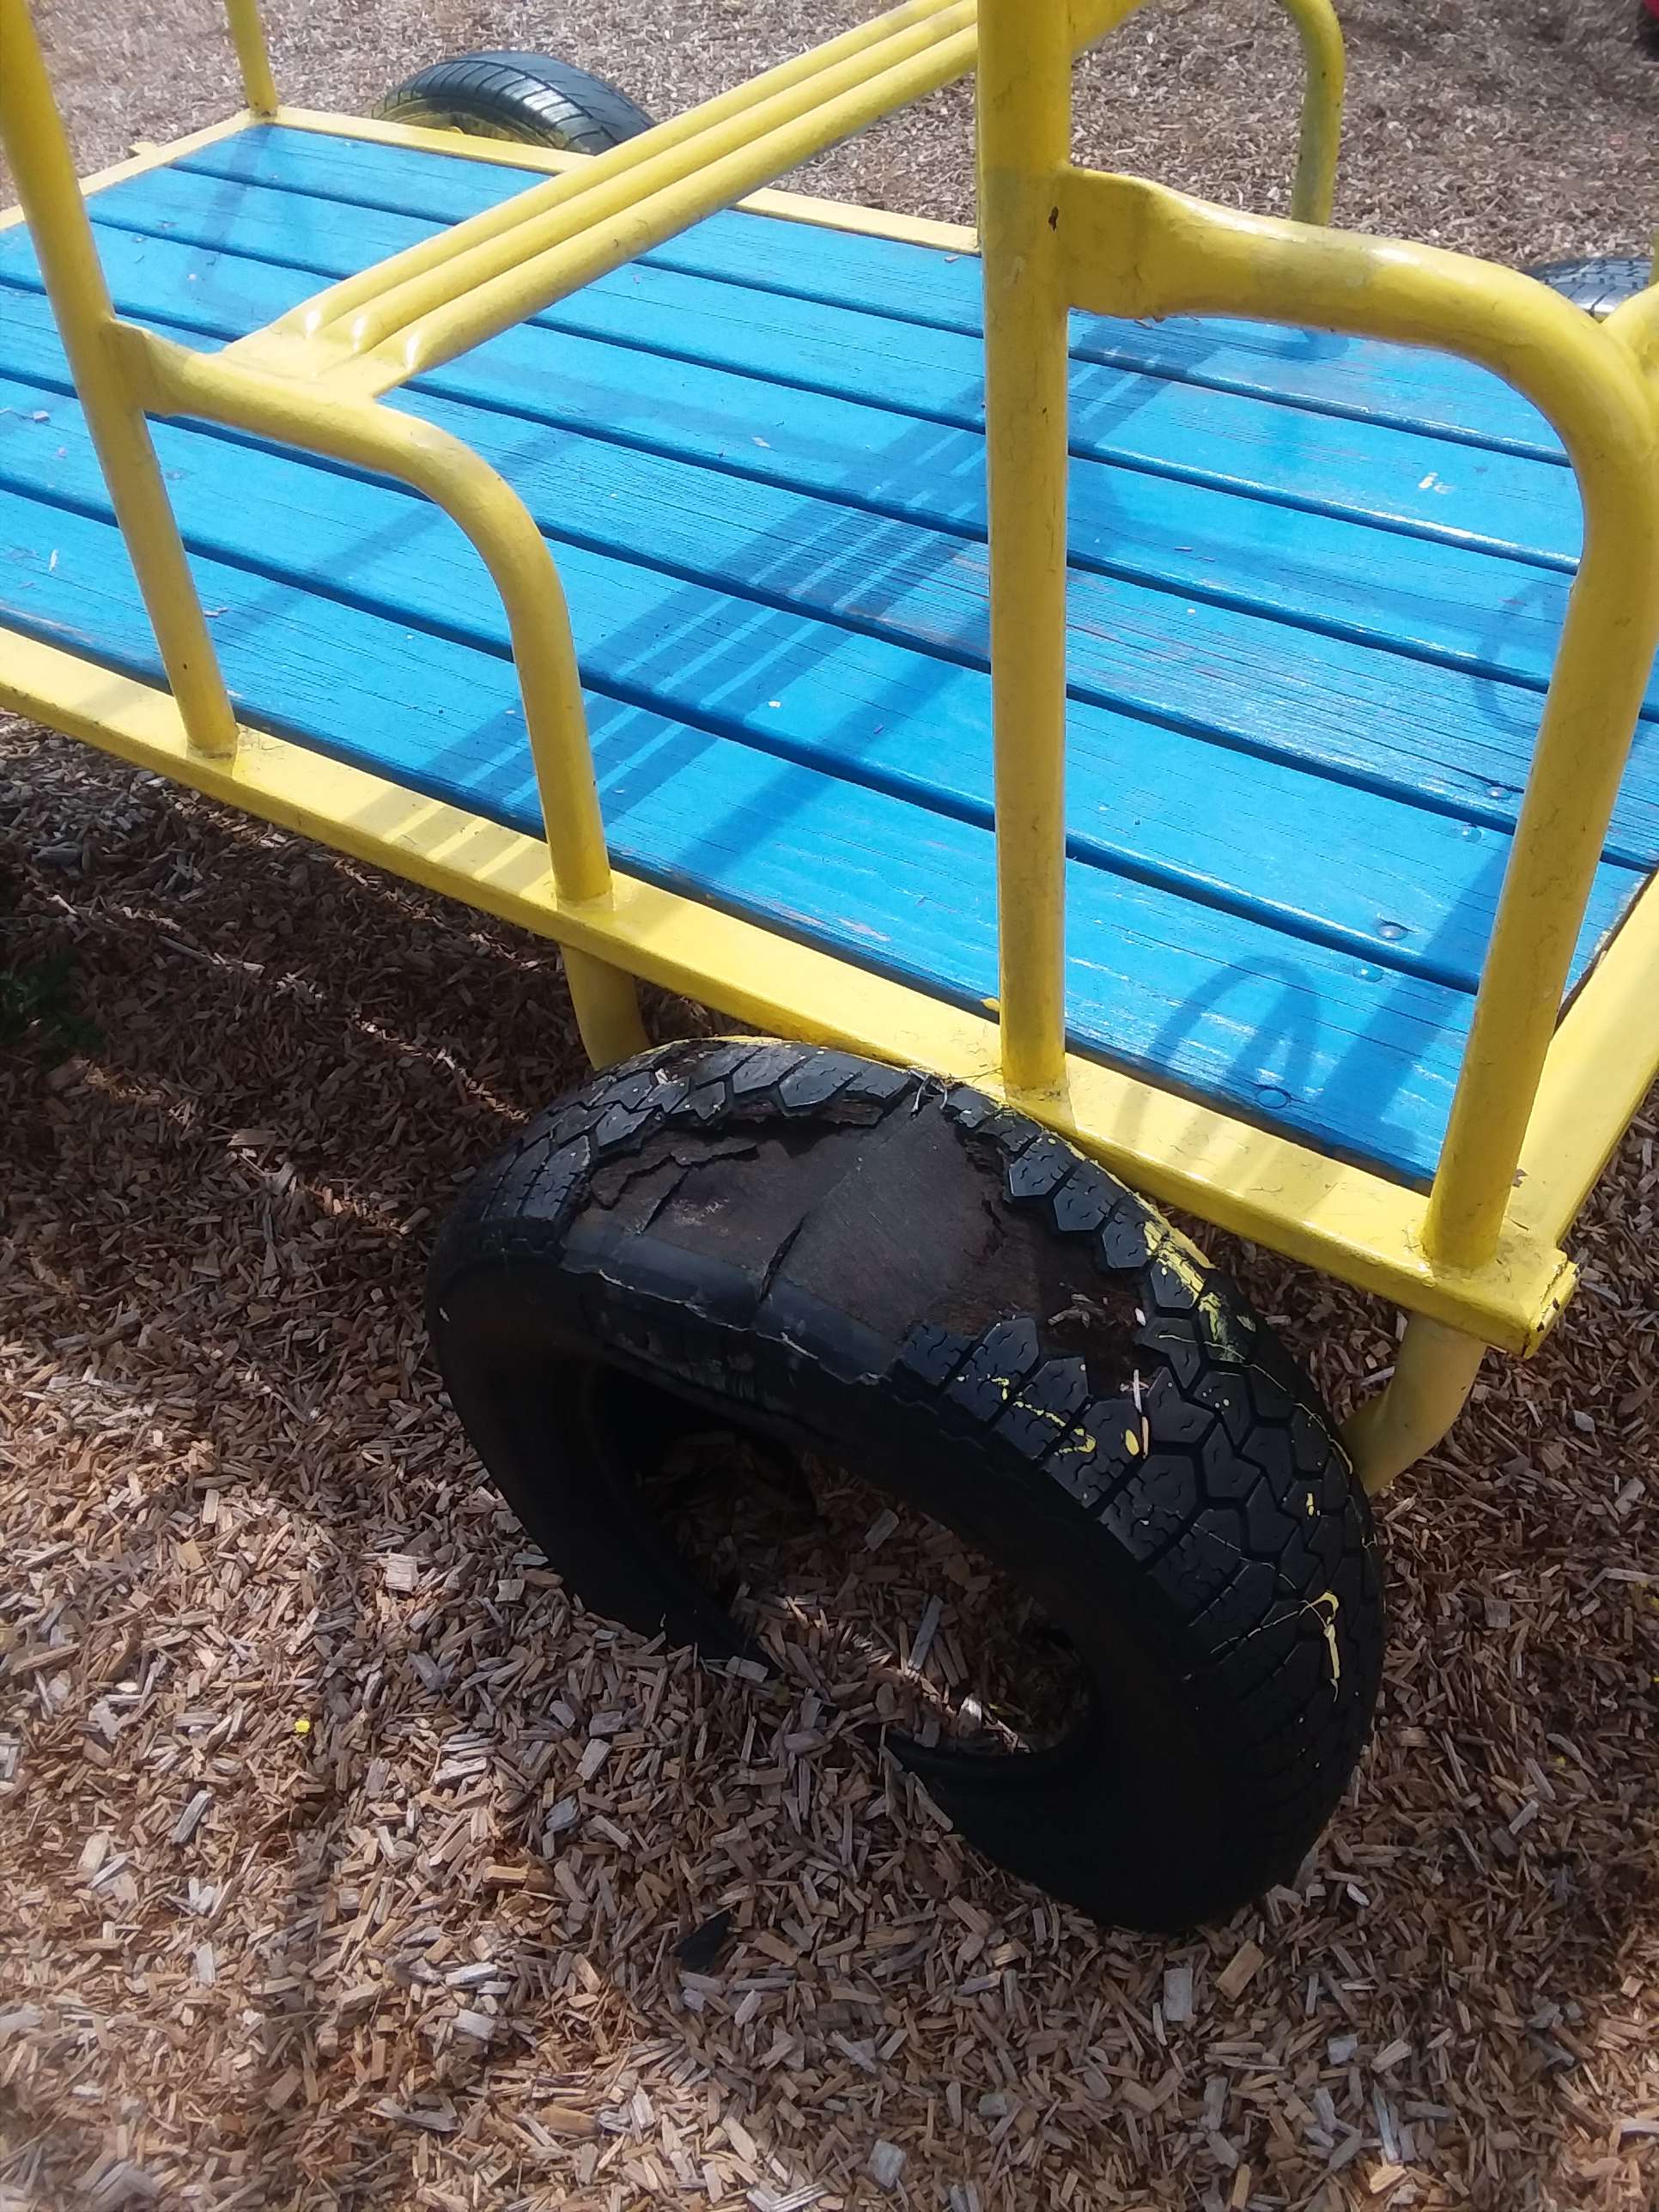
.2832(c)(1) Equipment …in good repair…
Sharp edges caused by wear, breaks, cracks
Paint condition, rust and other damage on play equipment
Toys that need cleaning

Slide 31
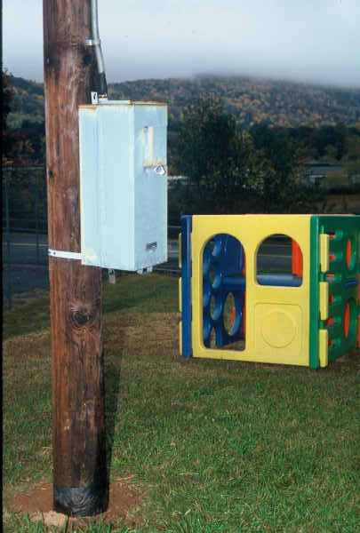
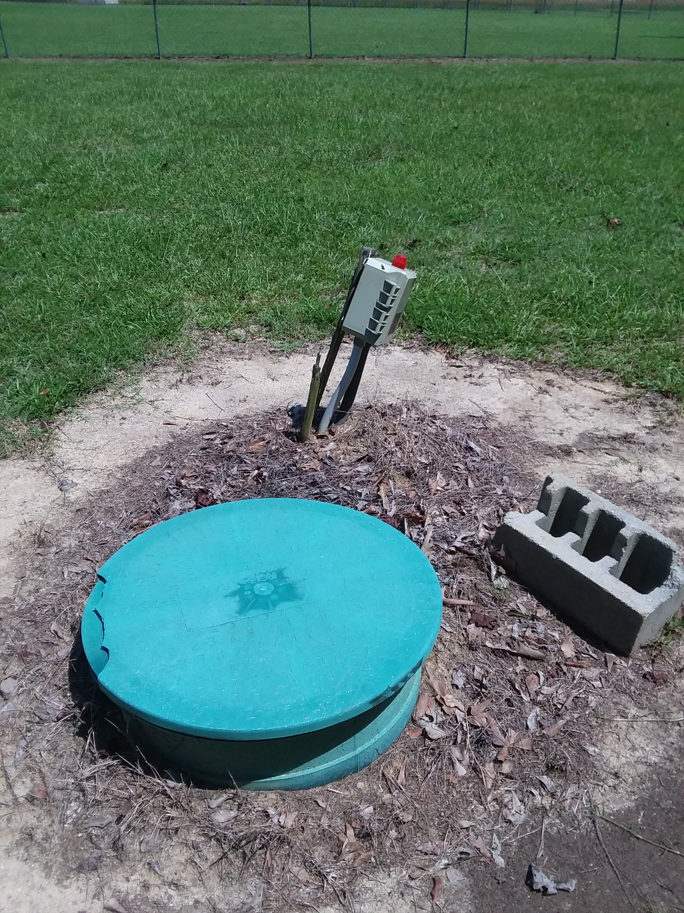
…Wells, grease traps, cisterns, and utility equipment shall be made inaccessible to children..2832(a)

Slide 32
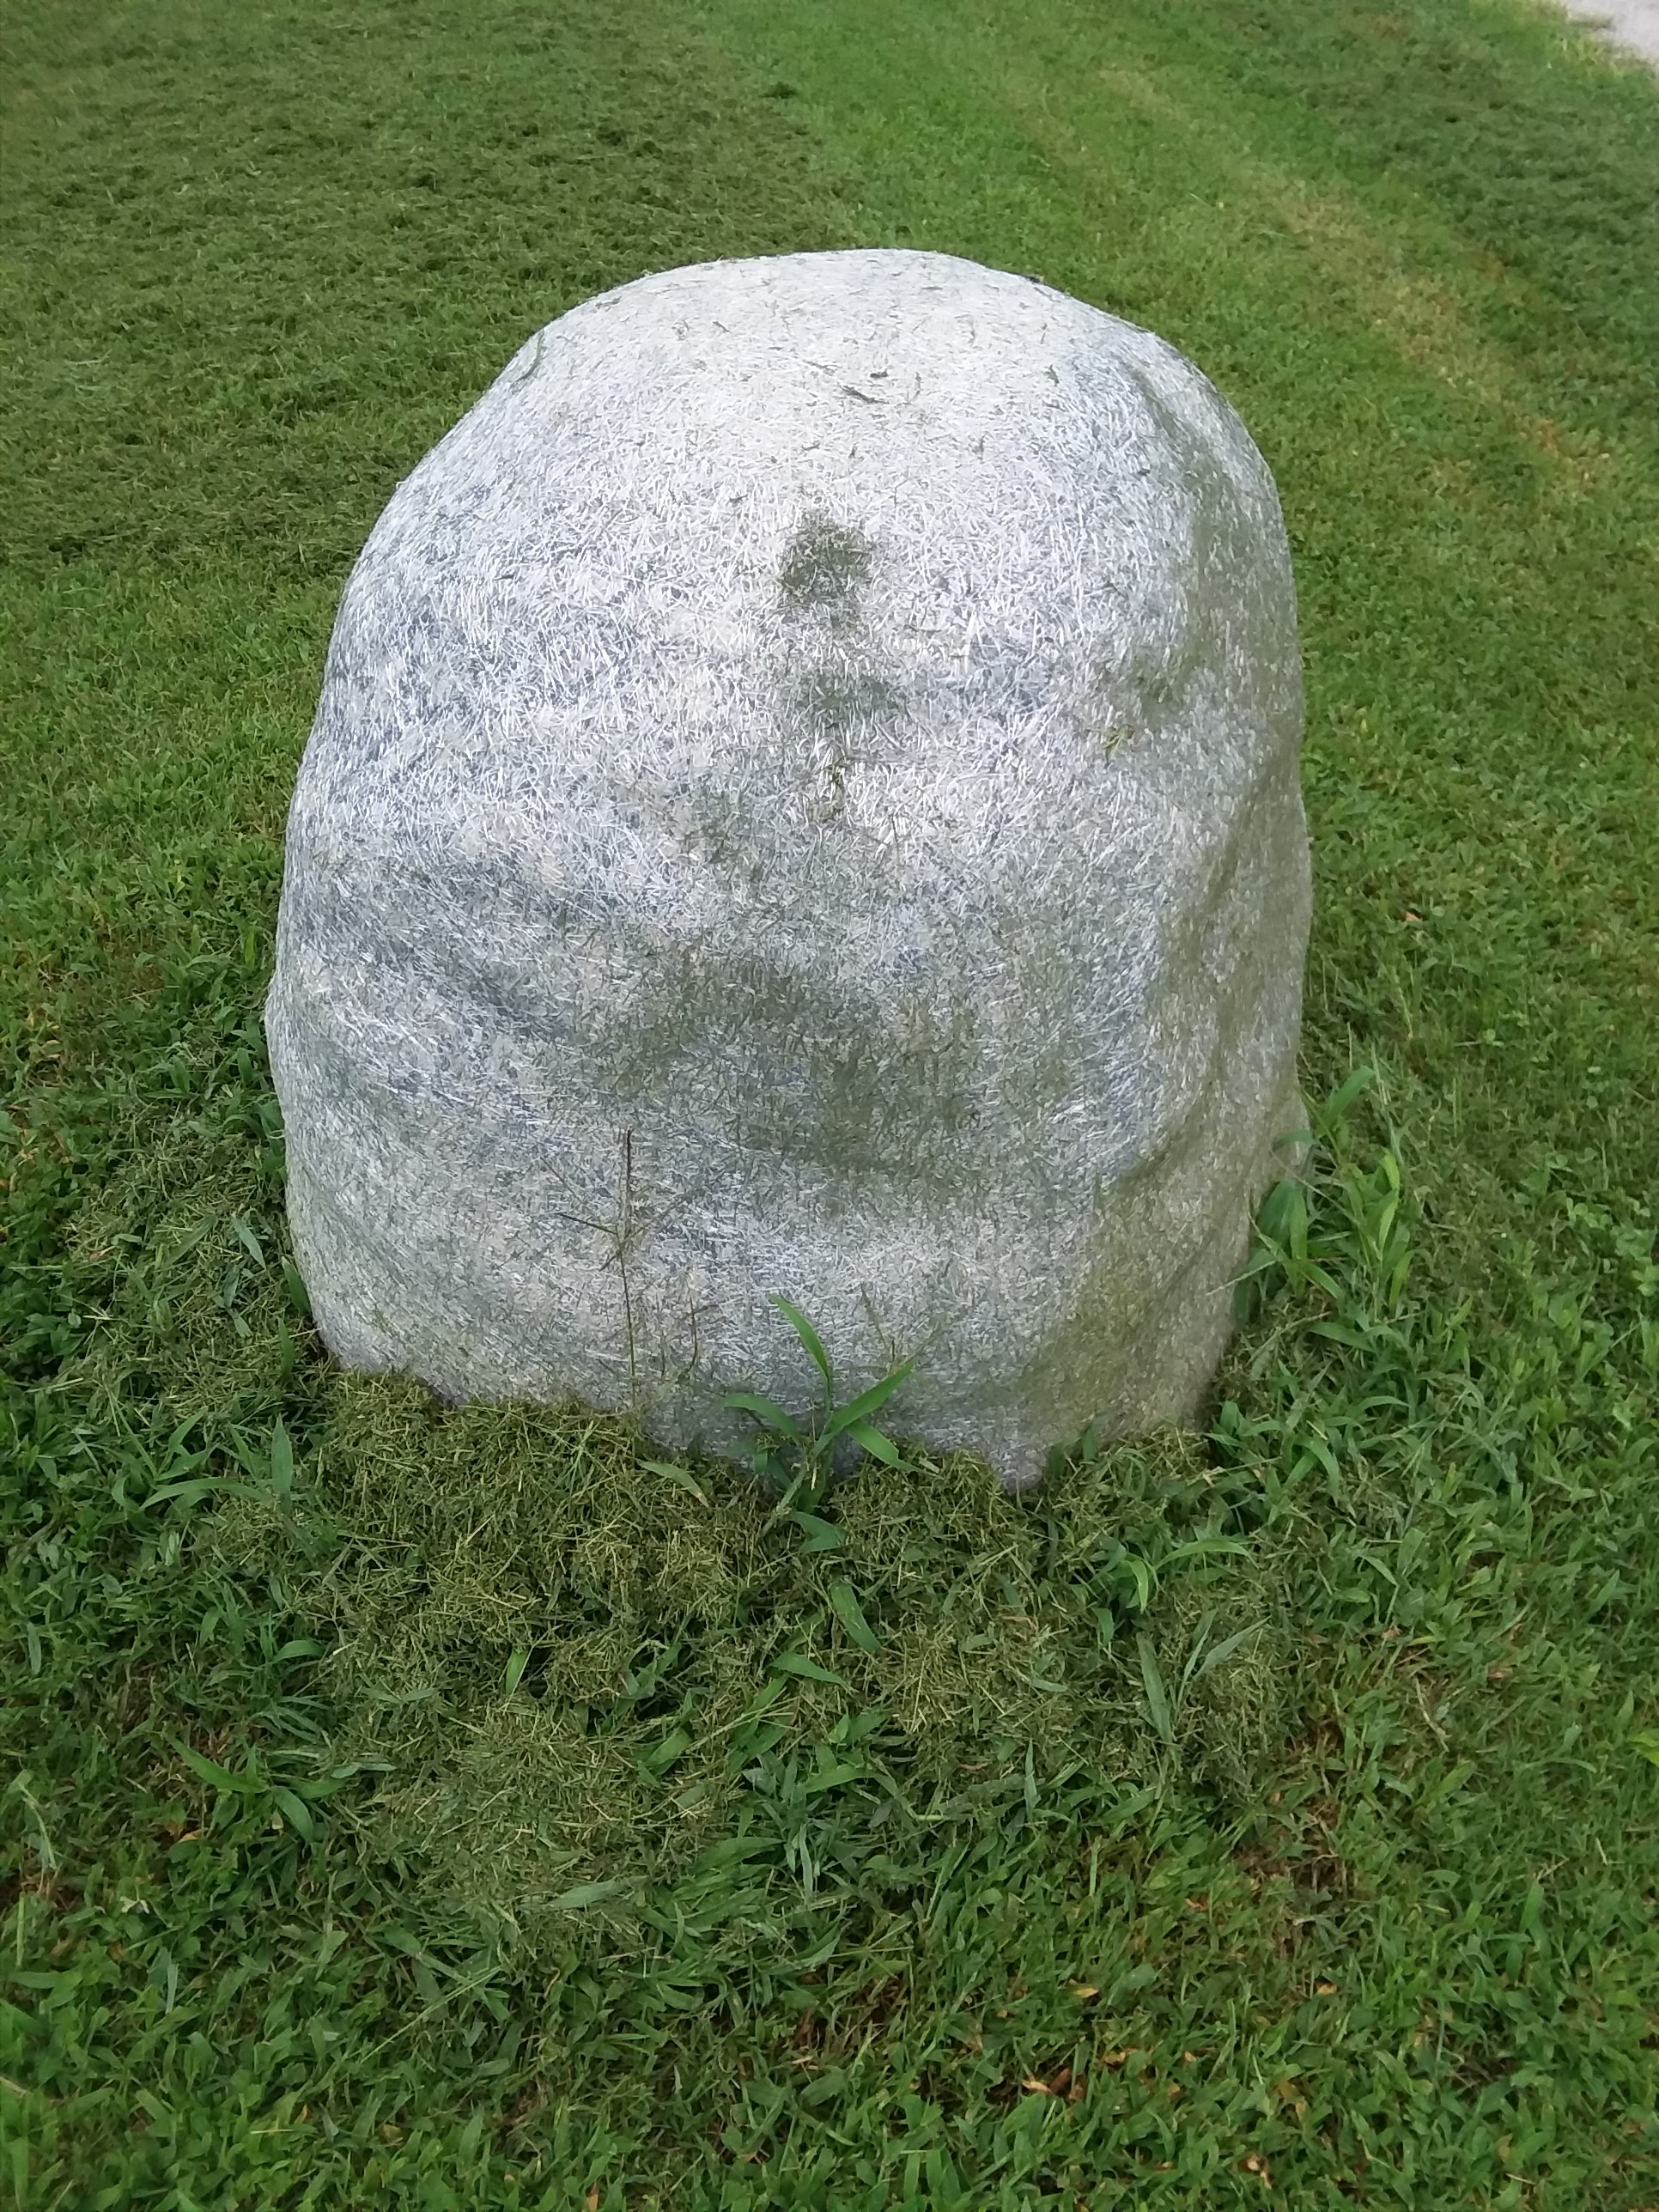
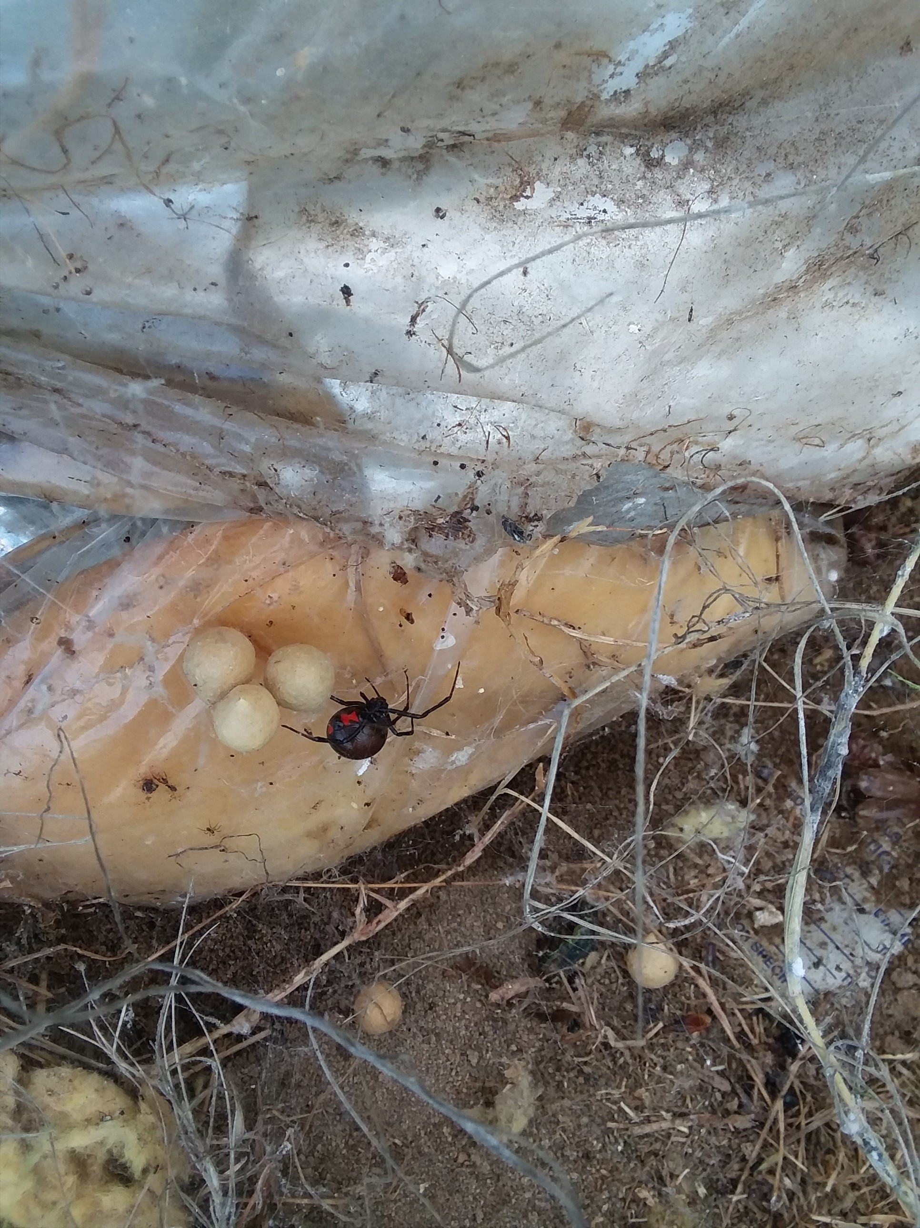
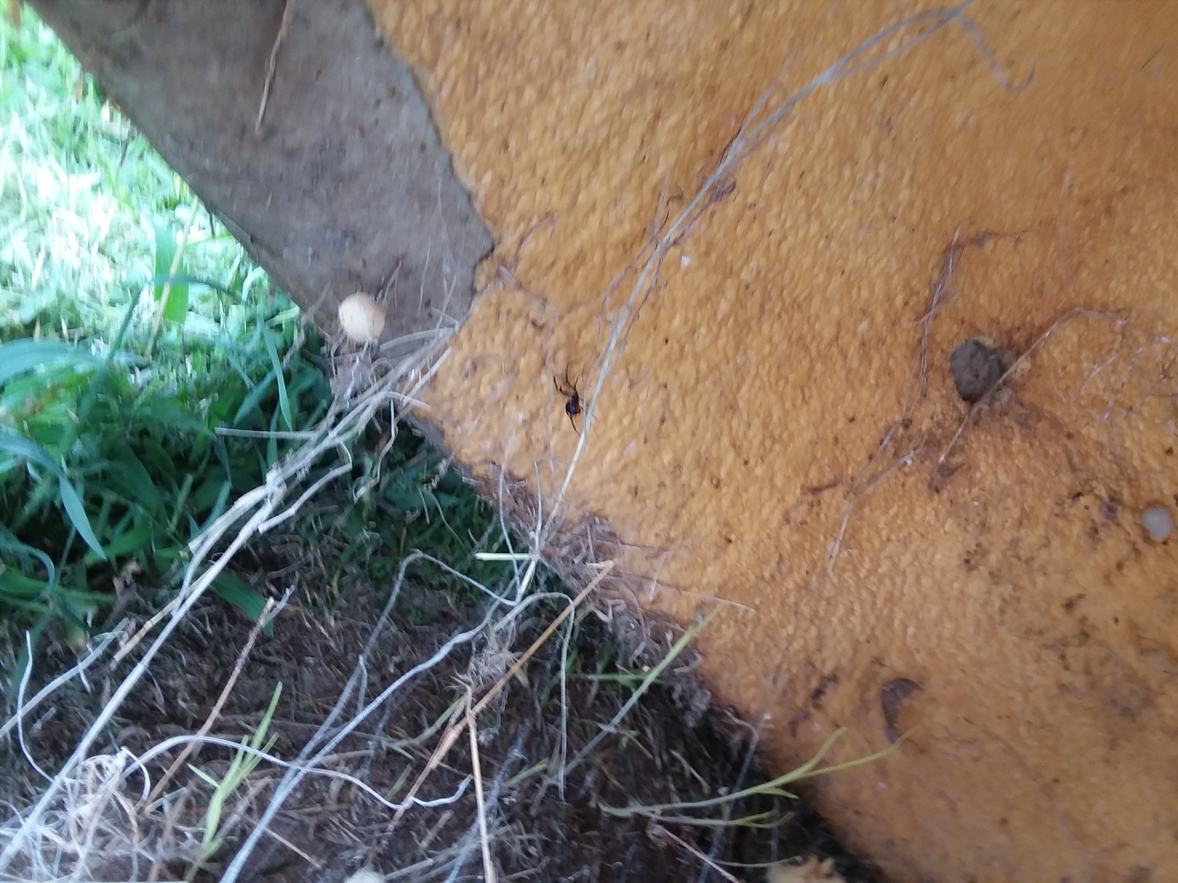
…inaccessible to children. .2832(a)

Slide 33
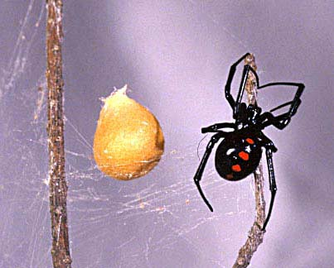
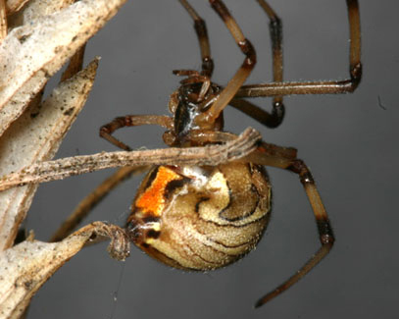
Black widows may not have the characteristic red hour glass.
Brown Widow

Slide 34
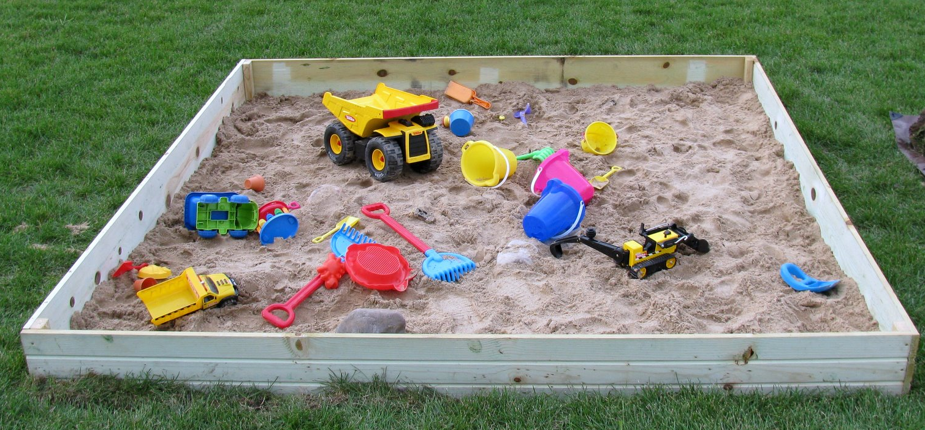
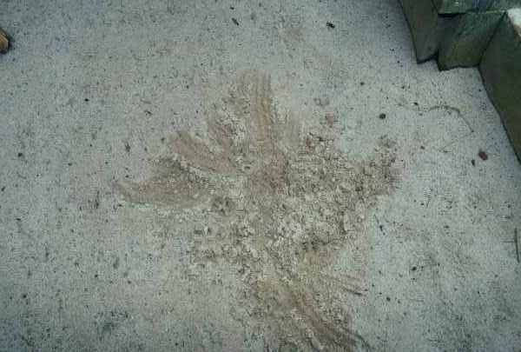
Why cover a sandbox? .2832(c)(2)
A sandbox used in outdoor play shall be constructed to allow for drainage of water and shall be covered when not in use and kept clean.

Slide 35
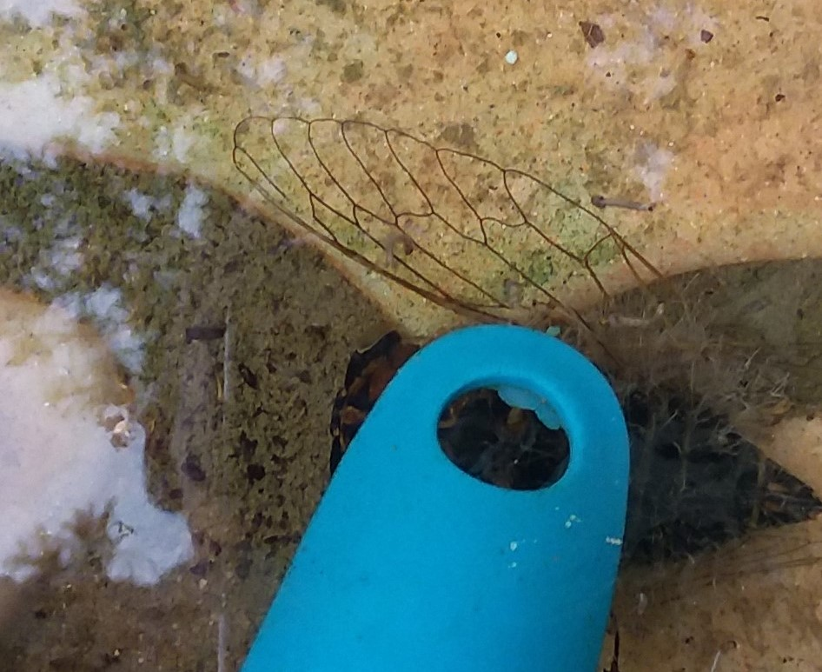
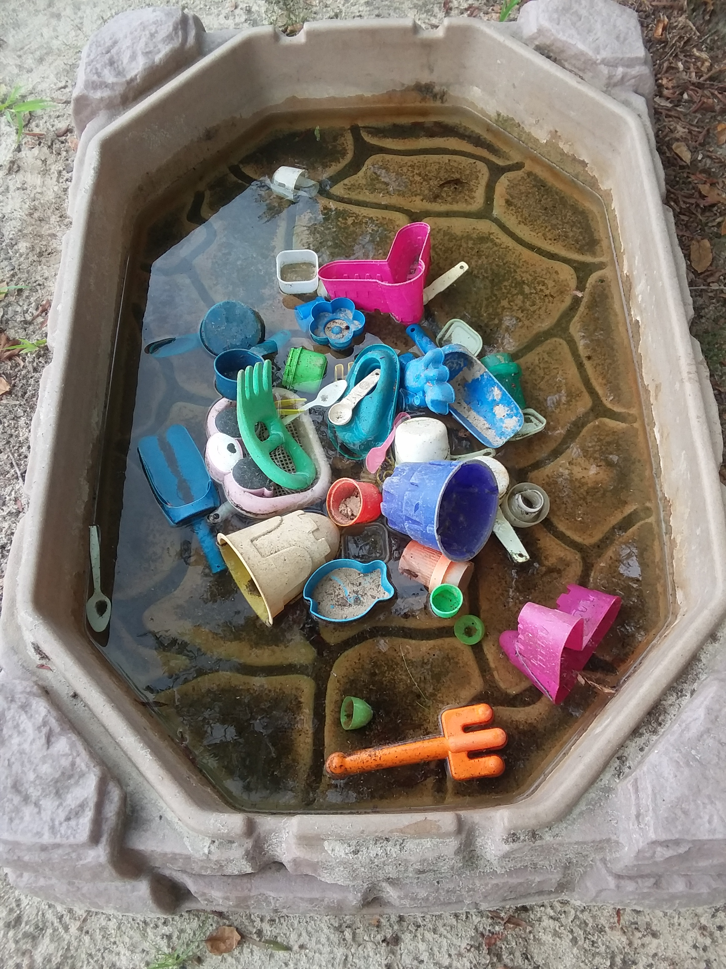
Water features/toys holding water .2832(b)
Sand toys, water tables and other items that can collect standing water in the outdoor learning environment shall be emptied and stored to prevent standing water.

Slide 36
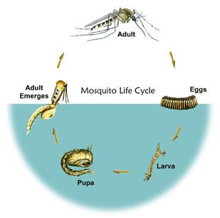
Water features/toys holding water .2832(b)
The life cycle typically takes two weeks, but depending on conditions, it can range from 4 days to as long as a month.
Mosquitos can travel long distances depending on the species, but don’t increase the population on the playground.

Slide 37
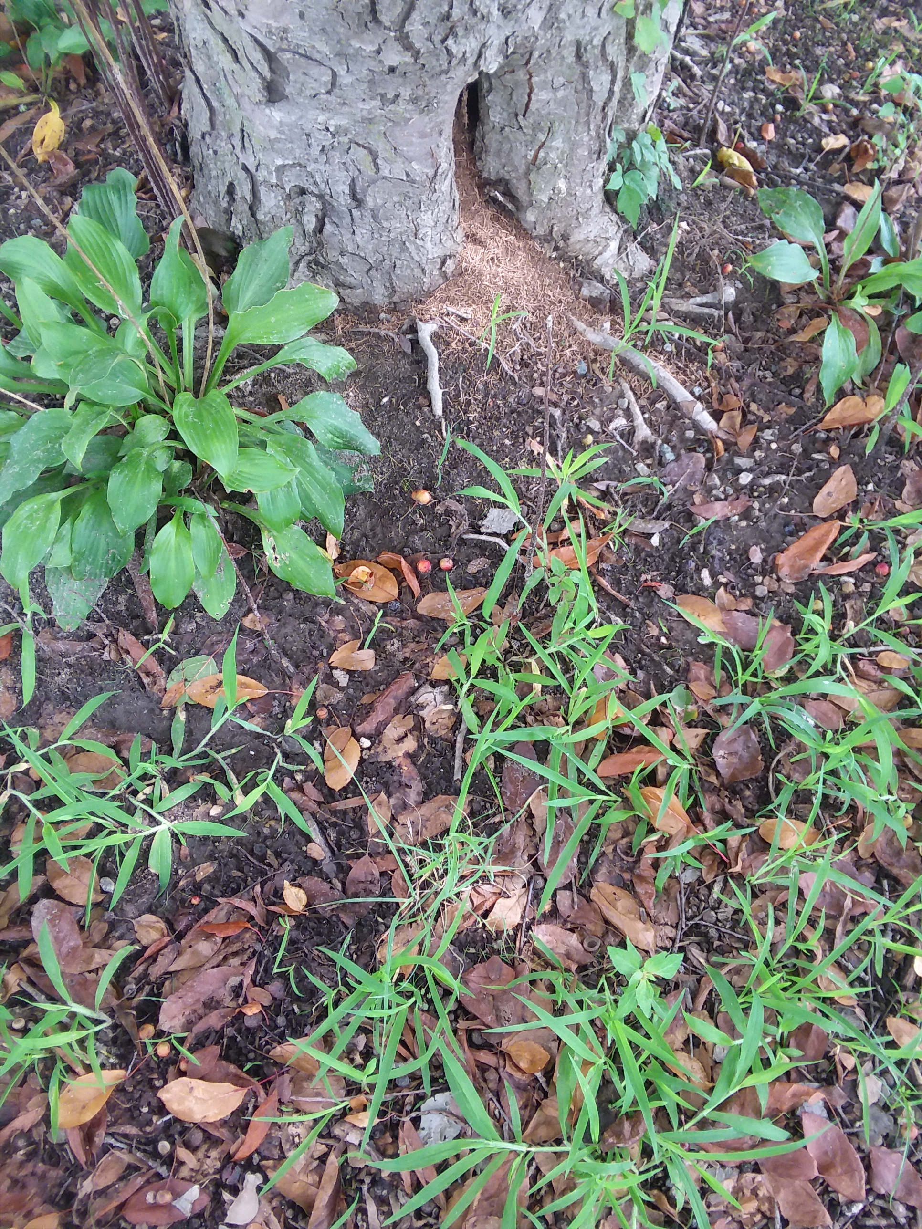
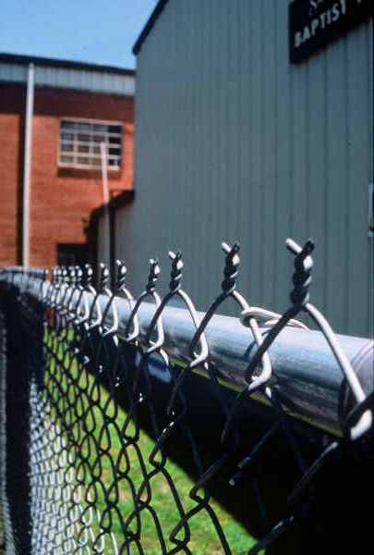
Other concerns:
Ours? We shouldn’t ignore hazards. Document with a comment on the comment addendum. Call DCDEE consultant if needed.

Slide 38
.2832(d) If a daily air quality forecast is made by the Division of Air Quality…
outdoor activities (noon-8PM) shall be restricted as follows.
Code orange-limit activity to 1 hour.
Code red-limit activity to 15 minutes.
Code purple-no physical activity.
Provisions shall be made to allow children with diagnosed asthma or with coughing or wheezing symptoms to participate in physical activity indoors on these days.

Slide 39
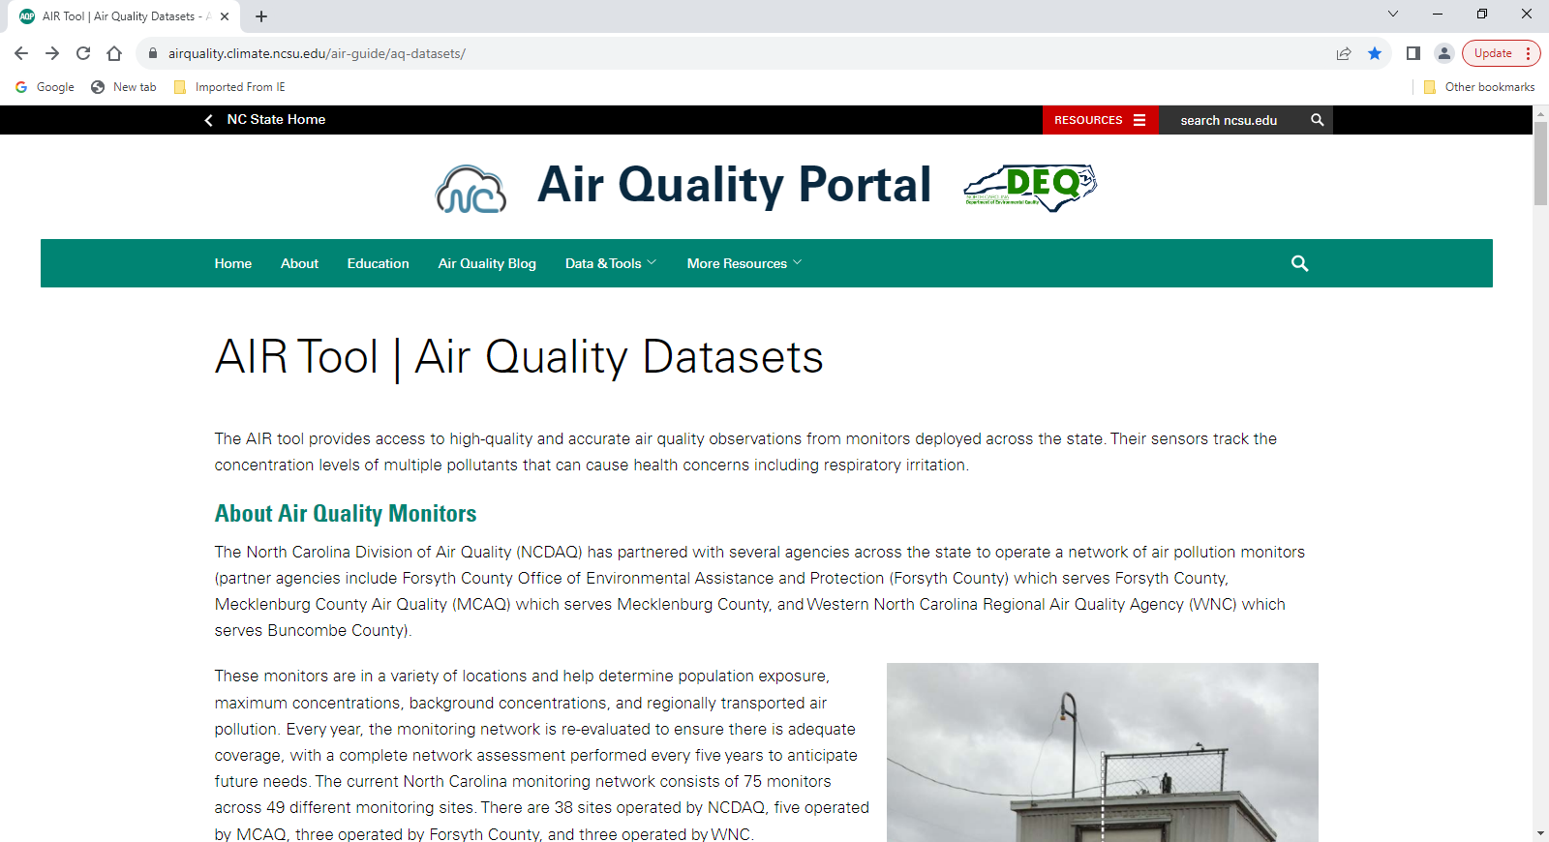
Airquality.climate.ncsu.edu/air-guide/aq-datasets/

Slide 40
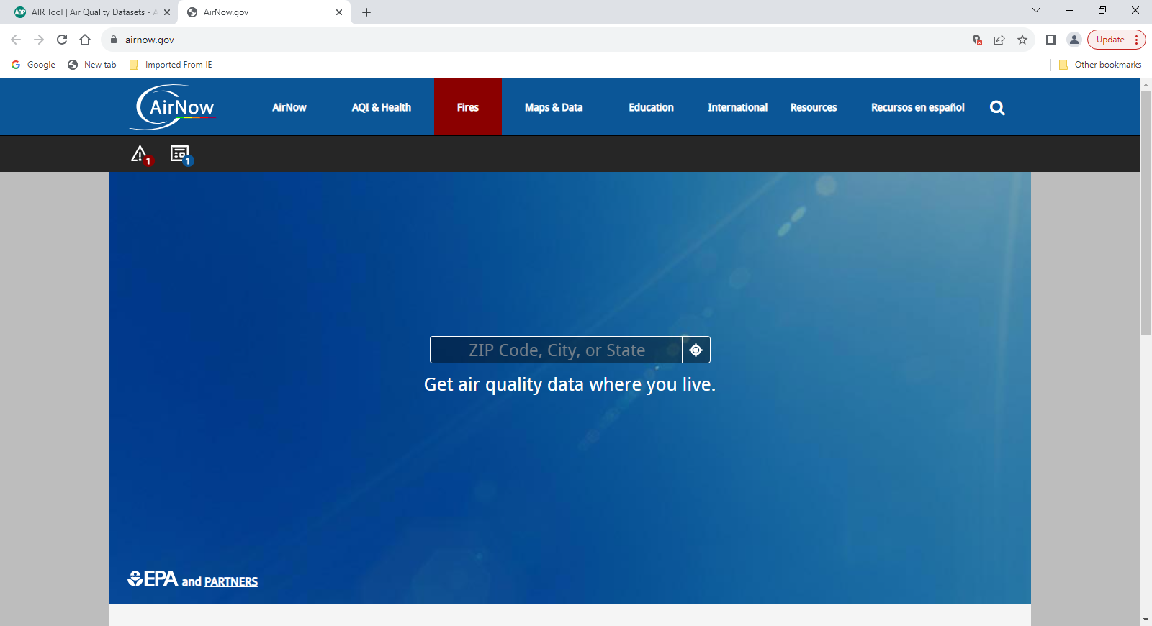
Scroll down and click on “AirNow”. Then you can enter a zip code.

Slide 41
.2832(e) When food service is provided in the outdoor learning environment…
It shall comply with all the food rules…
Food service tables shall be cleaned or covered prior to use
Handwashing shall comply with handwashing rule.

Slide 42
.2832(f) When diapering and toiling facilities are provided in the outdoor learning environment…
they shall meet all the diapering and toileting rules.
They shall meet the handwashing requirements
For diapering, hand sanitizing products are not allowed

Slide 43
.2832(g) Storage provided outdoors for children’s toys…
Shall be kept clean
Storage areas assessable to children shall be free of equipment that is not intended by the manufacturer to be used by children
Comply with .2820
Meet requirements for lighting
Keep an eye out for spiders

Slide 44
What meets the requirements for lighting?
Lighting for storage areas shall be 10 foot candles
How?…opening door , windows, sky lights, battery operated light, flashlight or electric lighting.

Slide 45
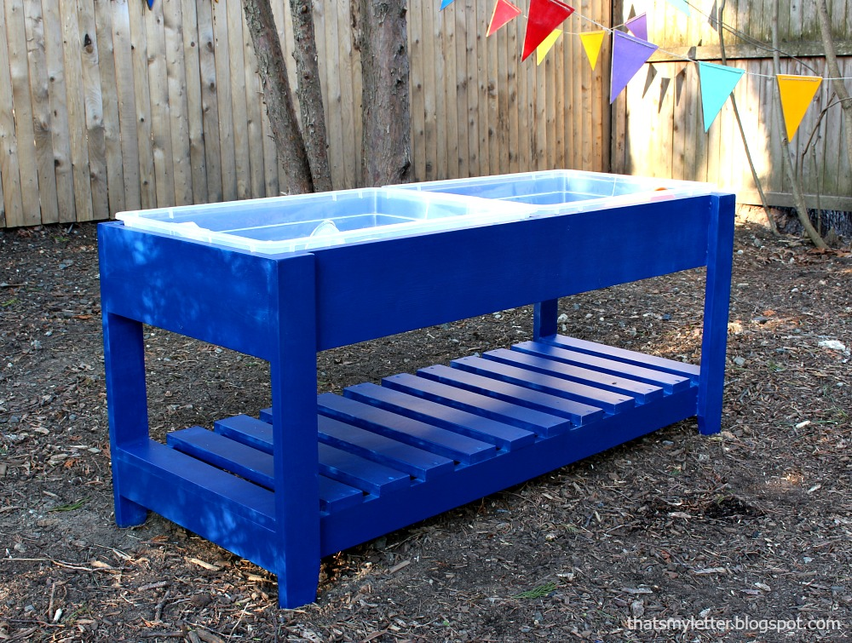
Outdoor water activity centers… .2832(h)
This looks pretty. They can build it themselves.
But who wants to clean under this table? What’s under there after 2 months?

Slide 46
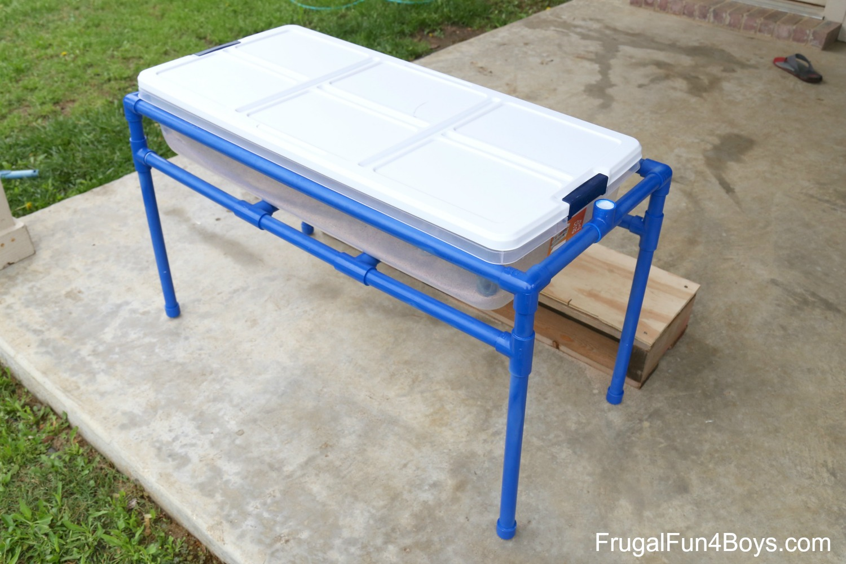
Outdoor water activity centers…
Promote items that are easy to maintain and clean.

Slide 47
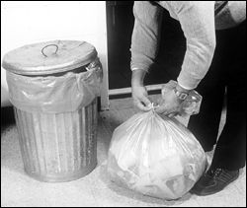
.2830 – plastic – lined, cleanable, covered containers
Solid Wastes
Remove food scraps and other waste materials daily
Notes:
Removed at least Daily to exterior 2 point #44
15A NCAC 18A .2830 SOLID WASTES
(a) In child care centers, food scraps and other putrescible materials shall be placed in a plastic-lined, cleanable,
covered container and removed to an exterior garbage area at least daily. Scrap paper, cardboard boxes and similar
items shall be stored in containers or designated areas.

Slide 48
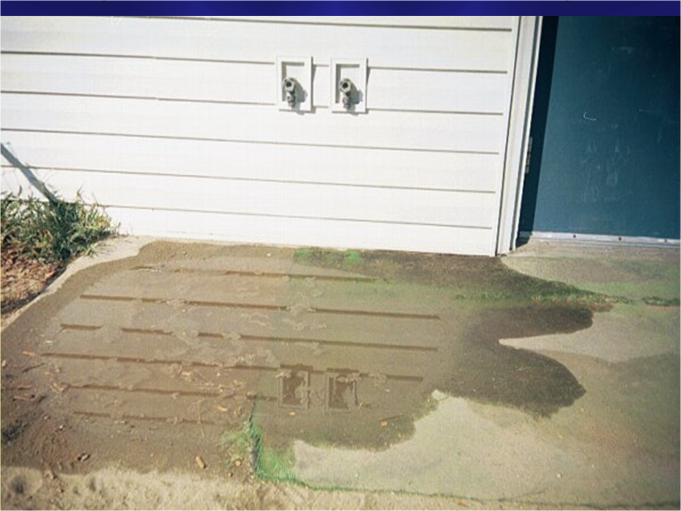
Can Wash Pad Does this meet the requirements of .2830(b)?
Need to eliminate standing water – mosquito control
Back flow prevention on the faucets to prevent back siphonage.
Cleaning facilities (>13 children), threaded nozzle and water of at least 80 F –drained to an approved system.
Notes:
(b) Solid waste containers, mops, and other cleaning equipment shall be kept clean when not in use. Facilities shall be provided at the child care center for the washing and storage of solid waste containers and mops, except that such facilities shall not be required for child care centers licensed for fewer than 13 children and located in a residence. Washing facilities required under this Paragraph shall include a faucet with a threaded nozzle that delivers water of at least 80 degrees Fahrenheit. The faucet shall be located in either a designated utility sink or above a curbed impervious pad that is sloped to drain into a system that meets the requirements of Rule .2829 of this Section. Washing facilities used for solid waste containers that were installed at the child care center prior to July 1, 1991 shall be permitted to be used if the facilities are in good repair.
Watch for Burn Hazard.

Slide 49
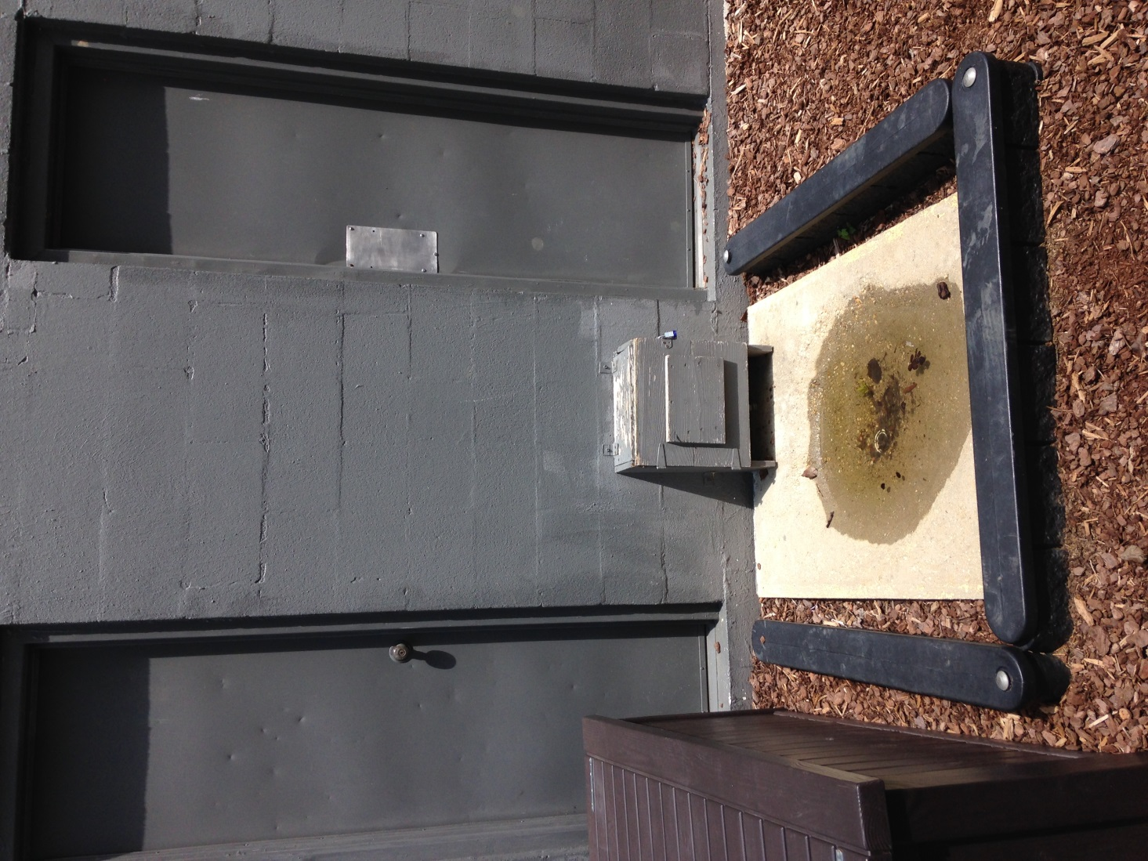
Notes:
Watch for Burn Hazard!!!!!!

Slide 50
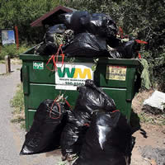
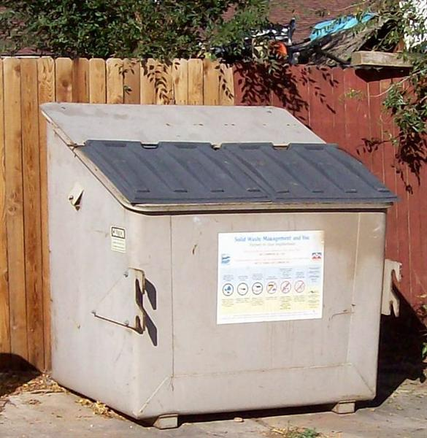
Exterior Garbage - .2830(c, d)
Notes:
(c) Dumpsters and other containerized systems shall be kept clean and covered.
(d) Solid wastes shall be disposed of to prevent conditions that attract and harbor pests and other public health nuisances.
http://www.deh.enr.state.nc.us/

Slide 51
Questions?
Alan Huneycutt, REHS, MPH
Children’s Environmental Health
704-618-0138
Alan.Huneycutt@dhhs.nc.gov

