Slide 1
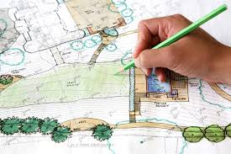
Plan Review Exercise
Child Care SOP 2026
Rob Pearsall
Brittany Stevenson
Ashley Mize
Megan Lee

Slide 2
Plan Review and Exercises
Submission and Application
Septic Systems & Wells
Lead In Child Occupied Facility
Hot Water and Refrigeration Requirements
Kitchen Requirements
Food Preparation Area
Diaper Changing

Slide 3
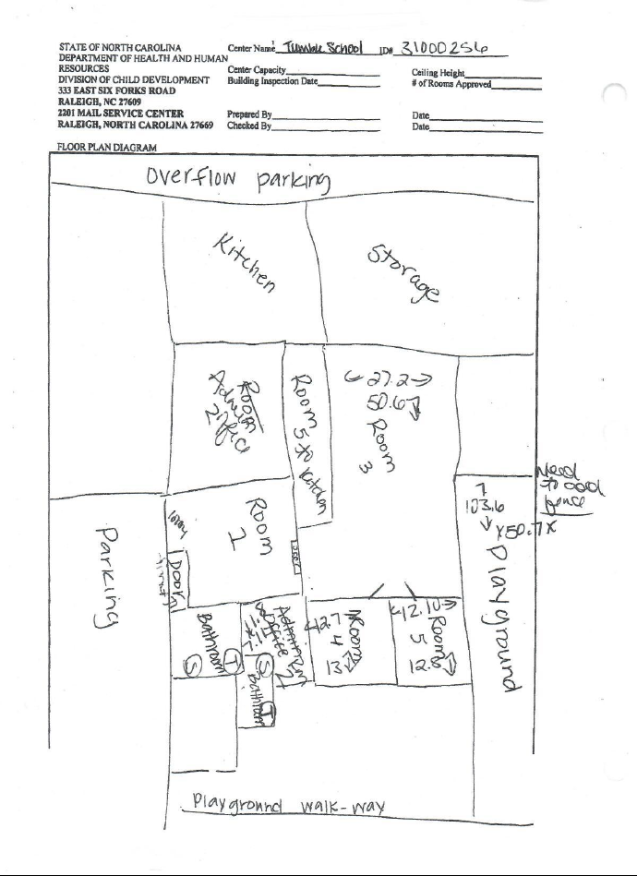
Plan Submission and Application

Slide 4
15A NCAC 18A .2802 APPROVAL OF CONSTRUCTION AND RENOVATION PLANS
(a) Construction plans drawn to scale and specifications for a new child care center that is not a chain or franchise child care center shall be submitted by the operator or the operator's designee to the local health department that serves the county in which the child care center is located for review and approval prior to initiating construction.
Plans drawn to scale and specifications for changes to building dimensions, kitchen specifications, or other modifications to existing child care centers, including chain or franchise child care centers, shall also be submitted to the local health department for review and approval prior to initiating construction.
Construction plans drawn to scale and specifications for prototype chain or franchise child care centers shall be submitted to DHHS, Division of Public Health, Environmental Health Section by mail at 5605 Six Forks Road, 1632 Mail Service Center, Raleigh, North Carolina 27699-1632. When requested by an operator of a child care center or by the Secretary of the Department, the local health department shall visit or inspect an existing or proposed center, within 30 days of the request, to determine compliance with this Section.

Slide 5
15A NCAC 18A .2802 APPROVAL OF CONSTRUCTION AND RENOVATION PLANS
(b) The local health department or the DHHS, Division of Public Health, Environmental Health Section, as applicable, shall approve plans described in Paragraph (a) of this Rule when the plans meet the requirements of the rules of this Section that pertain to the construction or renovation of child care centers.
(c) Construction and modifications shall comply with the plans approved pursuant to this Rule.

Slide 6
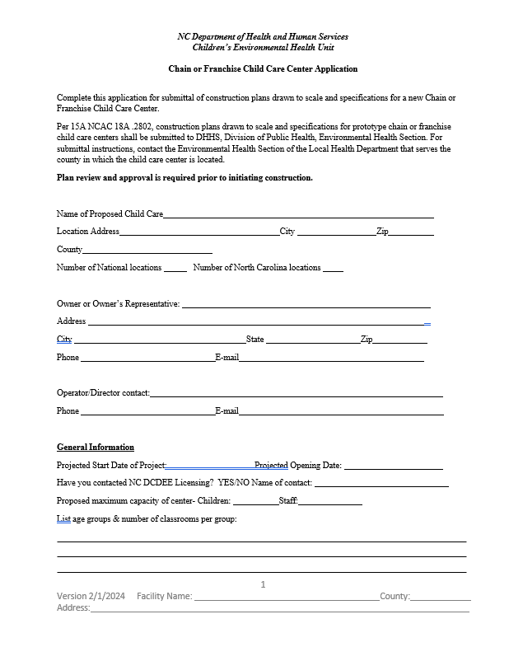
Application

Slide 7
Application Documentation
Completed Application
Site plan showing specific location of the property, buildings, playground, fencing, parking, utilities, dumpster, etc.
Floor plan drawn to scale of facility with the following labeled:
  Kitchen, Utility rooms
  Bathrooms
  Diaper changing stations
  Food preparation areas
  Ice machines
  Sinks (labeled with use)
  Washer & dryer
  Cubbies/lockers
  Storage areas (specify if lockable)
  Sick child area
  Offices
  Washing facilities for solid waste containers
  Classrooms with age group & number of children indicated

Slide 8
Application Documentation Continued
Equipment specification sheet for all food service and other equipment (refrigerator, water heater, dish machine, stove, exhaust fan, sinks, etc.)
Proposed Menu (one month minimum)
Locations of other Chain or Franchise Child Care Centers
Plumbing Plan (water supply including temperatures, waste plumbing, floor drains, floor sinks, water heater(s), tempering valves, washing facilities, laundry facilities, backflow prevention)
Water supply documentation (permits, applications, testing, etc.)
For wells/ground water supplies serving 25 or more people, documentation of compliance from DEQ
Sewage disposal documentation (permits, applications, inspections, etc.)

Slide 9
Septic Systems & Wells

Slide 10
15 NCAC 18A .2829
15A NCAC 18A .2829 WASTEWATER
In child care centers, all wastewater originating from the child care center shall be disposed of using a publicly-operated sewage treatment system or an individual sewage disposal system that meets the requirements of the rules at Section .1900 of this Subchapter. Septic systems shall be of adequate size to accommodate the wastewater needs of the anticipated number of children and staff for all shifts.
Notes:
2 Key Parts #43
How Do We Know If It Is Approved?
How Do We Know If It Is Sized Properly?
15A NCAC 18A .2829 WASTEWATER
In child care centers, all wastewater shall be disposed of in a publicly-owned wastewater treatment system or by an
approved properly operating on-site wastewater system under 15A NCAC 18A .1900. Septic systems shall be sized
to accommodate anticipated children and staff for all shifts.

Slide 11
Adequately Sized Septic System
Child Care Center
15 gal/person open ≤ 12 hr shift without laundry
Add 1 gal/person/hr open for more than 12 hrs per day
Add 5 gal/person with full kitchen (Full Kitchen meets Food Code. Warming Kitchen Does not meet Food Code.)
15A NCAC 18E .0401 (e) Where laundry is not specified for a facility in Table II, but is proposed to be provided, the DDF shall be adjusted to account for the proposed usage and machine water capacity. The applicant or a licensed professional shall provide cut-sheets for laundry machines proposed for use in facilities.
Notes:
2 Key Parts #43
How Do We Know If It Is Approved?
How Do We Know If It Is Sized Properly?
15A NCAC 18A .2829 WASTEWATER
In child care centers, all wastewater shall be disposed of in a publicly-owned wastewater treatment system or by an
approved properly operating on-site wastewater system under 15A NCAC 18A .1900. Septic systems shall be sized
to accommodate anticipated children and staff for all shifts.

Slide 12
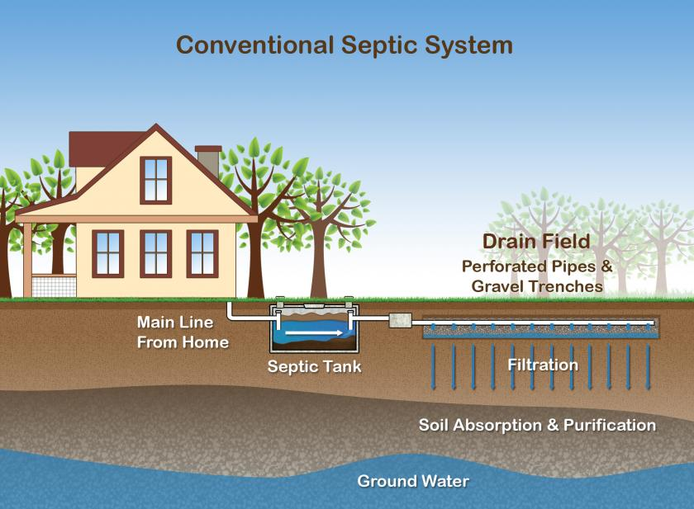
Basic Septic System
Notes:
Basic system

Slide 13
Basic Wastewater Considerations
  Community System or On-site (.1900 rules)
  Type of system - Permit
  Mechanical and monitoring records
  Check records for compliance
  Determine if there have been previous failures or repairs
  System Sizing
Notes:
If a new commercial built facility normally would go through plan review, which would include a septic system design by an authorized specialist based on use and projected flow rate.
A residential or home-based child care center may utilize an existing on-site system that an authorized agent will need to determine if it is adequate for the projected use. 15GAL/PERSON PROPOSED 15 gal/person open ≤ 12 hr shift Without Laundry - Add 1 gal/person/hr open for more than 12 hr shift hrs per day Add 5 gal/person with full kitchen Full Kitchen Meet Food Code. Warming Kitchen Does not meet Food Code.
If records are lacking you may be able to get a rough idea of the drain field size based on the size of the septic tank.
Tank should be pumped out prior to use and regularly once the child care center is operating.
What else should you do for a proposed child care center in an existing home / building
What about the water supply – is there a well or community system – is it in compliance. Has the water been tested for inorganic contaminates – i.e. lead, copper
Age of the dwelling – potential for lead based paint

Slide 14
Basic Considerations (cont.)
  What season is it
  Have there been any building additions, renovations or change of use
  When during the inspection, do you check the drain field area
  Are there any leaking faucets, hung toilets
  Centers located in basements
  If you are unsure consult with the on-site staff or regional specialist
Notes:
Systems Fail in wet months.
Additions could be over drainfield or system could not have been upsized.
Inspect at end. Don't want to track pathogens, cant fix during inspection.
Basements may need grinder pumps.
Watch for hung toilets – can easily flood out a system – kids putting things down the toilet.

Slide 15
Building Renovations and Change of Use
  Home to a residential child care home
  Does the center plan to increase enrollment
  What is on their menu
  Do other groups or organizations use the facility
Notes:
Increase in water flow and increased kitchen waste-Grease Trap
Remind people to check with zoning, the building inspector and fire inspector
Two shifts?
3 bedroom 360 15 x 24 = 360

Slide 16
15A NCAC 18A .2815 WATER SUPPLY
(a) A child care center's water supply shall meet the requirements of 15A NCAC 18C or 15A NCAC 18A .1700, as applicable.
The operator of a child care center using a groundwater supply that serves 25 or more people shall provide the local health department serving the county in which the child care center is located with documentation from the Department of Environmental Quality, Division of Water Resources, Public Water Supply Section that the well meets the requirements of 15A NCAC 18C.
In child care centers that use a non-community water supply, a water sample shall be collected by the Department once a year and submitted to the North Carolina State Laboratory of Public Health or other laboratory certified by the North Carolina State Laboratory of Public Health under 10A NCAC 42C .0102 to perform bacteriological examinations.

Slide 17
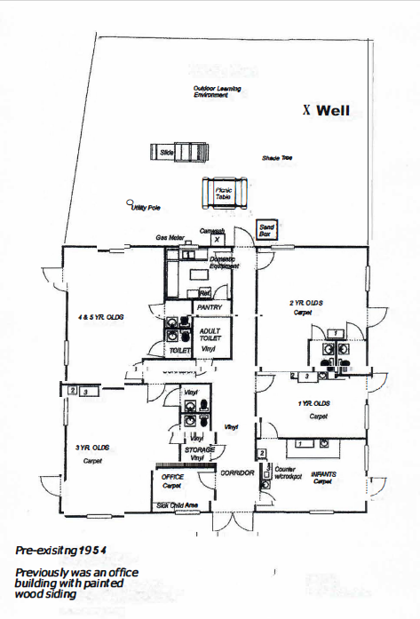
Septic Systems & Well Exercise

Slide 18

Lead In Child Occupied Facilities

Slide 19
15A NCAC 18A .2816 LEAD POISONING HAZARDS IN CHILD CARE CENTERS
(a) In child care centers, areas accessible to children shall be free of identified lead poisoning hazards as defined under G.S. 130A-131.7(7).

Slide 20
15A NCAC 18A .2816 LEAD POISONING HAZARDS IN CHILD CARE CENTERS
(b) The following actions shall be taken to ensure that drinking water in child care centers is free of identified lead poisoning hazards as defined under G.S. 130A-131.7(7)(g).
  (1) Child care operators, as defined under G.S. 110-86(7), shall test, once every three years, all water outlets used for drinking or food preparation.
  Samples shall also be collected and tested within 30 calendar days of completion of any renovations or repairs that may impact the facility's drinking water infrastructure, such as repair or replacement of all or part of drinking water service lines or faucets, at impacted outlets.
  The operator shall provide documentation of testing results for review by the Department during each unannounced routine sanitation inspection under Rule .2834(b) of this Section.
  (2) For child care centers that submit an application for licensure in accordance with 10A NCAC 09 .0302 after the effective date of this Rule, initial samples shall be collected by the child care operator and tested in accordance with Subparagraph (b)(4) of this Rule during the license application process.

Slide 21
Lead In Child Occupied Facility Exercise

Slide 22
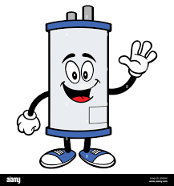
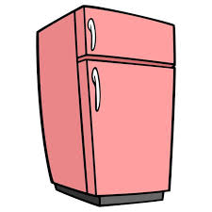
Hot Water and Refrigeration Requirements

Slide 23
.2815 (d) – Hot Water Requirements
.2815 (d) Water heating equipment shall be provided to meet the hot water requirements set forth in this Rule.
The capacity and recovery rates of water heating equipment shall be based on:
  number and size of sinks
  capacity of dishwashing machines
  capacity of laundering machines
  diaper changing facilities
  and other food service and cleaning needs for child-care centers

Slide 24
.2815 (e) – Hot Water Requirements
.2815 (e) Hot water used for cleaning and sanitizing utensils and laundry shall be provided at a minimum temperature of 120 degrees Fahrenheit at the point of use.
Water in areas accessible to children shall be tempered between 80 degrees Fahrenheit and 110 degrees Fahrenheit.

Slide 25

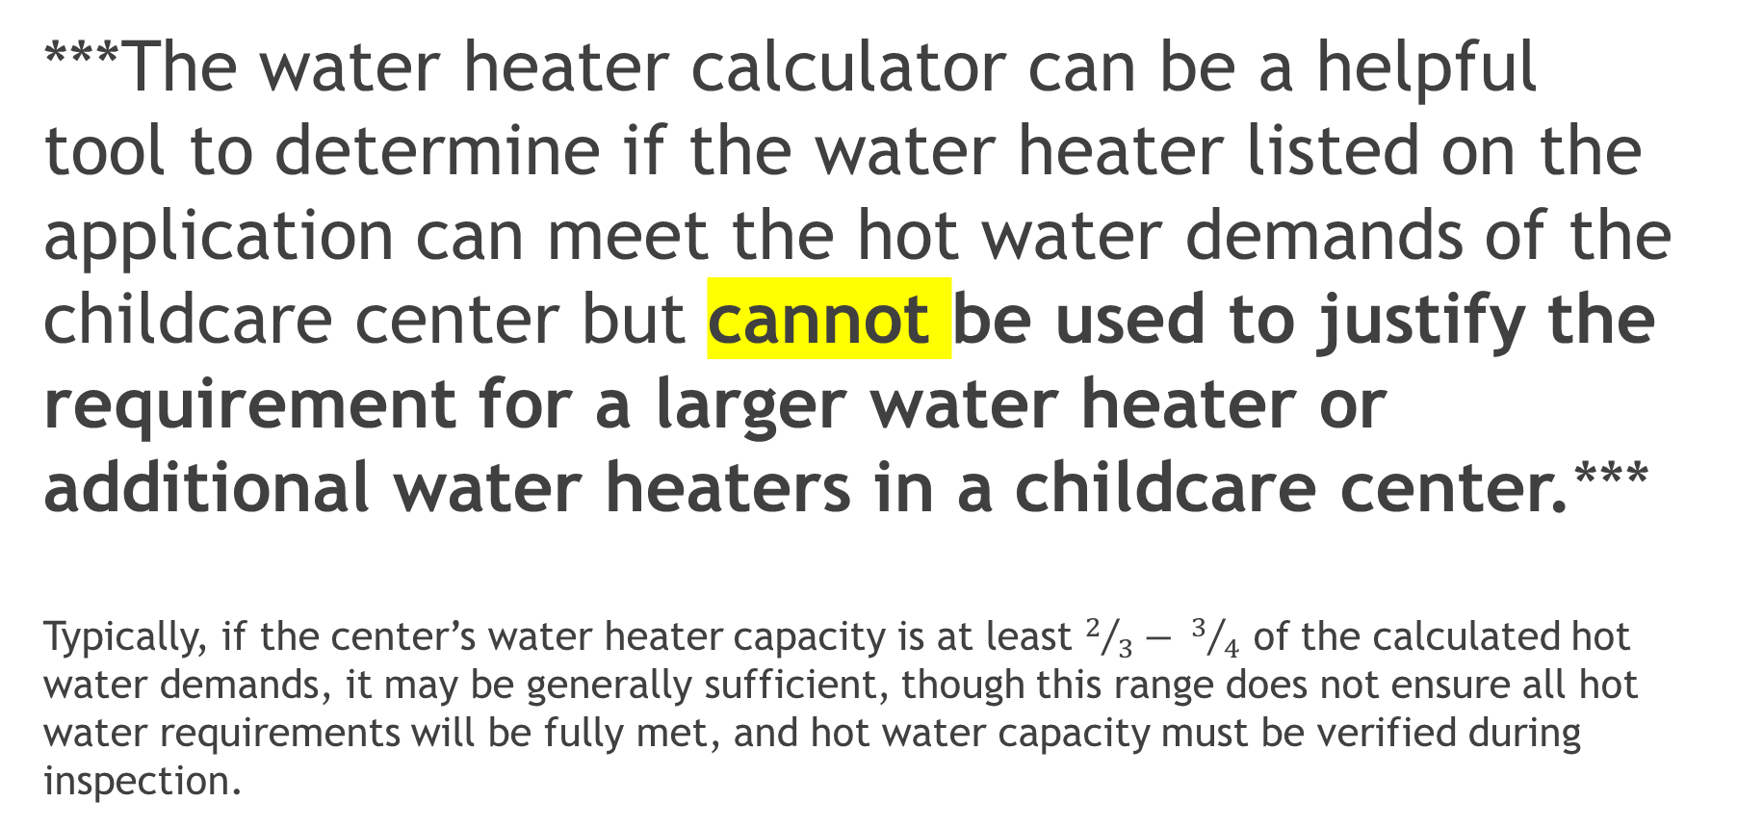
Water Heater Calculator
***The water heater calculator can be a helpful tool to determine if the water heater listed on the application can meet the hot water demands of the childcare center but cannot be used to justify the requirement for a larger water heater or additional water heaters in a childcare center.***
Typically, if the center’s water heater capacity is at least $2/3− 3/4$ of the calculated hot water demands, it may be generally sufficient, though this range does not ensure all hot water requirements will be fully met, and hot water capacity must be verified during inspection.

Slide 26
Water Heater Calculator
1. Application information used to determine recovery rate needed:
# of hand wash sinks, service sinks, prep sinks
# of ware washing sinks, how many compartments and size of compartments
# of dish washers
# of washing machines
2. Determine:
Temperature rise (hot water temperature needed – groundwater temperature)
Specification sheets for hot water heater – water heater input (BTU or kW)
3. Compare calculated recovery rate and determined temperature rise to the corresponding information on the submitted hot water heater specification sheets

Slide 27
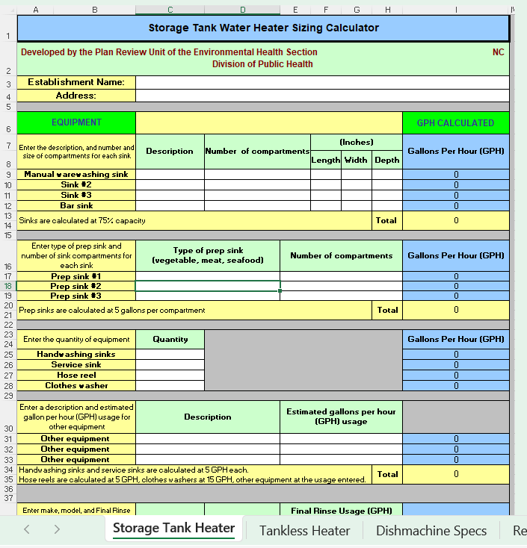
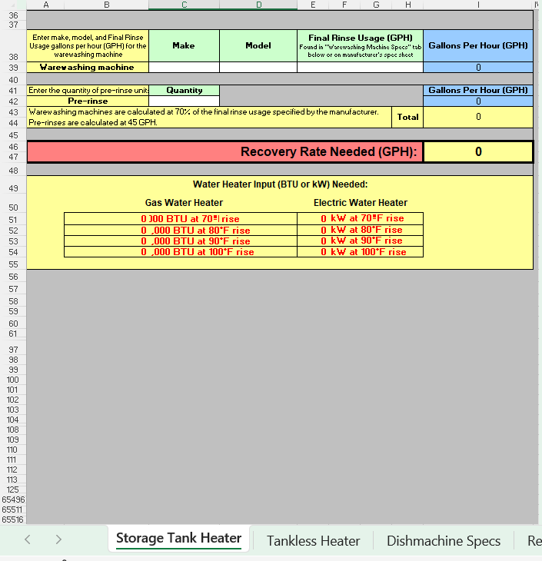
Water Heater Calculator – Storage Tank Water Heater
https://ehs.dph.ncdhhs.gov/faf/food/planreview/docs/WaterHeaterCalculator-0713.xls

Slide 28
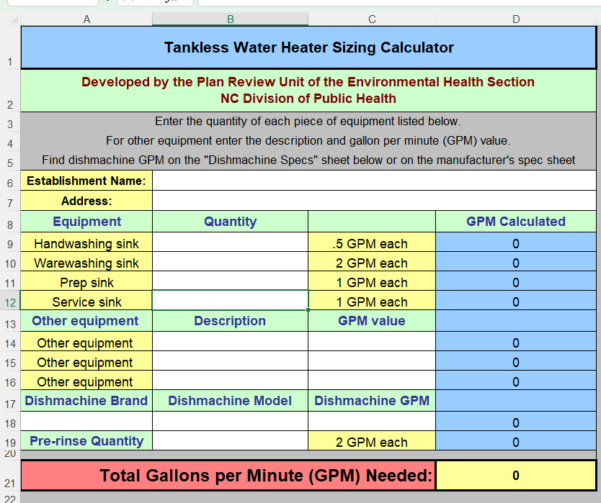
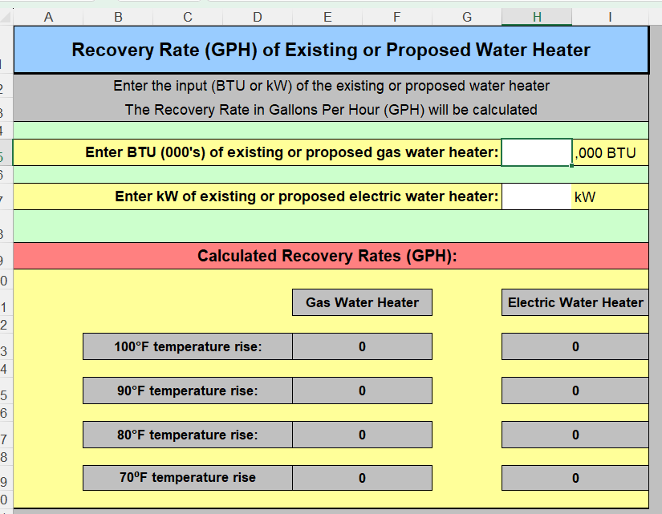
Tankless Water Heater Calculator & Recovery Rate Calculator

Slide 29
.2810 (a) & .2806 (j)(1) Refrigeration Requirements
.2810 (a) Each childcare center* shall have at least a two-compartment sink, drainboards or countertop space of adequate size, adequate refrigeration equipment and, when needed, adequate cooking equipment.
    *Except in childcare centers where they receive their food from a .2600 permitted establishment on the same campus as the childcare center
.2806 (j)(1) Refrigeration equipment shall be provided in such number and of such capacity to ensure the maintenance of potentially hazardous food at the required temperatures during storage.
.2806 (h) The temperature of potentially hazardous food provided by the childcare center for consumption by children shall be 45 degrees Fahrenheit or below

Slide 30
Domestic Refrigeration Reminder
.2810 (a) Childcare centers shall be permitted to use domestic kitchen equipment.
.2810 (d) Except in childcare centers licensed for fewer than 13 children and located in a residence, when domestic refrigeration equipment is used the following shall apply:
(1) except for thawing in a refrigerator, potentially hazardous foods shall not be prepared prior to the day that such foods are to be served;
(2) potentially hazardous foods that have been heated shall not be reheated or placed in refrigeration to be used in whole or in part on another day; and
(3) salads containing potentially hazardous food shall not be prepared on site. Prohibited salads include chicken, egg, tuna, crab, and other salads containing meat.

Slide 31
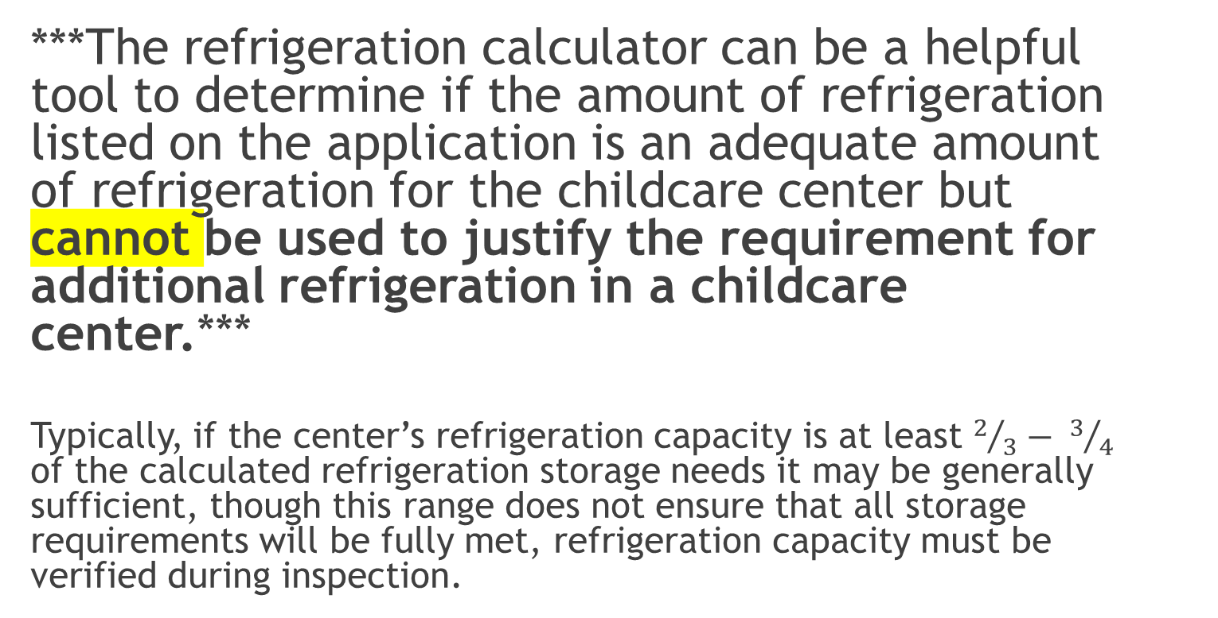
Refrigeration Calculator
***The refrigeration calculator can be a helpful tool to determine if the amount of refrigeration listed on the application is an adequate amount of refrigeration for the childcare center but cannot be used to justify the requirement for additional refrigeration in a childcare center.***
Typically, if the center’s refrigeration capacity is at least $2/3− 3/4$ of the calculated refrigeration storage needs it may be generally sufficient, though this range does not ensure that all storage requirements will be fully met, refrigeration capacity must be verified during inspection.

Slide 32
Refrigeration Calculator
Walk-in Refrigeration Calculator
Input: Number of meals between deliveries (based on application info)
Output: Square feet area of walk-in cooler/freezer needed
Reach-in Refrigeration Calculator
Input: Number of meals between deliveries (based on application info)
Output: Cubic feet of reach in refrigeration needed
Number of Meals Supported by Refrigeration
Input: Square feet of walk in space, cubic feet of reach-in space,
Output: Total number of meals supported (between deliveries)

Slide 33
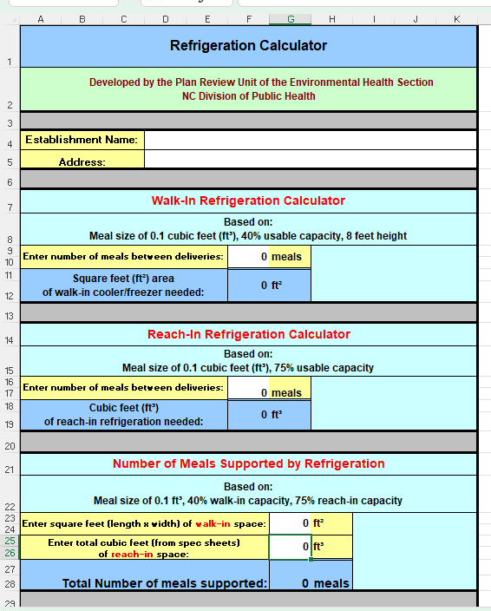
Refrigeration Calculator https://ehs.dph.ncdhhs.gov/faf/food/planreview/docs/RefrigerationCalculator-4-12.xls

Slide 34
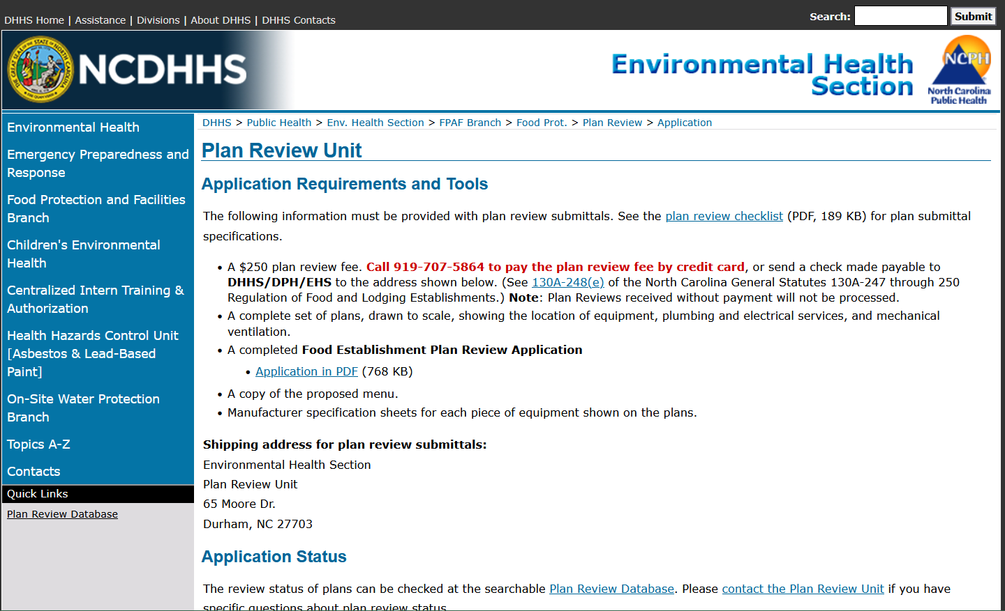
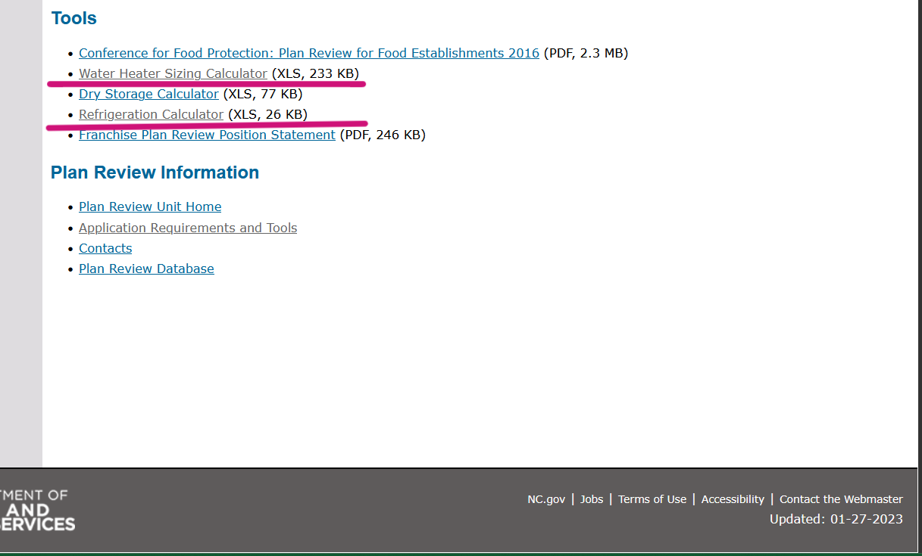
Calculators can be found here:
https://ehs.dph.ncdhhs.gov/faf/food/planreview/app.htm

Slide 35

Kitchen Area

Slide 36
15A NCAC 18A .2810 SPECIFICATIONS FOR KITCHENS, FOOD PREPARATION AREAS, AND FOOD SERVICE AREAS
(a) Each child care center shall have at least a two-compartment sink, drainboards or countertop space of adequate size, adequate refrigeration equipment and, when needed, adequate cooking equipment, except that this requirement shall not apply to child care centers located in a school that receives food supplies that are pre-prepared and ready to serve from a food service establishment permitted by a local health department, which is located at the same school campus and provides food during all hours of the child care center's operation. Child care centers shall be permitted to use domestic kitchen equipment. A child care center may use and wash multi-use articles and highchair feeding trays in a two-compartment sink, but shall not use or wash multi-service articles other than highchair feeding trays unless equipped with either:
  (1) a dishwasher and two-compartment sink, or
  (2) a three-compartment sink of sufficient size and depth to submerge, wash, rinse and sanitize utensils.

Slide 37
15A NCAC 18A .2810 SPECIFICATIONS FOR KITCHENS, FOOD PREPARATION AREAS AND FOOD SERVICE AREAS
15A NCAC 18A .2810 SPECIFICATIONS FOR KITCHENS, FOOD PREPARATION AREAS AND FOOD SERVICE AREAS
(b) A separate lavatory for handwashing is required in food preparation areas and kitchens. If the dishwashing area is separate from the food preparation area, an additional handwashing lavatory shall be required in the dishwashing area.
(c) A separate food preparation sink with drainboards or countertop space of adequate size shall be required when a review of construction plans, modifications, or change in child care procedures indicates that separate facilities are needed based on volume and preparation frequency.

Slide 38
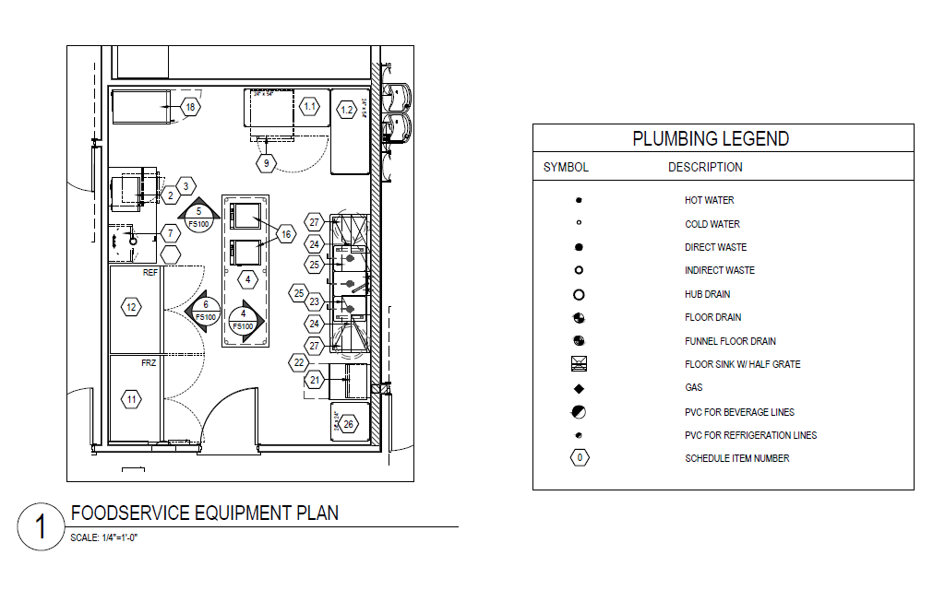
Kitchen Area Exercise

Slide 39
Food Preparation Area

Slide 40
15A NCAC 18A .2810 SPECIFICATIONS FOR KITCHENS, FOOD PREPARATION AREAS, AND FOOD SERVICE AREAS
(f) If food is prepared in a child care center classroom, then the classroom shall be equipped with a food preparation area. … This food preparation area shall contain a countertop that is kept clean and in good repair, a handwash lavatory, and refrigeration when items are stored that require refrigeration in accordance with Rules .2804 and .2806 of this Section.

Slide 41
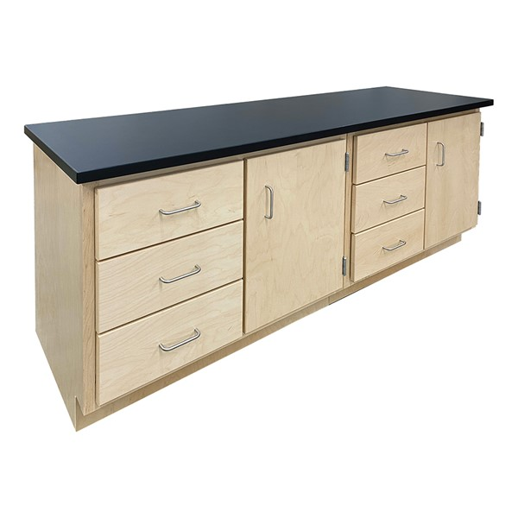
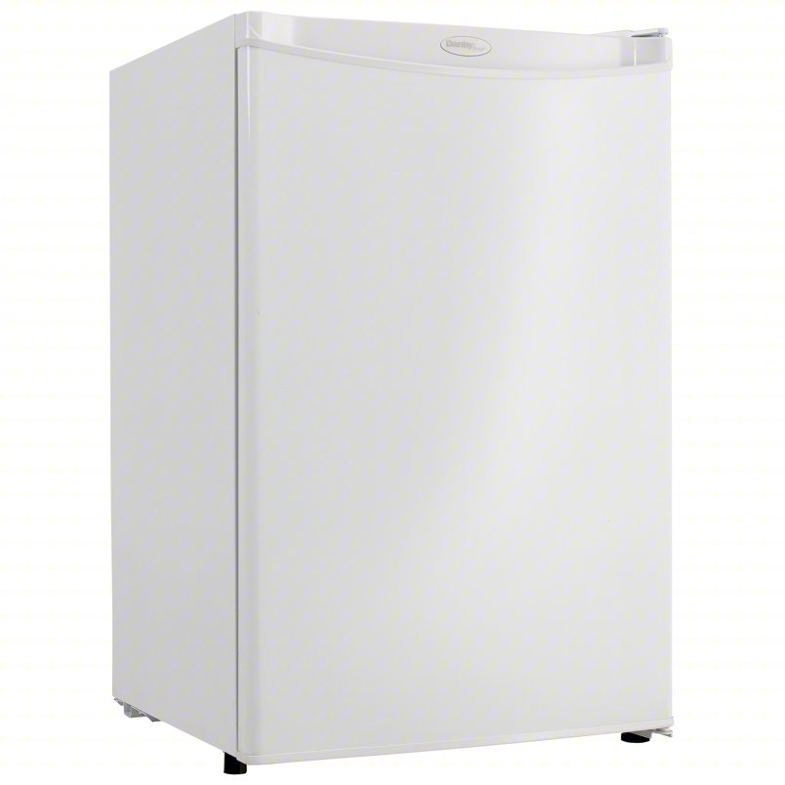
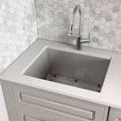
= Food Preparation Area
+
+

Slide 42
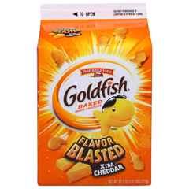
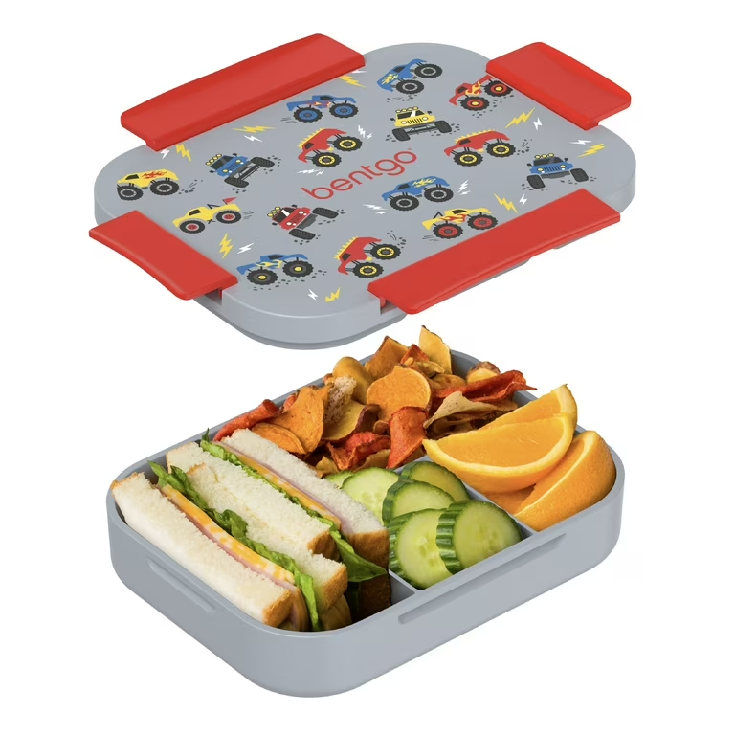
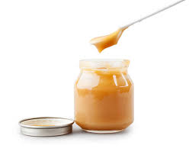
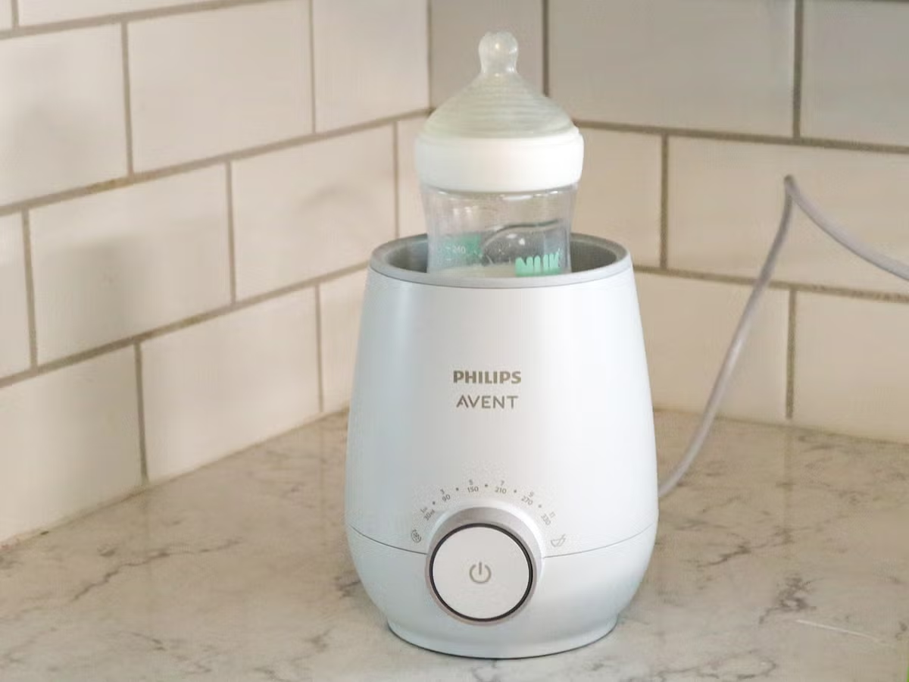
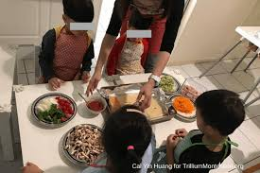
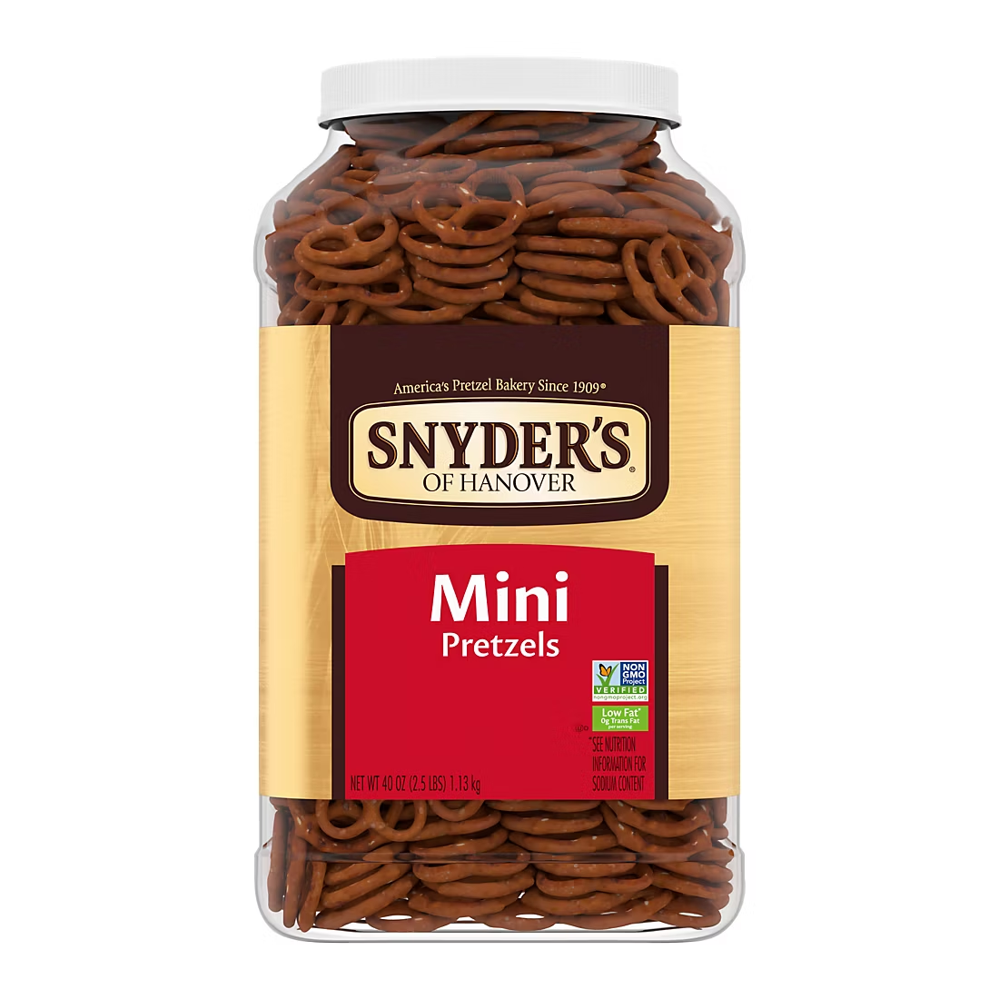
Does each classroom in a child care center require a Food Preparation Area? -NO
WHEN a Food Preparation Area is required:
  .2804 (k) Lunches, snacks, and other meals containing potentially hazardous foods shall be refrigerated at 45 degrees Fahrenheit or below and stored in the child care center kitchen or approved food preparation area.
  .2806 (b) Food that is stored in child care center classrooms or other rooms intended for child care use, shall be limited to foods that are individually packaged unless the classroom is equipped with a food preparation area.
  .2810 (f) If food is prepared in a child care center classroom, then the classroom shall be equipped with a food preparation area
  .2810 (f)(2) if bottles are warmed, bottles shall be warmed in the child care center's kitchen or food preparation area.

Slide 43
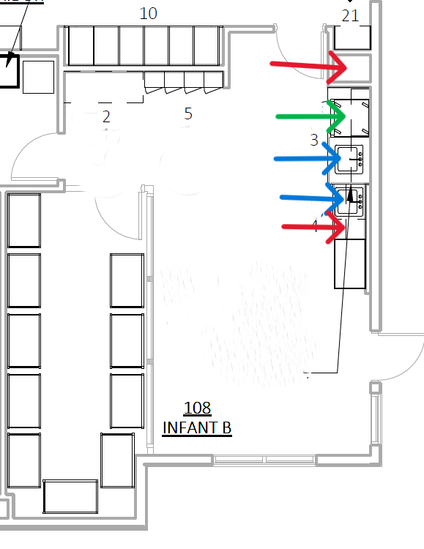
Food Preparation Area Exercise Infant Room #1
Key:
  Handwash sink BLUE
  Countertop RED
  Under-counter Mini Fridge GREEN

Slide 44
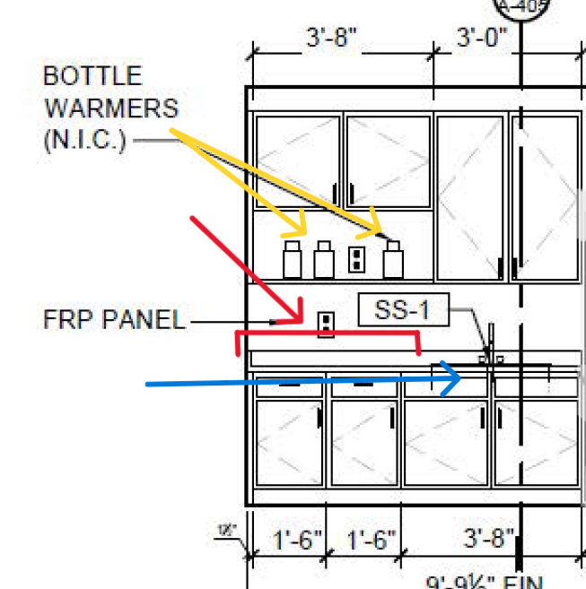
Food Preparation Area Exercise Infant Room #2
Key:
  Handwash sink BLUE
  Countertop RED
  Bottle Warmer YELLOW

Slide 45
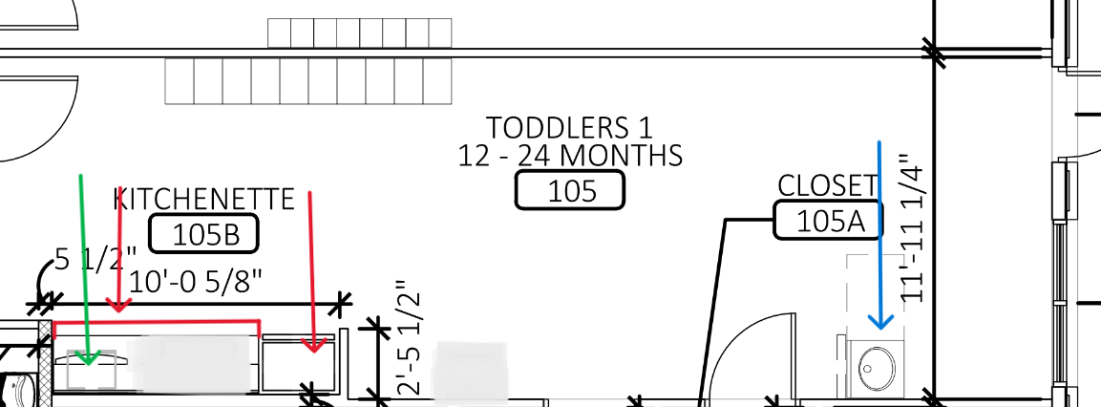
Food Preparation Area Exercise Toddler/Infant Room #3
Key:
  Handwash sink BLUE
  Countertop RED
  Under-counter Mini Fridge GREEN

Slide 46
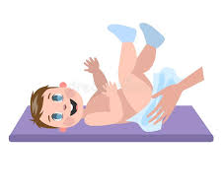
Diaper Changing

Slide 47
(a) In child care centers, children in diapers shall be changed at stations designated for diapering or toileting. Each diaper changing station shall include a handwash lavatory. For child care centers licensed for fewer than 13 children and located in a residence, and for diaper changing areas designated for school age children, a handwash lavatory shall be in or next to the diaper changing area.
15A NCAC 18A .2819 DIAPERING AND DIAPER CHANGING FACILITIES

Slide 48
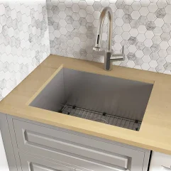
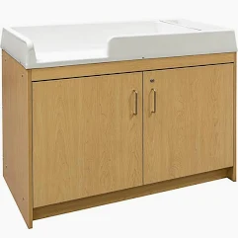
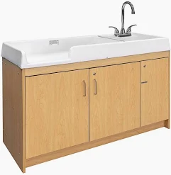
Approved Diapering Facilities include these items.

Slide 49
Diaper Changing Exercise Infant Room #1
Key:
  Diaper changing station RED
  Diaper changing hand wash sink BLUE
  Food prep hand wash sink GREEN

Slide 50
Diaper Changing Exercise Infant Room #2
Key:
  Diaper changing station RED
  Diaper changing hand wash sink BLUE

Slide 51
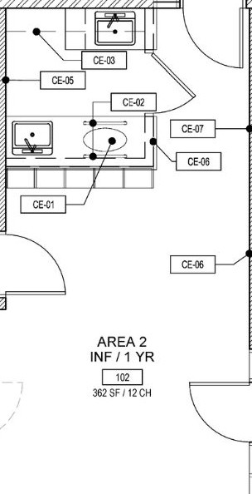
Diaper Changing Exercise Infant Room #3
Key:
  Diaper changing station RED
  Diaper changing hand wash sink BLUE
  Food prep hand wash sink GREEN

Slide 52

Plan Review
QUESTIONS

