Slide 1
Communicable Disease Prevention and Outbreak Investigation
W. David Brown, R.S., M.P.A.
Surveillance Coordinator
Children’s Environmental Health Program

Slide 2
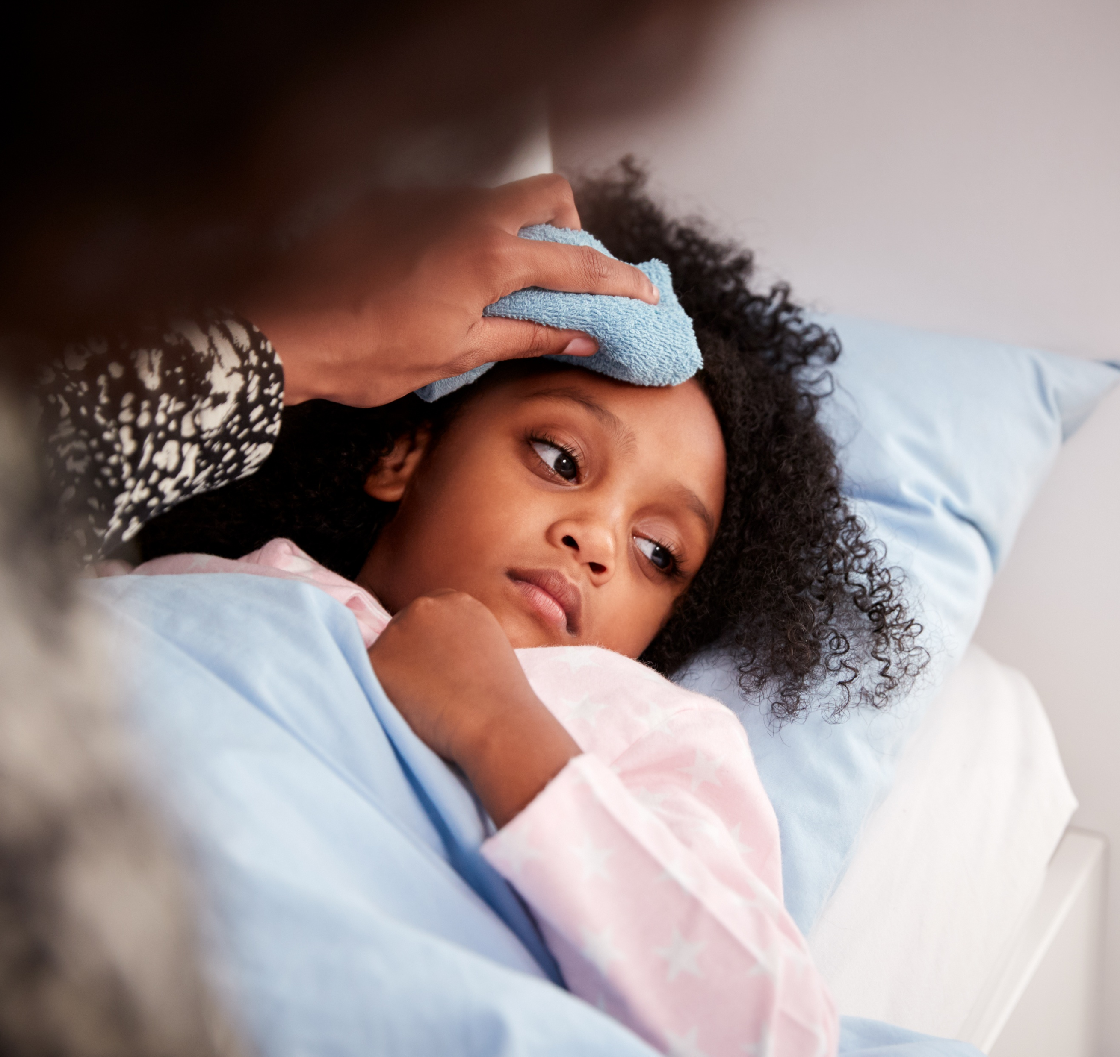
How is disease and illness spread in child occupied settings?

Slide 3
Modes of Transmission
Fecal-Oral
Blood
Food and drinking water
Surfaces
Animal to human
Airborne
Notes:
.2822 mouthable toys

Slide 4
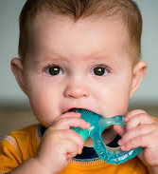
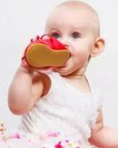

Mouthing
https://brightestbeginning.com/5-developmental-benefits-babies-get-from-mouthing/

Slide 5
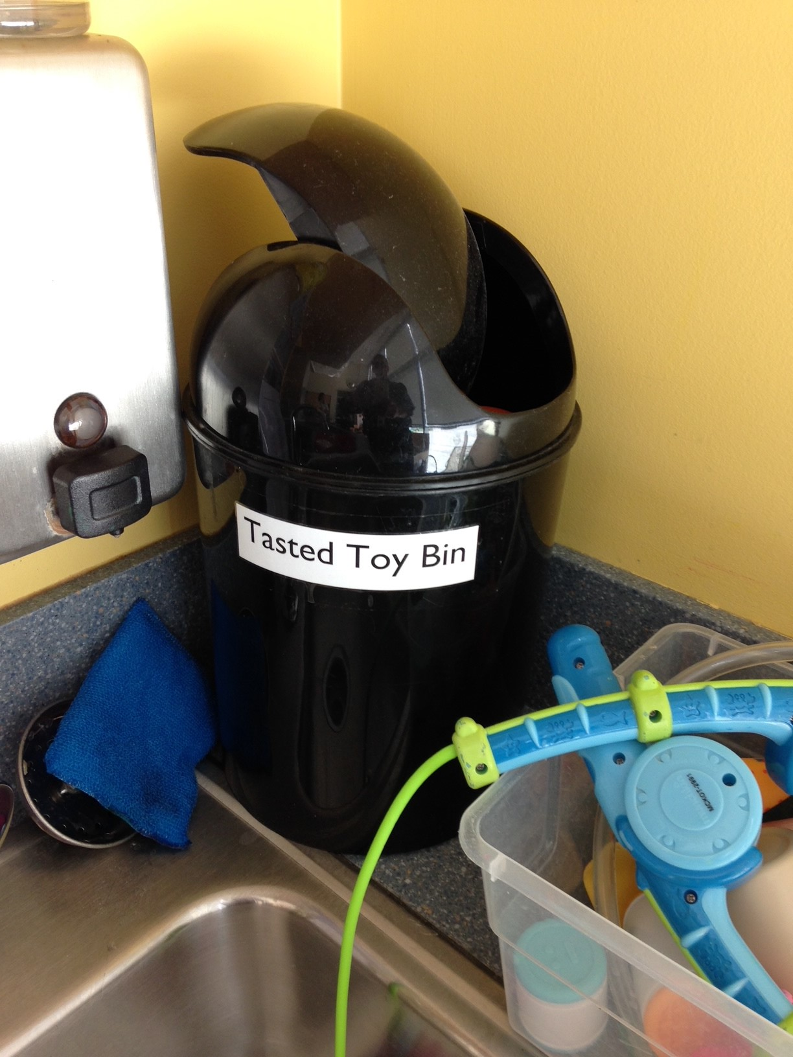
Mouthed toys - separated from other toys cleaned and sanitized .2822(a)

Slide 6
Measles Transmission in Child Occupied Facilities
“Because measles transmission is unlikely from surfaces, and because of … not knowing about a case until much later, we (DHHS) are recommending that individuals maintain their routine cleaning and disinfection. This specific guidance is added to our FAQs for schools and childcare centers.”
Source
From: Bryant, Veronica M <veronica.bryant@dhhs.nc.gov>
Sent: Thursday, February 26, 2026 11:24 AM
Subject: Measles Guidance in Child Cares

Slide 7
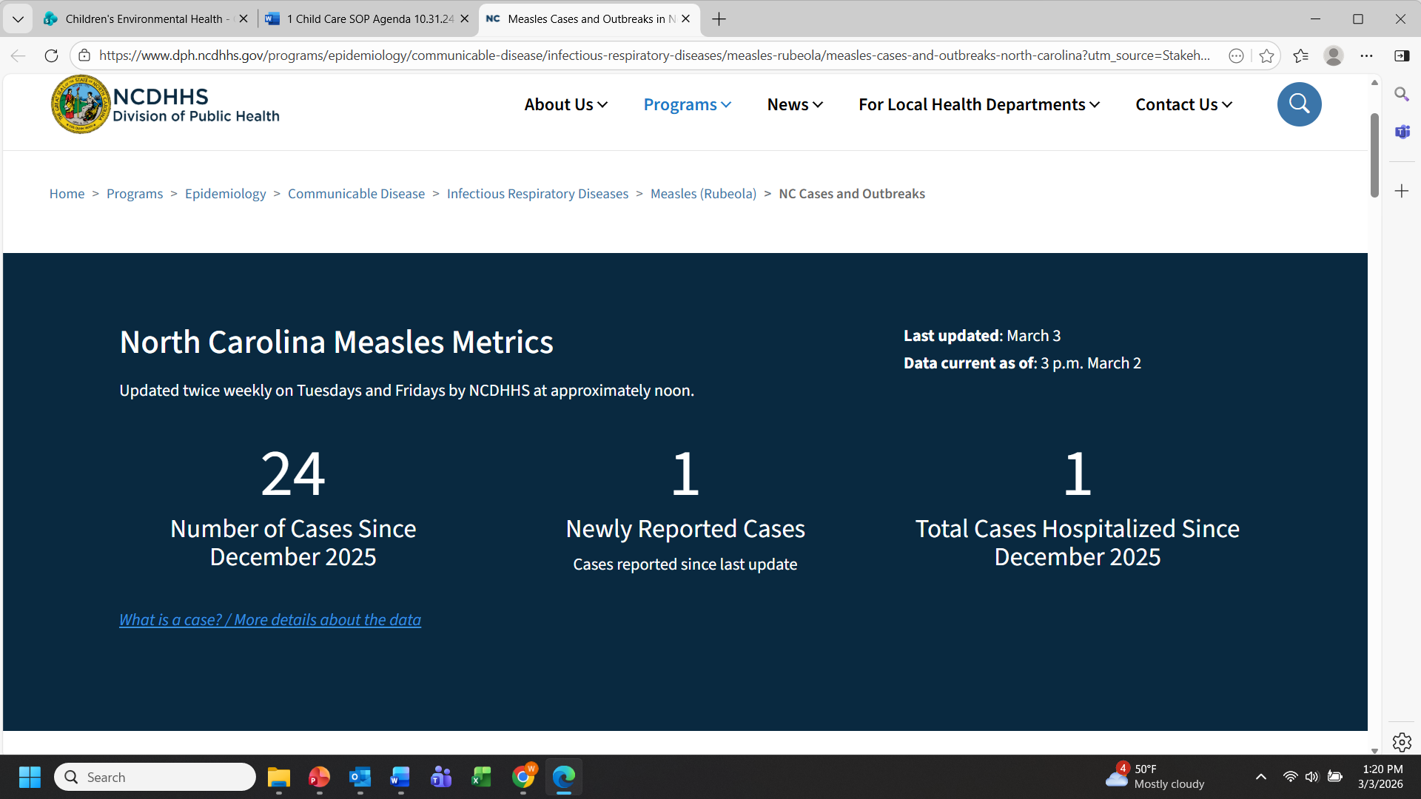

Slide 8
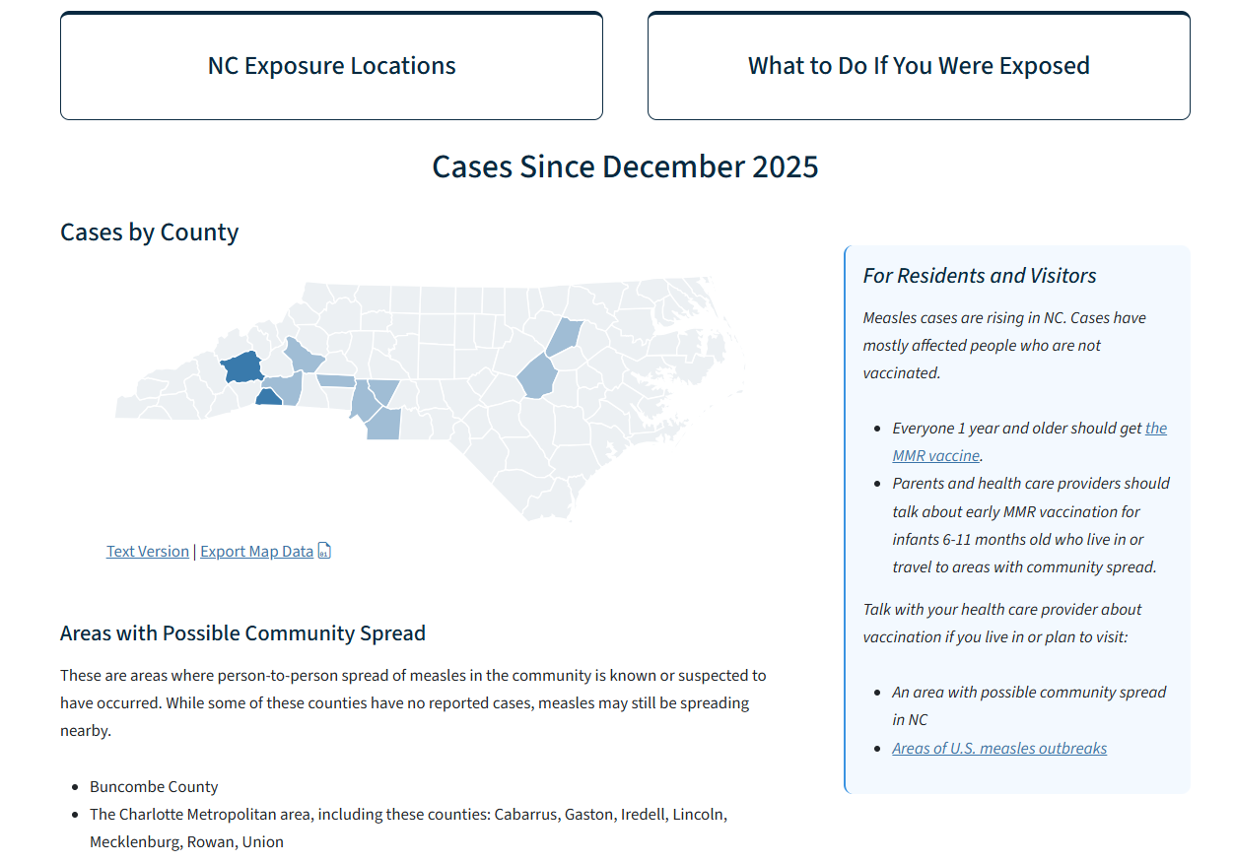

Slide 9
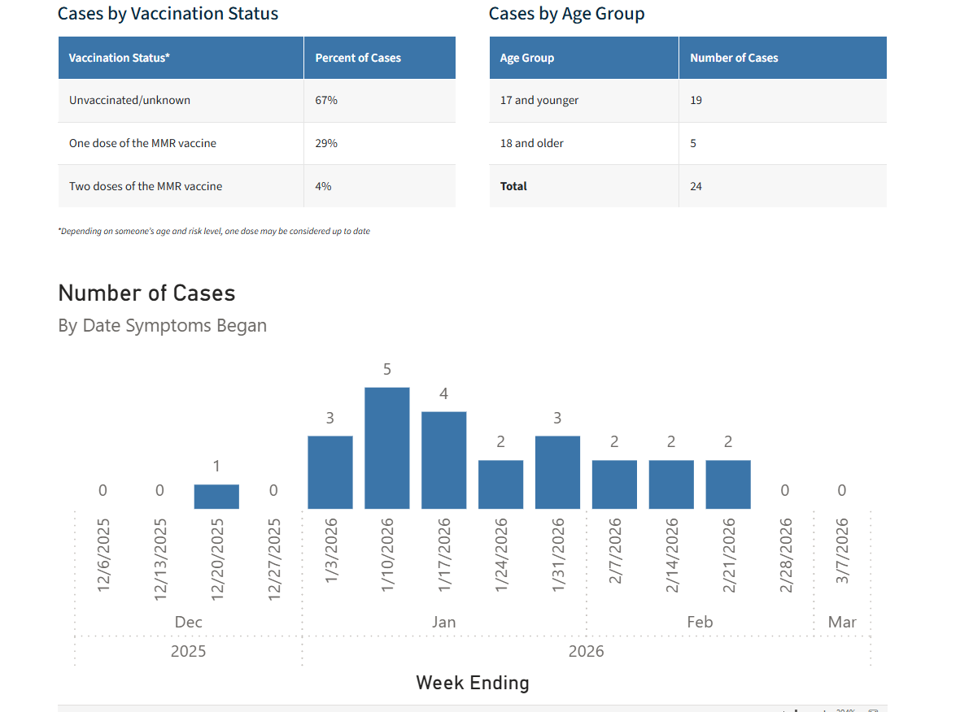

Slide 10
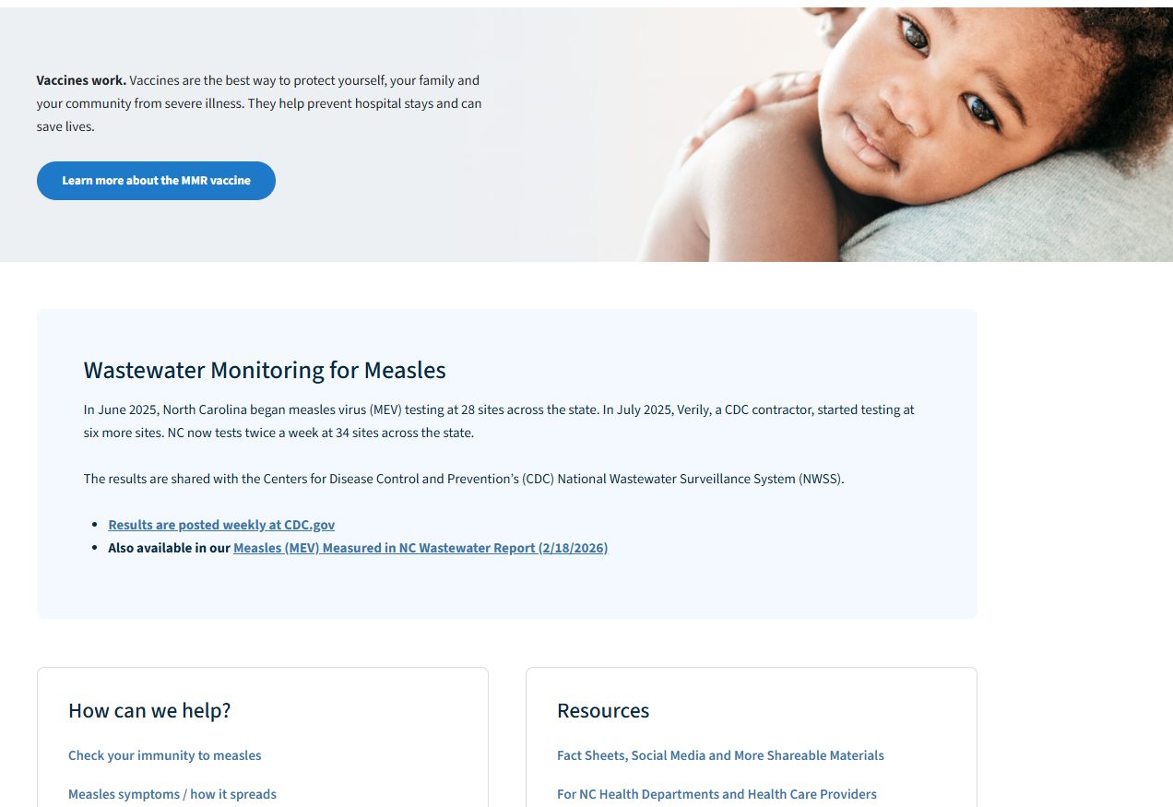

Slide 11
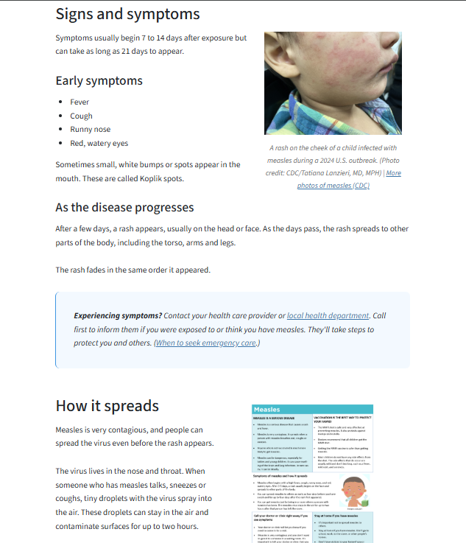

Slide 12
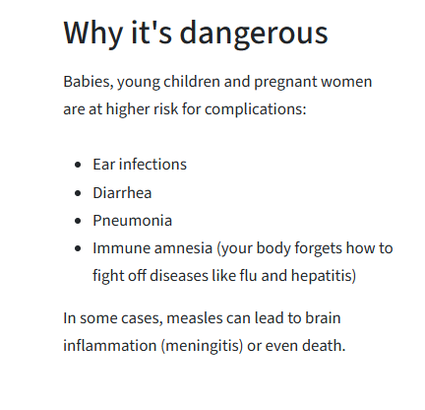

Slide 13
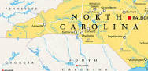
Our Neighbors – 90% of cases in unvaccinated people
As of February 27, 2026, the South Carolina Department of Public Health (DPH) reports 985 confirmed measles cases in an ongoing outbreak centered in the Upstate region, primarily Spartanburg County. This is a major, ongoing outbreak with significant community spread, prompting warnings about potential exposure locations, including retail and school sites.
Alan Huneycutt
Nykesse Roberts

Slide 14
Protective Measures
Hand washing .2803
Sick child policy
Toy Cleaning .2822
Sink/Toilet/Counter .2817, .2818
Diapering Area Disinfection .2819
Proper Food Handling .2806, .2807, 2808
Separate Storage for Clothes .2820
Vomit and Diarrhea Plan
TRAINING-TRAINING-TRAINING

Slide 15

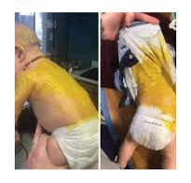
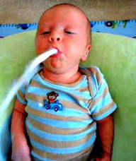
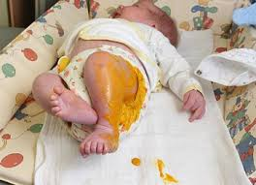

Slide 16
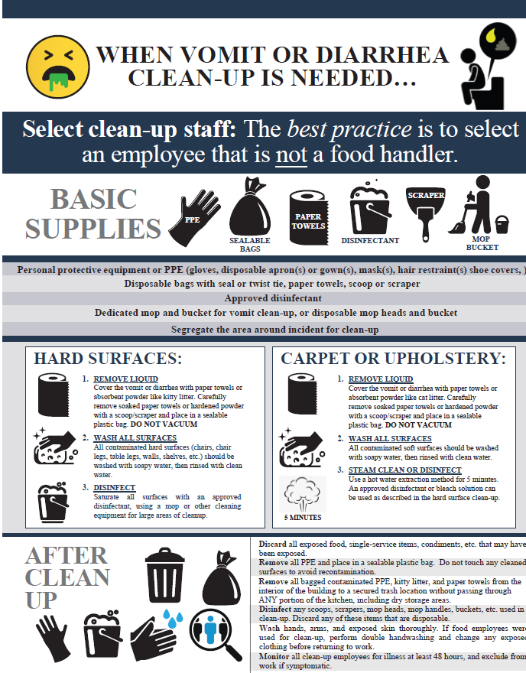
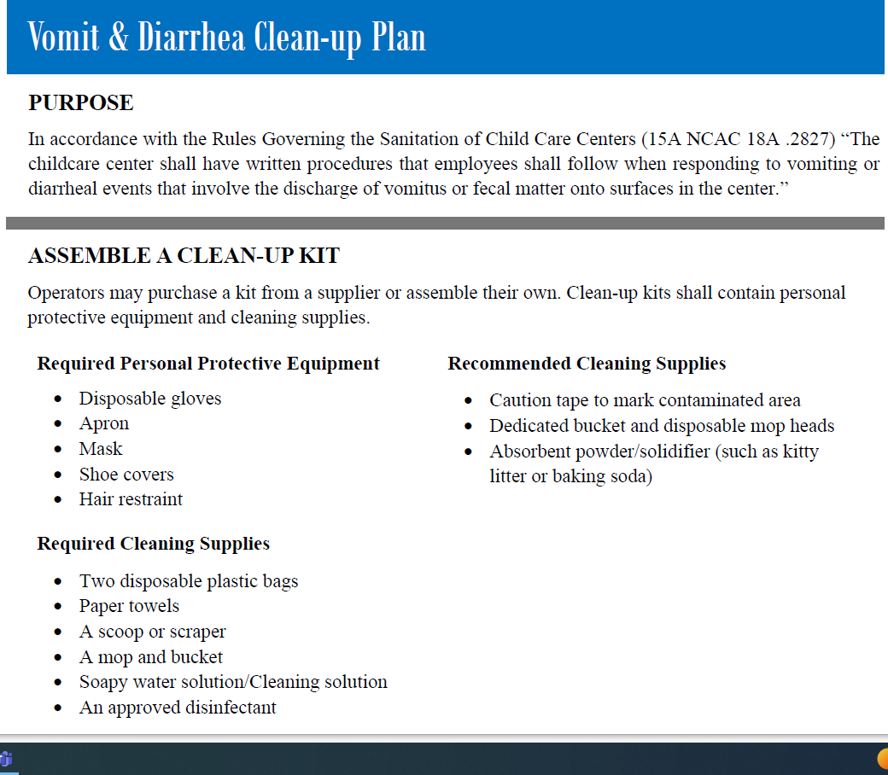

Slide 17

WORKING PARENTS
Almost three-fourths (74%) of moms with children under 18 are working in the labor force, and beyond that, moms are performing the unpaid work of caring for their children, completing household chores.
US Dept of Labor
May 2024
Notes:
Includes single parent households. Communicable Diseases are illnesses caused by microorganisms and transmitted from an infected person or animal to another person or animal. Some diseases are passed on by direct or indirect contact with infected persons or with their excretions. Most diseases are spread through contact or close proximity because the bacteria or viruses are airborne;

Slide 18

THE CAREGIVERS
When a child stays home sick someone must stay home to provide care—and this person is usually a mother, or an older child.
https://www.caregiver.org/caregiver-statistics-demographics

Slide 19
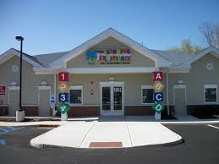
4,607 licensed child care centers
246,622 children enrolled in licensed
child care centers
https://ncchildcare.ncdhhs.gov/County/Child-Care-Snapshot
Source, Division of Child Development and Early Education Monthly Statistical Summary Report - May 2017
Number of Children Served Receiving Subsidy - 63,509

Slide 20

Impact and Cost of Illness
Child illness accounts for 40 per cent of parental absenteeism from work.
Children in child care are 30 percent more likely to contract a diarrheal illnesses than children cared for at home.
Children in child care centers were 4.5 times more likely to be hospitalized than children in other settings.
Parents of children in child care centers miss an average of 1 to 4 weeks of work each year to care for their sick children.
Over 34 million U.S. workers lack paid sick leave for family care
Employee workdays lost to illness cost US businesses between $2 - $12 billion/yr.
WHAT YOU DO MAKES A DIFFERENCE!
Illness associated with child day care: a study of incidence and cost.
D M Bell, D W Gleiber, A A Mercer, R Phifer, R H Guinter, A J Cohen, E U Epstein and M Narayanan.
Department of Pediatrics, Memphis State University.
http://www.ajph.org/cgi/content/abstract/79/4/479?ck=nck
Notes:
The costs of illnesses costs businesses between $2-$12 billion per year due to work days missed
Parents of children in child care centers miss an average of 1 to 4 weeks of work each year to care for their sick children

Slide 21
CHILD ILLNESS
What is the most common childhood surgery performed under general anesthesia?
The child’s average age for this procedure is one to three years.
More than a million are performed in North America each year.
Notes:
ear tube surgeries (myringotomy)

Slide 22
Ear tubes - tiny, hollow tubes, usually made of plastic or metal, that are surgically inserted into the eardrum creating an airway that ventilates the middle ear and prevents the accumulation of fluids behind the eardrum.
Doctors frequently recommend ear tubes if a child gets frequent ear infections or if the condition affects hearing and speech.
In children without tubes, ear infections are often treated with antibiotics by mouth or by injection. In children with tubes, the infection can drain out the tube and it can usually be treated with antibiotic eardrops.
In most children, ear tubes last somewhere between six months and two years before the body naturally pushes the tubes out and into the ear canal.

Slide 23
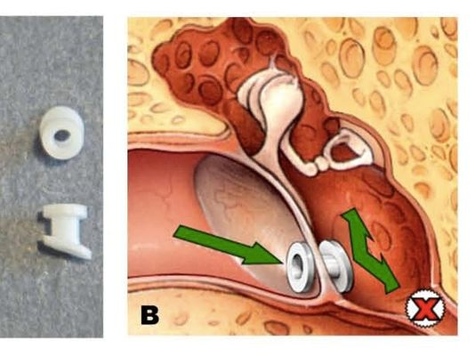
Seven percent of children in the U.S. receive a set of tubes by age three.

Slide 24
Risk Factors for Disease
Inadequate infection control
Understaffing
Staff turnover averages 40%
  https://www.indeed.com/career/preschool-teacher/salaries/NC
  Average salary for a preschool teacher in NC is $15.94
Lack of Training
Animals and pets
Spread of infection often occurs prior to recognition of symptoms
Notes:
Pets in child care centers can spread disease. For example box turtles, chickens, iguanas, snakes. Petting zoos and other animals
The average annual turnover in childcare facilities is about 40 percent.
No national standards exist and wide variation between States
http://profiles.nlm.nih.gov/ps/access/NNBCTV.pdf

Slide 25
Risk Factors of Illness
The strongest predictor of illness is the number of children in the room: crowded conditions and close contact
Poor personal hygiene
Limited immunity
Mobility of teachers and students
Poor classroom design and layout
Poor ventilation
Illness associated with child day care: a study of incidence and cost. D M Bell, D W Gleiber, A A Mercer, R Phifer, R H Guinter, A J Cohen, E U Epstein and M Narayanan.

Slide 26
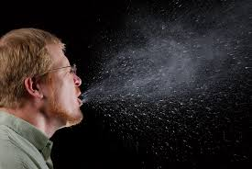
COVID-19 and Measles is spread by respiratory droplets released when people talk, sing, cough, or sneeze.

Slide 27

COVID-19 and Measles Prevention
Stay up to date with vaccines.
  Although vaccinated people sometimes get infected with the virus that causes COVID-19, staying up to date on COVID-19 vaccines significantly lowers the risk of getting very sick, being hospitalized, or dying from COVID-19.

Slide 28
Some germs spread in the air between people. This happens more easily in indoor, crowded spaces with poor airflow. To reduce the risk of exposure, it helps to improve air quality by increasing airflow, cleaning the air with air purifiers, or opting to gather outdoors.
Steps you can take
Bring as much fresh air into your space as possible by opening doors and windows and/or using exhaust fans.
If your home has a central heating, ventilation, and air conditioning system (HVAC, a system with air ducts that go throughout the home) that has a filter, set the fan to the "on" position instead of "auto" when you have visitors and use pleated filters. Change your filter every three months or according to the manufacturer's instructions.
Use a portable high-efficiency particulate air (HEPA) cleaner.
If possible, move activities outdoors.

Slide 29
Aim for 5 or more air changes per hour (ACH) of clean air. This can be achieved through any combination of central ventilation system, natural ventilation, or additional devices that provide equivalent ACH to your existing ventilation.
https://www.cdc.gov/respiratory-viruses/prevention/air-quality.html

Slide 30
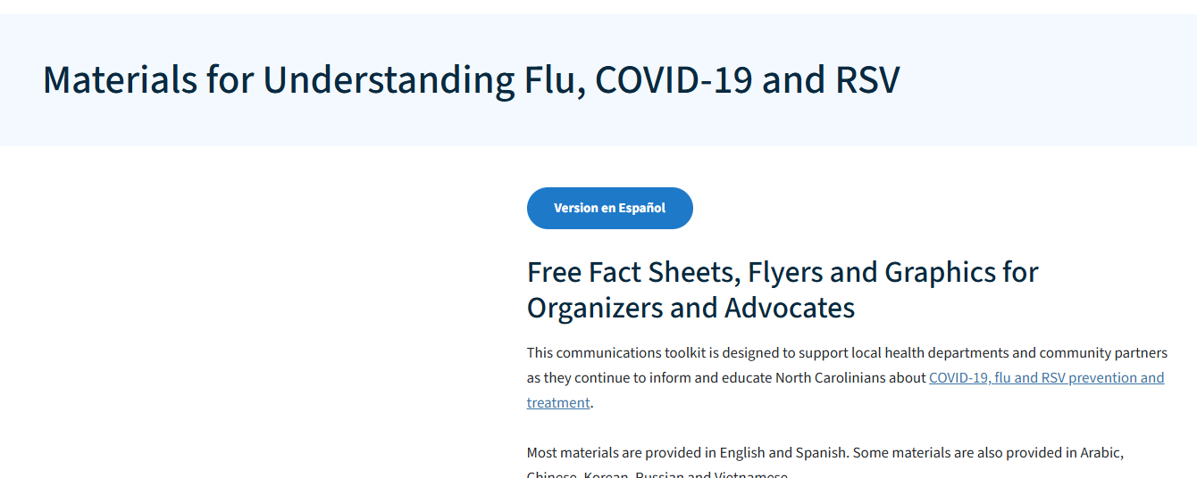
ncdhhs measles info

Slide 31
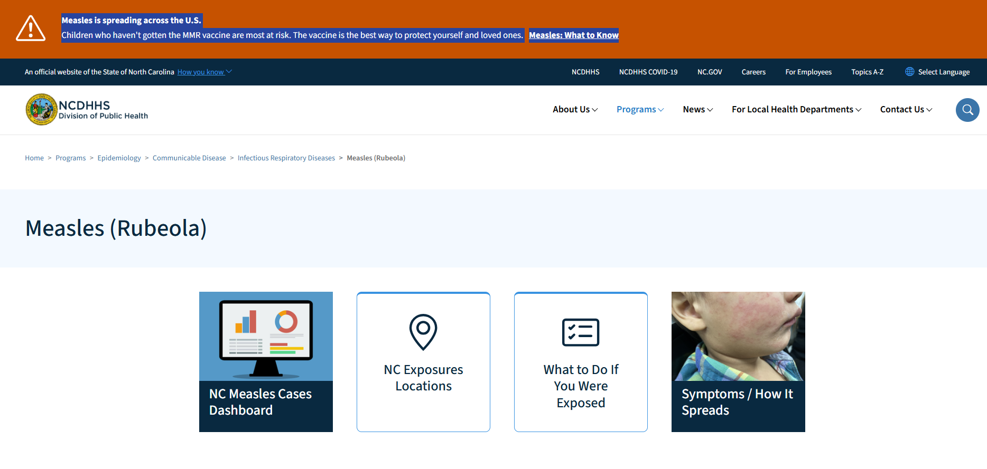

Slide 32
.
Veronica.bryant@dhhs.nc.gov
Mobile: 919-218-6943
5605 Six Forks Road
1632 Mail Service Center
Raleigh, NC, 27699-1632
Emergency Preparedness and Outbreak Coordinator
Division of Public Health, Environmental Health Section
North Carolina Department of Health and Human Services

Slide 33
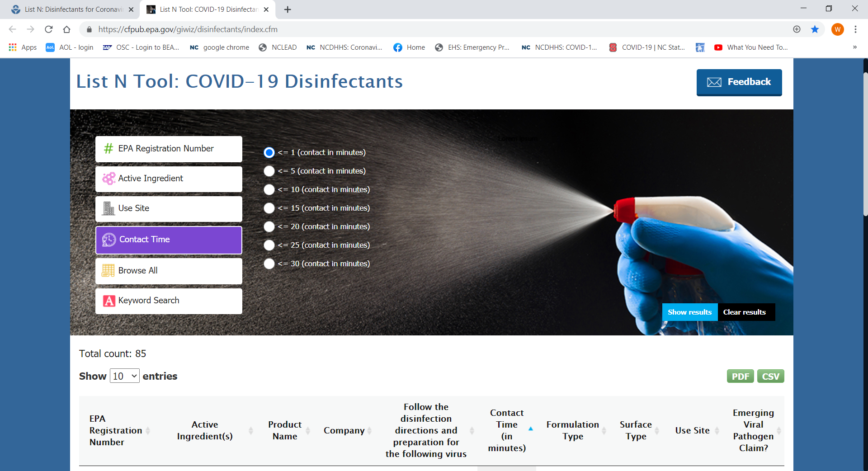
List N: Disinfectants for Coronavirus (COVID-19)
Click here to find a product to kill COVID-19

Slide 34
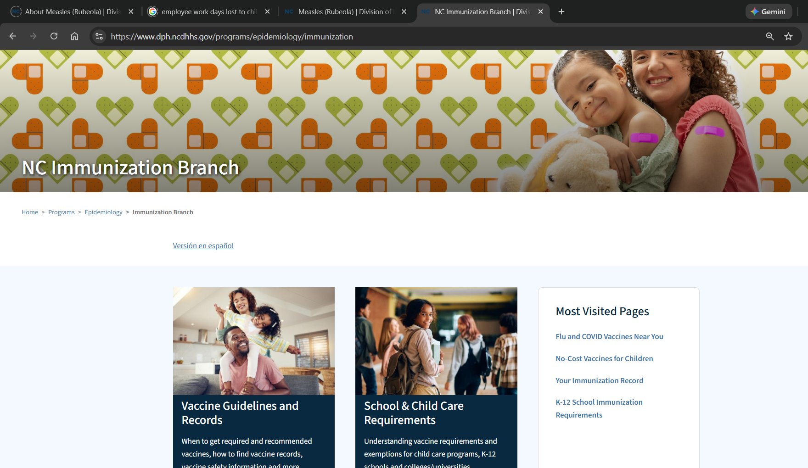

Slide 35
Required vs. Recommended in North Carolina
All children in North Carolina are required to be vaccinated against:
Diphtheria
Hepatitis B
Hib Disease
Measles
Meningococcal
Mumps
Pertussis (whooping cough)
Pneumococcal
Polio
Rubella
Tetanus
Varicella (chickenpox)
The medical community recommends children be vaccinated against the following diseases, although immunization against these diseases is not required for children in North Carolina:
Hepatitis A
Influenza
Rotavirus
Human Papillomavirus
Proof of required immunizations and health assessments are required within 30 days of the first date of attendance at school. After 30 days, children are generally excluded from school until documentation is provided.
Rubella (German measles) is not the same as measles (rubeola). They are caused by different viruses, although both cause a rash. Measles is typically more severe and highly contagious, while rubella is usually a milder illness, though it is dangerous during pregnancy. Both are prevented by the MMR vaccine.

Slide 37
Indiana University School of Medicine
The most common acute illness in children is the common cold, with children experiencing roughly 6 to 8 per year due to developing immune systems. Other highly prevalent, short-term illnesses include ear infections, gastroenteritis (stomach flu), and hand, foot, and mouth disease. Dental caries is the most common chronic disease.

Slide 38
Animals and Pets

Slide 39
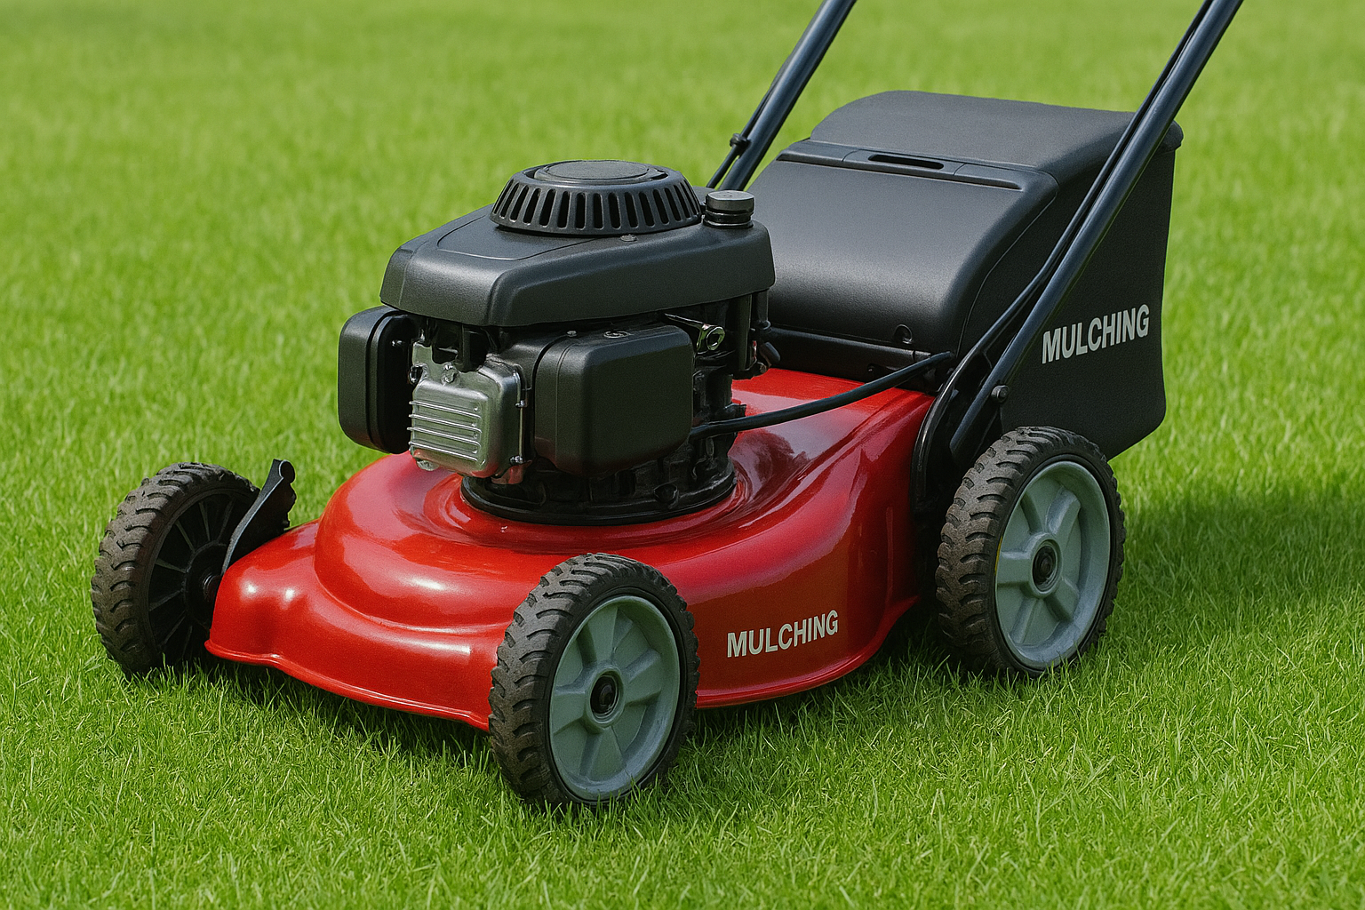
Mow your grass!

Slide 40
Salmonellosis from Pet Reptiles and Amphibians
Reptiles (lizards, snakes, and turtles) and amphibians (frogs, toads and salamanders) can carry infectious bacteria called Salmonella.
Salmonellosis is the disease caused by these bacteria. These same bacteria can also be found in uncooked foods like eggs, meat, and chicken or turkey.
https://www.mass.gov/info-details/salmonellosis-from-pet-reptiles-and-amphibians

Slide 41
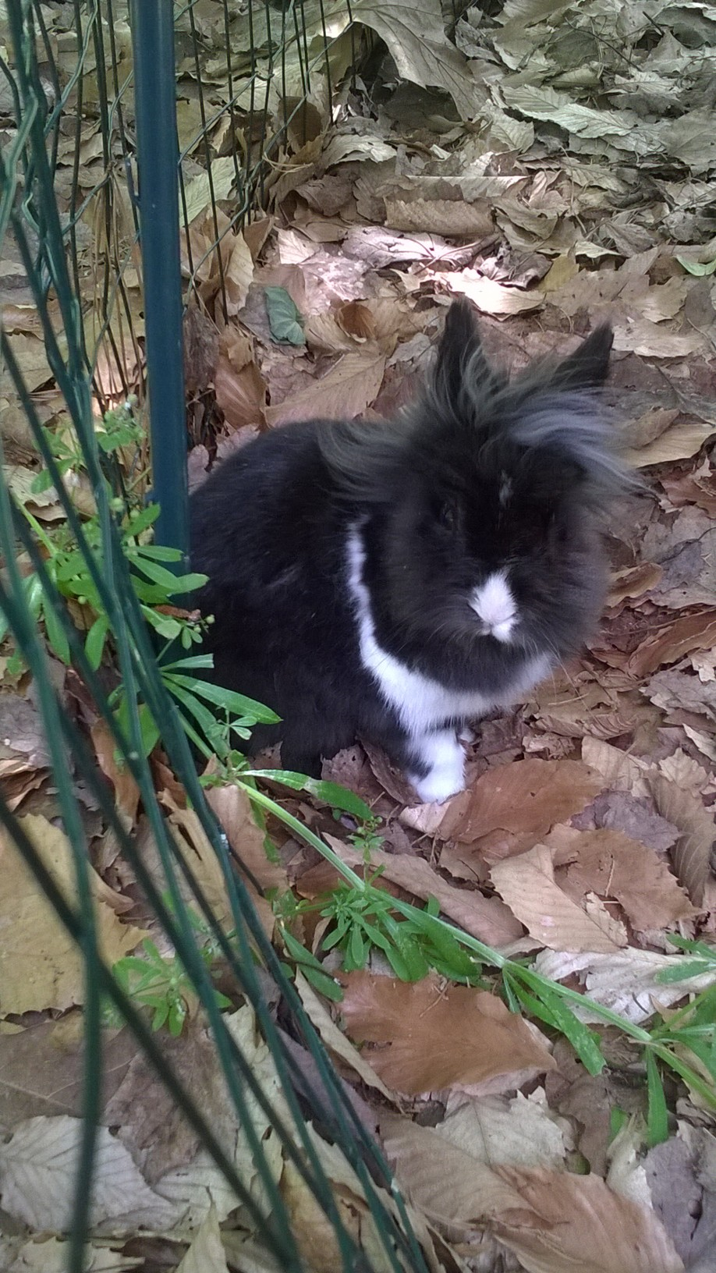
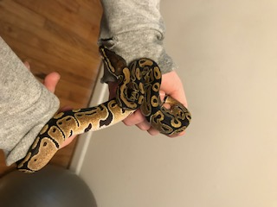
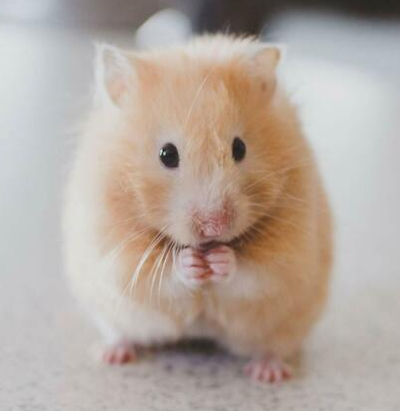
PETS
Scientists estimate that more than 6 out of every 10 known infectious diseases in people can be spread from animals, and 3 out of every 4 new or emerging infectious diseases in people come from animals.

Slide 42
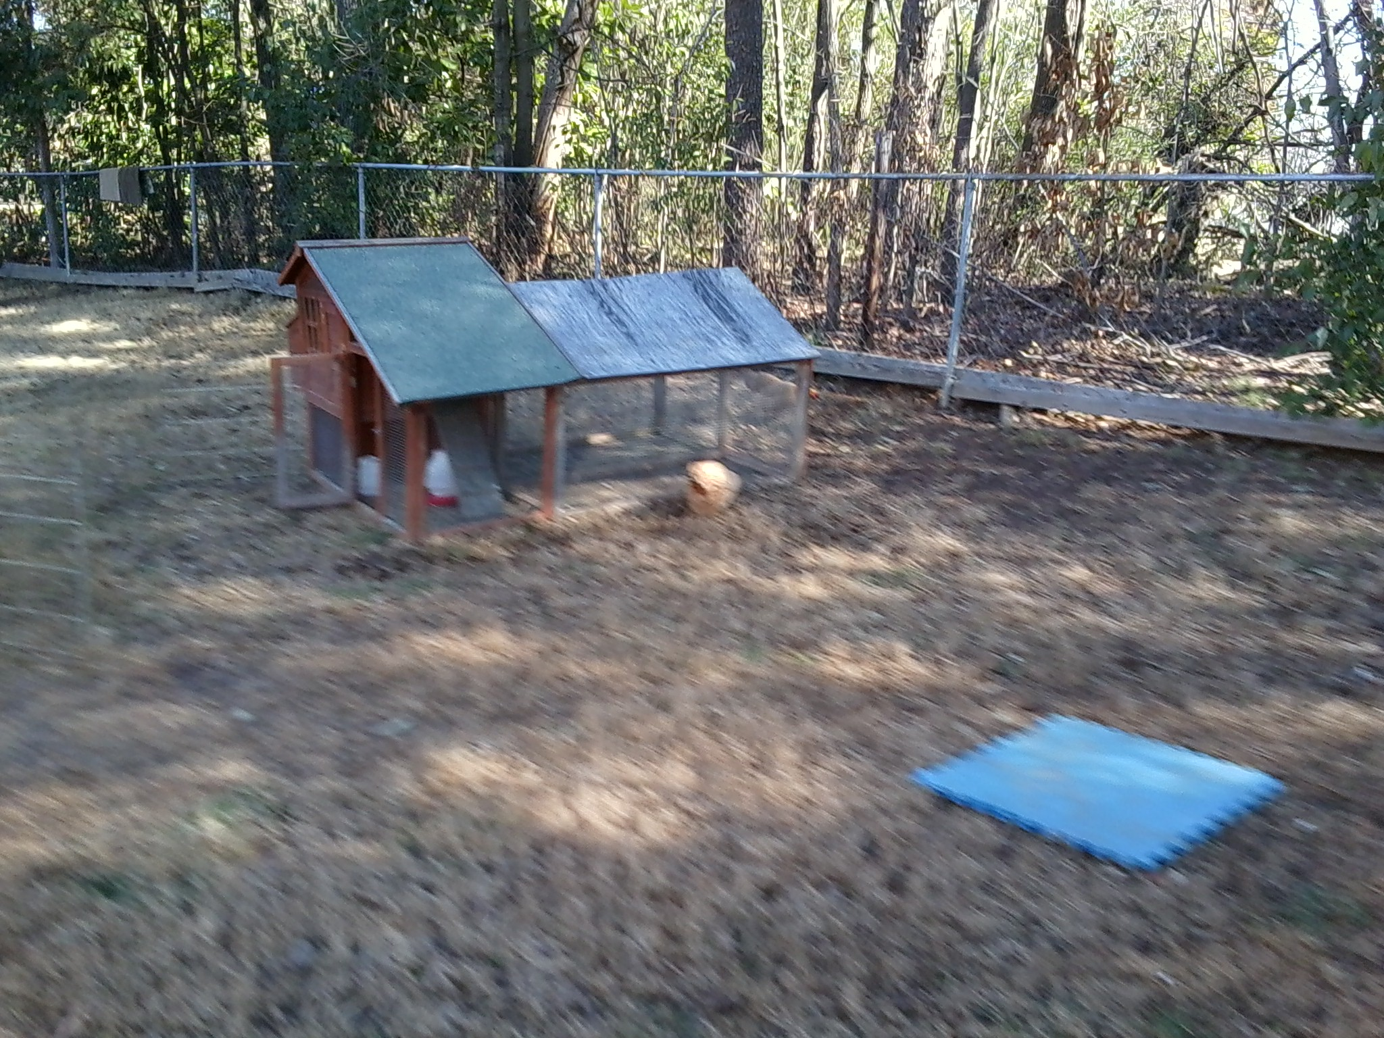

Slide 43
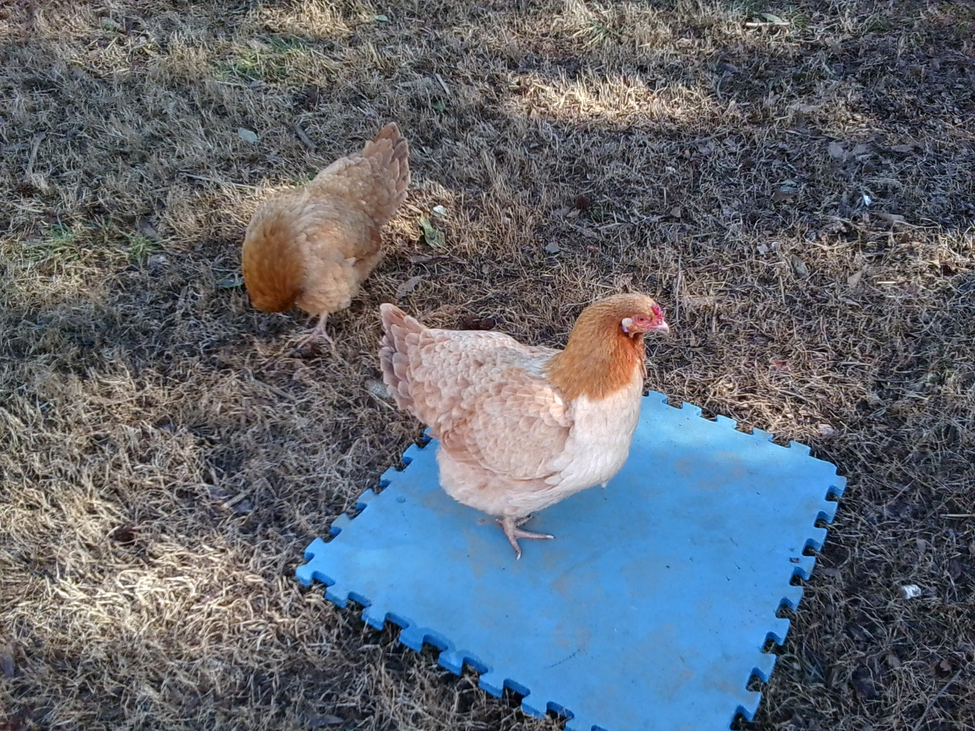
Notes:
.28319 (J)
Pets kept outdoors shall be in a designated area that is maintained and separate from the outdoor area used by the children.

Slide 44
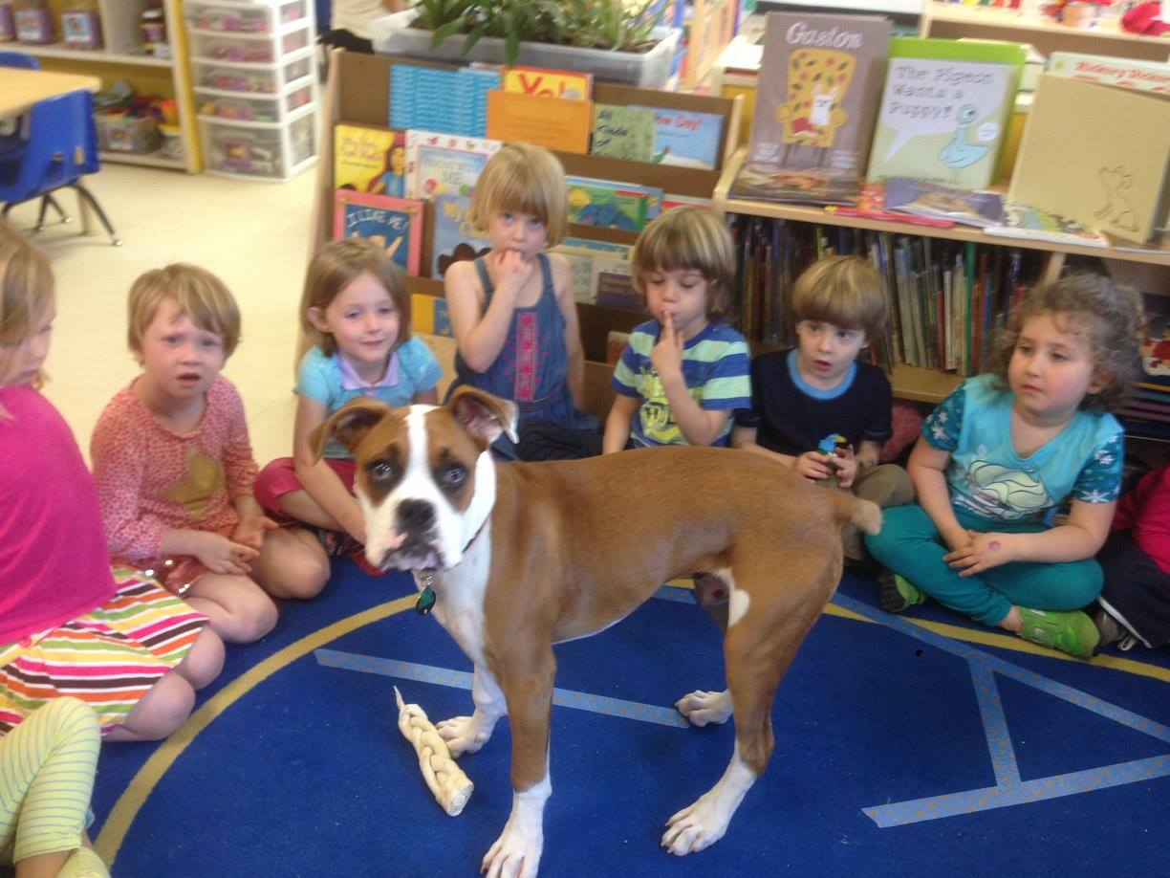
Hope Valley Preschool - Pet Education Program

Slide 45
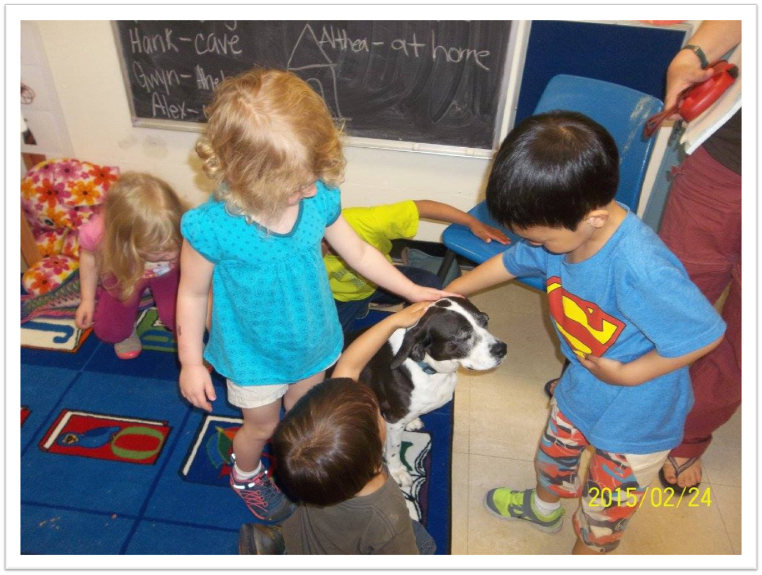

Slide 46
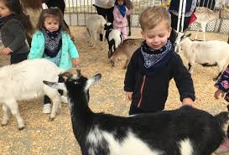
2004 State Fair

Slide 47
State faces E. coli lawsuit
Posted on Tuesday, Aug. 02, 2011 - By JANE STANCILL
North Carolina failed to properly warn the public and reduce the health risks associated with a petting zoo at the 2004 State Fair, say attorneys representing 14 children who became ill after exposure to E. coli bacteria from animal feces.
Opening arguments began Monday in a case brought by families who say they were unaware of the risks of allowing their children into a petting zoo with farm animals…An outbreak of E. coli illnesses was traced to the Crossroads Petting Zoo at the fair in 2004. In all, 108 children reportedly suffered serious diarrhea, and 15 of those came down with kidney failure a life-threatening complication that occurs in about 10 percent of those infected with E. coli O157:H7, a strain of the bacteria that was apparently transmitted from feces of goats and sheep at the petting zoo. Young children are especially at risk of developing the illness.

Slide 48
2017

Slide 49
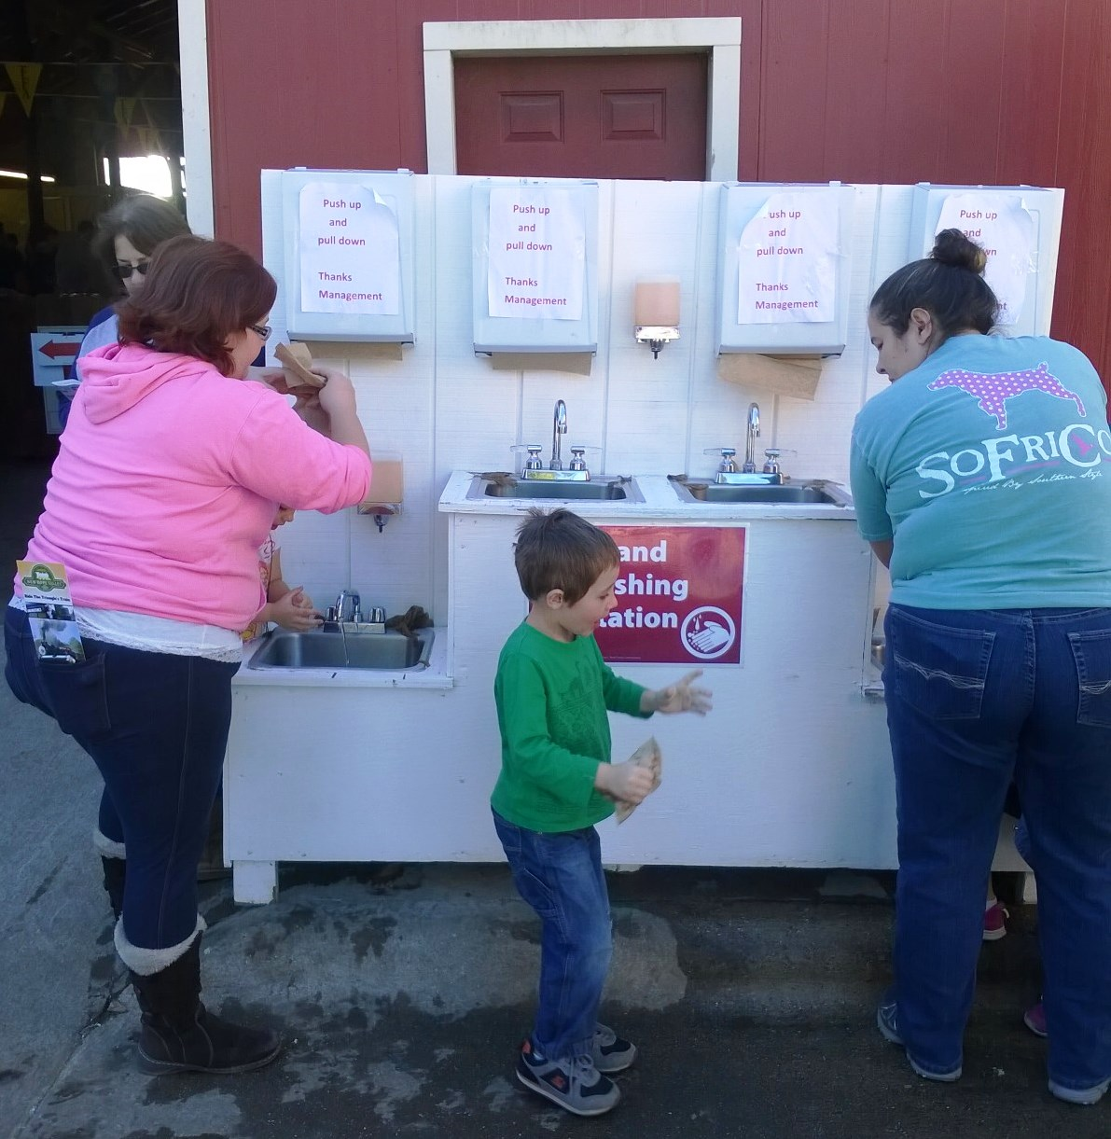
2018 NC State Fair

Slide 50
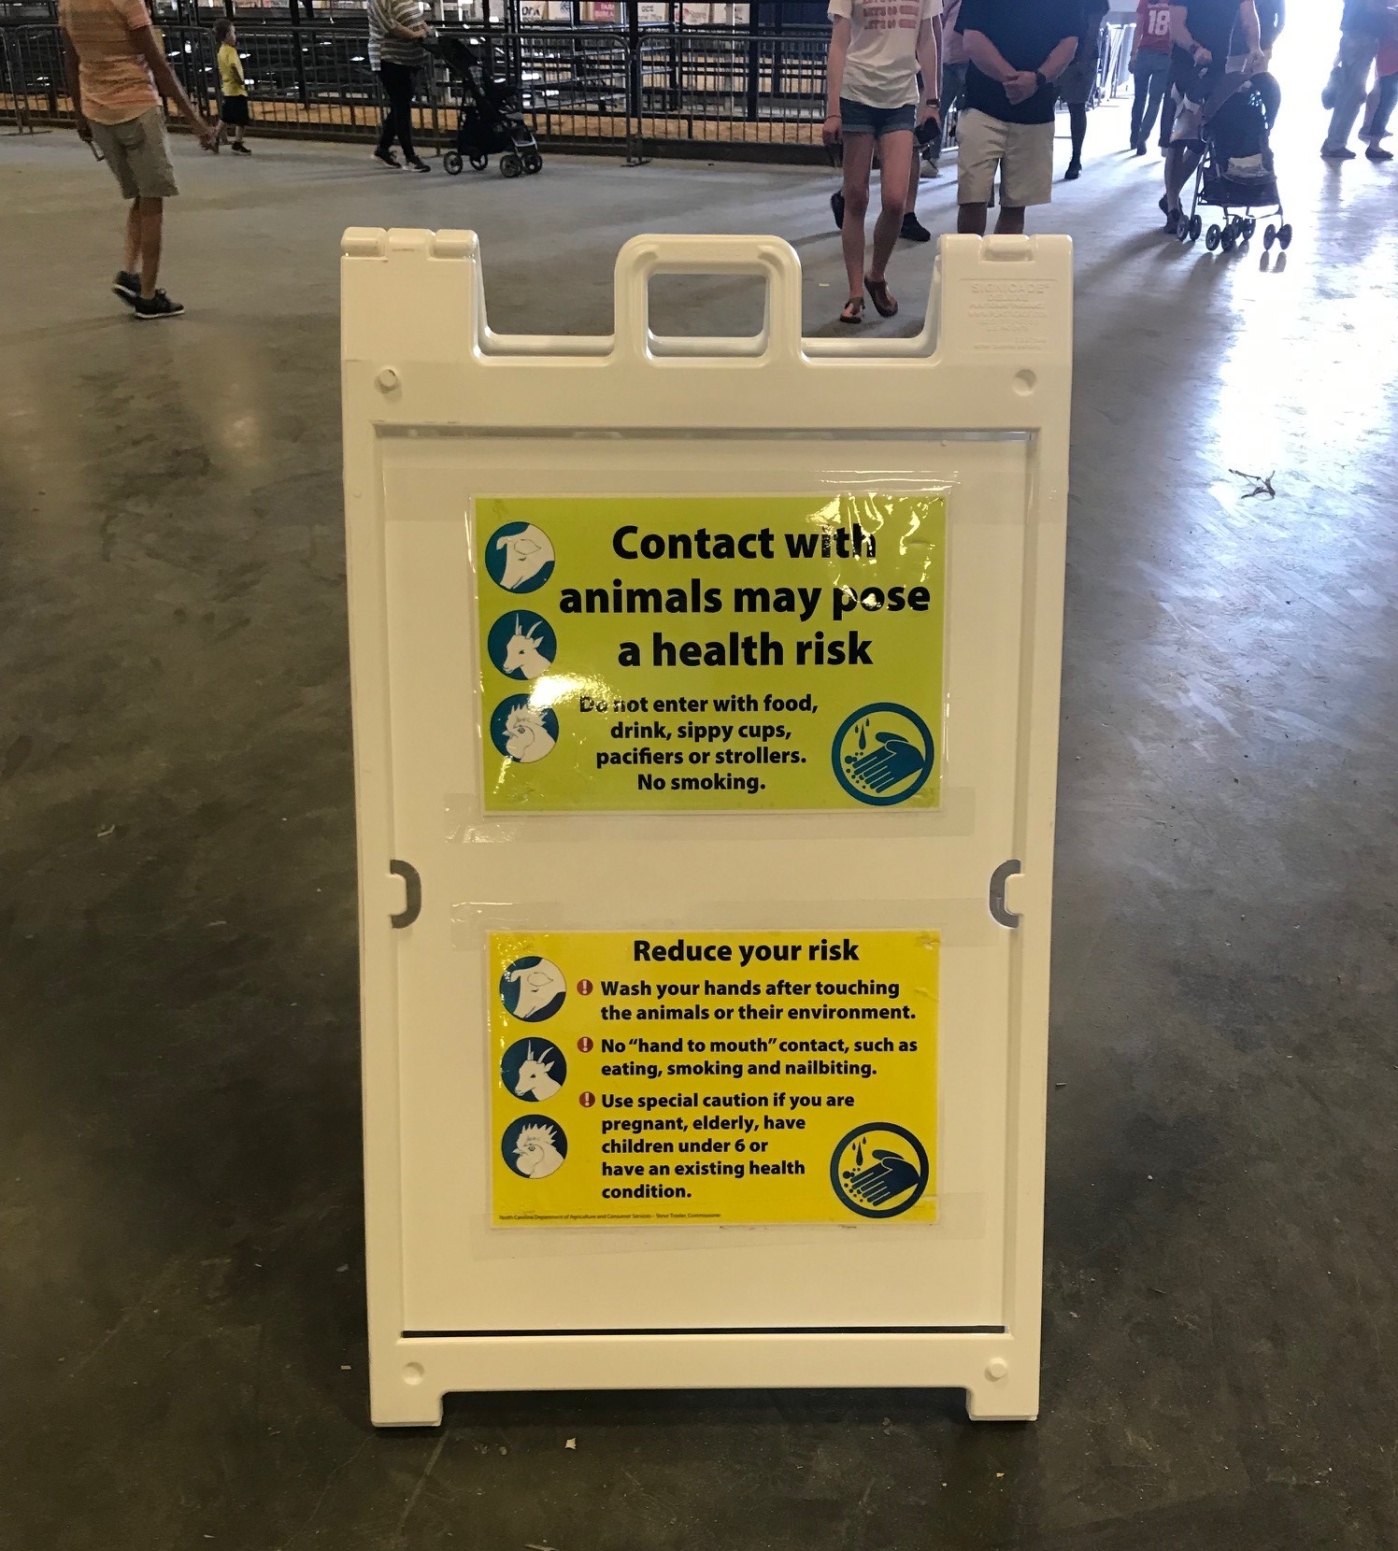
2021
NC State Fair

Slide 51
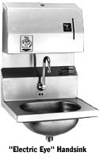
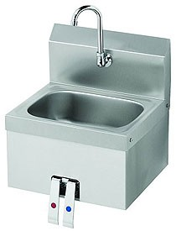
Lavatories
– is hand washing easy?
- conveniently located?

Slide 52
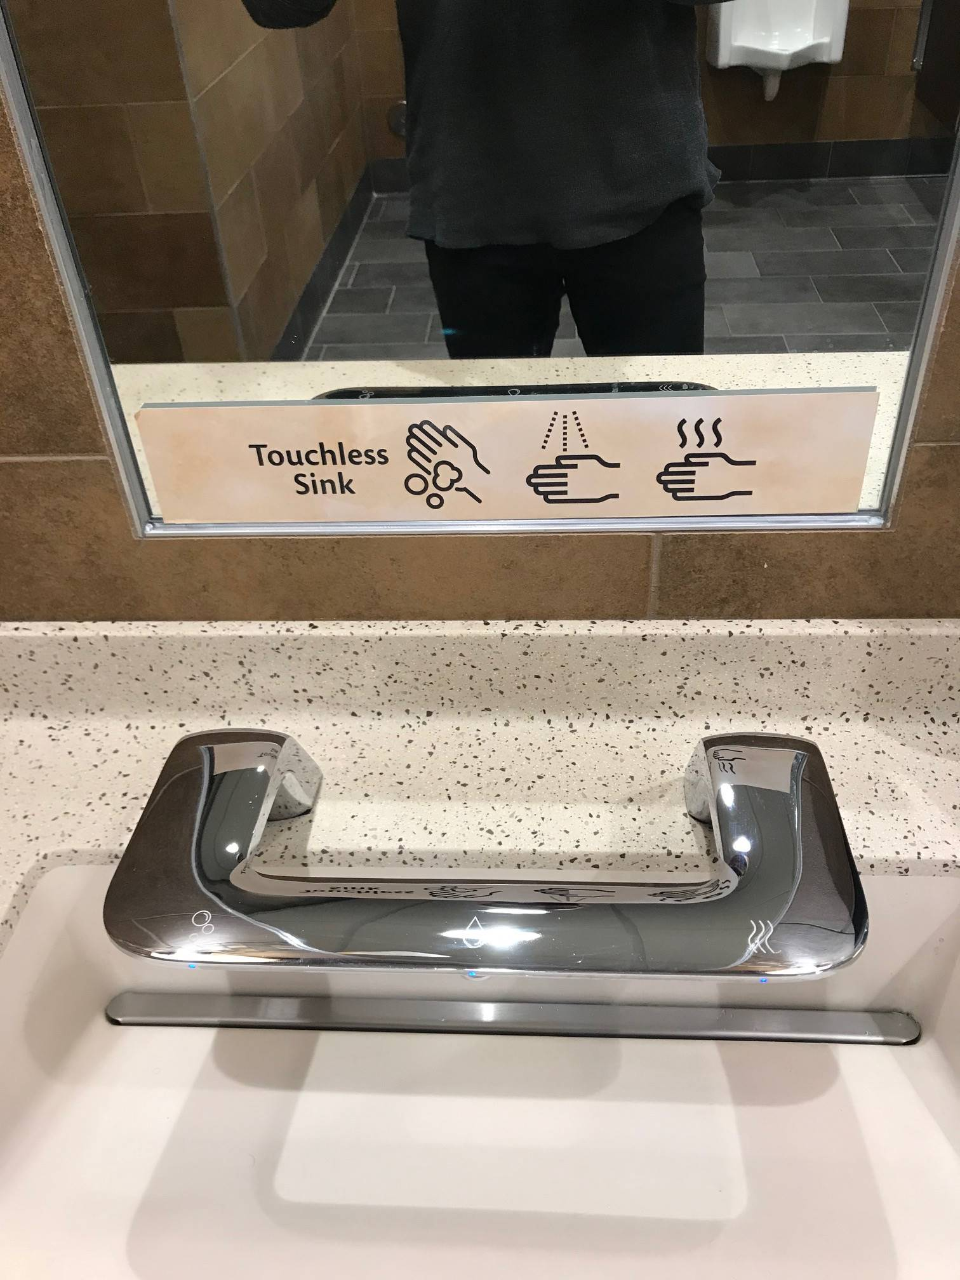
Wegman’s 3 in 1 Lavatory

Slide 53

Hand Washing
Tempered water (80 – 110 F), soap, and disposable towels
Demonstrate proper hand washing
Don’t assume
staff know how.

Slide 54


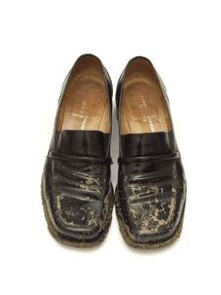
Mouth Contact Surfaces
Are sanitizing procedures being followed? - .2822
Are toys easily cleanable?
Discourage sharing of personal articles or toys
Floor surfaces – what about your shoes?
Notes:
Hard plastic toys may be washed and rinsed in a dishwasher and
cloth toys may be laundered and mechanically dried without requiring sanitizing.

Slide 55
Fecal Contamination
Most important sources of contamination:
  Hands, toys, sinks, and faucets
High levels of fecal coliforms are more likely to occur on sinks and faucets than on other classroom surfaces (that is why a separate hand sink is required for food preparation).
Laborde et al., 1995

Slide 56
Fecal Contamination
Infant classrooms are more often contaminated than classrooms for toddlers.
Greater levels of contamination on staff member’s hands in classrooms for infants.
  Laborde et al., 1995

Slide 57
Reducing fecal contamination
Wear disposable gloves
Hand sanitizers in addition to proper hand washing
Frequent disinfection of sinks and sanitizing of toys throughout the day.
Knee- or foot pedal-controlled sinks
All diapering activities conducted by one individual per room (best practice).
Laborde et al., 1995

Slide 58
Food Protection
The odds of children getting diarrhea in a center where the food preparer changed diapers is 18 times greater compared to centers where the food preparer did not change diapers
Best Practice, staff who prepare or serve food should not change diapers and staff who change diapers should not prepare food.
Wash raw fruits and vegetables
Temperatures maintained
Mohle-Boetani et al., 1995).

Slide 59
Who to Contact
  EPI team leader
  Environmental Health Supervisor
  Regional Environmental Health Specialist
  Division of Child Development
  Communicable Disease Control Nurse
  Laboratory Personnel
  Other State Personnel (e.g., Communicable Disease Control Section)
  Local pediatricians and hospital

Slide 60

Containing Cases
EPI Team
Visit the center and
  conduct interviews
  gather information – standard questionnaires
  keep your PIO informed
In addition, visit and/or inform child care centers and child care homes in the immediate outbreak area

Slide 61
Containing Cases
Exclude new admissions
Prevent transfers to other centers
Call area child care centers to inform them of the outbreak and instruct them not to accept children from the infected center
Contact area pediatric practices, ERs, clinics, and other health care providers for prompt reporting of additional cases

Slide 62
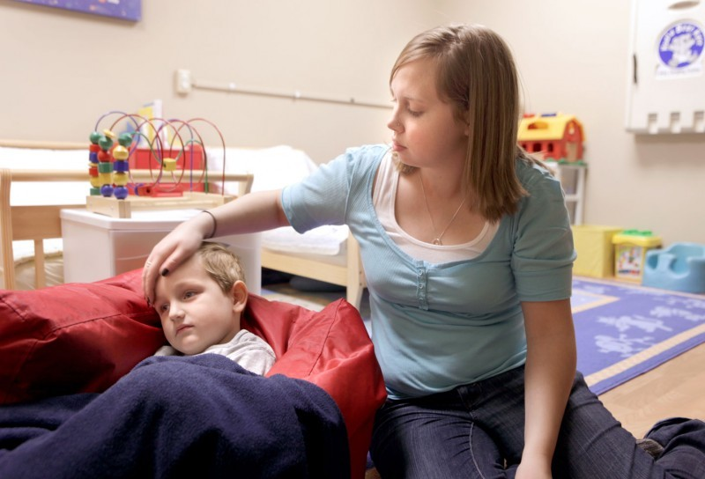
15A NCAC 18A .2836 MILDLY ILL CHILDREN

Slide 63
Additional Online Resources
CDC OutbreakNet Team - national surveillance on foodborne infections
http://www.cdc.gov/foodborneoutbreaks/
FOCUS on Field Epidemiology, UNC-SPH
www.sph.unc.edu/nccphp
Infection control:
  http://www.theific.org/oldsite/Manual/res.htm
Control of Communicable Diseases Manual, Chin, J. (2000)
American Academy of Pediatrics Red Book

