Slide 1
WATER SUPPLY Child Care Sanitation Tab 14
Children’s Environmental Health
2026

Slide 2

Inspection Form

Slide 3

Inspection Form, cont.

Slide 4
Who is regulated under the .1700 Rules?
Non-Community supplies serving an establishment regulated under
15A NCAC 18A
.2800 Child Care Centers
.2400 Public, Private, and Religious Schools

Slide 5
Public Water Supplies
Community
15 connections or 25 or more users for at least 60 days year round
RESIDENTS - LIVE THERE
Non-Community
not a community water system
Non-Transient
Transient
At least 25 of same persons more than 6 months
(Child Care Centers, Schools)
does not regularly serve at least 25 of the same more than 6 months
(Gas Station, Restaurant)

Slide 6
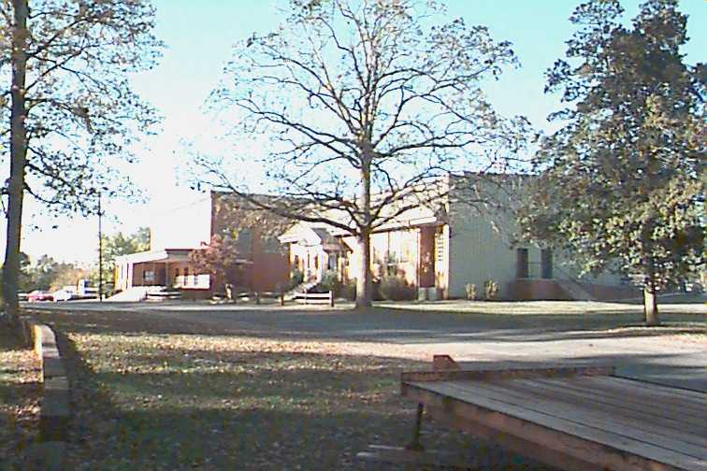
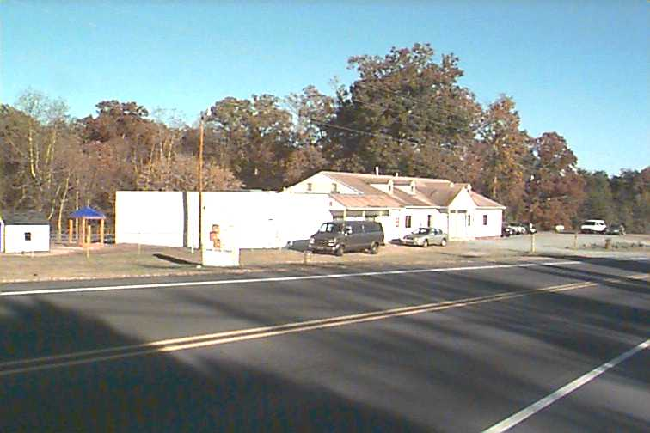
Non-Transient, Non-Community Examples

Slide 7
Water Supply .2815(a)
Shall meet 15A NCAC 18A .1700 Protection of Water Supplies.
*Any center using a groundwater supply that serves 25 or more people shall provide documentation from the Public Water Supply Section that the well meets the requirements of 15A NCAC 18C.*
A water sample shall be collected by the Department and submitted to state certified laboratory for bacteriological analysis annually if the child care center is not served by a community water supply.

Slide 8
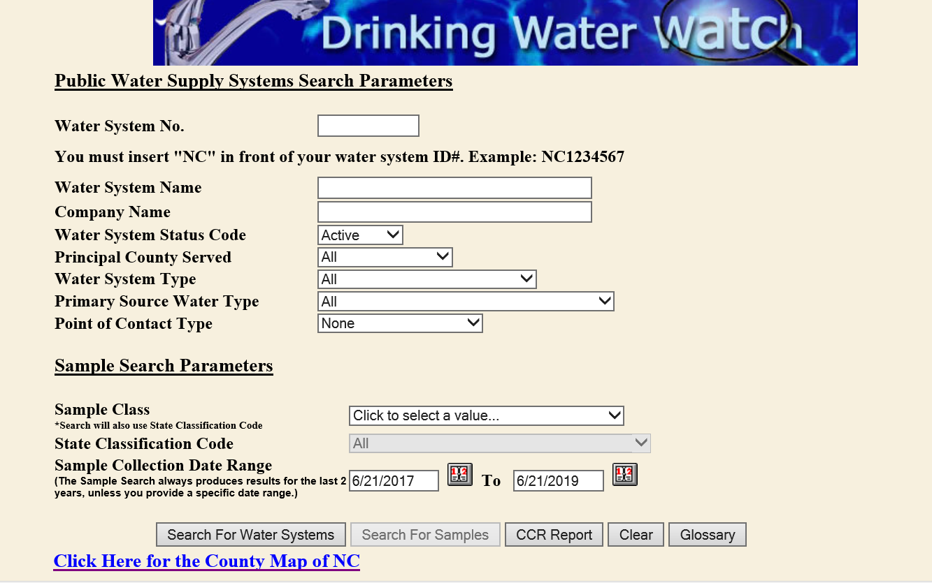
Public Water Supply:
https://www.pwss.enr.state.nc.us/NCDWW/

Slide 9
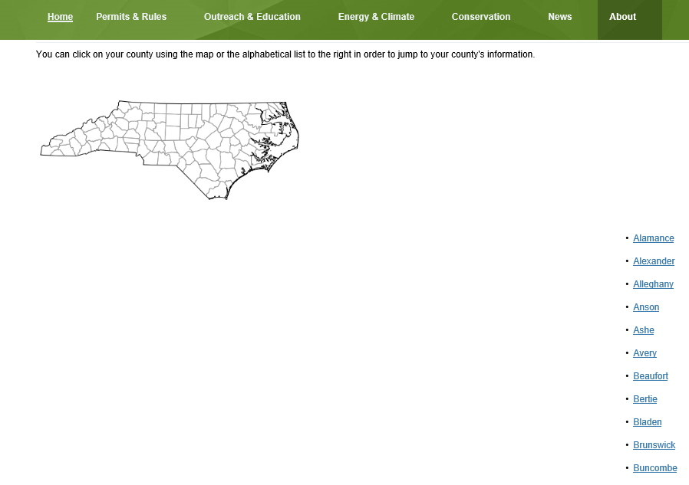
Public Water Supply:
https://www.ncwater.org/?page=125

Slide 10
Child Cares Served by Wells
Need to know the population of
children + staff + anyone else on system
24 or less = .1700 Rules, Non-Public
25 or over = NTNC = Public Water System
Requires PWS approval PRIOR to starting
Long history of problems
.1700 Rules Still Apply to BOTH

Slide 11
Scenario #1: Child Care
A child care has 18 children and 4 staff
Falls below threshold to be a Public system
.1700 rules apply

Slide 12
Scenario #2: Child Care
A child care has 20 children and 5 staff
.1700 rules apply
Non-Transient/Non-Community (PWS)

Slide 13
Scenario #3: School Cafeteria
350 student school
Non-Transient/Non-Community (PWS)
.1700 still requires EHS to inspect & sample
Annual sample by EHS
Any repairs, changes in treatment, or storage require PWS approval

Slide 14
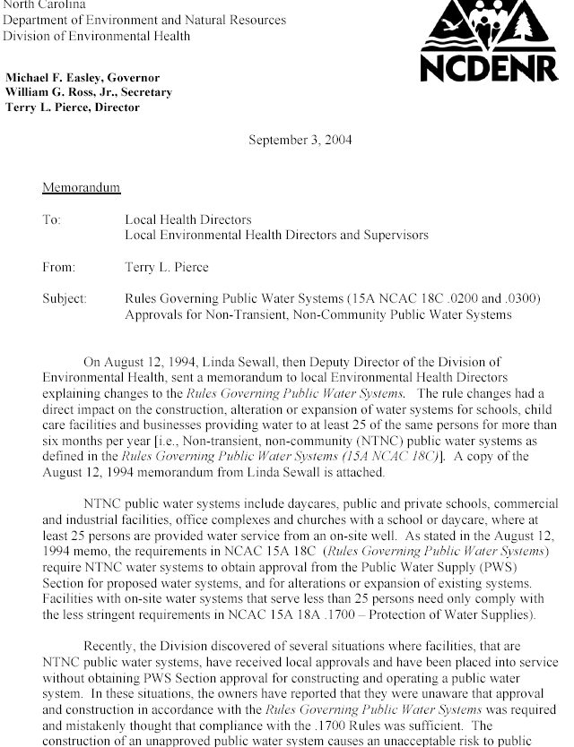

Slide 15
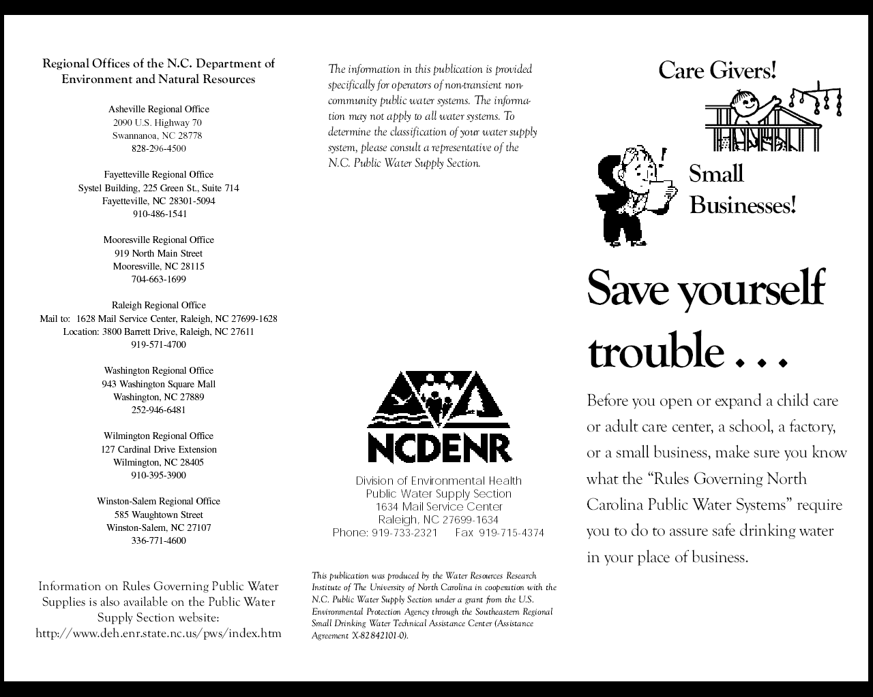
https://files.nc.gov/ncdeq/Water%20Resources/files/pws/publications/PWSS_requirement_brochure.pdf

Slide 16
.1720(c)(5) Check the Wellhead
An owner, licensee or permittee shall not
place or have placed a new source of contamination within the minimum setbacks

Slide 17
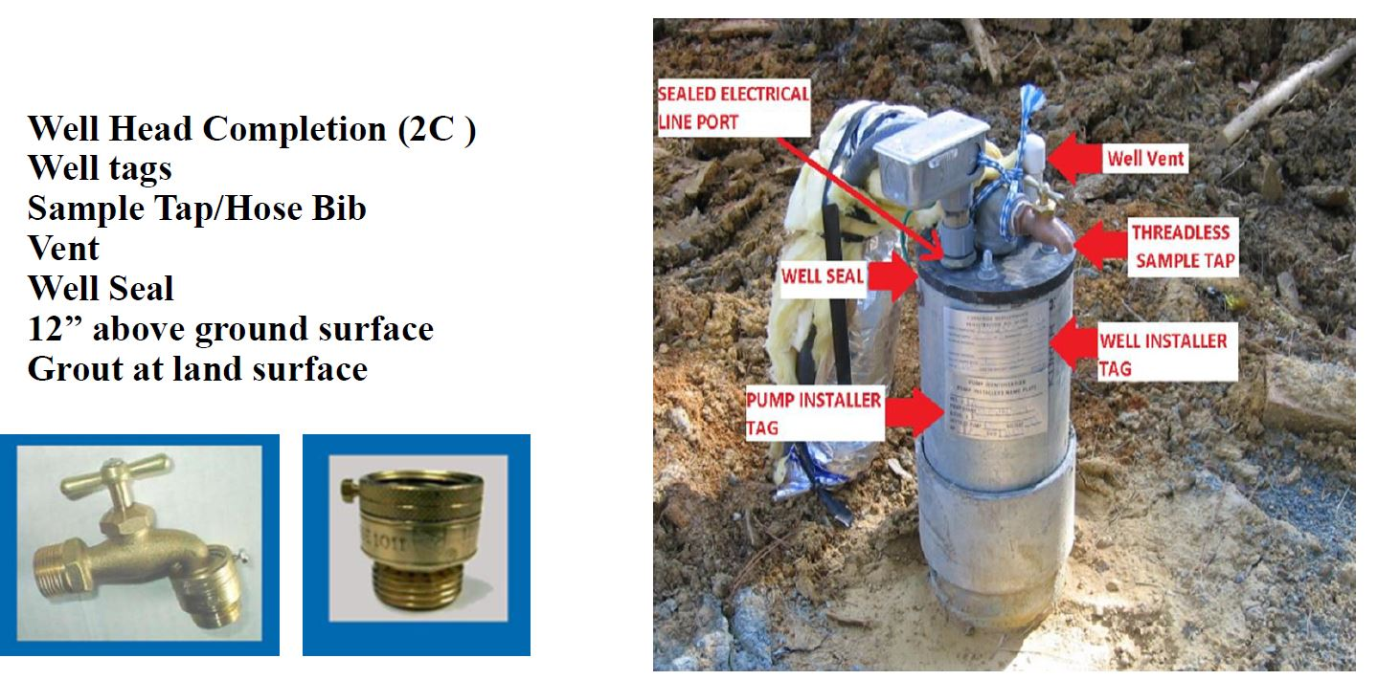
Wellhead

Slide 18
Setbacks by Construction Date
Minimum Horizontal Distance From: 7/1/93 or after prior to 7/1/93
Septic tank or nitrification field 100’ 50’*
Other subsurface ground absorption waste disposal 100’ 50’*
Industrial/municipal sludge spreading or wastewater irrigation site 100’ 100’
Water tight sewage or liquid-waste collection or transfer facility 50’ 25’
Other sewage or liquid-waste collection or transfer facility 100’ 100’
Animal feedlot or manure pile 100’ 100’
Fertilizer, pesticide, herbicide or other chemical storage area 100’ 100’
Non-hazardous waste storage, treatment or disposal lagoon 100’ 100’
Sanitary landfill 500’ 500’
Other non-hazardous solid waste landfill 100’ 100’
Animal barn 100’ 100’
Building foundation 50’ 25’
Surface water body 50’ 50’
Chemical or petroleum fuel UST 50/100’ 50/100’
Other source of groundwater contamination 100’ 100’
*Well constructed prior to 7/1/93 serving an establishment regulated under 15A NCAC 18A in operation prior to 7/1/93 shall only be required to meet these 2 setbacks

Slide 19
.1725 Water Quality
PRIOR to INITIAL USE
Or after construction, maintenance, repairs, pump installation, or a positive coliform sample
TWO CONSECUTIVE bacteriological samples
TAKEN AT LEAST 48 HOURS APART
Collected by the Department

Slide 20
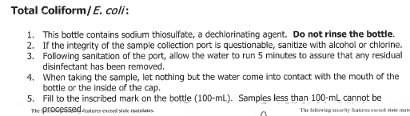
Bacteriological Sample Directions

Slide 21
1725 (a) Water Quality Confirmed contamination
- Confirmation -
Another positive sample result following the initial positive sample unless the last positive sample was preceded by two consecutive negative samples
Notes:
Initial testing: initial use, or after construction, maintenance, repair or pump installation or positive coliform sample. Two consecutive water samples must be taken at least 48 hours apart.
Example P + P or P+ N+ P not P+N+N+ P

Slide 22
Imminent Hazard-vs- Unsafe Water Supply
Deemed Imminent Hazard
Confirmation of the presence of fecal coliform bacteria
Determination by Environmental Epidemiology that the presence of chemical constituents meet the definition of an imminent hazard as defined in 130A-2(3)
Deemed Unsafe Water Supply
Confirmation of the presence of total coliform
Determination by Environmental Epidemiology that chemical constituents are present at levels in violation of water quality standards but do not constitute an imminent hazard.

Slide 23
One positive sample requires:
2 Consecutive negative samples be taken at least 48 hours apart
(no treatment between negative samples)
Follow-up samples must be taken quarterly for 1 year while the supply is in use
Notes:
Important consideration: 2 Consecutive negative samples are required before the supply is considered safe. The rules are applicable to all establishments being inspected by state rules except those served by a community supply
#2 consideration:When a supply has 1 positive sample, it must be sampled each quarter for 1 year
A positive sample, followed by a negative, followed by a positive is considered “confirmation”, requiring action.

Slide 24
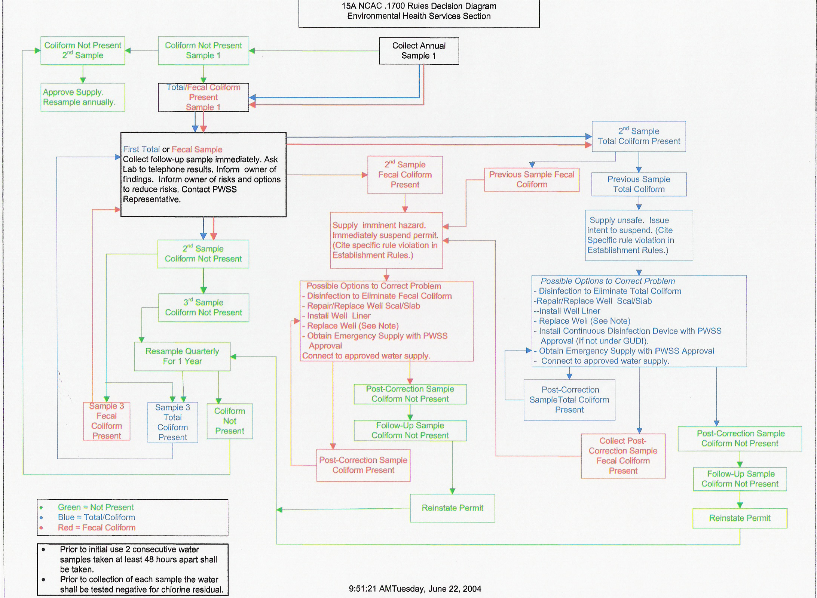

Slide 25
Summary Disapproval for water supply
.2834(d) Compliance, Inspections and Reports
A summary classification of disapproved shall also be issued and forwarded to DCD(EE) when a water sample is confirmed positive for fecal or total coliform or other chemical constituent in accordance with 15A NCAC 18A.1725(a).

Slide 26
Protection of Water Supply

Slide 27
.2815(b) Water Supply
Running water under pressure shall be provided in sufficient quantity to meet the needs of cooking, cleaning, drinking, toilets and outside uses

Slide 28
Protection of Water Supply
.2815 Water Supply (c) No cross connections with an unapproved water supply shall exist.
Cross-Connection
An actual or potential connection between a potable water supply and any non-potable substance or source.(source of contamination)

Slide 29
Forces Acting on Cross Connections
Backflow
The undesirable reversal of flow of water or other substances into the potable water distribution supply.
Backpressure
Backsiphonage

Slide 30
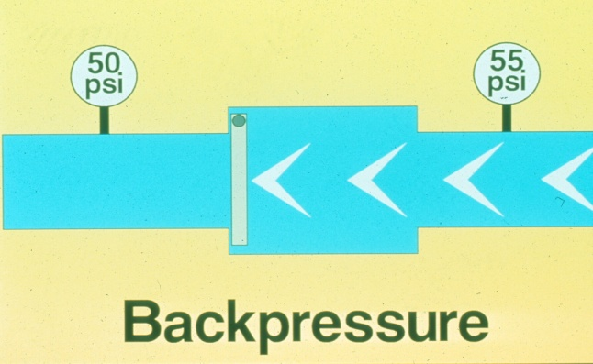
Forces Acting on Cross Connections
Backpressure
Backsiphonage
Vacuum or pulling force in water supply piping created by negative pressure causing nonpotable source to be drawn or siphoned into potable water source.
Pressure in down stream piping greater than supply pressure.

Slide 31
Protection of Water Supply
.2815 Water Supply (c) If the potential for back flow conditions exist, an approved atmospheric vacuum breaker or back flow prevention device shall be installed
Kitchen sinks
Can wash/ mop sink
Dishwashers

Slide 32
Backflow Prevention Methods
Physical
Air Gap (most desirable method of backflow prevention)
Air gap must be a minimum of one inch or twice the inside diameter of the supply pipe (“2xD or 1in”)
-Air Break (references waste lines only)

Slide 33
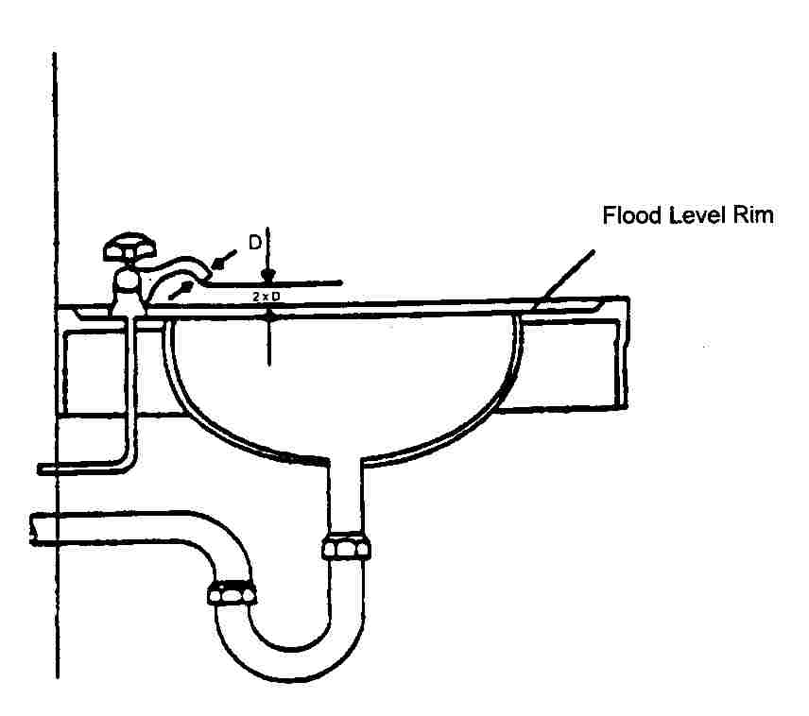
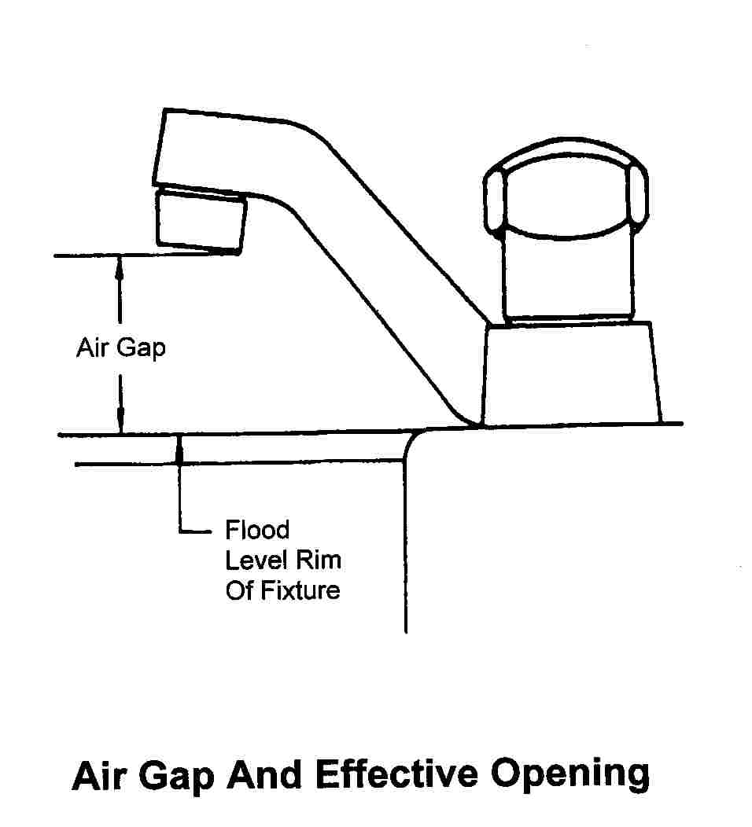
Air Gap
Notes:
Air Gap:
Offers the greatest safety against potential contamination due to backsiphonage. The air gap is at least twice the diameter of the faucet’s inside diameter and, in no case less than one-inch.

Slide 34
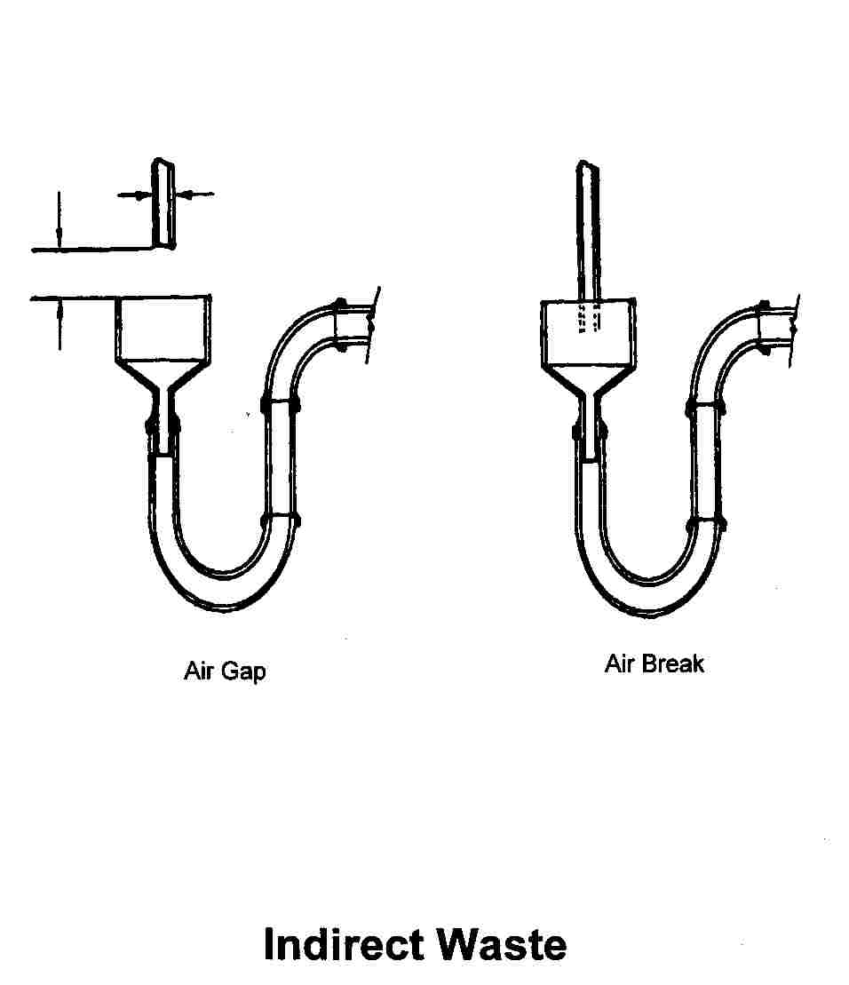
Indirect Waste

Slide 35
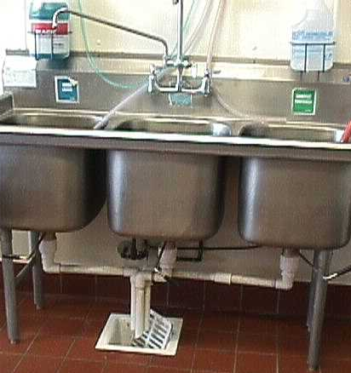
Plumbing at Three Compartment Sink
Sewage back up potential

Slide 36
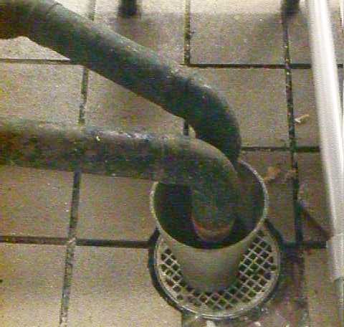
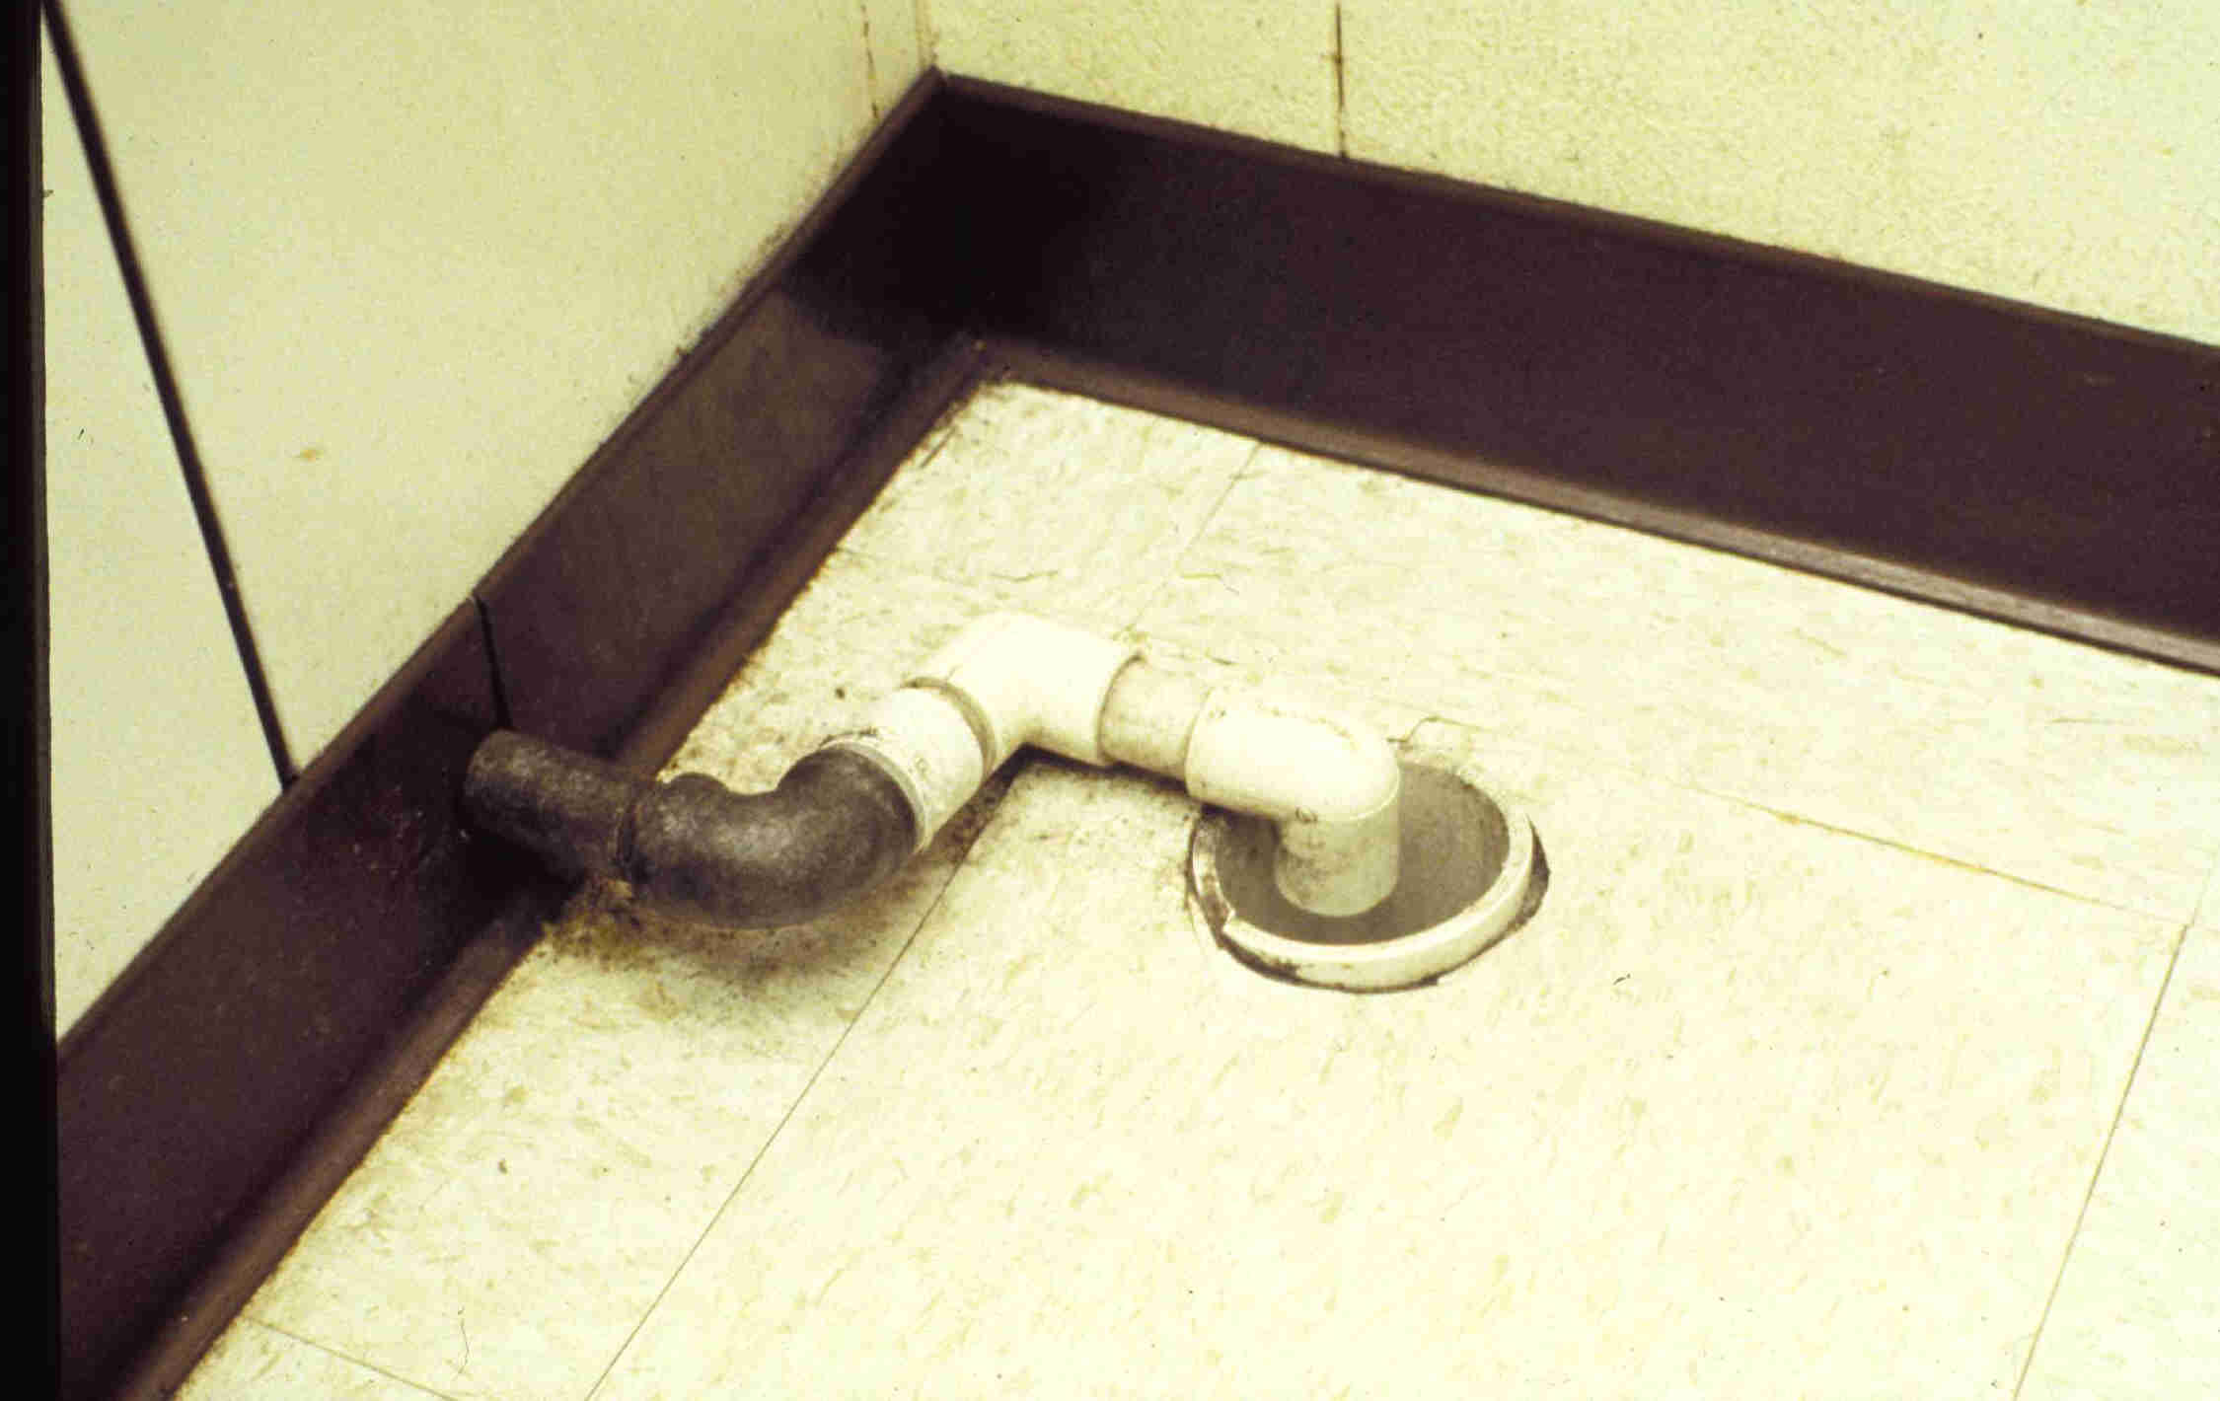
Air Break

Slide 37
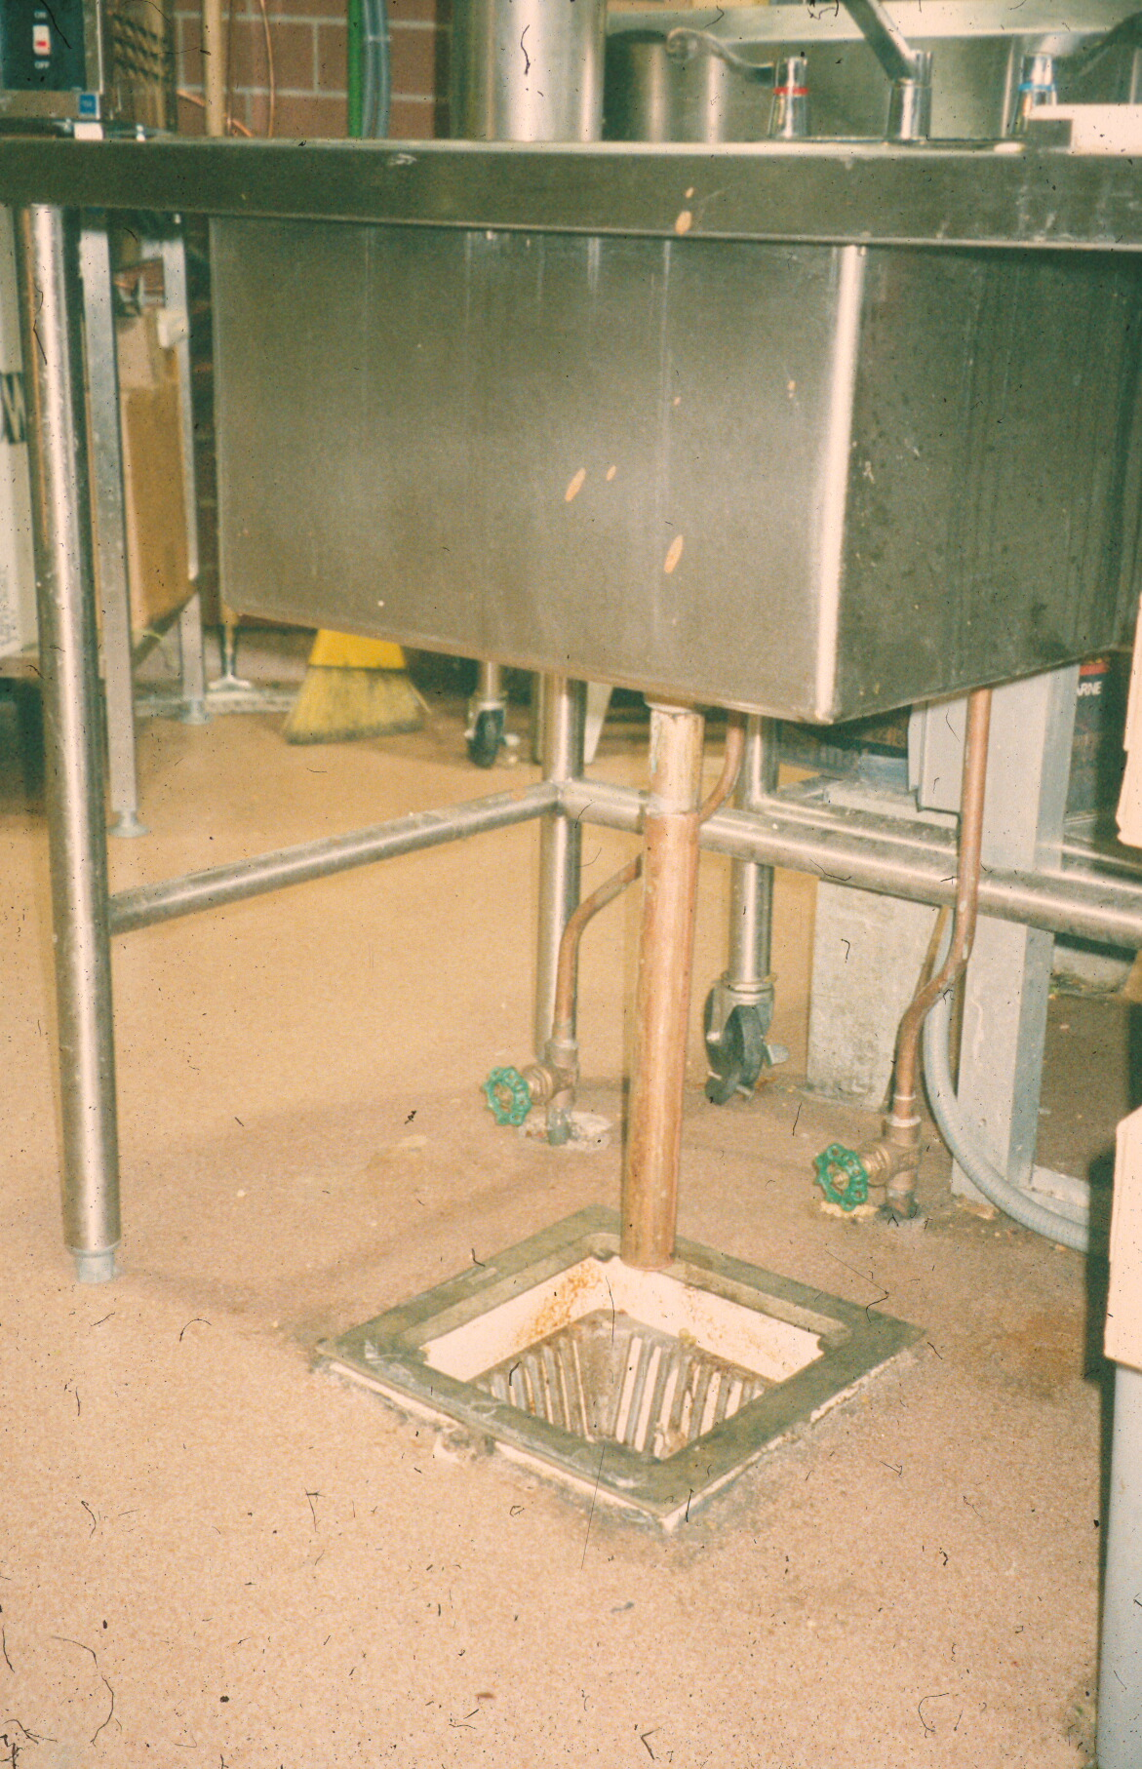
Air Gap

Slide 38
Backflow Prevention Methods
Mechanical
Consist of single to multiple check valves that open from the flow pressure of the potable water. Valves prevent any flow in the wrong direction.
Atmospheric Vacuum Breaker (AVC)
Hose Bibb Vacuum Breaker(HBVC)

Slide 39
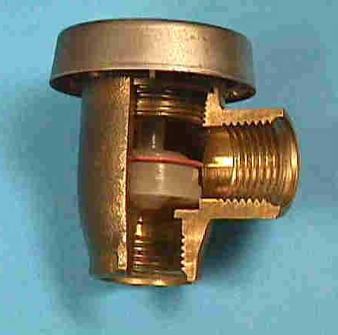
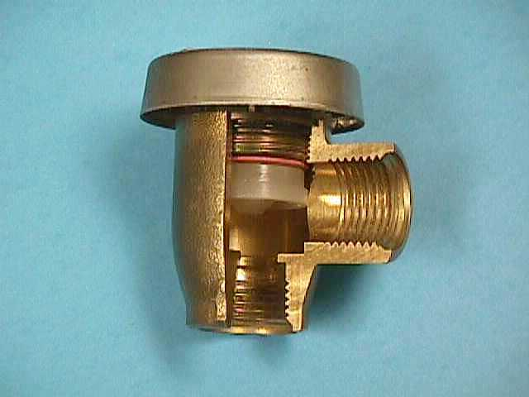
Atmospheric Vacuum Breaker
Vent
No Flow Condition
Flow Condition

Slide 40
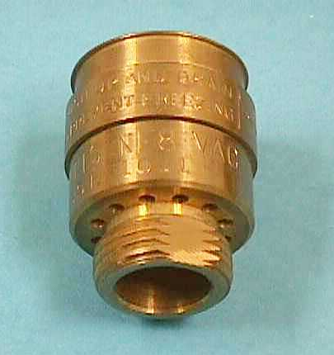
Hose Bibb Vacuum Breaker
Flow
Vent

Slide 41
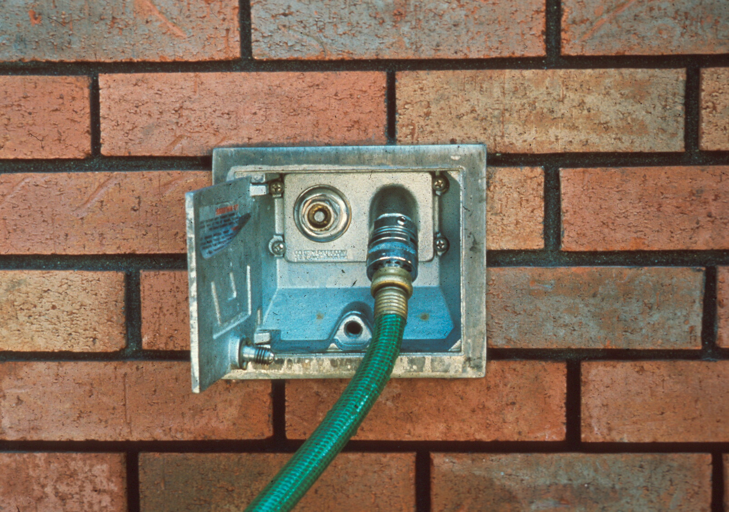

Slide 42
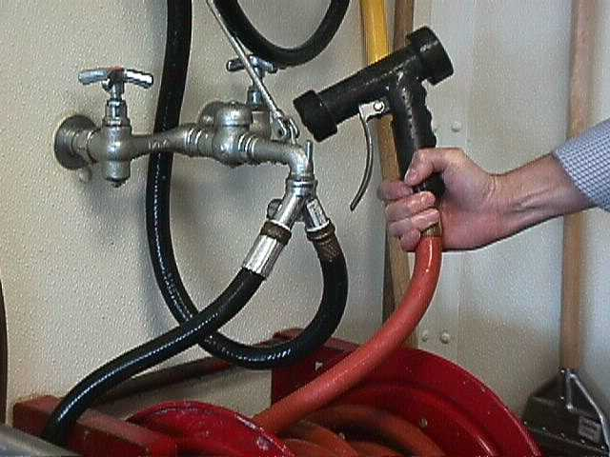
Atmospheric Vacuum Breaker

Slide 43
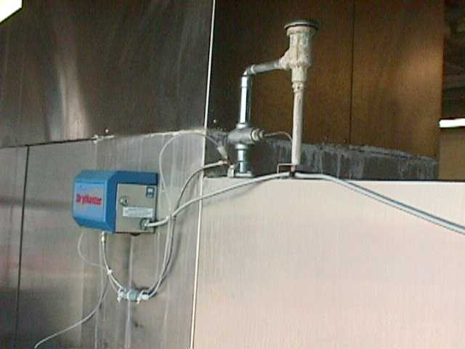
Atmospheric Vacuum Breaker
on Dishwasher
AVB
Chemical
Pump

Slide 44
Water Heater Requirements .2815(d)
Water heating equipment that is sufficient to meet the maximum expected requirements of the center shall be based on the following:
Number and size of sinks
Capacity of dishwashing machines
Capacity of laundry machines
Diaper changing facilities
Food service needs
Cleaning needs
* For CCC fewer than 13 and located in a residence existing water heater or equivalent replacement is adequate (must meet temperature requirements)
Notes:
Recommend that for fewer than 13 up to thirty minimum domestic heater40 gallons
Over that recommend 50 gallon domestic heater

Slide 45
.2815(d) cont.
hot & cold water under pressure shall be provided in all rooms where:
Food is prepared
Utensils or equipment are washed
Areas where water is required for cleaning & sanitizing
Diaper changing areas

Slide 46
Hot Water Requirements .2815(e)
For cleaning & sanitizing food utensils & laundry min 120°F (item 15, 6 point provisional item-kitchen)
*water in areas accessible to children
80 °-110°F (item 16, 4 point item)
*burn hazard (accessible to children)
excess of 120°F (item 17, 6 point provisional item)
-Handwash lavatories used exclusively by school aged children the minimum 80°F does not apply
-Child care centers serving only school age children are not required to provide hot water
-In the event of the loss of hot water contact HD immediately

Slide 47
Hot Water at Can/Mop Wash .2830(b)
Can/mop wash facilities
shall include a faucet with a threaded nozzle
Water of at least 80°F
In either a designated utility sink or above a curbed impervious pad sloped to drain into wastewater
Can cleaning facilities approved prior to July 1, 1991 shall be approved if in good repair.
<13 in a residence exempt

Slide 48
Water Supply
Drinking fountains .2815(f):
-comply with the North Carolina Plumbing Code
-be separate from handwash lavatories
-be kept clean
-be regulated that individual’s mouth does not come in contact with the nozzle and does not splash on the floor
Outdoor drinking fountains .2815(g)
-constructed to protect spout
-be kept clean

Slide 49
Springs
If proposed source:
Three step process
Approval of the site (investigation)
Design & Construction of a collection system
Water sampling & data collection extensive 6 months (under most severe anticipated environmental conditions)
Costly$$ to ensure springs as safe source

Slide 50
Things To Consider As Part of Plan Review
When converting an existing building to childcare:
Plumbing (Plumbing Code)
Structural integrity of building
Check zoning requirements child care center may not be permittable in that area
Water heater requirements/sink requirements
Water requirements Public Water Supply/Well
Sewage

Slide 51
Water Supply ~Plan Review~
Public Supply –vs- Private Water Supply (well)
Documentation from PWS for groundwater serving 25 or more
Plumbing concerns for new & existing structures
Temperature requirements and hot water accessibility
Backflow/back siphonage prevention
Anti-Scald devices-vs-tempering valves

Slide 52
~Plan Review~ *Hot Water Heaters*
Factors to consider:
# and size of sinks
Capacity of dishwashing machine
Capacity of laundry machine
Diaper changing facility
Food service needs
Is CC Center located in a residence
Size, Recovery & Capacity
Recommendations
*Domestic water heater*
Fewer than 13 up to 30
*Min. 40 gallon storage
30-49
*Min. 50 gallon storage
50-100
*Min. 80 gallon storage
over 100
*Min. 120 gallon storage

Slide 53
~Plan Review~ *Hot Water Heaters*
WaterHeaterCalculator-0713.xls (live.com)

Slide 54
~Plan Review~ *Tempering Valve-vs- Anti-scald device *
A tempering valve is meant to be used as a "BTU conserver", while a true anti-scald valve is recognized as a "safety" valve. Manufacturers and installers must understand the difference between these two valves, especially as they relate to safety and legal ramifications.

Slide 55
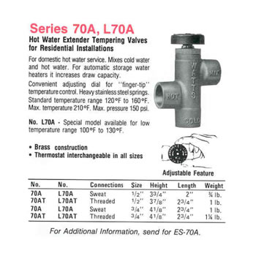
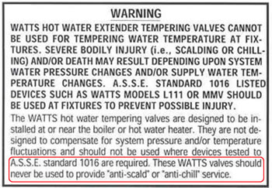
Figure 1 illustrates a standard "tempering" valve that is meant to be used as a "hot water extender" and not as a "safety" device.
~Plan Review~ *Tempering Valve-vs- Anti-scald device *
The manufacturer, as indicated in Figure 2, has made sure to point out that these tempering valves are not to be used to provide anti-scald service.

Slide 56
~Anti Scald Devices~ (Thermostatic Mixing Valves)
How do Thermostatic Mixing Valves work? TMV's blend hot water with cold water to produce water for direct ablutionary use. It incorporates a temperature sensitive element that reacts to water temperature entering the TMV. It reacts by controlling the travel of a shuttle, automatically adjusting the amount of hot and cold water entering the valve to deliver stable temperature warm water.

Slide 57
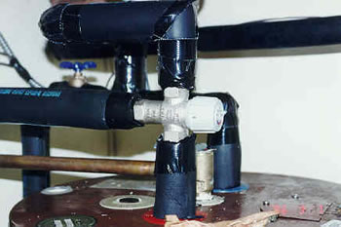
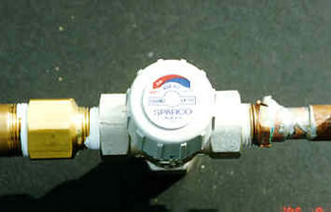
~Anti Scald Temperature Valves~

Slide 58
~Plan Review~
Do plumbing fixtures and connections meet NC Plumbing Code?
Approved backflow prevention device protect all water lines subject to backflow, back pressure or back siphonage?
Water heater isolated from classrooms?
Hot water heater sized to provide hot water in sufficient quantity based on need?
Consideration of separate water heaters for kitchen and handwash needs vs anti-scald devices

Slide 59
Water Supply Emergencies
Environmental Health
Emergency Preparedness and Recovery Guidance Manual
North Carolina
Revised 2018
Types of Water Supply Emergencies
Types of Notifications
Recommended Use Restrictions for Child Care Centers
https://ehs.ncpublichealth.com/faf/food/fd/docs/EH-PreparednessManual-Final.pdf

Slide 60
Boil Water Advisory means there is reason to suspect an increased risk for the water system to be contaminated. Boil water advisories are generally given when testing confirms the presence of total coliform bacteria in the water supply or if a pressure loss or break in the water system increases the risk that water system could have been contaminated with bacteria. Center may remain open for operations, but may want to take precautions. May use bagged ice, bottled water, food cooked with bottled or boiled water.
Types of Notices

Slide 61
Types of Notices (cont.) Fecal Coliform Bacteria Notice issued due to water testing positive for e. coli or other contamination, establishment should not operate until water supply is safe. DCDEE should be notified. Beverages, ice and any other food made with contaminated water should be discarded.

Slide 62
Scenario #1
Receive call from PWS that town of Cary is under a boil water notice
You have 3 child care centers in town located on that system
You receive a call from DCDEE asking what guidance to give the center.
What do you do?

Slide 63
Scenario #2
Receive notice from PWS that a child care center located on a well has tested positive for total coliform.
What do you do?
What guidance do you offer for the center?
What, if anything, is issued?

Slide 64
Scenario #3
Receive notice that a child care center located on a well has tested positive for total coliform. Confirmation sampling tested positive for fecal.
What do you do?
What guidance do you offer for the center?
What, if anything, is issued?

Slide 65
Questions?
Carissa Moore, REHS
Environmental Health Regional Specialist
Children’s Environmental Health
Division of Public Health, NC DHHS
828-417-4629
Carissa.moore@dhhs.nc.gov

