Slide 1
Chemical Storage including
Storage in Other Areas
Brenda Bass, REHS
Children’s Environmental Health
Notes:
Issues under storage covers many areas in a childcare center.

Slide 2
~Storage~ .2820(a)
In childcare centers, adequate space shall be provided for the storage of:
Equipment
Furniture
Toys
Clothes
Linen
Backpacks
Book bags
Diaper bags
Beds
Cots
Mats
Supplies
*and storage areas shall be kept clean!
Notes:
As I was reviewing this presentation, I realized that there may be other items that an operator has to find a place to store? Except chemicals, we will talk about them.
-Toileting supplies- another staff member will reference those items in a presentation later
Extra items( the abundance)- extra linen, arts and crafts, etc.
Sometimes, an operator must provide temporary storage? Any items that you can think of that are not included in my list:
Items that have to be stored until the end of the day, out of the way.
-Car seats/ baby carriers

Slide 3
SANITATION OF CHILD CARE CENTERS 15A NCAC 18A .2801 DEFINITIONS
"Adequate" means to be of the size, volume,
or technical specifications necessary to effectively
accommodate and support the planned, current, or projected workloads for the technology or constructed space.

Slide 4
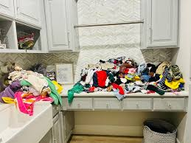
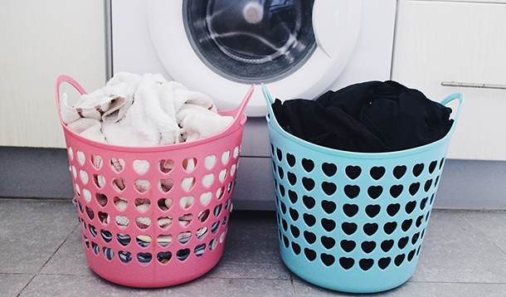
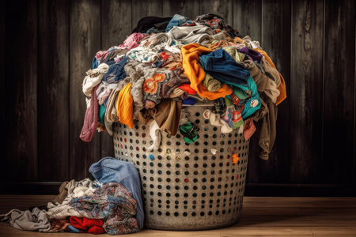
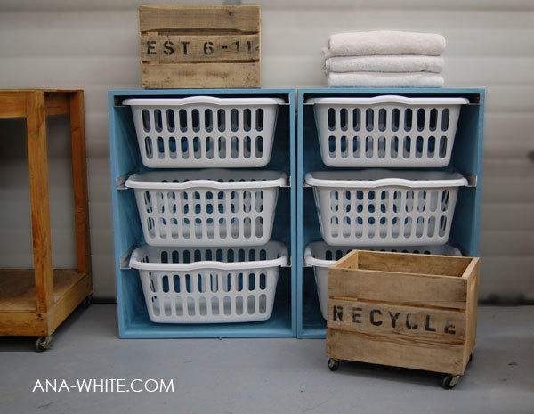

~Storage~ .2820(a)
Laundry that is NOT CLEAN shall be handled and stored
separately from clean laundry using separate containers that are
made clean between uses and kept in good repair.
Notes:
Under .2820(a) The second sentence stated …
This may include using portable shelving( on rollers) to able to be moved to clean or even stationary shelving, like the smaller units, that you can keep clean and move to clean the floor.

Slide 5
~Storage~
True or False
In childcare centers, all items stored in rooms where food or single service items are stored shall be at least 12 inches above the floor when placed on stationary storage units or 6 inches above the floor when placed on portable storage units.
False
Notes:
NEXT

Slide 6
To Be -or- Not To Be Locked… That Is the Question?!

Slide 7
Chemical Storage
15A NCAC 18A .2820 STORAGE
(b) Toxic substances, which include corrosive agents, pesticides, bleaches, detergents, cleansers, polishes, any product which is under pressure in an aerosol dispenser, and any substance which may be hazardous to a child if ingested, inhaled, or handled shall be kept in the original container or in another labeled container, used according to the manufacturer's instructions, and stored in a locked storage room or cabinet when not in use. Locked storage rooms and cabinets shall include those which are unlocked with a combination lock, electronic or magnetic device, keypad, key, or equivalent locking device

Slide 8
~Storage~
What’s Poison? Where is it Hiding?
(.2820)(b)Toxic substances shall be stored below or separate from medications and food.

Slide 9

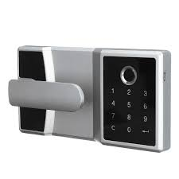

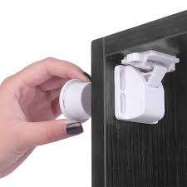
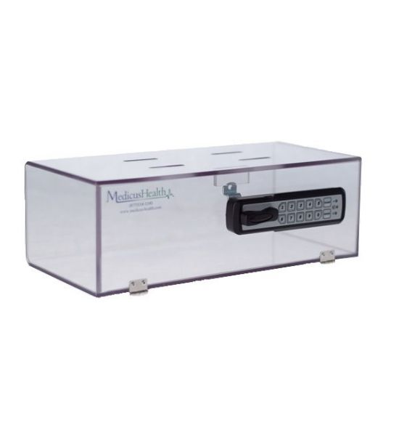
~Storage~
What’s Poison? Where is it Hiding?
Locked Storage Rooms & Cabinets
Combination lock
Key lock
Electronic or Magnetic device
Keypad
Equivalent locking device
Devices shall be kept out of reach of children and keys shall not be stored in the lock.
Notes:
Section b also states that …”Locked storage rooms and cabinets shall include those which are unlocked with a……”
So just remember that keys should not tied on A STRING the top of the locked box where children can have the ability to reach them.

Slide 10
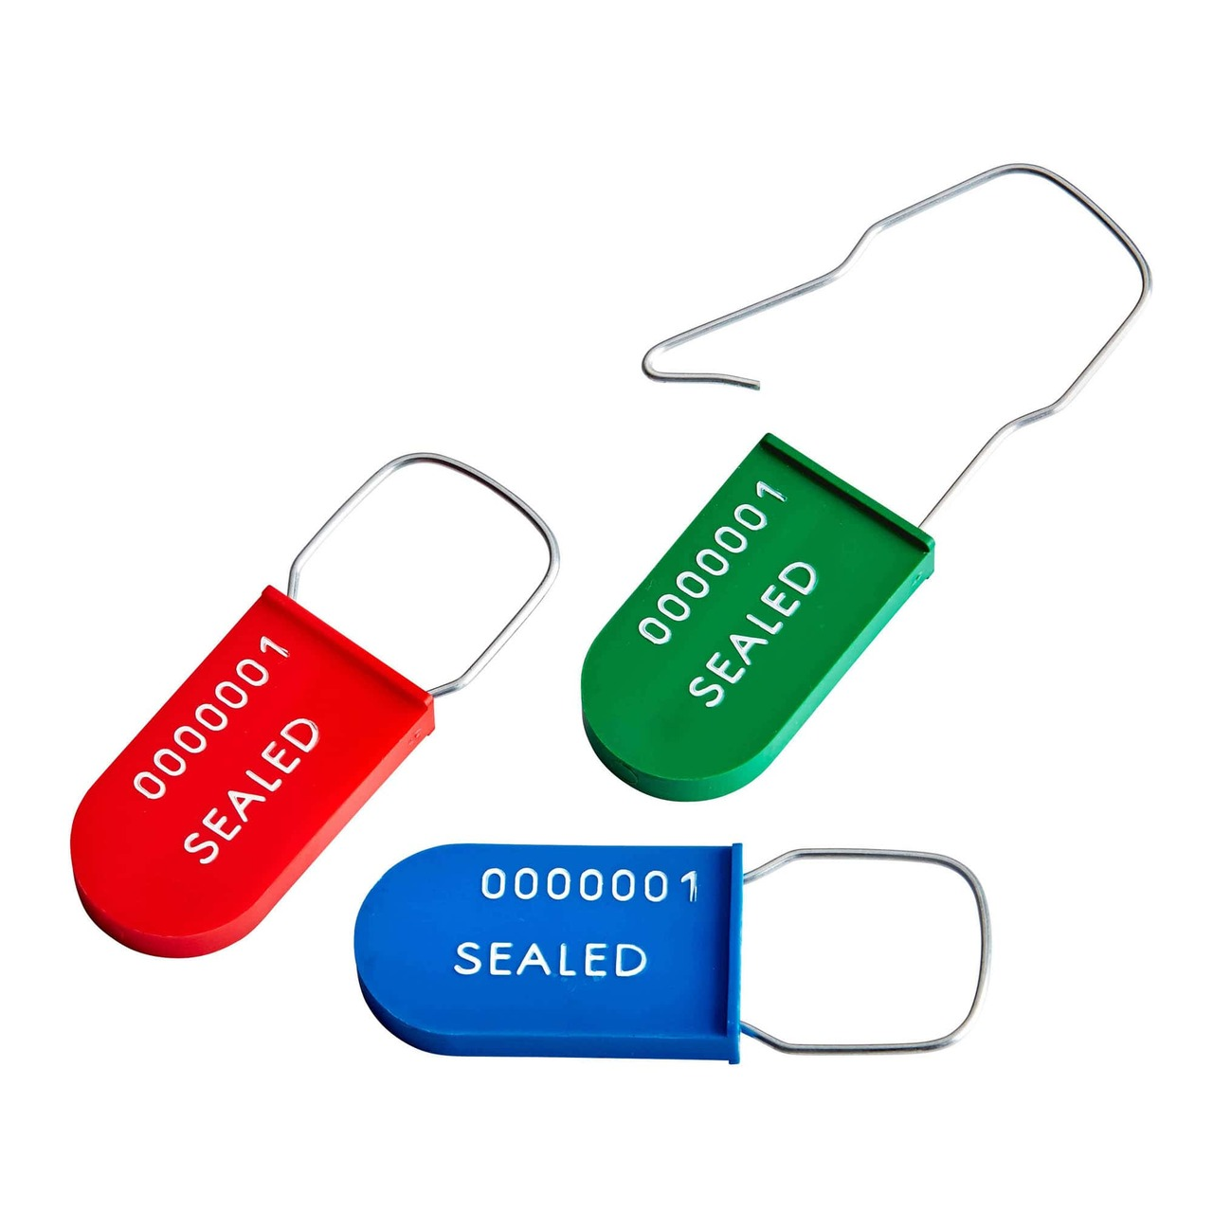
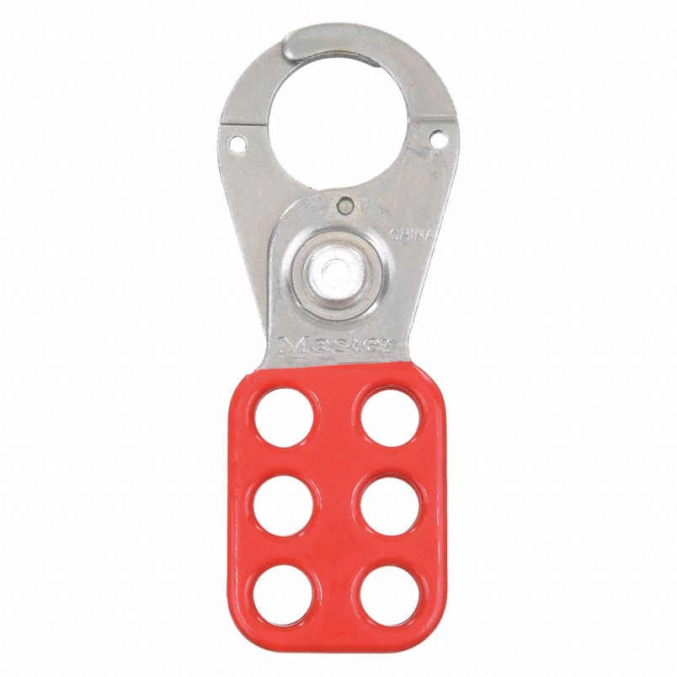
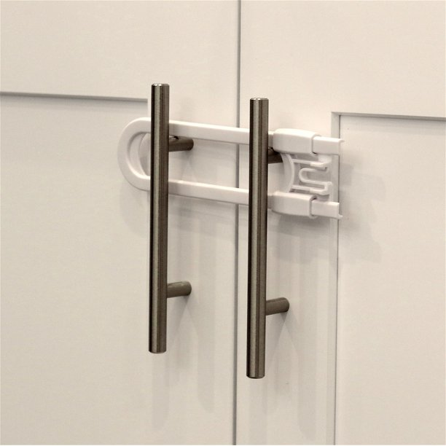
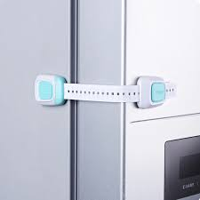
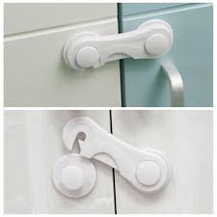

Would any of these meet the requirements of locked storage under .2820(b)?
Notes:
These are all listed if you just google locks. Some are plastic but the issue is none would meet the requirements just referenced/

Slide 11
~Storage~
What’s Poison? Where is it Hiding?
.2820 (b) Any other product that is labeled "keep out of reach of children" and does not have any other warnings on the label shall be kept inaccessible to children when not in use, but is not required to be kept in locked storage. For the purpose of Paragraphs (b), (c), and (d) of this Rule, a product shall be considered inaccessible to children when stored on a shelf or in an unlocked cabinet that is mounted a minimum vertical distance of five feet above the finished floor.​
Notes:
Clarifies that “inaccessible” definition is to be used only for (b), (c) and (d) of .2820

Slide 12
Inaccessible versus Keep Out of Reach
For the purpose of Rule .2820, a product shall be considered inaccessible to children when stored on a shelf or in an unlocked cabinet that is mounted a minimum vertical distance of five feet above the finished floor.​
However, “keep out of reach” is not defined by a specific height requirement but does require that children not have access or access is restricted by whatever means is effective and approved. An examples of kept out of reach in which we would not want to apply the inaccessible definition in .2820 is the use of bottle warming equipment.
Notes:
Further discuss

Slide 13
~Storage~
What’s Poison? Where is it Hiding?
Kept Inaccessible
Approved disinfectants
Detergent solutions
Hand antiseptics
Hand lotions
.2820(c) Non- aerosol sanitizing, disinfecting and detergent solutions, hand sanitizers and hand lotions shall be kept inaccessible out of reach to children when not in use, but are not required to be in locked storage.
These solutions shall be labeled accordingly as sanitizing, disinfecting or detergent (soapy water) solutions.
Bulk soap shall be kept inaccessible to children.
Notes:
Read the last sentence…all hand soap. Is that sentence completely true! No. everyone taking notes, correct that sentence.
Hand soap [other than that which is in bulk container] is not required to be kept inaccessible to children or in locked storage.

Slide 14
~Storage~
MEDICATIONS
.2820 (d) Medications including prescription and non-prescription items shall be stored in a separate locked cabinet or other locked container and shall not be stored above food.
6-point demerit item
Non-prescription diaper creams and sunscreen shall be kept inaccessible to children when not in use but are not required to be in locked storage.

Slide 15
.2820 (d) Designated emergency medications shall be stored out of reach of children but not required to be in locked storage.
Epi-Pen
Glucagon
Dilantin suppositories
The following medications, which may be administered by a metered dose inhaler (for
use in an aerosol machine), are also exempt.
Albuterol (Proventil, Ventolin, Volmax)
Terbutaline (Brethine, Bricanyl)
Combivent (albuterol/pratropium)
DuoNeb (albuterol/pratropium)
Foradil (formoterol)
Ipratropium
Maxair (pirbuterol)
Metaproterenol
Salmeterol (Serevent)
Xopenex
Notes:
East Carolina University pediatrician were consulted on this issue and concluded that emergency medications (where a delay of minutes could result in a serious negative outcome) should remain unlocked.
Below are some examples of emergency medications. These emergency medications need to be stored in an area of quick access for the provider yet be stored out of reach of children.

Slide 16
~Storage~
Shall be locked
.2820 (b)&.2820 (d)
Corrosive agents
Pesticides
Bleaches
Detergents
cleansers
Polishes
Aerosol dispenser
Hazardous if ingested, inhaled, handled
Medications
Shall be inaccessible
.2820 (b)(c)
“keep out of reach” products without any other warnings
Non-aerosol sanitizing & disinfecting solutions
detergent solutions (soapy water)
Hand sanitizers & lotions
Toothpaste(research)
Non-prescription diaper creams & sunscreens (d)
(g) Employees purses & other personal effects shall be kept out of reach of children.
Notes:
Non aerosol sanitizers- when not in use. I will discuss purses more in the next couple of slides.

Slide 17
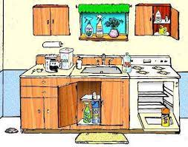

Chemical Storage
A locked kitchen is not considered to be a locked storage room or cabinet for the purposes of this Rule;…..
(e)
Chemicals in the kitchen must be stored in a locked storage room or cabinet. Just having the kitchen door locked does not satisfy requirement for this rule.
* See Storage of Hazardous Products in a Kitchen memo

Slide 18
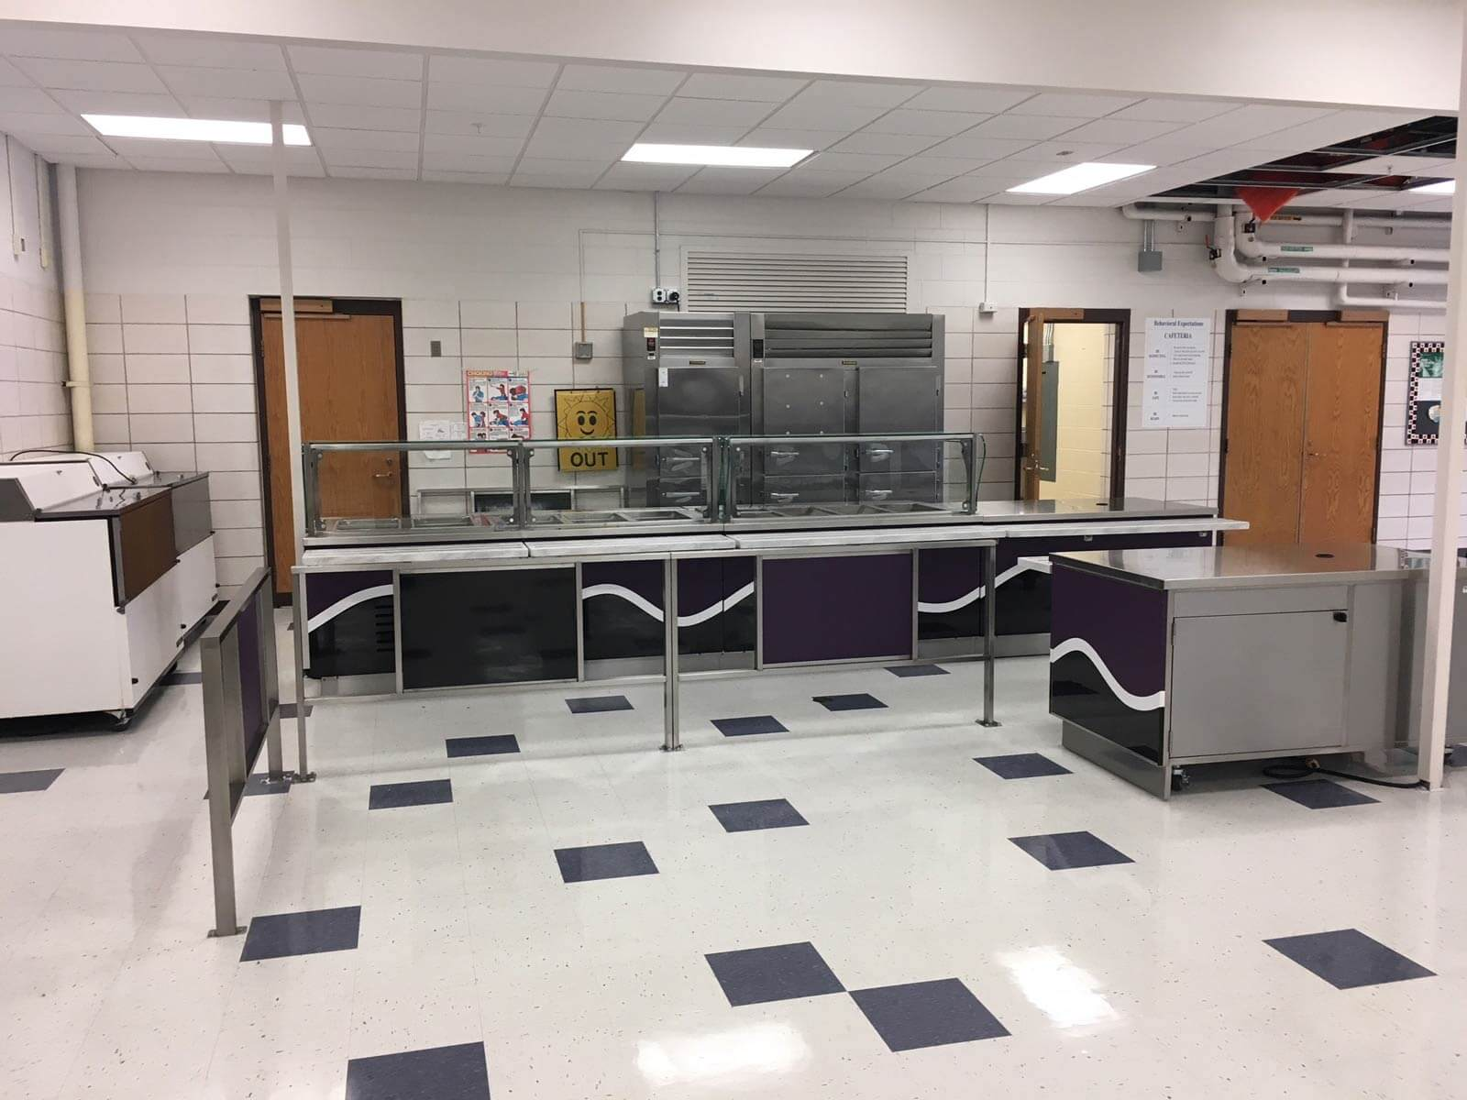
Storage… within a school and the use of the school’s kitchen
.2820(e) A locked kitchen is not considered to be a locked storage room or cabinet for the purposes of this Rule; however, for child care centers that are located within a school and that use the school cafeteria's kitchen to meet the kitchen requirements of the rules of this Section, it shall not be a violation of this Rule to store products described in Paragraphs (a)-(d) of this Rule unlocked in the cafeteria's kitchen, provided that the kitchen is kept locked and children are not permitted in the kitchen for any purpose.

Slide 19
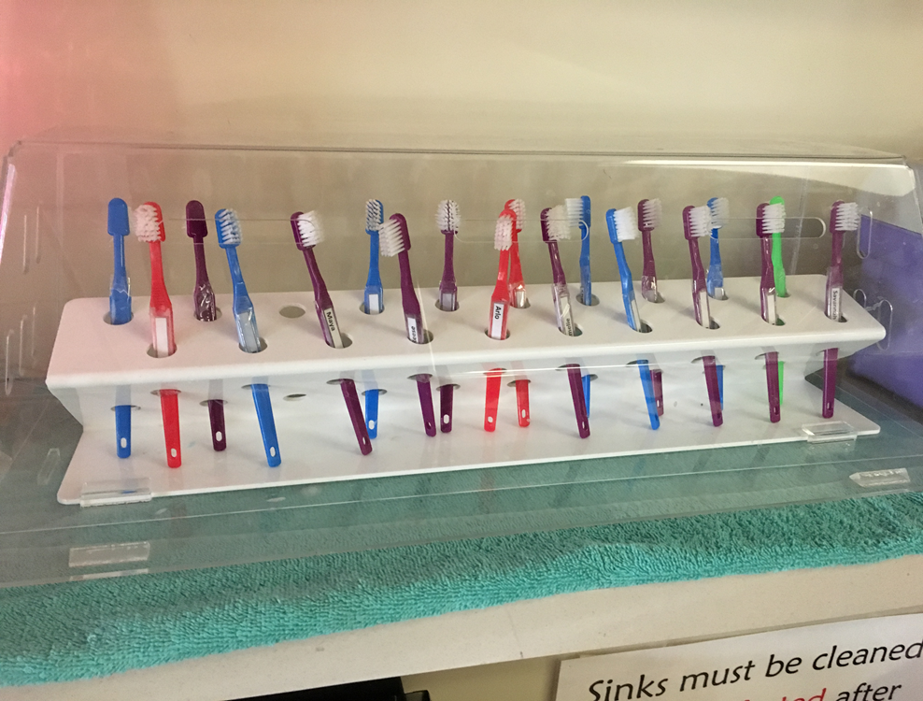
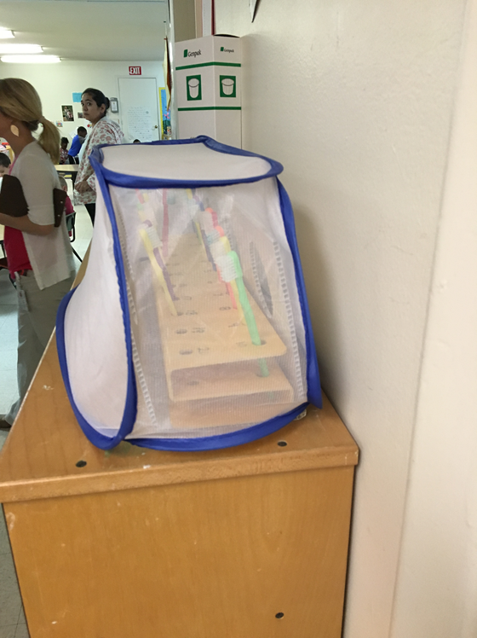
Other Storage Concerns
.2820(f) Toothbrushes shall be labeled with the name of the child to whom the toothbrush belongs, allowed to air dry after use protected and ….stored in a designated area.

Slide 20
~Storage~
.2820 (f)
Individual cubicles, lockers or coat hooks shall be provided for storage of coats, hats, or similar items.
Coat hooks shall be placed at least 12 horizontal inches apart if not in individual cubicles or lockers.
Combs shall be labeled and stored individually.
Toothbrushes shall be individually identified, allowed to air dry and protected from contamination.
When a container of toothpaste is used for multiple children, the toothpaste shall be dispensed on to an intermediate surface such as waxed paper.
Notes:
Under (c)….
The storage of coats and the labeling and storage of combs are important for public health reasons. David will discuss this more in his presentation.
There is information on CEH website called Tooth Talk: Toothbrushing Guidelines. I This guidance document was created by by DHHS- Oral Hygiene CEH reviewed this information. It does provide data on toothbrushes and how to store them.

Slide 21
~Storage~ .2821 Beds, Cots, Mats and Linen
Linen
(f)Linen shall be kept clean, in good repair and stored with the mat or cot that the linens are assigned to or stored apart from the mattress or cot in a manner that keeps the linen used for each child separate from the linens belonging to other children.

Slide 22
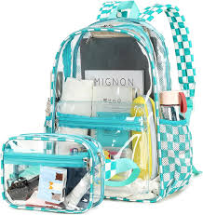
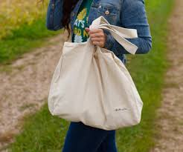
Other Storage Concerns
.2820 (g) Purses and other personal effects belonging to childcare center employees shall be kept inaccessible and shall be stored in accordance with this Rule, as applicable.
Notes:
.. Stored in accordance with this Rule, as applicable…. May contain medicine or hazardous products, which would require it to be locked or stored inaccessible. Going into someone’s purse or diaper bag is not a part of the sanitation inspection. But think about what may be in a purse….( next)
However, since purses are not considered a product, they are allowed to be kept out of reach of children by other effective means so long as the purse does not contain medications or hazardous products, which would require it to be locked or stored out of reach as defined in .2829(b).

Slide 23
Pocket Book Contents
Inhalers | Cigarettes/ e- cigarettes/ Vape cartilages
Mace/pepper spray | Matches/lighters
Guns | Knives
Medications | ?
Bug sprays, repellents | ?
Notes:
?? Other items
Alcoholic beverages
Items containing alcohol- handsanitizerscertain colognes, perfumes, cosmetics.
OTC items- ointments, creams
Choking hazards-large candies, small items( toys)
Small scissors
Sharp objects

Slide 24
Other Storage Concerns continues…
Purses, Pocketbooks/Diaper Bags and their Content
-Privacy issues
-Remind operator of potential hazards and liability
-Diaper bags & book bags should be inspected daily
by the operator when coming into your center
Notes:
Going into someone’s purse or diaper bag is not a part of the sanitation inspection. But think about what may be in a purse….( next)

Slide 25
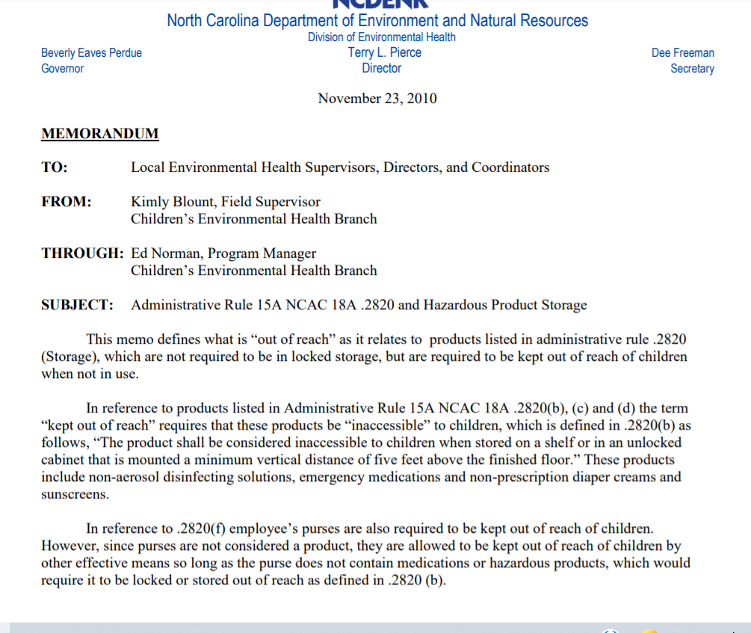
Notes:
In reference to .2820(f) employee’s purses are also required to be kept out of reach of children. However, since purses are not considered a product, they are allowed to be kept out of reach of children by other effective means so long as the purse does not contain medications or hazardous products, which would require it to be locked or stored out of reach as defined in .2820 (b). That section refers back to the hazardous/ chemicals. Information should be provided by the operator to staff, so that a locked facility can be provided or , restrictions should be discussed on what can come into the center.

Slide 26
~Other Storage Issues~
Office Supplies and Children’s Access
White-out (commonly left out on desk and therefore is accessible to children).
Permanent markers
If the office is being used as a sick area or is accessible to children, the office is subject to the inspection process. Office must be made “child proof”.
Notes:
Both may cause respiratory reactions or responses for some. White Out and permanent markers- Children should not have access to these items

Slide 27
~Storage~ .2821 Beds, Cots, Mats and Linen
(a)All beds, cots, mats and play pens shall be kept clean and in good repair, stored to prevent contamination and cleaned and sanitized between users.
Mats
(d) Mats shall be of a waterproof, washable material at least 2 inches thick and stored so that the side of the mat that makes contact with the floor does not touch the side of the mat that any child sleeps on.

Slide 28
~Storage~ .2832 Outdoor Learning Environment & Premises
(g) - Storage provided outdoors for children’s toys shall be kept clean and in good repair.
- Storage areas that are accessible to children shall be kept free of equipment that is not intended by manufacturers to be used by children and shall meet the requirements of Rule .2820.
- Storage areas shall meet requirements for lighting as requirements of Rule .2826 of this Section.
Notes:
2nd- There are a lot of storage building, that are being used for multiple items…like floor cleaner or stripper. Remember .2820 would apply.
.

Slide 29
~Other Storage Issues~
Plan Review
Generally, a major design flaw
throughout childcare centers
“Not Enough Storage”
Storage must be adequate!
Notes:
In reviewing a plan -of a new center or if doing renovations, think how important storage maybe today or even a year from now.

Slide 30
-Storage-
Major Areas of Concern:
Food Storage
(including Refrigeration & single service articles)
Individual Cubicle Storage
Toys & Furniture Storage (excess)
Equipment & Supplies Storage
Chemical & Hazardous Products Storage
Medication Storage
“Out of Reach” storage
Solid Waste Storage
Outdoor Learning Environment Storage
Bed/Cots/Mat Storage
Laundry & Linen Storage
Personal Belongings
Notes:
1st read list then- Including the employees personal belonging-coats, purses etc.?
David- brought up this concept, I have not even thought of them, where will employees take breaks or lunches?

Slide 31
Ask important questions such as:
Where are you storing diaper bags/book bags? Lunches from home( without PHF foods)? Soiled clothing? Soiled linen? Where’s your afterschool individual storage?
Where are you storing cots/mats/when not in use? Excess furniture, toys or other seasonal items such as Christmas trees? Garbage storage, mops, brooms etc. medications?

Slide 32
~Other Storage Issues~
Other important factors to consider such as:
Future or projected use
Will infant/toddler room possibly become 2yr old classroom?
Do you have enough space for the younger 1 verses the older 1 year old kids?
(this increases toys, cots and other room storage requirements)
Accessibility
Location of items near place or location to be used
Adequate sizing of storage doors to get items in/out
Ability to clean
Durable and cleanable material
Construction of shelving and containers
Can items easily be moved to facilitate cleaning (organized)?
Delivery Frequency
Capacity to handle volume of supplies based on delivery and or purchase schedules
Notes:
Some centers will experience grown and then about expansion. If infant/toddler room possibly become 2yr old classroom, require more room and more storage.
If you decide that you want a food preparation area in your infant room, Is there enough storage of all of the items needed . {f the center want to expand their menu or add a refrigerator can they even fit through your doorway and how much storage will you have to give up?

Slide 33
~Storage~
Where is it all marked?
Hazardous products? Demerits?
Medications? Demerits?
“Items marked keep out of reach” without other warnings?
Emergency medicine not inaccessible?
Disinfecting solution not inaccessible?
Hand antiseptics & lotions not inaccessible?
Diaper cream not inaccessible? Prescription?
Employee’s purse on the floor? visible medication inside?
Sunscreen not inaccessible? Aerosol sunscreen?
Essential oils sitting on a counter?

Slide 34
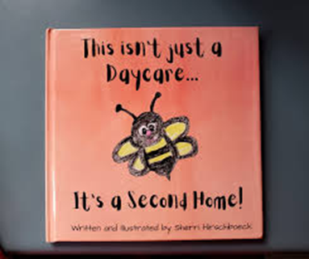
*Remember …..It’s All About The Children*
Questions?

