Slide 1
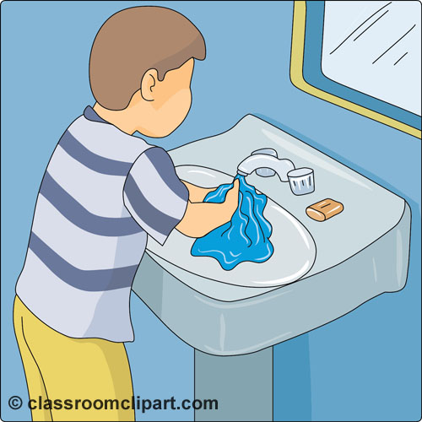
Sink Requirements
.2800 Child Care Sanitation Rules

Slide 2
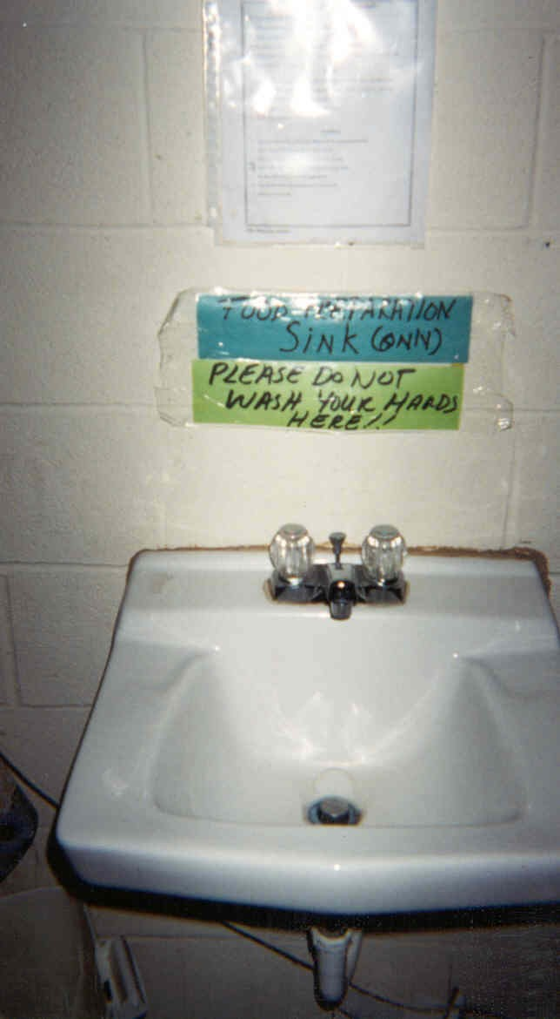
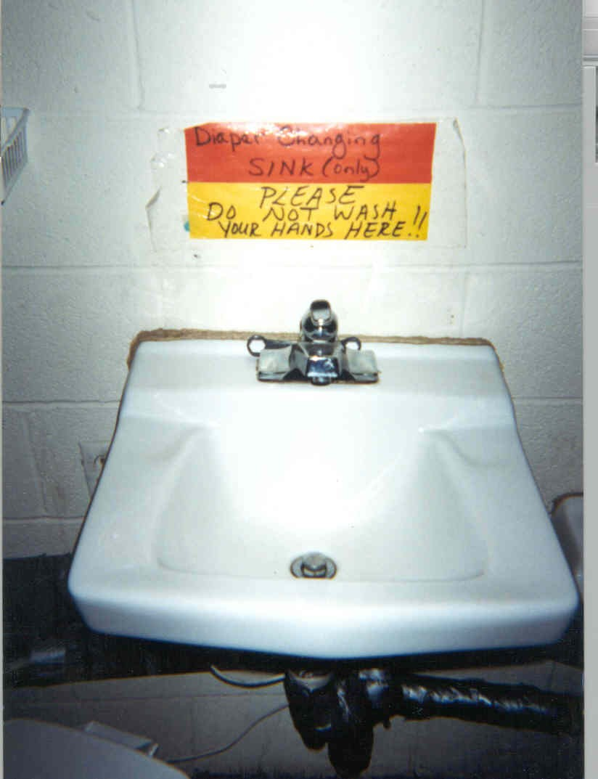
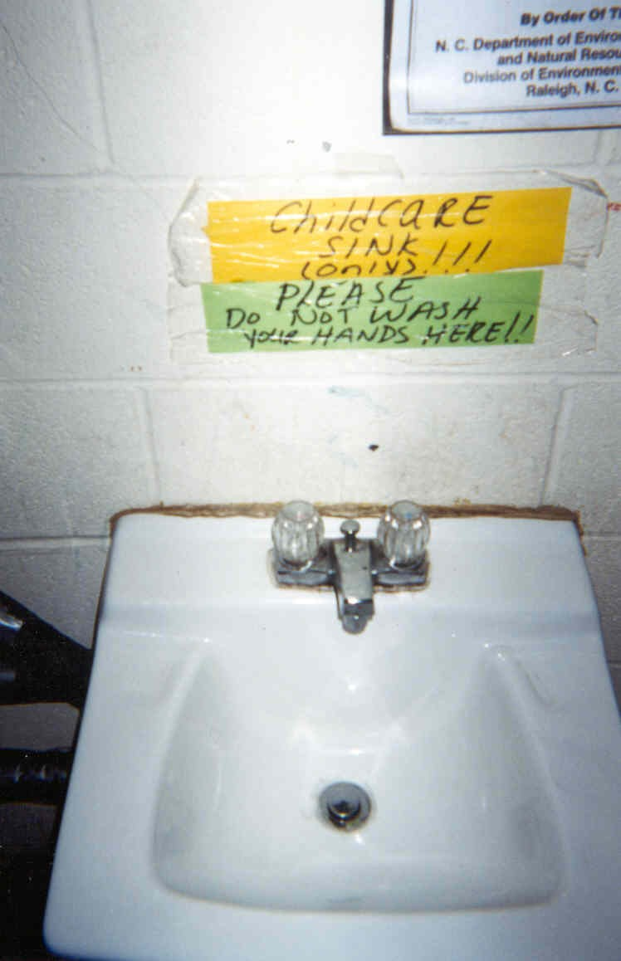

Slide 3
(22) “ Handwashing lavatory" means a sink that is equipped with hot and cold water under pressure and is used primary for handwashing
Employees shall wash hands: upon reporting for work;
before and after handling food; before bottle feeding or serving to other children; before handling clean utensils or
equipment; after toileting or handling of body fluids (e.g., saliva, nasal secretions, vomitus, feces, urine, blood,
secretions from sores, pustulant discharge); after diaper changing; after handling soiled items such as garbage, mops,
cloths and clothing; after being outdoors; after handling animals or animal cages; and after removing disposable
gloves. The use of hand sanitizing products does not replace the requirement for handwashing. However, except for
diapering, food preparation, and food service, hand sanitizing products may be used in lieu of handwashing while an
employee is supervising children outdoors if hands are washed upon returning indoors.
Children shall wash hands upon arrival at the child care center; after each diaper change or visit to the toilet;
before eating meals or snacks; before and after water play; after outdoor activity; and after handling animals or
animal cages. Except for diapering and before eating meals or snacks, hand sanitizing products may be used in lieu
of handwashing while children are outdoors if hands are washed upon returning indoors.

Slide 4
15A NCAC 18A .2818 LAVATORIES
In child care centers, lavatories shall be kept clean and in good repair and shall not be used for storage. Lavatories shall be mounted at an appropriate height to accommodate children or otherwise made accessible to children. Water from a handwash lavatory shall not be used for consumption. Lavatories with flush-rimmed sinks or with an attached operable drinking fountain shall not be used for handwashing.
(b) Lavatories shall be equipped with hot and cold water or tempered water provided through mixing faucets or pre‑mixing devices which provide water in the temperature range specified in Rule .2815(e) of this Section.
(c) Lavatories shall be cleaned and disinfected with each change of use, when visibly soiled, and at least daily. Change of use occurs when a handwash lavatory is used outside of its original intent. Change of use includes, but is not limited to, a classroom handwash lavatory used for rinsing toothbrushes, a food preparation handwash lavatory used for toy cleaning, or a classroom handwash lavatory used for diaper changing handwashing.

Slide 5
Diaper Changing Area
15A NCAC 18A .2819 DIAPERING AND DIAPER CHANGING FACILITIES
In child care centers, children in diapers shall be changed at stations designated for diapering or toileting.
Each diaper changing station shall include a handwash lavatory.
For child care centers licensed for fewer than 16 children and located in a residence, and for diaper changing areas designated for school age children, a handwash lavatory shall be in or next to the diaper changing area.
(b) Diapering surfaces shall be made of smooth, intact, nonabsorbent material and shall be kept clean and in good repair. Nothing shall be placed on the diapering surface except for those items required for diapering and the child whose diaper will be changed. If diapering is performed on the floor in a toilet room, then a smooth, intact, nonabsorbent barrier that is clean and in good repair shall be placed on the floor to minimize cross-contamination.
.

Slide 6
Marking Lavatory Use
#24. Reference .2819(a) Each diaper changing station shall include a hand wash lavatory.
The intent of this rule is that the hand wash lavatory is part of the diaper changing area, not located across the room or in an area that cannot be immediately accessed.
When a lavatory is needed for washing hands when entering the room from the playground or prior to eating a meal or snack, or after using the restroom, etc., IF there is not a sink specifically for this purpose then the diaper sink can be used AFTER a change of use.

Slide 7
Food Storage & Protection
.2806(b) Food that is stored in child care center classrooms or other rooms intended for child care use, shall be limited to foods that are individually packaged unless the classroom is equipped with a food preparation area.
(c) Notwithstanding Paragraph (b) of this Rule, bulk dry goods or food stored in freezers may be stored in rooms in child care centers that are not equipped with a food preparation area when all food preparation involving the bulk dry goods or frozen food is done in the kitchen or an approved food preparation area.

Slide 8
Food Preparation Areas
.2810(b) A separate lavatory for handwashing is required in food preparation areas and kitchens. If the dishwashing area is separate from the food preparation area, an additional handwashing lavatory shall be required in the dishwashing area.

Slide 9
Food Preparation Areas
2810 (f) If food is prepared in a child care center classroom, then the classroom shall be equipped with a food preparation area. Water from a handwash lavatory shall not be used for bottle warming or to prepare formula, mix dry cereals, or other foods. Toy cleaning and sanitizing may be conducted in the food preparation area. This food preparation area shall contain a countertop that is kept clean and in good repair, a handwash lavatory, and refrigeration when items are stored that require refrigeration in accordance with Rules .2804 and .2806 of this Section. The food preparation counters, food, and food-contact surfaces shall be out of reach of children and the following shall apply to food preparation counters, food, food-contact surfaces, and equipment used in food preparation:

Slide 10
Food Preparation Areas
2810(f)(1) all equipment shall be kept clean. Bottle warming equipment shall be cleaned and sanitized as required in Rule .2812 of this Section and the manufacturer's instructions;
2810(f)(2) if bottles are warmed, bottles shall be warmed in the child care center's kitchen or food preparation area. Bottle warming equipment shall be kept out of reach of children. Microwaves and slow cookers shall not be used to thaw or warm human milk, baby food, formula, or other bottled beverages meant for consumption by children. Bottles shall be warmed by placing bottles under running potable water or in containers of potable water or by using bottle warming equipment that is used in accordance with the manufacturer's instructions. Temperature restrictions listed in Rule .2815(e) of this Section do not apply to equipment manufactured specifically for bottle warming. If other bottle warming methods are used in food preparation areas, compliance with temperature restrictions listed in Rule .2815(e) of this Section is required; and
(3) after each use, multi-service articles provided by the child care center shall be cleaned and sanitized in the child care center kitchen.

Slide 11
Marking Lavatory Use
#8. Reference .2810(b) a separate lavatory is required in Food Preparation areas.
This sink is for HAND WASHING prior to preparing food or preparing bottles. It is NOT for obtaining water to prepare the bottles. This water should come from the kitchen or bottled water. This sink can be used to wash toys AFTER a change of use. This sink is not intended to be used for a hand wash sink after changing a diaper., hence the rule requiring a SEPARATE lavatory for food preparation.

Slide 12
1-Question: Can the handwash sinks required by rule 2810 only be used for handwashing required before engaging in food preparation and not for any other ‘types’ of handwashing?
Answer: .2810 (b) A separate lavatory for handwashing is required in food preparation areas and kitchens. If the dishwashing area is separate from the food preparation area, an additional handwashing lavatory shall be required in the dishwashing area.
.2810 (f) If food is prepared in a child care center classroom, then the classroom shall be equipped with a food preparation area. Toy cleaning and sanitizing may be conducted in the food preparation area.

Slide 13
Answer Continued: How do you mark this?
This is an example of educating the operator on which sinks are to be used when performing certain task. However, it is not recommended that demerits be taken if an operator is observed using the food prep hand wash lavatory outside of food prep and toy cleaning with a change of use. Our emphasis should be put on the act of handwashing. We encourage inspectors to use this as an educational opportunity to explain when the food prep area handwash sink should be used and the premise for that separation which is to reduce potential cross contamination. It is not encouraged to mark a violation in this situation. However, EHSs are trained that only food preparation handwashing and toy cleaning (with a change of use) is to occur at this sink. Other handwashing is to occur at other sinks located throughout the classroom. Classrooms are not required to have a food prep area, however, if equipped with one, training should occur on how the sink in this area is to be used.

Slide 14
Answer Continued:
It is recommended as a demerited violation if the separate handwash lavatory in the food prep areas is not provided This is a 6 point demerited item. Furthermore, if it is observed that the food prep handwash lavatory is being used to clean utensils or to prepare formula or for bottle warming, then that is also a demerited violation.

Slide 15
Define “ Change of Use”
Change of Use: is defined as using a handwash lavatory for purposes other than its original intent. Children washing their hands in a classroom lavatory after toileting or outside play does not constitute change of use because that sink is still ultimately used and intended for handwashing by the children. 2818(c) Lavatories shall be cleaned and disinfected with each change of use, when visibly soiled, and at least daily. Change of use occurs when a handwash lavatory is used outside of its original intent.

Slide 16
Examples of “ Change of Use”
Food Prep hand wash lavatory in food prep area
COU toy cleaning
COU rinsing of toothbrushes by operator
Regular classroom handwash lavatory
COU used to rinse toothbrushes by children
COU used to clean paint brushes
COU used to meet sink requirement for diaper changing
Sink Usage Question:
If a room has one handwash lavatory can it be used for handwashing after bathroom use and before eating without a change of use?
Yes if this is the handwash lavatory intended to be used by children then regular handwashing requirements for children is not considered a change of use.

Slide 17
Examples of “ Change of Use”
Is change of use required if diapering is done in the toilet room instead of a designated diaper station?
Answer: .2817 (a) …The toilet room shall include or be adjacent to a handwash lavatory. If diapering is conducted in the toilet room, and the intent of the sink is for children’s handwashing then handwashing occurring at that sink will not require a change of use.

Slide 18
Sink Usage Questions
Sink Usage: Question:
If a room has one classroom handwash lavatory, can it be used to fill water bottles, fill sippy cups, make formula, wash or rinse bottles/sippy cups?
No! Water from a handwash lavatory shall not be used for drinking or consumption. Nor shall it be used to wash, rinse or sanitize utensils or multi-service items.
If a room has a food prep handwash lavatory in a food prep area can that sink be used to fill water bottles, fill sippy cups, make formula, wash or rinse bottles/sippy cups?
No! Water from a handwash lavatory shall not be used for drinking or consumption. Nor shall it be used to wash, rinse or sanitize utensils or multi-service items.
If a room has multiple classroom handwash lavatories can one be designated and labeled to be used to fill water bottles, fill sippy cups, make formula, wash or rinse bottles/sippy cups?
No! Water from a handwash lavatory shall not be used for drinking or consumption. Nor shall it be used to wash, rinse or sanitize utensils or multi-service items.
If a room has a food preparation area that includes a handwash lavatory can an additional sink be added in that area to be used to fill water bottles, fill sippy cups, make formula, wash or rinse bottles/sippy cups?
Yes to fill water bottles, mix formula (food prep sink not a handwash lavatory)
No to washing, rinsing or sanitizing of utensils or multi-service items.

Slide 19
Marking Lavatory Use
#21. Reference .2818(c) Lavatories shall be cleaned and disinfected with each change of use, when visibly soiled, and at least daily. (now referenced specifically on the grade sheet)
Remember that a change of use is based on changing the intent of the use of the sink. For example: a sink that is intended for washing hands prior to preparing food/bottles is not intended for washing toys or toothbrush holders, therefore a change of use is required. This Change of Use includes allowing the proper contact time required by the manufacturer of the disinfectant.
Procedure: Clean and Disinfect prior to the change
Clean and Disinfect after the change of use occurs
(think of it as converting it back to its original intent)

Slide 20
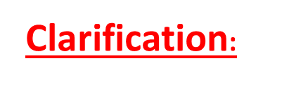
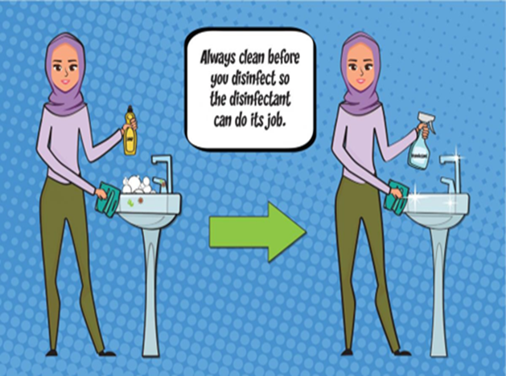

Continued Rules Changes Lavatories
Change of Use
Toy Cleaning
Cleaning and Disinfecting
Food Preparation Handwashing Lavatory
Change of Use as defined in .2818(c)

Slide 21
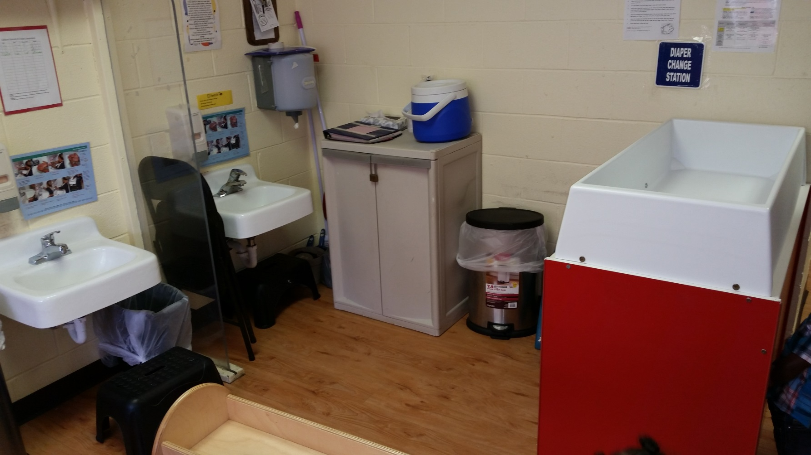
Diaper Changing- Any issues?

Slide 22
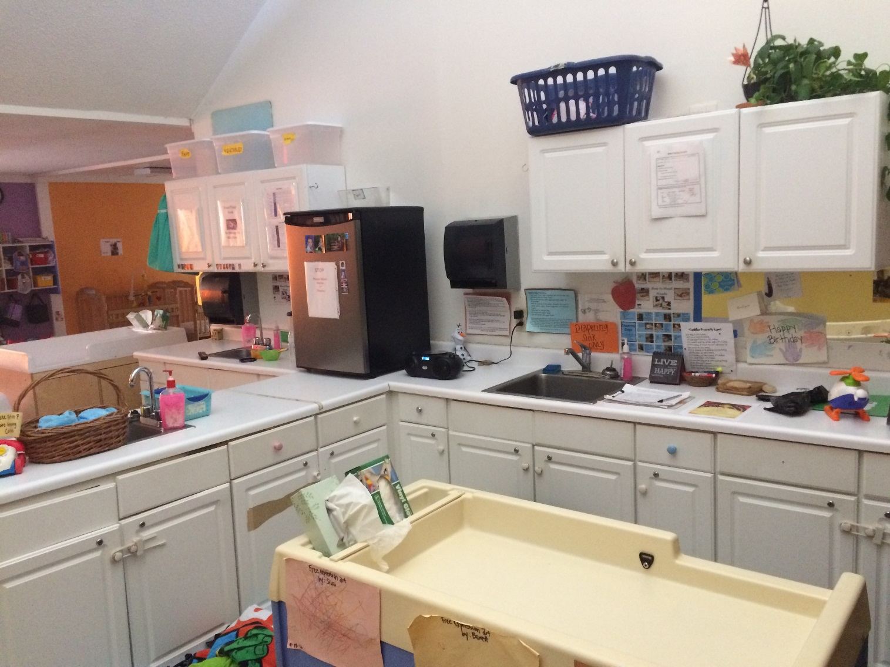
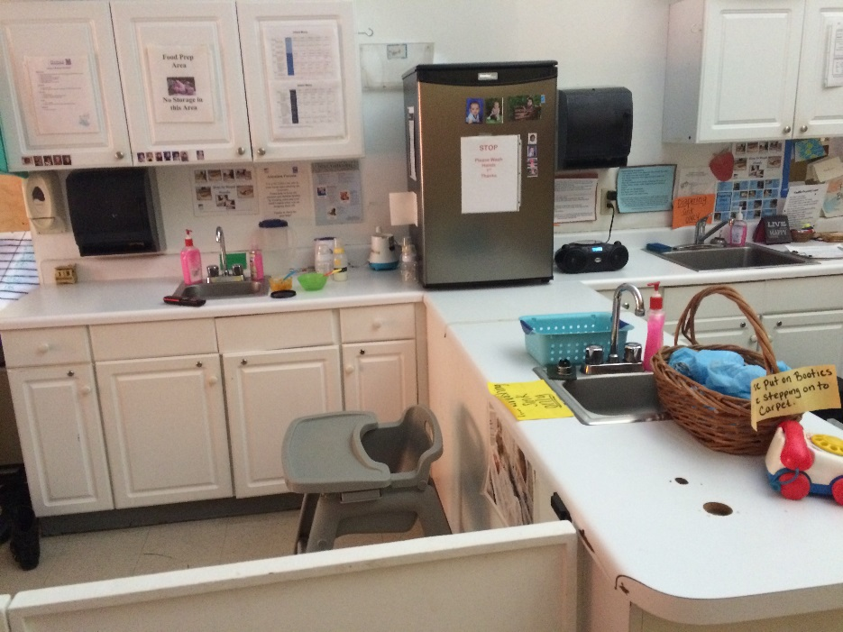
Diaper Changing –Any issues?

Slide 23
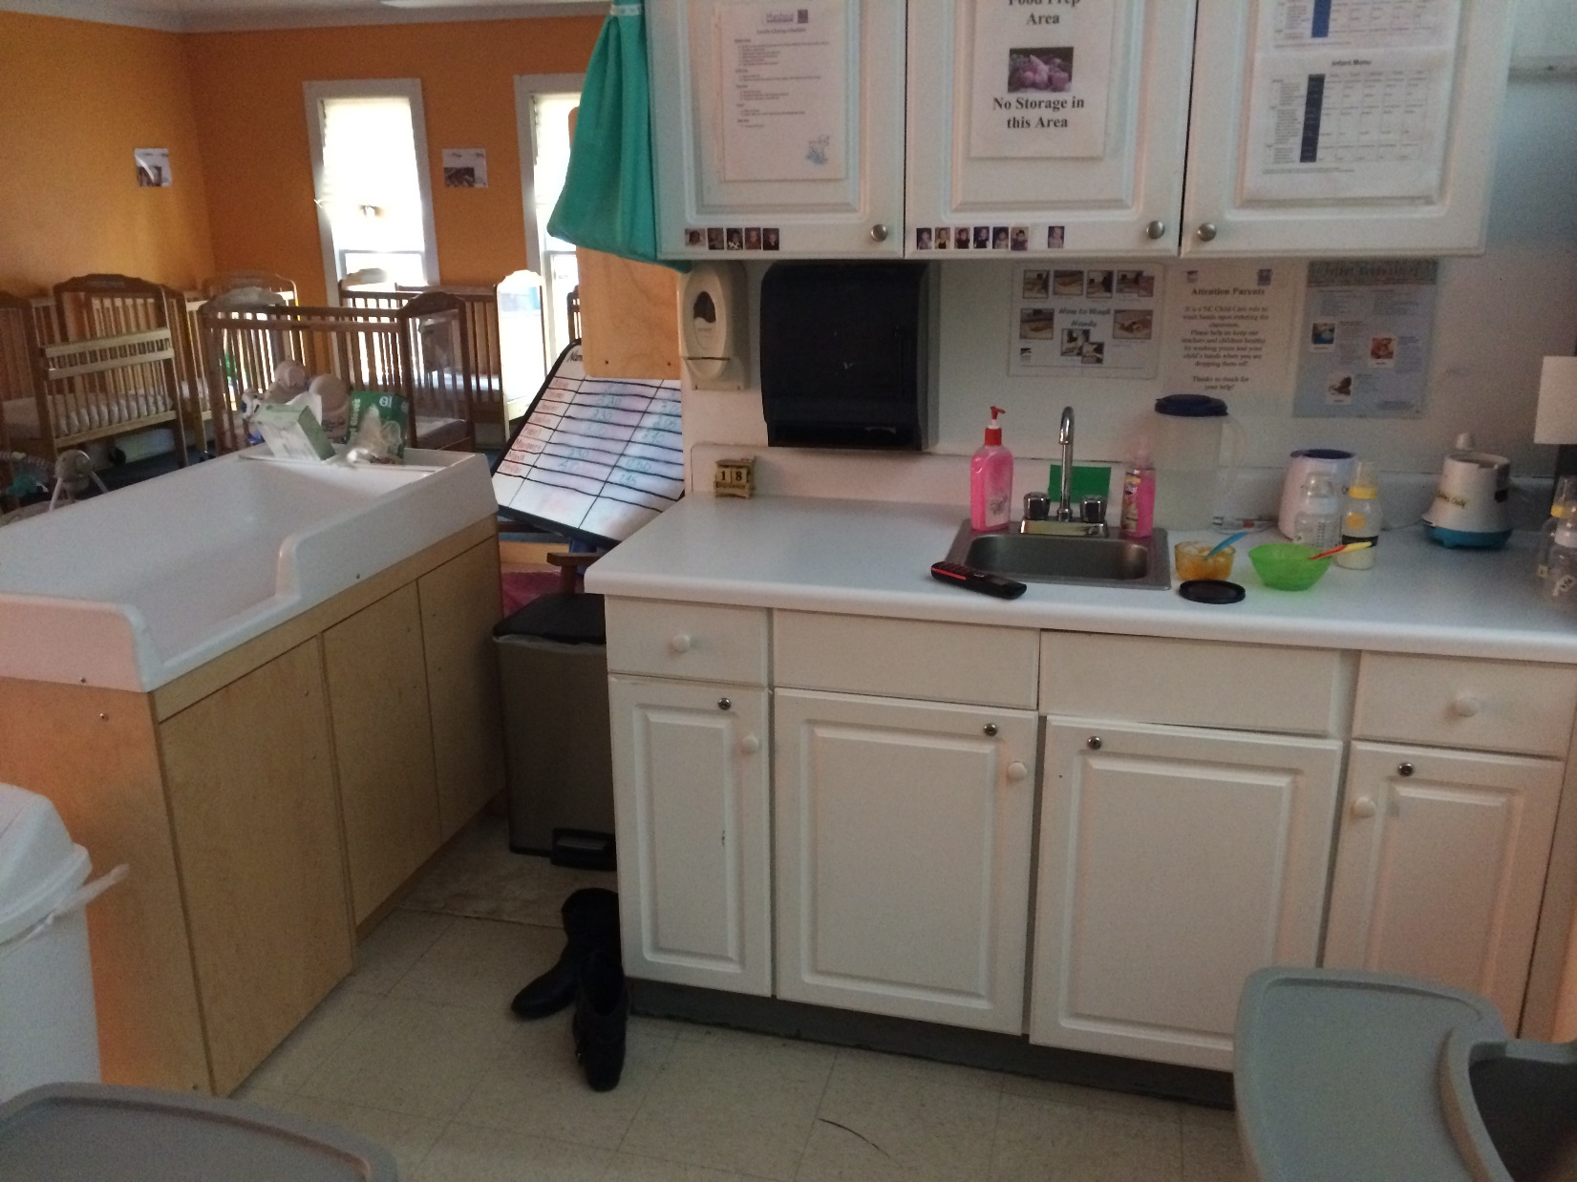


Slide 24
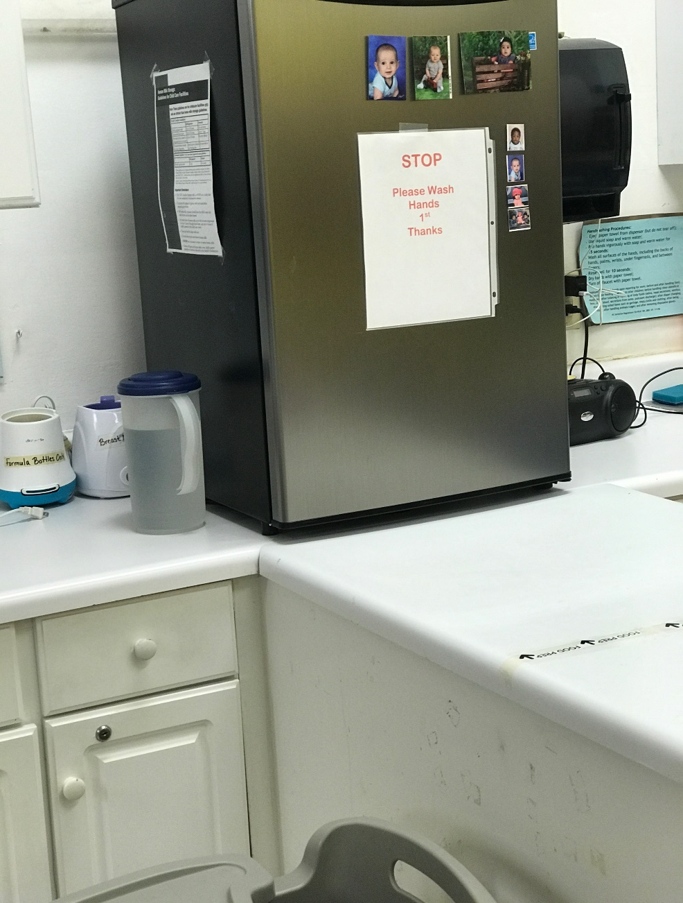

Slide 25
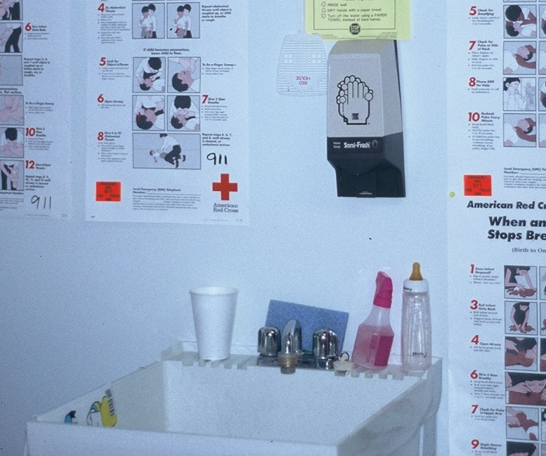

Slide 26
Question- Some don’t like the phrasing of ‘general’ handwashing or ‘general’ handwashing sinks, however, in thinking about how to get the message across is there phrasing that is preferred?
Answer: The phrasing that is discouraged is “general handwash sinks” (GHS) since the 2800 sanitation rules do not refer to general handwash sinks or define general handwashing per rule. However, the rules do specify when specific handwashing activities shall occur. It also specifies when handwash sinks are required. Some counties have required “general handwash sinks” in classrooms and locations that cannot be supported by the rules since we do not have GHS requirements. Minimum handwash sink requirements are mandated by building code which is referencing the lavatories required in 2817. Handwash lavatories in food prep areas, separate dishwashing areas and diaper changing stations are all additional lavatories that may be required per the child care sanitation rules. It is imperative that we understand the difference between recommendations and requirements per the rules.

Slide 27
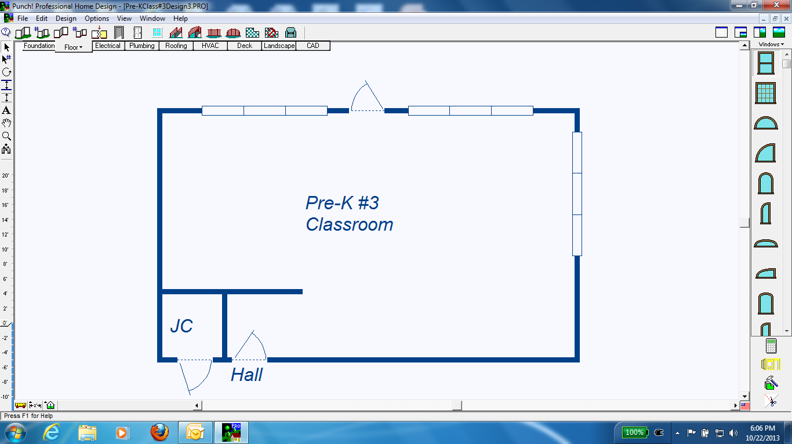

Slide 28
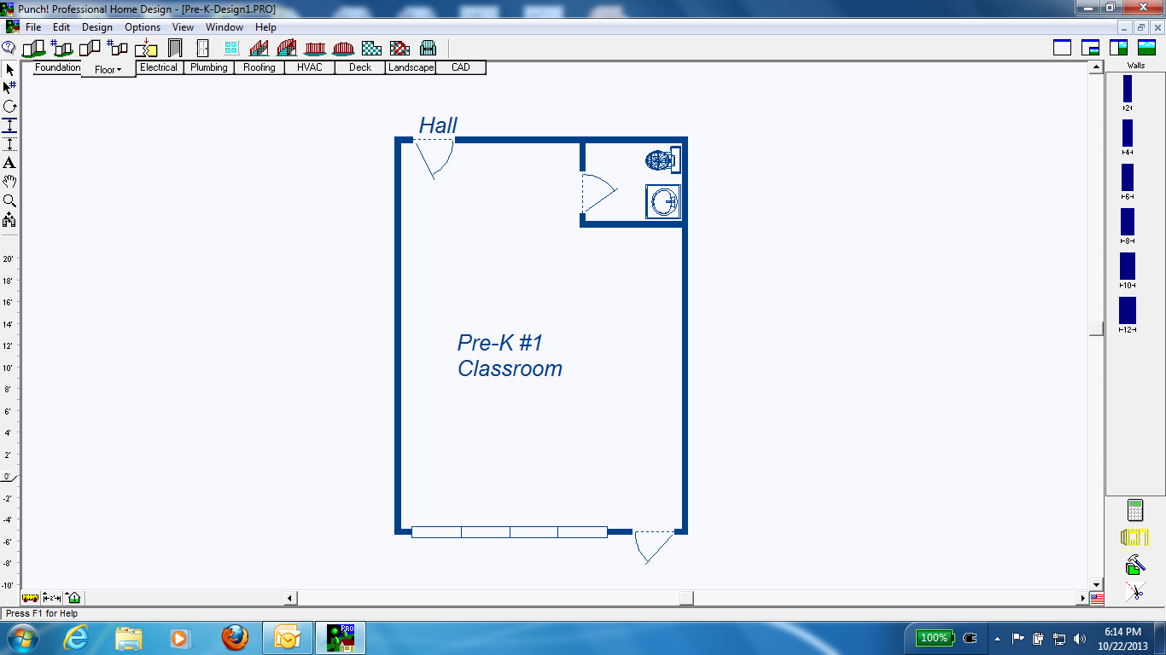

Slide 29
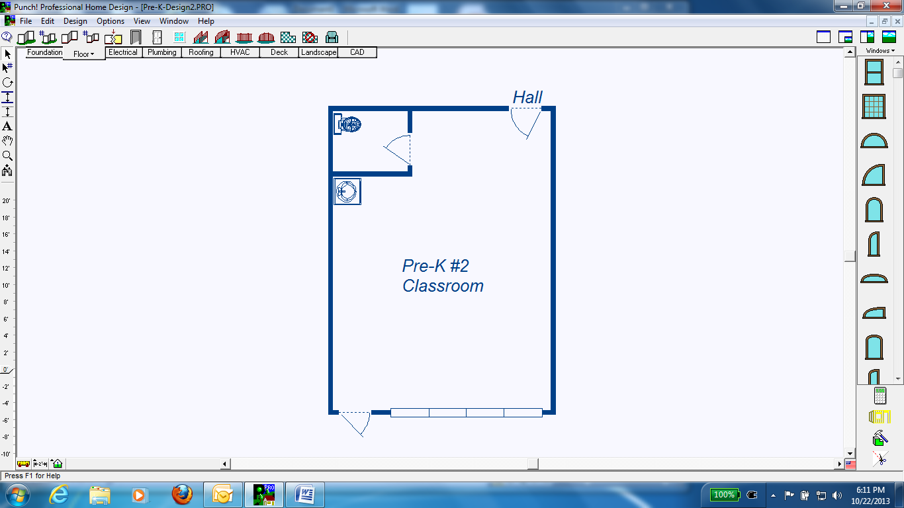

Slide 30
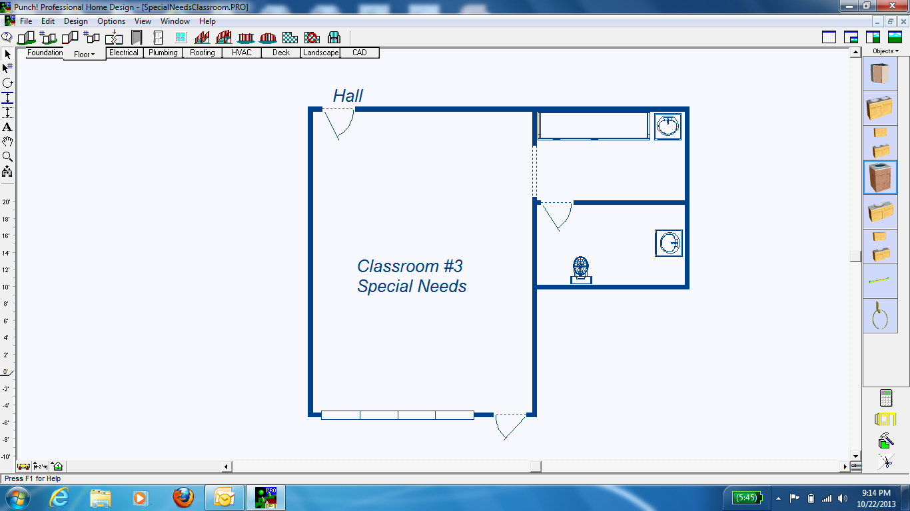

Slide 31
Now You Decide Adequate or Not?

Slide 32
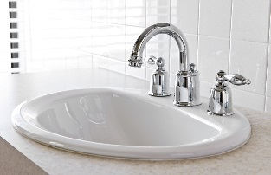
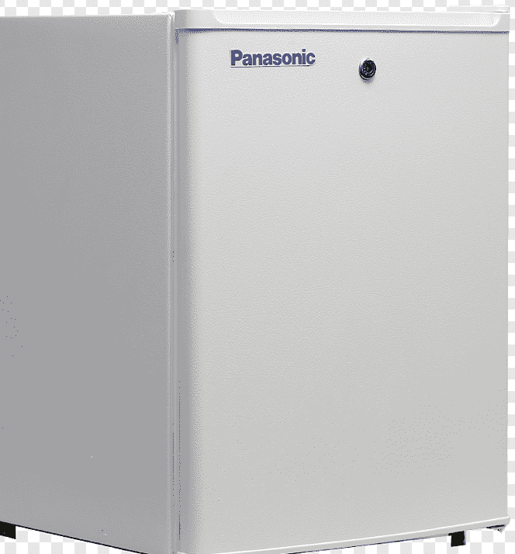
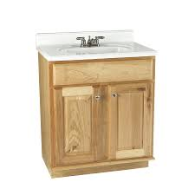
Infant Classroom
Infant food/bottle storage
Diaper Changing Table

Slide 33
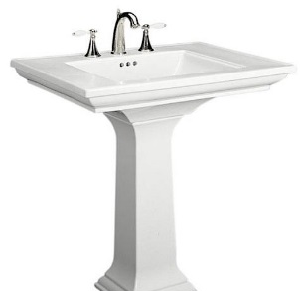
Toddler Classroom
Bulk Food Storage
Diaper Changing Table
Water play table
“Classroom handwashing Sink”

Slide 34
Diaper Changing Table
Food Prep area
3 yr old

Slide 35
Bulk Food Storage area

Slide 36
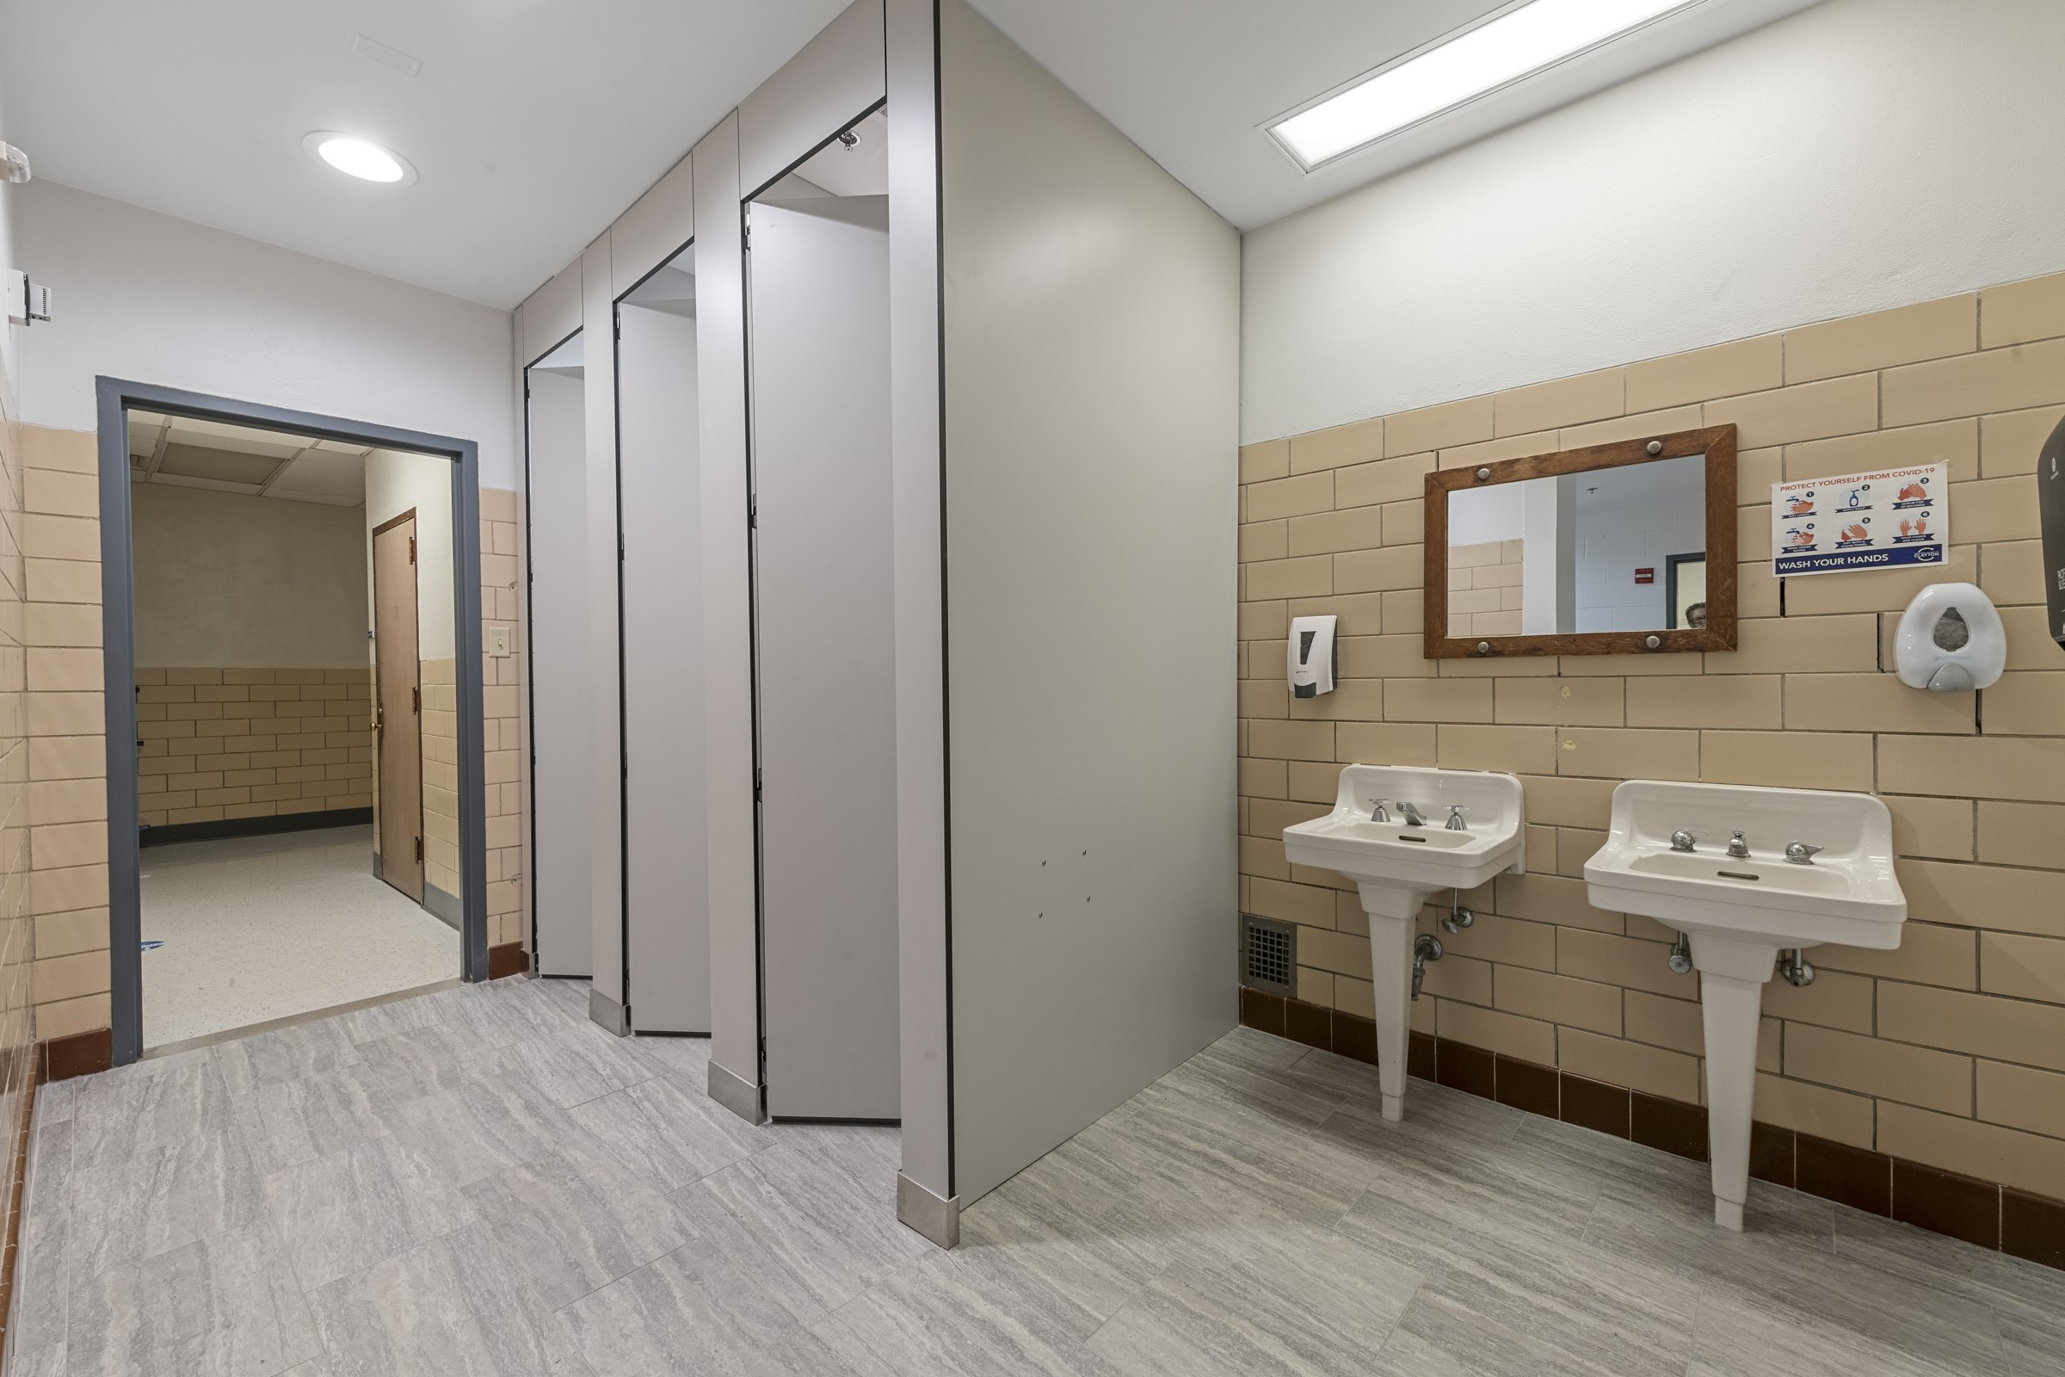
Lunches from home storage only
Is Food Prep Area Required?
Is this ideal?

Slide 37
Lunches from home
Is Food Prep Area Required?

Slide 38
Special Needs Classrooms
.
Special Needs Position Statement
Will need to incorporate in rule change

