Slide 1

Chapter 10 – “Means of Egress”
Mark G. Bailey
N. C. Dept. of Insurance
OSFM/Engineering Division

Slide 2
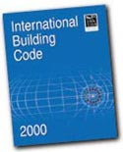


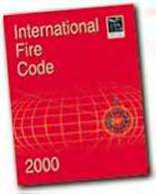




What Makes Up the North Carolina Fire Prevention Code?
North Carolina Building Code Council
2018 North Carolina Codes

Slide 3
How Is a Code Section Written?
Prescriptively
    (i.e. Door Width, Activation time, Travel Distance)
Performance-based
    (i.e. Locking Arrangements, Alternative Methods)
This class will concentrate on key elements of Chapter 10 and the reason they are written this way. This is important to understand the overall objective of Chapter 10 and to properly apply it.

Slide 4

Bldg Codes for Child Care
ACCESS REQUIREMENTS
EGRESS REQUIREMENTS
Accessible entrance requirements
Door width measurement
Accessible door hardware
Level of exit discharge
Remote exits
Acceptable room locations for children < 3 years old
Toilet fixtures

Slide 5
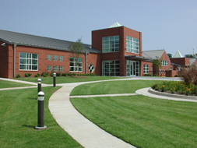
Accessible Entrance Requirements
An accessible entrance requires:
This means no stairs - no gravel paths
  Fixed, firm, non-slip
  4’- 0” wide path of travel with maximum 1:12 slopes

Slide 6
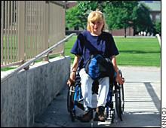
Accessible Entrance Requirements
An accessible ramp requires:
Maximum 1:12 slopes with minimum 4’-0” width between handrails on both sides
  Handrail extensions top and bottom of ramp within 27” of floor or ground surface
  2” edge protection where drop-offs > 1/2”

Slide 7
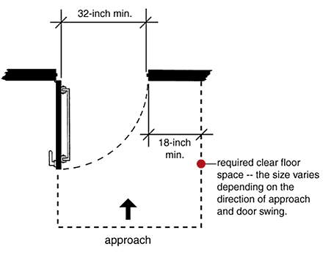
Door Width Measurement
The required 32” clear dimension is measured:
  with the door in the fully open position
  from the face of the strike jamb stop to the finished face of the door in the 90° open position
INSIDE
60” min
DIRECTION OF TRAVEL
OUT SWINGING DOOR
OUTSIDE

Slide 8
Door Width Measurement
The required 32” clear dimension is measured:
  with the door in the fully open position
  from the face of the strike jamb stop to the finished face of the door in the 90° open position
INSIDE
12” min
DIRECTION OF TRAVEL
60” min
IN SWINGING DOOR
OUTSIDE

Slide 9
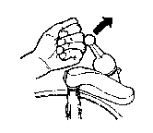
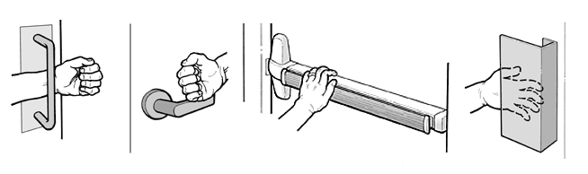
Accessible Door Hardware
Operable door hardware requires a shape that is easy to grasp with one hand and does not require tight-grasping, tight pinching, or any wrist-twisting motion to operate.
Similar requirements apply to lavatory controls, drawer pulls, etc.

Slide 10
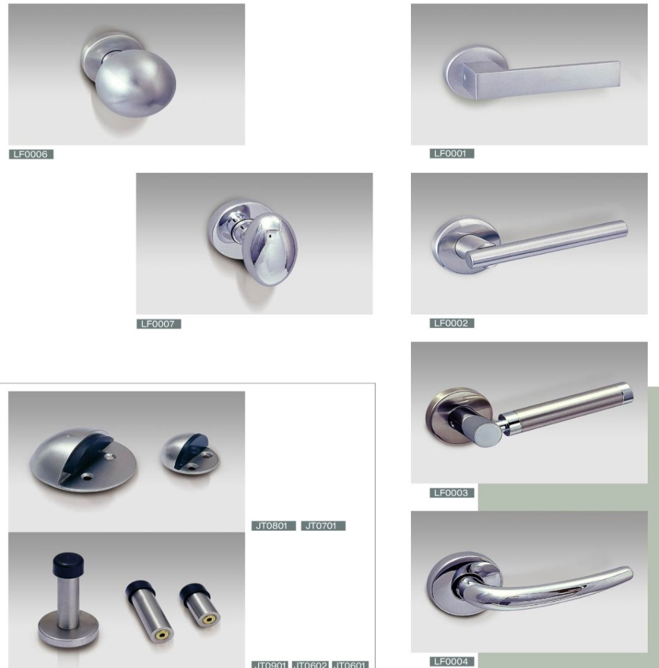
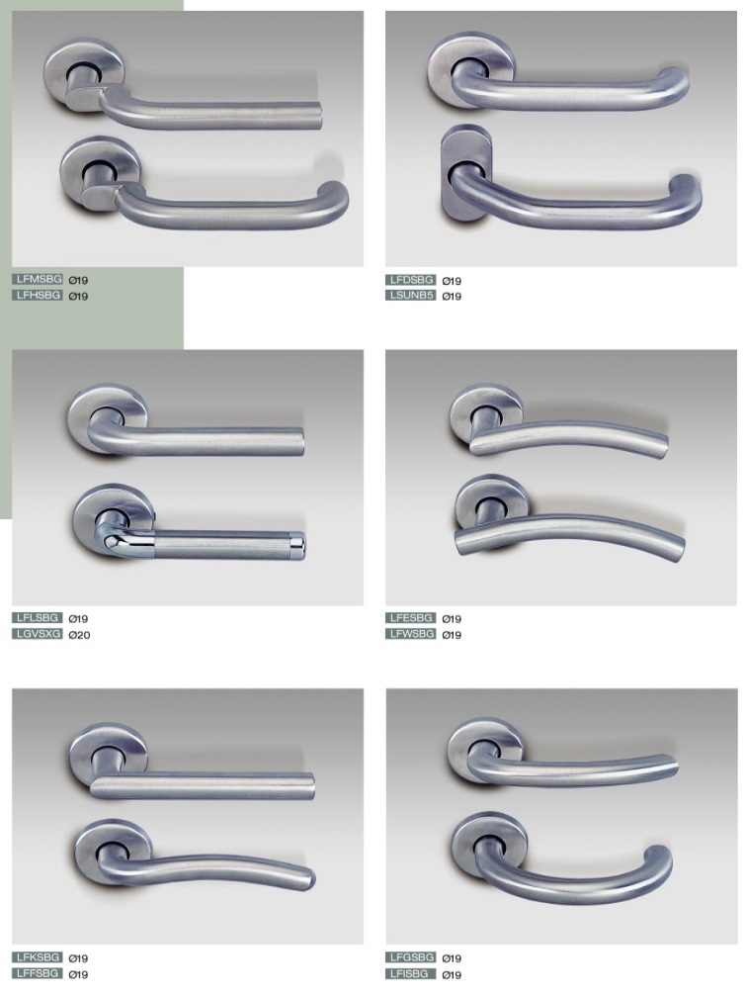
Accessible Door Hardware
DO NOT USE THESE
USE THESE

Slide 11
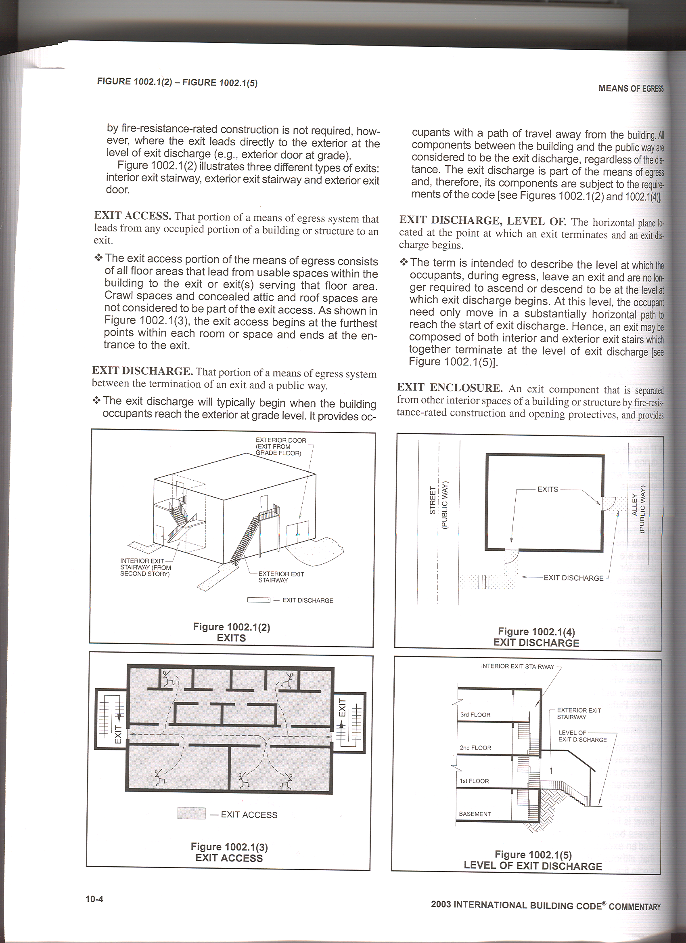
Level of Exit Discharge
1028 EXIT DISCHARGE, LEVEL OF - The horizontal plane located at the point at which an exit terminates and an exit discharge begins.
EXIT TERMINATES HERE

Slide 12

Double cylinder deadbolts
Allowed at the main exterior door of Group A (with an occupant load not exceeding 300 persons), Group B, F, M and S, subject to the following:
  Easily distinguishable
  Visible sign
  Can be revoked by the code official

Slide 13
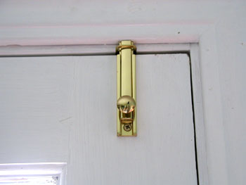
Bolt Locks
Manually operated bolt locks or surface bolts are not allowed (1010.1.9.4)

Slide 14

Delayed Egress Locks (1010.1.9.7)
Listed locks are required to be approved
Cannot be used on Groups A, E or H
Buildings are required to have a sprinkler or smoke detection system
Path cannot have more than one delayed egress lock
Subject to the 6 provisions in the code

Slide 15
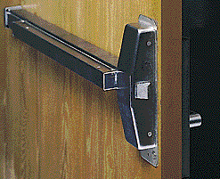
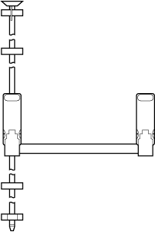
Panic Hardware (1010.1.10)
Required for doors serving
  Group A or E occupancies with an occupant load of 100 or more,
  Groups H-1. H-2, H-3 pr H-5 with any occupancy
Hardware has to extend over ½ of the door width
Required to unlatch at 15 lbs
No additional hardware is allowed, unless part of the panic hardware

Slide 16
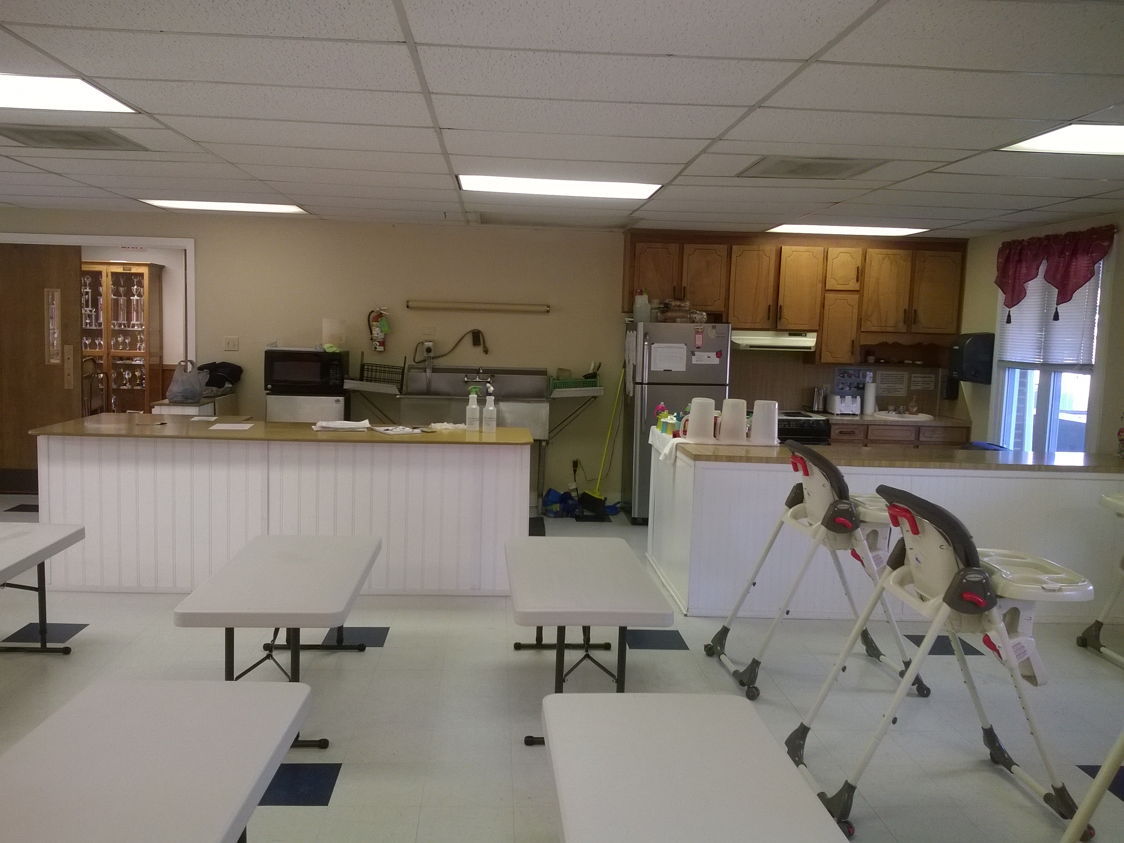
Kitchen Egress
The Problem:

Slide 17
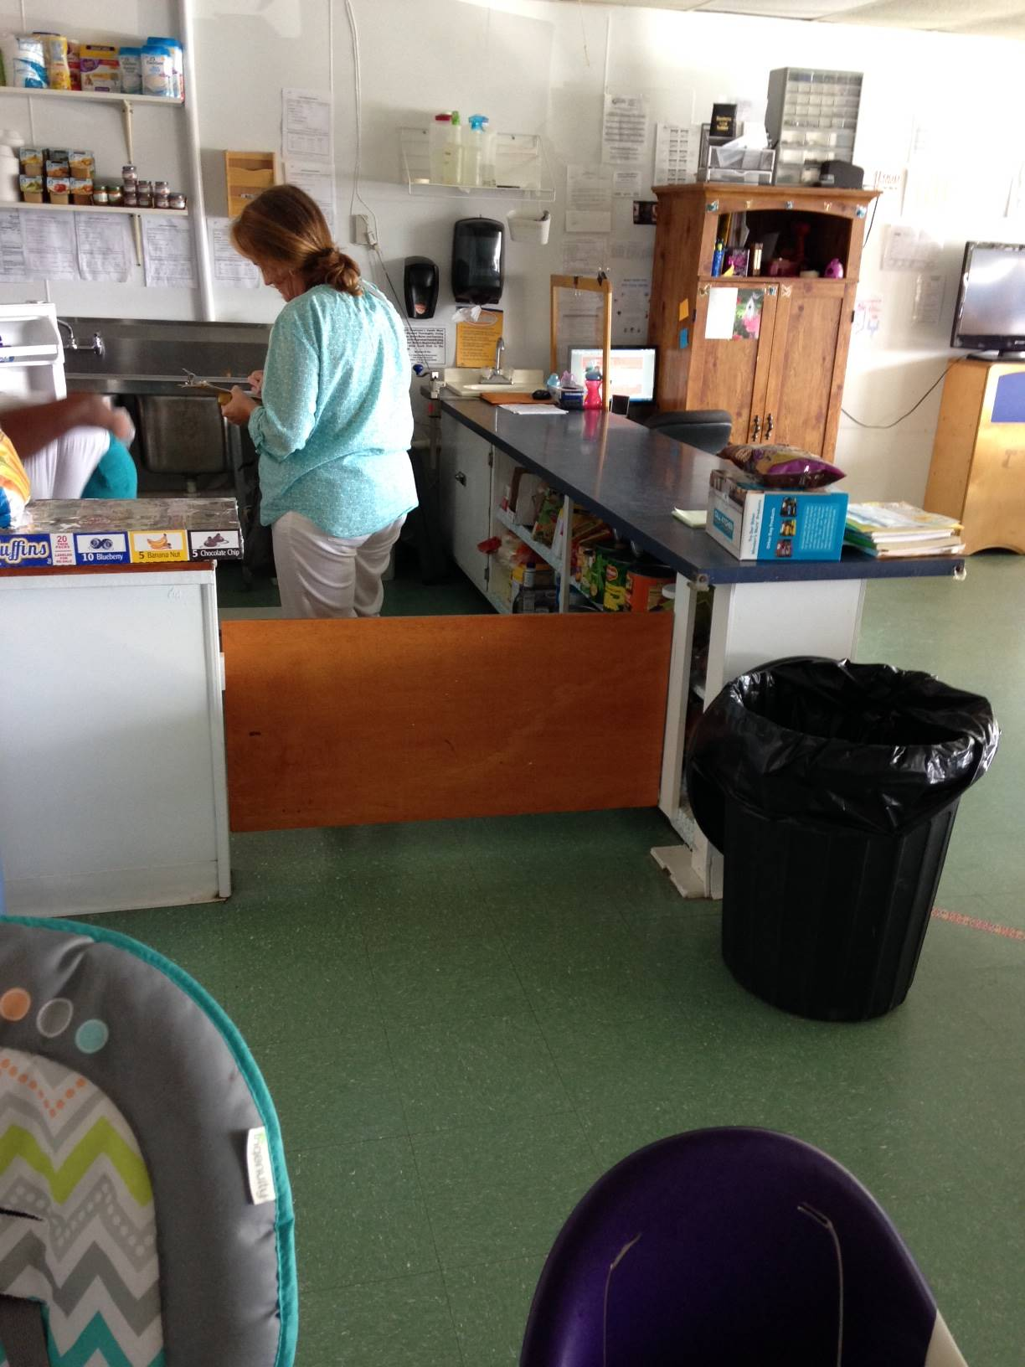
Kitchen Egress
One Solution:

Slide 18
Envir. Health Egress Questions
Question #1: Are Bolt Locks/Slide Bolt Locks approved to be used in a Child Care Center?
Answer : Section 1010.1.9.4 “Bolt locks” of the 2018 North Carolina Building Code prohibits use of these types of locks; see attached code section.

Slide 19
Bolt Locks
Manually operated bolt locks or surface bolts are not allowed (1010.1.9.4)

Slide 20
Envir. Health Egress Questions
Question #2: Does the Building Code require the kitchen to be locked?
Answer : No, the building code does not require kitchens to be locked nor does the building code allow egress through a kitchen Section 1016.2 (5), but it does require that if someone is located in a kitchen, they would have to be able to get out of the kitchen ; where most kitchens only require one means of egress (or one door to lead you to an exit).

Slide 21
Envir. Health Egress Questions
Answer (Cont.) : That door may be locked from the point of someone getting into the kitchen , but the person leaving the kitchen should be able to open the door with a single action as stated on Section 1010.9.5 “ Unlatching” nor should there be a key, special knowledge, or effort be required to open the door accordion to Section 1010.1.9 “Door operations” of the 2018 North Carolina Building Code.

Slide 22
Envir. Health Egress Questions
1016.2 Egress through intervening spaces. Egress through intervening spaces shall comply with this section.
  Exit access through an enclosed elevator lobby is permitted. Access to not less than one of the required exits shall be provided without travel through the enclosed elevator lobbies required by Section 3006. Where the path of exit access travel passes through an enclosed elevator lobby, the level of protection required for the enclosed elevator lobby is not required to be extended to the exit unless direct access to an exit is required by other sections of this code.
  Egress from a room or space shall not pass through adjoining or intervening rooms or areas, except where such adjoining rooms or areas and the area served are accessory to one or the other, are not a Group H occupancy and provide a discernible path of egress travel to an exit.

Slide 23
Envir. Health Egress Questions
1016.2 (Continued)
  Exception: Means of egress are not prohibited through adjoining or intervening rooms or spaces in a Group H, S or F occupancy where the adjoining or intervening rooms or spaces are the same or a lesser hazard occupancy group.
An exit access shall not pass through a room that can be locked to prevent egress.
Means of egress from dwelling units or sleeping areas shall not lead through other sleeping areas, toilet rooms or bathrooms.
Egress shall not pass-through kitchens, storage rooms, closets or spaces used for similar purposes.

Slide 24
Envir. Health Egress Questions
Question #3: What type of locks are approved to be used to lock the kitchen if the operator decides to lock the kitchen when it is not in use at the center? 15A NCAC 18A .2820 Storage (b) States, “All corrosive agents, pesticides, bleaches, detergents, cleansers, polishes, any product which is under pressure in an aerosol dispenser, and any substance which may be hazardous to a child if ingested, inhaled,

Slide 25
Envir. Health Egress Questions
Question #3 (Cont.): or handled shall be kept in its original container or in another labeled container, used according to the manufacturer's instructions and stored in a locked storage room or cabinet when not in use. Locked storage rooms and cabinets shall include those which are unlocked with a combination, electronic or magnetic device, key, or equivalent locking device.”

Slide 26
Envir. Health Egress Questions
Answer : The types of locks would be the type that can be open from the egress side by a single action without the need of key, special knowledge, or effort be required to open the door see Section 1010.1.9 through 1010.1.9.5.

Slide 27
Envir. Health Egress Questions
1010.1.9 Door operations. Except as specifically permitted by this section, egress doors shall be readily openable from the egress side without the use of a key or special knowledge or effort.
1010.1.9.1 Hardware. Door handles, pulls, latches, locks and other operating devices on doors required to be accessible by Chapter 11 shall not require tight grasping, tight pinching or twisting of the wrist to operate.
1010.1.9.2 Hardware height. Door handles, pulls, latches, locks and other operating devices shall be installed 34 inches (864 mm) minimum and 48 inches (1219 mm) maximum above the finished floor. Locks used only for security purposes and not used for normal operation are permitted at any height.

Slide 28
Envir. Health Egress Questions
1010.1.9.4 Bolt locks. Manually operated flush bolts or surface bolts are not permitted.
1010.1.9.5 Unlatching. The unlatching of any door or leaf shall not require more than one operation.
Exceptions:
Places of detention or restraint.
Where manually operated bolt locks are permitted by Section 1010.1.9.4.
Doors with automatic flush bolts as permitted by Section 1010.1.9.3, Item 3.
Doors from individual dwelling units and sleeping units of Group R occupancies as permitted by Section 1010.1.9.3, Item 4.

Slide 29
Envir. Health Egress Questions
Question #4: Can Rainwater or collected Rainwater be used in a Child Care Center?
Answer : 1)Rainwater is a nonpotable water as such rainwater is not safe for drinking, personal or culinary utilization.
  2) Untreated rainwater can only be used for outdoor irrigation, decorative foutains, yard hydrants, vehicle washing industrial processes (e.g., dust control, indoor bibs spray)

Slide 30
Envir. Health Egress Questions
Question #4 (continued): Can Rainwater or collected Rainwater be used in a Child Care Center?
Answer (continued): 3)Treated rainwater (disinfection and filtration) can only be used for toilet flushing, urinal flushing, evaporative cooling tower make-up, trap primers, fire suppression systems, clothes washers, outdoor pools and spas.

Slide 31
Envir. Health Egress Questions
Question #5: Are Air Fryers allowed to be used in a Child Care Center?
Answer : This one was a hard one, no this office does not have an opinion at this time on a non-fuel-burning appliance that is non vented and have not been tested by a third-party agency should as UL.
  I looked online at different types of Air Fryers and none of them had been tested (at minimal they should have been tested in accordance with UL 710B)

Slide 32
Envir. Health Egress Questions
Question #5 (continued): Are Air Fryers allowed to be used in a Child Care Center?
Answer (end): This appliance is designed for household use only. It may not be safe in environments such as staff kitchens, farms, motel and other non-residential environments (this caution comes from several air fryers manufactories owner’s manuals)

Slide 33
Envir. Health Egress Questions
Question #5 (continued): Are Air Fryers allowed to be used in a Child Care Center?
Answer (continued): As for the question; I would treat this Air Fryer just like a “fryer” it has the possibility of releasing vapors, hot steam and white smoke (which should be unplugged immediately).

Slide 34
Environmental Health Questions

Slide 35
Environmental Health Questions
Are there any new code updates as it relates to childcare and schools?
Answer : Yes, But the only building code change that affects some Family Child Care Homes does not come from the 2018 North Carolina Building Code. It comes from the North Carolina General Assembly Session Law 2025-36 House Bill 412, specifically sections 15c and 16c

Slide 36
Environmental Health Questions
Are there any new code updates as it relates to childcare and schools?
Answer (continued): There are five requirements within those sections, and they are as follows:
  (1) Rooms and areas within a family childcare home where occupants receive care shall be on the same level of exit discharge.
  (2) A family childcare home can increase their occupancy load

Slide 37
Environmental Health Questions
Are there any new code updates as it relates to childcare and schools?
Answer (continued): There are five requirements within those sections, and they are as follows:
  (3) Rooms and areas within a family childcare home where occupants receive care shall be located on the same level with, and within a maximum of 40 feet travel distance to, at least one 2A:10B:C fire extinguisher.

Slide 38
Environmental Health Questions
Are there any new code updates as it relates to childcare and schools?
Answer (continued): There are five requirements within those sections, and they are as follows:
  (4) A family childcare home shall have and maintain a Fire Safety, Evacuation, and Lockdown Plan compliant with Section 404 of the North Carolina Fire Code.

Slide 39
Environmental Health Questions
Are there any new code updates as it relates to childcare and schools?
Answer (End): There are five requirements within those sections, and they are as follows:
  (5) A family childcare home shall have carbon monoxide alarm and detection systems compliant with Section 915 of the North Carolina Building Code
  (6) A family childcare home shall have smoke alarms compliant with Section R907 of the North Carolina Building Code.

Slide 40

Environmental Health Questions
Question: Can latch doors in kitchens be used to keep children out?
Answer : Yes, you may use door hardware similar to the following:

Slide 41

Environmental Health Questions
Question: Can latch doors in kitchens be used to keep children out?
Answer (End) : Manually operated bolt locks or surface bolts are not allowed (1010.1.9.4)

Slide 42
Environmental Health Questions
Question: Please discuss air fryer usage in childcare. Can they be used?
Answer : Air Fryers are they domestic or commercial cooking?
{Under NCMC §917.2, appliances used where “domestic cooking operations occur” must be listed and labeled as household-type appliances.} Here are 4 questions to ask -

Slide 43
Environmental Health Questions
Question: Please discuss air fryer usage in childcare. Can they be used?
Answer (continued) :
Is this UL-listed as a household appliance?
Is it portable (plug-in, not hardwired)?
Is cooking volume limited (similar to residential use)?
Is it used occasionally vs. continuous production cooking?

Slide 44
Environmental Health Questions
Question: Please discuss air fryer usage in childcare. Can they be used?
Answer (continued) : Does it trigger a hood under §507?
Section 507 requires a Type I hood over appliances that produce grease or smoke.
What an Inspector Could Evaluate:
  1- Does the manufacturer list grease effluent output?

Slide 45
Environmental Health Questions
Question: Please discuss air fryer usage in childcare. Can they be used?
Answer (continued) :
What an Inspector Could Evaluate:
  2- Is the appliance producing visible grease-laden vapor?
  3- Is it used to fry large quantities daily?

Slide 46
Environmental Health Questions
Question: Please discuss air fryer usage in childcare. Can they be used?
Answer (continued) : Most electric air fryers:
  Are self-contained
  Produce minimal grease vapor externally
  Do not meet the threshold of “commercial cooking appliance”

Slide 47
Environmental Health Questions
Answer (continued) : If domestic classification applies → No commercial hood required.
However, if:
Used for high-volume daily meal prep
Producing grease-laden vapors consistently
Then the inspector could reclassify use as commercial → Type I hood may be required.

Slide 48
Environmental Health Questions
Answer (End) :
Electrical Requirements Air Fryers -
GFCI protection (if required by Electrical Code)
Dedicated circuit if manufacturer requires
No extension cords
Not placed under combustible cabinets unless listed for that clearance

Slide 49
Environmental Health Questions
Question: Please discuss portable sink usage in childcare. Are they still required to be permanently plumbed? Answer:
{Under the 2018 North Carolina Plumbing Code, portable sinks are generally not accepted as substitutes for required plumbing fixtures in commercial occupancies such as childcare centers. Required sinks must normally be permanently connected to an approved water supply and sanitary drainage system.}

Slide 50
Environmental Health Questions
Question: Are portable dishwashers allowed to be used in childcare centers?
This is a two-part question answer:
(A) Is it a commercial dishwasher?
If it is:
Large
Permanently installed
High-temperature sanitizing unit

Slide 51
Environmental Health Questions
Question: Are portable dishwashers allowed to be used in childcare centers?
Answer (continued) :
Then ventilation under §507.3 (Type II hood) may apply due to steam/moisture.
If it is:
A standard household portable dishwasher
Plug-in
Used for limited childcare mealware

Slide 52
Environmental Health Questions
Question: Are portable dishwashers allowed to be used in childcare centers?
Answer (End) : (B) Then it is treated as a domestic appliance, not a commercial kitchen device. Were Plumbing/Electrical (REQ.)
Proper air gap or approved drain connection
Backflow protection
GFCI protection
Proper water temperature capability (health code requirement, not mechanical code)

Slide 53
Environmental Health Questions
Question: Goerge Foreman Grills used in childcare. Are they considered frying if giving off grease laden vapors?
Answer: Section §917 Cooking Classification Key Determination:
Domestic classification if:
  UL-listed household appliance
  Portable
  Limited production cooking
  Similar to home meal prep
Then → Allowed without commercial listing.

Slide 54
Environmental Health Questions
Question: Are hood systems required for air fryers, george foreman grills, etc. either commercial or residential hoods?
Answer (Continued): Section 917 of the 2018 North Carolina Mechanical Code:
Domestic classification if:
  UL-listed household appliance
  Portable
  Limited production cooking
  Similar to home meal prep

Slide 55
Environmental Health Questions
Question: Are hood systems required for air fryers, george foreman grills, etc. either commercial or residential hoods?
Answer (End): Most childcare kitchens:
  Reheat food
  Prepare limited meals
  Operate more like residential kitchens than restaurants

Slide 56
Environmental Health Questions
Question: Are baby gates used to restrict access to kitchens and other rooms allowed?
Answer: Under the 2018 North Carolina Building Code Council adopted North Carolina State Building Code (2018 Building Code), baby gates are not specifically prohibited, but they cannot block or restrict the required means of egress from a room or space in a commercial childcare center.

Slide 57
Environmental Health Questions
Question: Are baby gates used to restrict access to kitchens and other rooms allowed?
Answer (Continued): Some North Carolina plan reviews Allow the Following:
  Gates across kitchen openings → sometimes allowed.
  Gates across classroom exit doors → not allowed.
  Gates in hallways or exit paths → not allowed.
  {Remember Gates shouldn't Delay or Trap children in a room}

Slide 58
Environmental Health Questions
Question: Can playground gates and fences be locked with chains in less safe neighborhoods? Is it permitted after hours?
Answer: During operating hours (children present)
Chains and locks on playground gates are generally not permitted if the gate is part of a required exit or egress path.
No key, tool, or special knowledge can be required to open them.

Slide 59
Environmental Health Questions
Question: Can playground gates and fences be locked with chains in less safe neighborhoods? Is it permitted after hours?
Answer (Continued):
Egress must remain unobstructed at all times the building is occupied.
If the playground is part of the required exit discharge area for classrooms, then:
  ❌ Not allowed
After hours (when the facility is closed)

Slide 60
Environmental Health Questions
Question: Can playground gates and fences be locked with chains in less safe neighborhoods? Is it permitted after hours?
Answer (Continued): After hours (when the facility is closed)
Yes — gates and fences may be chained and locked after hours if:
  The building and playground are not occupied, and.
  The locks are removed or unlocked before the center reopens.

Slide 61
Environmental Health Questions
Answer (End): After hours (when the facility is closed)
✅ Summary
Situation | Chains / Padlocks on Playground Gates
During operating hours | ❌ Not permitted if gate is part of required egress
During operating hours (non-egress gate) | ⚠️ Usually discouraged and may be rejected
After hours (facility closed) | ✅ Permitted

Slide 62
Environmental Health Questions
Question: Refrigerators plugged into classrooms for childcare and schools were observed plugged into surge protectors and extension cords. We were told that they had to be plugged directly into the wall. Is this accurate?
Answer: Under the 2018 NC Building Code, 2018 NC Fire Prevention Code, and 2018 NC Electrical Code (Article 400.8) , the combined effect of the rules is:

Slide 63
Environmental Health Questions
Answer (Continued-End):
Refrigerators — including portable ones — must be plugged directly into a wall outlet
  They cannot be connected to:
    ❌ Extension cords
    ❌ Surge protectors
    ❌ Power strips
    ❌ Daisy‑chained cords or taps
This is because they are not portable appliances and require permanent wiring and a dedicated receptacle.

Slide 64
Environmental Health Questions
Question: Can you discuss what determines if a hand sink is outside of the restroom versus inside the bathroom? What are the # of hand sinks and location based on as it relates to the number of toilets/occupants?
Answer: This is a design preference between the designer and the owner, and it is permitted as long as it meets the parameters outlined in Chapter 4 of the 2018 North Carolina Plumbing Code.

Slide 65
Environmental Health Questions
Question: Discuss diaper changing table locations that may block egress leading to an outside door in classrooms. Is there a minimum footage requirement to not block that door?
Answer: No — the 2018 North Carolina Building Code does not specify a minimum footage requirement for how far a diaper‑changing table must be from an egress door.

Slide 66
Environmental Health Questions
Answer (Continued): Because the code does not give a specific measurement, inspectors evaluate the setup using these criteria:
✔ Allowed if:
  The changing table does not reduce the required egress width (typically 36 inches).
  It does not block the door swing.
  It does not obstruct the path to the exit discharge.
  It does not create a pinch point or bottleneck.

Slide 67
Environmental Health Questions
Answer (Continued): Because the code does not give a specific measurement, inspectors evaluate the setup using these criteria:
❌ Not allowed if :
  The table narrows the egress path below the required width.
  The table blocks or partially blocks the door.
  The table creates a situation where children or staff cannot exit freely.
Maintain at least 36 inches of clear, unobstructed egress width from the door and along the exit path.

Slide 68
Environmental Health Questions
Question: Rain barrels: what can that water be used for if collected at childcare? Is that considered gray water?
Answer: This question was answered earlier.

Slide 69
Environmental Health Questions
Question: Can all windows be permanently sealed in a center? If so, how?
Answer: No — you generally cannot permanently seal all windows in a commercial childcare facility unless the building meets specific mechanical ventilation and emergency‑egress requirements. The NC Building Code does not require operable windows, but it does require:

Slide 70
Environmental Health Questions
Answer (Continued):
  Code‑compliant mechanical ventilation, and
  Emergency escape and rescue openings (EEROs) if required by occupancy classification and room use.
If any room requires an EERO, that window cannot be permanently sealed
Operable windows are NOT required if mechanical ventilation is provided
  Mechanical ventilation meets ASHRAE 62.1 requirements, and
  The HVAC system provides required outdoor air.

Slide 71
Environmental Health Questions
Answer (Continued):
  Code‑compliant mechanical ventilation, and
  Emergency escape and rescue openings (EEROs) if required by occupancy classification and room use.
If any room requires an EERO, that window cannot be permanently sealed
Emergency Escape and Rescue Openings (EEROs)
  Most childcare facilities cannot seal every window unless the building is fully sprinklered and designed without EEROs

Slide 72
Environmental Health Questions
Answer (End): You may permanently seal all windows only if, all of the following are true:
The building has a fully compliant mechanical ventilation system
No room requires an emergency escape and rescue opening
The building’s fire protection features (sprinklers, alarms) meet NCBC requirements
The local code official approves the design

Slide 73
Environmental Health Questions
Question: Are there any HVAC restriction access to children based on code?
Answer: Neither the 2018 NC Building Code nor the 2018 NC Mechanical Code contains a section that explicitly states “HVAC equipment must be restricted from child access in commercial childcare facilities.

Slide 74
Environmental Health Questions
Question: Are there any HVAC restriction access to children based on code?
Answer (Continued): However, childcare facilities must comply with general mechanical‑equipment protection rules, which effectively require that HVAC equipment not be accessible to children if it poses a hazard. This is enforced through placement, guarding, and compliance with NC Child Care Rules, which adopt the NC Building Code.

Slide 75
Environmental Health Questions
Answer (Continued): For a commercial childcare facility in North Carolina.
HVAC equipment must NOT be accessible to children if it:
  Has hot surfaces (e.g., heat pumps, condensing units)
  Has moving parts (fans, belts)
  Contains electrical hazards
  Could be climbed on
  Could be tampered with

Slide 76
Environmental Health Questions
Answer (End): Acceptable compliance methods:
  Locked mechanical rooms
  Roof‑mounted units
  Locked cages around outdoor units
  Fencing that meets NCBC requirements
  Indoor units placed above reach and behind secured panels
Building Inspectors will normally fail a facility if children can touch, climb, or tamper with HVAC equipment.

Slide 77

Questions?
How to reach me for answers to further questions:
  PHONE 919-647-0015
  FAX 919-715-0067
  E-MAIL mark.bailey@ncdoi.gov
On the e-mail, please include:
  your name,
  firm or jurisdiction, and
  phone number

