Slide 1
Diapering & Diaper Changing Facilities
Ashley Mize, REHS
Regional Specialist
Environmental Health Section
Children’s Environmental Health Program
2026

Slide 2

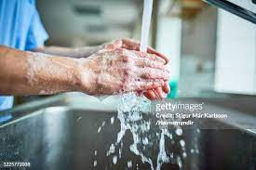
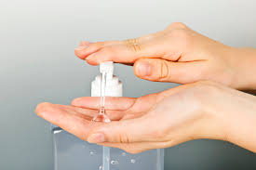
Handwashing .2803
Lists times & places handwashing must take place for children(a) and childcare employees(c).
Describes handwashing procedures(e).
Describes proper use of hand antiseptic products.(b)
(d)Except when the action that necessitates handwashing is diapering and before eating meals or snacks, hand antiseptics may be used in lieu of handwashing while a child is outdoors, provided that the child's hands are washed when the child returns indoors.

Slide 3
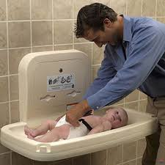
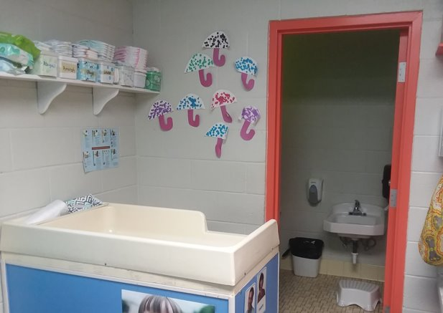
Diapering and Diaper Changing Facilities .2819(a)
Each diaper changing station shall INCLUDE a handwashing lavatory.
Exception - In or next to diaper changing area
Centers licensed for fewer than 13 children and located in a residence.
Diaper changing areas designated for school age children.

Slide 4
Diapering .2819(b)
Diapering surfaces shall be smooth, intact, nonabsorbent, easily cleanable and approved by the department.
Nothing shall be placed on the diapering surface except for those items required for diapering and the child whose diaper will be changed.

Slide 5
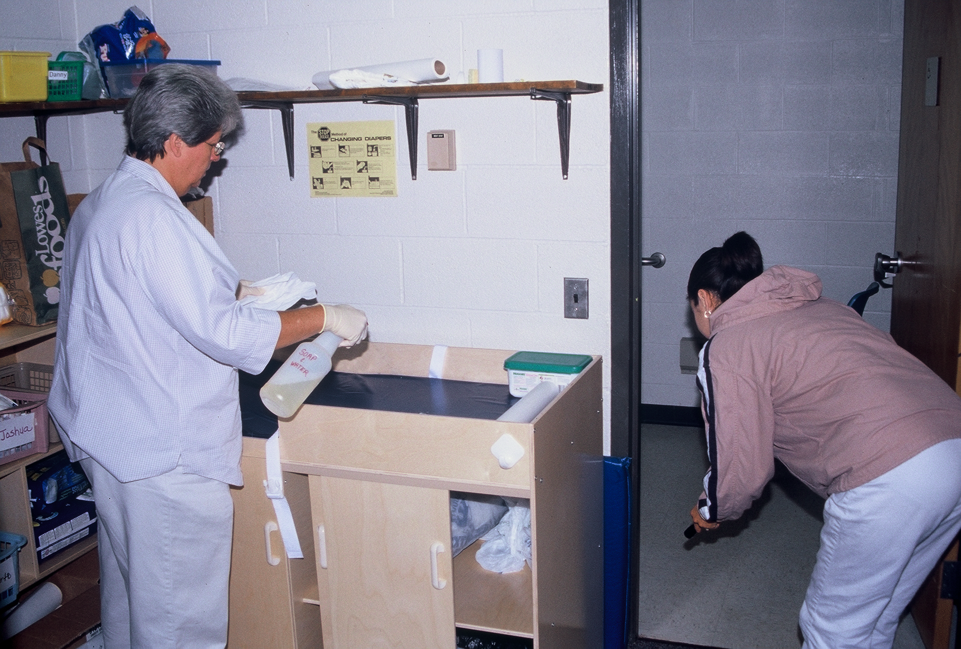
Diapering
(c) Diapering surfaces shall be disinfected using an approved disinfectant. Approved disinfectants and detergent solution shall be kept in separate and labeled bottles at each diaper changing station. Approved disinfectants that are chlorine disinfecting solutions shall be stored in hand pump spray bottles. No cloths or sponges shall be used on diapering surfaces.
Notes:
This is a picture of a center licensed designed for school are children, therefore it meets the exception..

Slide 6
Approved Disinfectant defined… [2]
A chlorine solution containing 500 to 800 parts per million (ppm) of chlorine or a disinfectant as defined at 40 C.F.R. 158.2203 that is registered with the United States Environmental Protection Agency (EPA) in accordance with 40 C.F.R. 152 with use indicated in schools and child care settings and that is prepared and maintained in accordance with Rule .2812(i) of this Section.

Slide 7
Approved Disinfectant
.2812(i)
(i) An approved disinfectant shall be provided for cleaning purposes. Throughout this Section, when an approved disinfectant is used in a childcare center, …
  1. the manufacturer's Safety Data Sheets for the disinfectant product shall be kept on file at the child care center …
  2. and the instructions for use of the disinfectant product shall be followed.
When a chlorine solution is prepared by a child care center employee for use as an approved disinfectant, then …
  1. the solution shall be prepared for use within 24 hours and...
  2. a testing method shall be used to ensure compliance with the prescribed chlorine concentration.
  3. To achieve the maximum germ reduction with a chlorine disinfecting solution, the surface being disinfected shall be made wet with the chlorine disinfecting solution and allowed to air dry or be dried only after the surface has been in contact with the chlorine disinfecting solution for a minimum of two minutes.

Slide 8
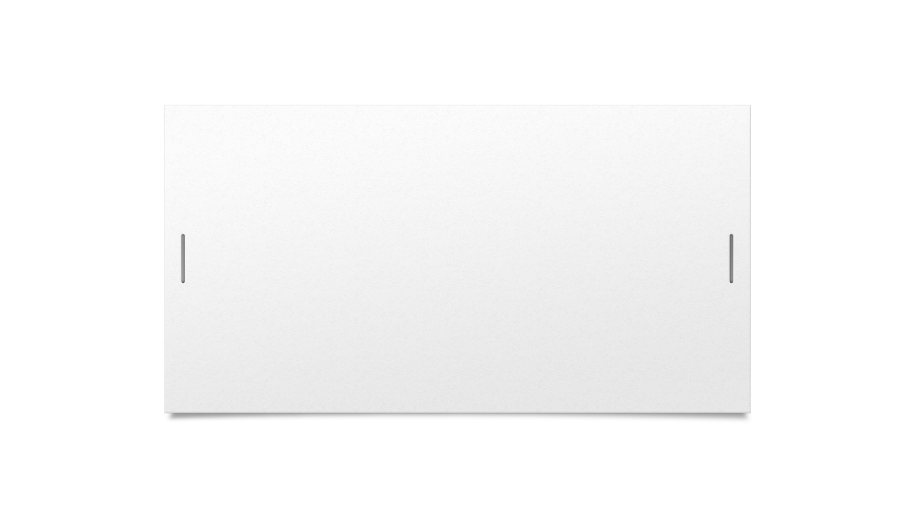


I know I have mixed my chlorine disinfectant correctly,
What went wrong ???!!!

Slide 9
Application | Bleach Per Gallon Of Water | Bleach Per Quart of Water | Bleach (Free Chlorine Concentration) | Recommended Labeling
 |  | 5.25% Sodium Hypochlorite
Disinfecting Strength | ¼ Cup | 1 Tablespoon | 500 – 800 ppm | Disinfectant
Sanitizing Strength | 1 tablespoon | ¾ Teaspoon | 50 – 200 ppm | Sanitizer
 |  | 6.00% Sodium Hypochlorite
Disinfecting Strength | 3 ½ Tablespoons | 2 ½ Teaspoons | 500 – 800 ppm | Disinfectant
Sanitizing Strength | 2 ½ Teaspoons | ½ Teaspoon | 50 – 200 ppm | Sanitizer
 |  | 8.25% Sodium Hypochlorite
Disinfecting Strength | 2 ½ Tablespoon | 2 Teaspoon | 500 – 800 ppm | Disinfectant
Sanitizing Strength | 2 Teaspoon | ½ Teaspoon | 50 – 200 ppm | Sanitizer

Slide 10


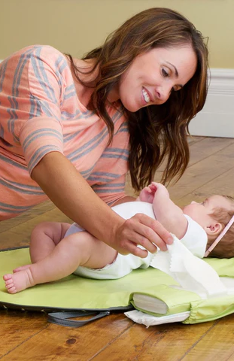


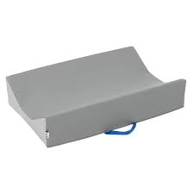
(c) If diapering is performed on the floor in a toilet room, then a smooth, intact, nonabsorbent barrier that is clean and in good repair shall be placed on the floor to minimize cross-contamination.
.2819(c)
Store barrier in a manner where a child can not have contact.
Examples are diapering mats or nonabsorbent medical grade paper liner.

Slide 11
Diapering .2819(d)
Diapering Procedures Demonstration
https://youtu.be/xdZ1pgEW5Wc?t=3

Slide 12
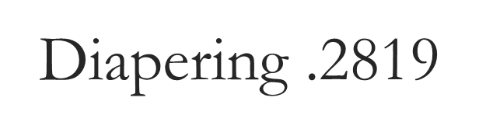
(e) Vinyl or latex disposable gloves shall be used by childcare center employees during the diaper changing process if the employee's hands have cuts, sores, or chapped skin.
(g) Receptacles containing soiled disposable diapers shall be emptied in a garbage area located outside the childcare center building daily.
(h)Proper methods for diaper changing and handwashing shall be posted in the diaper changing area.

Slide 13
SUMMARY:
Cleaning and Disinfecting with an approved disinfectant
Lavatories must be cleaned and disinfected with each change of use, as needed and at least daily.
Toilet fixtures shall be cleaned and disinfected at least daily and when visibly soiled.
Diapering surfaces shall be cleaned and disinfected after each use.

Slide 14
A Virtual
Mini Inspection
What issues do you see at these diaper changing stations?

Slide 15
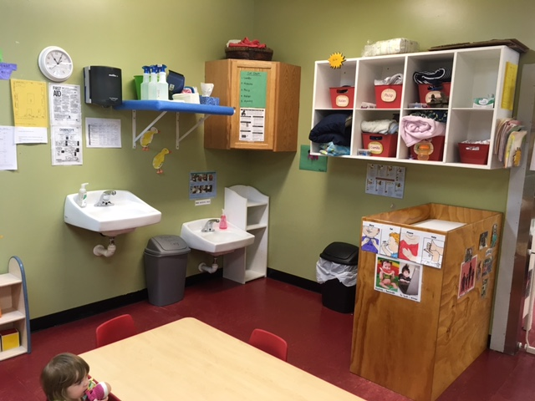

Slide 16
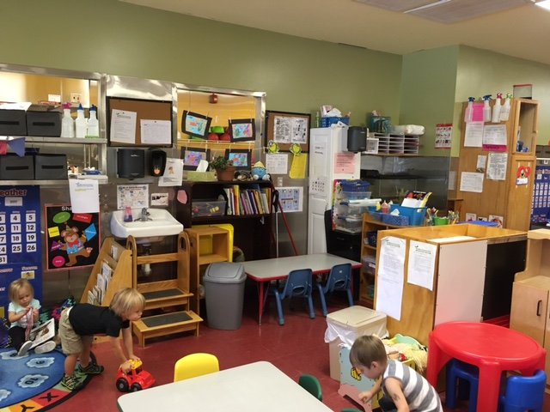

Slide 17
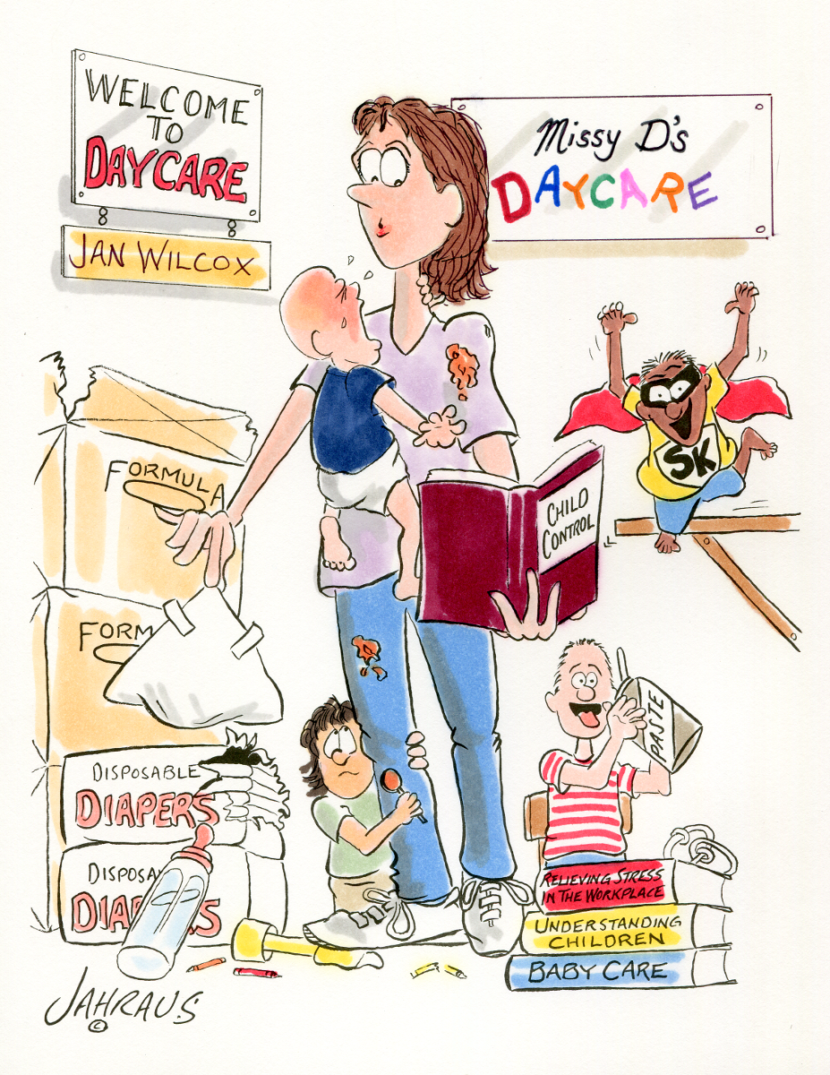

Thank you!

