Slide 1
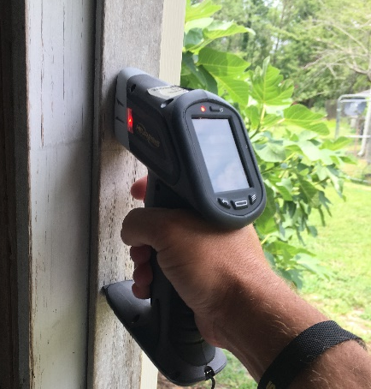

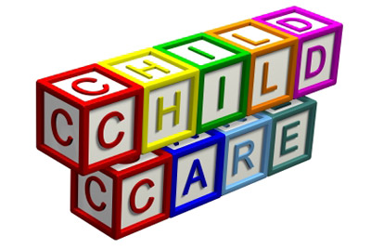
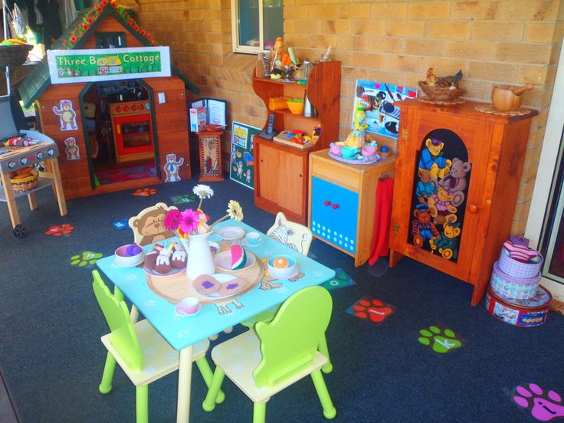
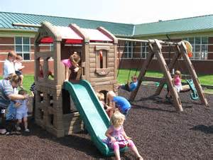
Emerging Issues
Child Care Sanitation SOP
March 11, 2026
Children’s
Environmental Health 2026

Slide 2
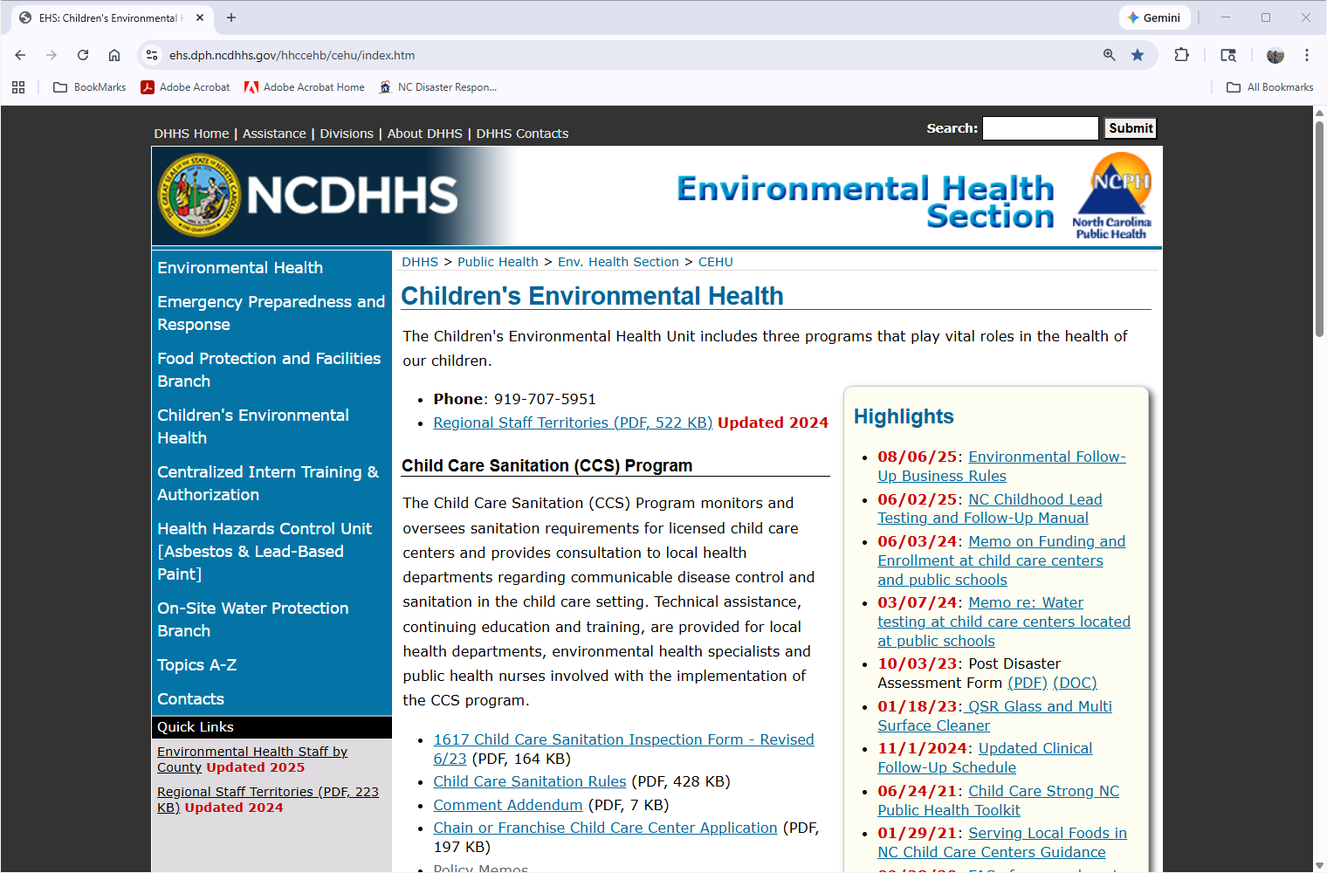

Slide 3
Children’s Environmental Health Program
Environmental Health Staff Regions
Barrette Gregory
(336) 202-0093
Ashley Mize
(336) 942-4441
Tonya Zimmerman
(704) 793-3057
Brittany Stevenson
(252) 908-0267
ASHE
ALLEG
SURRY
STOKE
CASWE
NORTH
GATES
CURRI
05
03
86
85
ROCKI
17
PERSO
VANCE
WARRE
HALIF
66
HERTF
37
PASQU
27
Carissa Moore
(828) 417-4629
WATAU
WILKE
79
73
GRANV
91
93
46
70
CAMDE
95
97
YADKI
FORSY
ORANG
39
42
PERQU
15
MITCH
AVERY
99
GUILF
68
FRANK
BERTI
CHOWA
72
61
06
34
41
ALAMA
DURHA
35
NASH
08
21
MADIS
YANCE
CALDW
ALEXA
DAVIE
01
32
64
EDGEC
MARTI
TYRRE
57
00
14
02
IREDE
30
DAVID
33
58
WASHI
89
BURKE
CATAW
49
29
RANDO
CHATH
WAKE
WILSO
94
DARE
HAYWO
BUNCO
MCDOW
12
18
ROWAN
76
19
92
98
PITT
28
SWAIN
44
11
59
LINCO
80
LEE
JOHNS
GREEN
74
BEAUF
GRAHA
87
JACKS
HENDE
RUTHE
55
CABAR
MONTG
53
HARNE
51
40
07
HYDE
38
MACON
50
45
POLK
81
GASTO
13
STANL
62
MOORE
43
WAYNE
48
CHERO
CLAY
56
TRANS
75
CLEVE
36
MECKL
84
63
96
LENOI
CRAVE
PAMLI
20
22
88
23
60
RICHM
54
JONES
25
69
Alan Huneycutt
(704) 618-0138
UNION
ANSON
77
HOKE
CUMBE
SAMPS
52
CARTE
90
04
47
26
82
DUPLI
16
SCOTL
31
Nykesse Roberts
(704) 560-8117
83
BLADE
ONSLO
ROBES
09
67
78
PENDE
71
Megan Lee
(252) 665-1828
David Brown (919) 218-5460 (Chatham, Orange, Durham, Lee)
Brenda Bass (984) 239-7383
COLUM
NEW H
24
65
BRUNS
10
Kimly Blount (252) 903-7925 (Edgecombe, Wake)
Robert (Rob) Pearsall
(910) 624-1835
Effective: 02/01/25

Slide 4


Child Care Sanitation
.2800 Rules
*New Policy Memos
*Child Care FAQs & Rule Interpretations
*CDI & General Comment Concerns
*Provisional Classification Requirements
*Kitchen Chemical Storage for Cafeterias
*Hot Water Accessibility
*

Slide 5
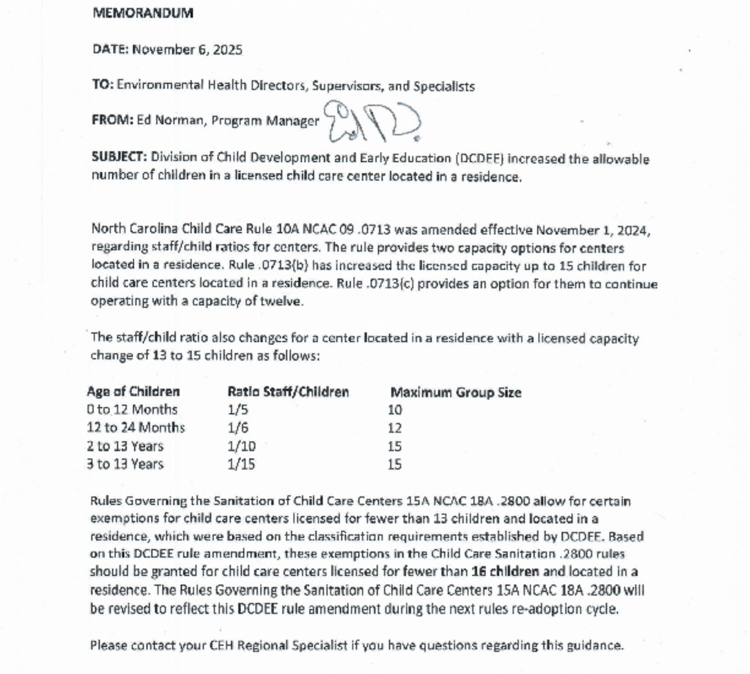

Slide 6
Child Care Center Located in a Residence
*Current sanitation Rules allows certain exemptions in the .2800 rules for child care centers licensed for fewer than 13 and located in a residence. This was based on classification requirement by DCDEE.
*DCDEE increased the number of allowable children from 13 to 15 children for child care centers located in a residence.
*Therefore, by policy we have increased the capacity number from 13, to fewer than 16 and located in a residence in the sanitation rules.
*Permanent change will occur during rule re-adoption.
*resolution

Slide 7
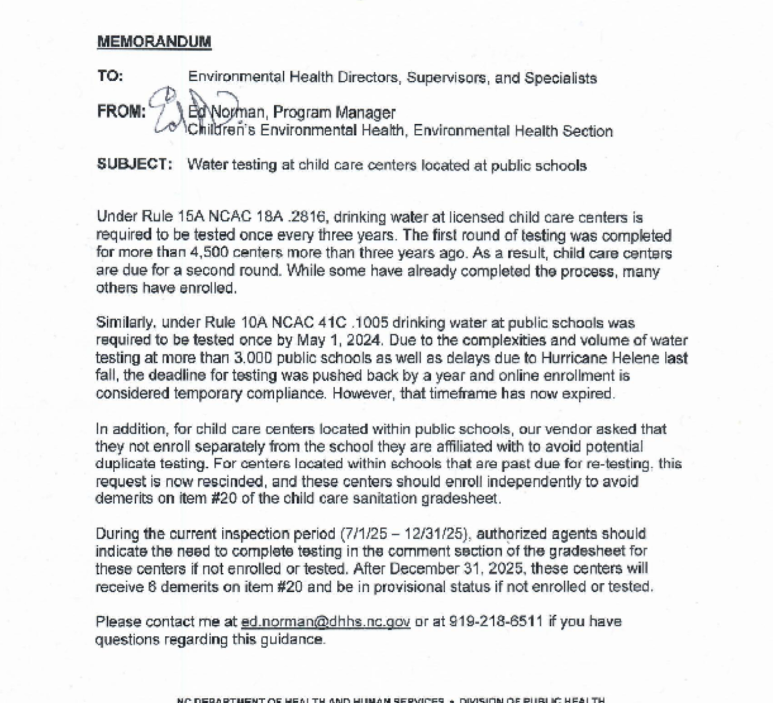
Water Testing Child Care Center Located in a School

Slide 8
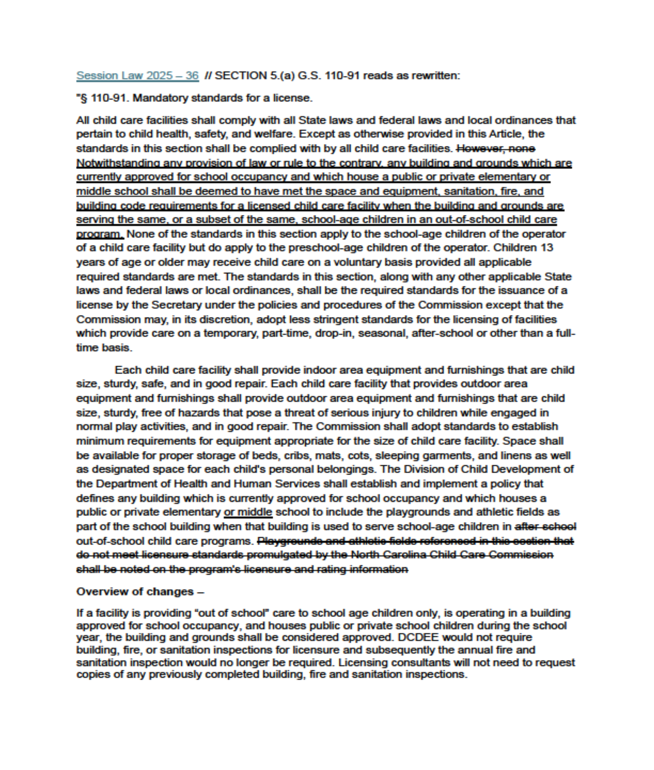
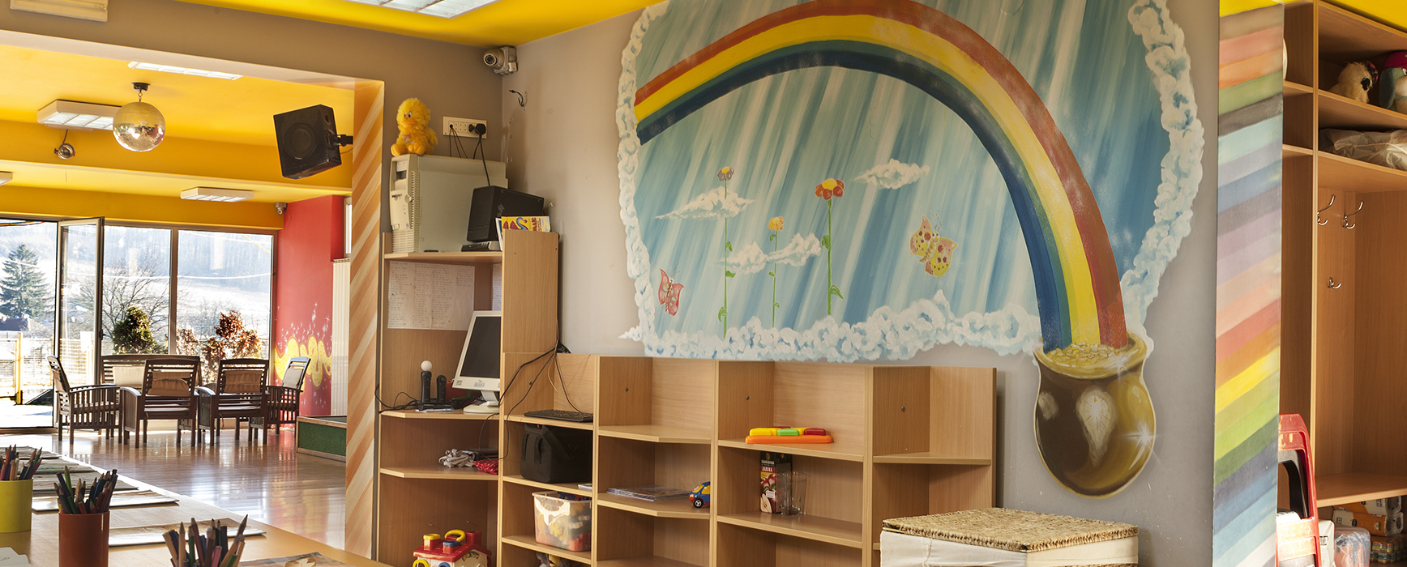
Facilities
No Longer Requiring a Sanitation Inspection
*Locations should be coded as a hard close

Slide 9
Child Care Sanitation
.2800 Rule
FAQs

Slide 10
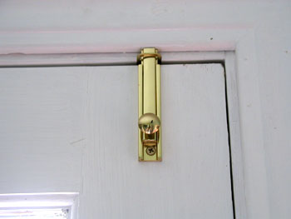
Are Bolt Locks/Slide Bolt Locks approved to be used in a Child Care Center?
Answer : Section 1010.1.9.4 “Bolt locks” of the North Carolina Building Code prohibits use of these types of locks
Manually operated bolt locks or surface bolts are not allowed
Do we mark this on a sanitization inspection: No
Recommended Action: Comment on the addendum that these type locks are being used and inform DCDEE immediately. Encourage the operator to reach out to their building code inspector for guidance.

Slide 11
CHILD CARE FAQs
Question: Are Air Fryers allowed to be used in a Child Care Center?
Answer: All commercial factory-built appliances should be tested, listed and labeled; at this time, DOI can not recommend the use of these unlisted/untested or unlabeled Air Fryers in a commercial kitchen.

Slide 12
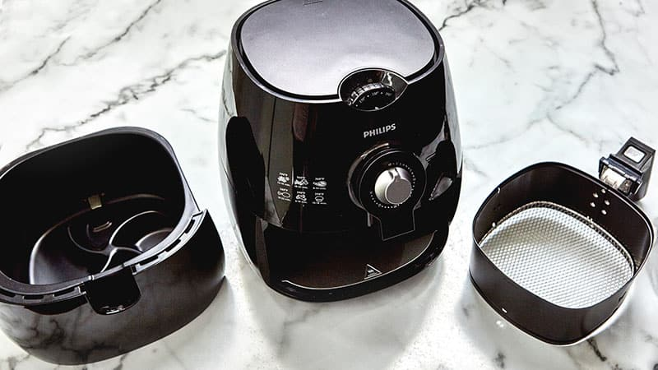
Are air fryers approved for child care use?
According to the Department of Insurance the answer is NO
2810 (e) A commercial hood shall be installed in accordance with G.S. 110-91 when frying is used for food preparation on-site at the child care center.
Guidance: Treat an Air Fryer just like a “fryer” it has the possibility of releasing vapors, hot steam and white smoke.

Slide 13
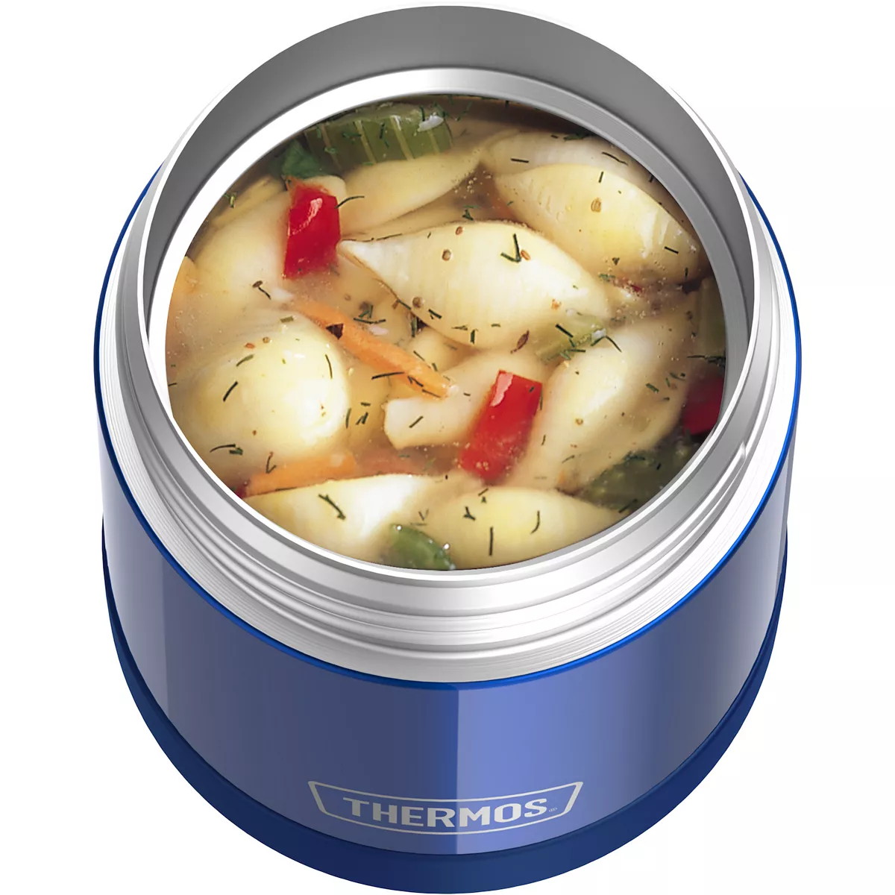
.2804 Food Supplies (k)
Lunches from Home
Rule allows: Hot foods that a child brings from home to the child care center in double-walled, insulated thermos containers may be stored outside of refrigeration at the child care center with the written permission of the child's parent or guardian.

Slide 14
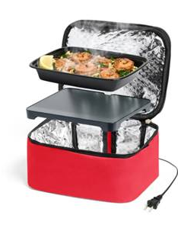
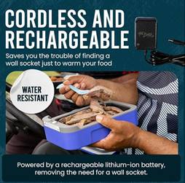
Question: Can this new technology be used in lieu of the double walled insulated thermos containers and meet requirement of the rule? NO
This rule refers only to hot foods brought from home in double walled insulated containers. However, the product was reviewed independently of the rule to see if it could be used.
Reviewed by Dept of Insurance
Battery operated (No)
Electric plug in (conditional approval: plug directly into an outlet)
Reviewed by Children’s Env Health
Acts more as an oven/cooking device versus a lunchbox
Major burn hazard concern if served directly to children from the device
Cannot be plugged in classrooms
.2804(k) Hot foods that a child brings from home to the child care center in double-walled, insulated thermos containers may be stored outside of refrigeration at the child care center with the written permission of the child's parent or guardian.

Slide 15
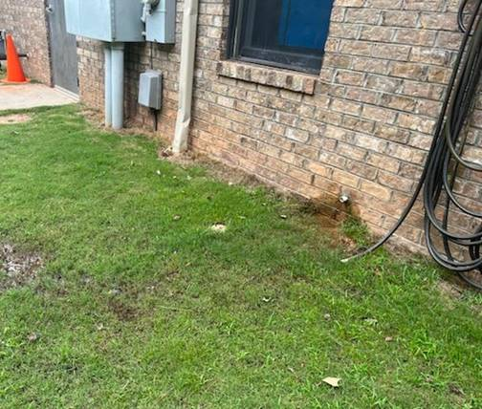
HVAC Condensation Discharge
Reminder: HVAC Discharge
Concern that children were drinking/playing in water from condensation lines being discharged on play areas.
Determined that condensation lines from HVAC equipment is considered utility equipment.
2832(a) Wells, grease traps, cisterns and utility equipment shall be made inaccessible to children.
Work with centers to bring them in compliance.

Slide 16
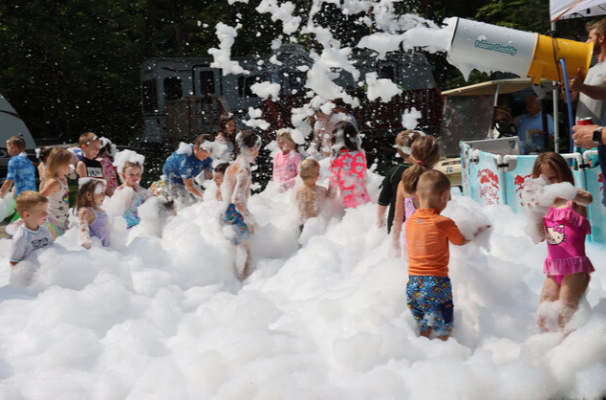
FOAM PARTIES AT CHILD CARE CENTERS?
Variables To Consider
Outdoor Setting
Supervision
Age Restrictions
non-potty-trained kids
Soap- eye irritation
Clean up
Guidance: Refer to DCDEE for approval and other restrictions

Slide 17
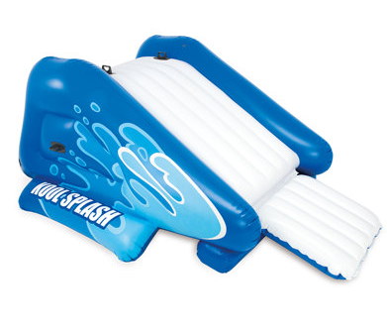
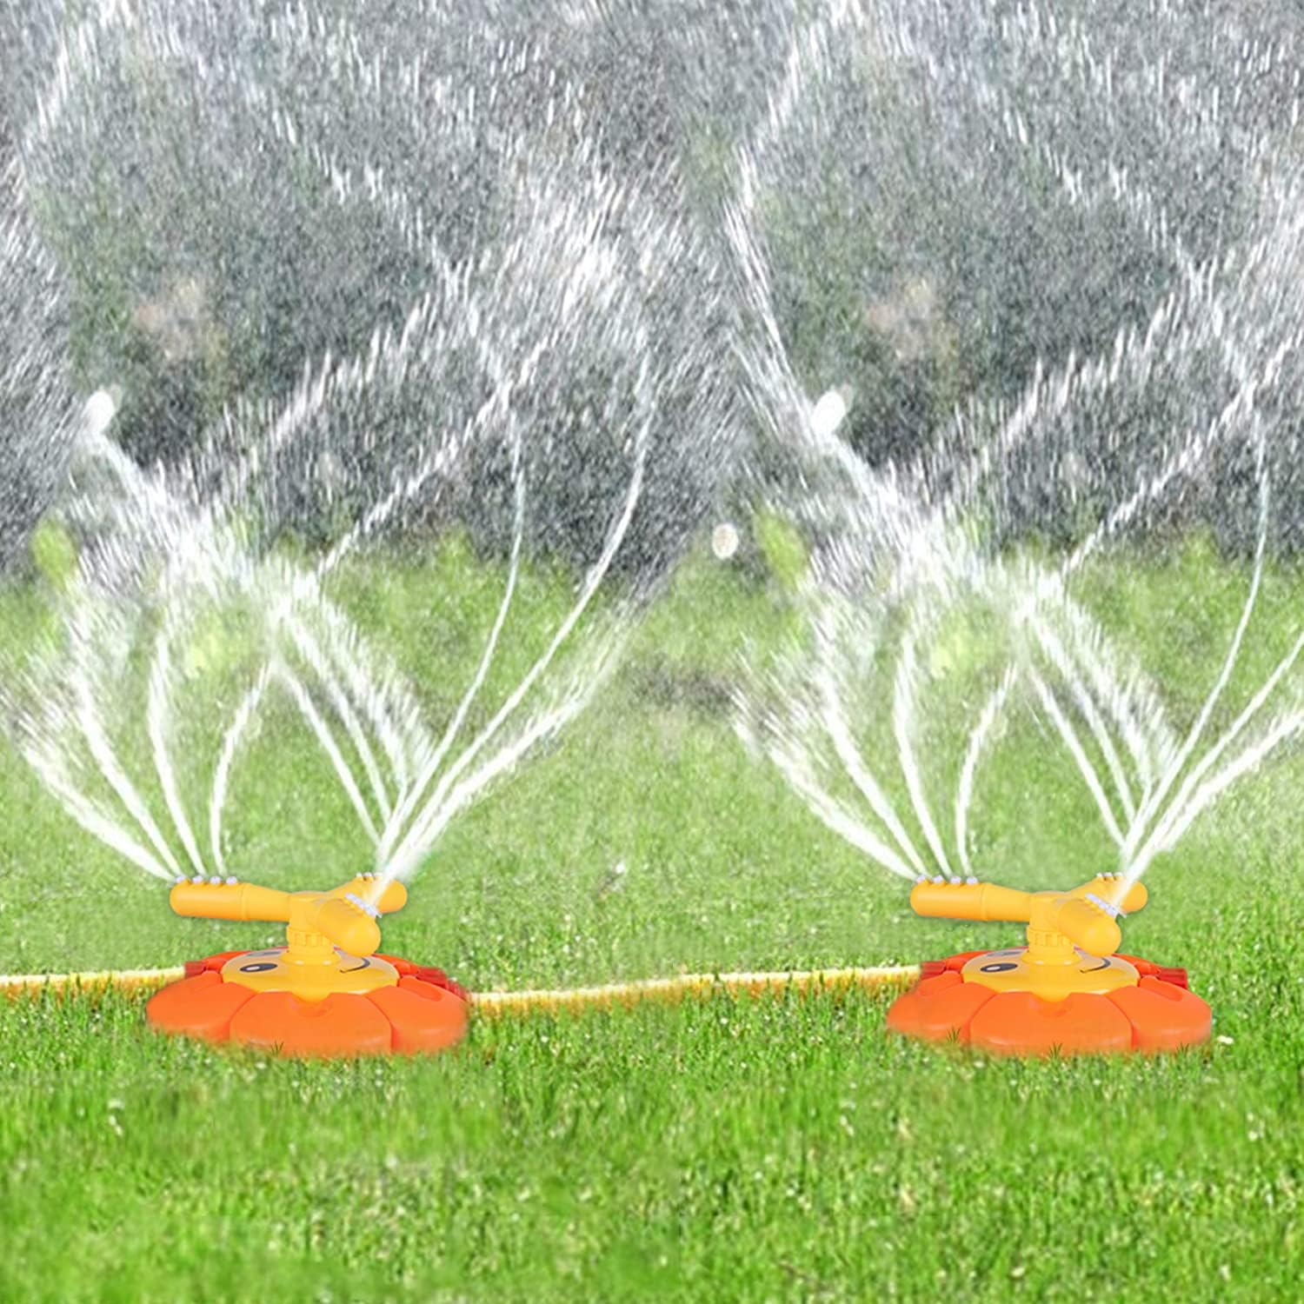
WATER SLIDES And SPRINKLERS AT CHILD CARE CENTERS?
15A NCAC 18A .2833 SWIMMING AND WADING POOLS (a) At child care centers, swimming and wading pools shall be designed, constructed, operated, and maintained in accordance with the rules in Section .2500 of this Subchapter. (b) Portable wading pools, natural bodies of water, and unfiltered water that is not potable shall not be utilized for children's recreation activities.
Any artificial body of water, such as a portable wading pool, when used for the public, such as when used at a licensed childcare center, would constitute a public pool. All public pools:
Require a permit - NCGS 130A-281; and
For the protection of the public health, must be equipped with a water circulation, filtration, and disinfection system. .2515
If activities such as slip and slides and sprinklers do not involve the impounding of water and allow the potable water to flow to waste such that the water is not pooled or recirculated, those activities would not meet the definition of a public pool and as such would be exempt from the requirements of the .2500 rules.
Further Guidance: Refer facility to DCDEE for other approvals and other restrictions.

Slide 18

It’s that time of year again!!
Can a childcare center hatch chicks in an incubator for a learning activity?
Yes!
As long as the chickens stay in the incubator that is being kept cleaned and the activity is supervised.2831 (a). Children are not to handle the chickens and they must be removed from the center once they hatch.

Slide 19
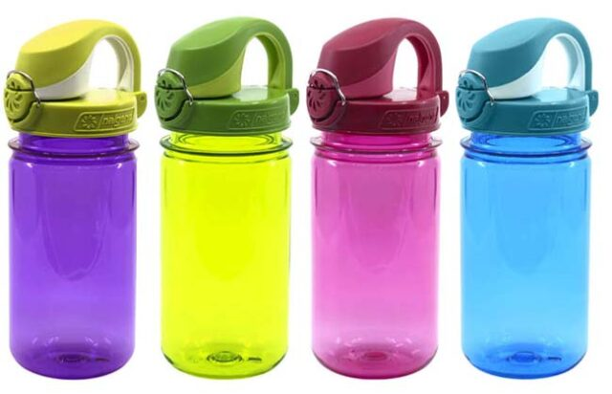
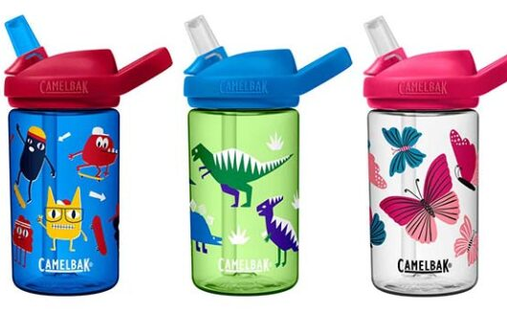
WHEN IS WATER, WATER?
Rule 2804(i) states: A water bottle that a child brings to the child care center from home and that is used only for water consumption by that child shall be exempt from the requirements of Paragraph (h) of this Rule. Instead, the water bottle shall be labeled with the name of the child to whom the water bottle belongs, individually stored in the child's cubby, and sent home with the child at the end of the day
Question: Does this include flavored water also?
Answer: No Flavored drinks are to be treated as “other beverages” brought from home and shall comply with paragraph (h) of 2810.

Slide 20
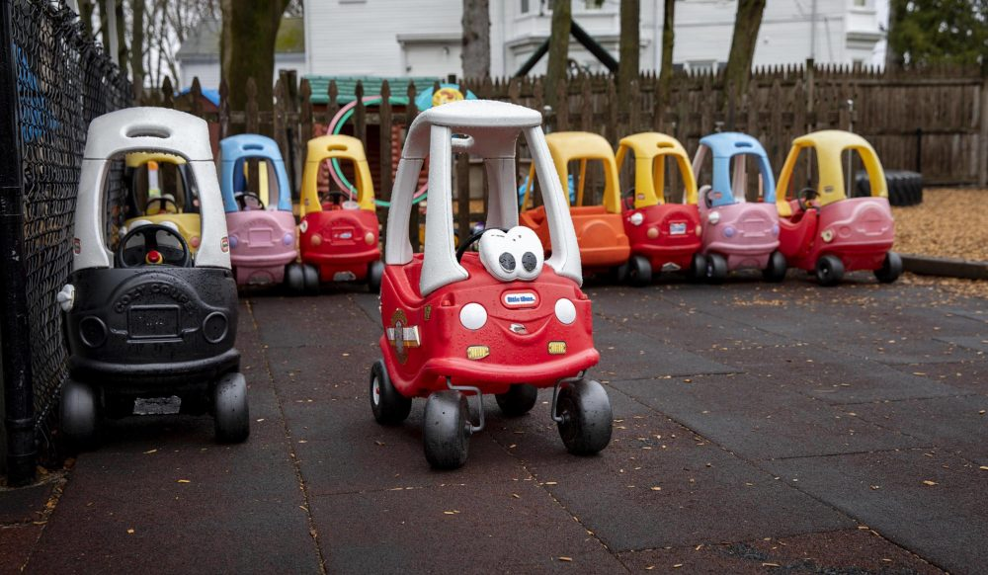
Child Care Continuing Issues 2025

Slide 21
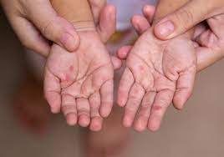
.2819 DIAPERING AND DIAPER CHANGING FACILITIES
Previous Rule: Childcare center employees shall change a child's diaper as follows:
(5) wiping hands with a disposable towelette or moistened paper towel.
*Previous rule did not indicate whose hands had to be wiped. Revised rule states that both the employee and child’s hands must be wiped in step 5.
Revised Rule: Childcare center employees shall change a child's diaper as follows:
(5) wiping the childcare center employee's hands and the child's hands each with a separate disposable towelette or moistened paper towel;

Slide 22
Chemical Storage
Locked Bathrooms
A locked bathroom door does not meet the requirement for chemical storage of hazardous products.
A locked employee’s restroom does not meet the requirement for chemical storage of hazardous products.

Slide 23
Chemical Storage Child Care
Offices/Foyers/Entrances/Sick Areas
Open office doors
Space in Open Foyer
Entrances including desk areas
Office space used as sick area
Must meet the requirement for chemical storage of hazardous products
There is a reluctancy by EHS to inspect these areas
However, chemicals are often improperly stored in these areas

Slide 24
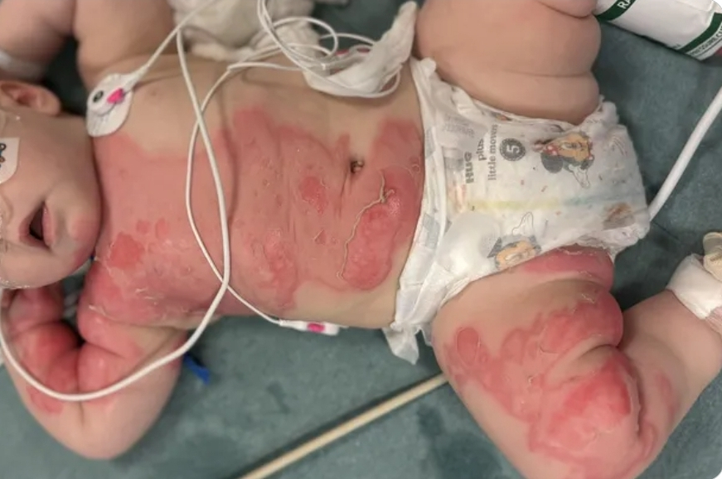
Child needed multiple surgeries to repair her burned skin after a bottle warmer fell on top of her while she was at daycare
The victim suffered third degree burns that covered 20 percent of her body

Slide 25

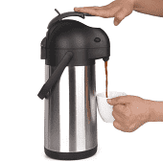
Hot Water Accessibility Issue
Water in areas accessible to children shall be tempered between 80°F (27°C) and 110°F (43°C). For handwash lavatories used exclusively by school-age children, the 80°F (27°C) minimum temperature requirement shall not apply. Hot water in an area accessible to any child, which is in excess of 120°F (49°C), shall be considered a burn hazard.
***Look for thermos type containers in food preparation areas used for bottle warming. The temperature of these insulated beverage dispensers can be in excess of 160°F. Deemed as a burn hazard when in temps in excess of 120°F.

Slide 26
Hot Water Accessibility Issue
Bottle Warmers
.2810 (f)(2) if bottles are warmed, bottles shall be warmed in the child care center's kitchen or food preparation area. Bottle warming equipment shall be kept out of reach of children. Microwaves and slow cookers shall not be used to thaw or warm human milk, baby food, formula, or other bottled beverages meant for consumption by children. Bottles shall be warmed by placing bottles under running potable water or in containers of potable water or by using bottle warming equipment that is used in accordance with the manufacturer's instructions. Temperature restrictions listed in Rule .2815(e) of this Section do not apply to equipment manufactured specifically for bottle warming. If other bottle warming methods are used in food preparation areas, compliance with temperature restrictions listed in Rule .2815(e) of this Section is required

Slide 27
Hot Water Accessibility Issue
Parent Comfort Stations
Centers have begun putting “parent comfort stations” at the front of their CC’s. These consist of breakfast type individually packaged snacks, and a coffee maker, along with coffee supplies. From a food standpoint there is no issue with what they have out. The pod style coffee makers do not contain any pre-heated water, but when pod is put in and buttons pushed, they do produce hot coffee. Some are using coffee makers that hold for more than one cup.
Concerns: If these areas are accessible and if in use or hot water is being stored, that could potentially be a violation. Also, children know how to operate these machines. What prohibits this from happening? These areas will need to be restricted so children cannot have access.

Slide 28
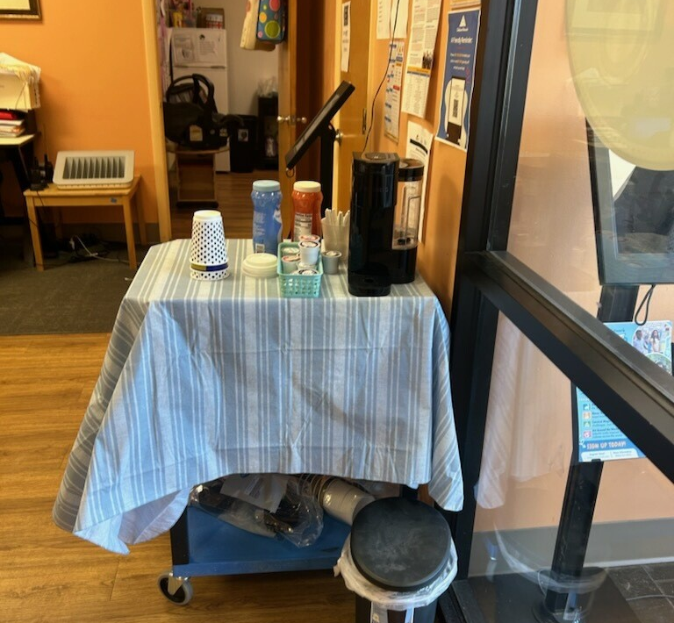
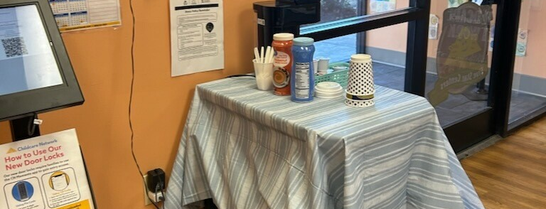
Hot Water Accessibility Issue
Parent Comfort Stations

Slide 29
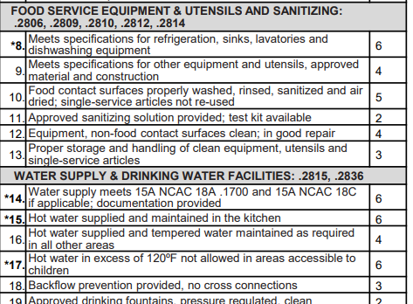
Where To Mark
DISCUSSION
Not Out of Reach
  In Excess of 120 degrees?
  Not in excess of 120 degrees?
Not Used in Accordance to Manufacturer’s Instructions

Slide 30
Questions?

Slide 31
General Comments & CDI
CEH Staff

Slide 32
COMMENT ADDENDUM
Observed unused bottles of milk from home being stored at room temperature on countertop. Several bottles temped between 57 and 62 degrees. Bottles have been observed on the countertop since the start of the inspection. Never refrigerated. CDI. Bottles were placed in kitchen refrigerator. 2804(k)Lunches, snacks, and other meals containing potentially hazardous foods shall be refrigerated at 45 degrees Fahrenheit or below and stored in the child care center kitchen or approved food preparation area.
Observed chemical aerosol cans, house paint, grease lightning, multi purpose cleaners throughout the center..2820(b) Toxic substances, which include corrosive agents, pesticides, bleaches, detergents, cleansers, polishes, any product which is under pressure in an aerosol dispenser, and any substance which may be hazardous to a child if ingested, inhaled, or handled shall be kept in the original container or in another labeled container, used according to the manufacturer's instructions, and stored in a locked storage room or cabinet when not in use. CDI. Chemicals were locked.
Observed heavily stained and frayed carpet in 3-year-old classroom. .2824(b) Floors and floor coverings in sleeping and play areas shall be kept clean and in good repair.
Observed operator during diaper change did not spray disinfectant on diaper surface after cleaning step. Educated operator. .2819(c) Diapering surfaces shall be disinfected using an approved disinfectant.
Observed toy chest in the OLE play area with built up dirt and debris..2832(c)(1) (c) For outdoor toys and play equipment, including all structures accessible to children, Equipment and toys shall be kept clean, in good repair, and free of peeling, flaking, or chalking paint, rust, and corrosion.

Slide 33
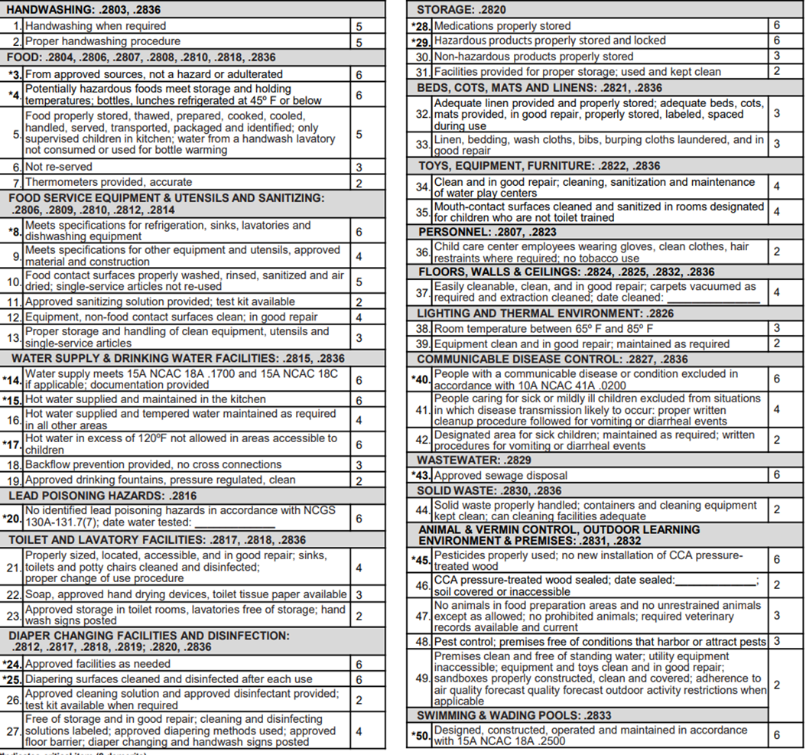
Question: Based on the comments on the addendum, what do you assume is the sanitization classification of this center?

Slide 34
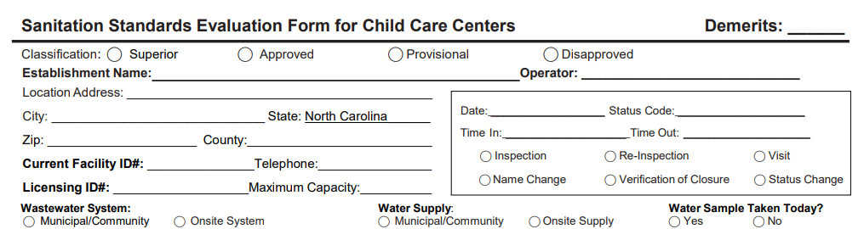
6
x

Slide 35
General Comment: Observed unused bottles of milk from home being stored at room temperatures. Several bottles temped between 57 and 62 degrees. Bottles have been observed on the countertop since the start of the inspection. CDI. Bottles were placed in kitchen refrigerator. 2804(k)Lunches, snacks, and other meals containing potentially hazardous foods shall be refrigerated at 45 degrees Fahrenheit or below and stored in the child care center kitchen or approved food preparation area.
General Comment: Observed chemical aerosol cans, house paint, grease lightning, multi purpose cleaners throughout the center..2820(b) Toxic substances, which include corrosive agents, pesticides, bleaches, detergents, cleansers, polishes, any product which is under pressure in an aerosol dispenser, and any substance which may be hazardous to a child if ingested, inhaled, or handled shall be kept in the original container or in another labeled container, used according to the manufacturer's instructions, and stored in a locked storage room or cabinet when not in use. CDI. Chemicals were locked.
Observed heavily stained and frayed carpet in 3-year-old classroom. .2824(b) Floors and floor coverings in sleeping and play areas shall be kept clean and in good repair. Demerit 4
General Comment: Observed operator during diaper change did not spray disinfectant on diaper surface after cleaning step. Educated operator. .2819(c) Diapering surfaces shall be disinfected using an approved disinfectant.
Observed toy chest in the OLE play area with built up dirt and debris..2832(c)(1) (c) For outdoor toys and play equipment, including all structures accessible to children, Equipment and toys shall be kept clean, in good repair, and free of peeling, flaking, or chalking paint, rust, and corrosion. Demerit 2

Slide 36
CDI- What Does It Mean For Child Care?
CDI is a specific term used by the food program. It is a box to check on the inspection sheet that has specific meaning and also has guidelines in the food rules and marking instructions explaining exactly when/how to use it and how many points may be taken if the CDI box is checked.
Usually if the violation was corrected during the inspection and that box is checked, the “VR” box wouldn’t be checked because a verification visit wouldn’t be required.

Slide 37
CDI- What Does It Mean For Child Care?
For Child Care Sanitation, if a provisional is earned due to a 6-point item being marked, the re-inspection is required, even if there was some type of correction during the inspection so this could be misleading, especially when the violation on the inspection isn’t clearly documented stating that a re-inspection will occur in 7 days.

Slide 38
CDI- What Does It Mean For Child Care?
Since the child care rules and inspection sheet do not use this term and do not have a “CDI” box, this term doesn’t mean the same thing for the child care inspections as it does in the food program and child care operators and DCDEE have no education on what it means.
We are asking EHS to spell out this term “during the inspections, so the meaning is clear to the operator and the licensing agency. We always want to try to get the center to correct violations while we’re there, if possible, and we want that documented in the comment. It can be clearly documented in the comment by stating “corrected by….”

Slide 39
CDI- What Does It Mean For Child Care?
NOTE: Even if the violation is corrected at the time of the inspection, marking the violation in most situations is still warranted and valid.
Issues related to CDI and general commenting provisional items:
*Licensing Agency (DCDEE) cannot address the deficiencies based on a “general comment”. Neither can an administrative action be issued based on GCs.
*Behavior is often not modified since there is no consequences for the action.
*Liability concerns for the inspector

Slide 40
CDI- What Does It Mean For Child Care?
HD Complaints:
*Provisional classification requires another inspection
*Reinspection viewed as a waste of time and resources
*No financial incentives to conduct these inspections
*Nothing to go back and inspect if corrected while conducting the inspection.
Unfortunately, until the law is changed, the required action for provisional classifications is still required.

Slide 41
CDI- What Does It Mean For Child Care?
We are asking EHS to be mindful of risk factors when conducting the inspections. Ask ourselves the following:
Are you considering the most risk-based factors when conducting your inspection?
Are we just conducting “floor, wall, ceiling” type inspections, when there are greater risk present?
Why are inspections noting 2 to 3 times more general comments than actual demerits and violations?
Is this a management approach to decrease the number of inspection visits?
Is there true confusion of what CDI means for Childcare?
More importantly, is this approach safer for one of our most vulnerable populations… our children?
As we move forward, take a look at your programs to see where you are and what you are allowing or requiring of your staff.

Slide 42
What does it mean?
Provisional Status in
Child Care
In North Carolina, a Provisional classification from a sanitation inspection in a child care center means the facility has some non-compliance issues.
It's a temporary classification that allows the facility time to correct the violations, but the provisional status may be extended or lead to a Disapproved classification if violations aren't addressed.

Slide 43
How does a center get a Provisional classification??
The inspection results are based on a demerit system, where points are deducted for violations. Provisional status is assigned when
  any 6-demerit item is violated (this is the most common reason)
  the total demerit score is more than 30 but not more than 45

Slide 44
6-demerit Items
Provisional Status in
Child Care
Any number or total of 6-demerit items that are marked on the Sanitation Inspection Form will result in a Provisional Classification (ex. a center receives ONE 6-demerit item, or receives FIVE 6-demerit items)

Slide 45
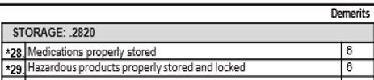
6-demerit items on CCC Form is noted by (*) next to the item number
*3. From approved sources, not a hazard or adulterated
*4. Potentially hazardous foods meet storage and holding temperatures; bottles, lunches refrigerated at 45º F or below
*8. Meets specifications for refrigeration, sinks, lavatories and dishwashing equipment
*14. Water supply meets 15A NCAC 18A .1700 and 15A NCAC 18C if applicable
*15. Hot water supplied and maintained in the kitchen
*17. Hot water in excess of 120ºF not allowed in areas accessible to children
*20. No identified lead poisoning hazards in accordance with NCGS 130A-131.7(7); date water tested: _____________
*24. Approved facilities as needed
*25. Diapering surfaces cleaned and disinfected after each use
*28. Medications properly stored
*29. Hazardous products properly stored and locked
*40. People with a communicable disease or condition excluded in accordance with 10A NCAC 41A .0200
*43. Approved sewage disposal
*45. Pesticides properly used; no new installation of CCA pressure treated wood
*50. Designed, constructed, operated and maintained in accordance with 15A NCAC 18A .2500

Slide 46
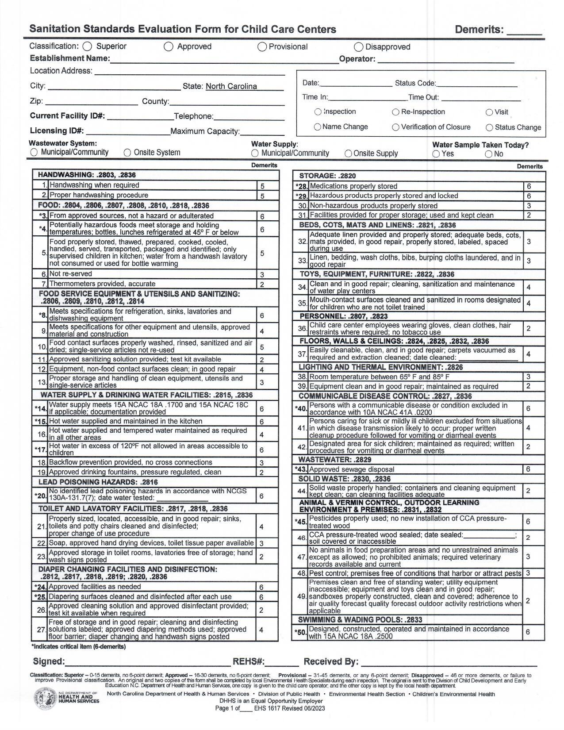
What do I do when a center receives a provisional classification?
Make sure the “Provisional” Status is marked on the inspection form and the grade card
Leave the Provisional grade card in the designated located of the center
Forward a copy of the inspection to the center’s child care consultant

Slide 47
Once a center is “put in provisional” do I have to go back?
Yes.
The provisional classification period shall not exceed seven days unless construction or renovation is necessary to correct any violation, in which case the Department may specify a longer provisional classification period.
  This means you should return to the center AFTER the 7-day classification period.
  If you go back prior to the 7 days, and the provisional item is not corrected, you will have to return AGAIN after the 7-day time period.

Slide 48
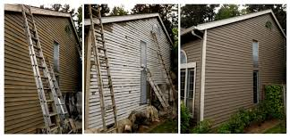


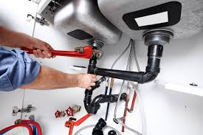
How do I know how long to give the center if construction or renovation is required?
Using your professional judgement, based on the construction or renovation needs, you will determine a reasonable time period for the provisional item(s) requiring the construction or renovation.
Normally a 2 week to 30-day period is accessed for construction issues. Be clear in your documentation and the comment addendum how much time is being granted for the constructional provisional period.
Lead remediation timeframes will be longer and fall within the timeframe guidance of the 3100 Rules (Lead Poisoning Prevention)

Slide 49
The Re-inspection
You must conduct a FULL INSPECTION when you return to complete the re-inspection.
A new grade card must be left
Forward a copy of the re-inspection to the child care consultant

Slide 50
What do I do if the center receives ANOTHER provisional on the re-inspection?
  It depends:
  If the ORIGINAL provisional item is still out of compliance, the center will then be placed in a Disapproved status.
  If another (different from the initial inspection) provisional item is now marked, the center will stay in Provisional status, and you will have to complete another re-inspection for that item.
  If multiple provisional items were marked on the initial inspection, and ANY of them are still not in compliance, the center will be placed in Disapproved status.

Slide 51
Questions?

Slide 52
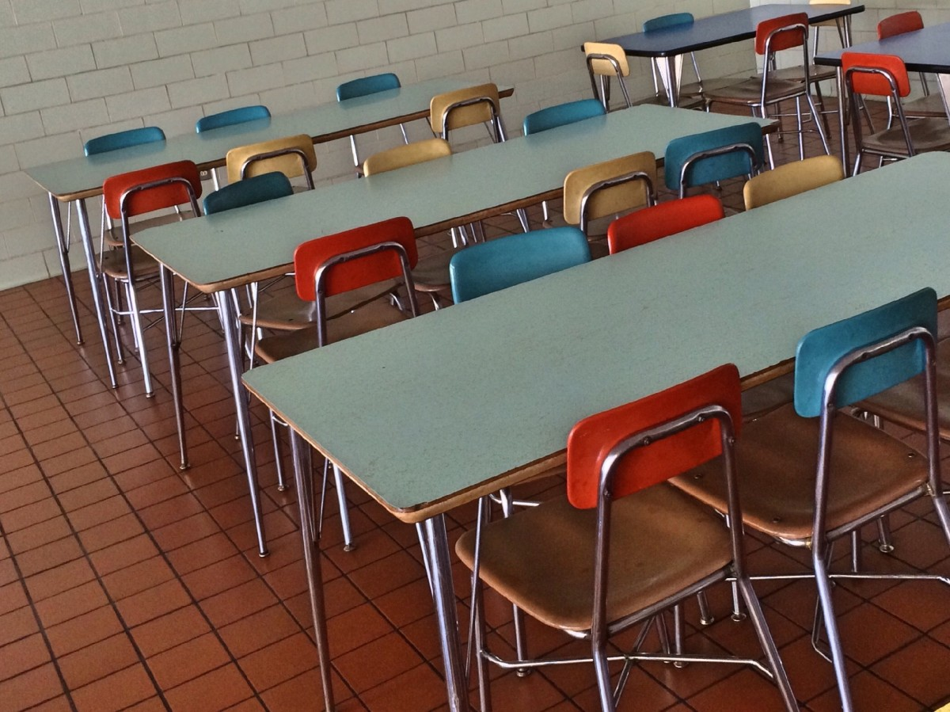
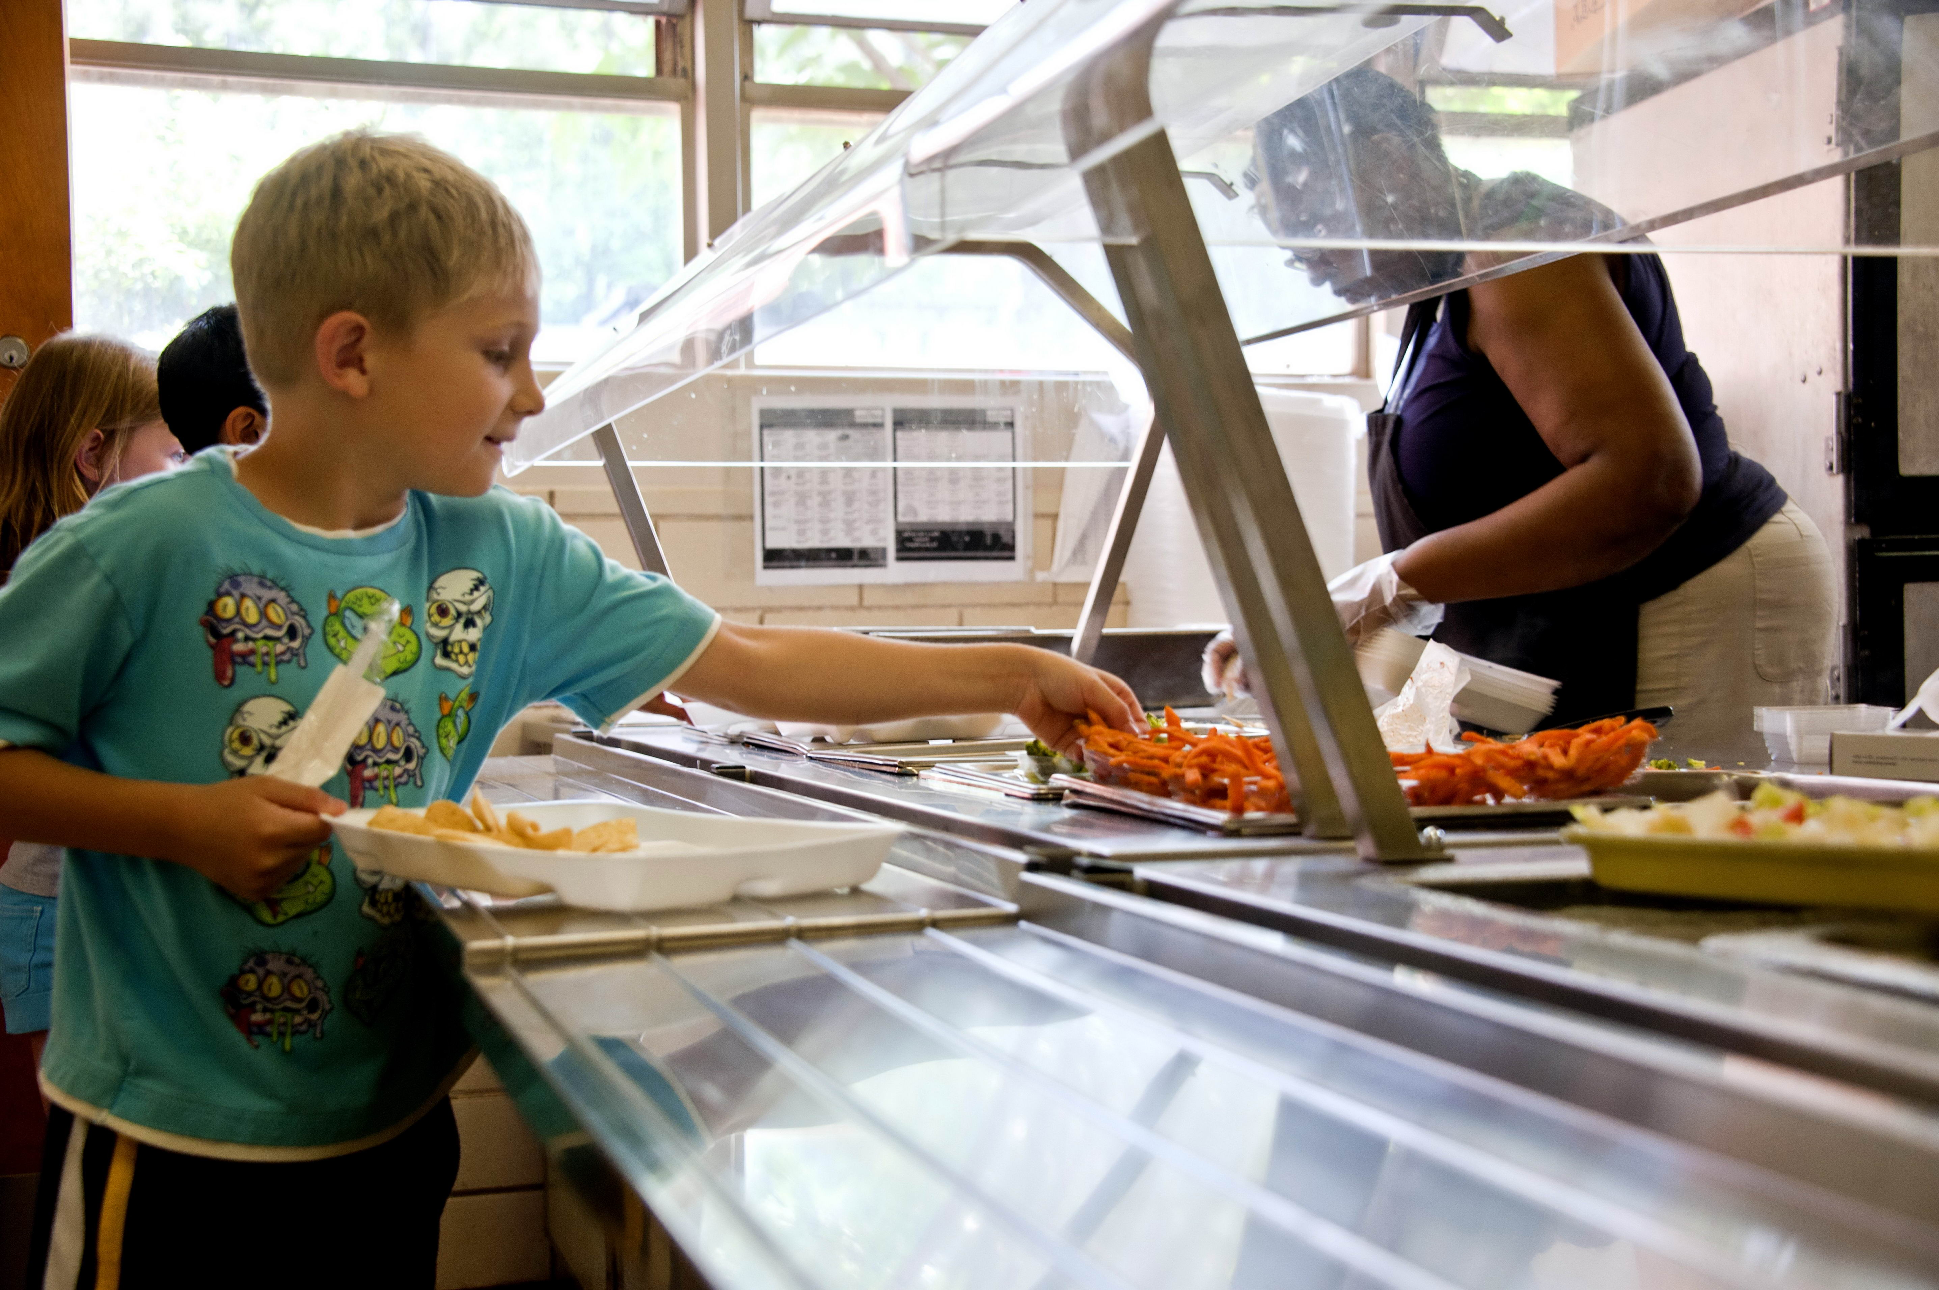
Chemical Storage in Child Care Center Cafeteria Kitchen

Slide 53
Chemical Storage in the Kitchen
What does the rule say?
  .2820(b) Toxic substances…..shall be….stored in a locked storage room or cabinet when not in use. Locked storage rooms and cabinets shall include those which are unlocked with a combination lock, electronic or magnetic device, keypad, key, or equivalent locking device.
  .2820(e) A locked kitchen is not considered to be a locked storage room or cabinet for the purposes of this Rule
Explanation
  Even if the kitchen is locked, items in the kitchen that are required to be locked must be in a separate locked storage room or cabinet within the locked kitchen.

Slide 54
Centers Located Within a School
What does the rule say?
  2820(e) A locked kitchen is not considered to be a locked storage room or cabinet for the purposes of this Rule;
  However, for child care centers that are located within a school and that use the school cafeteria's kitchen to meet the kitchen requirements of the rules of this Section, it shall not be a violation of this Rule to store products described in Paragraphs (a)-(d) of this Rule unlocked in the cafeteria's kitchen,
  Provided that the kitchen is kept locked
  Children are not permitted in the kitchen for any purpose

Slide 55
Centers Located Within a School continued…
Explanation:
  Kitchen doors must be ‘locked’ with a device approved by the local building/fire code inspector or Fire Marshal’s Office
  A restriction must be placed on the license by DCDEE prohibiting children from being in the kitchen for any purpose
If both conditions are not attainable then hazardous products must be stored in accordance with Administrative Rule 15A NCAC 18A .2820.
For compliance issues, local Registered Environmental Health Specialists should have child care centers contact their local building/fire code inspector or Fire Marshal’s Office to determine how to appropriately lock kitchen doors. Child care operators should also contact DCDEE to request the license restriction.

Slide 56
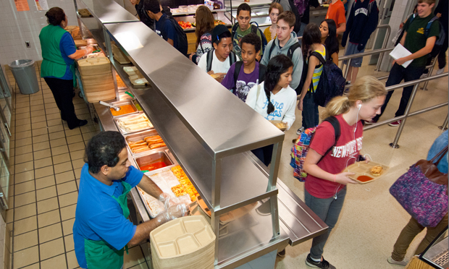
Question: For service lines that go inside the cafeteria, would this policy apply?
NO
This policy requires no access or activity in the kitchen for these programs. If a licensed Pre-K Program eats in the cafeteria and goes through a service line that makes the kitchen accessible, then rule cannot apply to this situation.
.2820(e) A locked kitchen is not considered to be a locked storage room or cabinet for the purposes of this Rule; however, for child care centers that are located within a school and that use the school cafeteria's kitchen to meet the kitchen requirements of the rules of this Section, it shall not be a violation of this Rule to store products described in Paragraphs (a)-(d) of this Rule unlocked in the cafeteria's kitchen, provided that the kitchen is kept locked and children are not permitted in the kitchen for any purpose
This Photo by Unknown Author is licensed under CC BY-ND

Slide 57
Question: Are chemicals that are attached to sinks and dishwashers in the kitchen required to be stored locked?
NO
These chemicals are considered in “continuous use”
Other Questions?

Slide 58
QUESTIONS?

