Slide 1
Change of Use … the review Brenda Bass Regional Environmental Health Specialist Children’s Environmental Health

Slide 2
.2818 Lavatories (c) *Lavatories shall be cleaned and disinfected with each change of use, when visibly soiled, and at least daily. *Change of use occurs when a handwash lavatory is used outside of its original intent. *Change of use includes, but is not limited to, a classroom handwash lavatory used for rinsing toothbrushes, a food preparation handwash lavatory used for toy cleaning, or a classroom handwash lavatory used for diaper changing handwashing.

Slide 3
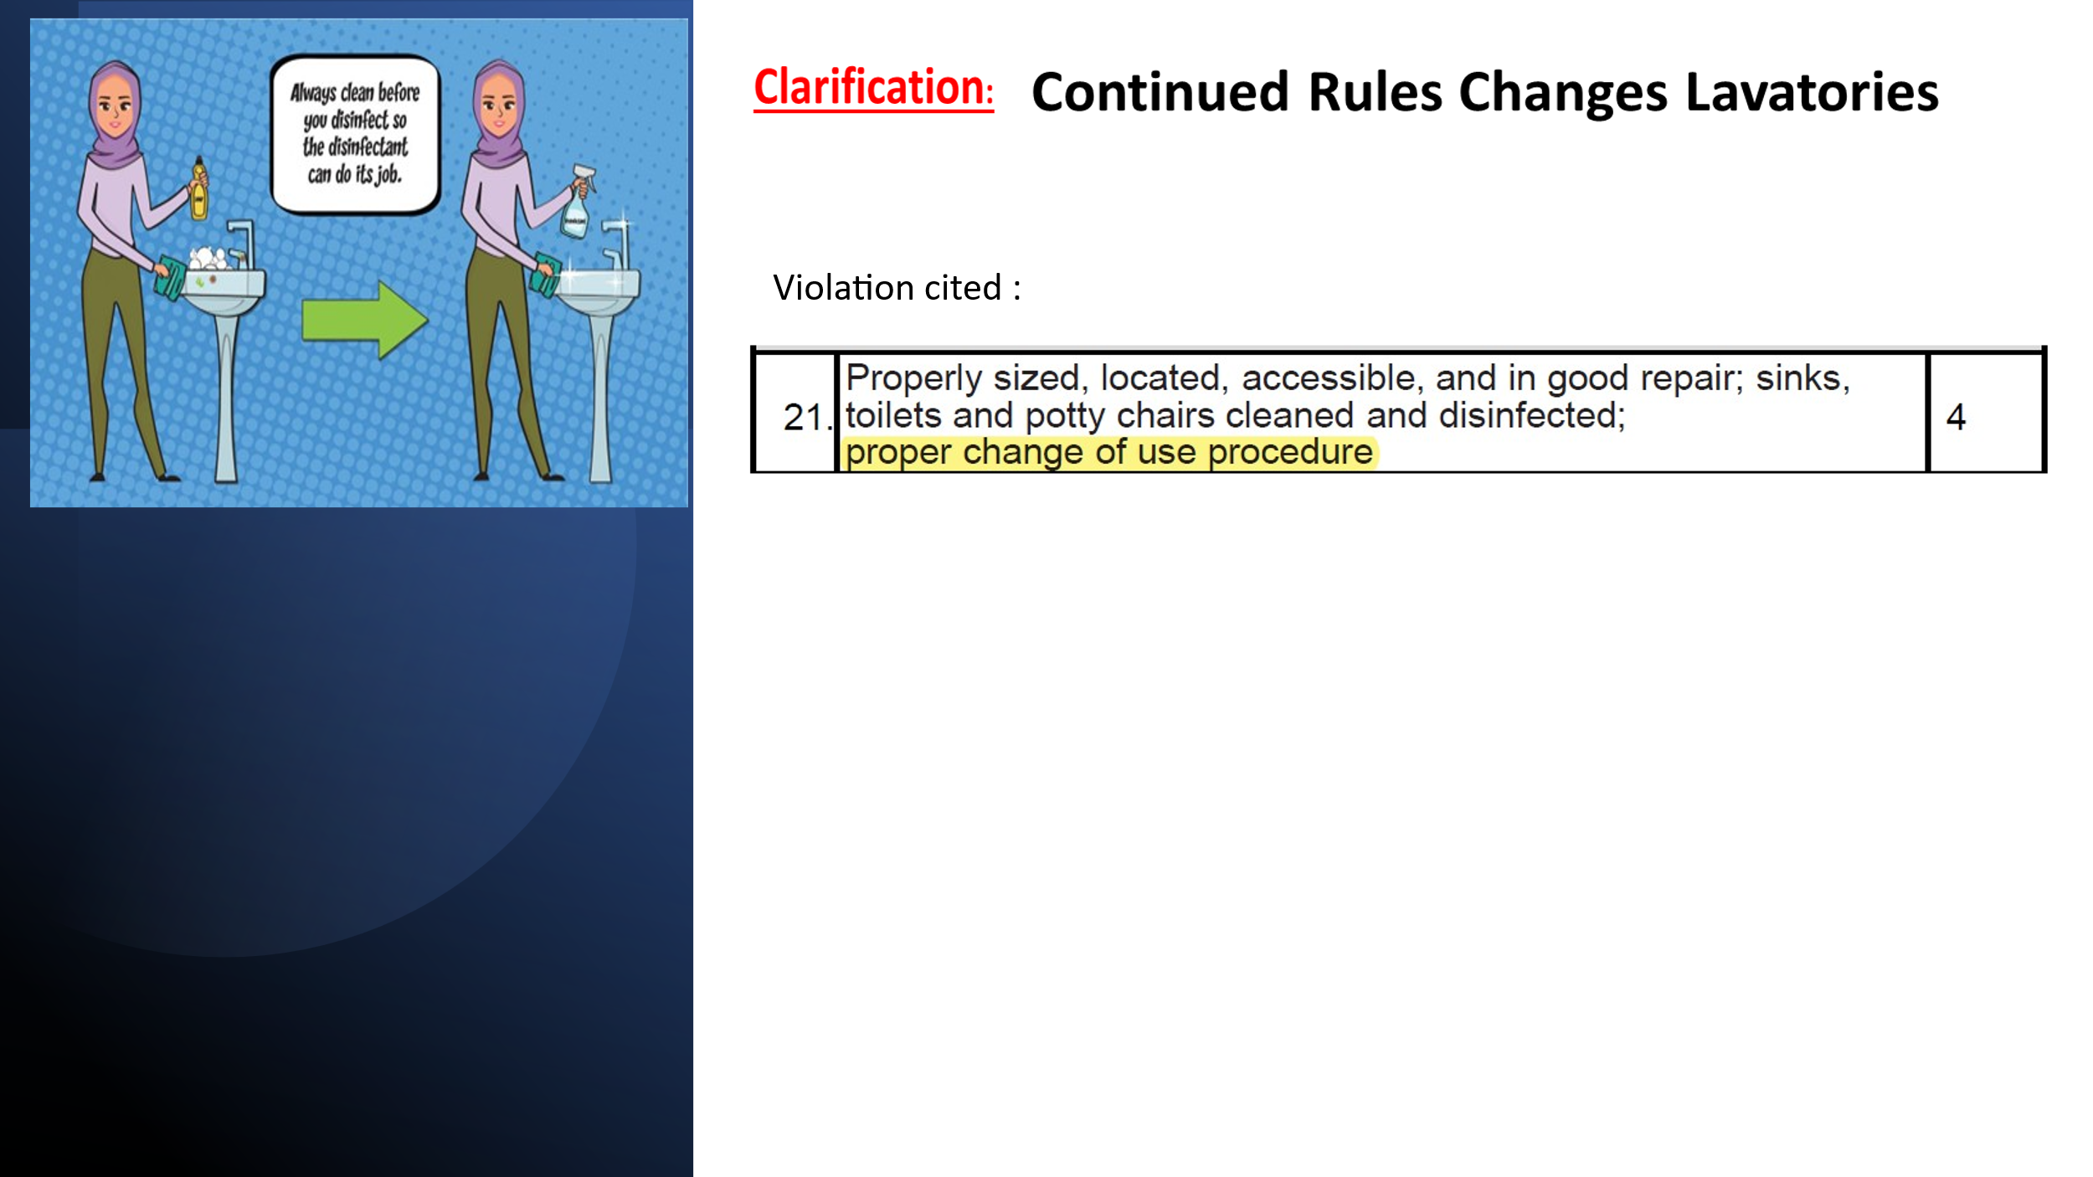
Original Use( Intended Use)

Slide 4
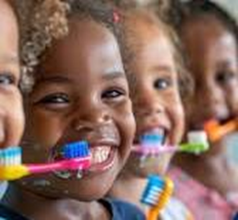
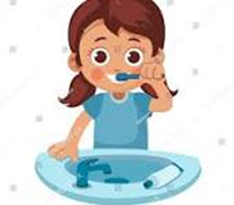
New Activity
Guidelines for Toothbrushing in NC Childcare Program
Page 2
Clean up
Steps discussed:
12. After all children’s teeth are brushed, clean and disinfect sink before rinsing toothbrushes…
16. After rinsing all brushes, clean and disinfect sink ….
Change to another activity

Slide 5
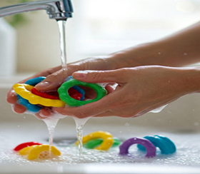
New Activity
15A NCAC 18A .2810 SPECIFICATIONS FOR KITCHENS, FOOD PREPARATION AREAS AND
FOOD SERVICE AREAS
(f) Toy cleaning and sanitizing may be conducted in the food preparation area.
Change to another activity

Slide 6
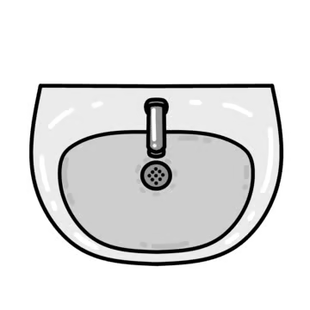
New Activity
Change to another activity

Slide 7
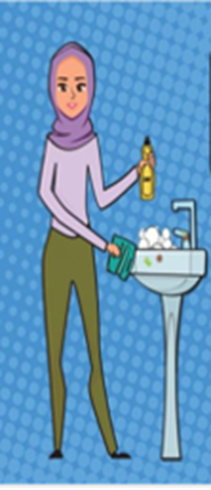
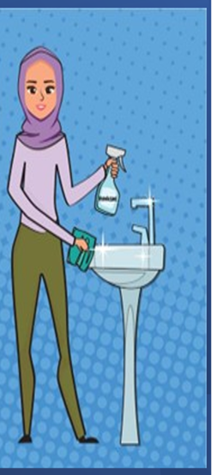

Original Intent

Slide 8
Let’s Go Over the Steps….

